Slide 1
Selected Recent results on SM and top physics from ATLAS and CMS
Yanwen Liu
University of Science and Technology of China
2nd China LHC Physics workshop, PKU, December 18,2016

Slide 2
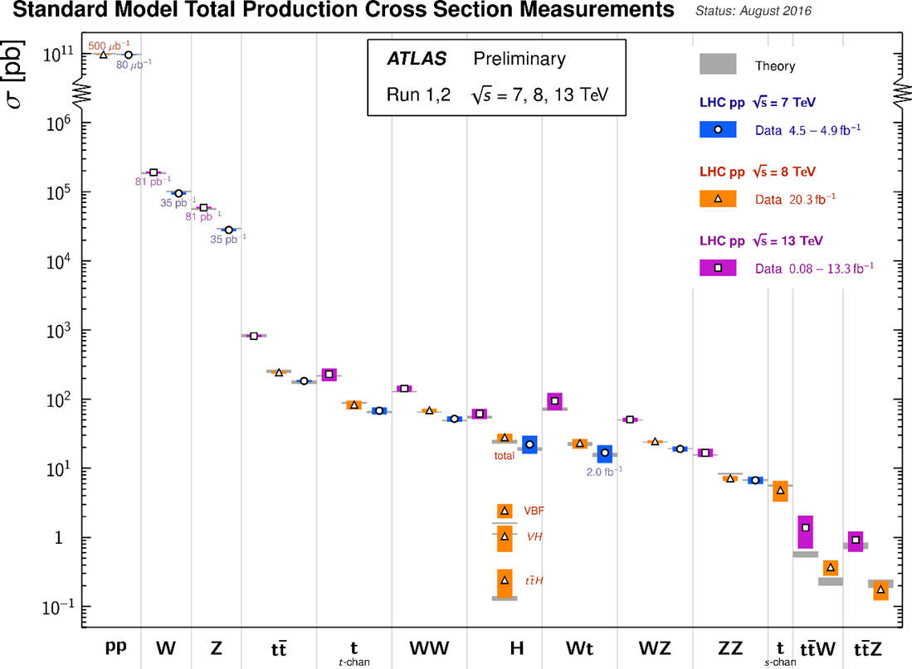
Introduction
Measurement of SM prerequisite to searches for BSM
Exciting on its own right: rare processes starting to be observed
Search for new phenomena by precision measurement!
Electroweak processes
Top related processes
8 orders of magnitude of electroweak measurements!
See also the parallel talks today and tomorrow

Slide 3
Electroweak measurement
Common methodology
Exploit signatures of leptons, photon, MET
Data-driven background estimation whenever possible
“Prompt” background estimated by simulations
Compare measured “fiducial/full cross sections” with theory
BSM effects parameterized with Effective Field Theory/Anomalous Couplings
Topics in this talk:
See also talks at this workshop by
Karri DIPETRILLO (Harvard and IHEP)
Leggat DUNCAN (IHEP)
Qun Wang(PKU)
Daneng Yang (PKU),
Ruiqi Zhang(USTC),
Fengwangdong Zhang(PKU)
Zhaoru Zhang, Jing Li (PKU)
….
$$W^{+}W^{−}$$
$$W^{±}W^{±}$$
$$WWW$$
$ZZ$
VBS $W$
VBS $Z$
VBS $Wγ,Zγ$

Slide 4
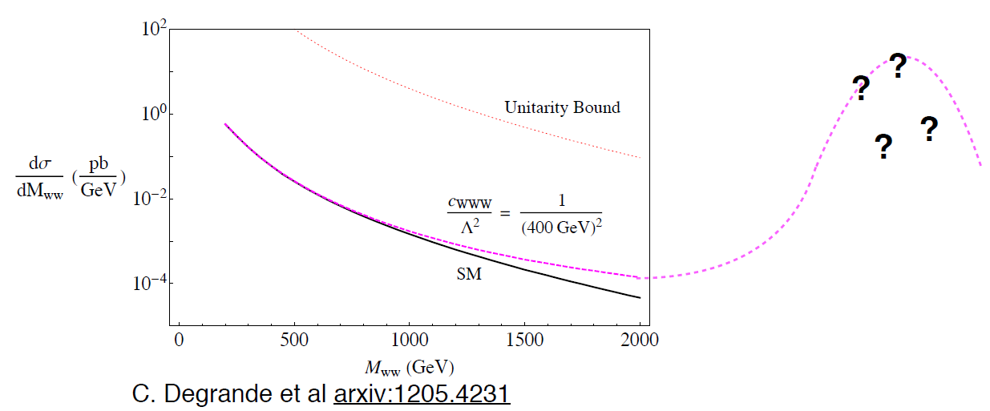
Unknown new physics at energy scale beyond the reach of the collider

Slide 5
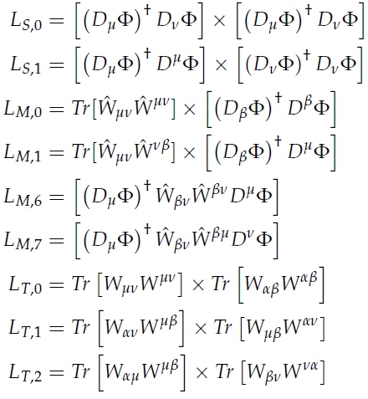
CP conserving Operators
Dim-6
Dim-8

Slide 6
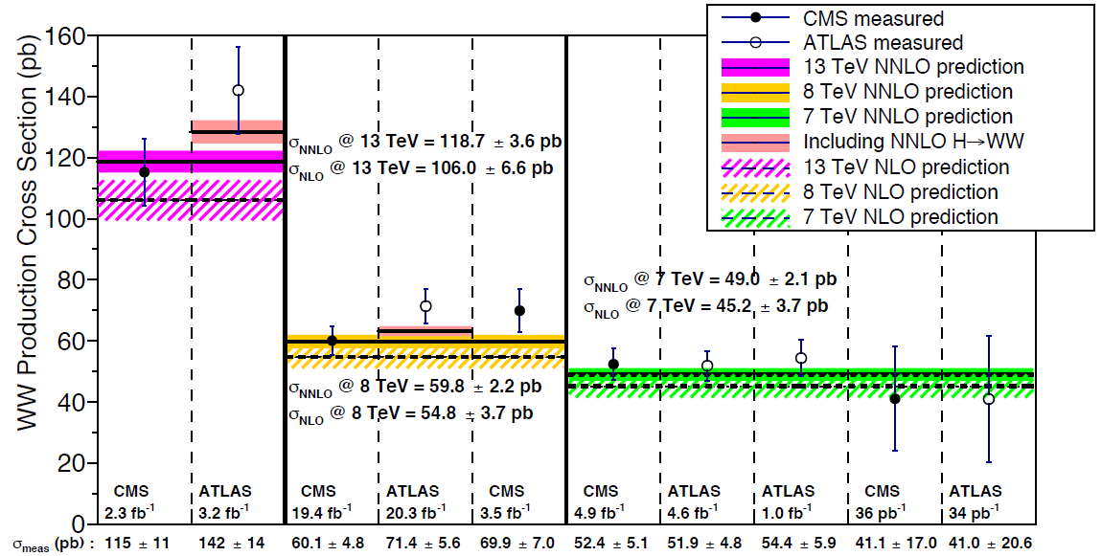
Measurement of W⁺W⁻ cross section
CMS, 13 TeV, 2.3 fb⁻¹ : CMS-PAS-SMP-16-006
CMS, 8 TeV 3.5 fb⁻¹ : arXiv:1301.4698
CMS, 8 TeV, 19.4 fb⁻¹ : arXiv:1507.03268
CMS, 7 TeV, 4.9 fb⁻¹ : arXiv:1306.1126
CMS, 7 TeV, 36 pb⁻¹ : arXiv:1102.5429
ATLAS, 13 TeV, 3.2 fb⁻¹ : ATLAS-CONF-2016-090
ATLAS, 8 TeV, 20.3 fb⁻¹ : arXiv:1603.01702
ATLAS 7 TeV, 4.9 fb⁻¹ : arXiv:1210.2979
ATLAS 7 TeV, 1.0 fb⁻¹ : arXiv:1203.6232
ATLAS 7 TeV, 34 pb⁻¹ : arXiv:1104.5225
Since 8 TeV: Theoretical uncertainty due to jet veto in event selection included
PRD 85(2012)034011 , Steward and Tackmann
Notes:
WW production has been measured by both CMS and ATLAS since the beginning of data-taking. 7, 8, 13 TeV …. Mild excess (20%) at 8 TeV generated discussions, jet veto uncertainty, for example. USTC long term involvement..

Slide 7
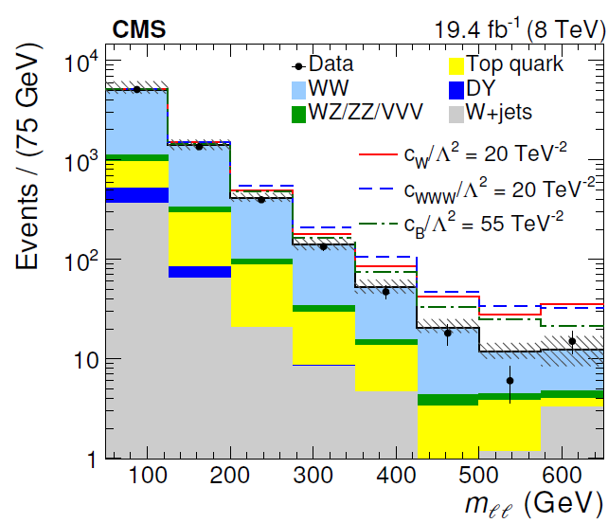
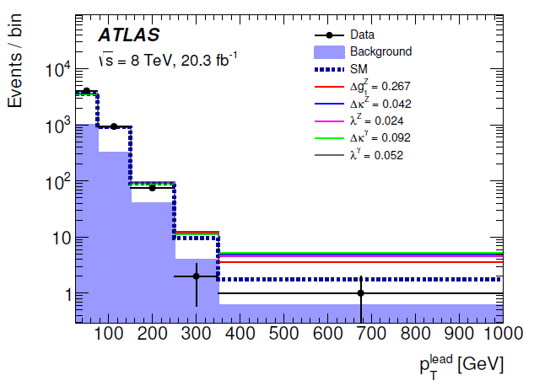
Limits on EFT
Parameter | CMS [TeV⁻²] | ATLAS [TeV⁻²]
C_{WWW}/Λ² | [-5.7, 5.9] | [-4.6,4.6]
C_{W}/Λ² | [-11.4,5.4] | [5.9,10.5]
C_{B}/Λ² | [-29.2,23.9] | [-20.9,26.3]

Slide 8
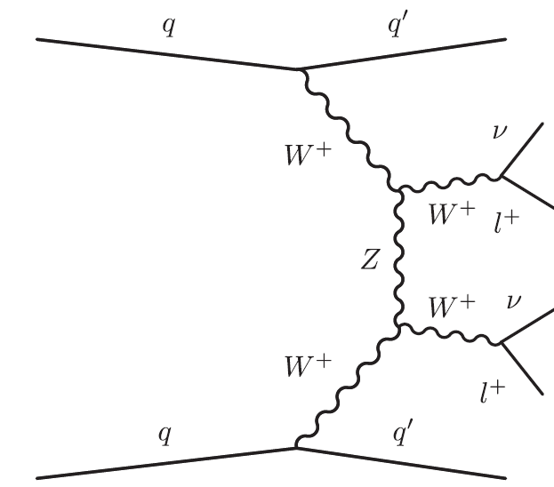
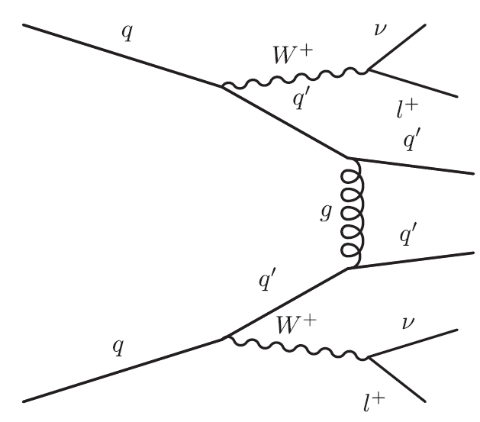
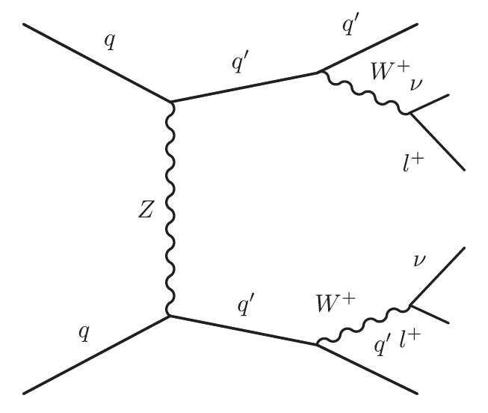
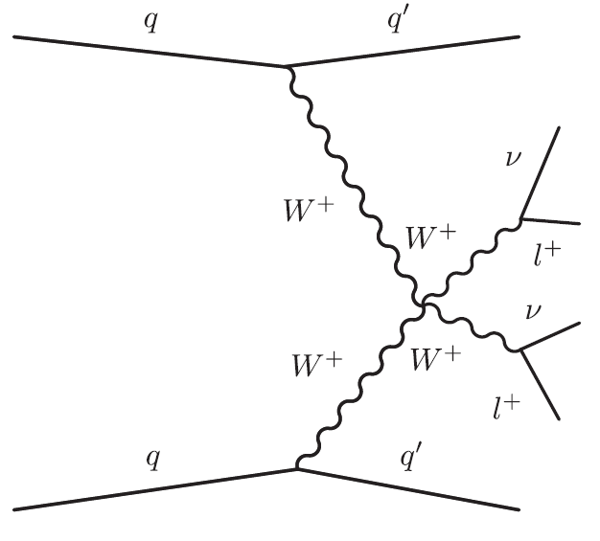
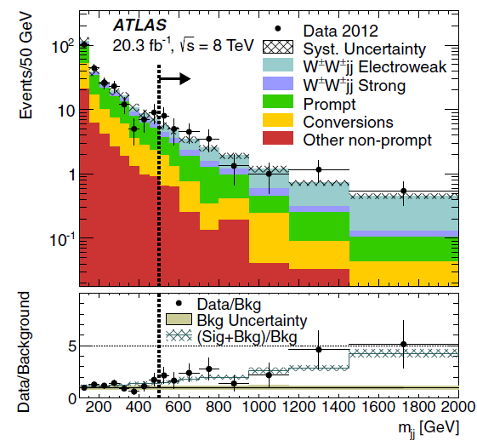
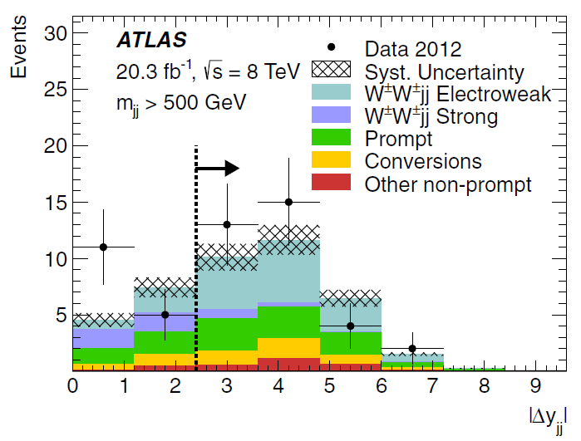
Same sign WW
CMS: PRL114(2015)51801
ATLAS :PRL113(2014)141803
arXiv:1611.02428v1
Stringent test of the SM
Understanding the spontaneous electroweak gauge symmetry breaking (W_{L} W_{L} scattering) !
Sensitive to Quartic Gauge Couplings
VBS topology: large m_{jj} and Δy_{jj}

Slide 9
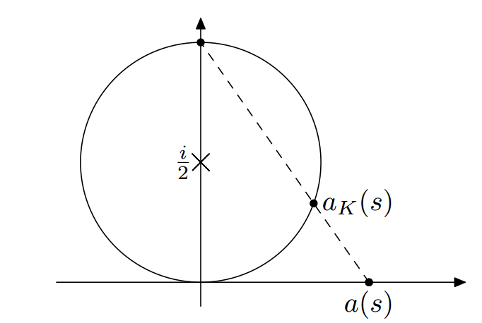
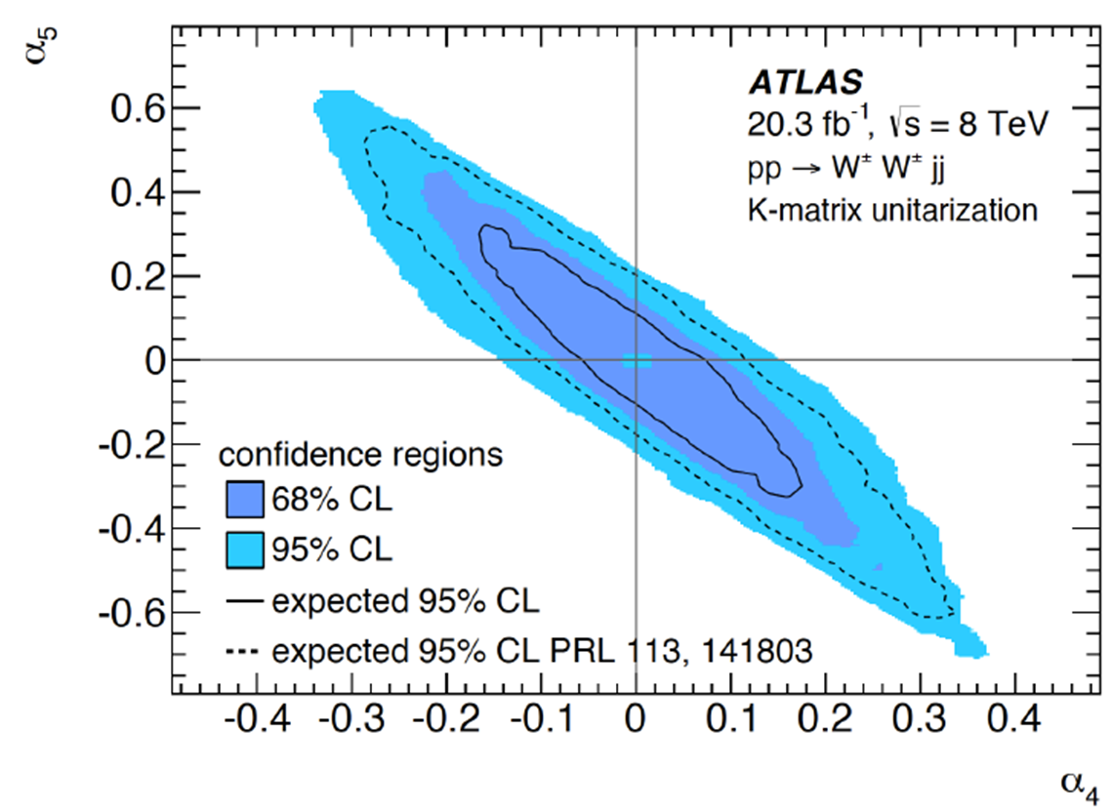
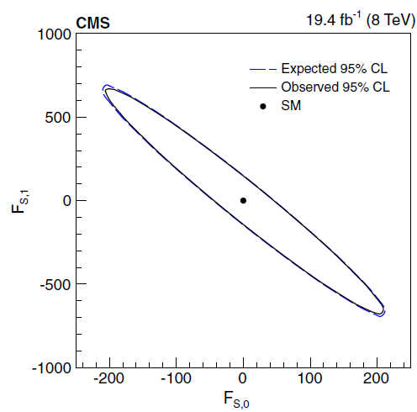
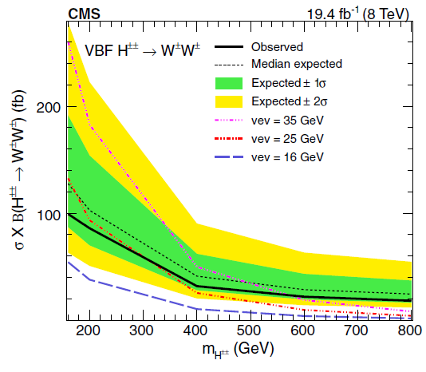
Limits on BSM (CMS)
K-matrix unitarization applied!
arXiv:0806.4145v1
Georgi-Machacek Model of Higgs triplets
Notes:
Results from CMS and ATLAS can not be combined / compared yet.

Slide 10
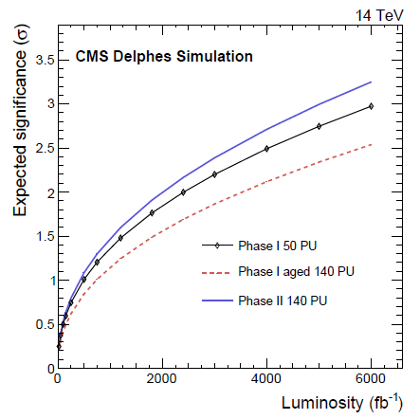
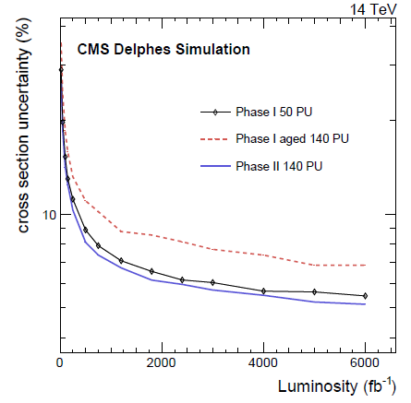
Perspective on WW electroweak VBS
Significance for longitudinal scattering
Cross section precision

Slide 11
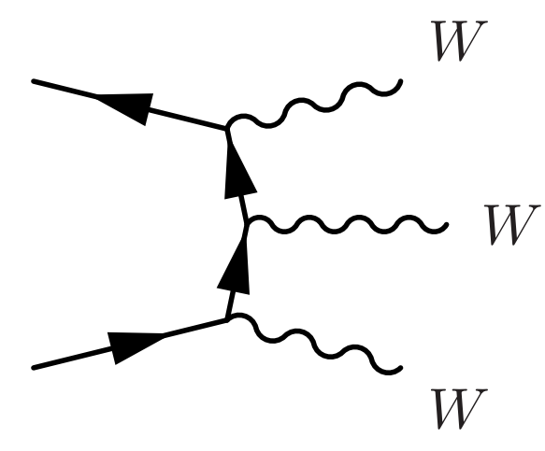
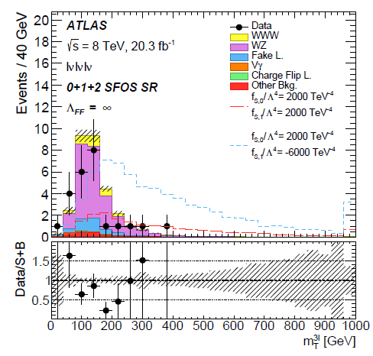
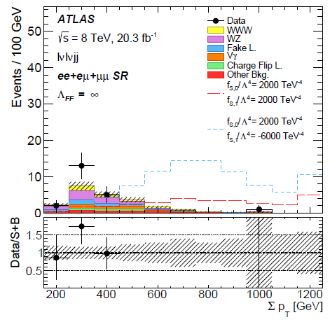
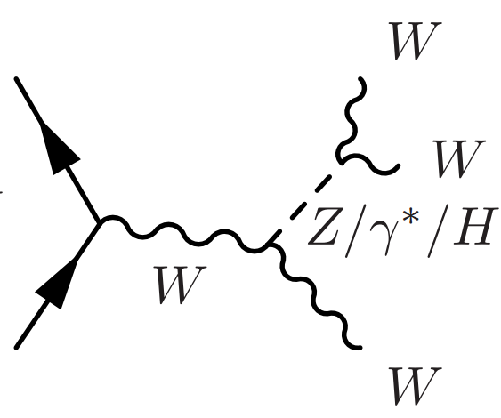
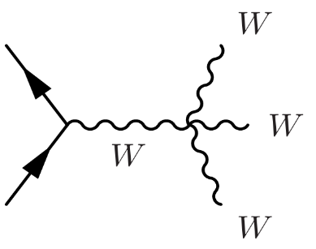
WWW production at ATLAS
arXiv:1610.05088v1
3-lepton
2-lepton (same charge)

Slide 12
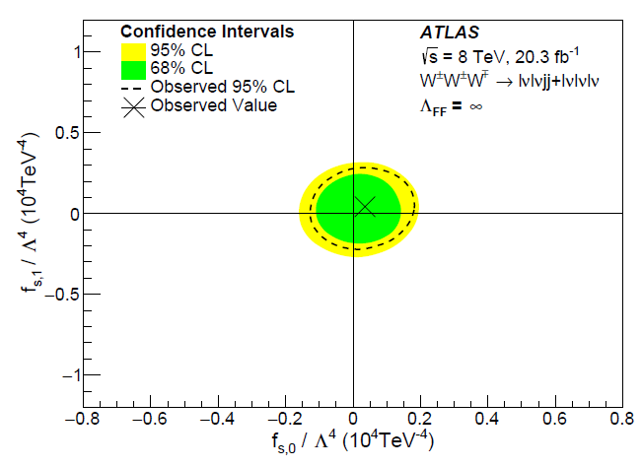
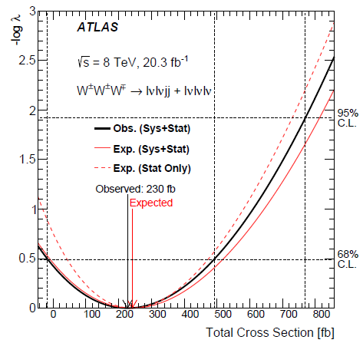
Results and Limits
Limits can be compared to CMS
Less stringent than those from WW scattering

Slide 13
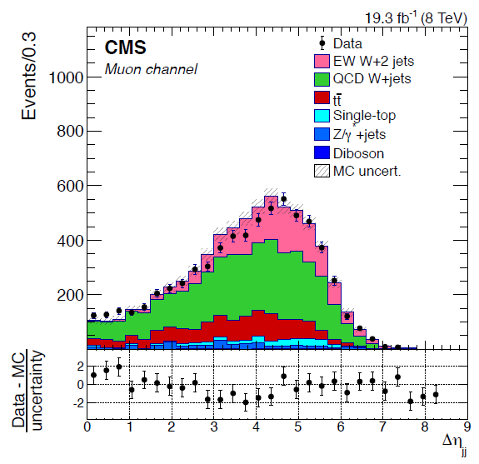
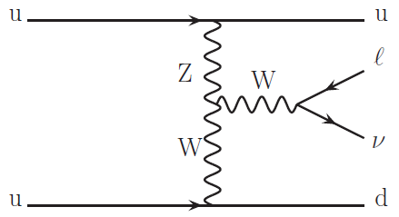
VBS W production (CMS)
arXiv:1607.06975
Fiducial: p$Tj1$ > 60 GeV, p$Tj2$ > 50 GeV, |η_{j}|<4.7
M_{jj} > 1 TeV
Measured Cross section: 0.42$±$0.04(stat)$±$0.09(syst)$±$0.01(lumi) pb

Slide 14
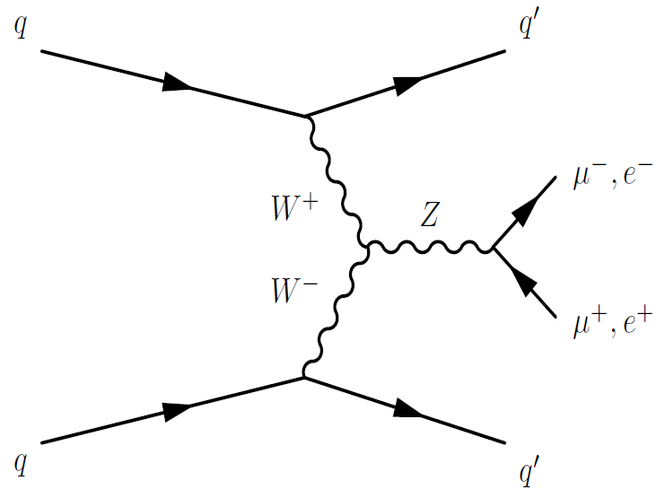
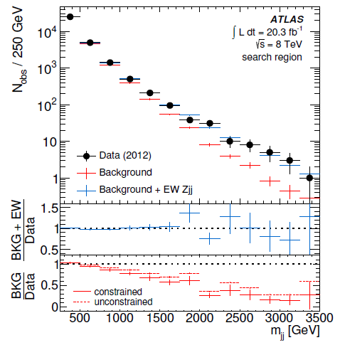
VBS Z production (ATLAS)
ATLAS: JHEP 04(2014) 031
Z production in VBS can be used to study coupling of gauge bosons
Search region:
81 < M_{ll} < 101 GeV P_{T}(ll) > 20 GeV
p$Tj1$ > 55 GeV, p$Tj2$ > 45 GeV
M_{jj} > 250 GeV
No jet with p_{T} > 25 GeV between j₁ and j₂.
Signal significance > 5σ

Slide 15
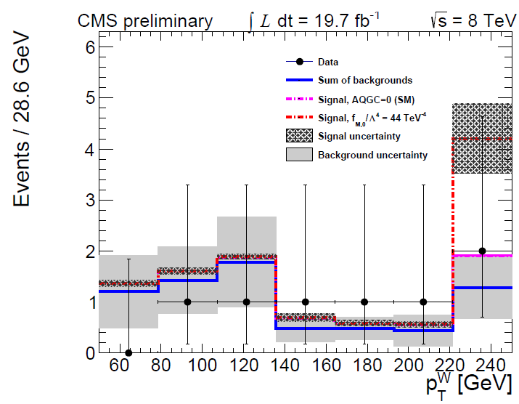
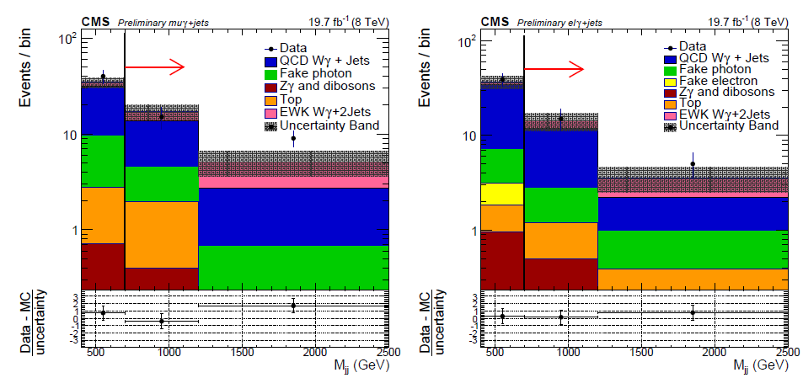
Wγ production in VBS
CMS SMP-14-011
Electroweak production significance 2.7 σ
Cross section greater than 4.3$×$SM excluded

Slide 16
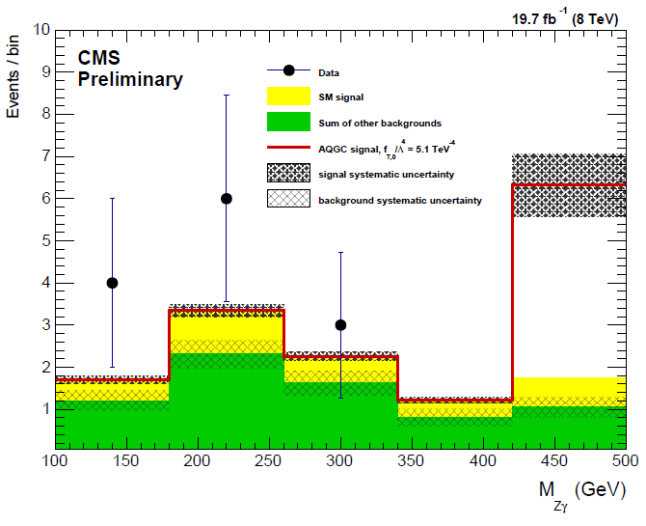
Zγ production in VBS
CMS SMP-14-018
M_{jj} > 800 GeV:
background: 0.6
signal: 5.0
DATA 7 (significance of 4.5 σ)
Cuts optimized for anomalous couplings

Slide 17
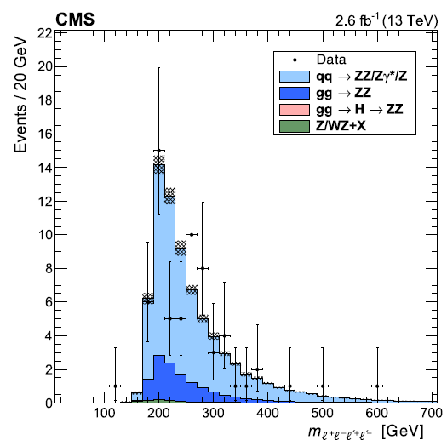
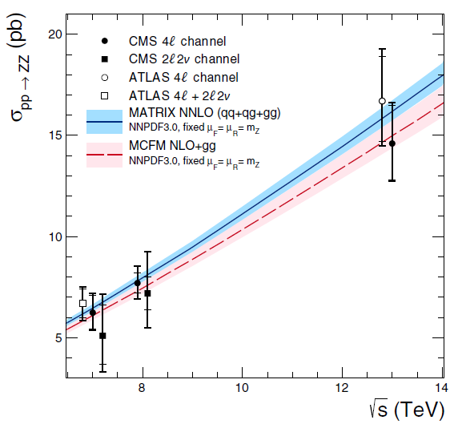
ZZ production (4-lepton)
CMS: PLB763(2016)280
ATLAS: PRL116(2016)010801
Very clean signature to study the structure of electroweak theory and to test NNLO QCD correction
PLB735(2014)311

Slide 18
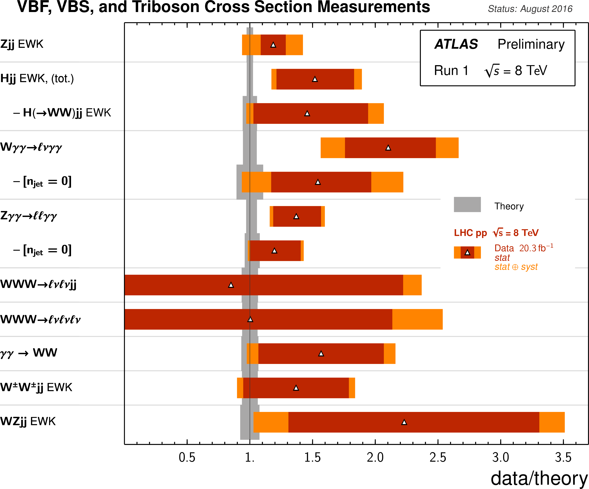

Slide 19
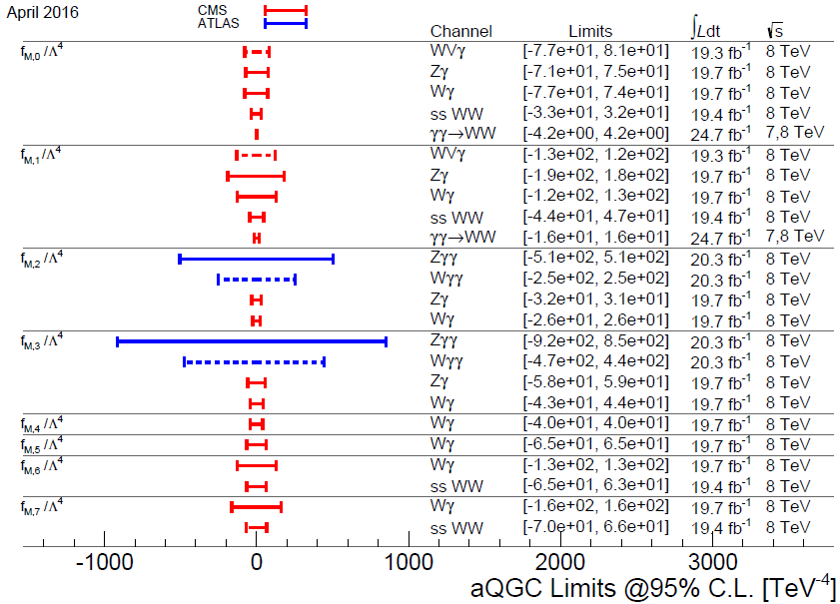
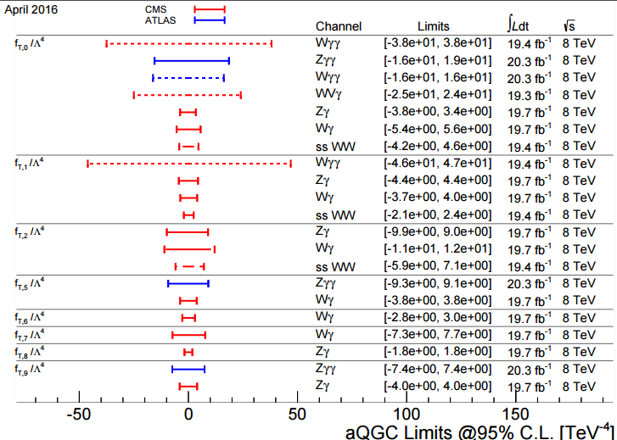
Summary of limits on quartic gauge couplings

Slide 20
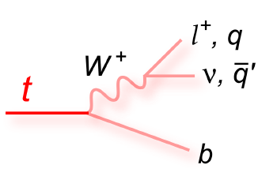
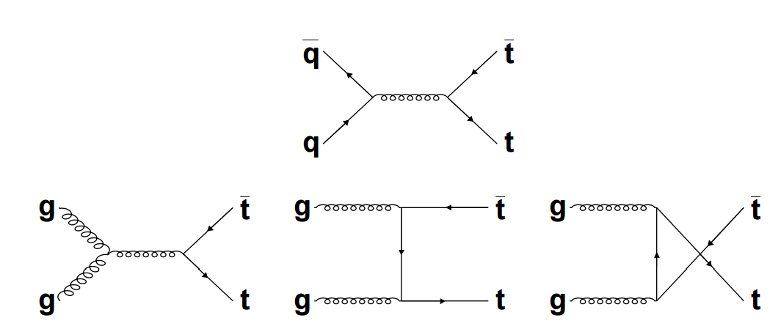
Top production at the LHC
Single top produced through electroweak
$t\overline{t}$ produced through QCD
Top decay 100% to$Wb$
Topics:
Production cross sections
Search/observation of $ttW,ttZ$
Search for $tZ$ (FCNC)
$W$ polarization in top decay

Slide 21
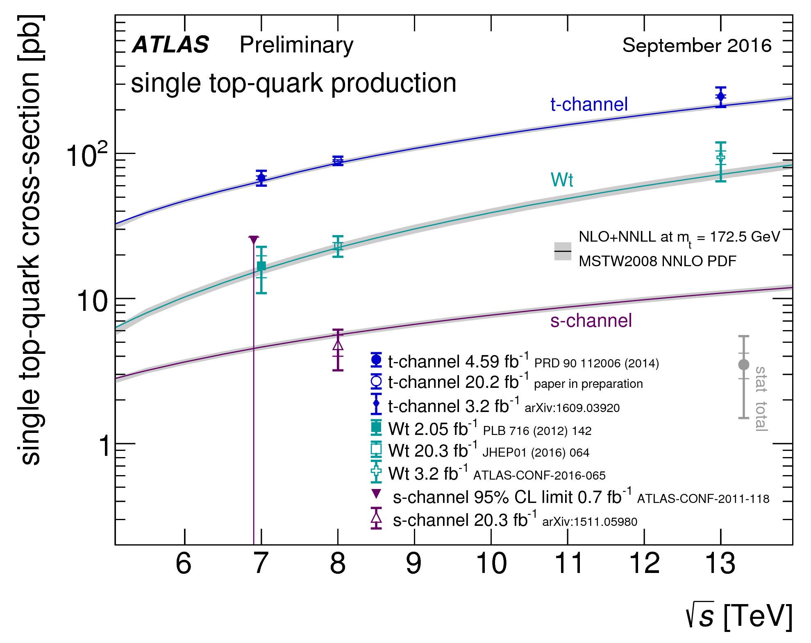
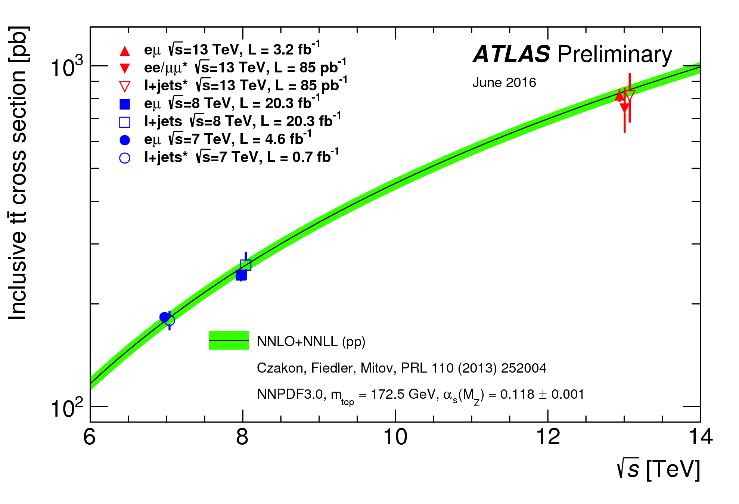
Top quark production Cross Sections

Slide 22
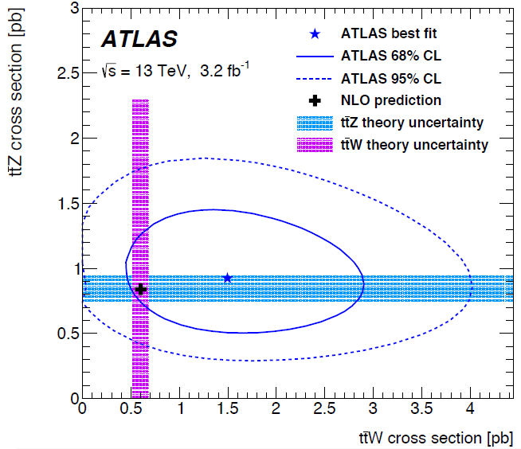
$ttW ttZ$ production
ATLAS: arXiv: 1609.01599v1
$ttZ$: 3.9 σ, $ttW$: 2.2 σ

Slide 23
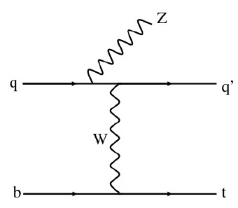
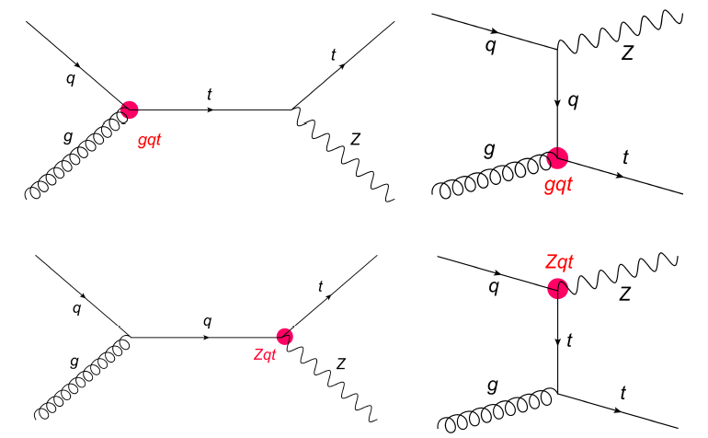
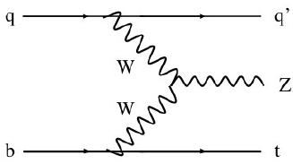
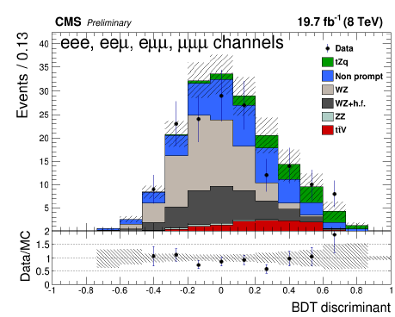
Search for $tZ$ production
CMS: TOP-12-039
Very rare in SM
3-lepton + b-jet signature : 8.2 fb (theo)
Sensitive to BSM (FCNC)
Observation of 2.4 σ
Consistent with SM
Notes:
IHEP leading role

Slide 24
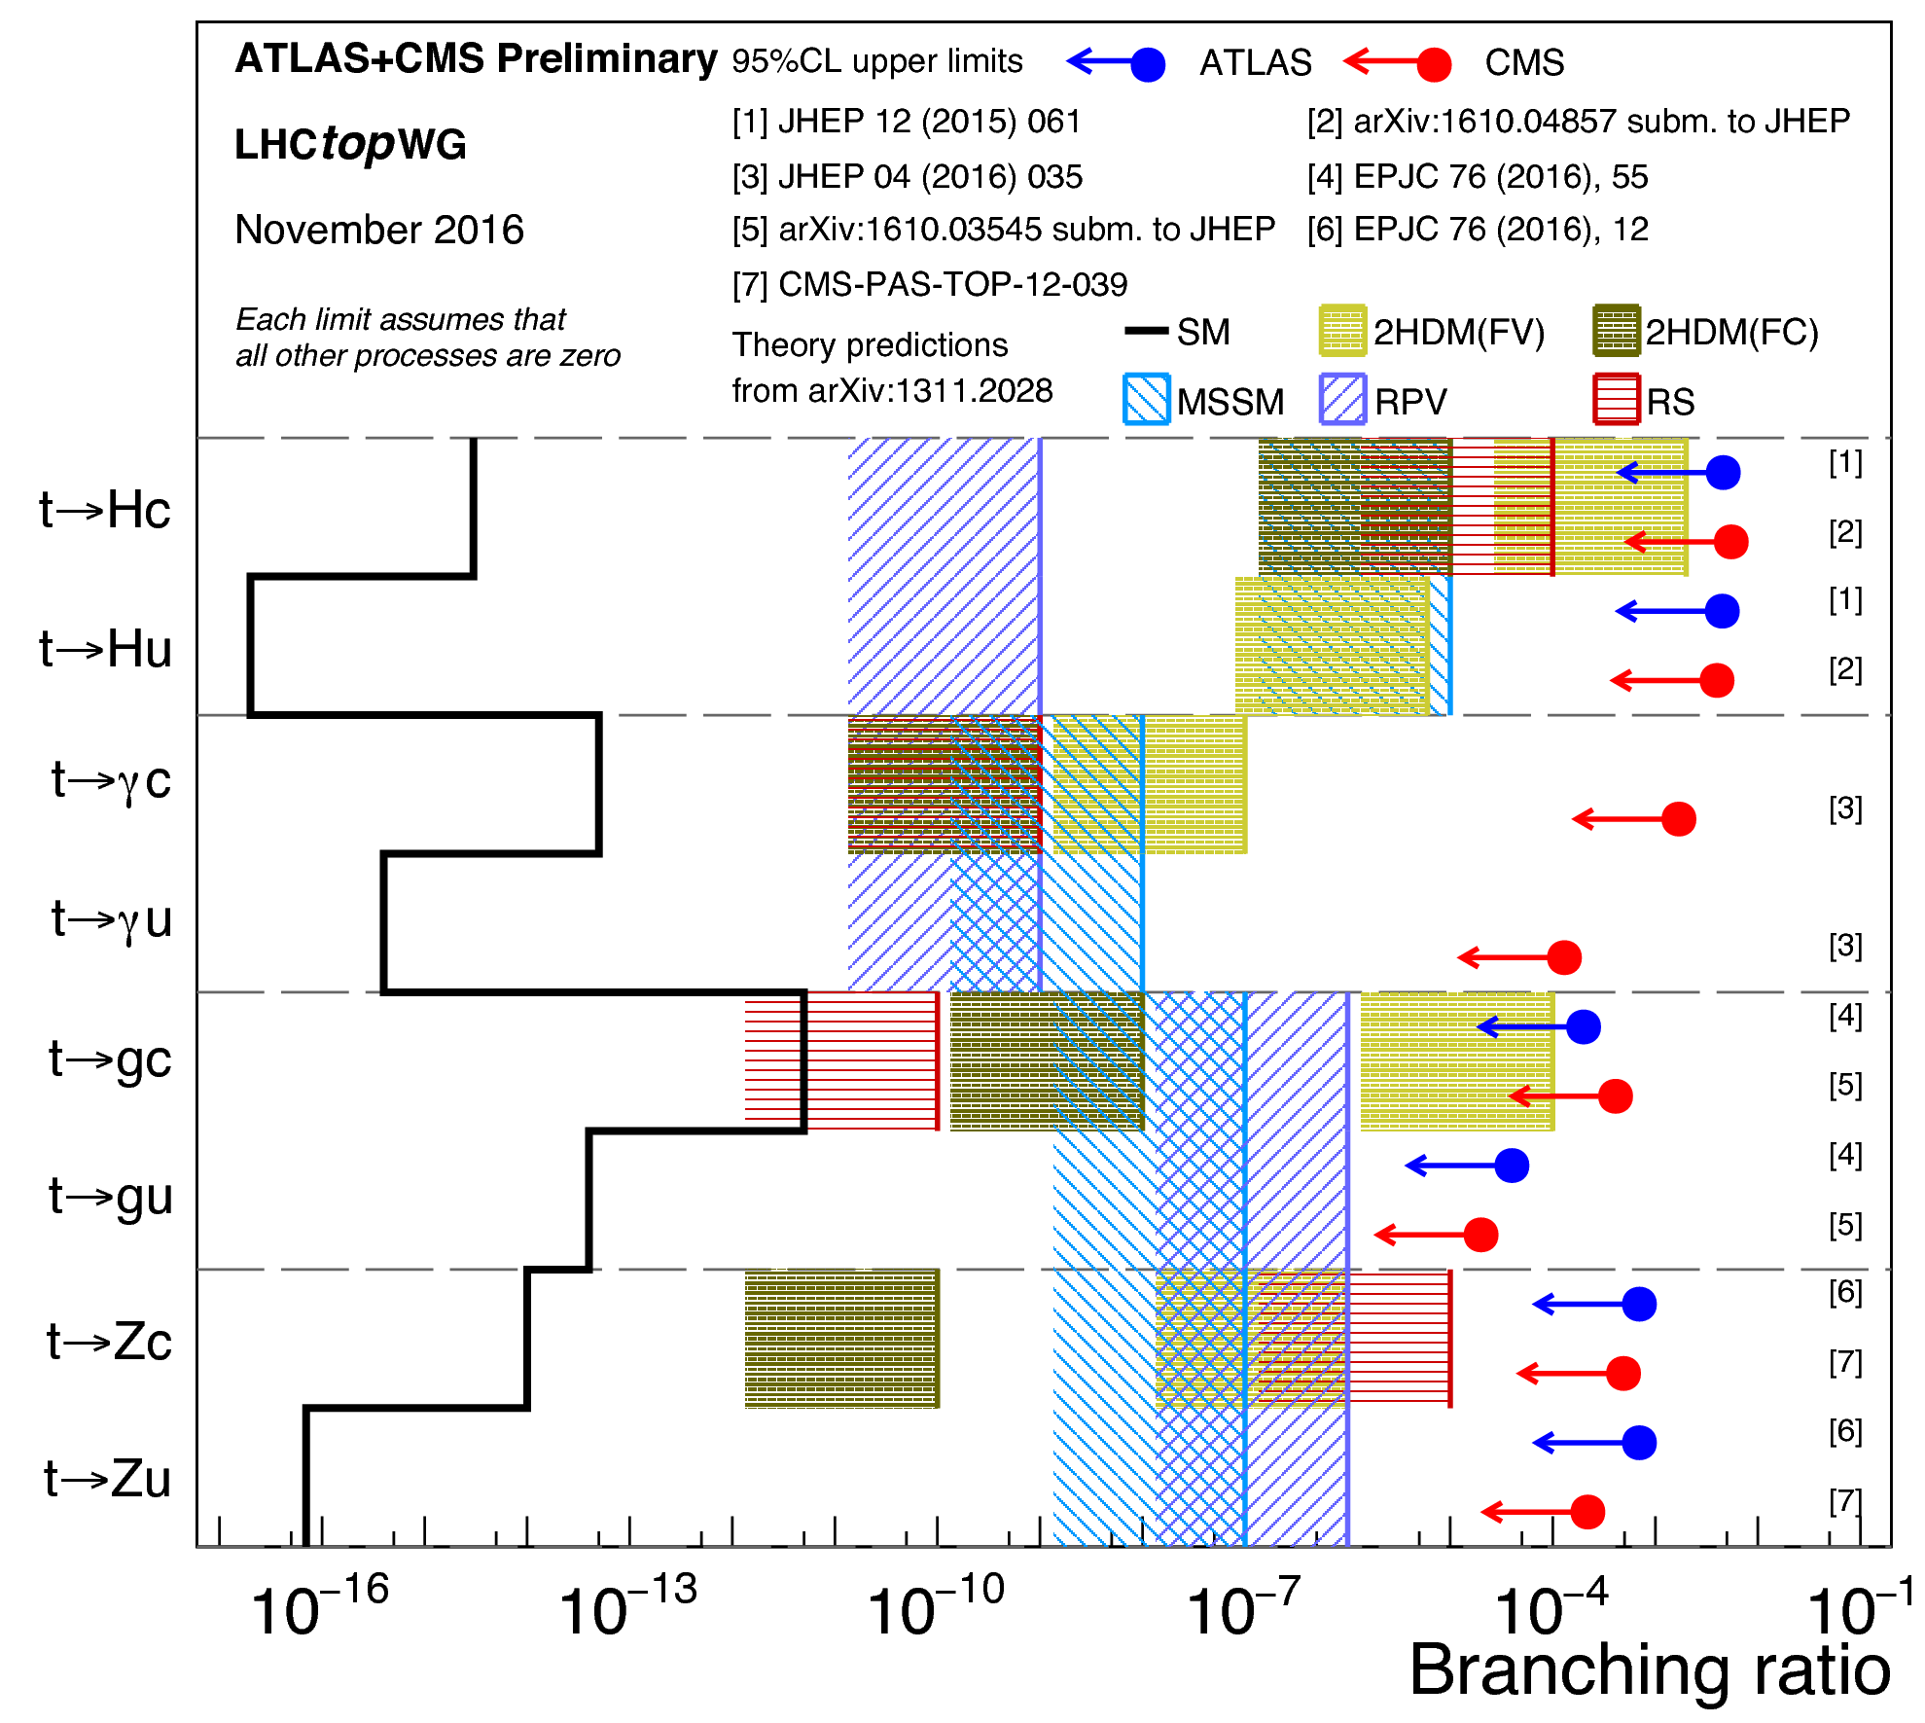
Summary of FCNC decay

Slide 25
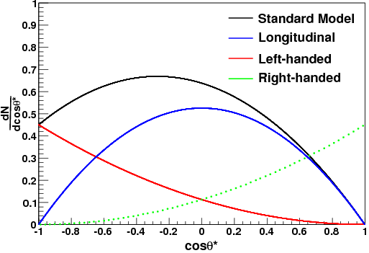
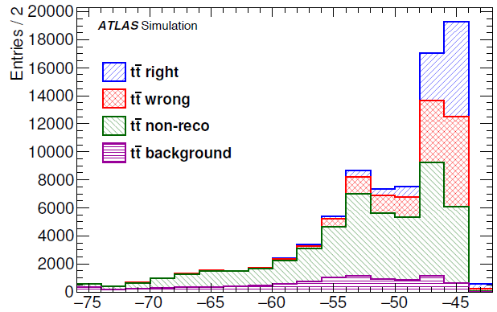
$W$ polarization in top decay
ATLAS: arXiv:1612.02577v1
Measure the helicity fraction of the W bosons from top decay
Important test of the $V−A$structure of weak interaction
Sensitive to effects of new physics
The observable : angle between charged lepton(down type quark) and b quark direction in $W$ rest frame
Best measurement so far: $t\overline{t}$ in 1-lepton
Event selection: Exactly one lepton, >=4 jets (>=1 b-tag)
Exploit on-shell top and W masses in likelihood to pick the right permutation.

Slide 26
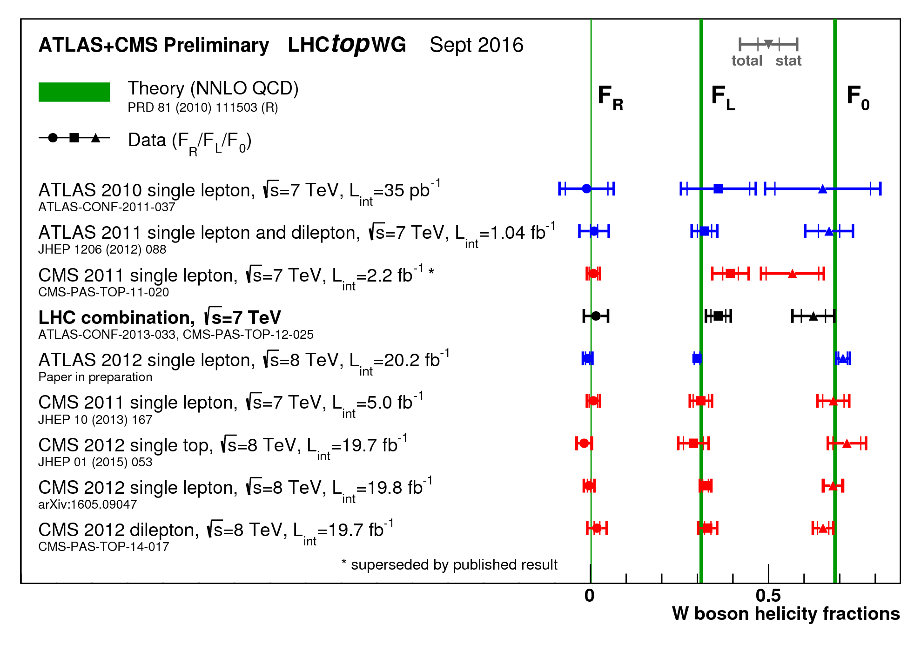
Summary: W helicity in top decay

Slide 27
Conclusions/Summary
More and more rare processes start to be observed
The standard model is tested on an unprecedented scale
No surprises yet
Most results shown are from 8 TeV data. Expect updates soon!

