Slide 1
ATLAS phase II strip tracker upgrade
Zhijun Liang
IHEP, CAS
Tsinghua University

Slide 2
Outline
Introduction to ATLAS tracker phase II upgrade
ALTAS tracker phase II upgrade activity in China
  Silicon strip detector module R & D
  CMOS sensor R & D
Summary

Slide 3
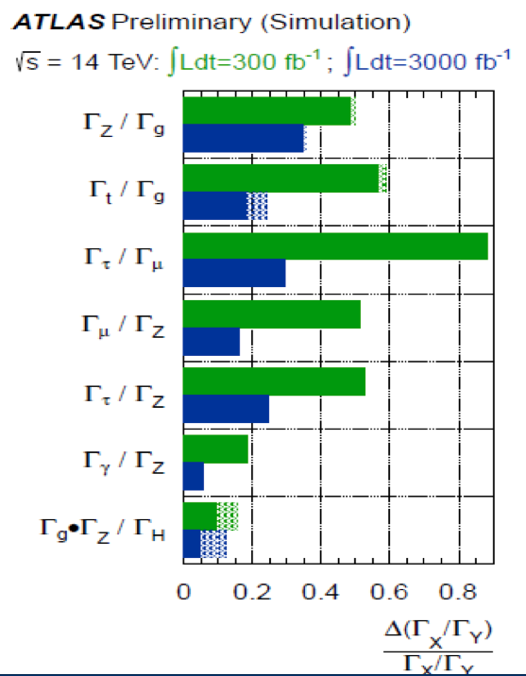


High luminosity LHC
In ten year, CERN will upgrade Large
Hadron collier (LHC) to high luminosity LHC
Higgs precision measurements
new physics search
LHC
High luminosity LHC
LHC
HL-LHC

Slide 4
ATLAS tracker phase-II upgrade
ATLAS need to build a new full-silicon tracking detector (ITK) to handle high luminosity LHC (HL-LHC) upgrade
Radiation hardness requirement
In ATLAS phase II upgrade
（ Equivalent neutron flux ）
2×10¹⁵ Neq/cm²
Present ATLAS strip detector is designed only up to 2×10¹⁴ Neq/cm²

Slide 5
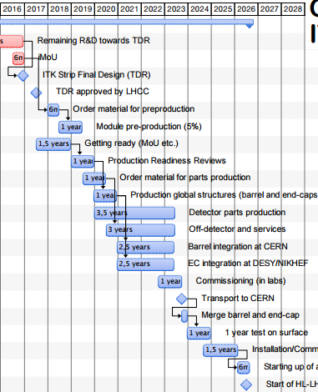
Timeline of ATLAS strip detector upgrade
End of 2016 , technical design report（TDR）
2018-2019 pre-production
2020-2023 production

Slide 6
Research grant for ATLAS ITK phase II upgrade
ATLAS China group got the research grant supported by Ministry of Science and Technology of China (MOST): 13 million Yuan
This grant covers the following R & D and small scale production: Front-end electronic readout ASIC design for ATLAS strip detector
Silicon strip detector module prototyping and production
CMOS-based silicon strip detector performance study

Slide 7
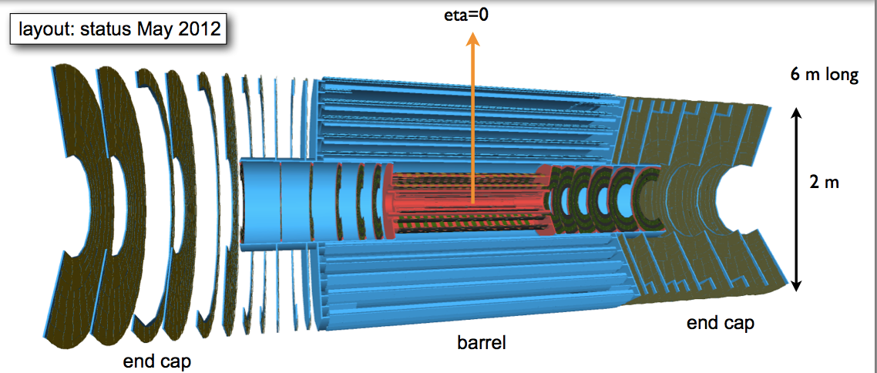
Silicon Strip Detector Module Production
ATLAS Strip detector Phase 2 upgrade | total | ATLAS China group expected contribution
Area | 190 m² | 10 m²
Modules | 20,000 | 1000
China is going to build 1000 strip modules in phase 2 upgrade
  Contribute 5% of ATLAS phase 2 strip detector
  covers large area of detector : 10m²

Slide 8
Stave/Petal concept
Stave/Petal concept

Slide 9
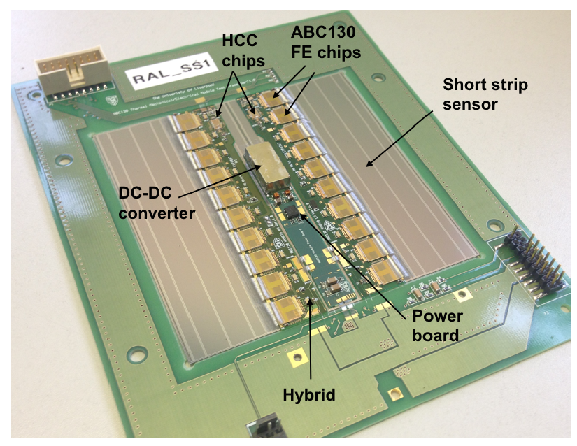
Silicon detector module
Basic unit of strip detector: module
  Silicon sensor
  PCB hybrid controller (readout ASIC + controller electronic)
  Power board

Slide 10
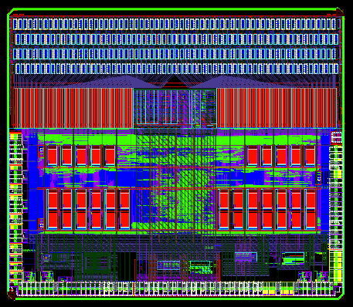
Frontend electronic
China contribute to the readout ASIC prototyping
  L0 trigger has higher requirement on trigger rate
  Redesign the digital part of readout ASIC
  Collaborate with CERN electronics group and University of Pennsylvania
  More details in Weiguo’s talk
prototype of readout ASIC:
ABCN130 chip
ABC
ABC*
ABC
ABC*
Readout chip
ABC*
Readout chip
ABC
ABC
STAR
ABC*
analogue
ABC*
ABC
ABC
ABC*
ABC
ABC*
Digital
ABC
ABC*
ABC
ABC*
Power control
ABC
HCC
ABC*
HCC*
Hybird controler
Hybird controler

Slide 11
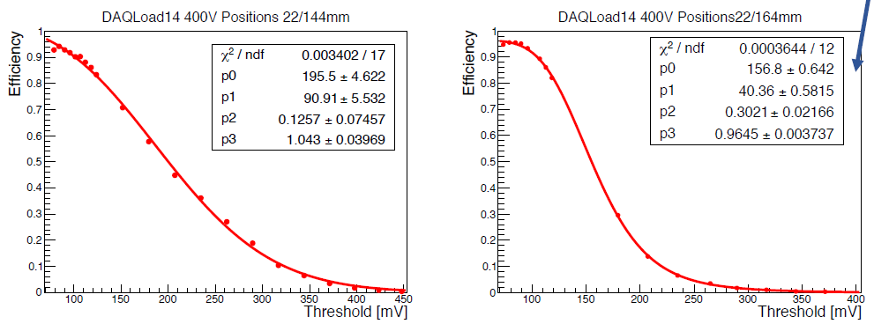
Beam test for ATLAS upgrade
contribute to beam test DAQ framework development (EU-DAQ)
Active in beam test study : measure S-curve of module and hit efficiency
beam test result from ATLAS China included in ATLAS upgrade TDR.
Before irradiation
After irradiation
S-surve of strip module before/after irradiation
S/N after irradiation is estimated to be about 20

Slide 12
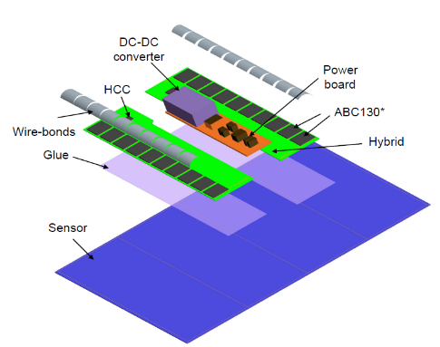
Silicon strip detector module prototyping and production
contribute to module R & D
Manufacturing module building tool
Readout chip
Hybrid PCB
sensor
Power board
Hybrid controller
Detector Module
ASIC Pickup tool
Detector module

Slide 13
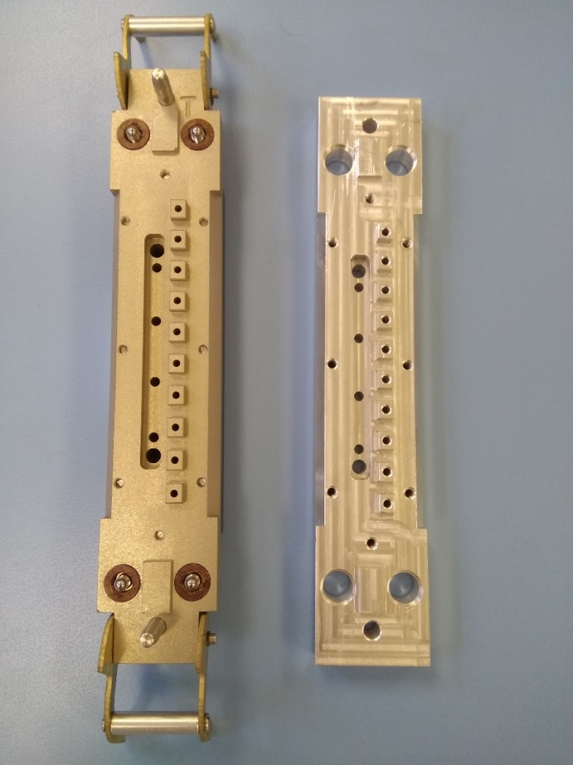
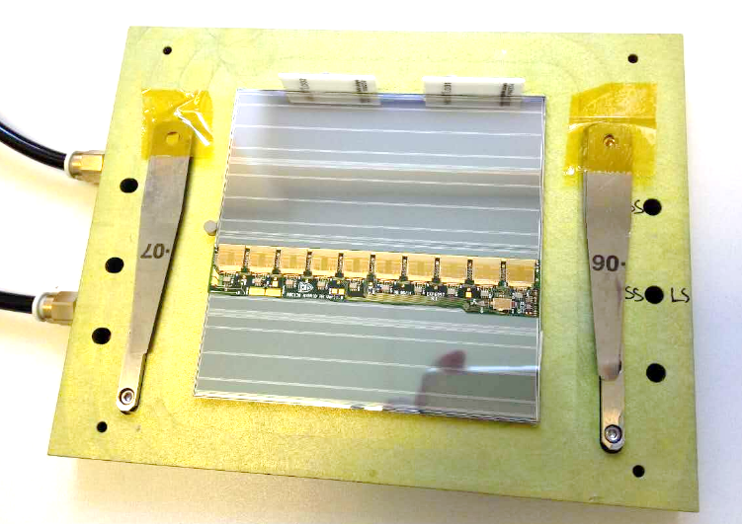
Silicon strip detector module prototyping
participate in module tooling R & D
  The planarity tool made in China is within 20 μm
  Meet the design requirement
Contribute to module prototyping.
Prototype module made by China group
Made by
Liverpool
Made by
IHEP

Slide 14
Export control
Key Radiation hard chip, embargo against China
  Frontend readout chip ABC130
  hybrid control chip HCC,
  monitoring chip AMAC,
  DC-DC chip FESAT
Embargo exemption：
  CERN hires layers to apply for embargo exemption for many countries.
  Prof Joao Costa is contact for about embargo exemption application for China
International Collaboration：
  Make use of facility aboard from our collaborators to train our people.
  Learn the key technology

Slide 15
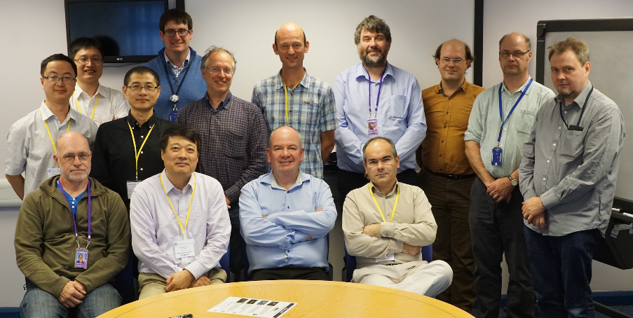
International Collaboration
collaborate with Rutherford Appleton Lab(RAL) in module R & D
ATLAS China group visit RAL in 19 Sep,2016
  Discuss the collaboration in ATLAS upgrade project

Slide 16
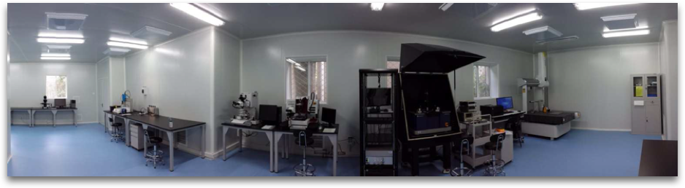
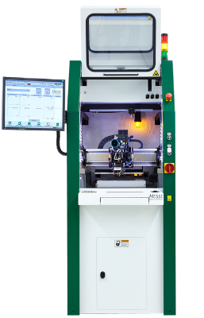
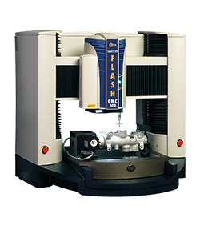
Laboratory
State key lab has a 150 m² Thousand grade clean room
With probe station, wire bonder for detector R & D
BJ 820
Flash CNC 300

Slide 17
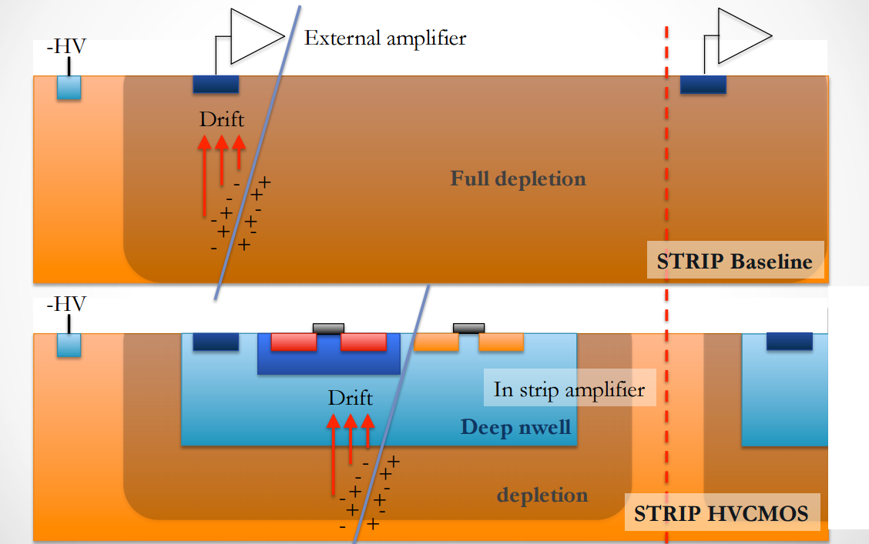
CMOS silicon strip sensor R & D
China contribute to new detector technology R & D: CMOS strip sensor
  CMOS technology has been widely used in digital camera, cell phone
  The advantage of CMOS sensor:
  Lower material budget, Monolithic, has potential to reduce the cost
CMOS sensor is the alternative solution for ATLAS strip upgrade
  First time using CMOS technology in Strip tracker
母板
子板
FPGA

Slide 18
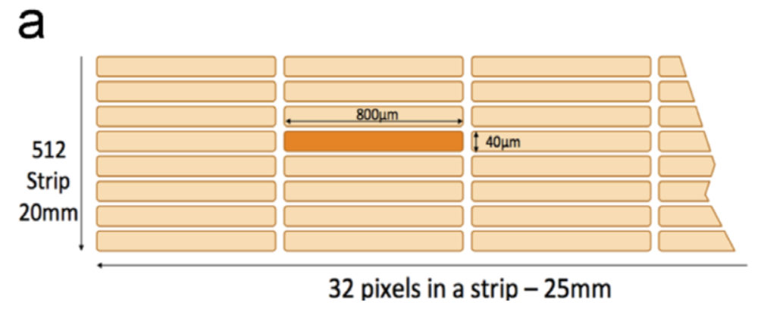
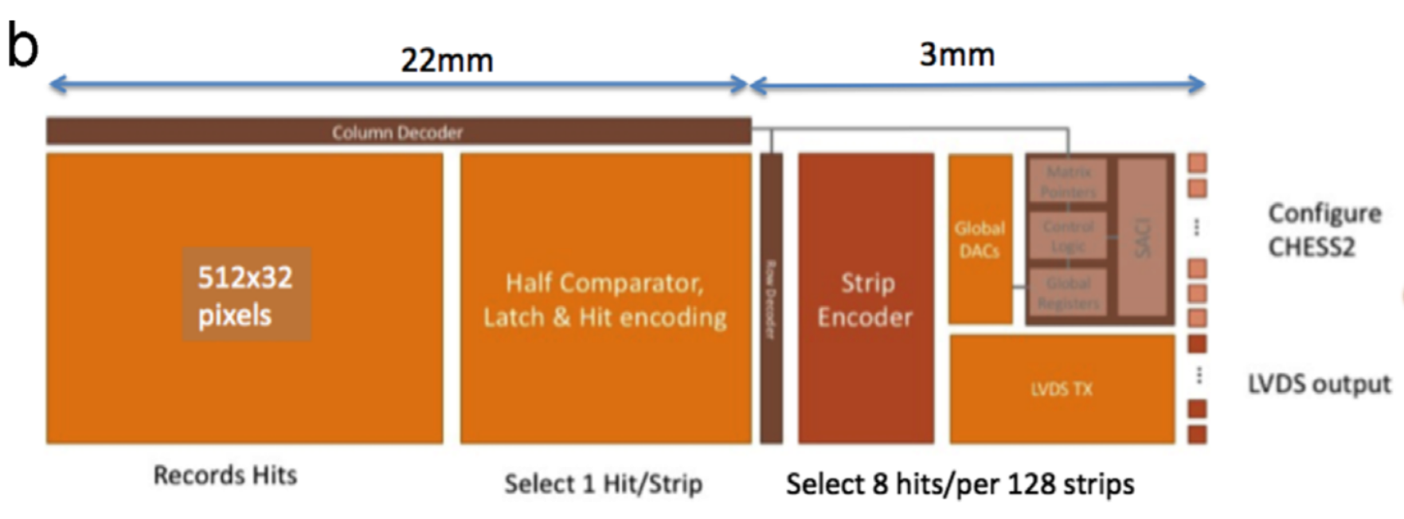
CMOS silicon strip sensor R & D
AMS 350 technology
  Pixel size: 40X800 μm
  Digital readout
  Frontend electronic (Amplifier) intergated on sensor
2016-12-17
18
EPJC 70 (2010) 723

Slide 19
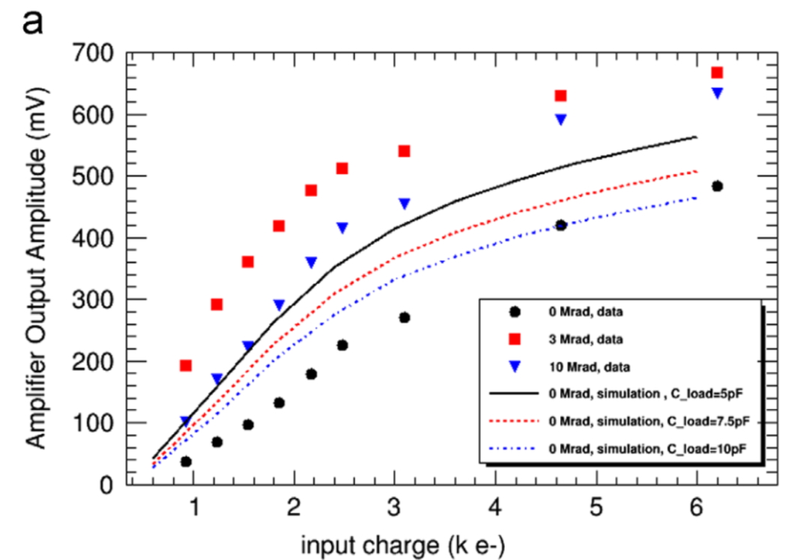
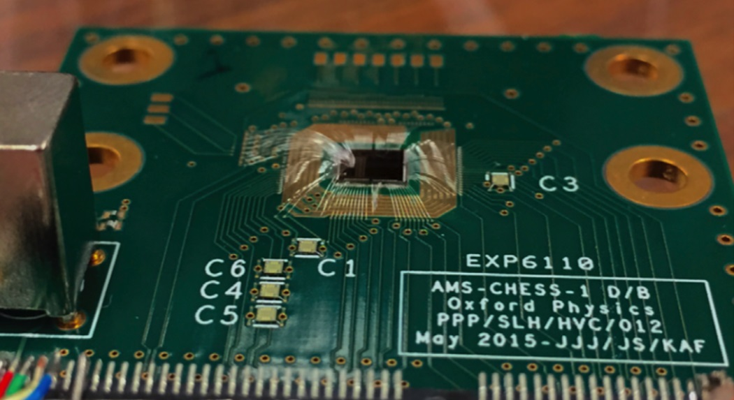
CMOS silicon strip sensor R & D
Contribute to testing CMOS sensor
  First measurement on CMOS amplifier performance after irradiation.
  ATLAS china group member is the first author and corresponding author
Nuclear Instruments and Methods in Physics Research A 831 (2016) 156–160
2016-12-17
19

Slide 20
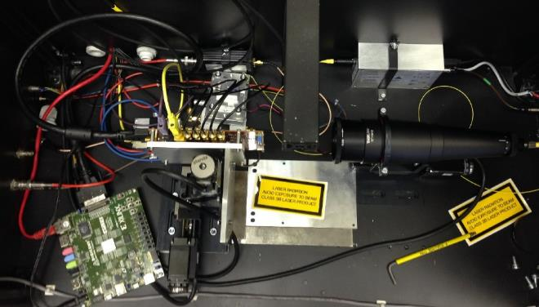
CMOS silicon strip sensor R & D
CMOS testing in local lab
Laser induced Scanning Transient Current Technique (Laser TCT)
Testing CMOS strip sensor with laser TCT in Laboratory
IHEP Laboratory
Mother Board
Laser
FPGA
Electronic and DAQ system
Laser TCT system

Slide 21
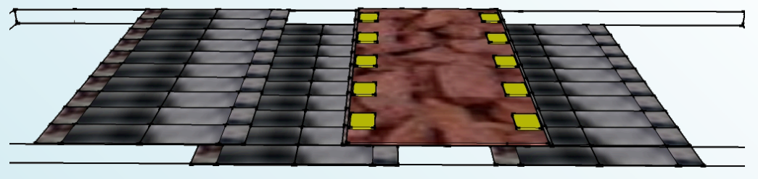
ABCN’ readout chip and prototype module for CMOS sensor
Prototyping a CMOS strip detector module in next two year.
Need a new readout chip ABCN’
  Mainly to handle buffering of data
3 interested parties: Oxford, IHEP, UBC

Slide 22
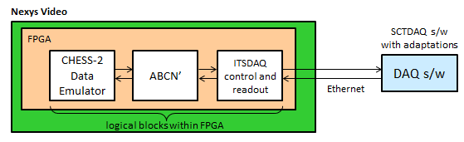
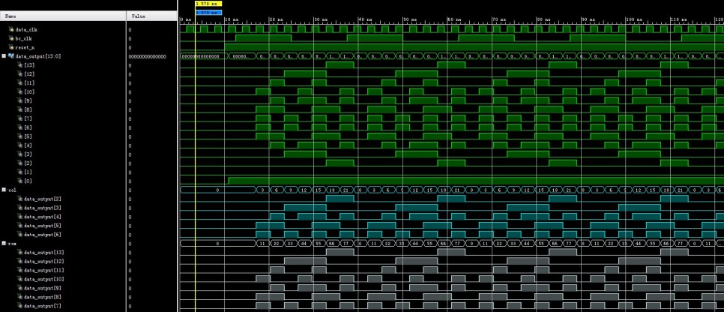
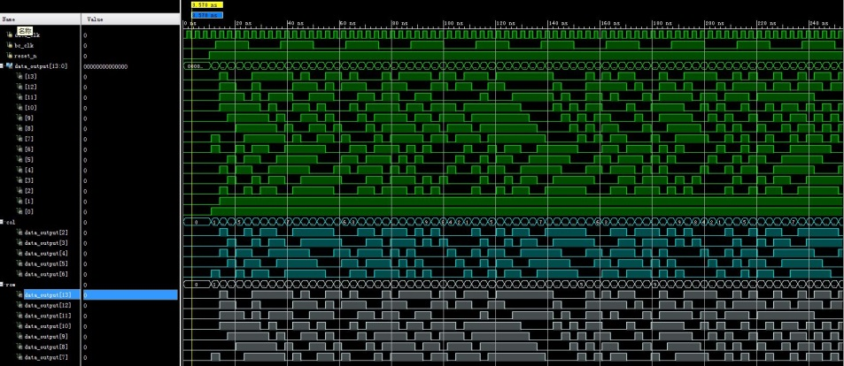
ABCN’ FPGA emulator 1/2
ABCN’ readout chip R & D, Before CMOS sensor is ready
  We need to emulator to emulate the CMOS sensor output
  IHEP and USTC team make FPGA emulator : Two versions
    Fixed pattern: put out the same pattern of hits every 25ns
    Pseudo-random pattern: generate random hit pattern

Slide 23

ABCN’ frontend readout chip
China contribute to ABCN’ chip development
  Buffering the digital data from CMOS sensor
  Full Digital readout chip
  Back-end readout : Nexys Video FPGA
Digital daughterboard
Adaptor board
Nexys Video
CHESS-2
SCTDAQ s/w
with adaptations
Array 1, 128 strips
FPGA
ABCN’
ITSDAQ control and readout
Test structures
DAQ s/w
Array 2, 128 strips
Array 3, 128 strips
power
logical blocks within FPGA
B is FMC
A is an edge connector
A
B

Slide 24
Summary
ATLAS tracker upgrade activity in China
  R & D for key technology
    High spatial resolution
    Large area detector
    Radiation hardness
  Plan to make significant contribution in ATLAS upgrade project

Slide 25
Backup
IHEP activity in ATLAS tracker upgrade
Front-end electronic readout ASIC design for ATLAS strip detector
Silicon strip detector module prototyping and production
CMOS-based silicon strip detector performance study

Slide 26
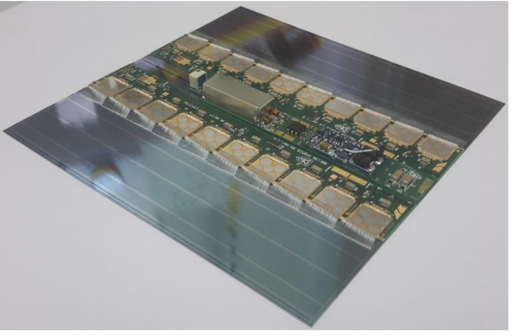
Silicon detector module
Basic unit of strip detector: module
  Silicon sensor
  PCB hybrid controller (readout ASIC + controller electronic)
  Power board
Module controller
Readout ASIC
Silicon sensor
Power board

Slide 27
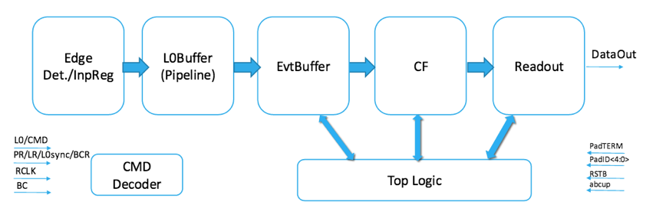
Digital electronic design in readout ASIC
IEEE RT2016 poster（Libo Cheng）
TWEPP2016 talk（Weiguo Lu）
IHEP contribute to redesign of digital part of readout ASIC chip
setup verification system to verify the ASIC design (based on SystemVerilog )
Next steps :
1.finalizing the digital part of ASIC design and simulation
2.Plan to test the performance of readout ASIC next year

Slide 28
芯片禁运问题
目前硅微条探测器模块芯片，包括读出芯片ABC、控制芯片HCC、电流监控芯片AMAC、DC-DC芯片FESAT以及高压转换芯片因为抗辐照原因，均对中国禁运。
积极申请禁运豁免：ATLAS和CMS合作组内多个国家面临相同问题，CERN专门聘用律师统一协调针对技术（GF/IBM CMOS工艺）申请禁运豁免（出口许可）。高能所为ATLAS合作组代表单位，高能所Joao Costa教授被任命为ATLAS方联络人。
国际合作：在禁运问题完全解决之前，积极利用国际合作，借用国外合作单位先进设施开展预研工作。充分锻炼人才队伍，为后期回到国内开展建造任务奠定扎实基础。

Slide 29
硅微条探测器模块
硅微条径迹探测器最基本机械单元，由硅微条传感器、复合PCB控制板（读出电子学ASIC芯片+控制芯片）、电源板等构成，使用银胶或紫外凝胶粘合，通过打线实现电气连接。
模块控制芯片
硅微条探测器模块及主要组件
前端读出电子学ASIC芯片
硅微条传感器
高、低压电源控制板

