Slide 1
VBF H(->bb)+photon
Zhijun Liang (梁志均）
( IHEP, Chinese Academy of Science )
On behalf of ATLAS collaboration

Slide 2
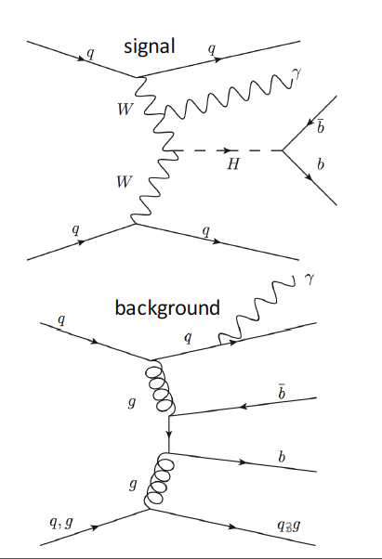
Introduction
Search for H->bb in VBF events containing a central photon
Advantages of requiring a photon
extra handle for trigger
suppresses QCD background containing initial state gluons
Special VBF production
Sensitive to WWH VBF production
not sensitive to ZZH VBF
Existing results for inclusive VBF (H->bb)
ATLAS in Run 1
observed (expected) upper limit : 4.4 (5.4) x SM
CMS in Run 1
observed (expected) significance : 2.2 (0.8)
observed (expected) upper limit : 5.5 (2.5) x SM
CMS in Run 2 (2015 data)
observed (expected) upper limit: 3.0 (5.0) x SM
None for VBF + photon
ATLAS-CONF-2016-063

Slide 3
Major Background process
QCD pbbjj +γ production
Inspired by Barbara Mele’s paper
http://arxiv.org/abs/hep-ph/0702119

Slide 4
MC Samples
Signal samples (VBF H(->bb)+γ):
generated with Madgraph, parton shower by Pythia8
Z(bb)γ+jets (resonance background )
EWK VBF H(->bb)+γ
generated with Madgraph, parton shower by Pythia8
QCD VBF H(->bb)+γ
generated with Madgraph, parton shower by Pythia8
QCD γbb+jets (Non resonance background )
generated with Madgraph, parton shower by Pythia8
For MVA training

Slide 5
Trigger
Threshold for single photon trigger and 4jets triggers are high.
Single photon: trigger EF_g120_loose (ET>120GeV. too high )
General 4jet triggers : ET>100GeV (too high)
Dedicated trigger developed in 2015 for this analysis.
Analysis is mainly based on VBF0b trigger.
L1 item : L1EM22VHI (trigger on EM object with ET>22GeV)
HLT :
Medium ID photon, pT >25GeV
4 HLT jets pT >35GeV, |eta|<4.9
Mjj>700GeV
Nick name | Trigger name | Integrated lumiosity
VBF0b | HLT_g25_medium_L1EM22VHI_4j35_0eta490_invm700 | 2.5 fb-1 (2015) 10.1 fb-1 (2016)

Slide 6
Event pre-selection

Slide 7
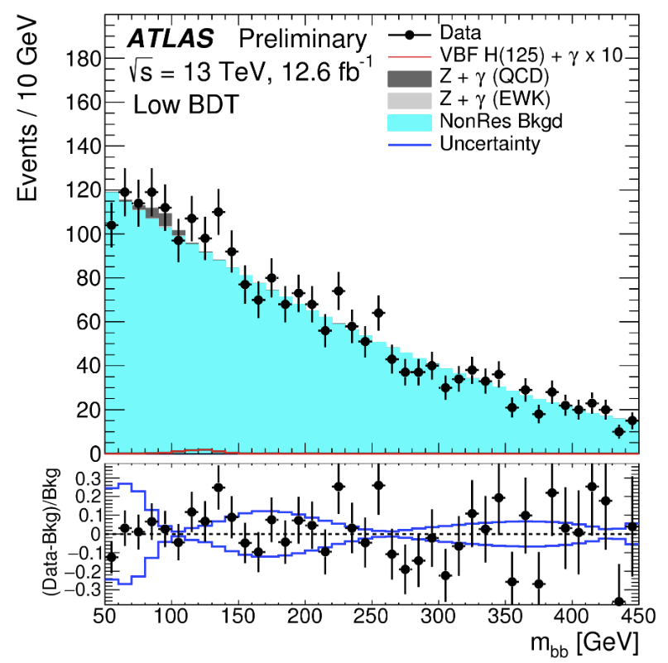
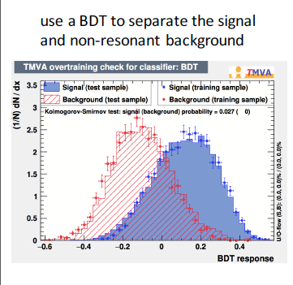
Analysis strategy
Pre-selection cut
MVA analysis (boosted decision tree)
category the events into three category
VBF like events in high BDT output category
The correlation between MVA input variable and m_{bb} is weak
Extract signal from m_{bb} fit
Perform fit in m_{bb} spectrum

Slide 8
MVA studies
BDT training samples:
signal: HbbjjaSM125 (direct tag)
background: NonResbbjja (truth tag)
11 BDT input variables:
variable | definition
dRB1Ph, dRB2Ph, dRJ1Ph, dRJ2Ph | angular separation between the selected jets and the photon
mJJ, dEtaJJ | kinematics of the VBF jets
WidthJ1, WidthJ2 | calorimeter jet width of the VBF jets
pTBal | pT balancing variable for selected final state objects
cenPhJJ | centrality of the photon with respect to the VBF jets
HT_soft | scalar sum pT of the soft TrkJets (pT>7GeV, not close to the final state objects)

Slide 9
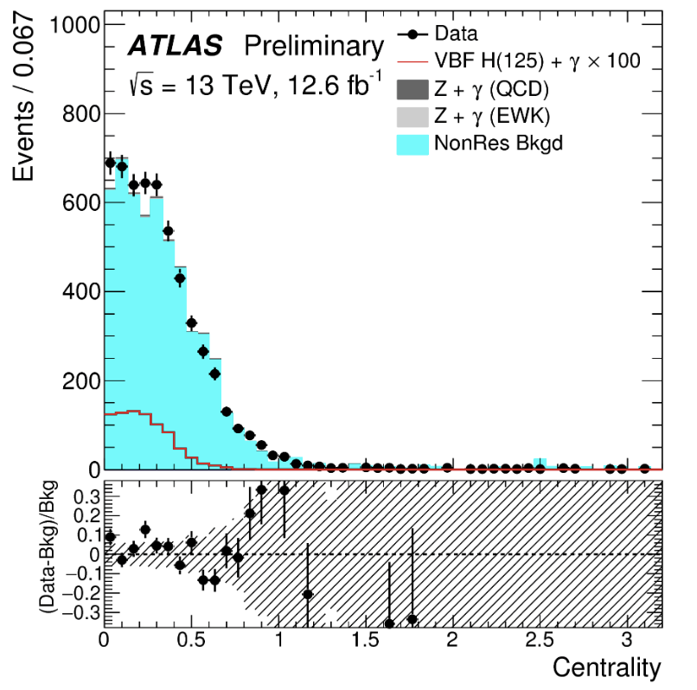
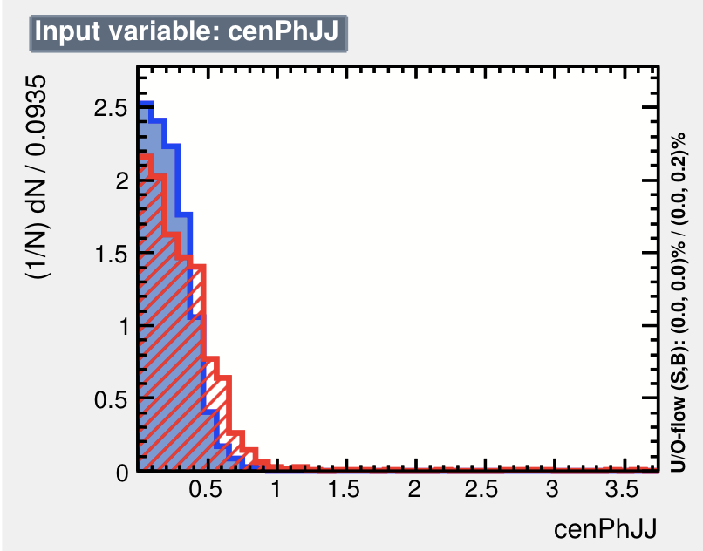
MVA Input varialbe: centrality and Mjj

Slide 10
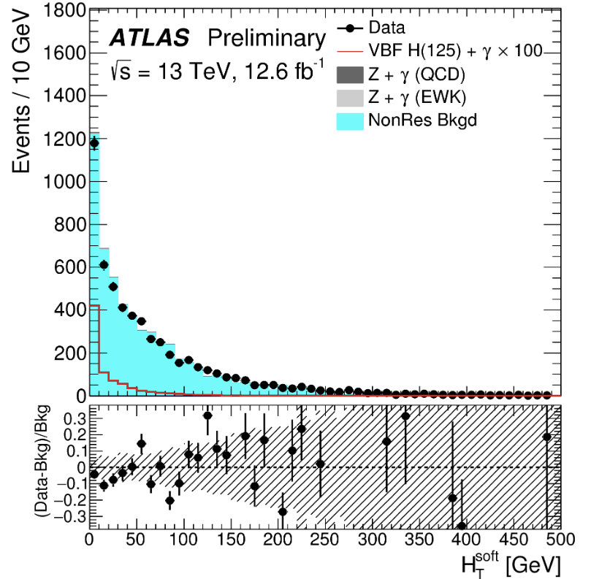
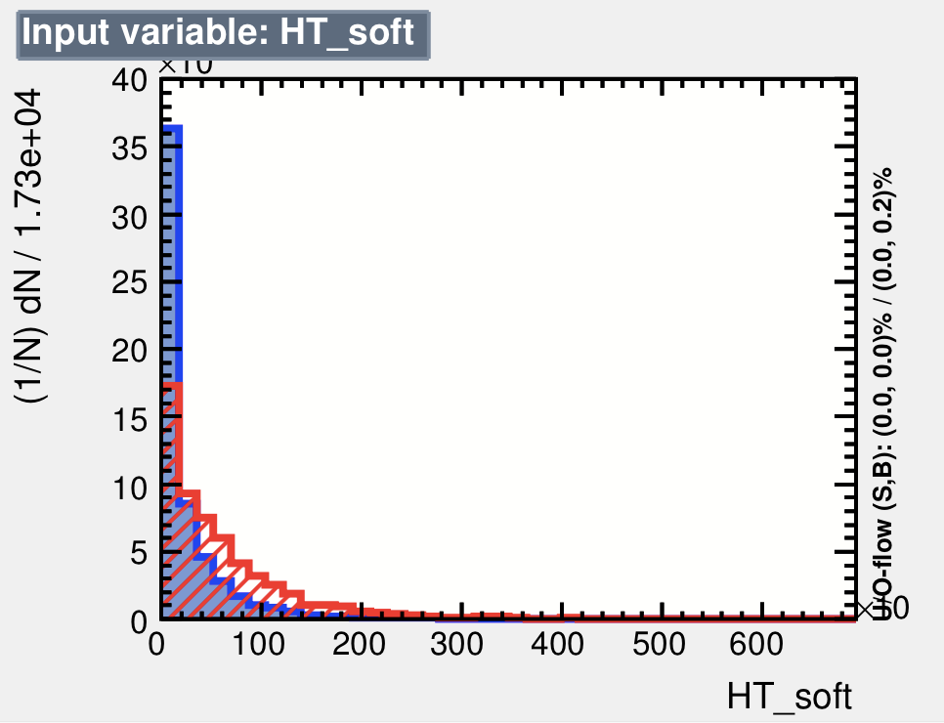
MVA Input varialbe: H_{T}^{soft}
Low QCD activity in rapidity gap of two VBF jets for VBF signature

Slide 11
m_{bb} Fit configurations
H+γ fit configuration
H+γ normalization μ_{H is} the parameter of interest.
H+γ and Z+γ shape from MC simulation
Z+γ normalization from MC predictions
The normalization of are from MC simulation.
Non-resonance background is fitted as 2nd order polynomial
Z+γ fit configuration
EWK Z(bb)γ+jets and QCD Z(bb)γ+jets are considered as signal
H+γ and Z+γ shape from MC simulation
H+γ is normalization from MC simulation
Non-resonance background is fitted as 2nd order polynomial

Slide 12
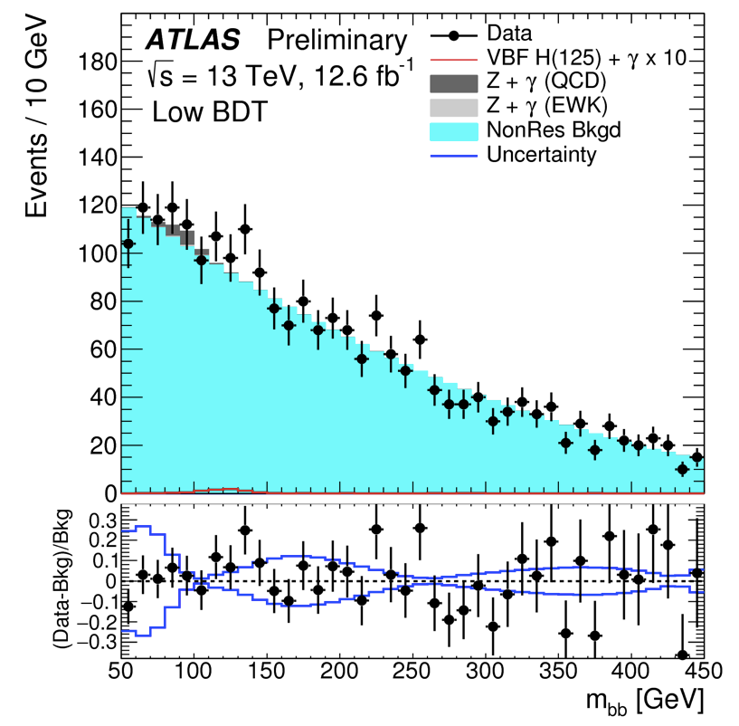
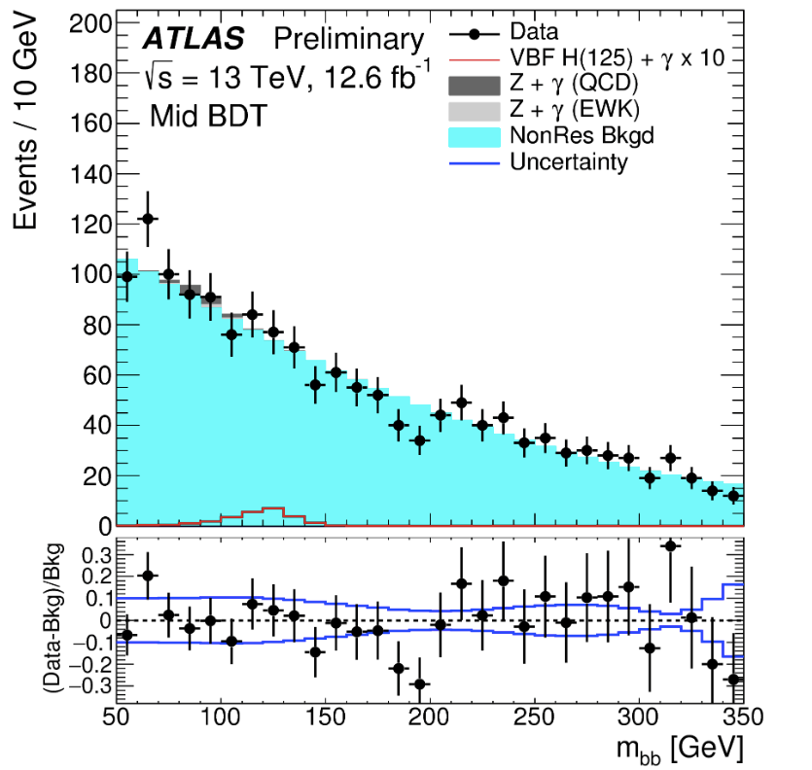
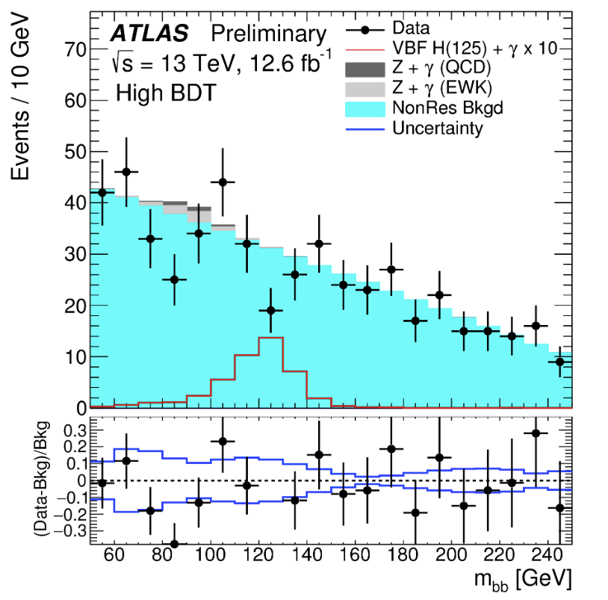
m_{bb} fit
Mbb fit with 3 category : high/medium/low BDT region
Low BDT
Medium BDT
High BDT
BDT categories | BDT score | mBB fit range
low | BDT < -0.1 | [50, 450] GeV
medium | -0.1 < BDT < 0.1 | [50, 350] GeV
high | BDT > 0.1 | [50, 250] GeV

Slide 13
Result
ATLAS-CONF-2016-063
H+γ fit configuration
H+γ normalization μ_{H is} the parameter of interest.
Z+γ normalization and Z+γ shape from MC simulation
Z+γ fit configuration
EWK Z(bb)γ+jets and QCD Z(bb)γ+jets are considered as signal
H+γ normalization and H+γ shape from MC simulation

Slide 14
Systematic uncertainties
Theoretical uncertainties for H+gamma and Z+gamma
QCD scale systematics
Parton shower systematics
PDF uncertainty
Non-resonance background systematics
Statistics in mbb sideband region
The bias in fit function
Experimental uncertainties
Trigger uncertainty
Modelling of MVA input variable ( jet width , HTsoft)
Jet systematics (Jet energy scale)
Photon systematics (photon ID, EM energy scale)
B-tagging efficiency systematics

Slide 15
Impact of each systematics
Non-resonance background systematics is the leading systematics.

Slide 16
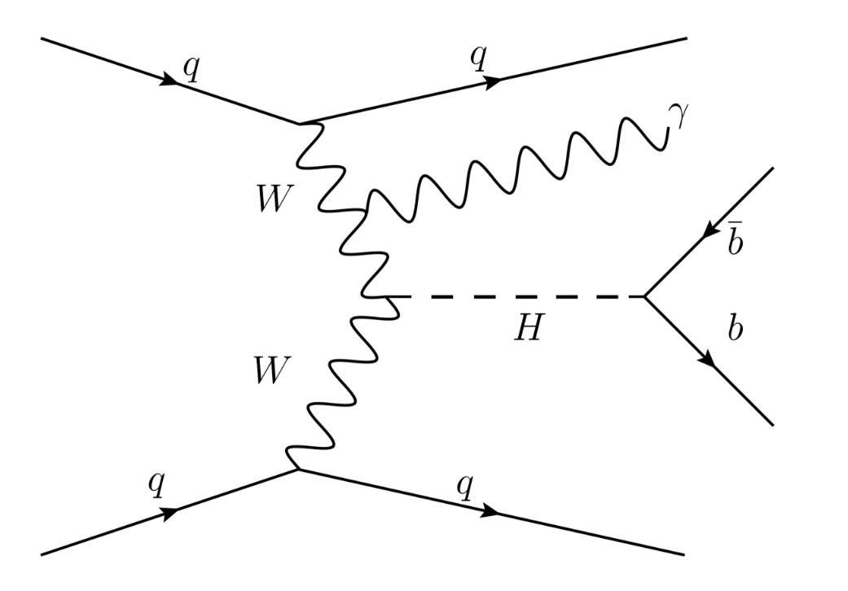
Summary
First VBF H(->bb)+γ search in LHC.
The observed 95% CL upper limit on signal cross section
4 times SM cross section expectation.
A validation measurement with Z(->bb)+γ
signal strength: 0.3 ± 0.8
Observed upper limit is 2 times SM cross section expectation.
IHEP ATLAS group contribution
Propose this new final state
Lead analysis as Analysis contact
Give ATLAS approval talk

Slide 17
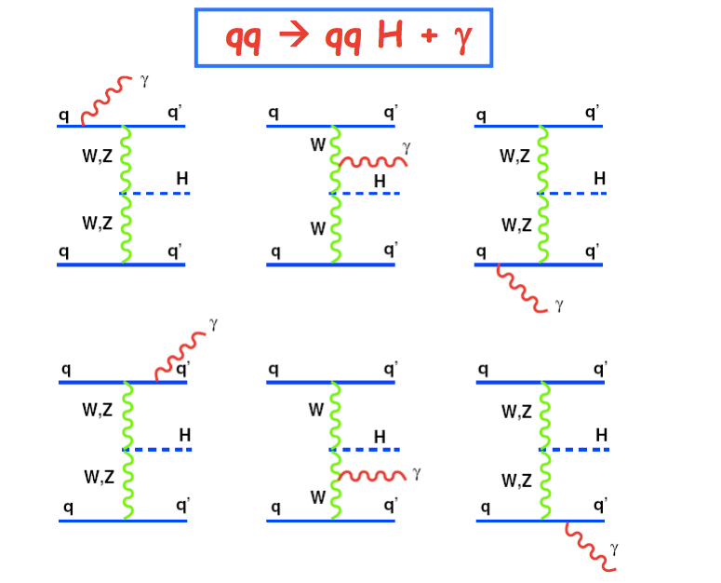
Introduction
Inspired by Barbara Mele’s paper
http://arxiv.org/abs/hep-ph/0702119
Introduce a new channel in VBF H->bb
pp->h(bb) jj +γ
Measurement of bbH and WWH coupling
By requiring a central photon
S/B ratio is much better than VBF H->bb
Help to do trigger the events

