Slide 1
Recent Progress from CMS-China
Yajun Mao
For CMS China Group
2nd CLHCP Workshop
2016.12.17-20
Notes:
The analysis has been performed on the pp-collision data sample recorded by the CMS detector at the center-of-mass energy of 8TeV, corresponding to an integrated luminosity of 19.3fb-1. The obtained results are interpreted as a search for a SM higgs boson, as well as in the context of a beyond the SM scenario, based on an effective theory where a second scalar particle besides the resonance at 125GeV completes the unitarization of the WW scattering

Slide 2
Overview
Physics Analysis
Detector Upgrade
Summary

Slide 3
1. Overview

Slide 5
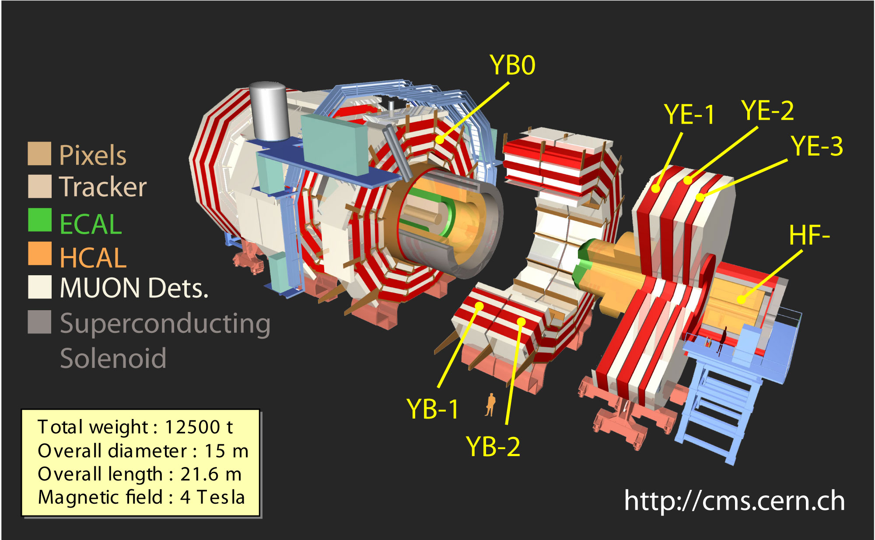
The CMS Detector
Plus Side
Minus Side
12/17/2016
Physics Seminar @ LZU
5

Slide 6
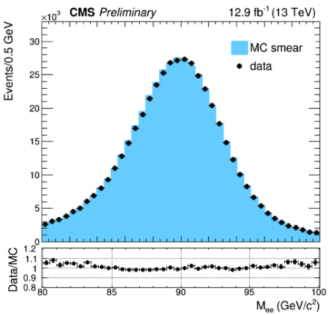
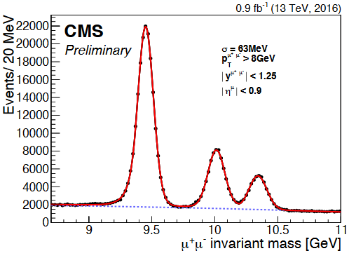
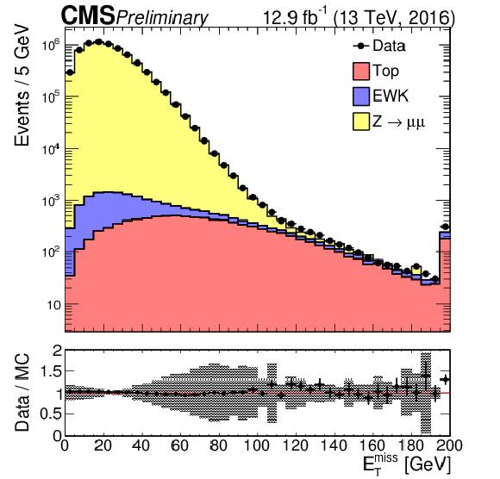
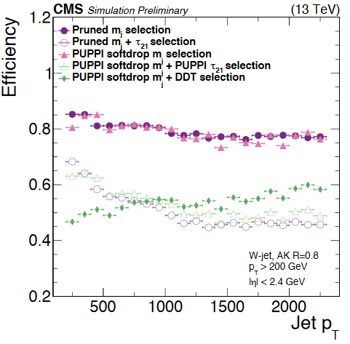
2016 Detector Performance
$$e$$
$$μ$$
MET
W-Jet tagging

Slide 7
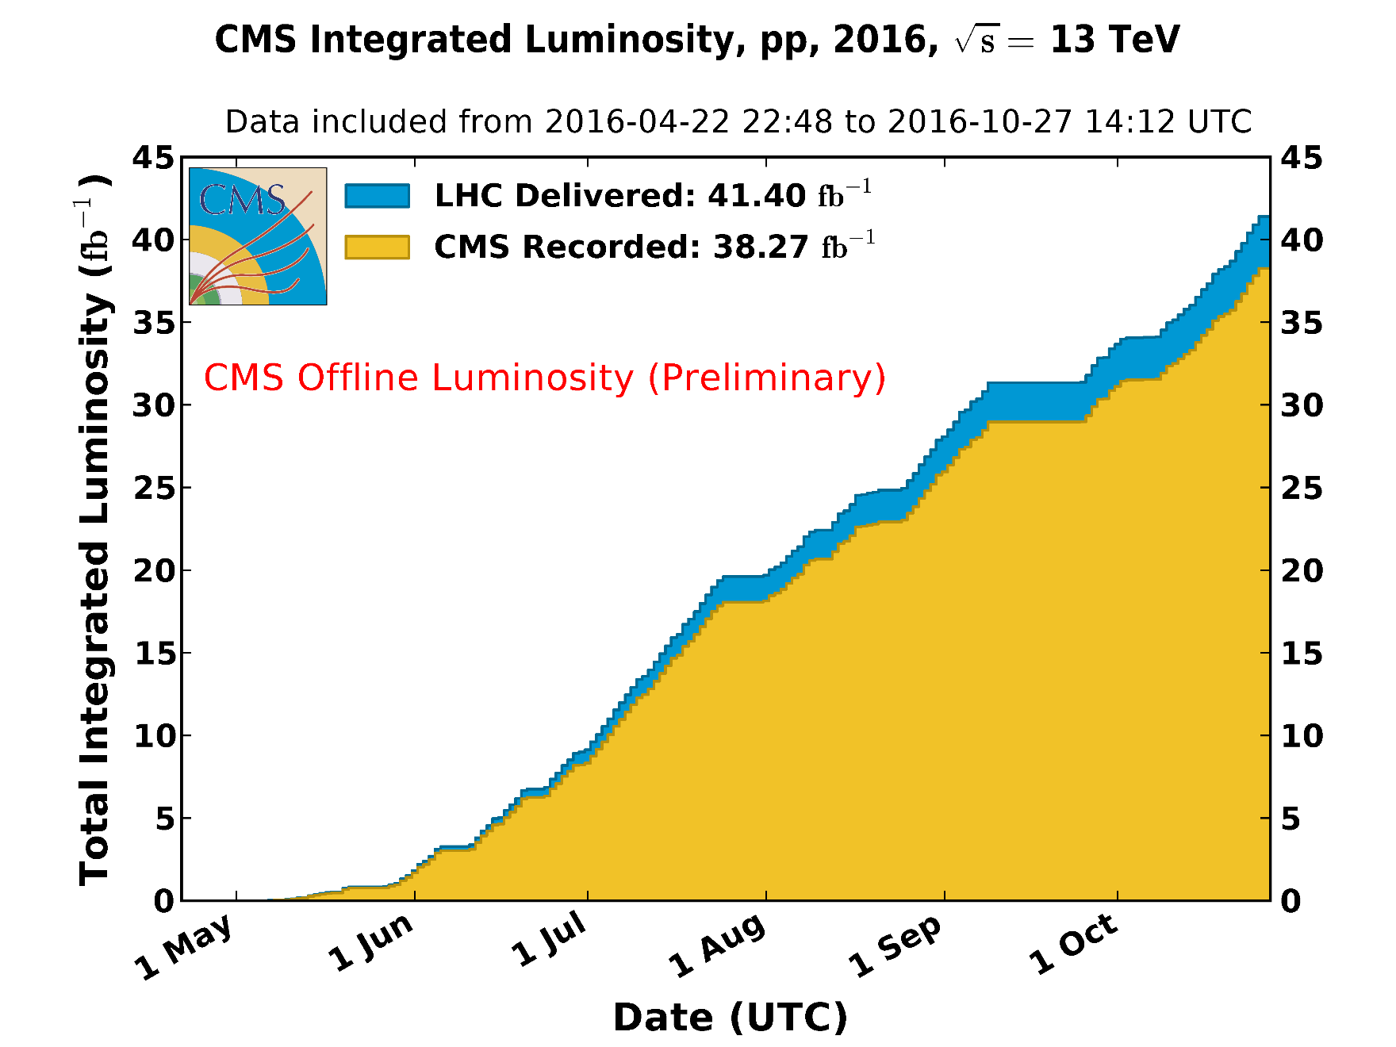
CMS pp Luminosity 2016

Slide 8
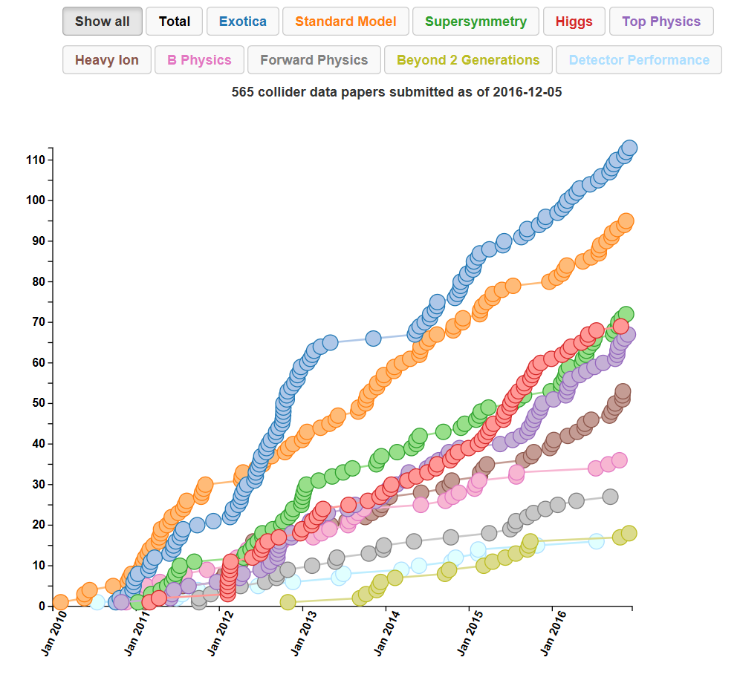
CMS pp Luminosity 2016

Slide 9
CMS China Group
Coordinator: Guoming CHEN (IHEP)
Deputy Coordinator：Yajun MAO (PKU)
IHEP PKU BeiHang THU
~ 20 ~20 ~6 ~ 4
Higgs SM NP
Analysis
+ Exotic + Exotic
+ SM
Upgrade
EMC GEM MRPC
+ Trigger (+Trigger)

Slide 10
2. Physics Analysis

Slide 11
IHEP Analysis Overview
Higgs Property：
Run I H→ZZ→4l, x-section, JHEP
Run I ATLAS+CMS Higgs combination, JHEP
Run II H→γγ, PAS
Run II H→ZZ→4l, PAS
Run II ttH, multi-leptons, H→bb, PAS
Exotics：
Run II ZZ heavy resonance, 2l2q, PAS
b*→bW search, JHEP
Majarona neutrino, PAS
di-tau resonance search, PAS
b’→bZ， t’→tZ search, PAS
Run II $b\overline{b}$ resonance search, PAS
SM：
Run II ZZ→4l, Z →4l, x-section, PLB
RunI tZq search, 2.4σ, PAS
Statistics:
Papers: 5 + 2
PAS: 18
AN: 28
talks: 15 （国际）
talks: 19 （国内）
Contact：6

Slide 12
PKU Analysis Overview
Exotics：
WH resonance, EPJC
Run I WV 0.8-4TeV, PAS
Run I WV 0.6-1TeV, PAS
Run II WV 0.6-4.5TeV, PAS
Run I Anomalous WWV coupling, PAS
SM：
VBF W+2Jets, JHEP
VBS Wγ+2Jets, PAS
VBS Zγ+2Jets, PAS
B^{+/-}->K^{+/-}μ⁺μ⁻ ,FNC study, PAS
Statistics:
Papers: 2 + 2
PAS:
AN:
talks: （国际）
talks: （国内）
Contact：6

Slide 13
Beihang Analysis Overview
Exotics：
Run II Z’ →2l, 4l search,
Run II Zγ resonance search,
Statistics:
Papers:
PAS:
AN:
talks: （国际）
talks: （国内）
Contact：

Slide 14
高能所陈明水等

Slide 15
高能所张华桥，北大李晶 等

Slide 16
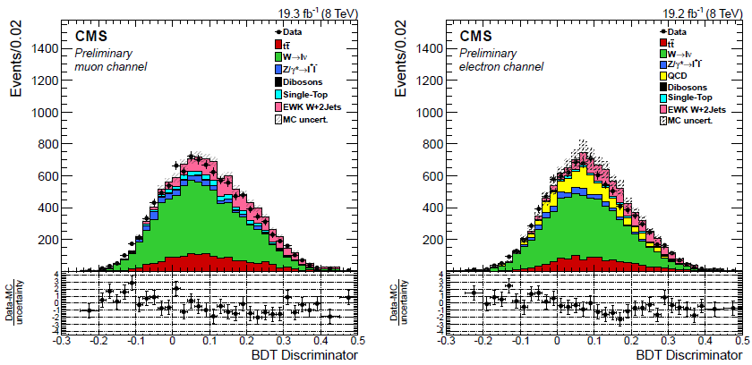
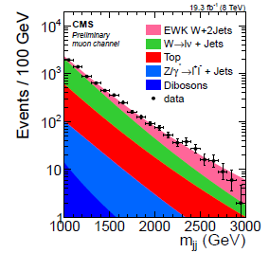
$VBF Wjj$
CMS, 8TeV
arXiv:1607.06975
Accepted by JHEP
北大李晶负责
EWK Wjj simulated by MG at LO, QCD Wjets from MG MLM matching
DATA-driven QCD Wjets normalization from BDT control
Signal extracted from unbinned maximum likelihood fit to Mjj
Floating QCD Wjets shape

Slide 17
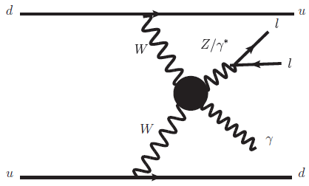
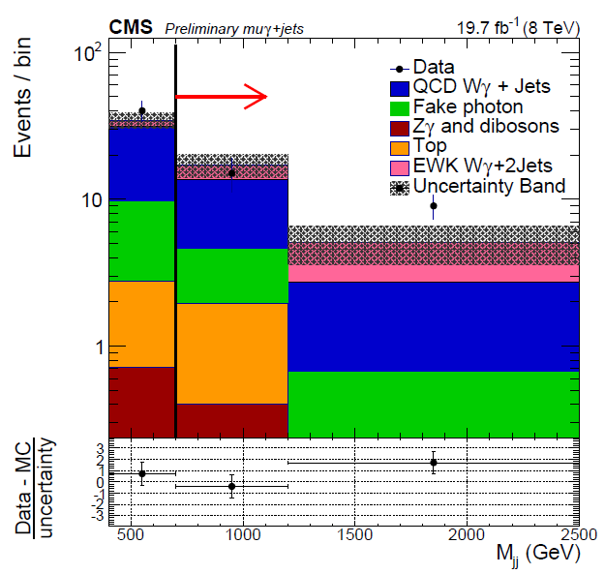
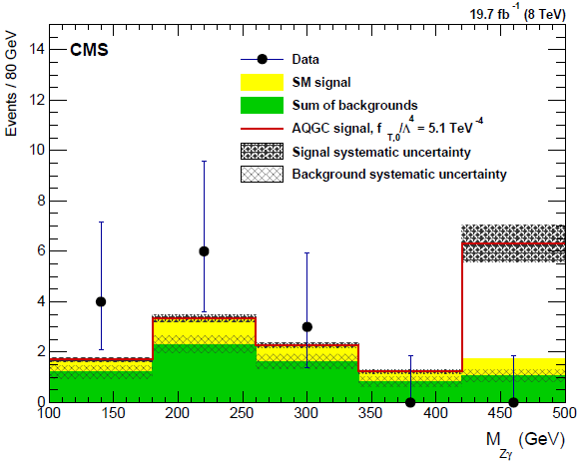
$VBS Wγ, Zγjj$
CMS, 8TeV
CMS-PAS-SMP-14-011/018
QCD Z$γjj:$ MC Shape + DD Normalization
Jet/Electron Fake Photon
Jet fake Electron: MET Template
Signal Extracted from binned
Mjj fit [400-800], [800- ] GeV
Two Opposite Sign Leptons with PT>20GeV
Photon PT>25GeV
Two Jets with PT>30GeV
70GeV<mll<110GeV
北大张冯望东、张照茹负责
First Evidence!
aQGC
limit
set
based on
$M_{Zγ}$

Slide 18
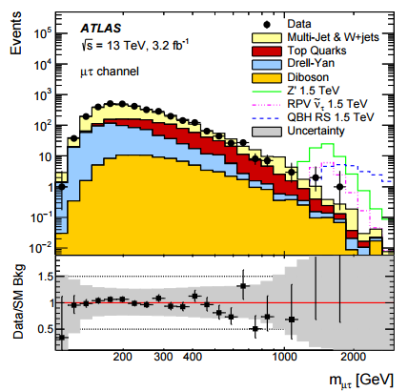
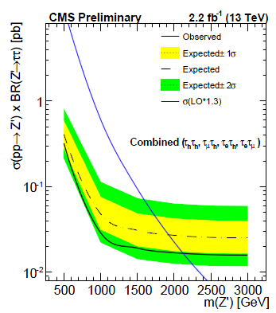
LFV
ATLAS 2015 arXiv:1607.08079
CMS-PAS-EXO-16-001 2015
2015
CMS-PAS-EXO-16-008
$$Z′→ττ$$
高能所Romeo负责

Slide 19
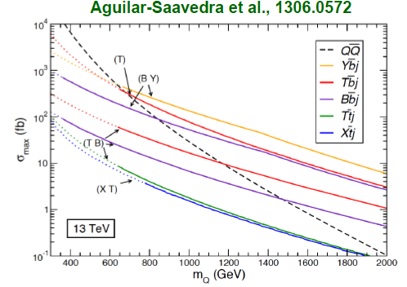
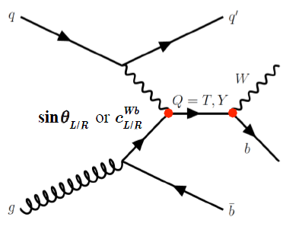
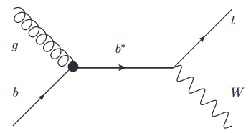
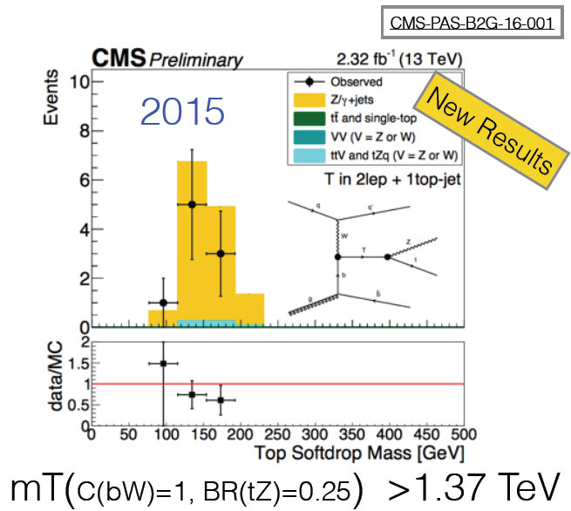
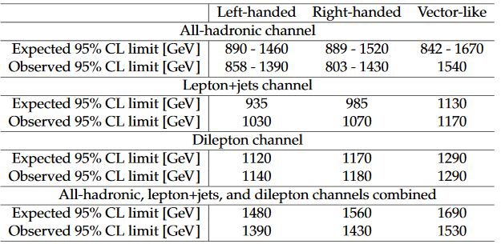
VLQ CMS-PAS-B2G-16-001, JHEP01(2016)166
高能所廖红波等负责
高能所张华桥负责
Excited b*->tW

Slide 20
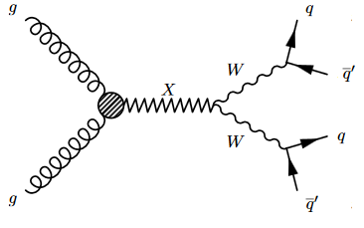
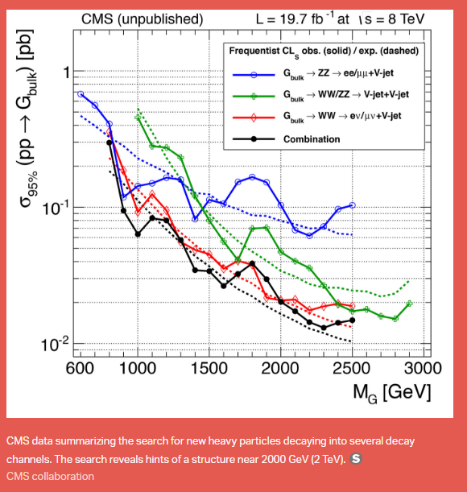
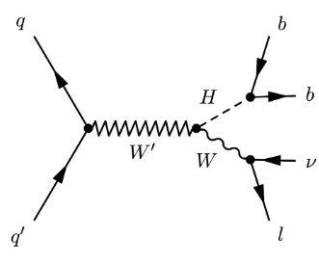
Di-boson (W,Z,γ,H) Resonance
Although Run2 Data don’t support the 750GeV/2TeV excess, Di-boson search has become a hot topic at LHC
Spin 0/1/2: Higgs/Radion, W’/Z’, Graviton
IHEP, SJTU γγ, hh
IHEP ZZ, Zγ
SDU,NJU ZZ, WW
USTC VBS WW
PKU: WW,WZ,WH
….

Slide 21
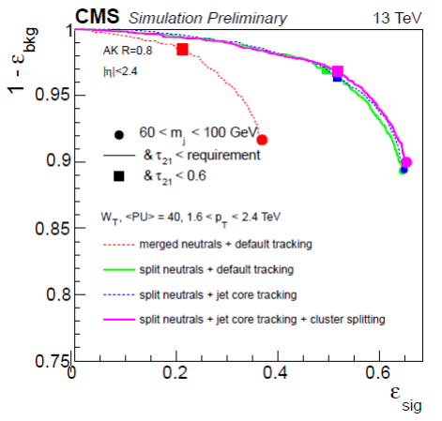
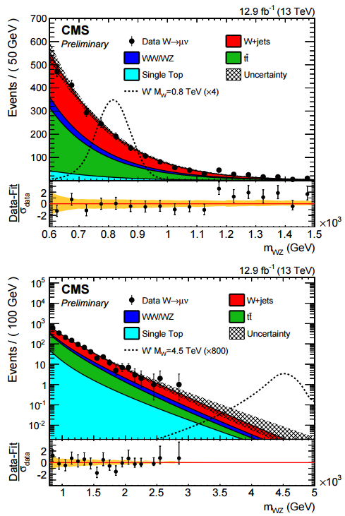
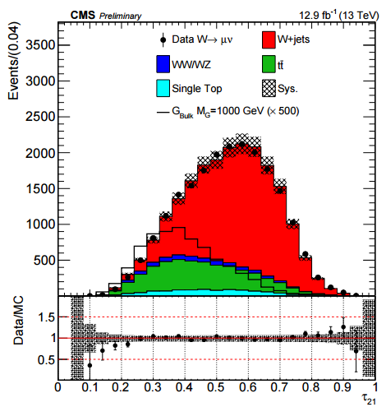
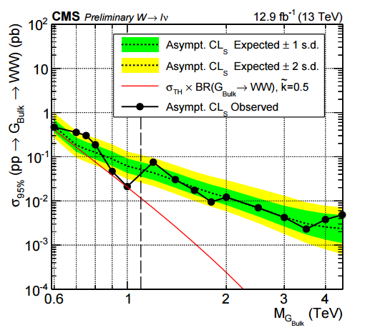
CMS ICHEP2016 CMS-PAS-B2G-16-020
low and high mass searches:$τ_{21}<$0.45,0.6
W and Z regions 65-95 / 75-105 GeV
JME-14-002
北大
黄璜、徐子骏
负责
Comparable with
ATLAS-CONF-16-062

Slide 22
3. Detector Upgrade

Slide 23
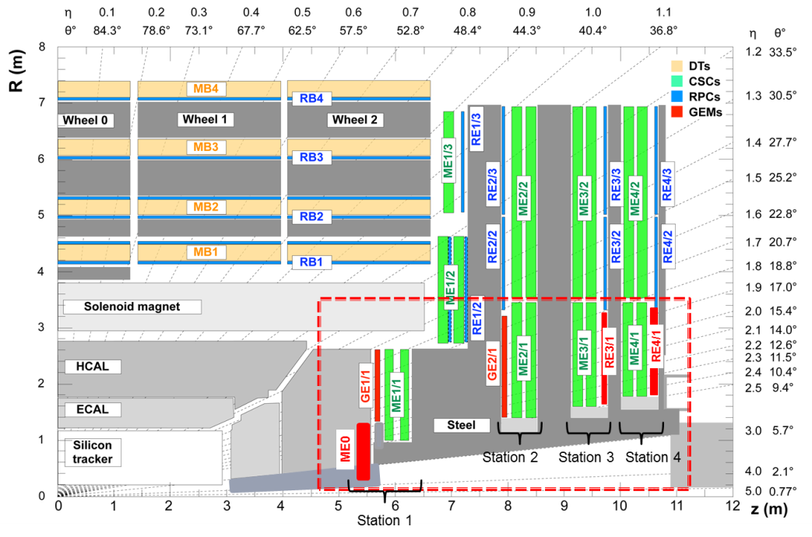
CMS PhaseII Upgrade projects of Chinese Group
Endcap HGCalo：
端盖内圈高粒度量能器升级（高能所）
Endcap μ detector(GEM)
端盖内圈第一、第二层GEM 探测器和最内圈ME0探测器 （北京大学）
Endcap μ detector
Glass mRPC
端盖内圈第三、第四层玻璃多层RPC探测器
（清华大学）
L1 track trigger：
一级径迹触发升级
（高能所）

Slide 24
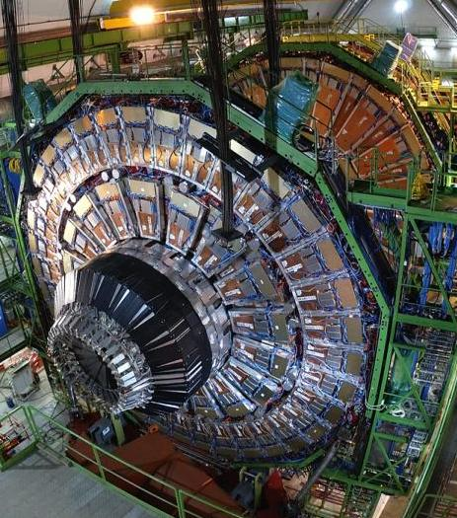
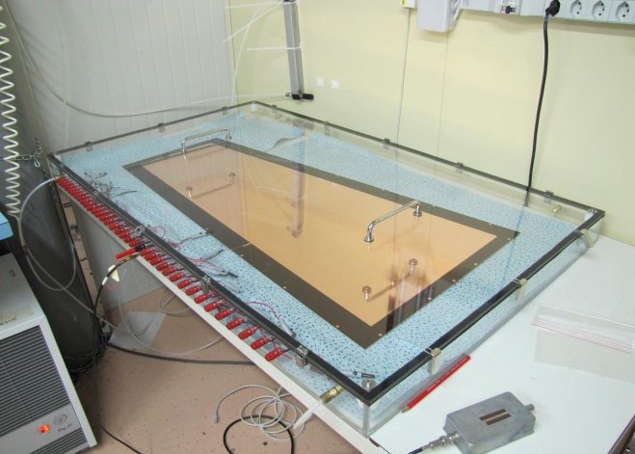
CMS Endcap Inner Ring μ Detector (GEM) Upgrade
研制CMS二期升级要求的基于GEM等微结构探测技术的高计数率、高效率、高时间空间分辨端盖μ子探测器
承担部分GE2/1和ME0探测器生产测试任务,
生产、测试GE1/1和GE2/1的8层前端电子学板。
GE1/1 Detectors
GE1/1 prototype
Notes:
完成研制CMS 二期升级所要求的基于GEM 和MRPC的端盖子触发探测器，生产12 个GE2/1和12 个ME0探测器, 生产、
测试GE1/1 和GE2/1 的8 层前端电子学板共480 块; 建造6 个可直接应用二期升级的RE3/1子探测器；
完成SciFi探测器关键部件检测系统升级。

Slide 25
CMS Endcap Inner Ring μ Detector (MRPC) Upgrade
采用具有自主知识产权的国际先进的低电阻玻璃，研制高计数率、高时间分辨、低噪声的MRPC探测器；
采用玻璃拼接技术研制大面积MRPC；
承担部分RE3/1、RE4/1探测器生产任务。
20cm
450 mm
1020 mm
27cm
540 mm
RE3/1 探测器拼接方法。
25 cm
Notes:
完成研制CMS 二期升级所要求的基于GEM 和MRPC的端盖子触发探测器，生产12 个GE2/1和12 个ME0探测器, 生产、
测试GE1/1 和GE2/1 的8 层前端电子学板共480 块; 建造6 个可直接应用二期升级的RE3/1子探测器；
完成SciFi探测器关键部件检测系统升级。

Slide 26
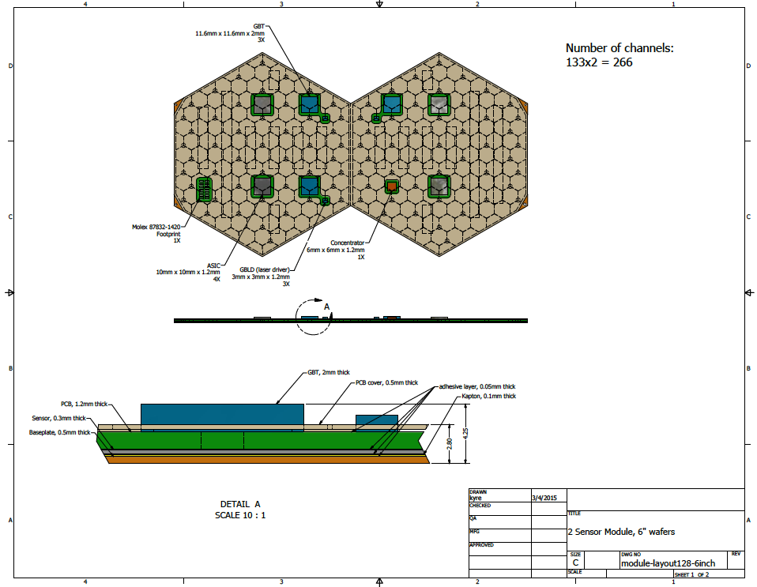
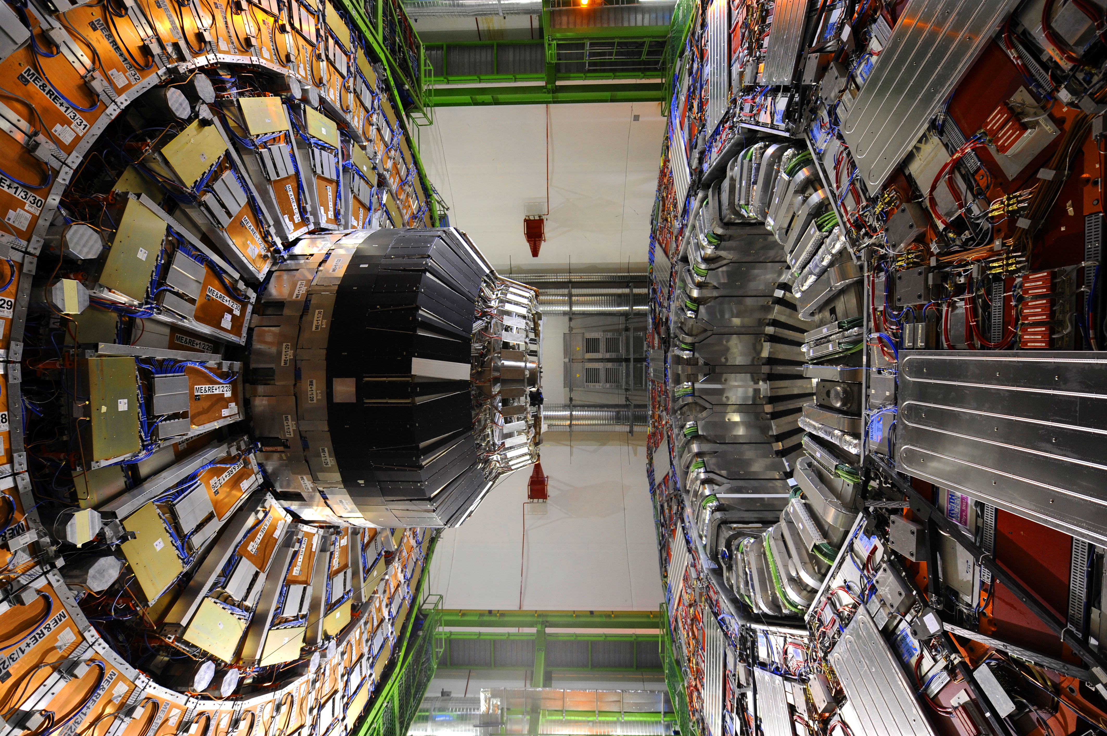
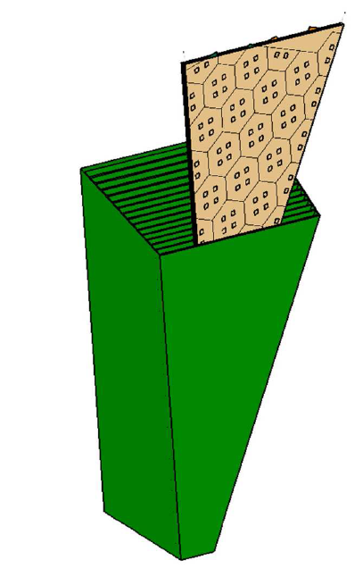
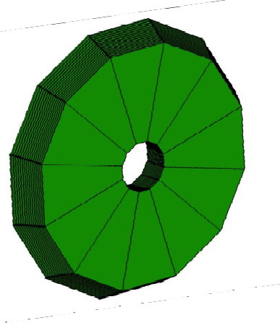
CMS Endcap High Granularity Calorimeter (HGC)
根据不同工艺的硅传感器性能测试，设计出抗辐射、提供三维簇射位置读出和精确的能量和时间分辨的硅传感器;
设计出组装方案，建立量产条件，
参与实验束测试研究并进行部分硅模块的量产。
Module
FE-ASICs
Cassette
Si sensor
Notes:
参与研制高粒度量能器样机并建造7 个硅模块样机, 参与硅传感器的性能研究；建立基于ATCA／ xTCA 的开发环境，
合作完成开发新型模式识别寻迹技术，开发出智能控制软件，完成研制适用于硅径迹探测器海量数据的高速传输与预处理版。

Slide 27
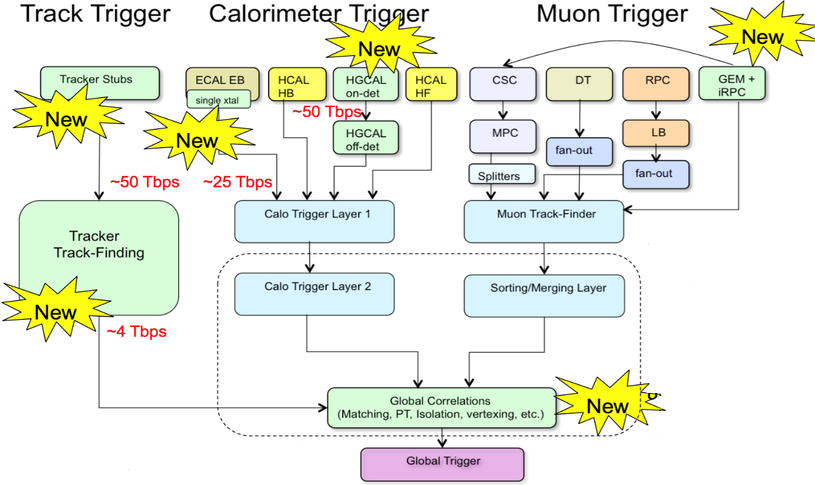
CMS L1 Trigger upgrade
开展硅径迹室三种候选寻迹方案的研究，合作开展寻迹插件的研究;
独立研制海量数据的高速传输汇总插件，并开展基于xTCA架构的智能控制软件的开发;
完成量产样机，建设量产条件; 完成CMS一级径迹触发升级的部分量产。
6GEM
4Ecal
5Hcal
3径迹头
2径迹触发
1联合寻迹
Notes:
参与研制高粒度量能器样机并建造7 个硅模块样机, 参与硅传感器的性能研究；建立基于ATCA／ xTCA 的开发环境，
合作完成开发新型模式识别寻迹技术，开发出智能控制软件，完成研制适用于硅径迹探测器海量数据的高速传输与预处理版。
。性能指标通过联调测试

Slide 28
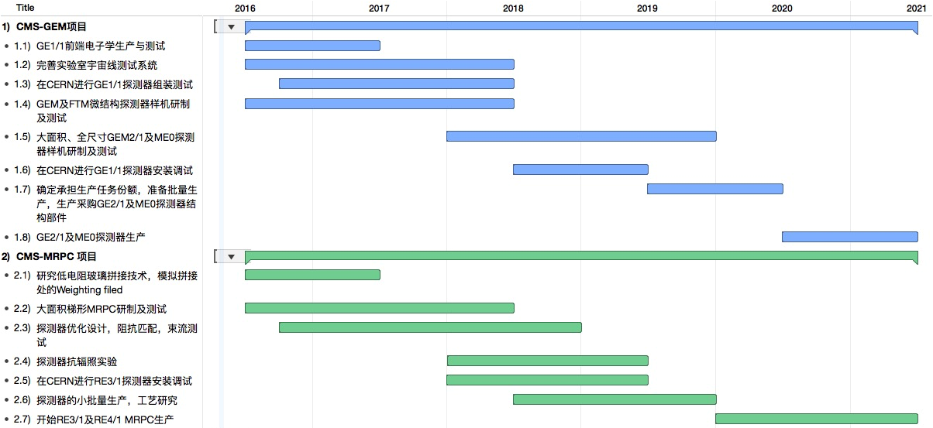
Schedule for CMS Endcap Inner Ring μ Detector Upgrade
完成原理样机
全尺寸模型
建造、测试
模型建造、测试
小批量生成
批量生成

Slide 29
Schedule for CMS HGC and L1 Track Trigger Upgrade

Slide 30
CMS-China Talks in this workshop
Higgs物理 1. Measurements of Higgs boson production in the diphoton decay channel at 13TeV, Junquan TAO (IHEP/CAS) 2. Higgs boson production in the four-lepton final state, Dr. AHMAD MUHAMMAD (IHEP) 3. Search for lighter Higgs-boson like resonances in the diphoton final state, Junquan TAO (IHEP/CAS) 4. ttH results at CMS, Huaqiao ZHANG (Institute of High Energy Physics (IHEP)) 标准模型 5. Vector boson production in association with jets from CMS, Fengwangdong ZHANG (Peking University) 6. Tri-Boson Results from CMS, Daneng YANG (school of physics Peking Uniersity) 7. W/Z+Jets at 13TeV from CMS, Qun WANG (Peking University) 8. VBS results from CMS, Zhaoru ZHANG (Peking University) 9. VBF Results from CMS, Jing LI (Peking University) 10. Search for associated production of a Z boson with a single top quark and for tZ flavour-changing interactions in pp collisions at 8 TeV, Leggat DUNCAN (IHEP) 新物理 11. Search for a heavy scalar boson decaying into a pair of Z bosons in the 2l2nu final state in CMS, Li YUAN (Beihang University) 12. Search for new resonances decaying to WW/WZ to lvqq in the CMS experiment, Zijun XU (Peking Univ.) 升级 13. CMS High granularity calorimeter upgrade project progress, Huaqiao ZHANG (IHEP) 14. The production and test of frond-end electronics board (GEB) for CMS-GEM GE1/1 project in China, Wei SHAN (PKU) 15. CMS Phase I Trigger Upgrade, Zhen An LIU (IHEP) 16. Development of glass RPC for CMS muon upgrade, Yi WANG (THU) 17. AM method based Level 1 Track Trigger Demonstration System for CMS Phase2 Upgrade, Zijun XU (Peking Univ.),

Slide 31
Summary
CMS China Group members worked very hard
Great progress on Higgs property, SM physics and exotics
Upgrade work is in good shape
Rich Mine ahead!
Looking forward to
SM and non-SM Surprises.

Slide 32
Thank you!

Slide 33
Backup

Slide 34
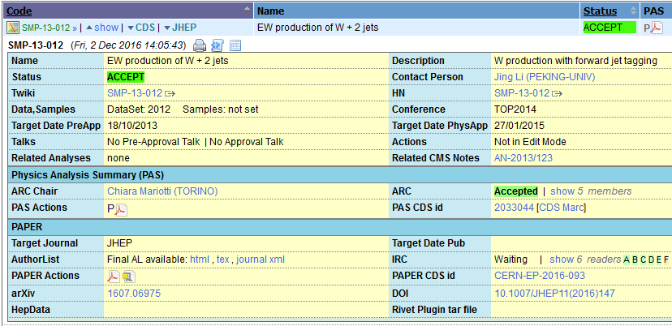

Slide 35
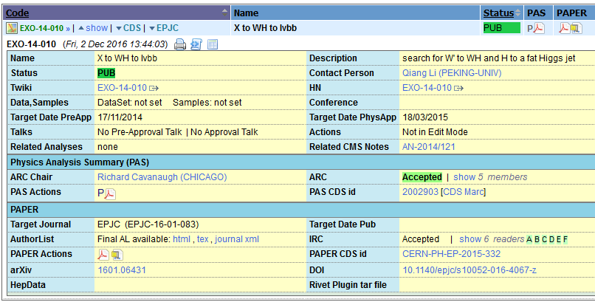
WH Resonance

Slide 36
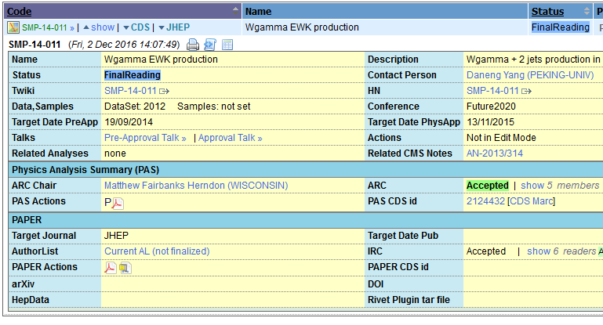

Slide 37
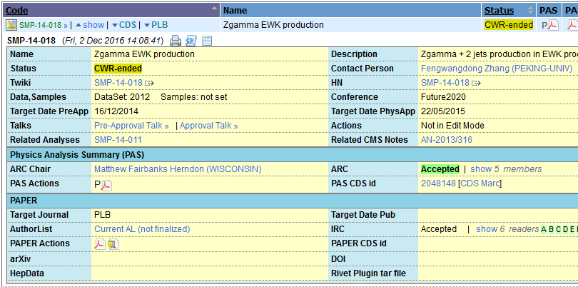

Slide 38
