Slide 1

CEPC Partial Double Ring
Lattice Design and DA Study
SU Feng GAO Jie WANG Dou WANG Yiwei
Li Yongjun BIAN Tianjinan BAI Sha DUAN Zhe GENG Huiping ZHANG Yuan XU Gang XIAO Ming
Key Laboratory of Particle Acceleration Physics and Technology
Institute of High Energy Physics
Chinese Academy of Sciences
2016.4.29

Slide 2
Out line
CEPC PDR Lattice Layout
CEPC Double Ring Layout
CEPC DR DA without FFS
Next

Slide 3
CEPC Partial Double Ring Layout
1/2RF
1/2RF
IP1_ee
RF
RF
3.2Km
1/2RF
1/2RF
Bypass
about 42m
IP4_pp
IP2_pp
Bypass
about 42m
1/2RF
1/2RF
IP1_ee/IP3_ee, 3.2Km
IP2_pp/IP4_pp, 1132.8m
4 Short Straights, 141.6m
4 Medium Straights, 566.4m
4 Long Straights, 849.6m
2 Short ARC, 24*FODO, 1132.8m
4 Medium ARC, 112*FODO, 5286.4m
4 Long ARC, 124*FODO, 5852.8m
C=59044m
RF
RF
IP3_ee
1/2RF
1/2RF
SU Feng
2016.1.4

Slide 4
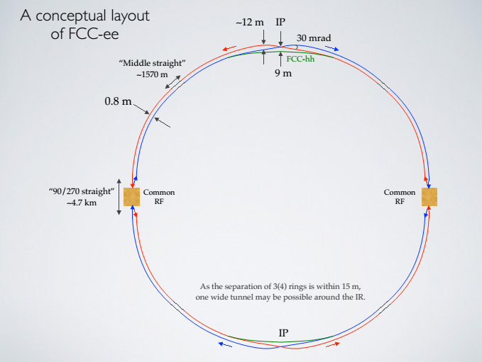
Double Ring Scheme
FCC-ee Oide-150917

Slide 5
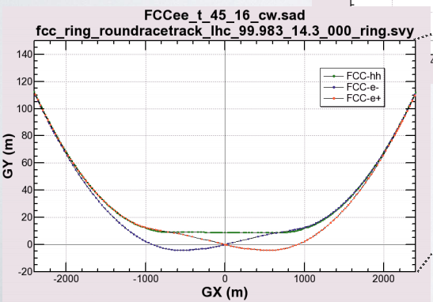
Double Ring Scheme

Slide 6
CEPC Double Ring Scheme Layout
IP1_ee
Common RF
IP4_pp
IP2_pp
Common RF
56km
1132.8m
IP3_ee
30mrad
16.9m
Su Feng
2016.4.28
566m

Slide 7
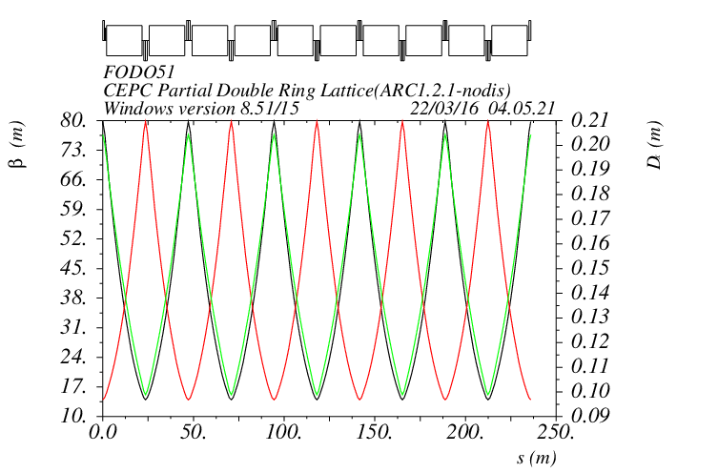
ARC FODO 90/90 non-interleave
SF1
SF1
SD1
SD1

Slide 8
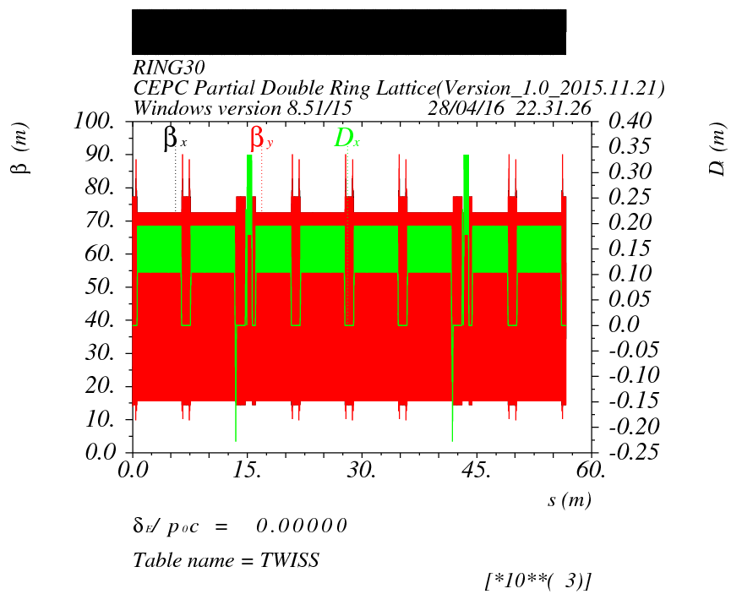
Optics of CEPC Double Ring (no FFS)
IP2
IP3
IP4
IP1

Slide 9
DA of CEPC Double Ring (2 family, no FFS)

Slide 10
CEPC Double Ring Scheme Layout
IP1_ee
Common RF
Common RF
1132.8m
IP4_pp
IP2_pp
56km
Common RF
Common RF
IP3_ee
30mrad
16.9m
Su Feng
2016.4.28
566m

Slide 11

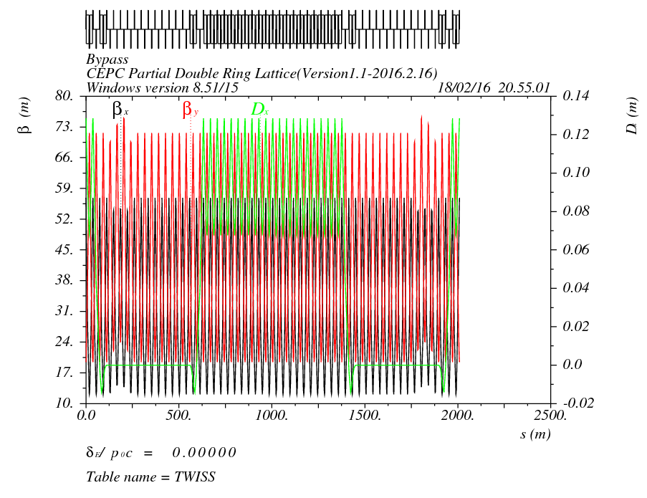
CEPC Bypass at IP2/4
12L_{c}
12L_{c}
566.4m
12L_{c}
12L_{c}
566.4m
L=42m
s
s
12L_{c}
24L_{c}
12L_{c}
566.4m
566.4m
Cell length=47.2m

Slide 12
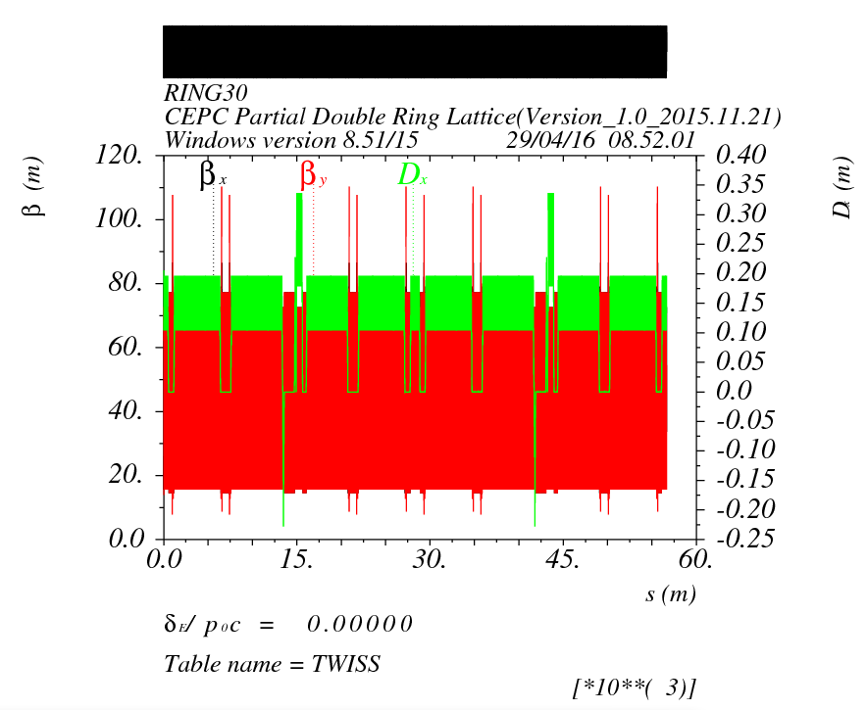
Optics of CEPC Double Ring (bypass,no FFS)
IP2
Bypass
42m
IP3
IP4
Bypass
42m
IP1

Slide 13
DA of CEPC Double Ring (bypass, no FFS)

Slide 14
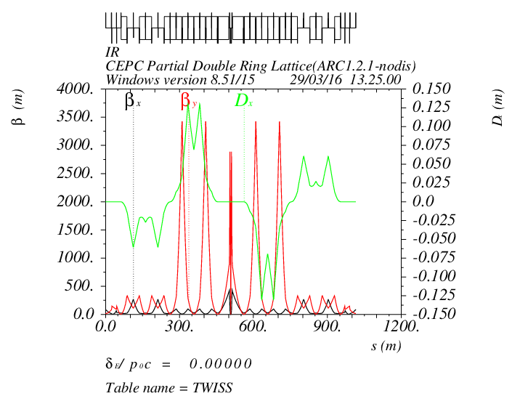
DA of CEPC Double Ring (2 family, with FFS)
Wangdou-test20160328

Slide 15
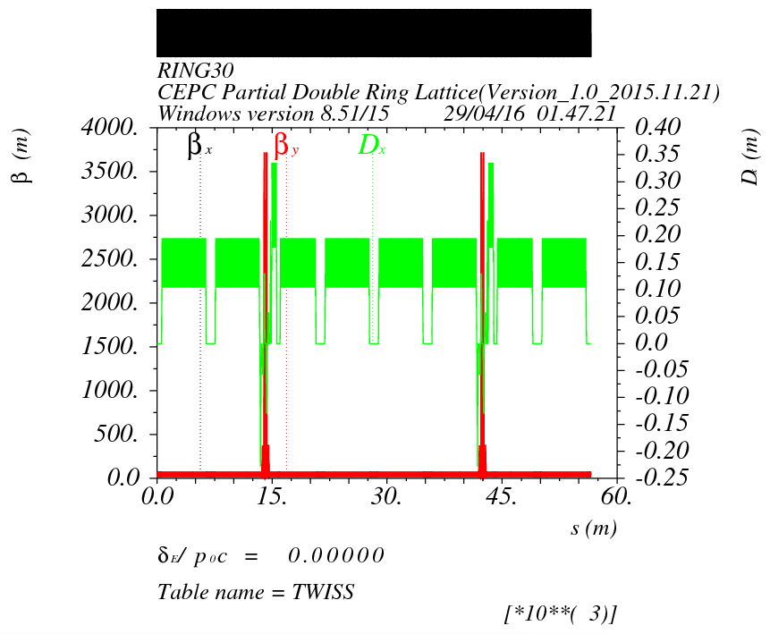
Optics of CEPC Double Ring (with FFS)
IP2
IP3
IP4
IP1

Slide 16
DA of CEPC Double Ring (2 family, with FFS)

Slide 17
Next to do
一、DA 优化：
二、计算环境配置，Latt-cepc.python code 改进：
三、……

Slide 18
Thank You !

