Slide 1
CEPC Booster 误差效应及轨道校正的初步研究
魏源源 张闯 崔小昊 边天剑
2016年4月29日

Slide 2
Magnet Field errors
The earth field outside the magnet: B_{x}=0.55±0.026Gs, B_{y}=0.45±0.027Gs, B_{z}=0.25±0.03 Gs  B= 0.8±0.04Gs
Inside the magnet, B_{y}=7.0±0.05Gs is dominated by residual field, B_{x}=0.4±0.04Gs reduced due to the shielding while B_{z}=0.25±0.03 Gs.
The 24h field stability (σ_{B}) for 30 Gs-150 Gs is about (1-2)×10⁻³;
The magnet ramps smoothly around the low fields with accuracy better than 1×10⁻³;
The field error ΔB_{y}/B_{y} ∼ 10⁻⁴ for x∈(-60, 60) mm and B_{y}∈(30-150) Gs
Booster Magnet Field errors
Dipole magnets 〈ΔB/B〉 < 2×10⁻³ Quadrupole magnets 〈ΔK/K〉 < 5×10⁻⁴

Slide 3
Alignment parameters
Component | 〈y〉 (mm) | 〈x〉 (mm) | 〈tilt〉 (mrad)
Dipole magnets | ±0.2 | ±0.3 | ±0.1
Quadrupole magnets | ±0.1 | ±0.1 | ±0.1

Slide 4
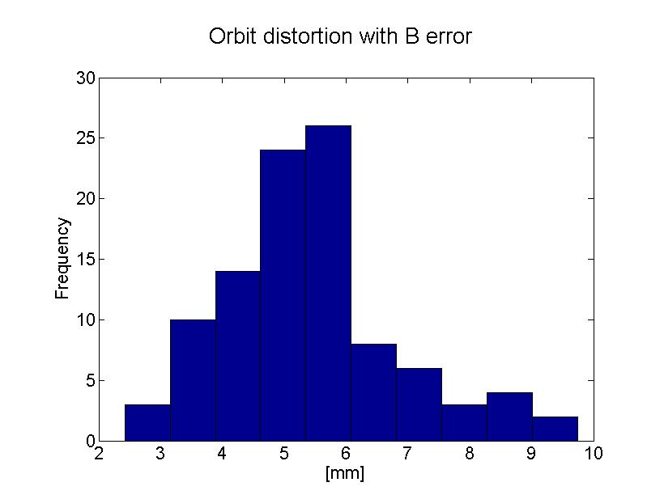
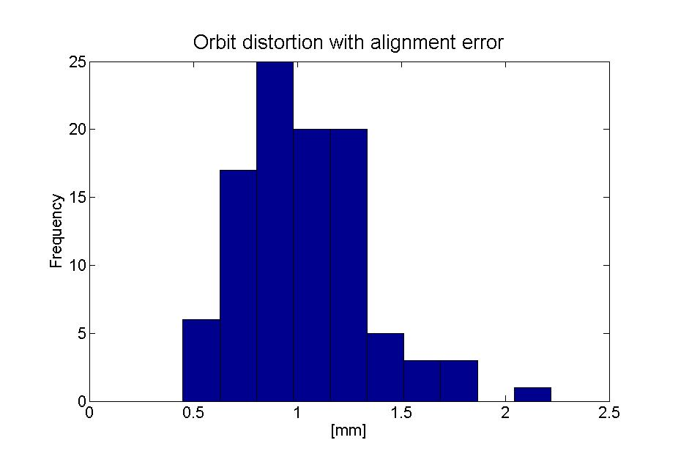
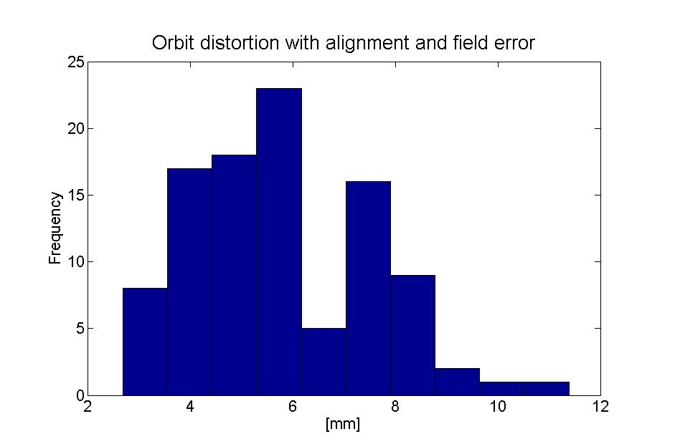
Orbit Distortion with Field Errors and Alignment
60◦、70m cell lattice
(130.47,130,43), 6GeV
Simulate with AT

Slide 5
Orbit Correction System
BPM
BB
BPM
HCOR
VCOR
BPM：782，H&V
HCOR:
VCOR:

Slide 6
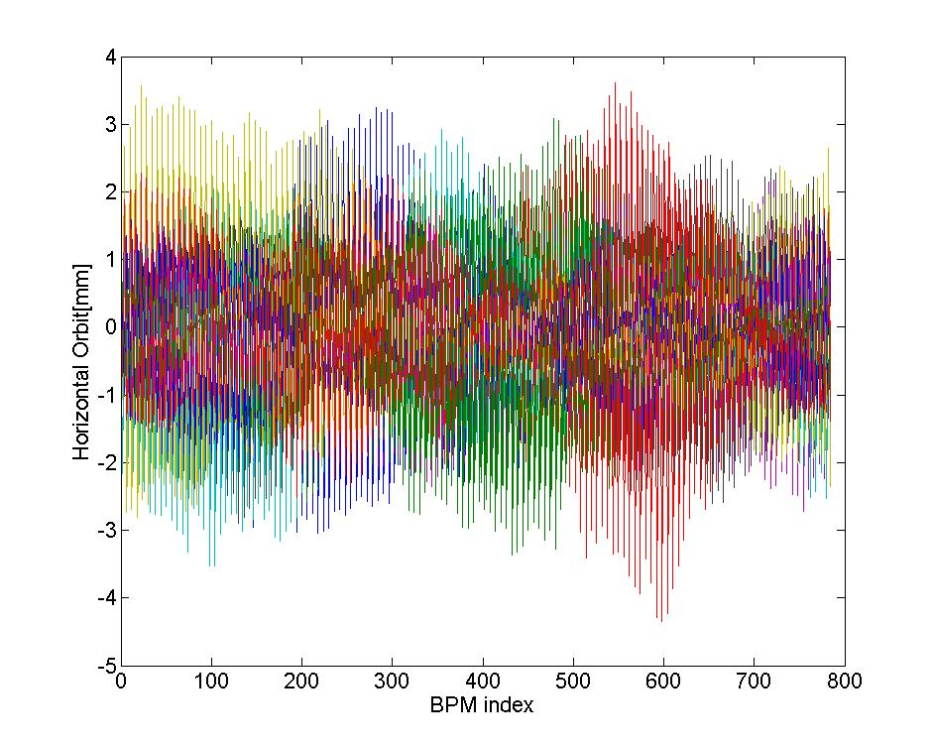
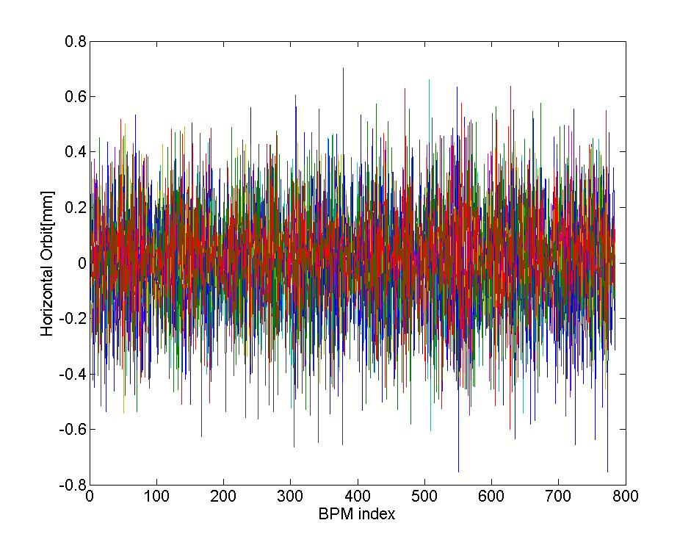
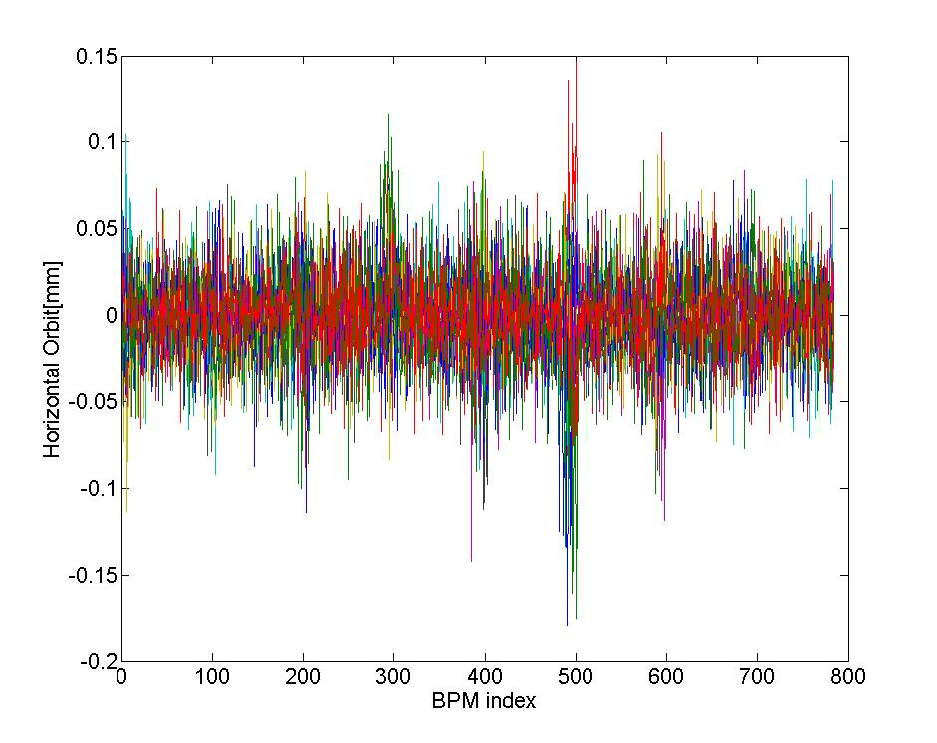
Correction results
校正前水平轨道
校正前垂直轨道
校正后水平轨道
校正后垂直轨道

Slide 7
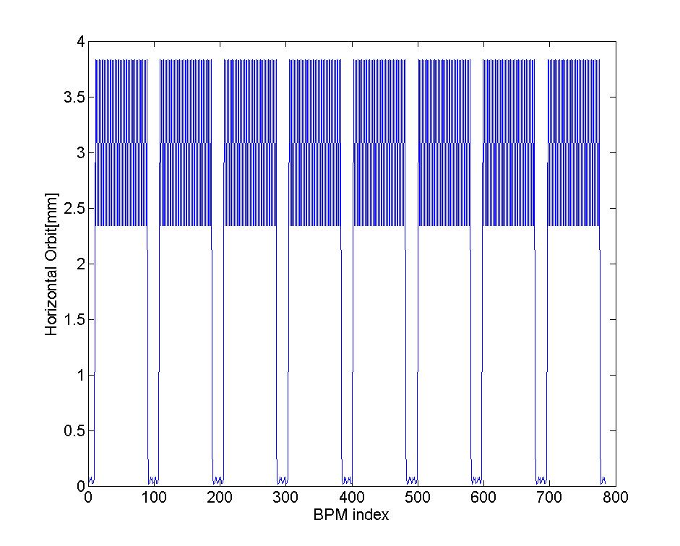
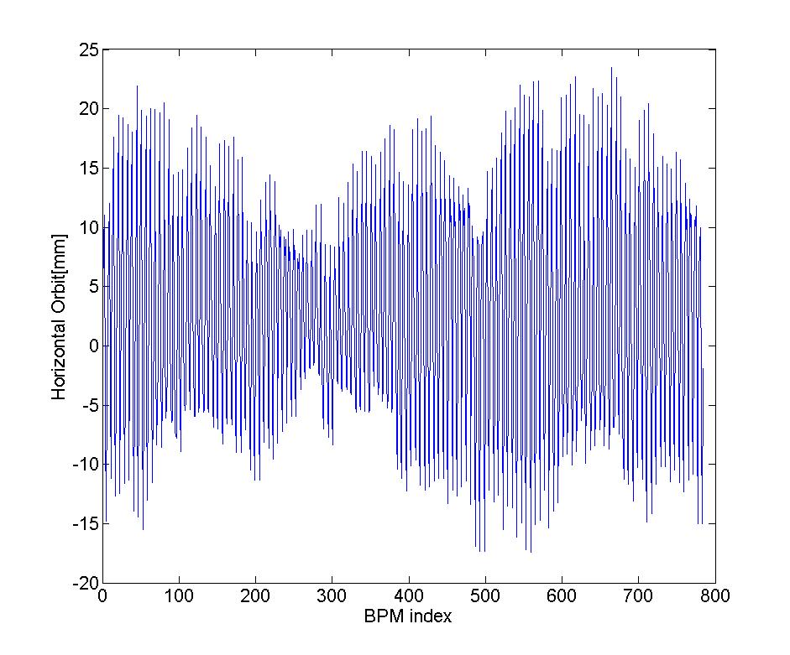
Earth field effect
Earth field will cause the change of beam energy
Consider the earth field of drift -> Δp/p~0.442%
Earth field of drift
Earth field of drift & errors

Slide 8
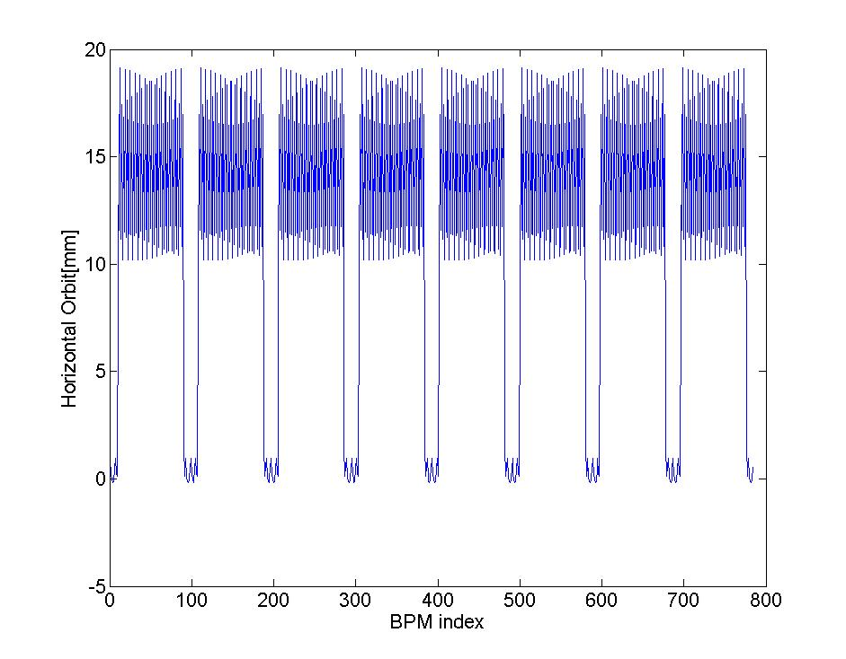
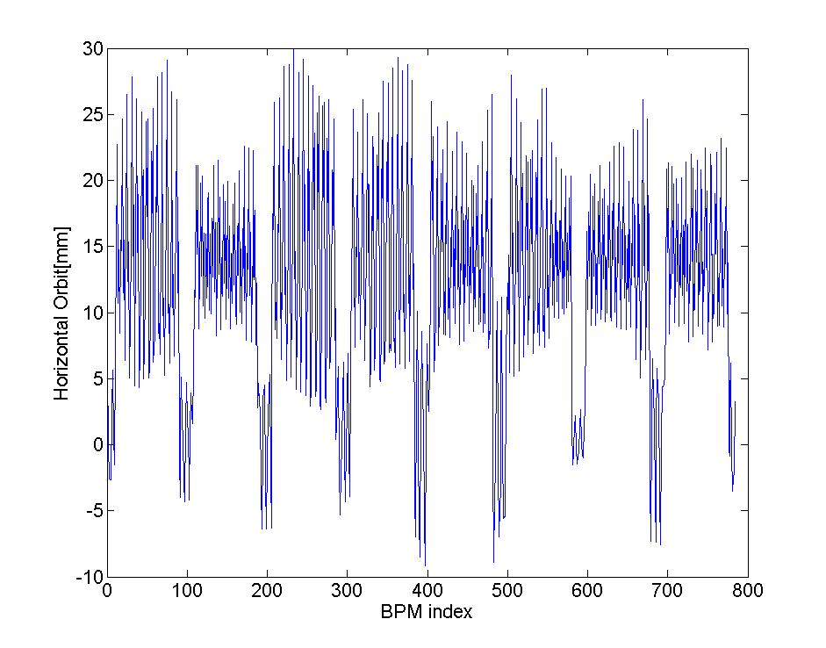
Earth field effect
Consider the earth field all along the ring -> Δp/p~2%
Earth field along the ring
Earth field of drift+errors

Slide 9
To do list
Consider the effect of earth field including Bx and Bz
Consider the field components of the magnets.

