Slide 1
Solenoid compensation
Sha Bai, Weichao Yao
CEPC AP meeting
2016-04-29

Slide 2
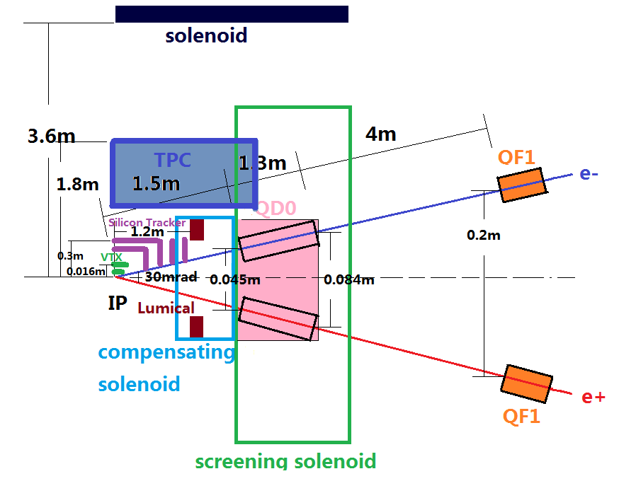
Local double ring MDI layout
Detectors (including silicon tracker, vertex detector, TPC etc on….) which are “far” from this region, should be same as in the single ring.

Slide 3
Final Focus layout-sketch of solenoids
Compensating solenoid is located between IP and QD0
- crossing angle α = 30 mrad
Radius of: Length:
- compensating solenoid R = 0.1 m L=0.7m
- screening solenoid R = 0.15~0.2 m L=2.6m

Slide 4
Compensating and screening solenoids
Item | Compensating Solenoid | Compensating Solenoid | Screening-Solenoid(QD0)
Central field (T) | 7.5 | 5.25 | 3.5
Length (m) | 0.7 | 1 | 2.6
Conductor Type | NbTi-Cu Conductor 4×2mm
Coil turns | 2450 | 2500 | 6500
Current density (A/mm | 220 | 210 | 137.5
Coil inner diameter (mm) | 200 | 200 | 300
Coil out diameter (mm) | 256 | 240 | 340

Slide 5
Field distribution on the R=0(axis),R=0.05m,R=0.1m and R=0.15m @ L_comp=0.7m

Slide 6
Contour profile Field map @L_comp=0.7m

Slide 7
Variation of main and compensating solenoids lengths
Area of residual field
B_comp_max
Geom.length:
L1 = 0.7m
L2 = 1m
Conditions:
B_main*L_main+B_comp*L_comp=0
L* = L_main +L_comp = 1.5m

Slide 8
With no solenoid
βx
βy
Dx
Dy

Slide 9
Solenoid & anti-solenoid Slice – 0.01m
βx
βy
Horizontal dispersion
Vertical dispersion
Horizontal and vertical unstable
Real tune: u_{x}=0 u_{y}=-0.5

Slide 10
Conclusions and Prospects
Compensating solenoid and screening solenoid are designed to compensate the 3.5T detector solenoid.
Large field is not easy to get for small aperture solenoid.
Solenoid coils can be made of round NbTi-Cu conductor using direct winding technology, which is fit for 0~8T.
Solenoid magnets sliced in pieces; QD0 magnet sliced in same pieces to insert solenoid pieces with longitudinal field; should be checked for simulation in lattice.

