Slide 1
CEPC injector beam dynamics
Cai MENG, Guoxi Pei , Xiaoping Li,
Shilun PEI, Jingru Zhang, Xiangjian Wang
Institute of High Energy Physics, CAS, Beijing

Slide 2
Outline
1
Introduction
1
Electron linac
2
3
Positron linac
3
4
Summary & Plan
4
5

Slide 3
1. Introduction: CEPC Injector
Main parameters:
Parameter | Symbol | Unit | Value
Beam energy (e+/e-) | E_{e-}/E_{e+} | GeV | 6
Repetition rate | f_{rep} | Hz | 50~100
Bunch population (e+/e-) | N_{e-}/N_{e+} |  | 2×10¹⁰
Energy spread (e⁺/e⁻) | σ_{E} |  | <1×10⁻³
e⁻ bunch charge at target |  | nC | 10
e⁻ beam energy |  | GeV | 4
Emittance | ε | mm-mrad | 0.3

Slide 4
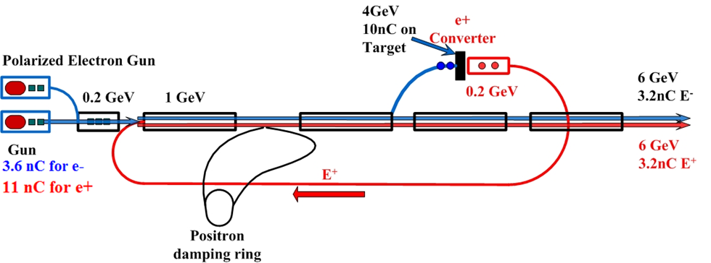
1. : CEPC Injector Layout
?
频率选择
  Booster频率为1300MHz
  直线加速器的频率选2856.75MHz
其中，2856.75MHz=3.25MHz×879，1300MHz=3.25MHz×400MHz
3.25 MHz

Slide 5
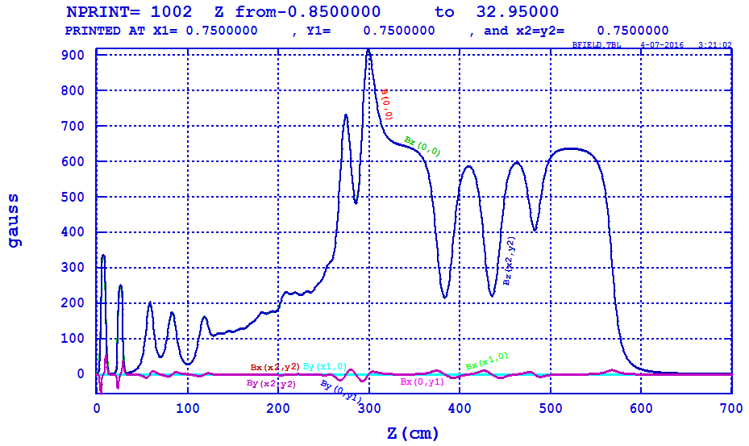
2. Electron linac Lattice
Bunching System
  SHB1:142.8375 MHz
  SHB：571.35 MHz
  S-band Buncher (1): 2856.75 MHz
First accelerating structure
  S-band accelerator (3): 2856.75 MHz ~ 24 MV/m

Slide 6
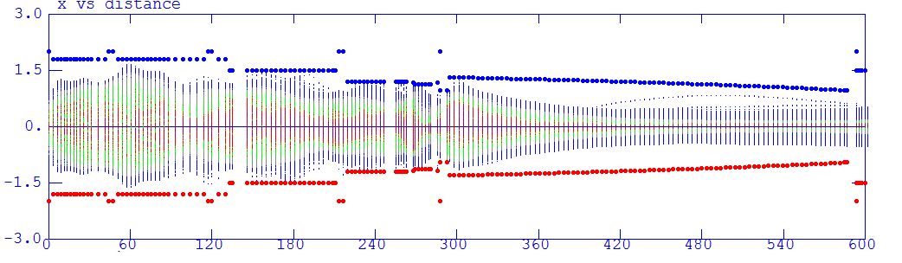
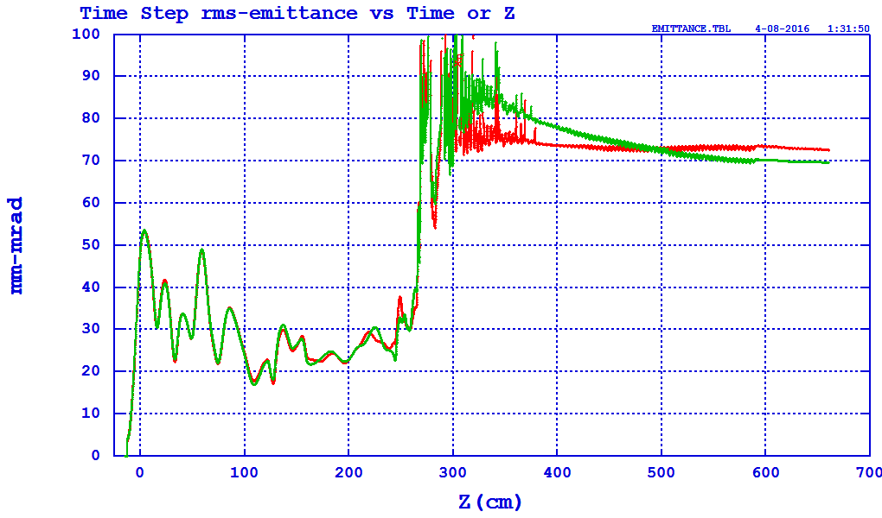
2. Electron linac Bunching System
加发射度图
加包络图
加传输效率图
92%
Emittance.Norm.rms=75 mm-mrad

Slide 7
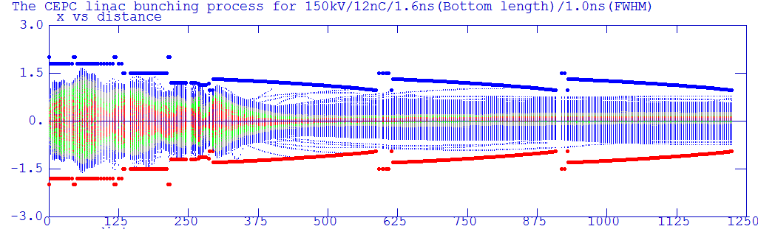
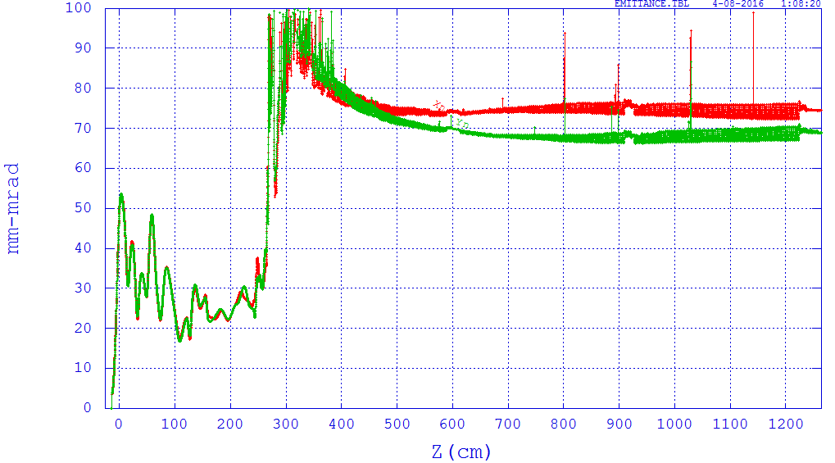
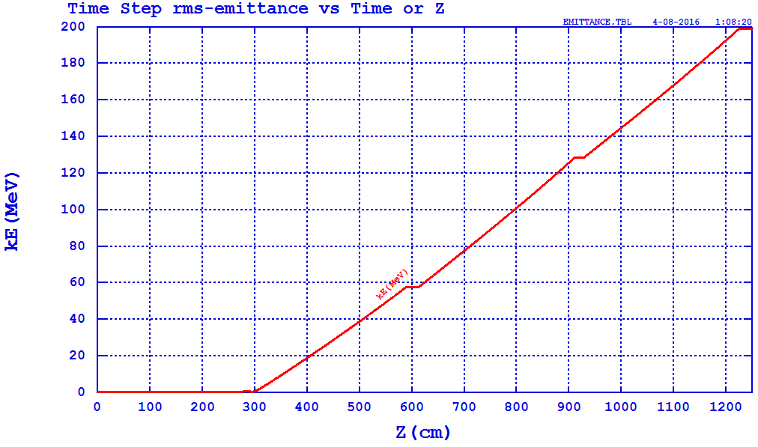
2. Electron linac First accelerating structure
200 MeV
Emittance.Norm.rms=75 mm-mrad

Slide 8
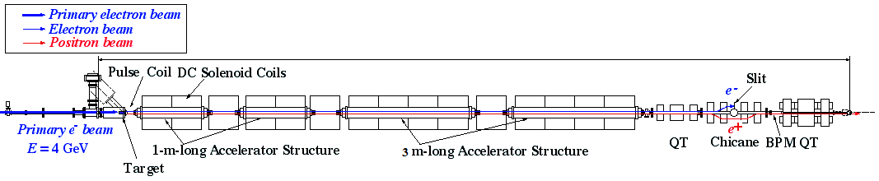
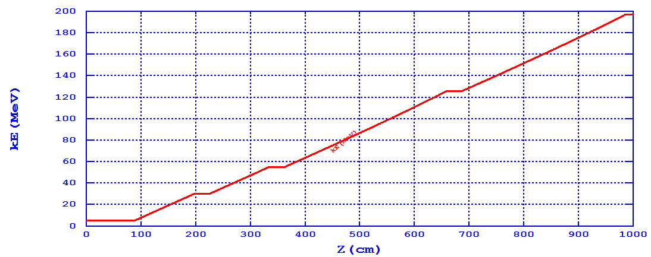
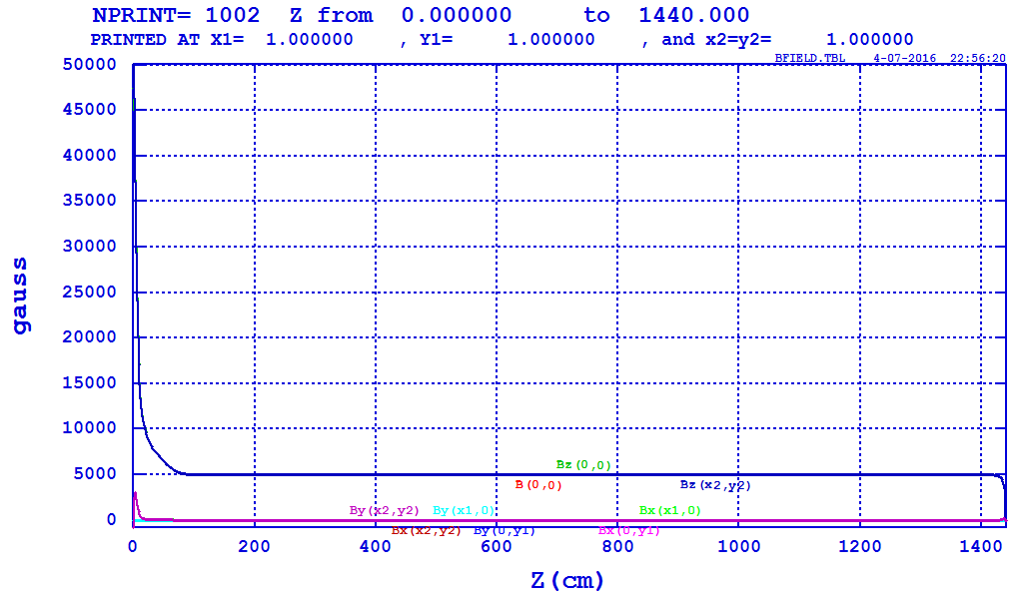
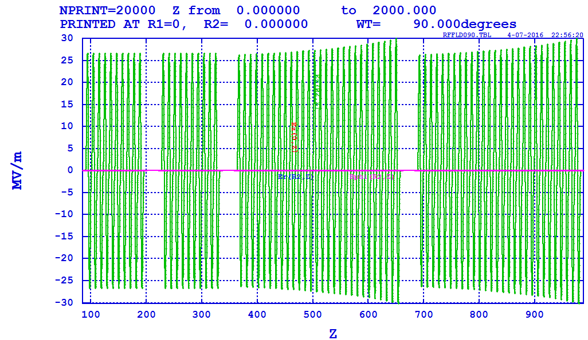
3. Positron linac Lattice
Positron beam distribution from target
AMD： 5T->0.5 T
The first two 1 m accelerator structure : r=15mm
The following 3m accelerator structure: r=13mm->9.5 mm
2856.75 MHz

Slide 9
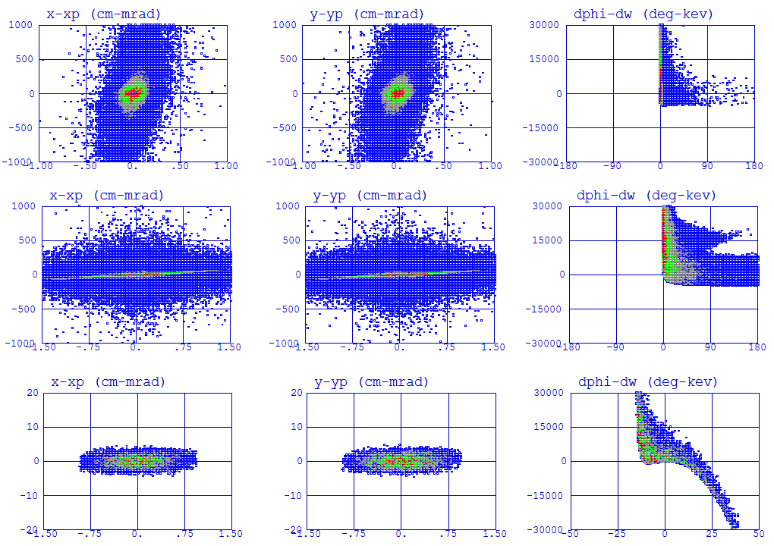
3. Positron linac Distribution
After Target
After AMD
After accelerator
@ 200 MeV

Slide 10
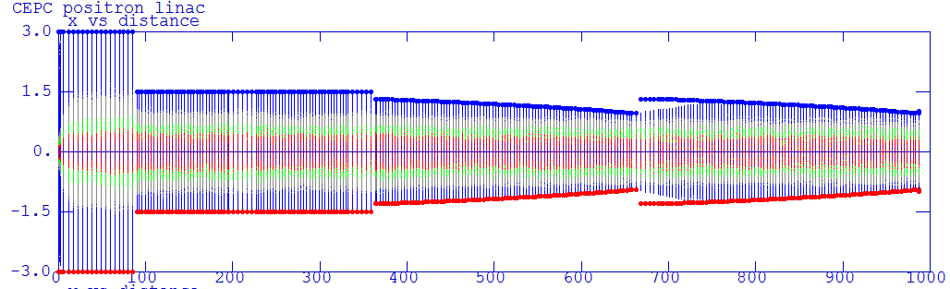
3. Positron linac Beam loss
Aperture change
Chopper

Slide 11
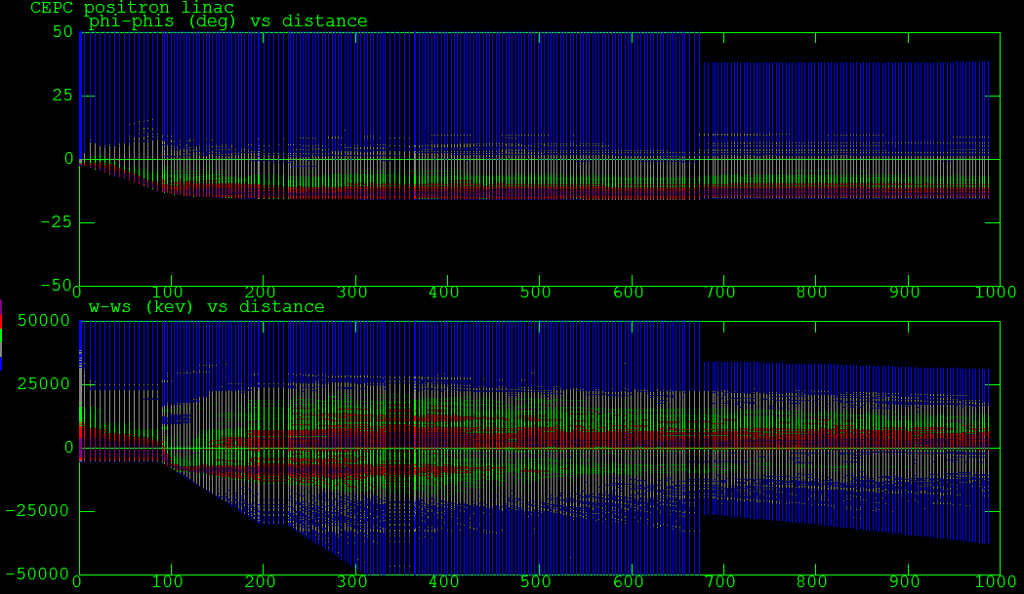
3. Positron linac Longitudinal profile

Slide 12
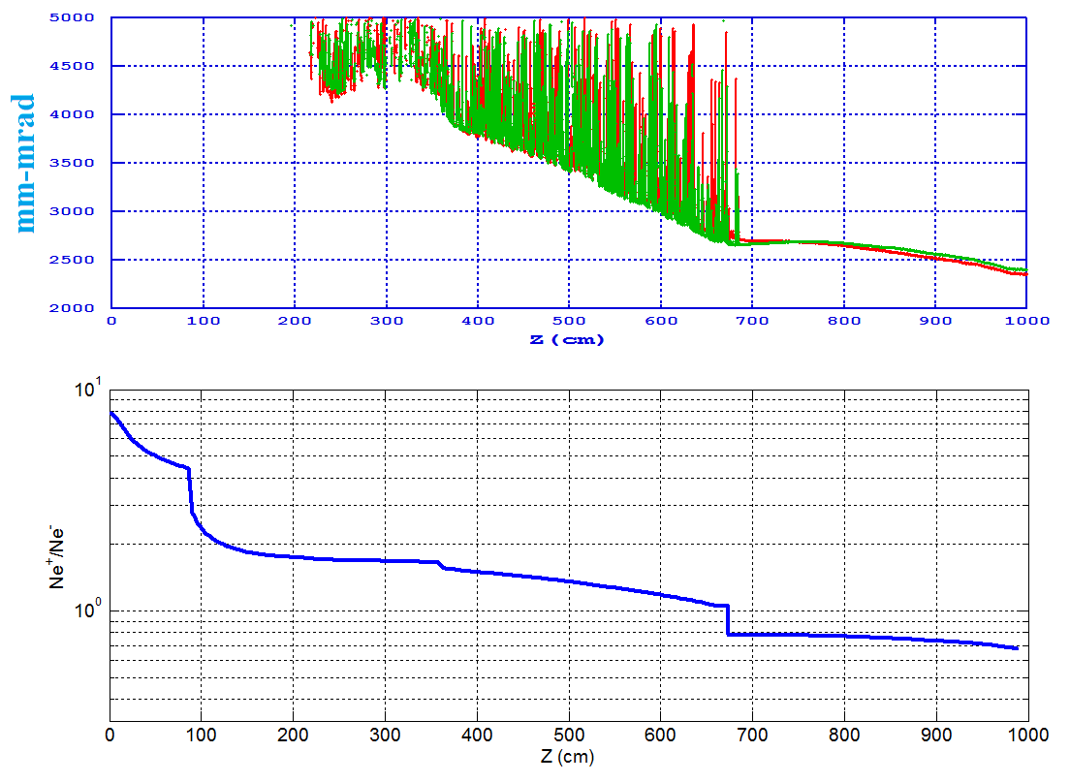
3. Positron linac Emittance
Chicane
Transport line
Energy spread
Ne⁺/Ne⁻=0.68
Emittance.Norm.RMS=2500 mm-mrad
Emittance.RMS@6GeV=0.21 mm-mrad

Slide 13
Summary&Plan
Bunching System and first accelerating structure of electron linac have been proposed. (92%)
Positron capture and accelerating have been discussed. (Emittance, Yield)
Beam dynamic results
High energy e-/e+ simulation including wakefield
Chicane design for separating off electron
Optimization of linac
Transport line design
……

Slide 14
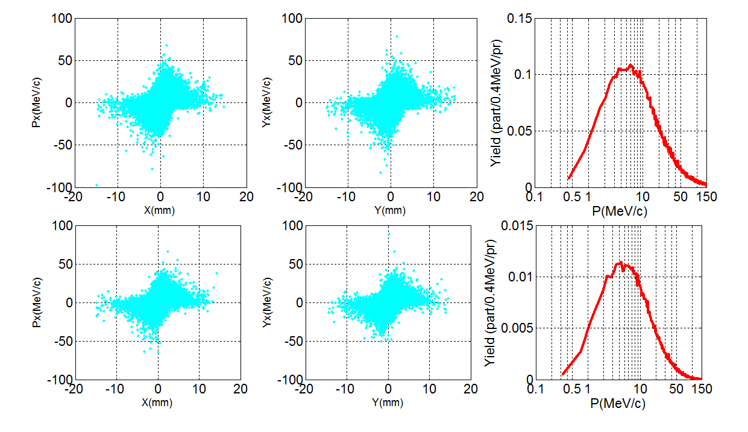
4 GeV VS 240 MeV
4GeV@13mm
240MeV@8mm

Slide 15
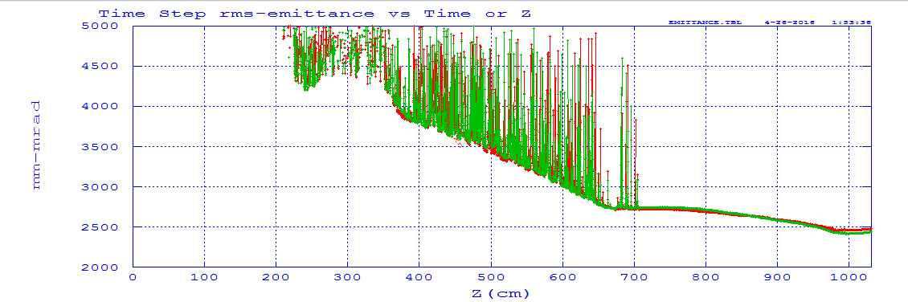
BEPCII ?
0.36 nC
Emittance.Norm.RMS=2500 mm-mrad
Emittance.RMS@1.89GeV=0.66 mm-mrad
BEPC: e+ 0.1 nC, 0.24 mm-mrad at 1.89 GeV

