Slide 1
CEPC Booster 误差效应及轨道校正的初步研究
魏源源 张闯 崔小昊 边天剑
2016年5月6日

Slide 2
Magnet Field errors
The earth field outside the magnet: B_{x}=0.55±0.026Gs, B_{y}=0.45±0.027Gs, B_{z}=0.25±0.03 Gs  B= 0.8±0.04Gs
Inside the magnet, B_{y}=7.0±0.05Gs is dominated by residual field, B_{x}=0.4±0.04Gs reduced due to the shielding while B_{z}=0.25±0.03 Gs.
The 24h field stability (σ_{B}) for 30 Gs-150 Gs is about (1-2)×10⁻³;
The magnet ramps smoothly around the low fields with accuracy better than 1×10⁻³;
The field error ΔB_{y}/B_{y} ∼ 10⁻⁴ for x∈(-60, 60) mm and B_{y}∈(30-150) Gs
Booster Magnet Field errors
Dipole magnets 〈ΔB/B〉 < 2×10⁻³ Quadrupole magnets 〈ΔK/K〉 < 5×10⁻⁴

Slide 3
Alignment parameters
Component | 〈y〉 (mm) | 〈x〉 (mm) | 〈tilt〉 (mrad)
Dipole magnets | ±0.2 | ±0.3 | ±0.1
Quadrupole magnets | ±0.1 | ±0.1 | ±0.1

Slide 4
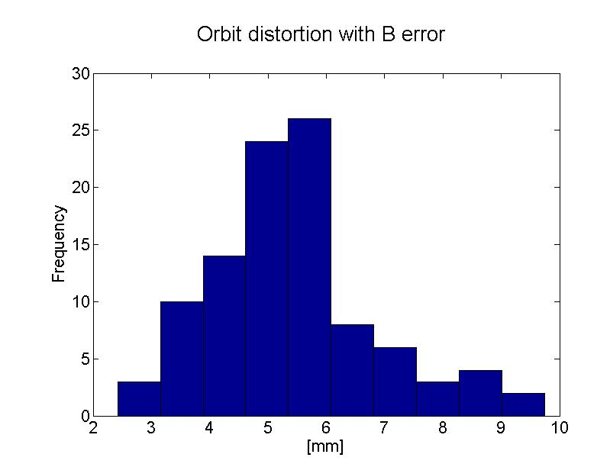
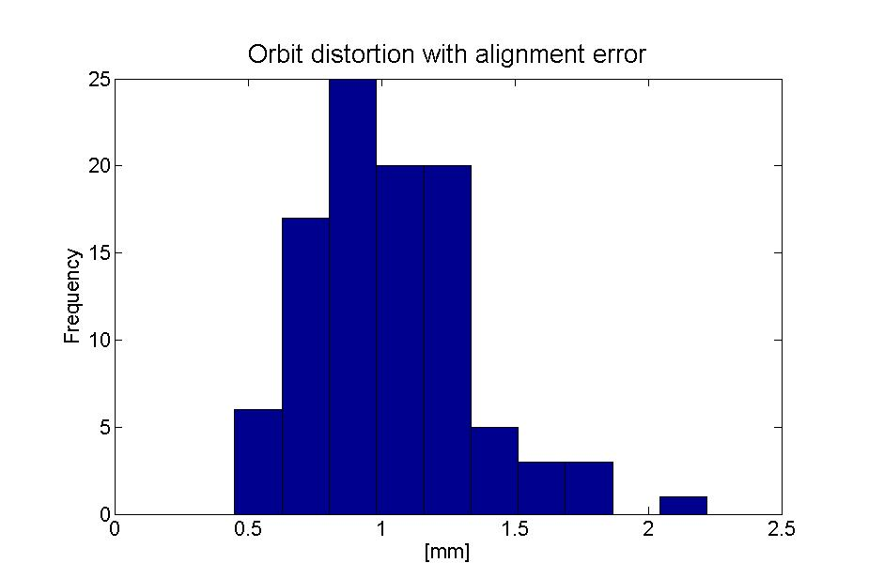
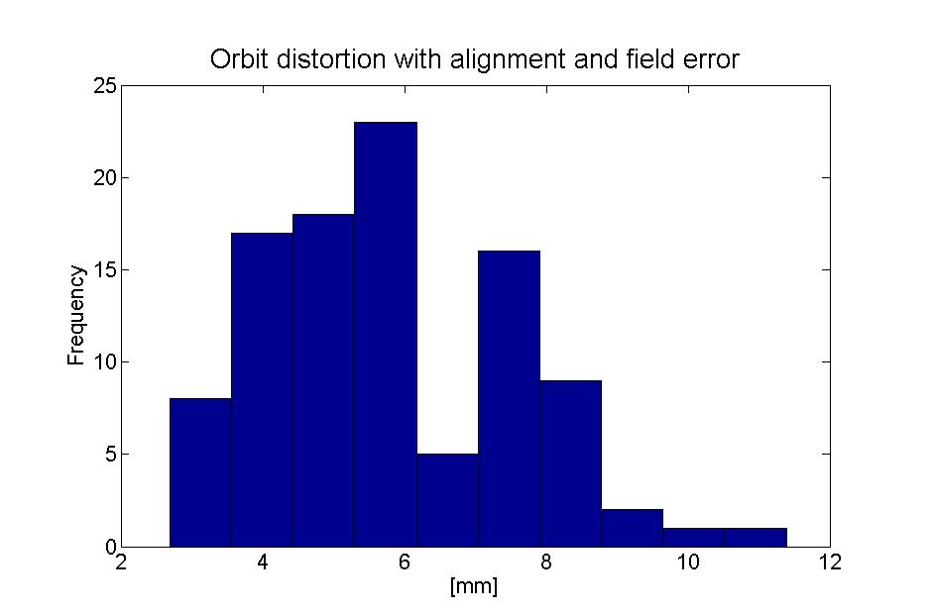
Orbit Distortion with Field Errors and Alignment
60◦、70m cell lattice
(130.47,130,43), 6GeV
Simulate with AT

Slide 5
Orbit Correction System
BPM
BB
BPM
HCOR
VCOR
BPM：782，H&V
HCOR:
VCOR:

Slide 6
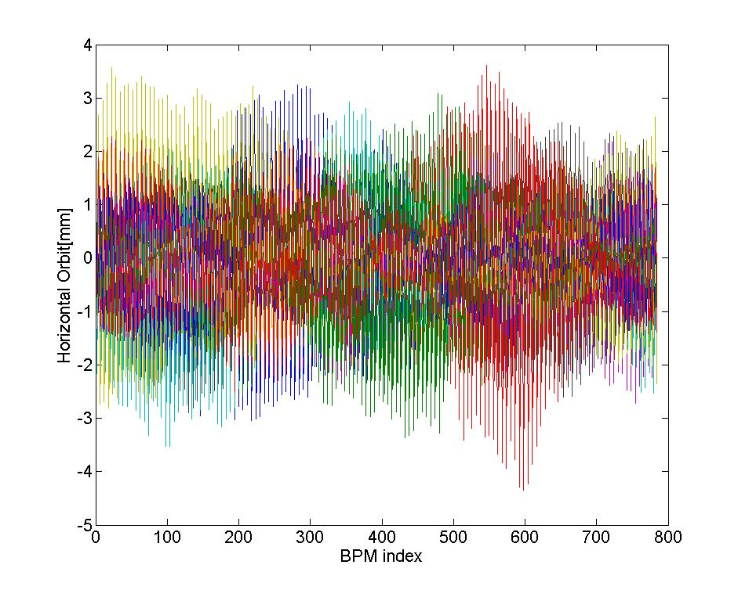
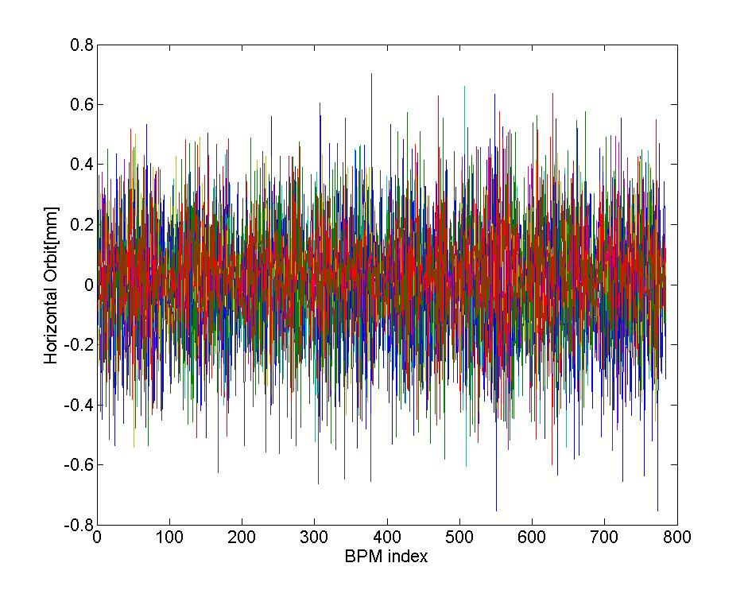
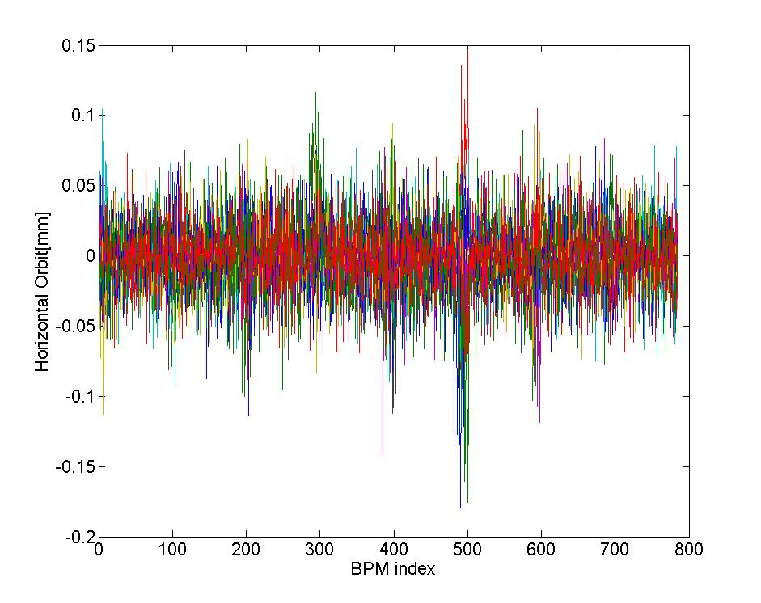
Correction results
校正前水平轨道
校正前垂直轨道
校正后水平轨道
校正后垂直轨道

Slide 7
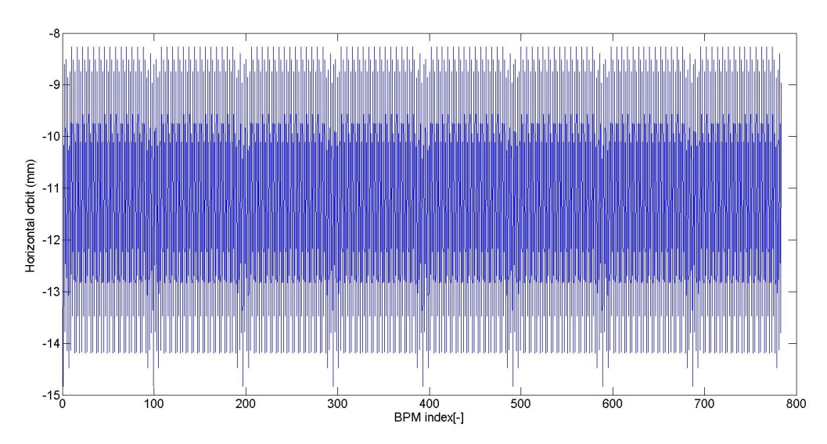
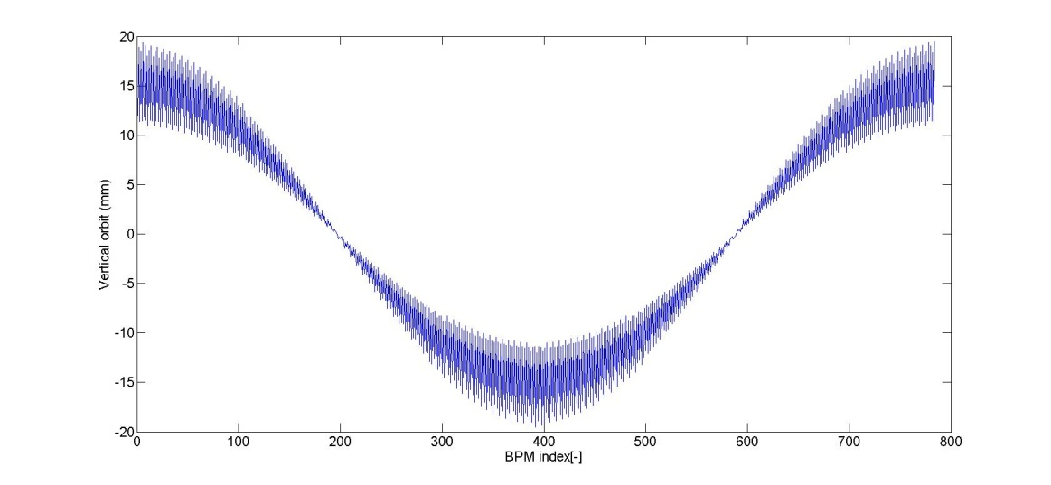
Earth field effect of By &Bx
Earth field By will cause the change of beam energy
Consider the By of all the elements
Δp/p=ηθ/α_{p}L₀=1.68%, Θx=LBy/Bρ
Earth field Bx will cause the vertical orbit distortion
Θ_{y}=LBx/Bρ , Bx=0.6cosψ_{s} （Gs）
Horizontal orbit with By、Bx of all the elements
Vertical orbit with By、Bx of all the elements

Slide 8
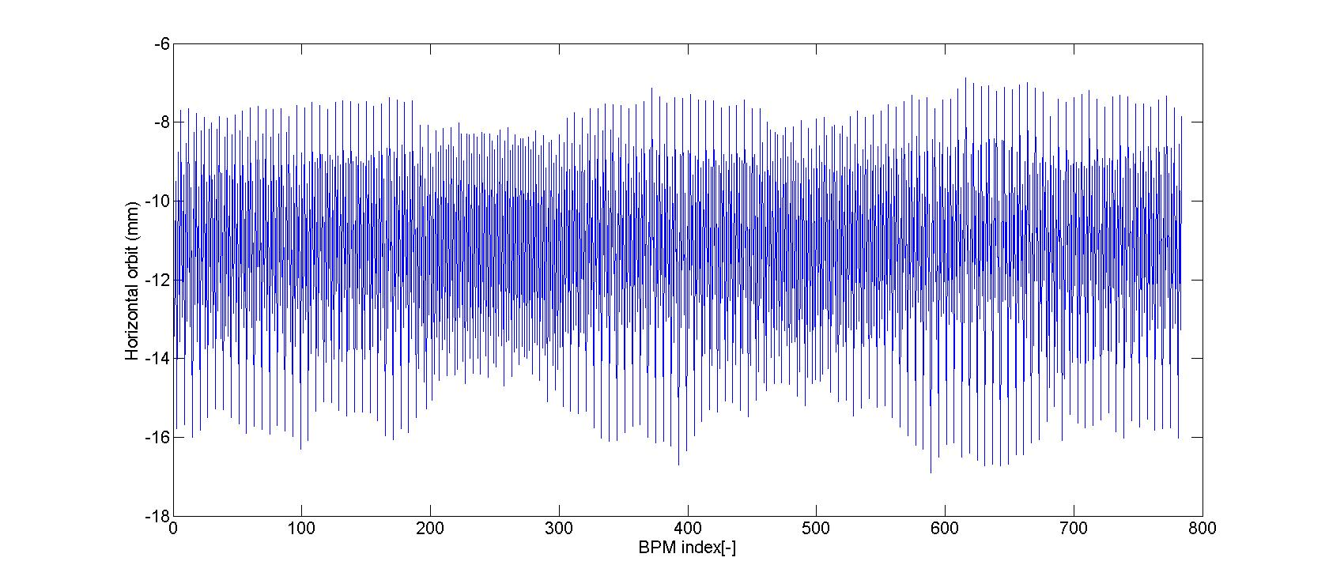
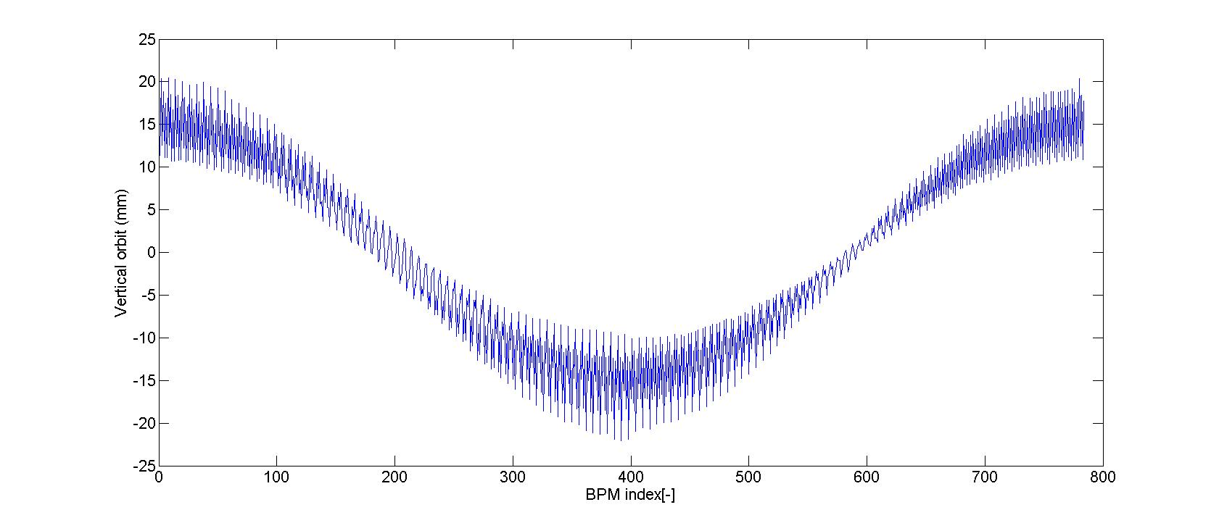
Earth field effect of By &Bx
Horizontal orbit with By、Bx of all the elements &errors
Vertical orbit By、Bx of all the elements & errors

Slide 9
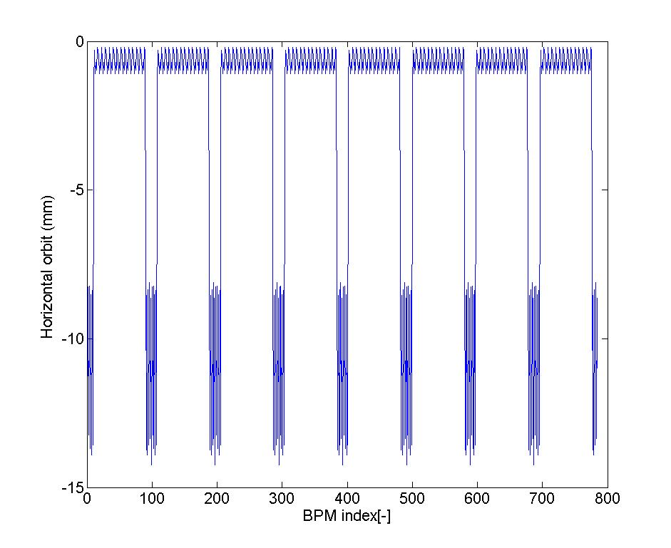
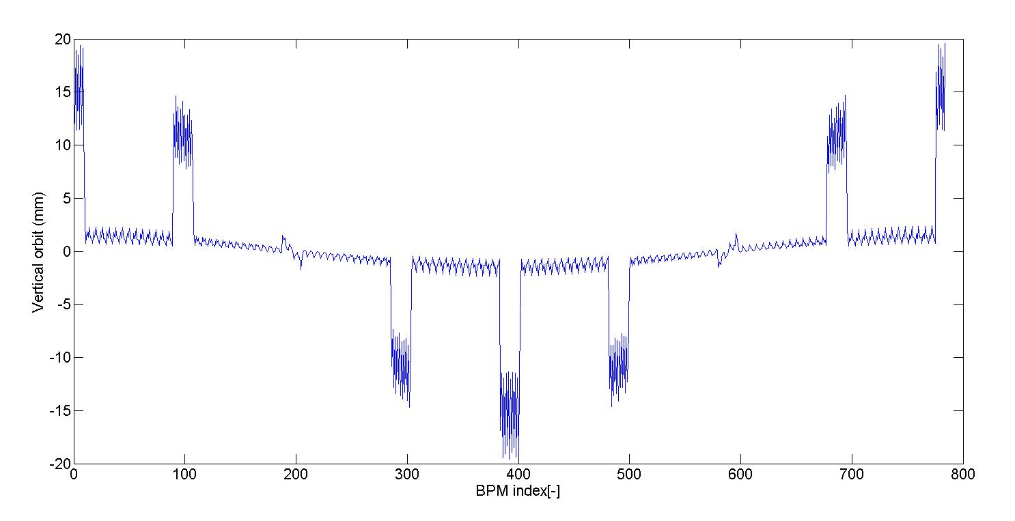
Earth field effect of By &Bx
Consider the By @ Bx in the drifts
Δp/p=ηθ/α_{p}L₀=0.13%
Horizontal orbit with By、Bx in the drifs
Vertical orbit with By、Bx in the drifs

Slide 10
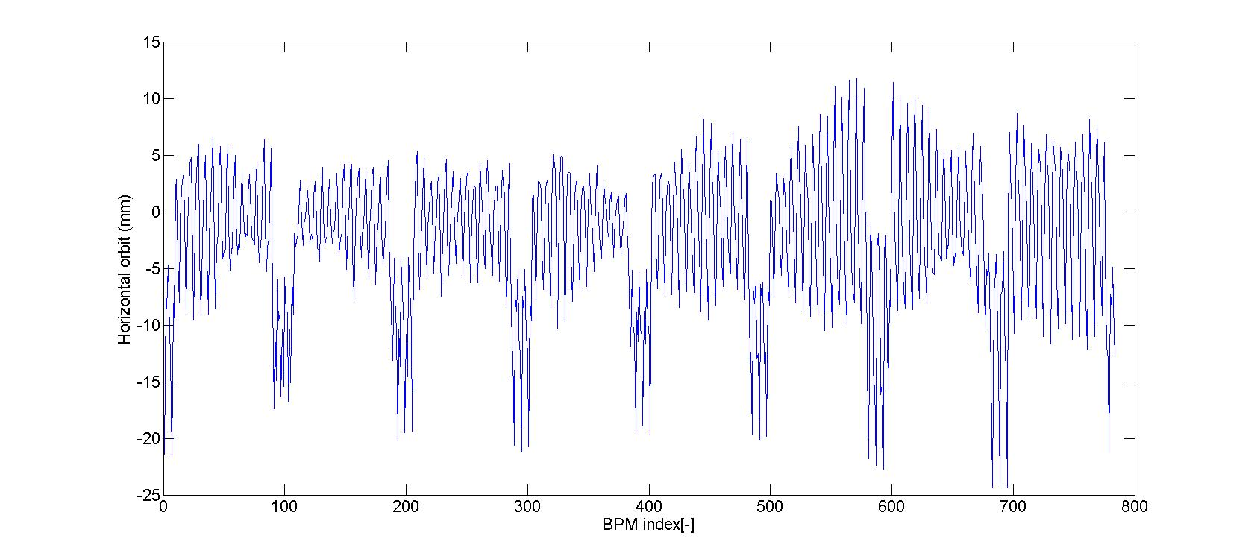
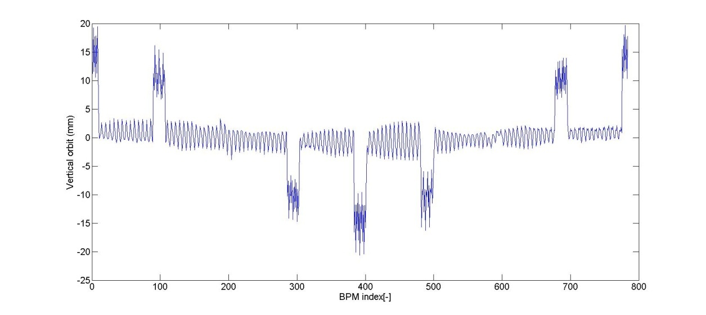
Earth field effect of By &Bx
Horizontal orbit with By、Bx in the drifts & errors
Vertical orbit with By、Bx in the drifts & errors

Slide 11
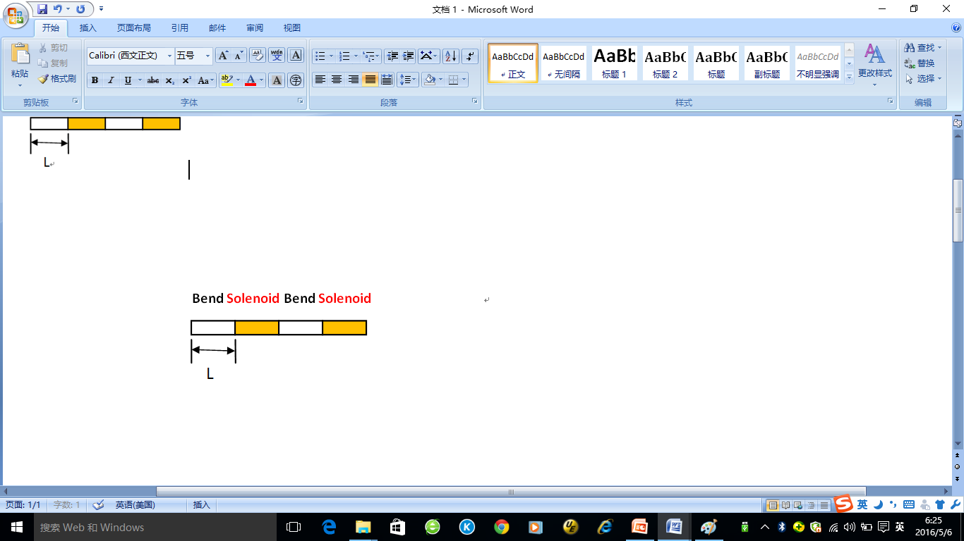
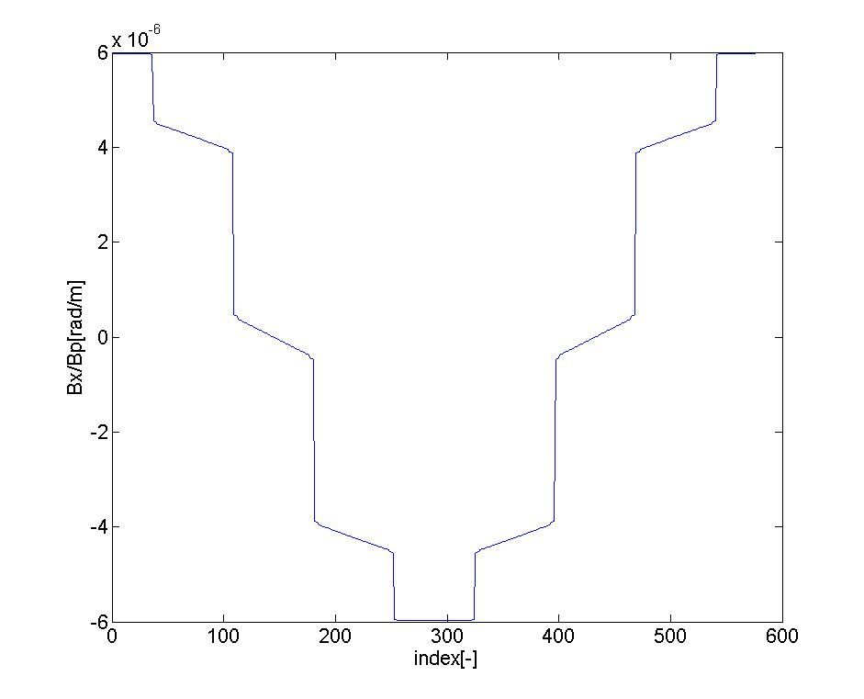
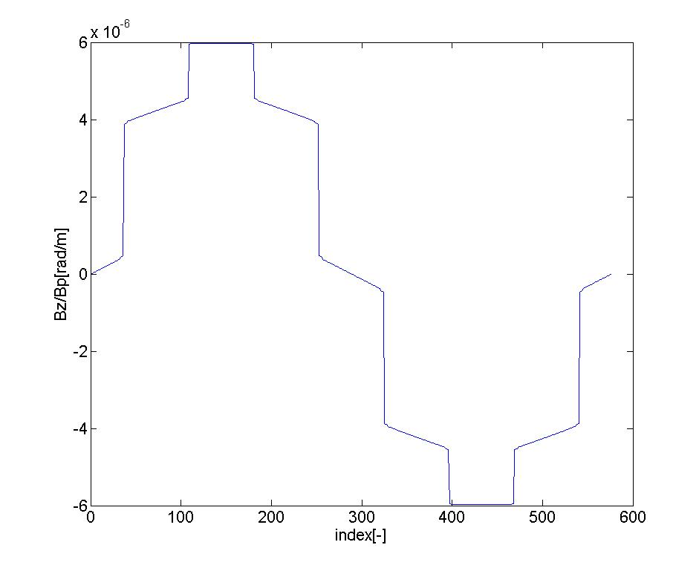
Earth field effect of Bz
Consider the Bz in the drifts
k_{z}=Bz/Bρ , Bz=0.6sinψ_{s} （Gs）
Bx along the drifs
Bz along the drifs

Slide 12
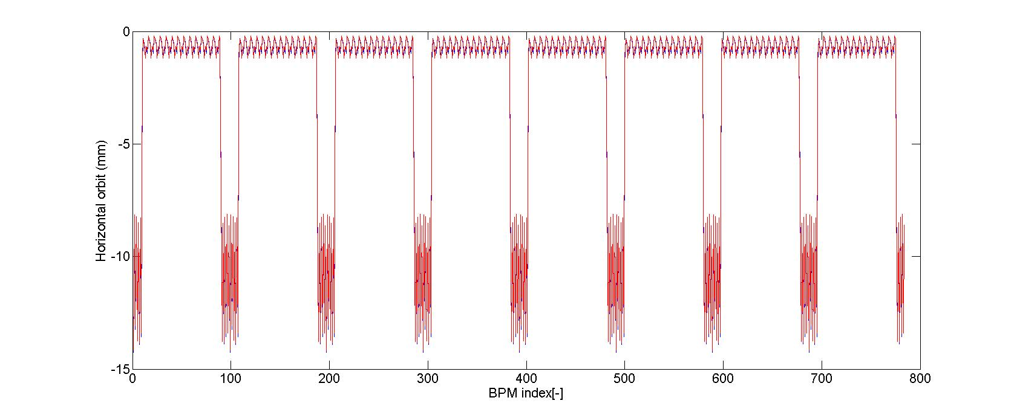
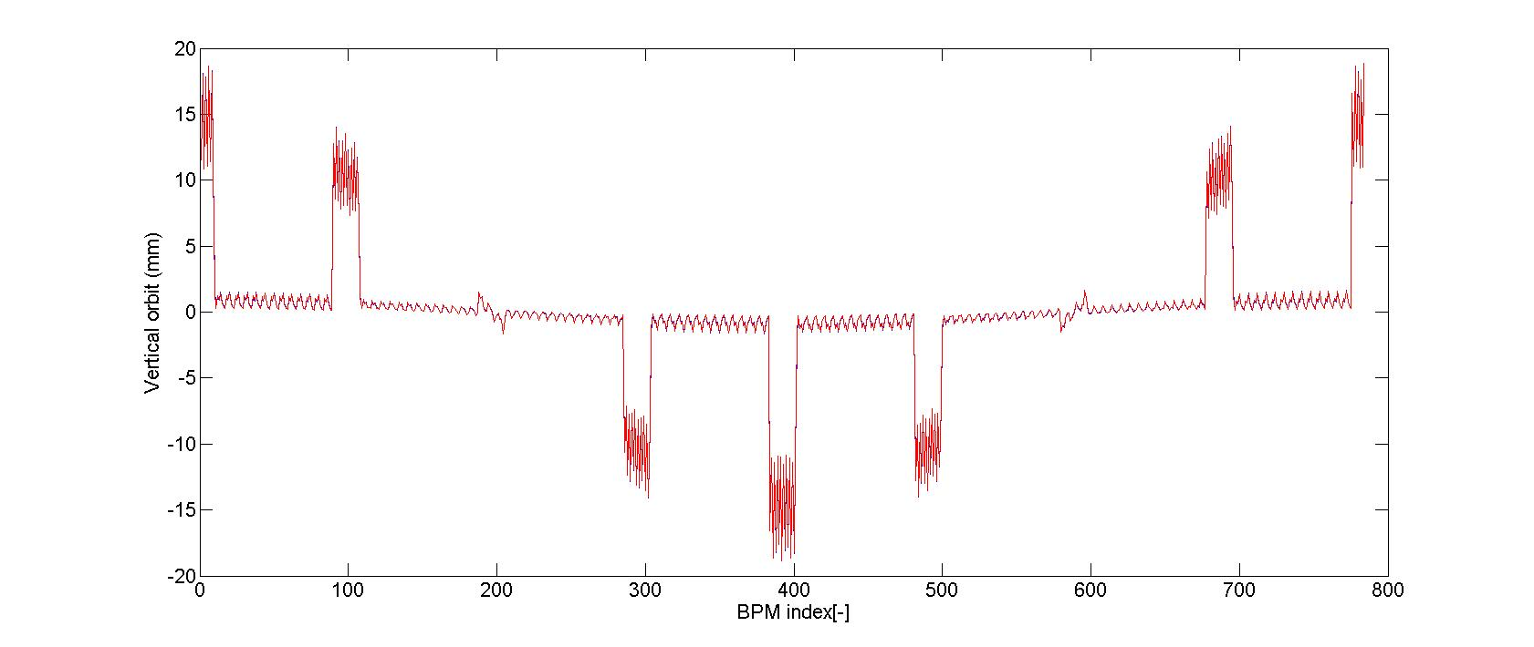
Earth field effect of Bz
Horizontal orbit with By、Bx、Bz in the drifs
Vertical orbit with By、Bx、Bz in the drifts

Slide 13
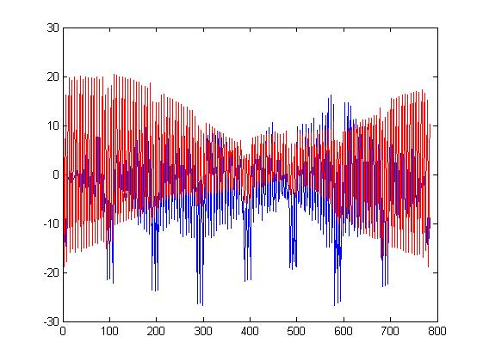
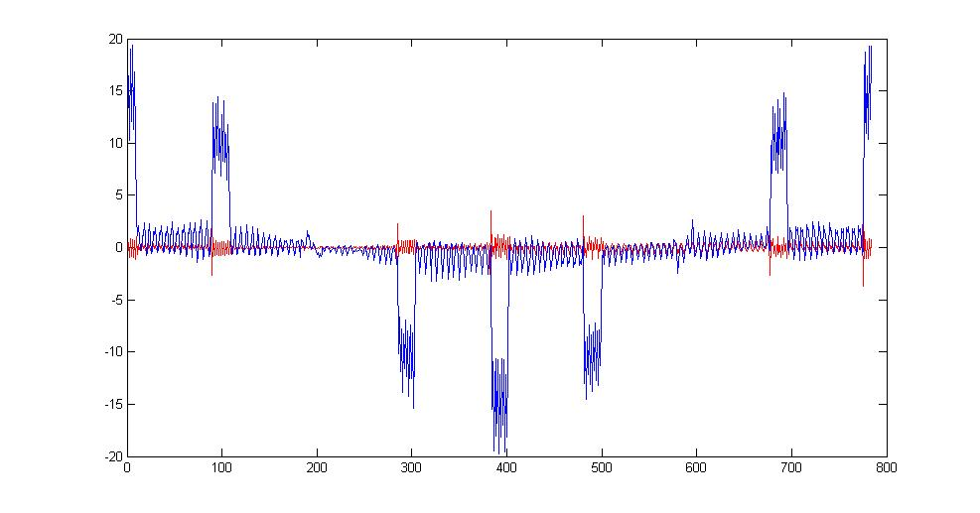
Correction result (to be studied)
Horizontal orbit before(blue)
and after(red) correction
Verticalorbit before(blue)
and after(red) correction

Slide 14
To do list
Consider Bz effect in all magnets
Sextupoles included
Correction

