Slide 1
Update on pretzel scheme design
Geng Huiping
CEPC Accelerator Group Meeting
2016.05.06

Slide 2
Contents
DA optimization on main ring (Keep phase advance difference of straight sections constant, reduce straight section length, and study DA behavior).

Slide 3
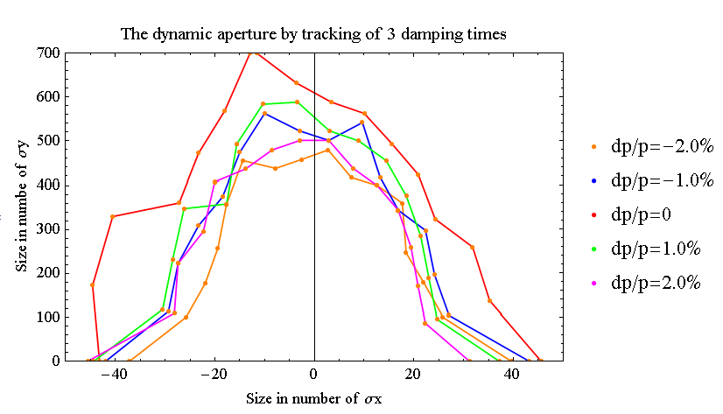
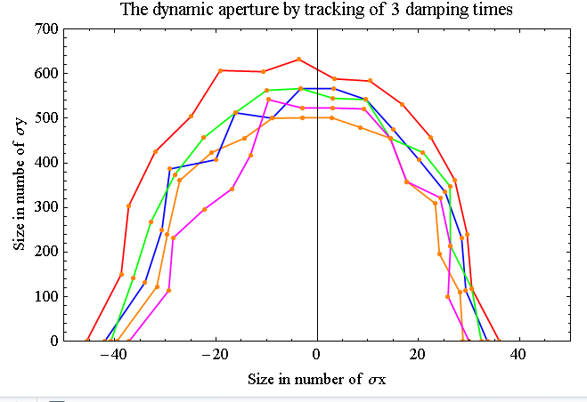
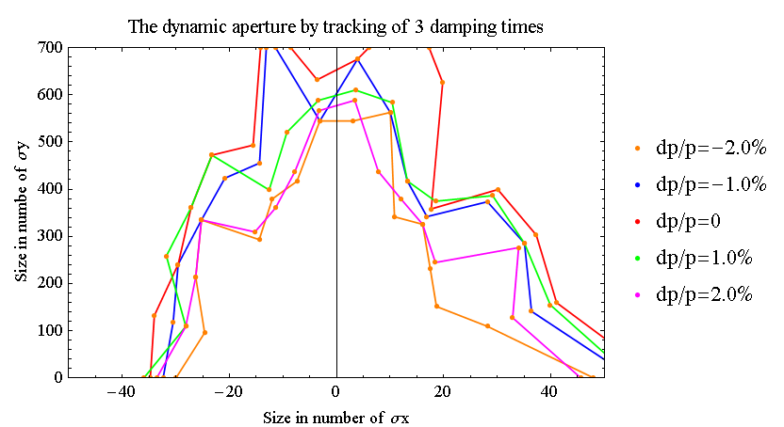
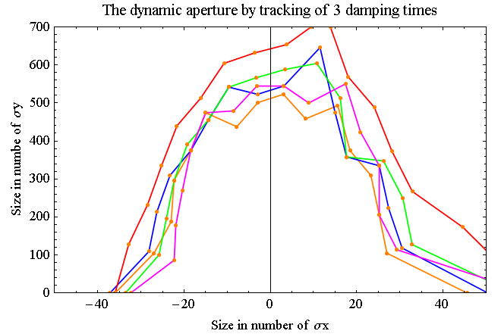
DA optimization-1
Start with（18+34）FODO layout， keep the phase advance difference constant, reduce the length of both straight sections and study the DA.
16+32
18+34
14+30
12+28

Slide 4
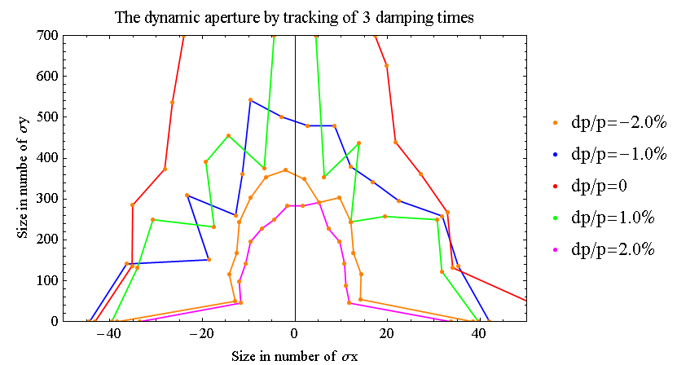
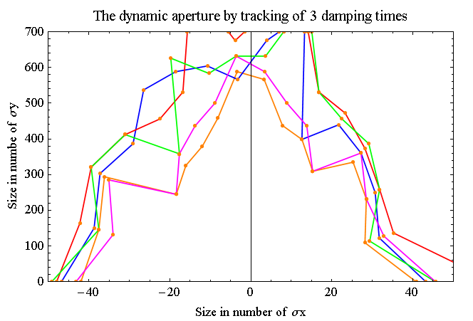
DA optimization-2
Start with（18+34）FODO layout， keep the phase advance difference constant, reduce the length of both straight sections and study the DA.
10+26
8+24

Slide 5
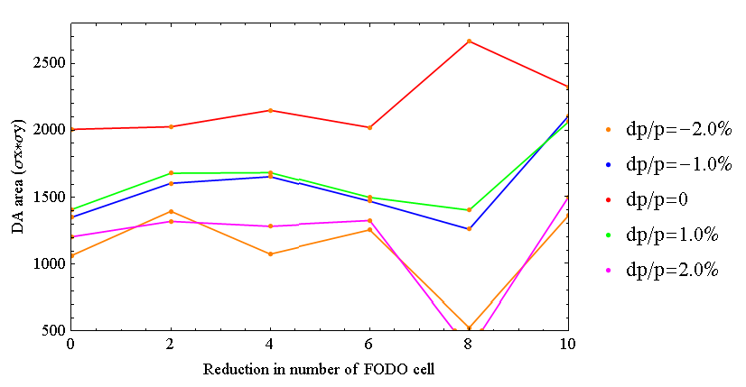
DA optimization-3
Start with（18+34）FODO layout， keep the phase advance difference constant, reduce the length of both straight sections and study the DA.

Slide 6
Summary
DA does not depend on length of straight section so much, but more phase advance difference and working point ?

