Slide 1
BEPCII 设计与调试
于程辉
for the BEPCII accelerator team
June 24, 2016

Slide 2
Contents
Overview of BEPCII
Road to 1.0*10³³cm⁻²s⁻¹
Operation with energy 1.0~2.3GeV
Synchrotron radiation running
Summary

Slide 3
Overview of BEPCII operation

Slide 4
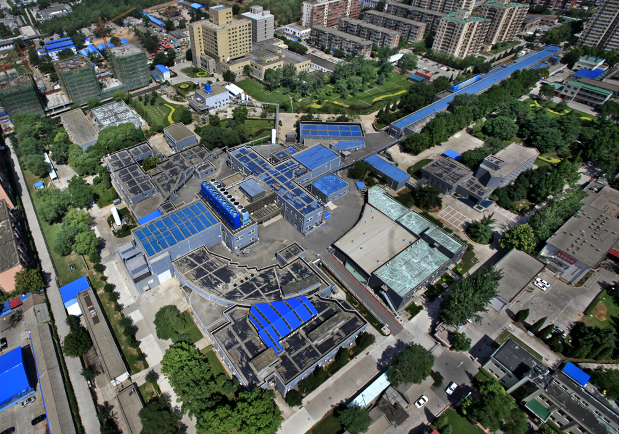
北京正负电子对撞机的三个应用平台

Slide 5
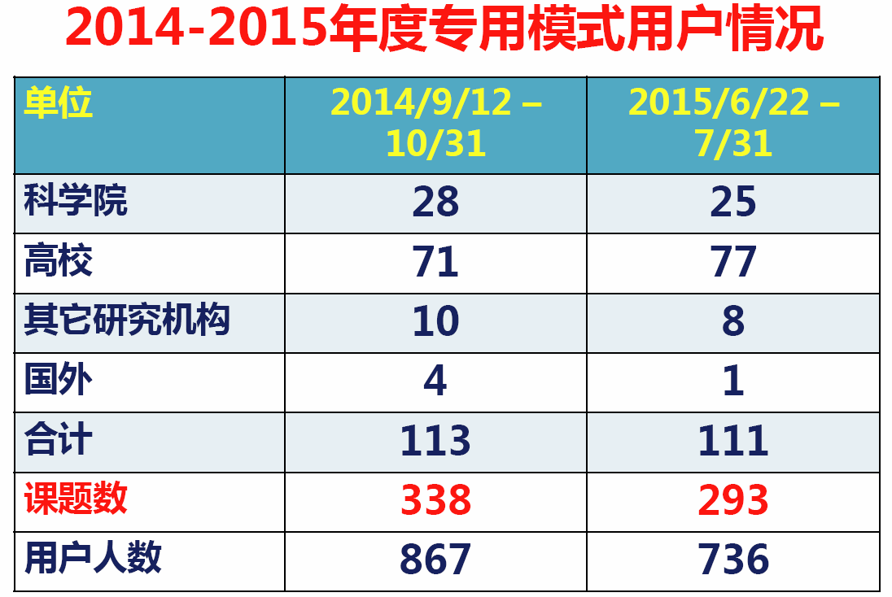
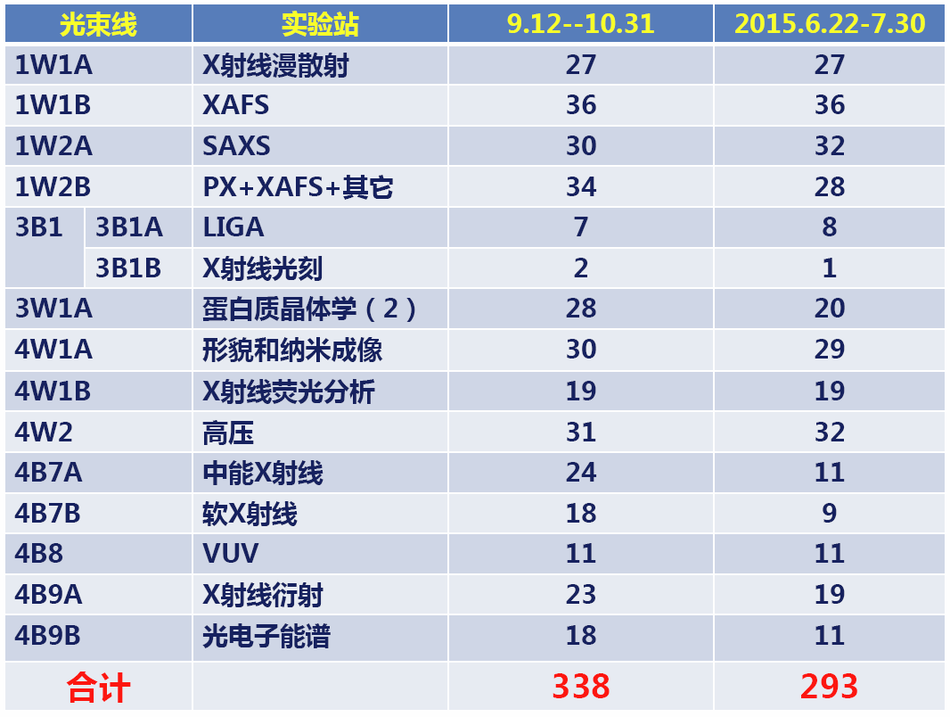
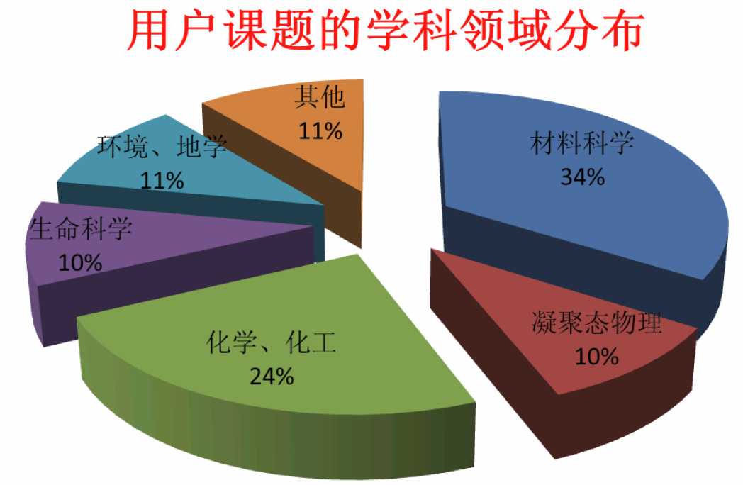
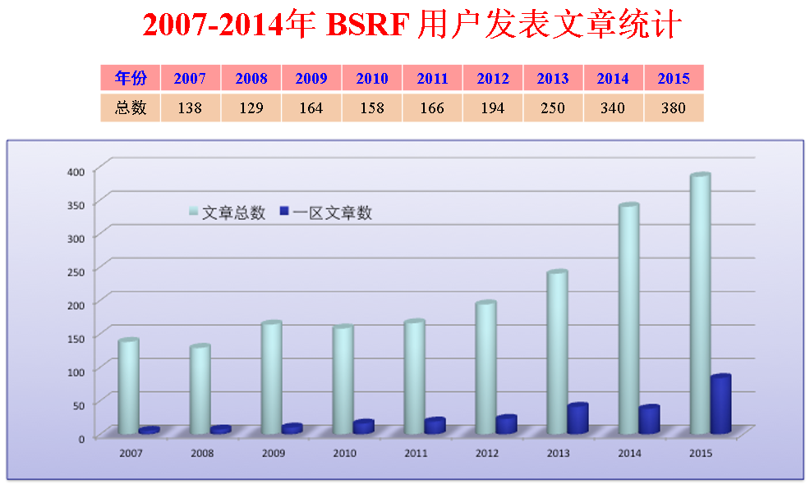
北京同步辐射装置

Slide 6
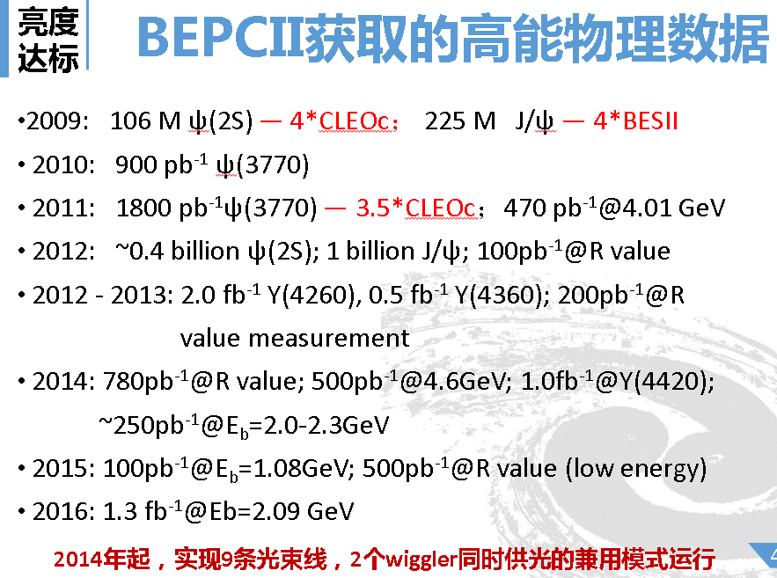
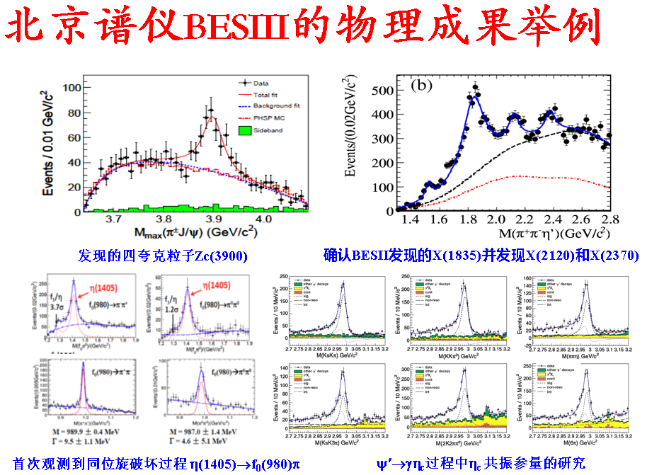
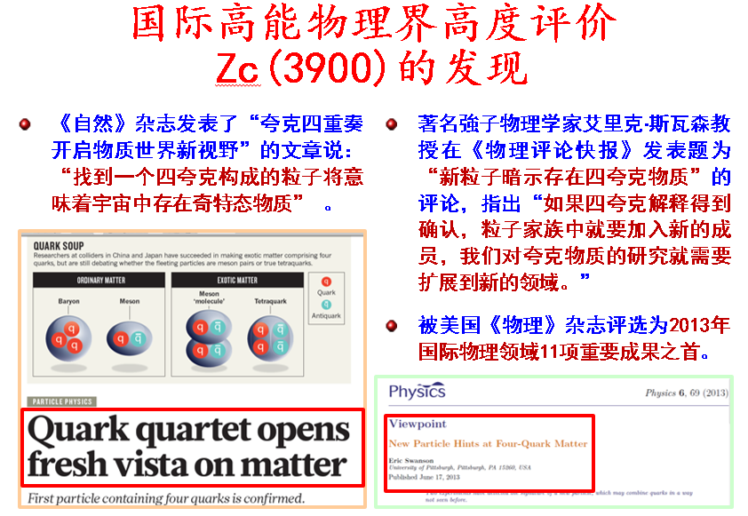
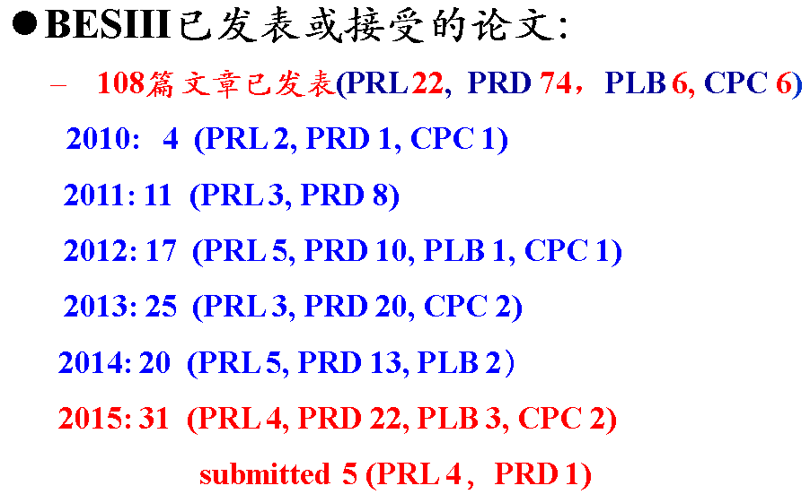
北京谱仪

Slide 7
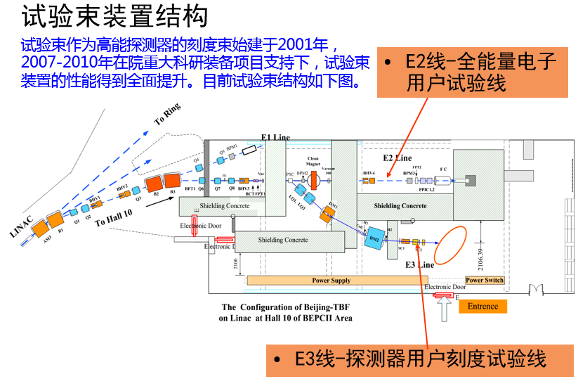
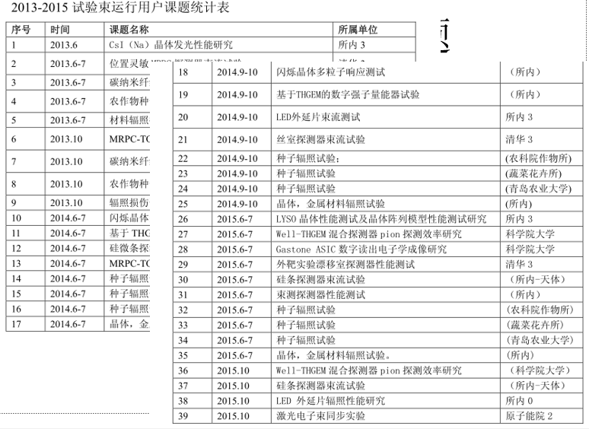
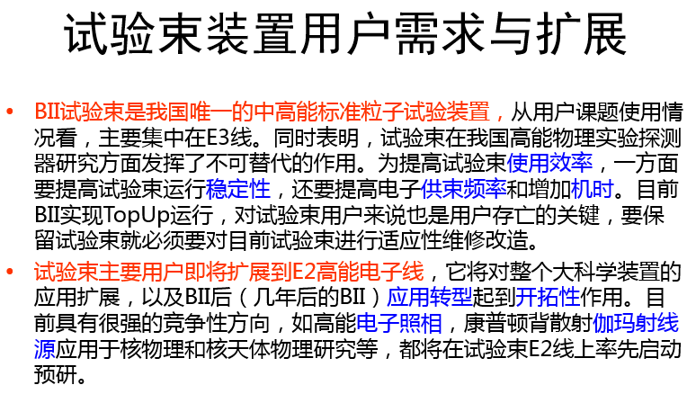
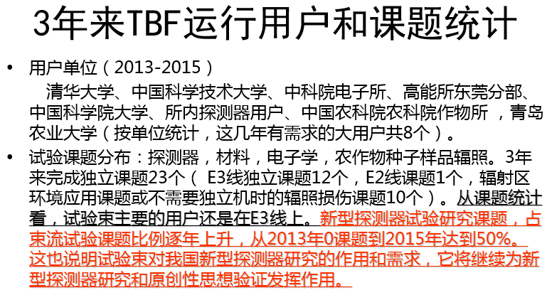
北京试验束装置

Slide 8
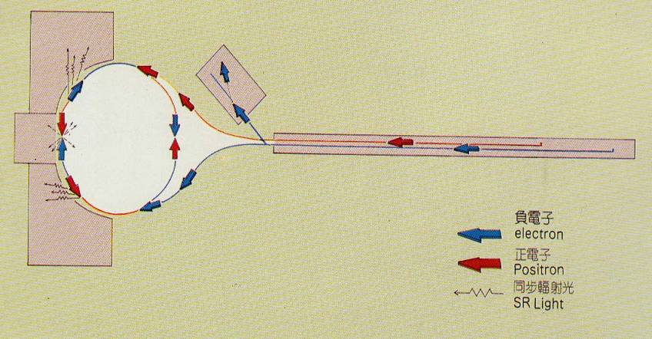
BESIII、BSRF和试验束装置的概述
六个月→ BESIII取数 + BSRF兼用光用户实验（9）
三个月→ BSRF专用光用户实验（15） + 试验束装置实验
一个月→ 加速器专用机器研究 + 设备检修 + 参观 + ……

Slide 9
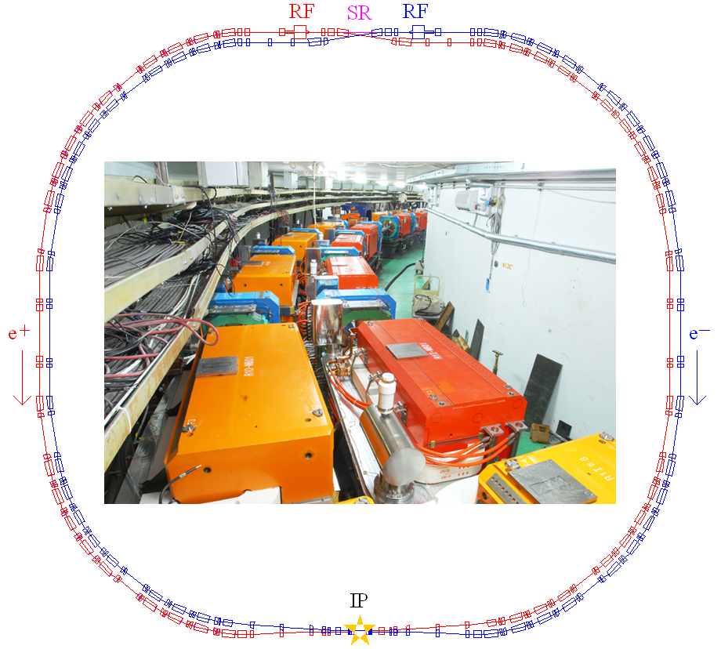
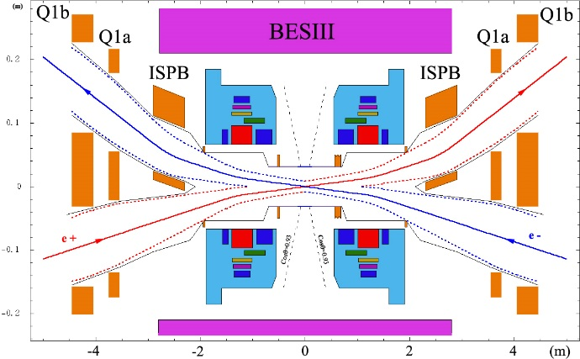
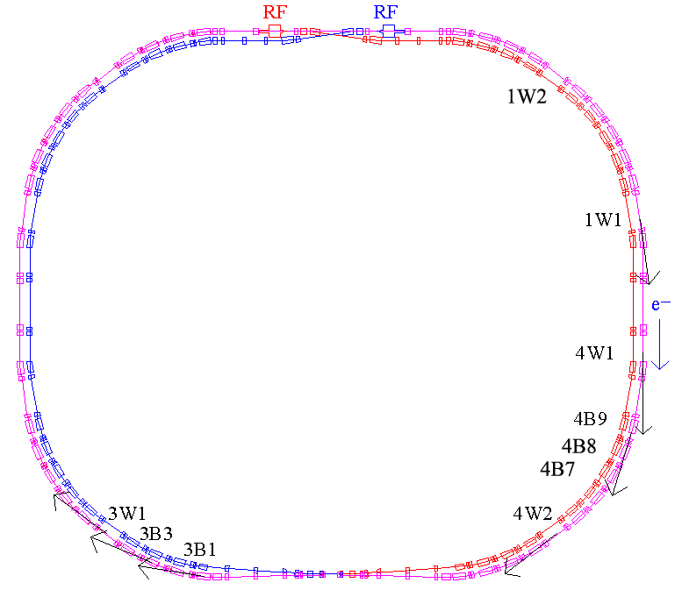
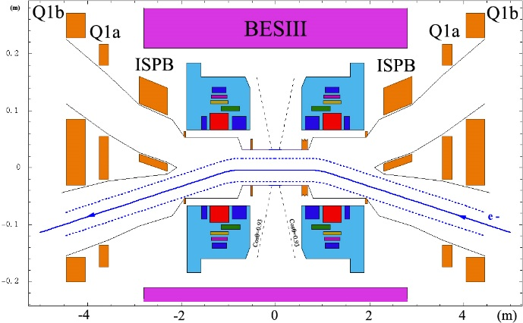
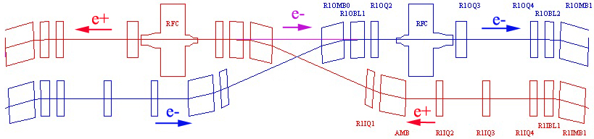
Collider SR Facility

Slide 10
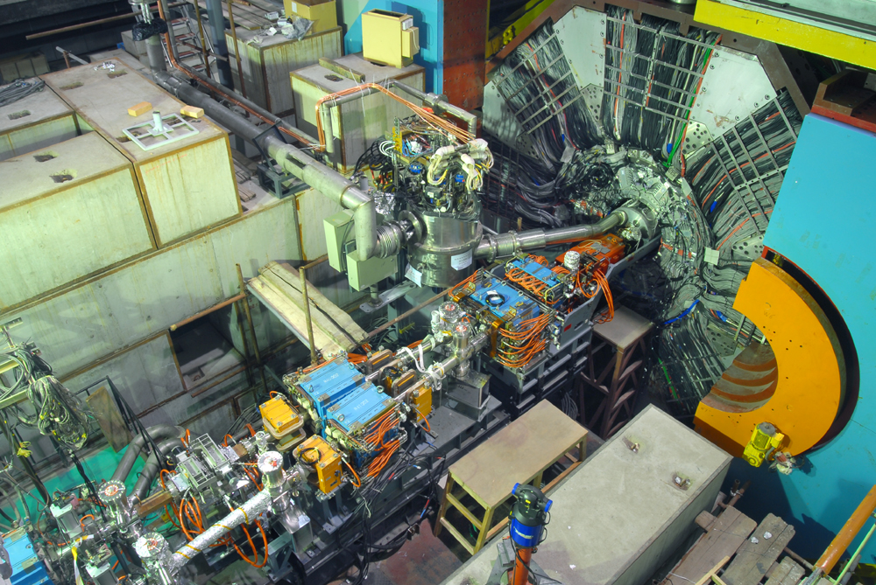
Integrated of IR in May 2008

Slide 11
Operation schedule
  2008.6.22 -2008.12.18 Luminosity commissioning & Detector tuning
  2008.12.18-2009.1.20 Synchrotron radiation operation for users
  2009.1.20-2009.1.31 Installed movable masks, remove profiles
  2009.2.1-2009.3.2 Luminosity commissioning @1.89GeV
  2009.3.2-2009.4.14 High energy physics,100M ψ(2S)events @1.84GeV
  2009.4.14-2009.5.19 Luminosity commissioning, L=3.3×10³²cm⁻²s⁻¹
  2009.5.19-2009.6.1 High energy physics,@1.825GeV
  2009.6.1-2009.7.31 High energy physics,200M J/ψ events@ 1.55GeV
  2009.12.18-2011.4.28 High energy physics @ 1.89GeV
  2011.4.28- now High energy physics @ 1.0-1.6GeV and 1.9-2.3GeV

Slide 12
Main parameters achieved in collision mode at 1.89GeV
parameters | design | Achieved (Not at the same time)
 |  | BER | BPR
Energy (GeV) | 1.89 | 1.89 | 1.89
Beam current (mA) | 910 | 910 | 910
Bunch current (mA) | 9.8 | >10 | >10
Bunch number | 93 | 119 | 119
RF voltage | 1.5 | 1.5 | 1.5
Beam-beam parameter | 0.04 | 0.043
β_{x}*/β_{y}* (m) | 1.0/0.015 | 1.0/0.0135 | 1.0/0.0135
Inj. Rate (mA/min) | 200 e⁻ / 50 e⁺ | >1000 | >100
Lum. (× 10³³cm⁻²s⁻¹) | 1.0 | 1.0

Slide 13
2. Road to 1.0×10³³ cm⁻²s⁻¹ @1.89GeV

Slide 14
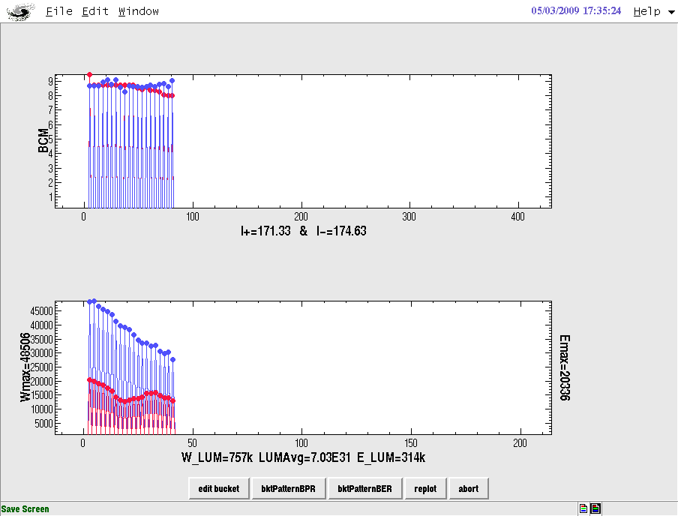
Commissioning with designed lattice
Parameters | Values
Operation energy | 1.0~2.1 GeV
Optimized energy | 1.89 GeV
Beam current | 910 mA
Bunch current | 9.8 mA
Circumference | 237.5 m
Number of particles | 4.5×10¹²
β function at IP | 1.0 m/1.5 cm
Horizontal emittance | 144 nm⋅rad
Working point | 6.53/5.58
Harmonic number | 396
Bunch number | 93
Bunch spacing | 2.4 m
RF voltage | 1.5 MV
RF frequency | 499.8 MHz
RF cavity number per ring | 1
Energy loss per turn | 121 keV
Synchrotron radiation power | 110 kW
Damping time | 25/25/12.5 ms
Natural energy spread | 5.16×10⁻⁴
Momentum compaction | 0.0235
Natural bunch length | 1.35 cm
Crossing angle at IP | 11×2 mrad
Beam-beam parameter | 0.04
Luminosity | 1.0×10³³cm⁻²s⁻¹
BEPCII started on Jun. 22, 2008. BER and BPR accumulated beam successfully on Jun. 22 and Jun. 26 respectively.
The luminosity reached 1.3×10³²cm⁻²s⁻¹ @ ~520mA*520mA before Dec. 17, 2008. A long time was taken to study the source which caused a strong longitudinal instability in both BPR and BER.

Slide 15
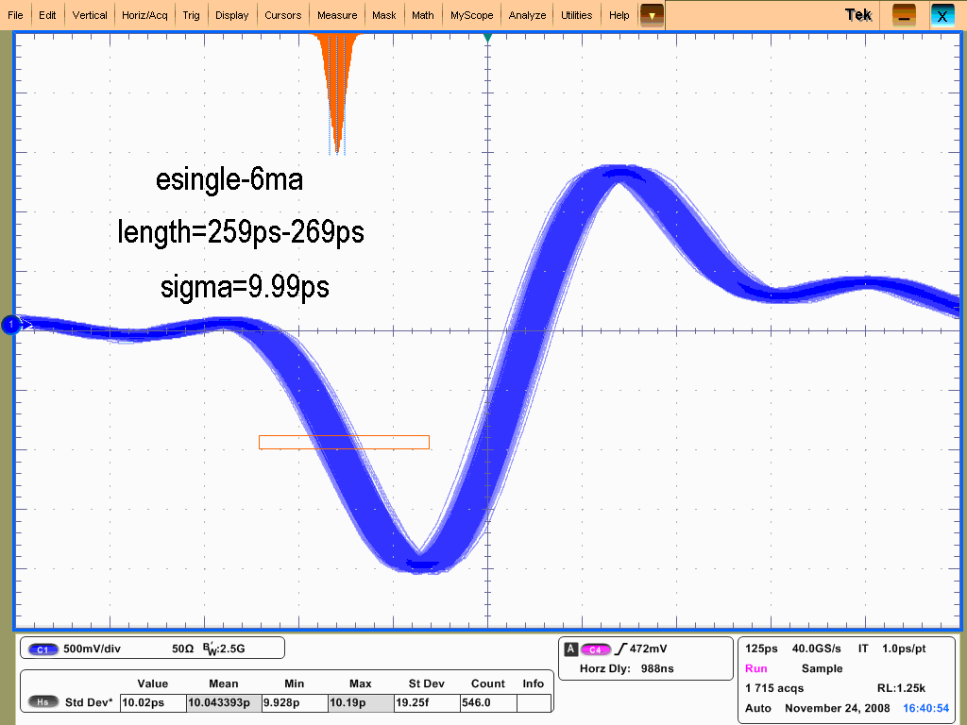
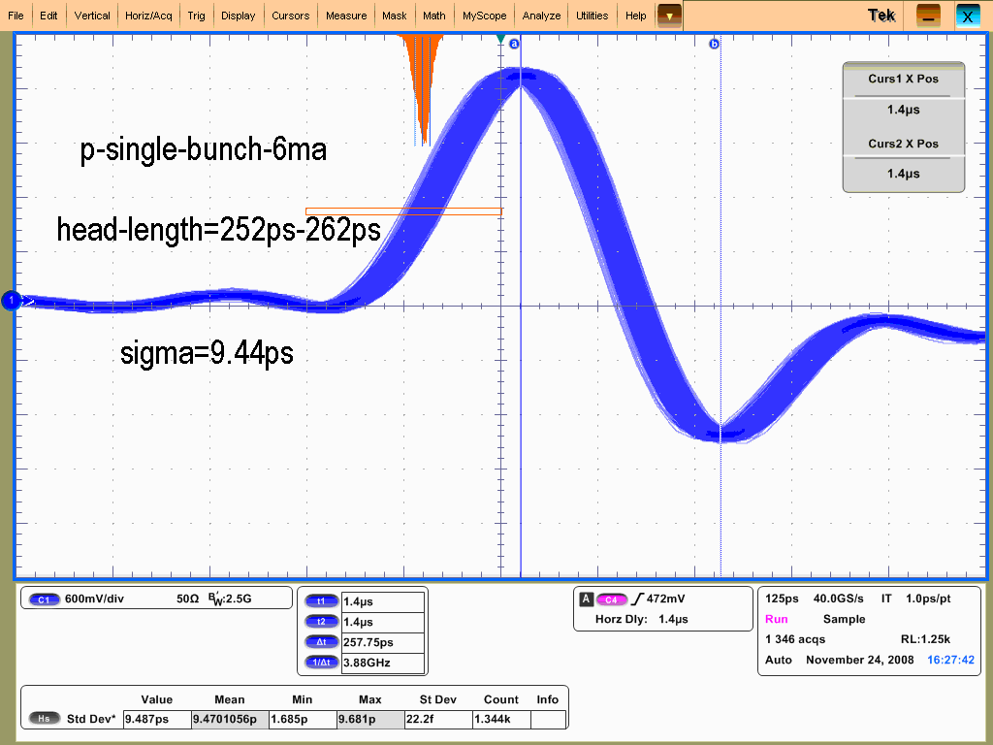
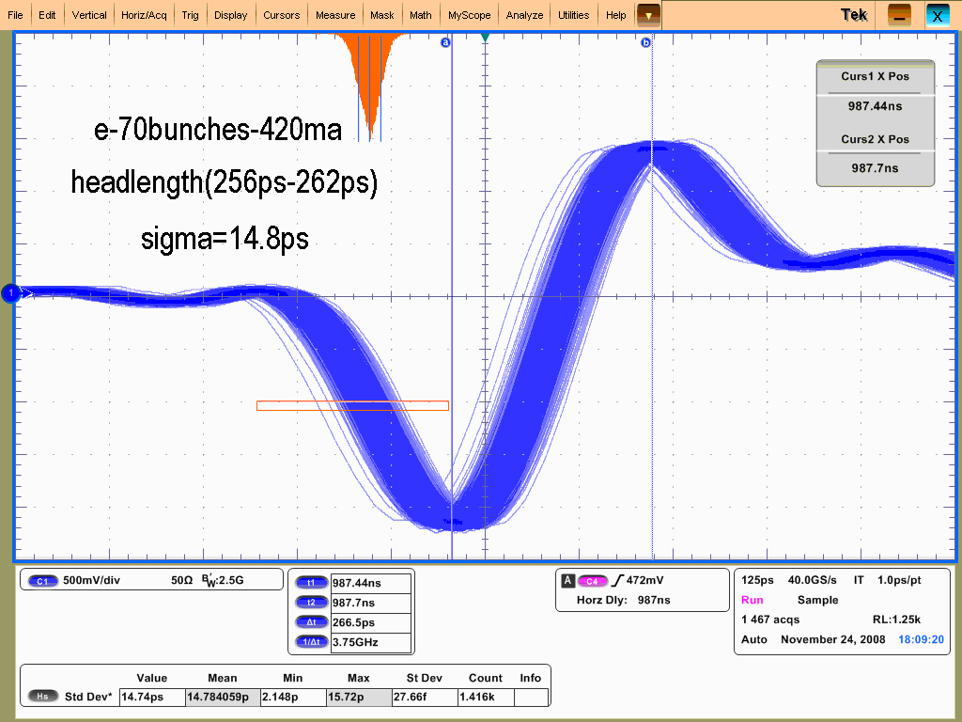
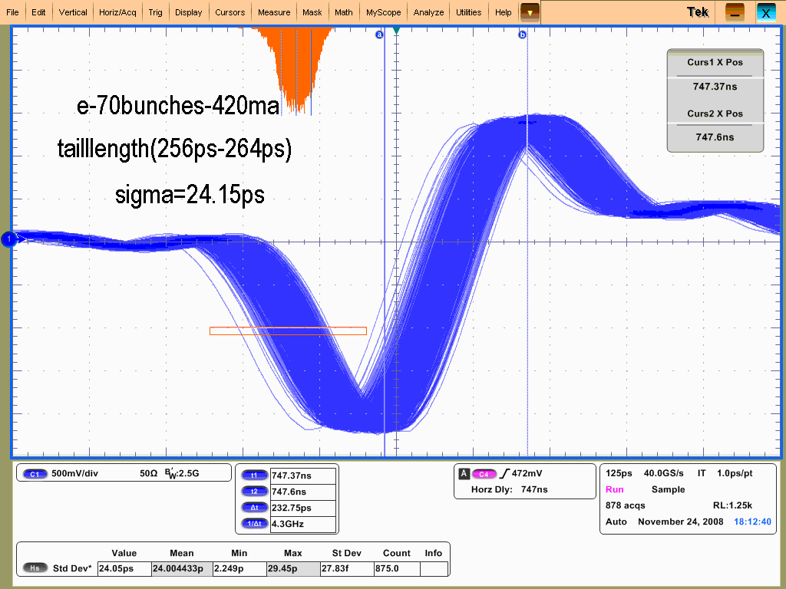
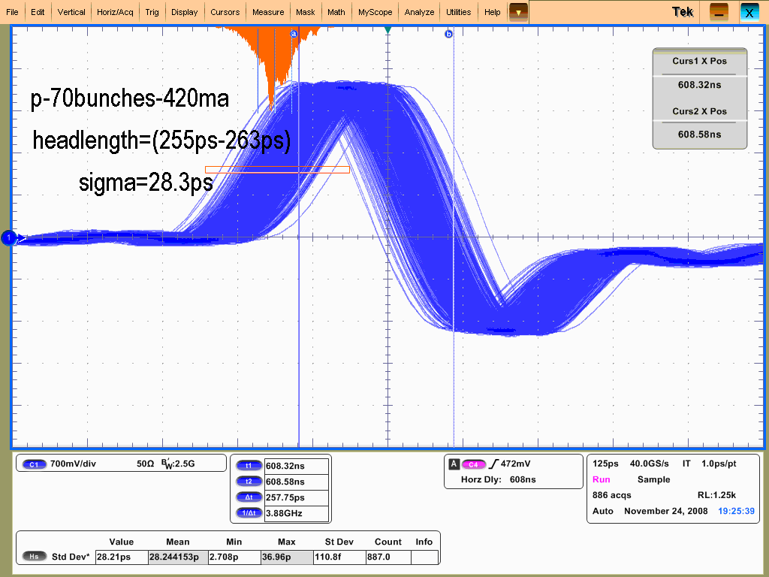
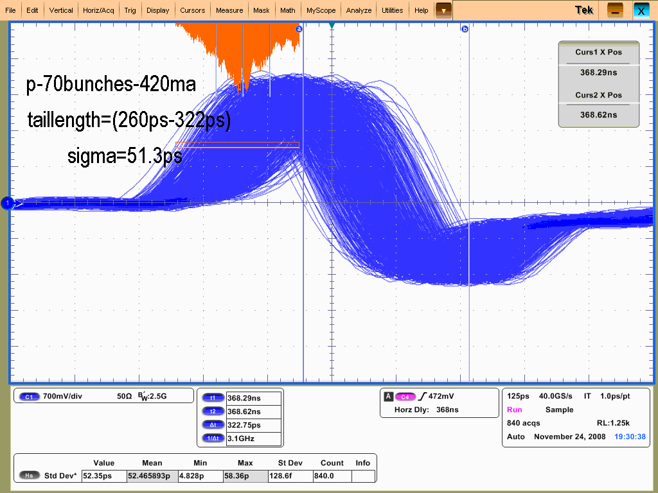
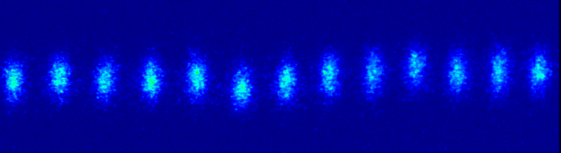
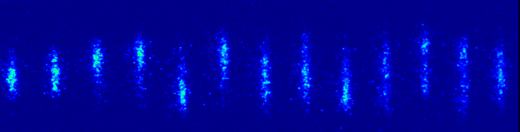
Dipole and quadrupole mode oscillation
Single e- bunch Single e+ bunch
Head part Tail part Head part Tail part
Continuous 70 bunches, 4 bucket bunch spacing, in collision
longitudinal
BER: dipole mode oscillation BPR: dipole and quadrupole oscillation

Slide 16
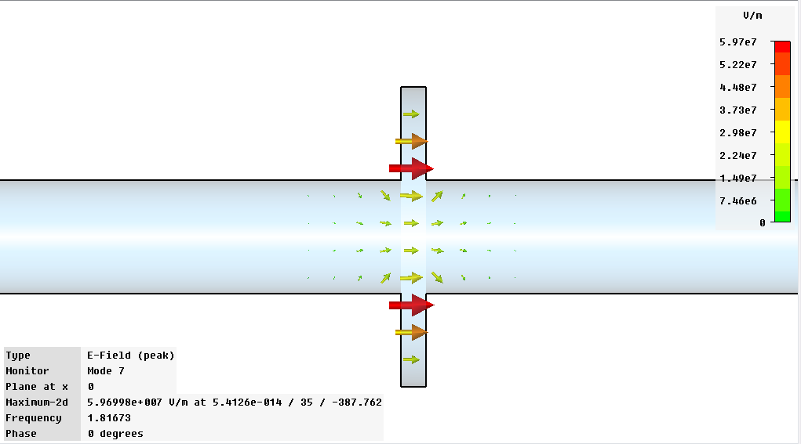
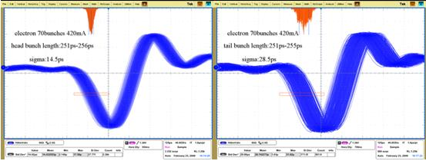
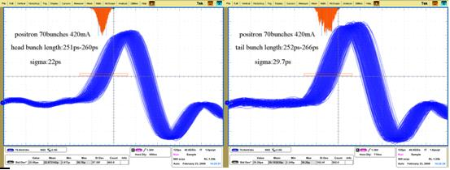
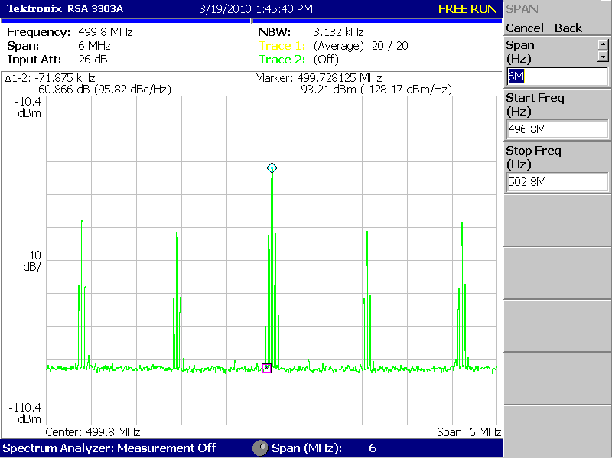
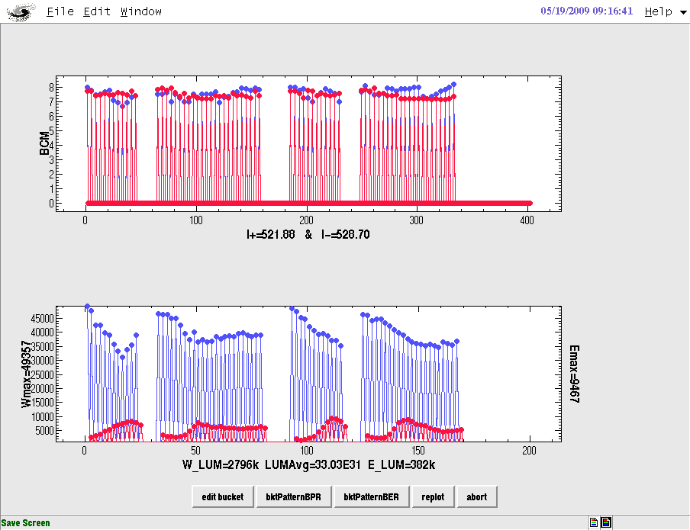
Quadrupole mode oscillation in BPR was removed
BER tail bunch
BPR tail bunch
Continuous 70 bunches, 4 bucket bunch spacing, in collision
Profile in BPR
(HOM simulated by T.M. Huang)
Two profiles in the BPR were removed in Jan. 2009.
After that luminosity was improved from 1.3×10³²cm⁻²s⁻¹ to 2.3×10³²cm⁻²s⁻¹. Dipole mode oscillation in longitudinal direction in both BER and BPR still existed. The luminosity of tail bunch reduced obviously

Slide 17
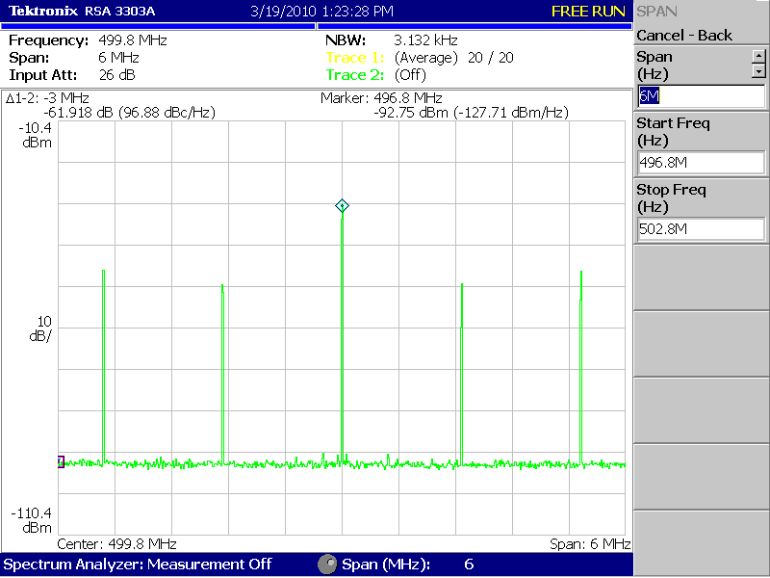
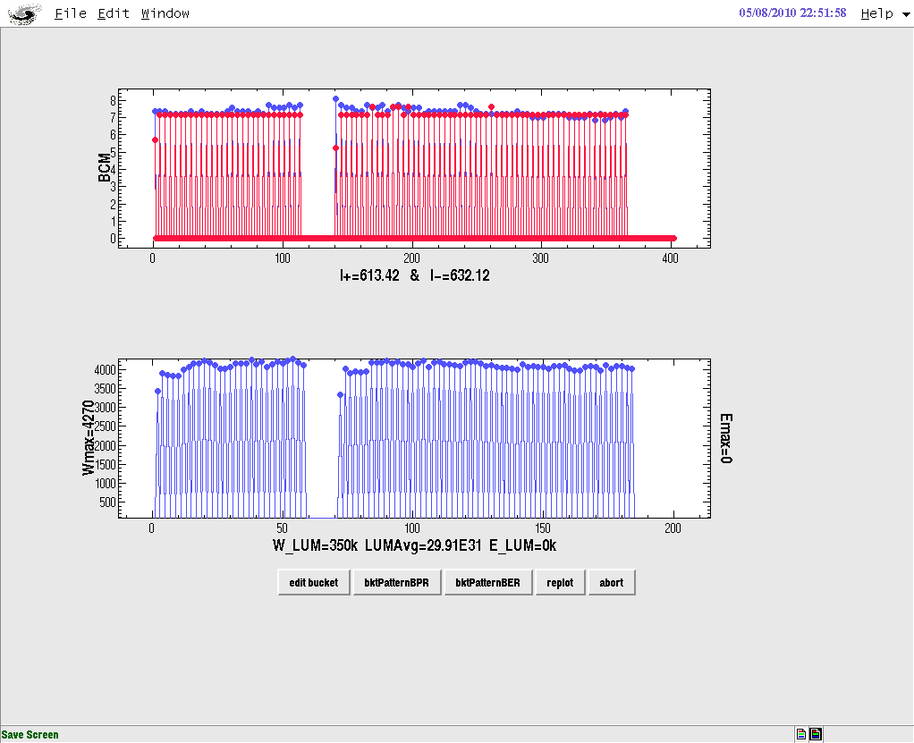
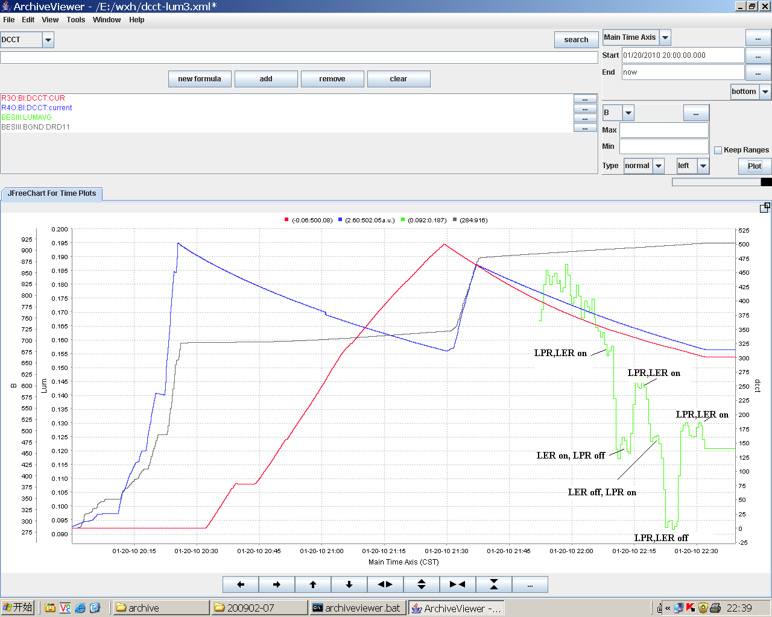
The horizontal tune was moved from 0.53 to 0.505 on May 5, 2009. The luminosity reached 3.3×10³²cm⁻²s⁻¹ @ ~520mA*520mA in 10 days.
Longitudinal feedback systems were installed into BPR and BER during the summer shutdown in 2009. The commissioning of BEPCII with longitudinal feedback system began on December 18th, 2009. The longitudinal instability was suppressed effectively so that the luminosity was improved about 30%.

Slide 18
The data taking at the energy of 1.89 GeV started from the beginning of 2010. The beam current and luminosity were improved step by step, together with the control of detector background and the luminosity optimization systematically. The maximum beam current and luminosity reached 750 mA and 6.49×10³² cm⁻²s⁻¹, respectively until April 28th, 2011, the time that BESIII began the data taking plans for other energy points(1.0~2.3 GeV)

Slide 19
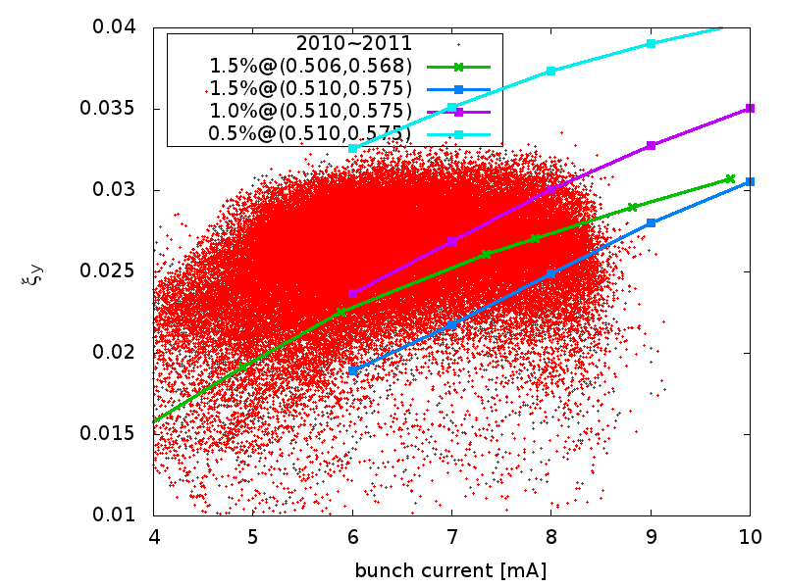
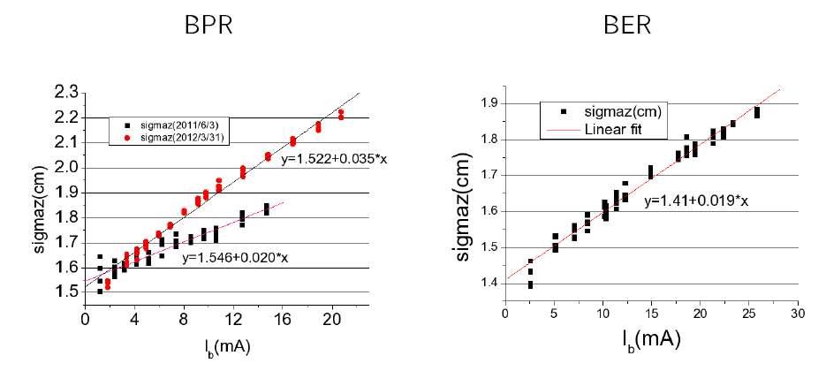
The beam-beam parameter was suppressed obviously under 0.033 at any bunch current even with sufficient collision tuning. Bunch lengthening effect was considered to explain the phenomenon.
1.34cm
1.34cm
1.55cm

Slide 20
Commissioning with upgrade lattice
Parameters | Values
Operation energy | 1.0~2.1 GeV
Optimized energy | 1.89 GeV
Beam current | 910 mA
Bunch current | 9.8 mA
Circumference | 237.5 m
Number of particles | 4.5×10¹²
β function at IP | 1.0 m/1.5 cm
Horizontal emittance | 144 nm⋅rad
Working point | 6.53/5.58
Harmonic number | 396
Bunch number | 93
Bunch spacing | 2.4 m
RF voltage | 1.5 MV
RF frequency | 499.8 MHz
RF cavity number per ring | 1
Energy loss per turn | 121 keV
Synchrotron radiation power | 110 kW
Damping time | 25/25/12.5 ms
Natural energy spread | 5.16×10⁻⁴
Momentum compaction | 0.0235
Natural bunch length | 1.35 cm
Crossing angle at IP | 11×2 mrad
Beam-beam parameter | 0.04
Luminosity | 1.0×10³³cm⁻²s⁻¹
Parameters | Values
Optimized energy | 1.89 GeV
Beam current | 910 mA
Bunch current | 7.0 mA
β function at IP | 1.0 m/1.5 cm
Horizontal emittance | 100 nm⋅rad
Working point u_{x}/u_{y} | 7.505/5.580
Harmonic number | 396
Bunch number | 130
Bunch spacing | 1.8 m
RF voltage | 1.5 MV
Momentum compaction | 0.0170
Natural bunch length | 1.15 cm
Beam-beam parameter | 0.04
Luminosity | 1.0×10³³cm⁻²s⁻¹
A new lattice was designed to control the bunch length. The natural bunch length was reduced from 1.35 cm to 1.15 cm by decreasing the momentum compaction from 0.0235 to 0.0170. More collision bunches are required.

Slide 21
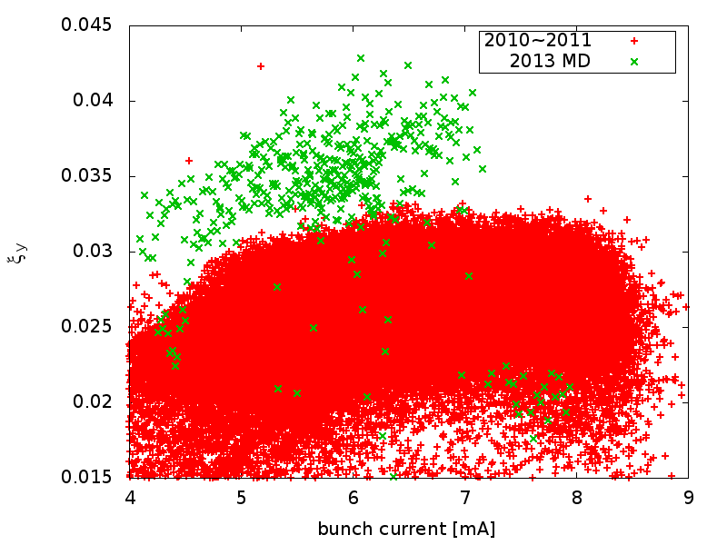
Since BESIII doesn’t take data at the energy of 1.89 GeV during period of April 28th, 2011 to 2018. A dedicated machine study to test the new lattice at the energy of 1.89 GeV was performed during February 28th to March 7th, 2013. The restriction to the beam-beam parameter was broken. The maximum beam-beam parameter reached 0.043.
During the commissioning with 130 bunches, the transverse multi-bunch instability was too serious to keep beam stable by the feedback system. The luminosity optimization was done with 120 bunches. The maximum stable beam current was 750 mA. The maximum luminosity reached 7.08×10³² cm⁻²s⁻¹ @ 734 mA*735 mA while the beam-beam parameter was 0.0349.

Slide 22
Commissioning with upgrade lattice
Parameters | Values
Optimized energy | 1.89 GeV
Beam current | 910 mA
Bunch current | 7.0 mA
β function at IP | 1.0 m/1.5 cm
Horizontal emittance | 100 nm⋅rad
Working point | 7.505/5.580
Harmonic number | 396
Bunch number | 130
Bunch spacing | 1.8 m
RF voltage | 1.5 MV
Momentum compaction | 0.0170
Natural bunch length | 1.15 cm
Beam-beam parameter | 0.04
Luminosity | 1.0×10³³cm⁻²s⁻¹
Parameters | Values
Optimized energy | 1.89 GeV
Beam current | 910 mA
Bunch current | 8.3 mA
β function at IP | 1.0 m/1.35 cm
Horizontal emittance | 122 nm⋅rad
Working point | 7.505/5.580
Bunch number | 110
Bunch spacing | 1.8 m
Momentum compaction | 0.0181
Natural bunch length | 1.15 cm
Beam-beam parameter | 0.04
Luminosity | 1.1×10³³cm⁻²s⁻¹
The bunch number should be controlled as less as possible to keep beam stable with a high beam current. The lattice with low momentum compaction was improved. The emittance was increased from 100 nm to 122 nm to increase the collision bunch current.

Slide 23
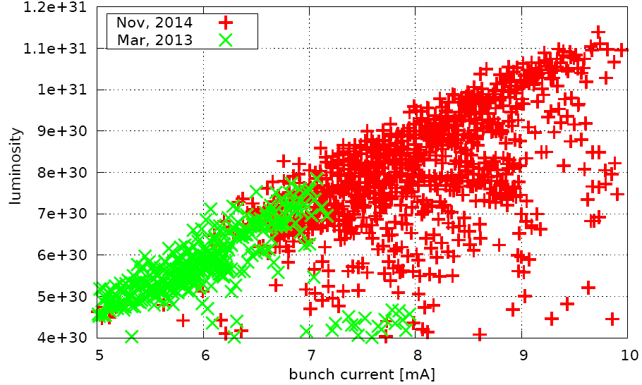
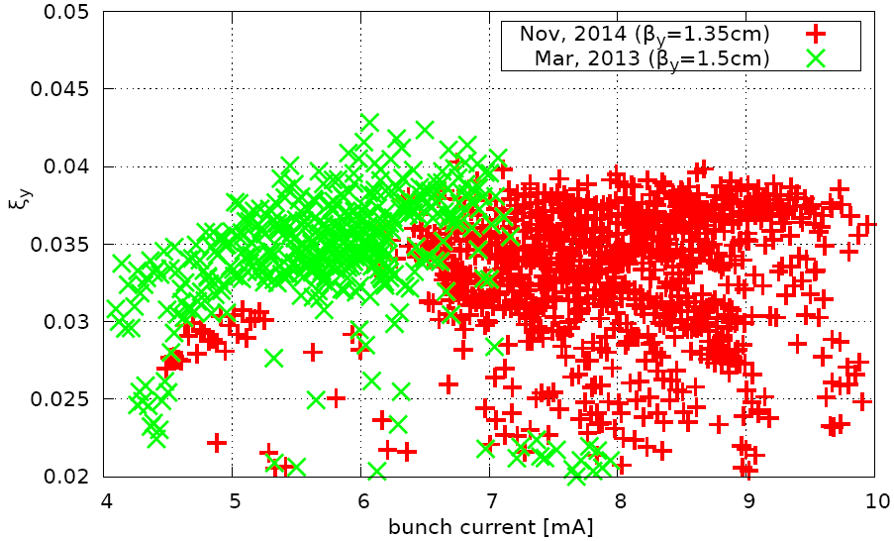
Commissioning with upgrade lattice
The maximum beam-beam parameter reached 0.040 with the bunch current of 8.6mA in Nov. 2014.
The maximum stable beam current was 730 mA due to series hardware failures. The maximum luminosity reached 8.53×10³² cm⁻²s⁻¹ with the beam current of 696 mA*707 mA and 92 bunches while the beam-beam parameter was 0.0397 on Nov. 20th, 2014.

Slide 24
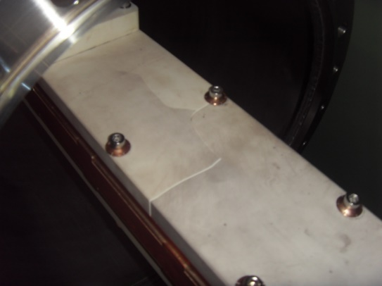
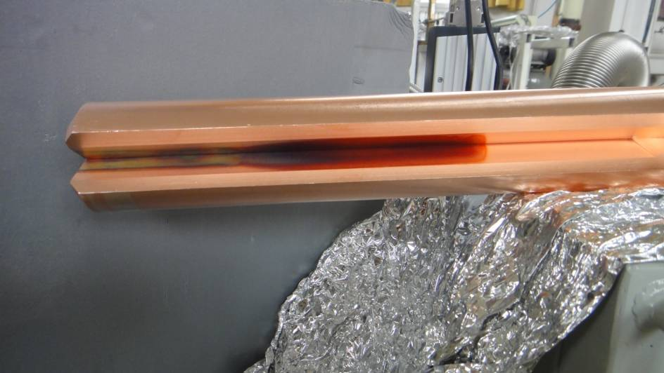
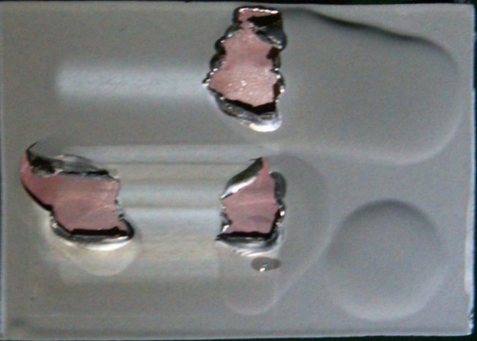
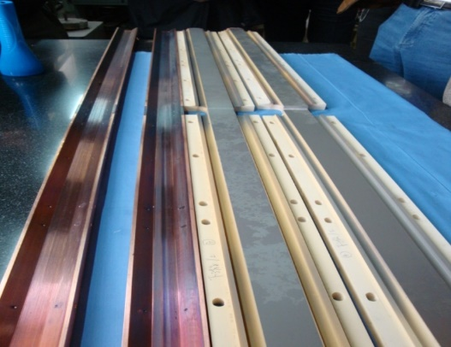
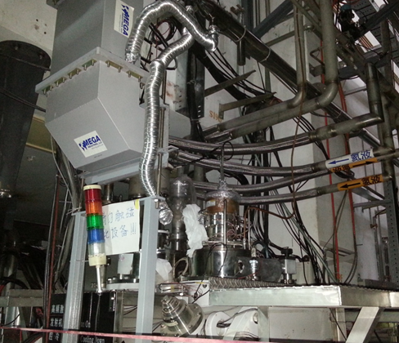
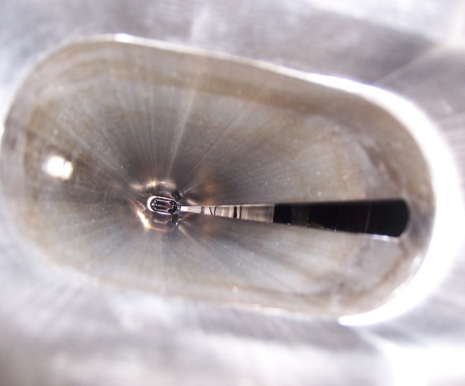
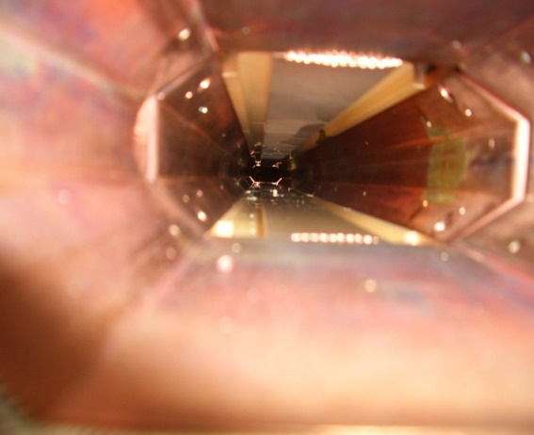
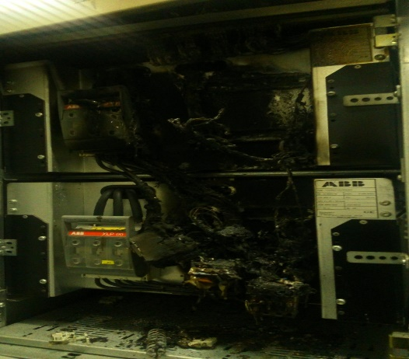




Hardware failures which limited the increase of beam current

Slide 25
Hardware failures which limited the increase of beam current
1, Dedicated machine study at 1.89GeV (Nov.4～13 , 2013)
Failure of RF coupler from Nov. 6
2, Dedicated machine study at 1.89GeV (Jan. 25～Feb. 5, 2014）
Failure of cryogenic system from Jan. 28
3, Dedicated machine study at 1.89GeV ( Mar. 30～Apr. 6)
Failure of transverse feedback system
4, Dedicated machine study at 1.89GeV (May 29～Jun. 8)
Failure of longitudinal feedback system
5, Dedicated machine study at 1.89GeV (Nov. 1～Dec. 26, 2014）
Failure of RF coupler
6, Dedicated machine study at 1.89GeV (Mar. 7～14, 2015)
Failure of power supply from Mar. 8.
7, Dedicated machine study at 1.89GeV (Nov. 11～Dec. 19）
Vacuum leak of RF cavity

Slide 26


1.0×10³³cm⁻²s⁻¹ was achieved on Apr.5, 2016
The stable beam current reached 910 mA with 105 bunches while the hardware failure was few during the commissioning in April 2016. Filling pattern optimization was the most important step to get higher luminosity when the beam current was higher than 800mA. The design luminosity of 1.0×10³³cm⁻²s⁻¹ was achieved with the beam current of 849 mA*852 mA and 119 bunches while the beam-beam parameter reached 0.0384 on April 5th, 2016.

Slide 27

1.0×10³³cm⁻²s⁻¹ was achieved on Apr.5, 2016
Celebration !

Slide 28
The luminosity could not be higher even the beam current was higher than 850 mA because the multi-bunch instability was too strong to be suppressed effectively by the feedback system. The dedicated measurement and analysis are carried out. The upgrade plan to improve the feedback system has been proposed.

Slide 29

Collision tuning system of BEPCII
The collision tuning system was developed from 2003. It consists of BESIII solenoid compensation, global coupling correction, X-Y coupling tuning at the IP, relative orbit deviation tuning, optics deviation tuning, chromaticity (dQ_{x,y}/dE, dβ_{x,y}/dE, dα_{x,y}/dE) knob, etc.
×F_{R}
The luminosity reduction caused by deviations and multi-bunch instability could be eliminated effectively.

Slide 30
3. Operation with energy 1.0~2.3GeV

Slide 31



The operation energy of BEPCII is decided by the BESIII working plan. The operation energy region of BEPCII is designed from 1.0 to 2.1 GeV. Actually, BEPCII has been operated in the energy region from 1.0 to 2.3 GeV with a full energy injection according to the requirements of high energy physics.
Status of power supply @2.1-2.3GeV

Slide 32

The energy region was separated into three parts: from 1.0 GeV to 1.6 GeV, 1.6 GeV to 1.9 GeV and 1.9 GeV to 2.3 GeV. The horizontal Emittance is the key parameter for the low energy region. Bunch length is the key parameter for the high energy region.
Parameters | Values
Beam energy | 1.0 GeV
β function at IP | 1.0 m/1.2 cm
Horizontal emittance | 54 nm⋅rad
Working point | 6.505/5.580
Momentum compaction | 0.0286
Natural bunch length | 0.6 cm
Parameters | Values
Beam energy | 1.89 GeV
β function at IP b_{x}/b_{y} | 1.0 m/1.35 cm
Horizontal emittance | 122 nm⋅rad
Working point u_{x}/u_{y} | 7.505/5.580
Momentum compaction | 0.018
Natural bunch length | 1.15 cm
Parameters | Values
Beam energy | 2.3 GeV
β function at IP b_{x}/b_{y} | 1.0 m/1.5 cm
Horizontal emittance | 144 nm⋅rad
Working point u_{x}/u_{y} | 7.505/5.580
Momentum compaction | 0.017
Natural bunch length | 1.5 cm
Low energy Medium energy High energy

Slide 33
Physics data in the past years
2009: 106 M ψ(2S) , 225 M J/ψ
2010: 900 pb⁻¹ ψ(3770)
2011: 1800 pb⁻¹ψ(3770) ；470 pb⁻¹@4.01 GeV
2012: 0.4 billion ψ(2S); 1 billion J/ψ; 100pb⁻¹@R value
2013: 2.0 fb⁻¹ Y(4260), 0.5 fb⁻¹ Y(4360); 200pb⁻¹ @R value
2014: 780pb⁻¹@R value; 500pb⁻¹@4.6GeV; 1.0fb⁻¹@Y(4420);
~250pb⁻¹@E_{b}=2.0-2.3GeV
2015: 100pb⁻¹@E_{b}=1.08GeV; 500pb⁻¹@R value (1.0-1.6GeV)
2016: 1.5 fb⁻¹@Eb=2.09 GeV

Slide 34




Beam power Beam Current
Bunch number Bunch Current

Slide 35



The peak luminosity and scaling laws from 1.0 GeV to 2.3 GeV
For the high energy region the beam current had to be decreased due to the limitation of RF power. The bunch length and emittance could not be well controlled.
For the low energy region the multi-bunch instability was very serious due to longer damping time. The injection efficiency was also affected by the longer damping time.

Slide 36
4. Synchrotron radiation running

Slide 37
BSR and beam lines
Parameters | Values
Energy | 2.5 GeV
Beam current | 250 mA
Circumference | 241.13 m
Horizontal emittance | 160 nm⋅rad
Harmonic number | 402
RF voltage | 3.0 MV
RF frequency | 499.8 MHz
RF cavity number | 2
Energy loss per turn | 336 keV
Synchrotron radiation power | 84 kW
Damping time | 12/12/6 ms
Working point | 7.28/5.20
Natural energy spread | 6.66×10⁻⁴
Momentum compaction | 0.0165
Natural bunch length | 1.2 cm
There are 14 beam lines including 8 extracted from 5 wigglers in the BSR. Every year, 3 months dedicated experiment time are spent to the users.

Slide 38


Top-up operation of BSR was realized on Apr.5, 2016
The operation for synchrotron radiation facility was designed as a decay scheme. Beam from linac was injected into storage ring every 6 hours. The dedicated machine study for top-up operation started in April 2014. With the well control for both injecting beam and circulating beam and well control of radiation dose for both detector and beam stations, top-up operation was realized on October 27th, 2015.

Slide 39


Parasitic operation of collider
Parasitic operation with 2 wigglers on was realized in 2014 after the fine tuning for the luminosity. During the data taking of high energy physics, 9 beam lines of synchrotron radiation facility, which are distributed in the outer ring of BER, could provide synchrotron light for the users without affecting the luminosity.

Slide 40
5. Summary
BEPCII is now in a good performance for both high energy physics and synchrotron radiation users.
The design luminosity of 1.0×10³³ cm⁻²s⁻¹ has been achieved with continuous efforts of luminosity optimization and hardware improvements.
Top-up injection has been realized for synchrotron radiation facility. The top-up operation of the collider is being studied for much higher integral luminosity.

Slide 41
谢 谢 ！

