Slide 1
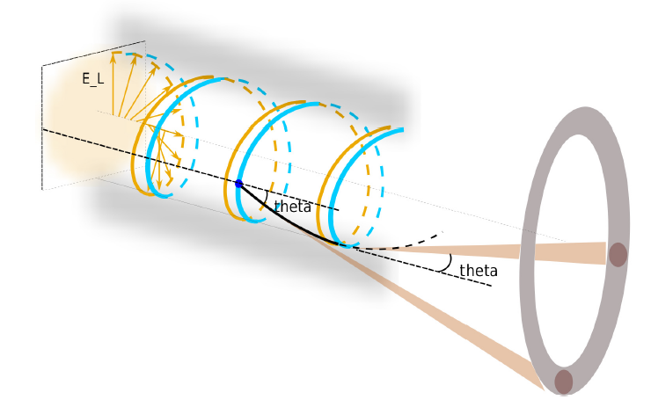
Nearly Critical Dense (NCD) plasmas for 10nC electron beam and brilliant γ ray emission
激光核物理，北京, 2016.6.23~25
X.Q.Yan, W.J.Ma, Y.B.Zou, W.B.Zhao, R.H.Hu, B.Liu, C.Lin, H.Y.Lu, Y.Y.Zhao, K.Zhu, Y.R.Lu , Z.Y.Guo, X.T.He , J.E.Chen
Institute of Heavy Ion Physics (IHIP) && Center of Applied Physics and Technology (CAPT), Peking Univeristy, China
Notes:
Manuel has introduced GeV Carbon Beam in the experiments.
I am going to tell you the GeV mono-energetic proton beam generation by laser plasma interactions.
And pay more attention: how to decrease the energy spread of ion beam, which is an essential requirement in many application.

Slide 2
Outline
Laser driven gamma beam (MeV)
Laser Synchrotron X/Gamma ray in NCD plasma
NCD to enhance the particle acceleration
Recent progress at Peking University
Notes:
After introduction, I try to explain yhy PSA can generate monoenergetic ion beam?
In a real situation, although are Multi-dimensional effects and instabilities,
we can still generation GeV mono-energetic proton beam in PSA regime.

Slide 3
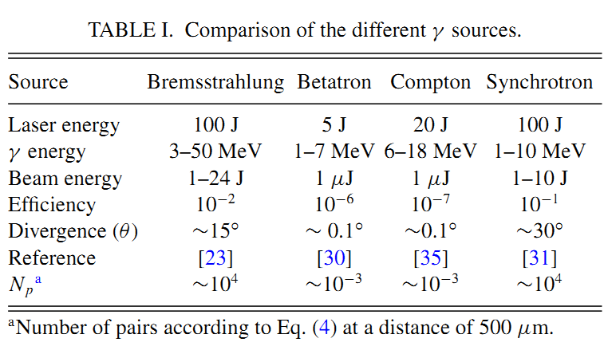
INTENSE COMPACT SOURCES OF MEV PHOTONS
>10^21W/cm2
X. Ribeyre,..., V. T. Tikhonchuk, PHYSICAL REVIEW E 93, 013201 (2016)
Notes:
Pair creation in collision of gamma-ray beams produced with high-intensity lasers

Slide 4
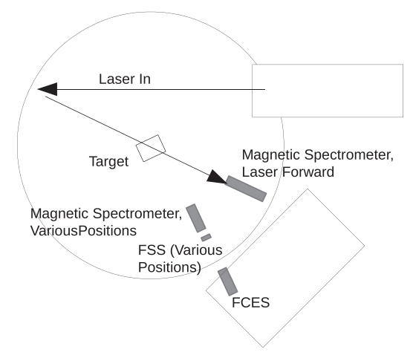
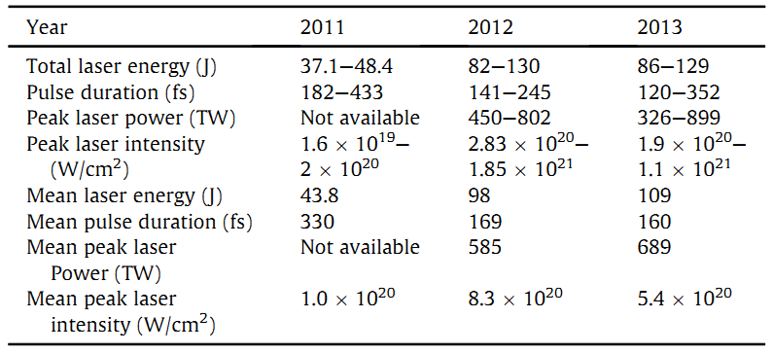
Bremsstrahlung
Henderson, A., et al., HIGH ENERGY DENSITY PHYSICS, (2014).

Slide 5
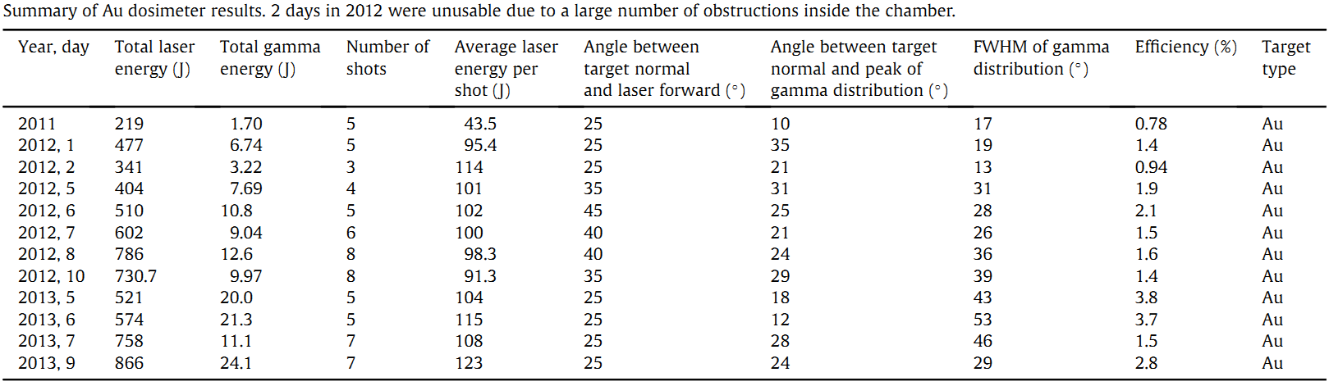
Bremsstrahlung
Henderson, A., et al., HIGH ENERGY DENSITY PHYSICS, (2014).

Slide 6
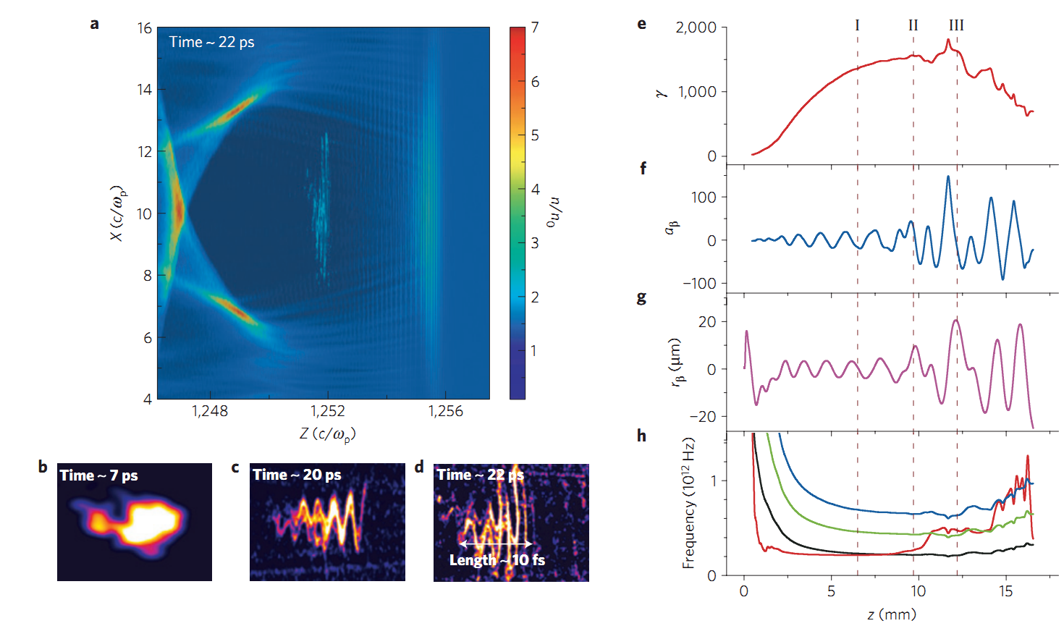

Betatron
Cipiccia, S., et al., NATURE PHYSICS, (2011).
Notes:
A=2

Slide 7
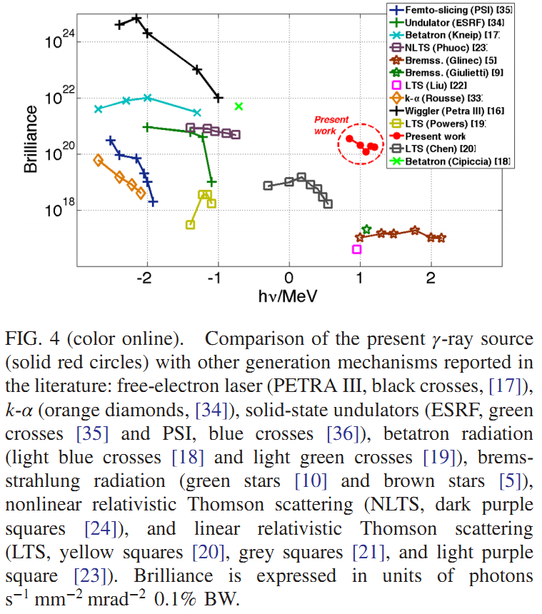
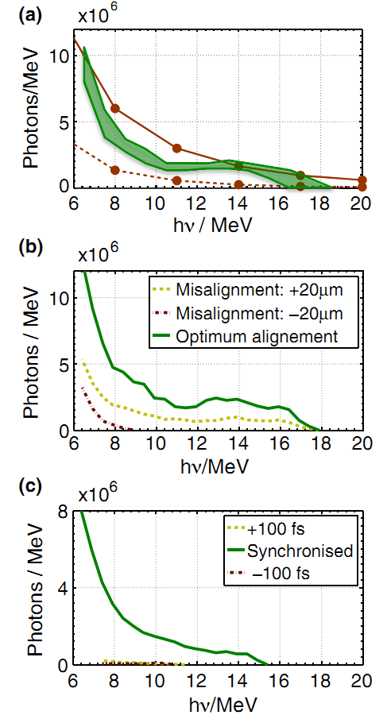
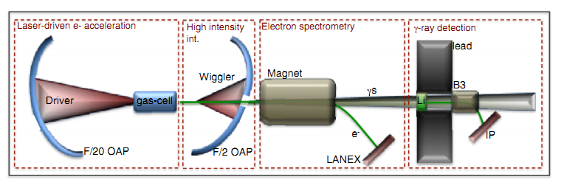
nonlinear relativistic Thomson scattering
Sarri, G., et al., PHYSICAL REVIEW LETTERS, (2014).
Notes:
A=2

Slide 8
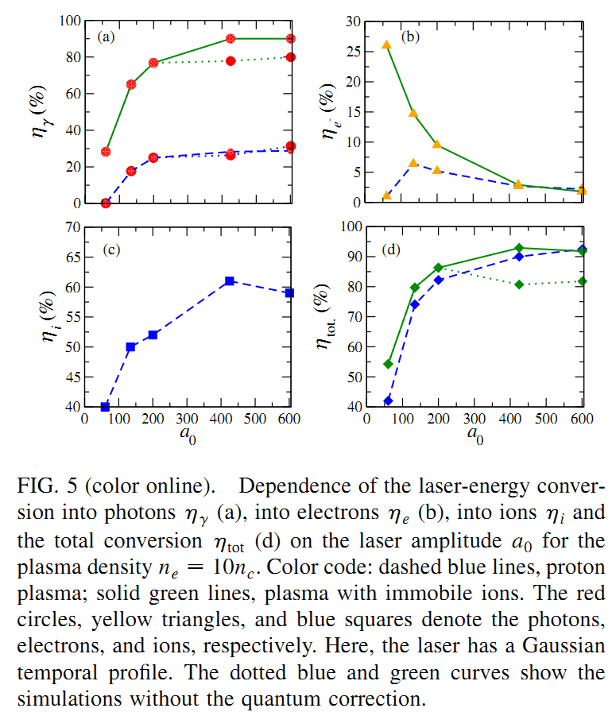
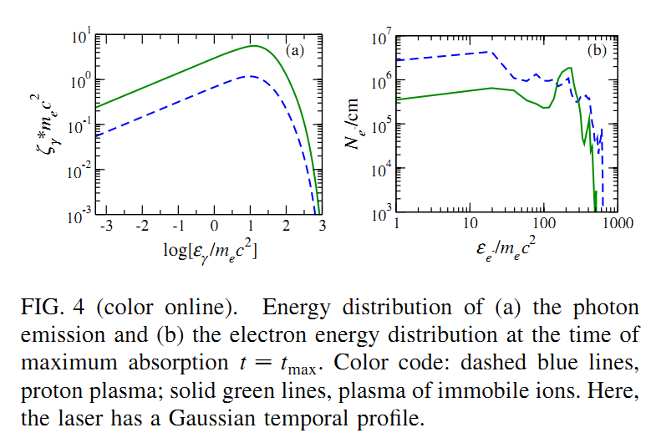
Synchrotron
Capdessus, R., E. D'Humieres and V.T. Tikhonchuk, PHYSICAL REVIEW LETTERS, (2013).
Notes:
A=200 10nc 100lambda

Slide 9
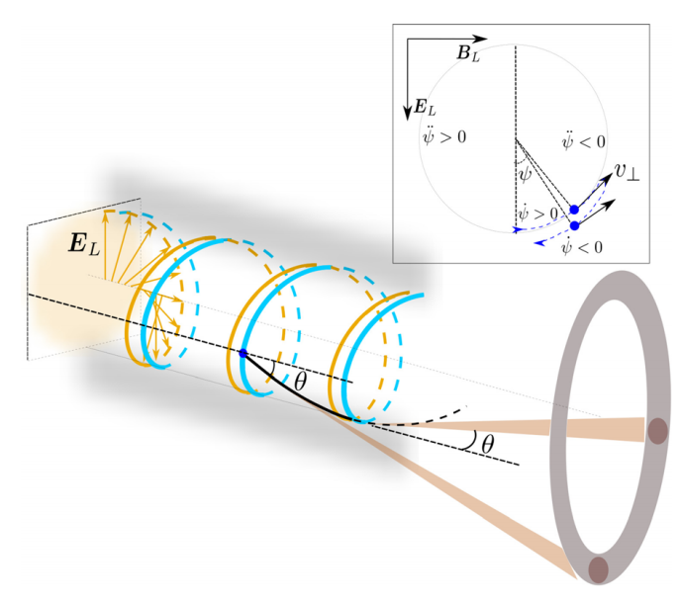
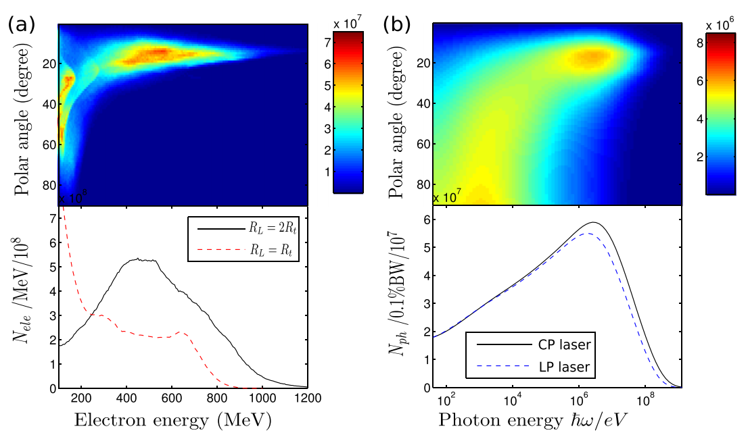

Synchrotron
Liu, B., et al., PHYSICS OF PLASMAS, (2015).

Slide 10
Outline
Laser driven gamma beam (MeV)
Laser Synchrotron X/Gamma ray in NCD plasma
NCD to enhance the particle acceleration
Recent progress at Peking University
Notes:
After introduction, I try to explain yhy PSA can generate monoenergetic ion beam?
In a real situation, although are Multi-dimensional effects and instabilities,
we can still generation GeV mono-energetic proton beam in PSA regime.

Slide 11
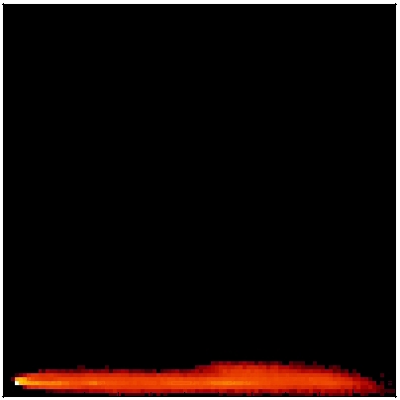
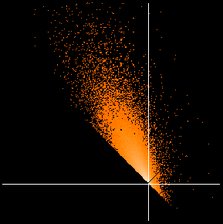
How do the electrons gain energy?
Short pulses (< λ_{p})
e
Laser Wakefield
Acceleration
(short pulses)
d_{t} p = e E + v × B
c
d_{t} p²/2 = e E • p = e E|| p|| + e E⊥ p⊥
Γ⊥
0 10⁴
Direct Laser Acceleration (DLA)
Gain due to transverse (laser) field:
0 10⁴
Γ||
Long pulses (> λ_{p})
⎧
Γ⊥ = 2 e E⊥ p⊥dt
Direct Laser
Acceleration
(long pulses)
⎭
Wake Acceleration
Gain due to longitudinal (plasma) field:
Γ⊥
0 2x10³
⎧
Γ|| = 2 e E|| p|| dt
⎭
MtV courtesy
-2x10³ 0 10³
Γ||

Slide 12
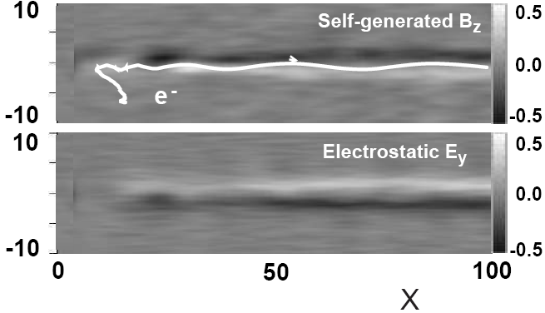
Direct Laser Acceleration or IFEL
B
E
space charge
n = e(1-f)n₀
j = efn₀c
Radial electron oscillations
Direct Laser Acceleration
Betatron acceleration (inverse FEL)
electron
momenta
Pukhov,MtV, Sheng, Pop, 6, 2847 , 1999

Slide 13
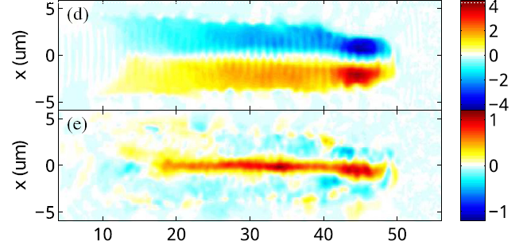
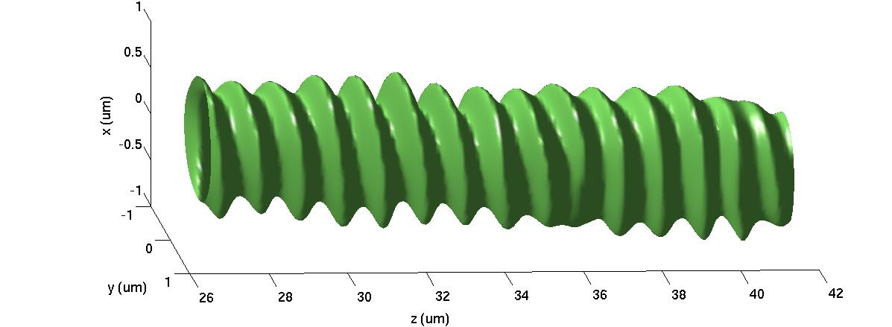
Azimuthal and axial magnetic fields are generated
circularly polarized laser in uniform NCD
Looks like a Solonoid

Slide 14
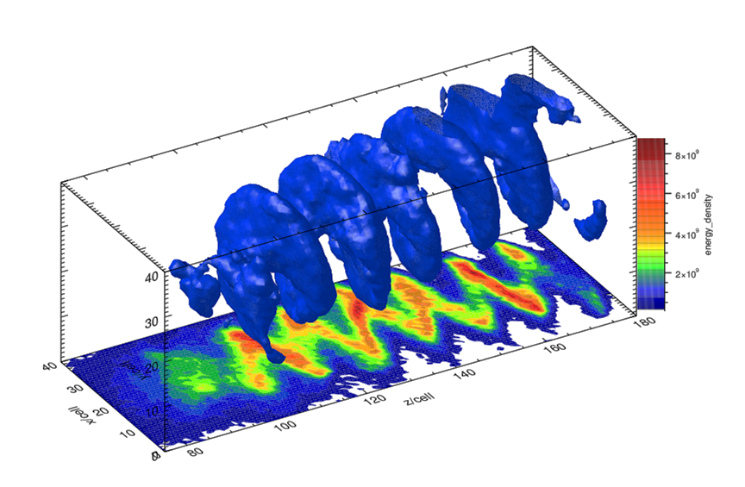
Self Matching Resonance Acceleration
In near critical density (NCD) plasma ponderomotive force drives high density electron (~10nC charge).
resonance acceleration occurs in betatron frequency ω_{β}=ω_{L}, where ω_{L} =(1-v_{z}/v_{ph})ω_{0,} ω₀ laser frequency in vacuum, v_{z} and v_{ph} are axial and phase velocity in plasma respectively.
B. Liu et al., PRL 110, 045002(2013)

Slide 15
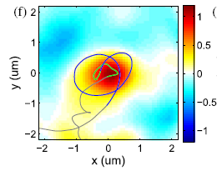
SMRA resulted hundreds MeV electrons
电子一旦被俘获，会自动找到共振的相位和频率！
逆自由电子加速过程IFEL!

Slide 16
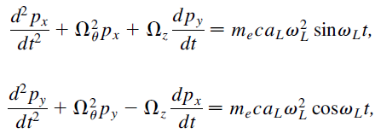






Self-matching resonance acceleration in interaction of CPL with NCD plasma
2D analysis of test particle under laser field
Relativistic equations for slowly varying electron momentum.
[ B. Liu et al., PRL 110, 045002(2013)

Slide 17

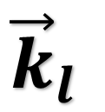


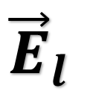

Why the electron beam is overdense?
$${\vec{E}}_{l}$$
ponderomotive phase
$ψ=θ−φ_{l}$
$$ψ$$
$${\vec{k}}_{l}$$
$$\vec{R}$$
Notes:
C图中红色虚线为数值计算得到的粒子轨迹，对应D中相同颜色的粒子，实线为PIC粒子追踪得到的电子的相轨迹。

Slide 18
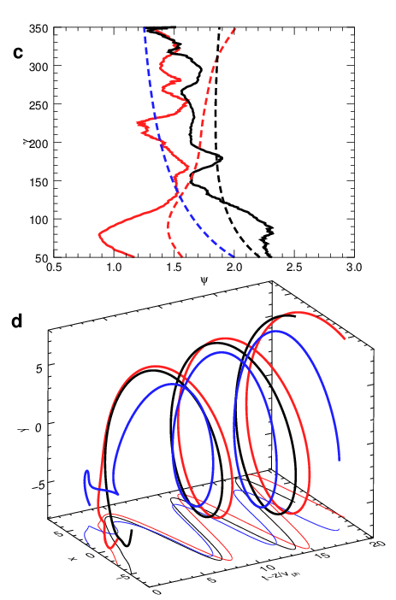
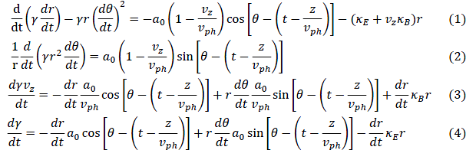

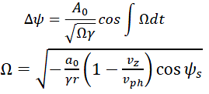
Why the electron beam is overdense?
电子稳相加速
Electron phase stability acceleration in NCD

Slide 19
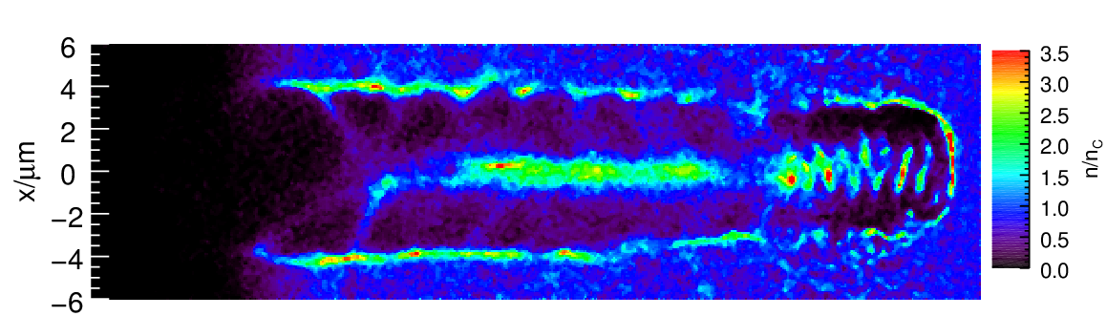
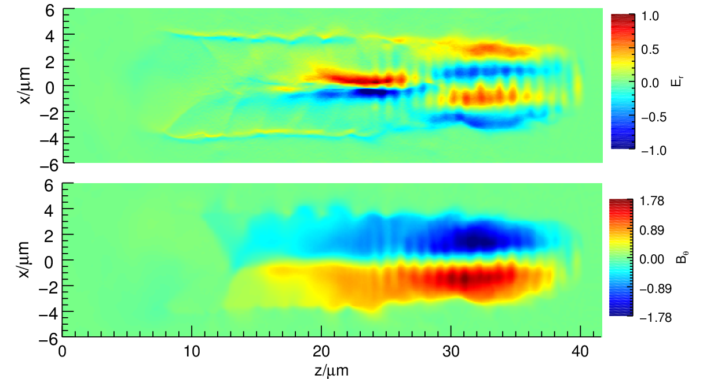

PIC Simulations
Circularly Polarized Laser
$a_{0}\sim 10, E\sim 100MeV$
$a_{0}\sim 100, E\sim 1000MeV$
Relativistic transparent plasma
Notes:
图中激光的位置在33-40微米。第一个图是电子密度，第二和第三幅图是磁场大小。

Slide 20

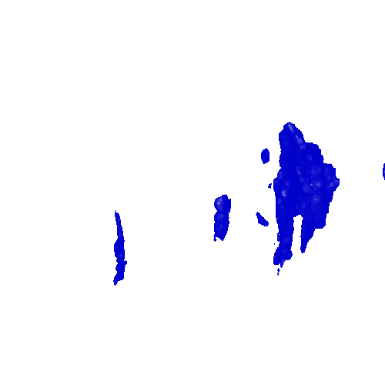

Slide 21
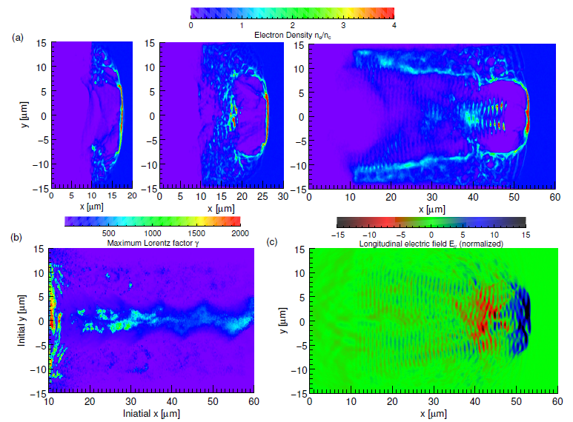
monoenergetic beam in Hybrid Acceleration Regime (DLA+Wake)
R.H.Hu,B.Liu, et al., srep, 2015

Slide 22
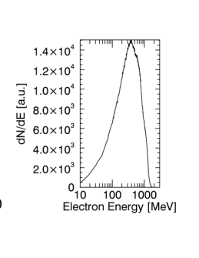
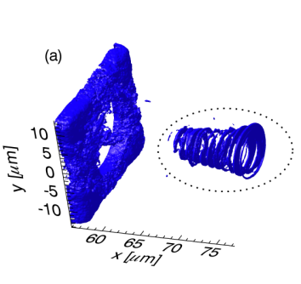
0.5GeV 10 nC quasi-monoenergetic electrons
I~10^22W/cm2, 50T, n=5.5*10^20/cm3
R.H.Hu,B.Liu, et al., srep, 2015

Slide 23
Outline
Self Matching Resonance Acceleration in NCD
Laser Synchrotron X/Gamma ray in NCD plasma
NCD to enhance the particle acceleration
Recent plan at Peking University
Notes:
After introduction, I try to explain yhy PSA can generate monoenergetic ion beam?
In a real situation, although are Multi-dimensional effects and instabilities,
we can still generation GeV mono-energetic proton beam in PSA regime.

Slide 24
electron distribution and motion (radiation).
B.Liu, R.H.Hu, et al., submitted, 2014

Slide 25
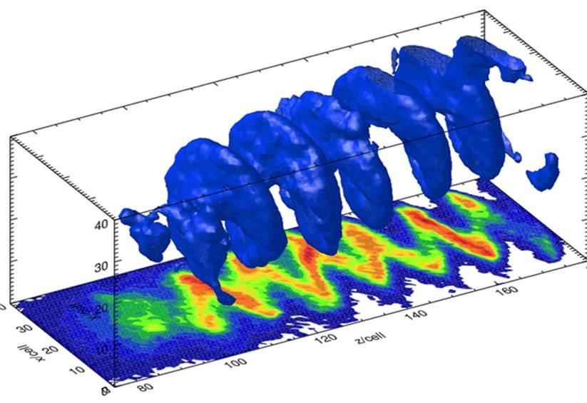

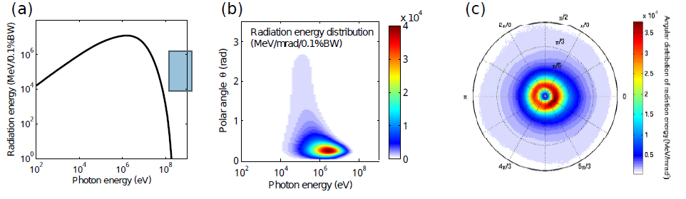
Laser Synchrotron Gamma photon
100MeV
MeV photon
B.Liu, et al.,to be submitted(2013)
Liu, B., et al., PHYSICS OF PLASMAS, (2015).

Slide 26


Scaling of photon energy and number

Slide 27
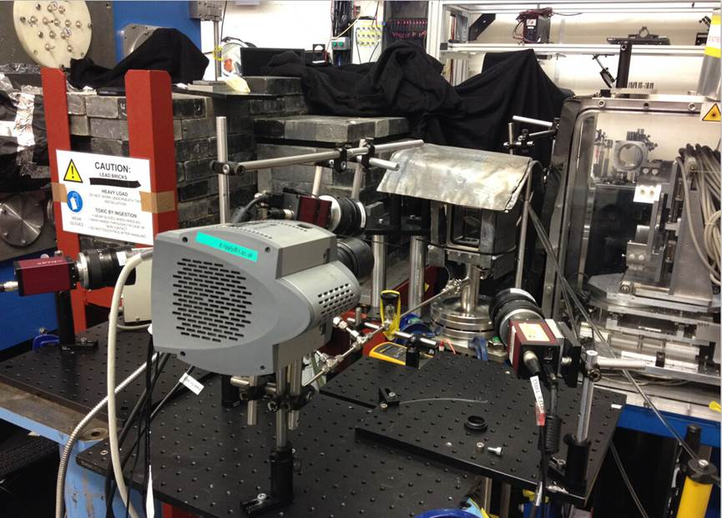
The experiment conditions and results @ RAL
3
RAL, Gemini Laser
a~10, n~0.4 nc
MeV photons
observed
2
1
PKU: Novel Bubble Chamber gamma spectrum

Slide 28
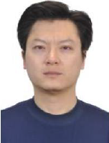
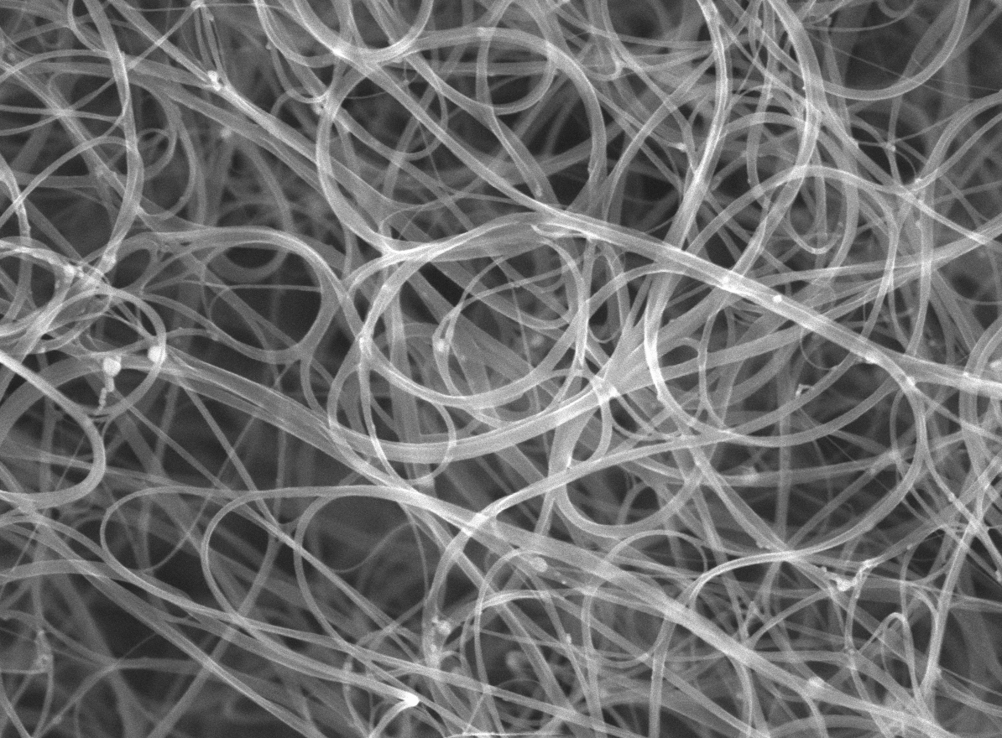



利用碳纳米管泡沫产生超薄临界密度等离子体
碳纳米管泡沫：~1%固体密度，微米尺度高度均匀，激光预脉冲电离后可形成超薄临界密度等离子体，可作为相对论非线性光学器件。
10²⁰ W/cm²
1μm
$$n_{e}/n_{c}$$
pulse contrast
10²
10¹
10⁰
10⁻¹
10⁻²
10¹¹ W/cm²
$$x$$
~ tens of nm

Slide 29
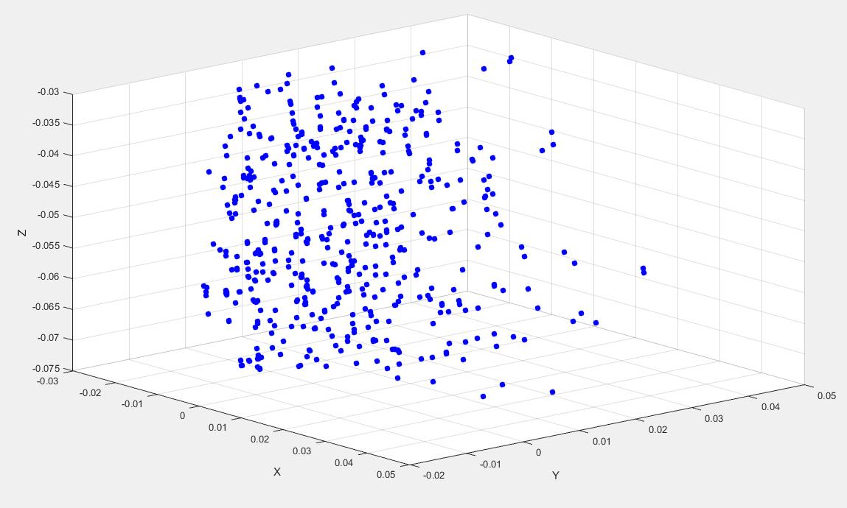
IV. The method to reconstruct the bubbles in 3-D

Slide 30
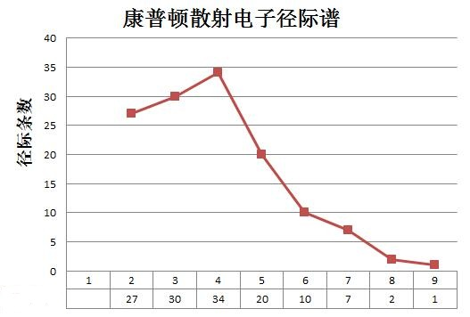
V. Our instruments and energy spectrum analysis
NO. 113822

Slide 31
Outline
Self Matching Resonance Acceleration in NCD
Laser Synchrotron X/Gamma ray in NCD plasma
NCD to enhance the particle acceleration
Recent plan at Peking University
Notes:
After introduction, I try to explain yhy PSA can generate monoenergetic ion beam?
In a real situation, although are Multi-dimensional effects and instabilities,
we can still generation GeV mono-energetic proton beam in PSA regime.

Slide 32
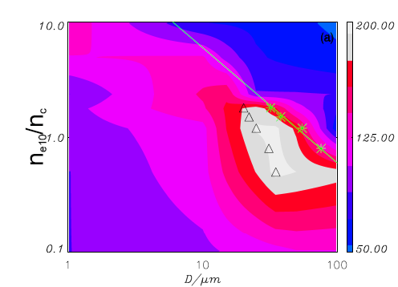
200MeV proton generated by NCD+ nm foil
30fs,10^20W/cm2，～30J
NCD
Plasma lens
Nm foil
H.Y.Wang,C.Lin et al., PoP, 20, 013101 (2013)

Slide 33
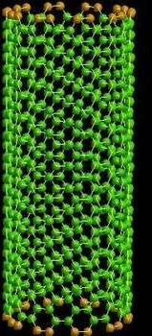
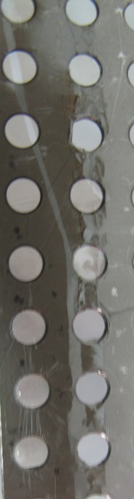
Recent experiments at RAL-Gemini
nanotube＋DLC
Physical Review Letters 115, 064801 (2015)

Slide 34
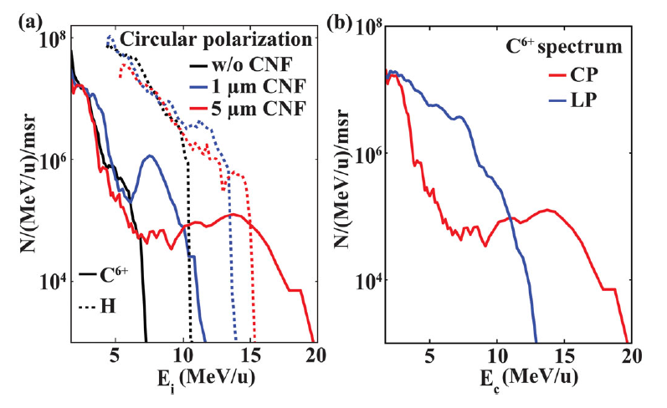
1) 碳纳米管泡沫+类金刚石纳米薄膜复合靶实现高效离子加速
μm厚度
碳纳米管泡沫
nm厚度
类金刚石薄膜
三倍离子能量增益
J.H.Bin*, W.J.Ma*,H.Y.Wang, X.Q.Yan et. al. “Ion Acceleration Using Relativistic Pulse Shaping in Near-Critical-Density Plasmas”. Physical Review Letters 115, 064801 (2015).

Slide 35
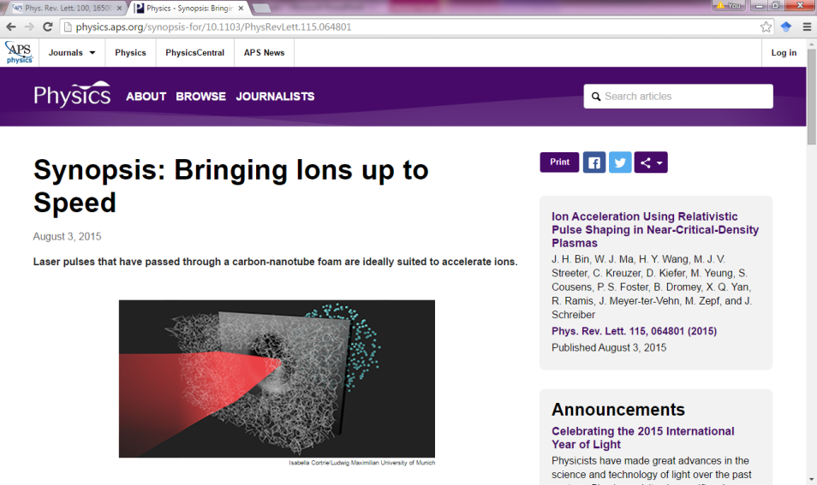
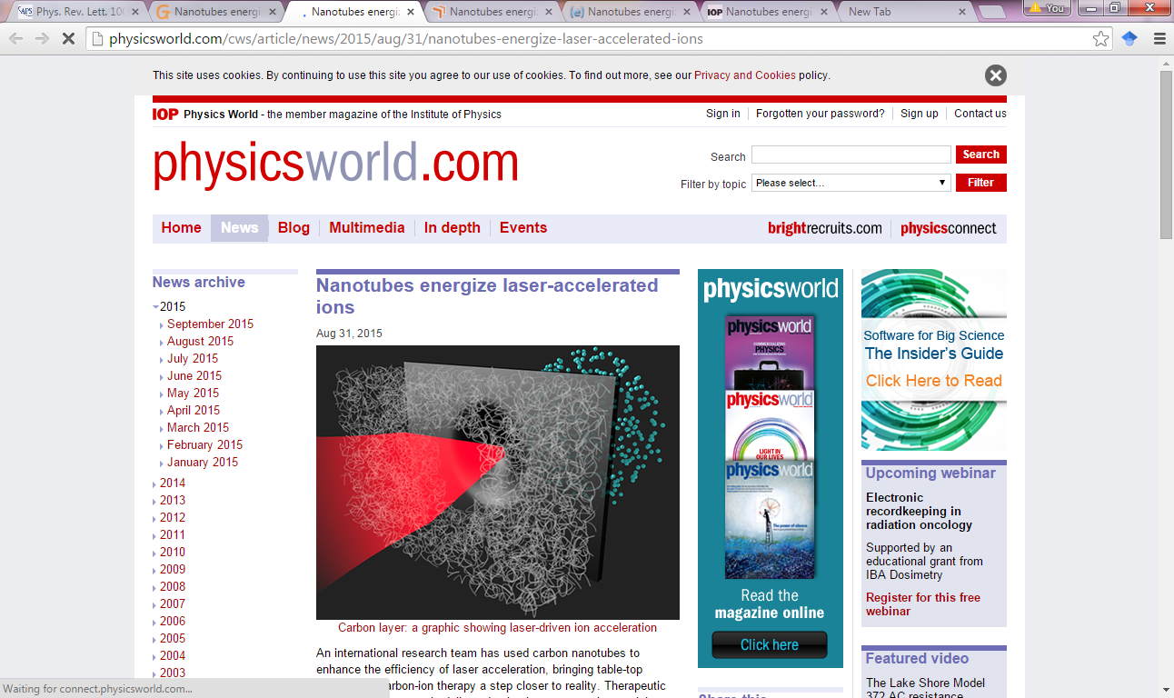
PRL editor selected
APS news: “Synopsis : bringing ions up to speed”
IOP physicsword: “Nanotubes energize laser-accelerated ions”

Slide 36
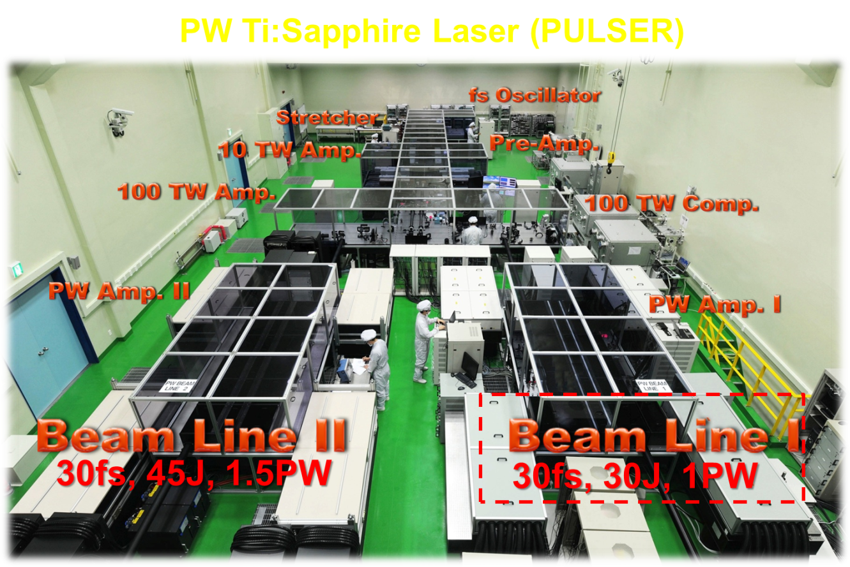

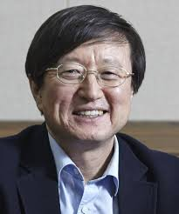

2)飞秒激光驱动碳离子加速新纪录
1.5 PW laser (PULSE) in Center for Relativistic Laser Science(IBS), Korea
PI：
X. Q. Yan
C.H. Nam
25fs-30fs,
Double plasma mirror, 9.2J on targets for LP,
I = 5.45x10²⁰ W/cm²
2015.03

Slide 37
Carbon Nano-Tube (as NCD lens) + DLC foil
Experiments were performed using the CoReLS PW Laser in Korea (Prof.C.H.Nam).
Proton ~60MeV
Carbon ~600MeV
Cutoff energy of protons/carbons for linear polarization
By Yan, Ma, Lin, Schreiber, Zepf, Kim && Nam et al.,

Slide 38
Outline
NCD to enhance the particle acceleration
Self Matching Resonance Acceleration in NCD
Laser Synchrotron X/Gamma ray in NCD plasma
Recent plan at Peking University
Notes:
After introduction, I try to explain yhy PSA can generate monoenergetic ion beam?
In a real situation, although are Multi-dimensional effects and instabilities,
we can still generation GeV mono-energetic proton beam in PSA regime.

Slide 39
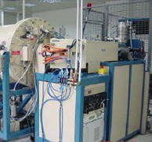






Institute of Heavy Ion Physics @Peking U. China
4.5 MV electrostatic
2*6 MV tandem, AMS/material
AMS facility
RFQ neutron radiography
2*1.7MV tandem
accelerator physics
In 2007, upgraded to
SKL of Nuclear Physics and Technology
nuclear physics
Found in 1983
ion beam physics
medical physics and imaging
39
Linac
Laser accelerator
Notes:
39
加速器是核科学中的核心工具！

Slide 40
Compact LAser Plasma Accelerator (CLAPA )
>15MeV (100MeV) laser-driven proton accelerator based on RPA/PSA mechanism
~10M$, Project of the Chinese Ministry of Science and Technology (MOST)
High contrast (> 10¹⁰), high focus intensity (>10²⁰W/cm²) fs laser system
Nanometer-thickness target manufacture system
Proton generation, transportation and diagnosis
Proton irradiation research platform
System integration and control program Development
40
Notes:
40
得到国际承认的新理论、应对挑战的新技术；强激光技术、加速器技术与 ICF 人员结合的优势

Slide 41

激光加速器实验室

Slide 42



国家科技部重大仪器专项（2012YQ0312）
北京大学激光加速器（示意图到装置）
CLAPA Laser （激光参数）
Pulse Energy: | 5 J
Pulse Duration: | < 25 fs
Wavelength: | 800 nm
Contrast Ratio: | 10¹⁰:1 @ 100 ps 10⁹:1 @ 20 ps
 | 10⁶:1 @ 5 ps
新型光源（FEL）束线
Betatron beam
三代光源线
Animal Irradiation
动物肿瘤辐照终端
Laser激光

Slide 43


Compact LAser Plasma Accelerator (CLAPA) at PKU
15-100MeV proton
Heavy ion
Gamma ray
Novel light source
fs neutron
QED

Slide 44








Acknowledgement
C.Lin, H.Y.Lu, Y.Y.Zhao, Y.X.Geng, K.Zhu, Y.B.Zou, Y.R.Lu , Z.Y.Guo, X.T.He , J.E.Chen
MPQ/LMU: J. Meyer-ter-Vehn , D.Habs, J. Schreiber, A.Henig, W.J.Ma, J.H.Bin
SHJU/IOP: Z.M.Sheng, Y.T.Li, J.Zhang
IZEST/UCI: T.Tajima
Ecole Polytech: J.Fuchs
Jena Uni. H.Y.Wang, M.Zepf
IAPCM: B.Liu, J.Liu

Slide 45







PKU CLAPA group
马文君 研究员
（千人计划）
林晨 研究员
（百人计划）
卢海洋 研究员
（百人计划）
邹宇斌
副教授
博士后1名
研究生15-20名
袁忠喜
（教授高工）
赵研英
（工程师）
朱昆
（高工）

Slide 46
谢谢倾听
感谢支持
  国家自然科学基金委
  科技部
  高技术
  XX专项

