Slide 1
上海光源激光伽玛射线站的建立
张焕乔
（中国原子能科学研究院）

Slide 2
同意设计报告提出的科学目标
1）核天体物理
2）光致核反应
3）核结构
4）极化物理
5）介子物理
6）空间γ辐射总剂量效应
7）γ探测器精确标定

Slide 3
建立一台能区在03-15.5Mev和250-417Mev，单色性~5%，γ光子通量在105-107光子/秒（低能）和106光子/秒（高能），发散度~0.5mrad的偏振γ线站，是发展我国核物理所需要的重要设备，提出的指标是切实可行的，本人大力支持该项目的实施。

Slide 4
The aim of nuclear astrophysics is to work with astrophysics modellers and observational astronomers to:
Understand the abundance pattern of the elements that we see around us and understand the nuclear reaction processes that have created them and the astrophysical sites where these occur (stars or explosive sites like novae, X-ray bursters, supernovae etc.)
Develop models to describe these sites and test the predictions against measurements of element abundances and energy output (optical or gamma observations or pre-solar grains
Nuclear
Reaction rates
Observational
Tests
Astrophysical conditions
(pressure, temperature
and abundances)
Abundances
+
Light Curves
MODEL
Hydrodynamical
development

Slide 5
This effort requires an effective collaboration between the different scientific fields
Astronomers
Observe astrophysical sites and
measure energy output and
element abundances
Astrophysicists
Develop models of the sites in
terms of the material dynamics
and nuclear reactions
Nuclear Physicists
Measure, or if not feasible then
calculate, the necessary
reaction rates or decay rates

Slide 6
Often challenges emerge related to the model development
Studying the effect of including new physics into the models is compromised because the uncertainties in the nuclear reaction rates are so big that they mask the effects
Notes:
2-D simulations of mixing at the core-envelope interface during nova outbursts (from Casanova et al. (2010), A&A, in press).

Slide 7
But which reactions are the problem and so need to be measured?
Run sensitivity studies with models to see which reactions have the largest effect on the energy generation or element synthesis. These are the ones for which accurate reaction cross sections are needed.
Novae
X-ray Bursts

Slide 8
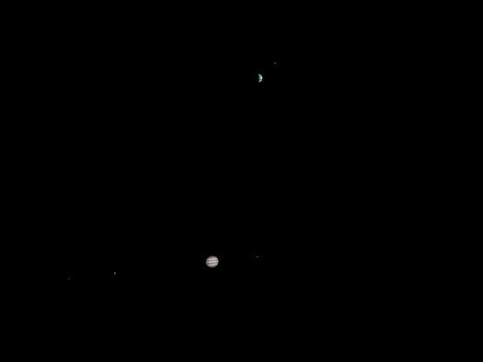
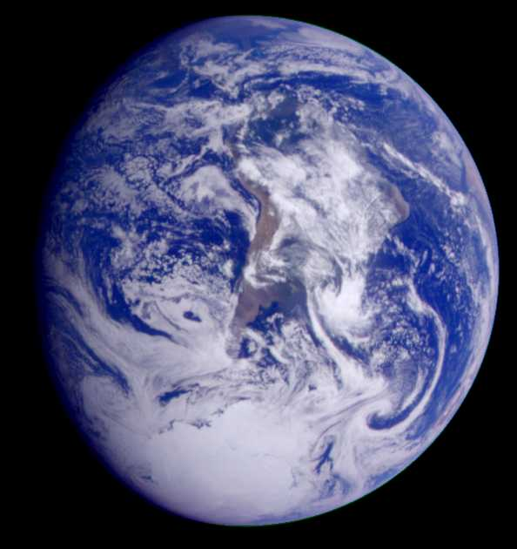
Plan: new study of ¹²C(α,γ)¹⁶O
3. A Technique to measure ¹²C(α,γ)¹⁶O

Slide 9
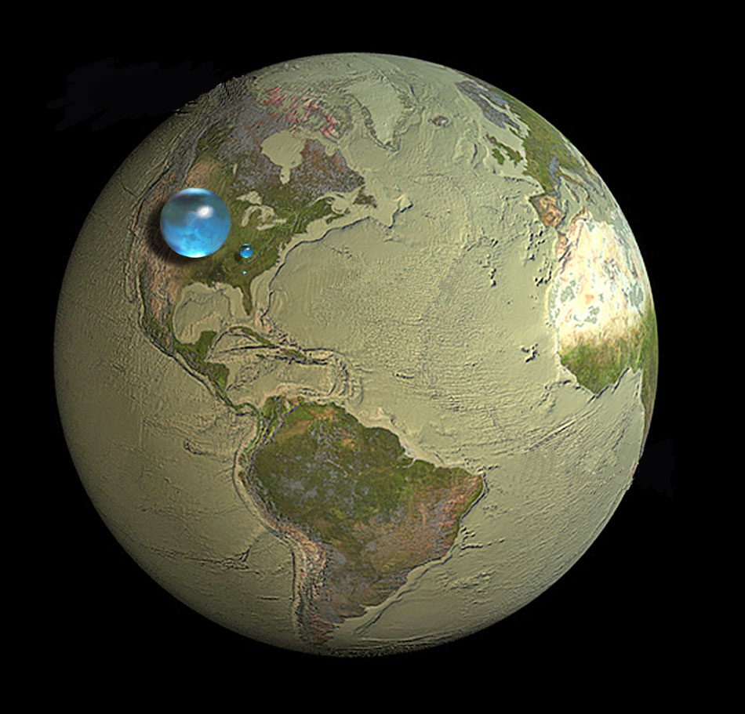
Plan: new study of ¹²C(α,γ)¹⁶O

Slide 10
α(¹²C,¹⁶O)γ
Goal
1 fb

Slide 11
¹²C(α,γ)¹⁶O
‘High’ intensity α-beams
‘thin’ targets
‘Low’ detection efficiency
R. Kunz, thesis, 2002
Luminosity= I t ε ~ 10³¹/(sec cm²)
(1 count/day/1 pb)

Slide 12
Step 1: Measure the time-inverse reaction: ¹⁶O(γ,α)¹²C
Advantage:
Larger cross section for time-inversed reaction
Factor of 10² improvement
Disadvantage:
Lower beam intensities at the HIγS facility (10⁻⁶)

Slide 13
Step 2: Use a liquid target for the (γ,α) measurement (x 10⁶)
Advantages:
The γ’s (8-10 MeV) have a much larger range than charged particles (α or ¹²C)
use thicker targets (~10 g/cm² (e.g. water) vs. 10 μg/cm²) (10⁶)
Disadvantages:
Need a detector that is insensitive to γ’s but sensitive to charged particles (e.g. α’s)

Slide 14
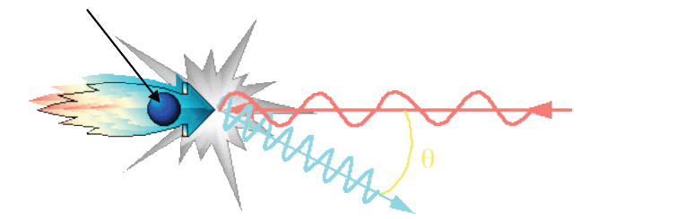
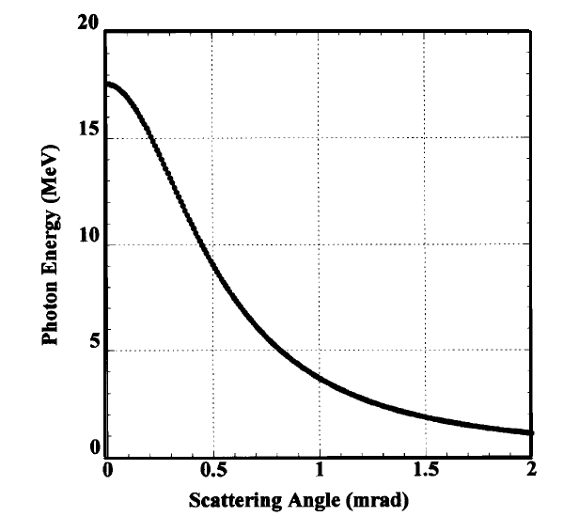
1. Accelerator: HIγS
Relativistic electron (E_{e})
I_{γ} ~ 10⁷⁻⁸ photons/sec
Laser light (λ_{L})
γ (E_{γ})
E_{γ}(θ)
ex. λ_{L}=1.064μm, E_{e}=800MeV
⇒ E_{γ} = 11MeV
θ

Slide 15
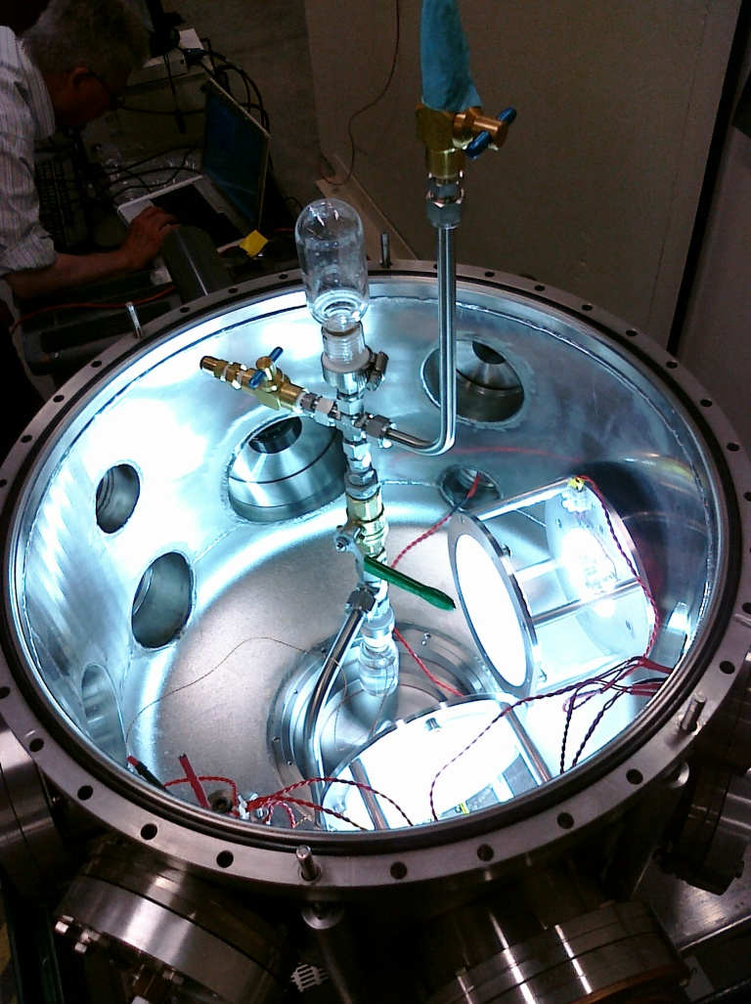
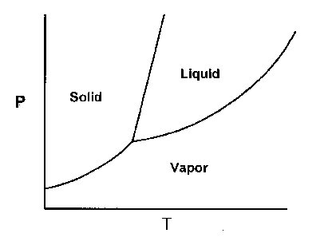
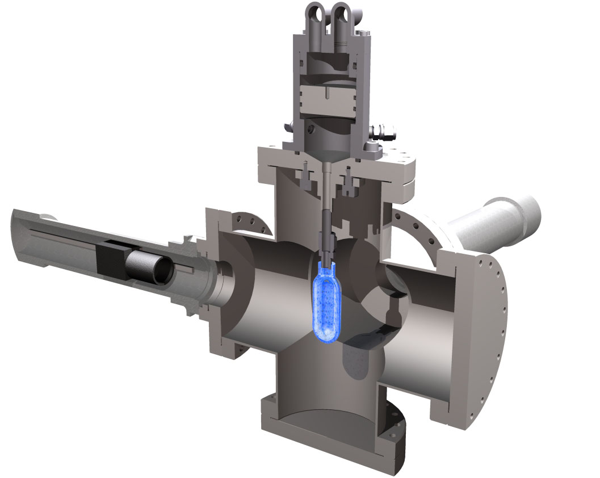
Proof of Principle of a superheated bubble chamber for the ¹⁹F(γ,α)¹⁵N reaction
P~ 1-6 atm T~20-50 C
2 fast cameras

Slide 16
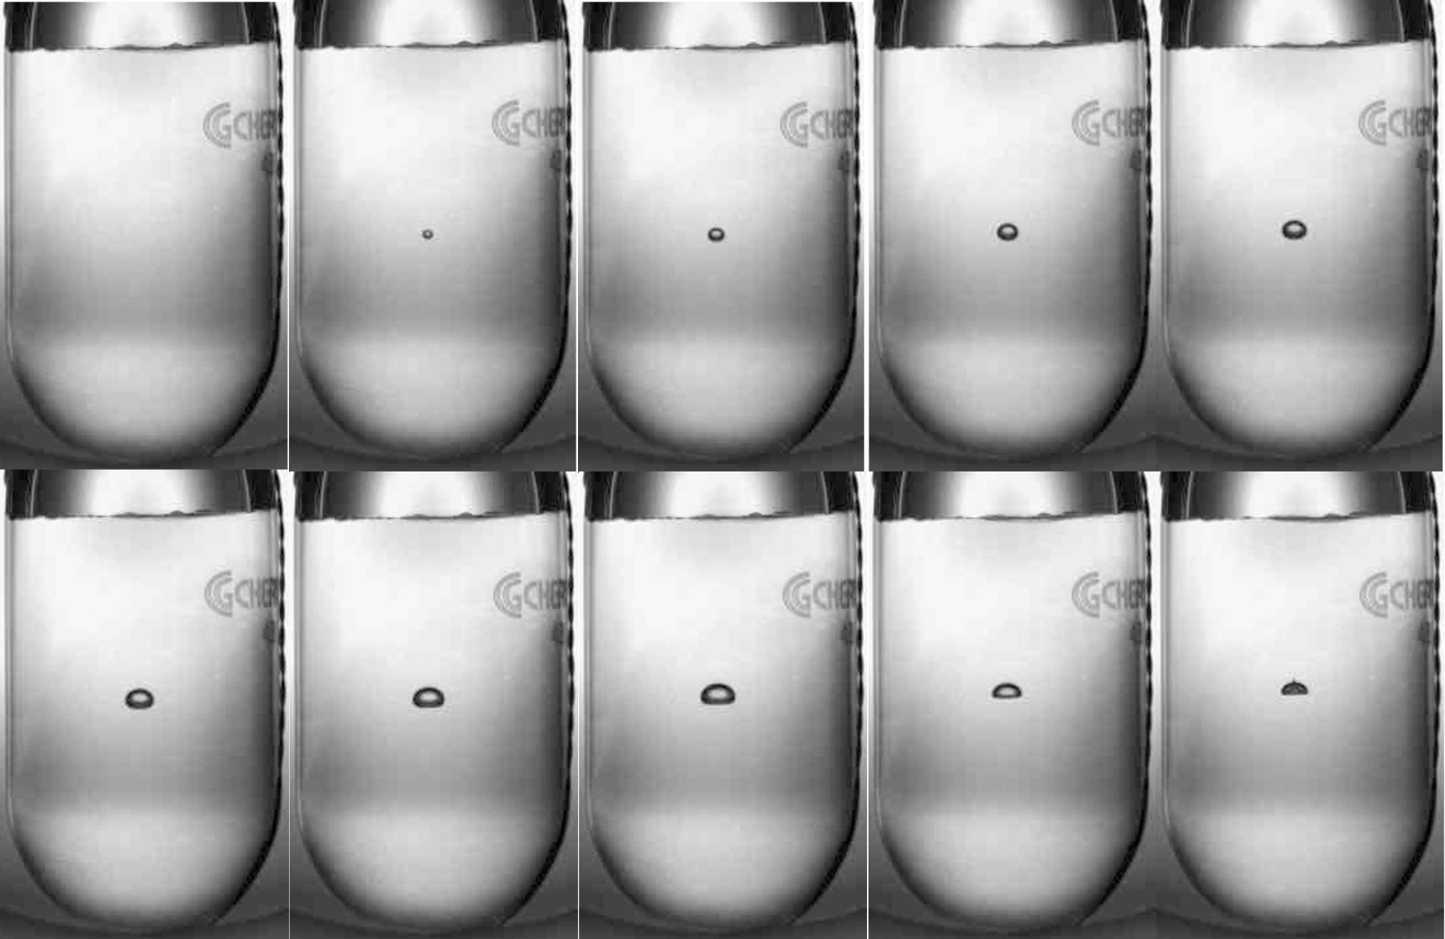
A ‘successful’ bubble
Δt=10 ms
beam
Dead time ~1-2 sec → detector for low count rates

Slide 17
Conditions for ¹⁹F(γ,α)¹⁵N in C₄F₁₀ E_{γ}=5-6 MeV
p

Slide 18
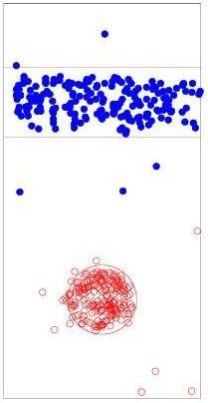
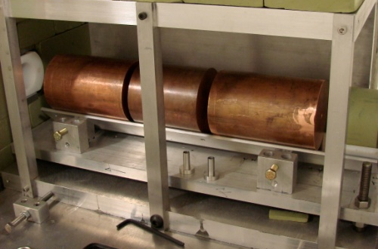

Position sensitivity in 3D
Cu collimator
Camera-2’
Camera-1’
2 fast cameras
Δx < 1 mm

Slide 19
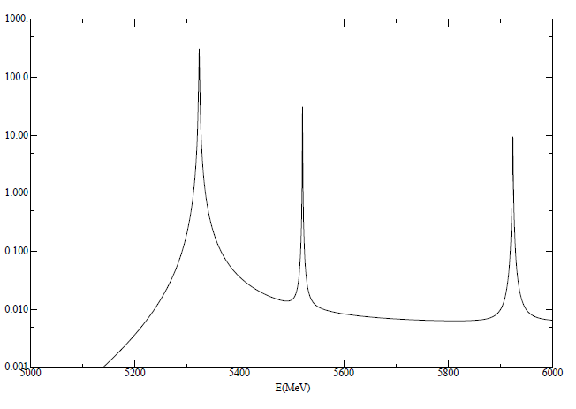
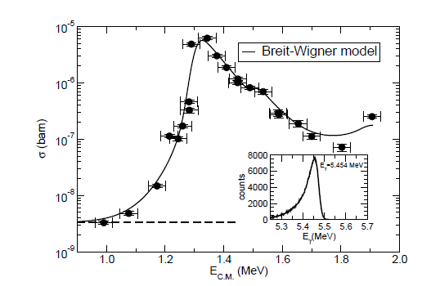
Theoretical spectrum of ¹⁹F(γ,α)¹⁵N from Breit-Wigner
Γ=1.3 keV
σ (μb)

Slide 20
Measurement of the ¹⁵N(γ,α)¹⁹F cross sections over 3 orders of magnitude with high efficiency
data
6 μb
2x10³ γ/sec
500 / hour
Breit-Wigner model using literature values for known resonances
xx
3 nb
3x10⁶ γ/sec
400 / hour
C. Ugalde et al. PLB 719, 74(2013)

Slide 21
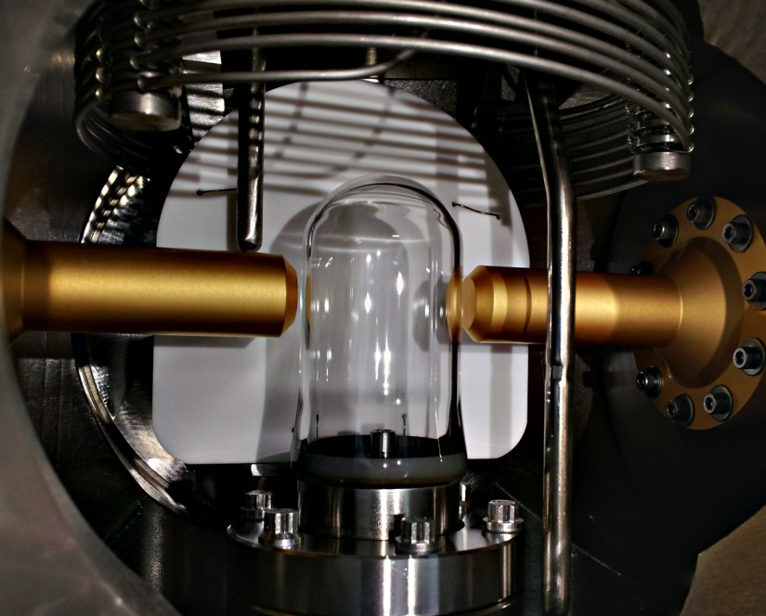
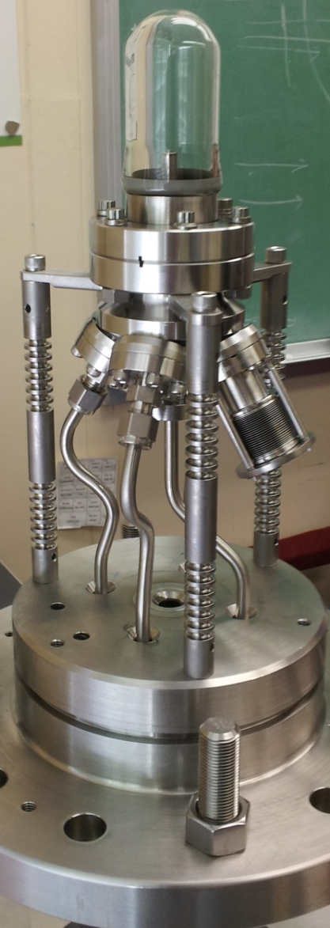

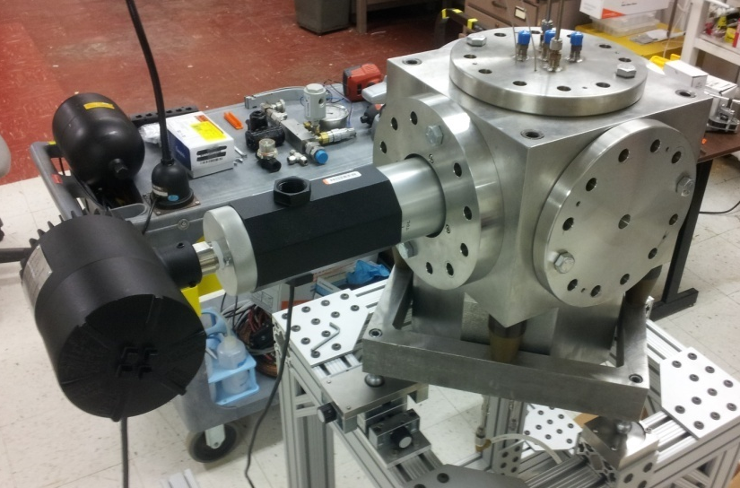
¹⁶O(γ,α)¹²C - Status of the H₂O bubble chamber
P~75 atm T=250 C more massive, more safety issues

Slide 22
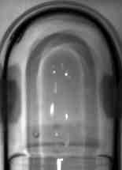
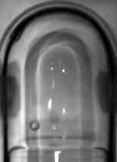

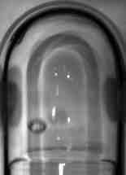
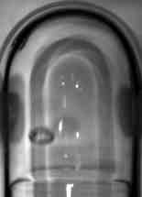
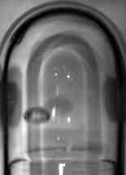
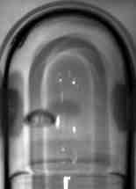

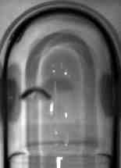
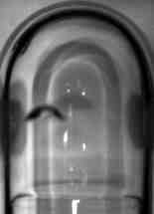
neutron-induced bubble in superheated H₂O (T=210C, 10 atm)

Slide 23
remaining problems
Purity: solubility of oil (¹²C) in water (use Ga-In-Sn as a buffer)
Purity of H₂O: ^{17,18}O, ²H (use enriched water)
Reactions of superheated water with glass
Higher intensity gamma sources

Slide 24
Thank you for your attention

