Slide 1
Overview of MDI design I
Sha Bai
CEPC AP meeting
2016-05-13

Slide 2
MDI outline
IR Layout
Solenoid compensation
Superconducting magnet
Background
Collimator
Shielding
Luminosity calorimeter
Vertex detector
Mechanics……

Slide 3
Machines
Double ring with crossing angle: BEPCII, SuperKEKB, FCC-ee, CEPC……
Single ring with pretzel: LEP, CESR, CEPC……
Linear collider: ILC, CLIC, TESLA……

Slide 4
Comparison of MDI design parameters
 | BEPCII | SuperKEKB | FCC-ee | CEPC
Energy | 1.89GeV | 4.0/7.0GeV | 175GeV | 120GeV
Crossing-angle | 22mrad | 83mrad | 30mrad | 30mrad
L* | 1m | 0.7m | 2.2m | 1.5m
Solenoid central field | 1.0T | 1.5T | 2T | 3.5T
Solenoid effective length | 3.68m | 2.4m | 12m | 7.6m

Slide 5
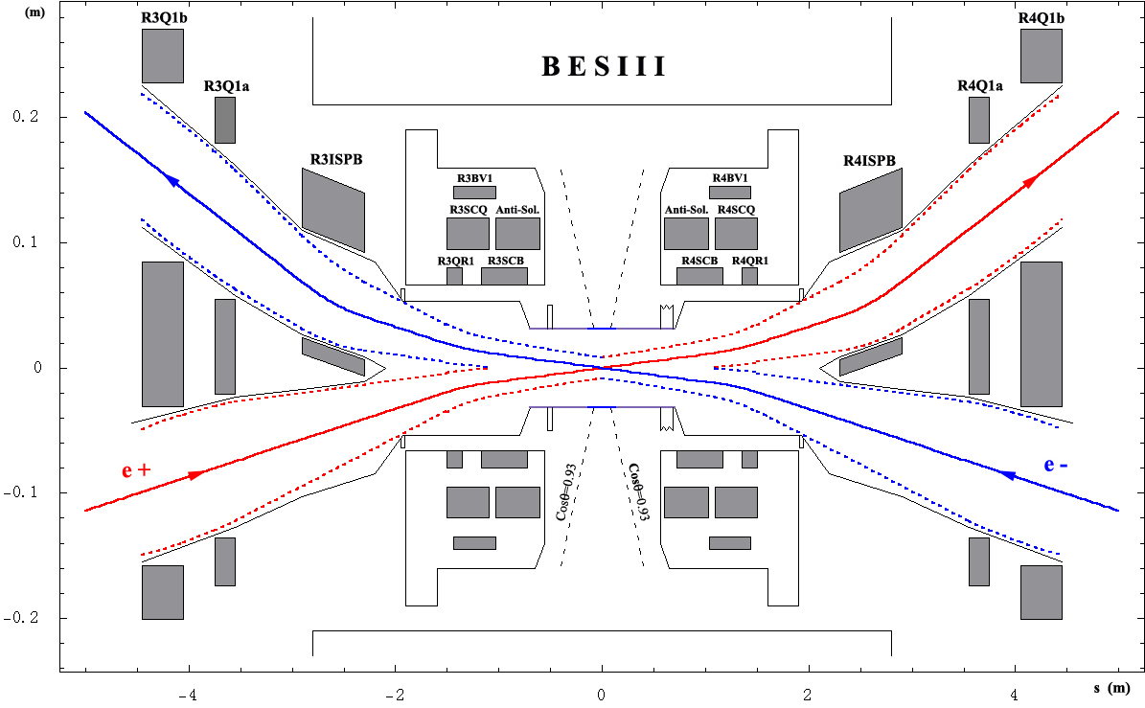
BEPCII
在对撞模式下，正、负电子束流以22 mrad的交叉角在对撞点对撞，然后穿越超导磁铁，在超导磁铁出口处两束流轨道中心分开的距离约为62 mm。为了进一步加大束流轨道的分离，在对撞点每一侧的内环都安装了一块切割型二极磁铁ISPB。在对撞区范围内内环的束流都是远离对撞点的，因此束流经过ISPB磁场偏转产生的同步光不会打在对撞点附近而引起本底问题。ISPB磁铁后面将安装水平聚焦四极铁Q1a和Q1b。由于受到了束流轨道分离量的限制，ISPB、Q1a和Q1b都必须设计为切割型磁铁。

Slide 6
BEPCII超导磁铁设计参数
北京谱仪的超导螺线管长约3.6 m, 其场强约为1.0 T。 它的存在将引起束流的水平和垂直方向振荡的耦合，使束流垂直尺寸增加，结果造成亮度下降。为了补偿谱仪螺线管场对束流的扰动，在加速器超导磁铁内设计有3个反螺线管（AS1，AS2，AS3）和1个斜四极磁铁。反螺线管AS1位于距对撞点0.63 m处，长约0.3 m, 场强为3.0 T （其场的方向与谱仪螺线管场方向相反），它用于抵消从对撞点到超导四极磁铁之前的谱仪螺线管场。反螺线管AS2将抵消在超导四极磁铁处的谱仪螺线管场，并使得超导四极磁铁范围内纵向场基本为零。反螺线管AS3位于超导四极磁铁之后，长约0.12m，它用于抵消谱仪螺线管的边缘场。超导磁铁内的斜四极磁铁则用以校正残余的耦合。
 | 场强B 梯度G | 线圈 内/外半径 (mm) | 距对撞点 (mm) | 总长度(mm) | 有效长度(mm)
反螺线管 AS1,2,3 | --- | 95.1/105.9 | 630~933 | 303 | --
 | --- | 115.4/119.0 | 1035-1381 | 346 | --
 | --- | 102.3/105.9 | 1474-1590 | 116 | --
SCQ | 18.744 T/m | 95.1/108.1 | 961-1457 | 496 | 400
SCB HDC | 0.543 T 0.056 T | 108.5/111.8 | 633-1307 | 674 | 400
垂直校正子 VDC | 0.059 T | 111.9/113.5 | 904~1514 | 610 | 380
斜四极子 SKQ | 0.937 T/m | 113.6/115.2 | 954~1464 | 510 | 400

Slide 7
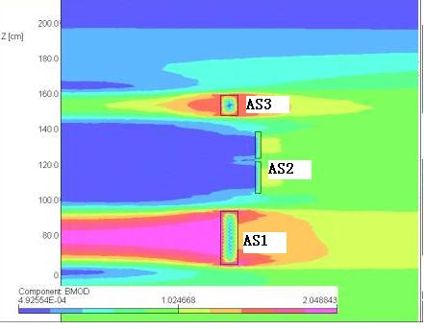
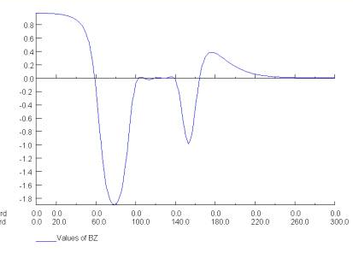
反螺线管AS1，AS2，AS3附近的磁场分布
沿谱仪中心线的纵向积分磁场分布

Slide 8
IR of SuperKEKB
Interaction region of the SuperKEKB. The two cryostats, QCS-L and QCS-R, are assembled inside of the Belle detector. The superconducting solenoid of the Belle detector is shown by the red rectangles.

Slide 9
Solenoid compensating in SuperKEKB
Magnet Parameters of Compensation Solenoids
Bz profile along the Belle axis in the interaction
region by 2D calculation.

Slide 10
IR of FCC-ee

Slide 11
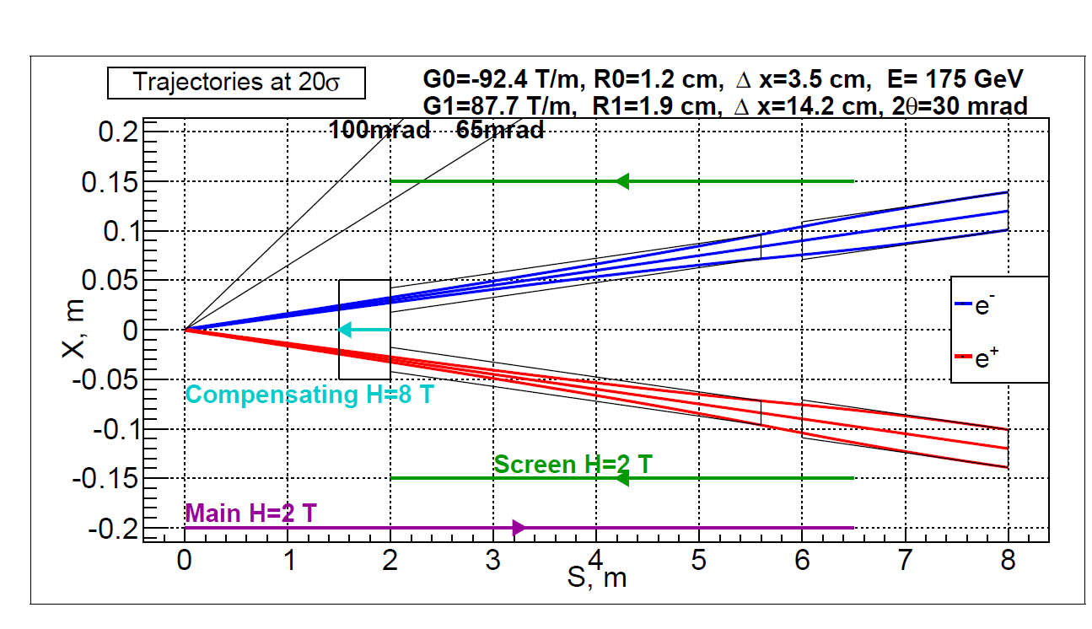
FCC-ee solenoid compensation
Final quads
Main detector solenoid
2
1
Quad screening solenoid
4
3
Compensating solenoid
1 – Half of main solenoid length ( 1 m)
2 – Length of compensating solenoid (0.7 m)
3 – Overlap of compensating and screening solenoids (5 cm)
4 – Length of screening solenoid ( 3.95 m)
Transverse half size:
- compensating solenoid - R = 0.1 – 0.15 m
- screening solenoid - R = 0.15 m

Slide 12
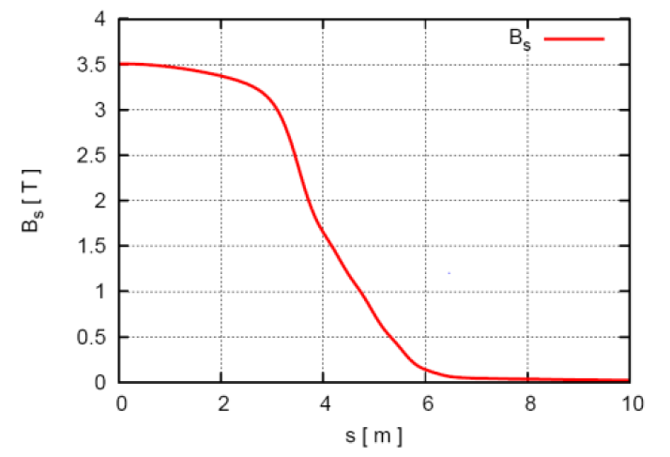
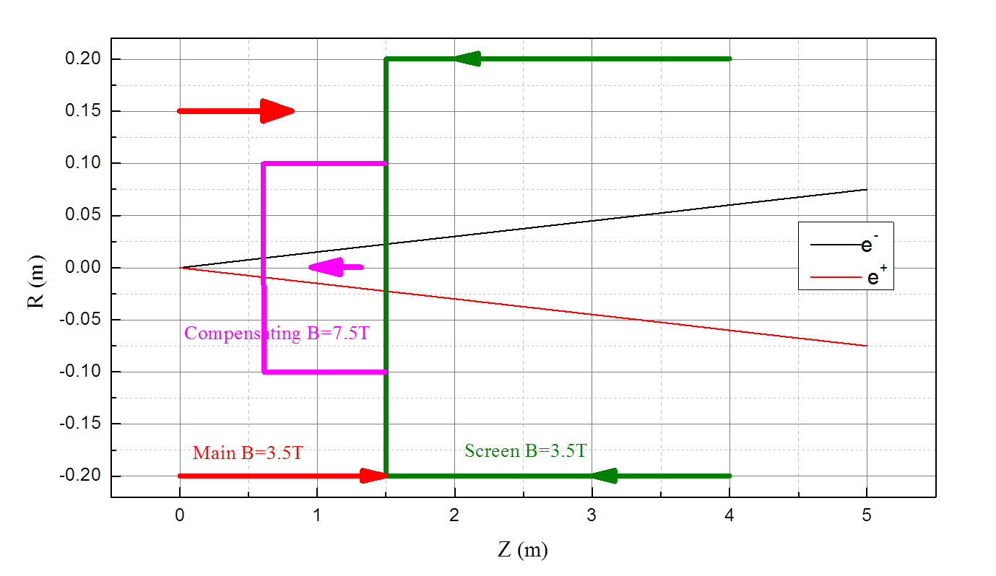
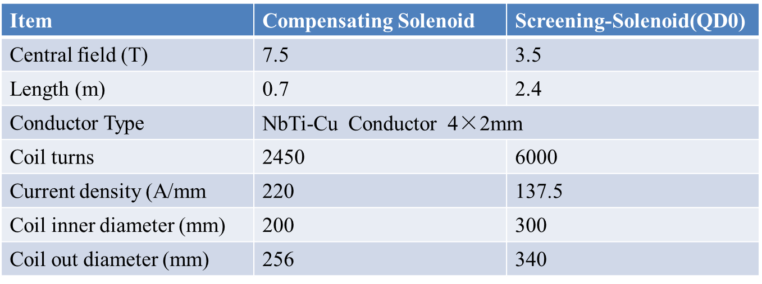
CEPC detector solenoid central field is about 3.5T, and the effective length is about 7.6m.
CEPC anti-solenoid design
CEPC detector solenoid
CEPC anti-solenoid design parameters

Slide 13
References
BEPCII Design report.
H. Yamaoka, et al., “Solenoid field calculation of the SuperKEKB interaction region”, Proceedings of IPAC2012, THPPD023, New Orleans, Louisiana, USA.
Yukiyoshi Ohnishi, et al., “Accelerator design at SuperKEKB”, Prog. Theor. Exp.Phys.2013, 03A011.
T. Abe, et al. “Belle II Techincal design report”, KEK Report 2010-1.
M. Koratzinos, et al., “The FCC-ee interaction region magnet design”, Proceedings of IPAC2016, THOPR023, BEXCO, Busan Korea.
Mike Sullivan, “Progress report on the IR layout”, report in the FCC-ee MDI meeting, 2016-05-09.
S. Sinyatkin, “MDI and Head-on collision option for electron-positron higgs factory”, presentation in The first IHEP-BINP collaboration meeting, 2016-01-12.

