Slide 1
CEPC partial double ring FFS design
Dou Wang, Jie Gao, Feng Su, Yuan Zhang, Jiyuan Zhai, Yiwei Wang, Bai Sha, Huiping Geng, Tianjian Bian, Na Wang, Xiaohao Cui
CEPC AP meeting, 2016.05.13

Slide 3
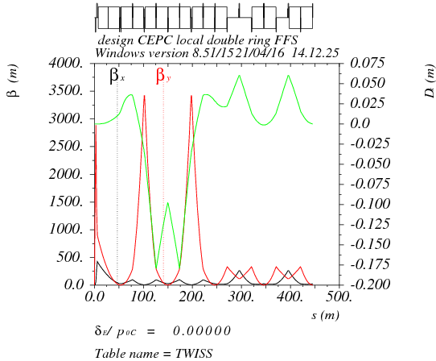
Higher order chromaticity correction in FFS
Quadrupole pair, sextupole pair, octupole pair.

Slide 4
Main sextupole scan-1
ANGLE:=0.55*0.11E-2
Critical energy= 104kev
VARIABLE "TAR" SET TO 1.03759159e-21
k2hs = 12.0390943 ;
k2vs = 61.05953775 ;
sdqx = 0.0003550753638 ;
sdqy = 0.001262171022 ;
wwx = 31.40871865 ;
wwy = 25.84760159 ;
dqx0 = 4.722257884e-12 ;
dqy0 = -3.186364495e-11 ;

Slide 5
Main sextupole scan-2
ANGLE:=0.11E-2
Critical energy= 190kev
VARIABLE "TAR" SET TO 5.96771436e-21
k2hs = 6.582430847 ;
k2vs = 33.55590912 ;
sdqx = 0.0003778515548 ;
sdqy = 0.001134476048 ;
wwx = 33.39201438 ;
wwy = 21.79579772 ;
dqx0 = -7.523853893e-11 ;
dqy0 = 1.751789441e-11 ;

Slide 6
Main sextupole scan-3
ANGLE:=1.5*0.11E-2
Critical energy= 285kev
VARIABLE "TAR" SET TO 1.99795144e-21
k2hs = 4.864862799 ;
k2vs = 22.3536694 ;
sdqx = 0.0002047489039 ;
sdqy = 0.002049013286 ;
wwx = 21.33725775 ;
wwy = 24.68472653 ;
dqx0 = 2.6563816e-11 ;
dqy0 = 3.594878472e-11 ;

Slide 7
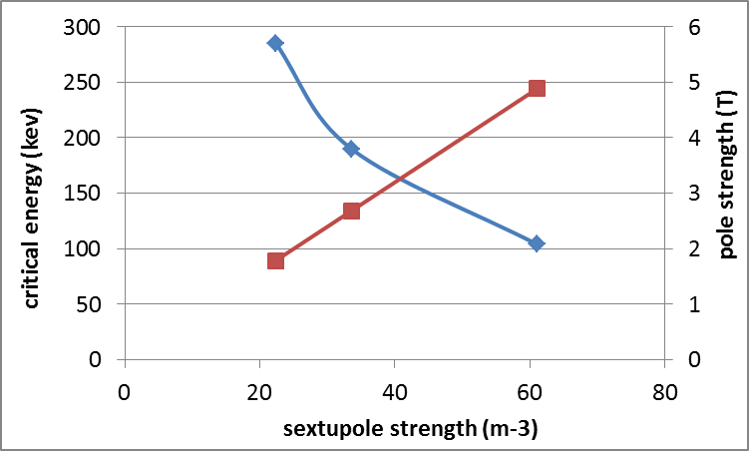
K2 vs. critical energy
* Assume the inner iris of sextupole is 2cm.

Slide 8
Thanks！

