Slide 1
CEPC PDR ARC Redesign
SU Feng, GAO Jie, WANG Yiwei, WANG Dou
BIAN Tianjian, Bai Sha, TANG Jingyu
2016.5.20

Slide 2
Out line
The circumference should be also considered of SPPC requirement…
48km（this Monday）-> 53 Km

Slide 3
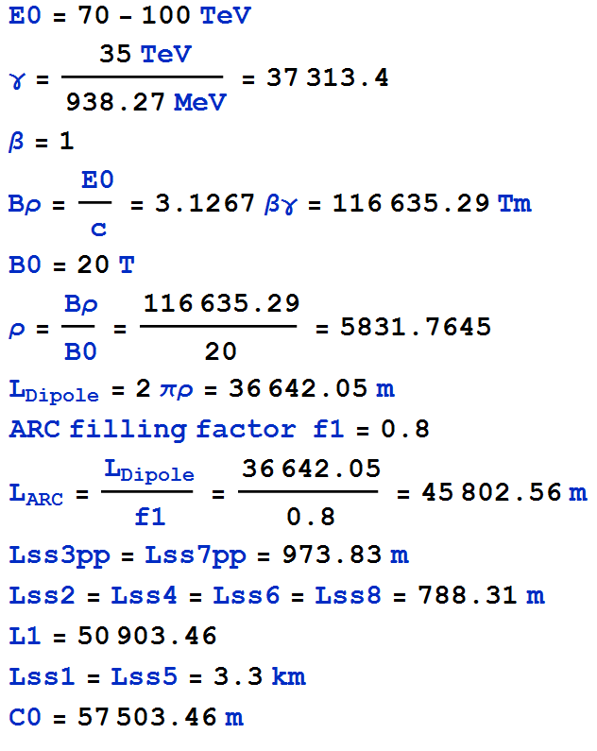
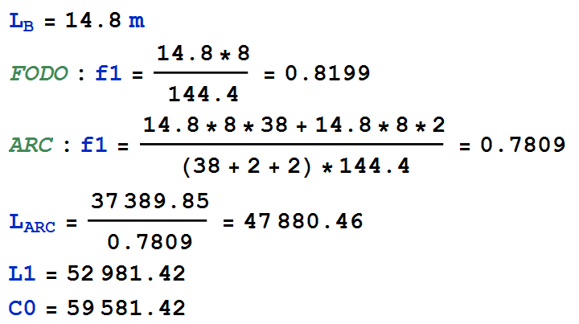
ARC Length

Slide 4
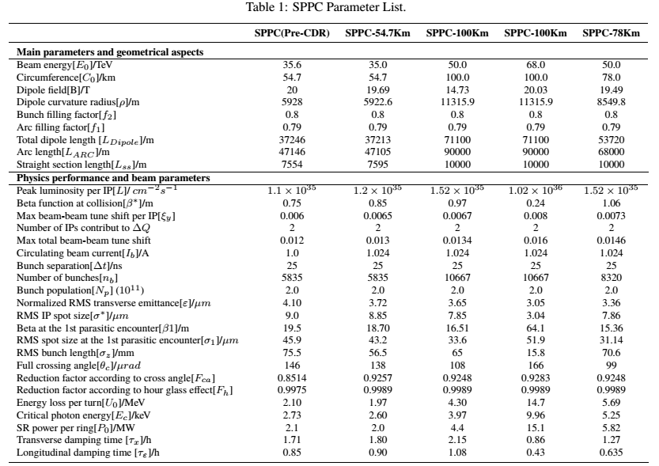
SPPC Parameter

Slide 5
CEPC Partial Double Ring Layout
1/2RF
1/2RF
IP1_ee
RF
RF
3.2Km
1/2RF
1/2RF
Bypass
about 42m
IP4_pp
IP2_pp
Bypass
about 42m
1/2RF
1/2RF
IP1_ee/IP3_ee, 3.2Km
IP2_pp/IP4_pp, 1132.8m
4 Short Straights, 141.6m
4 Medium Straights, 566.4m
4 Long Straights, 849.6m
2 Short ARC, 24*FODO, 1132.8m
4 Medium ARC, 112*FODO, 5286.4m
4 Long ARC, 124*FODO, 5852.8m
C=59044m
RF
RF
IP3_ee
1/2RF
1/2RF
SU Feng
2016.1.4

Slide 6
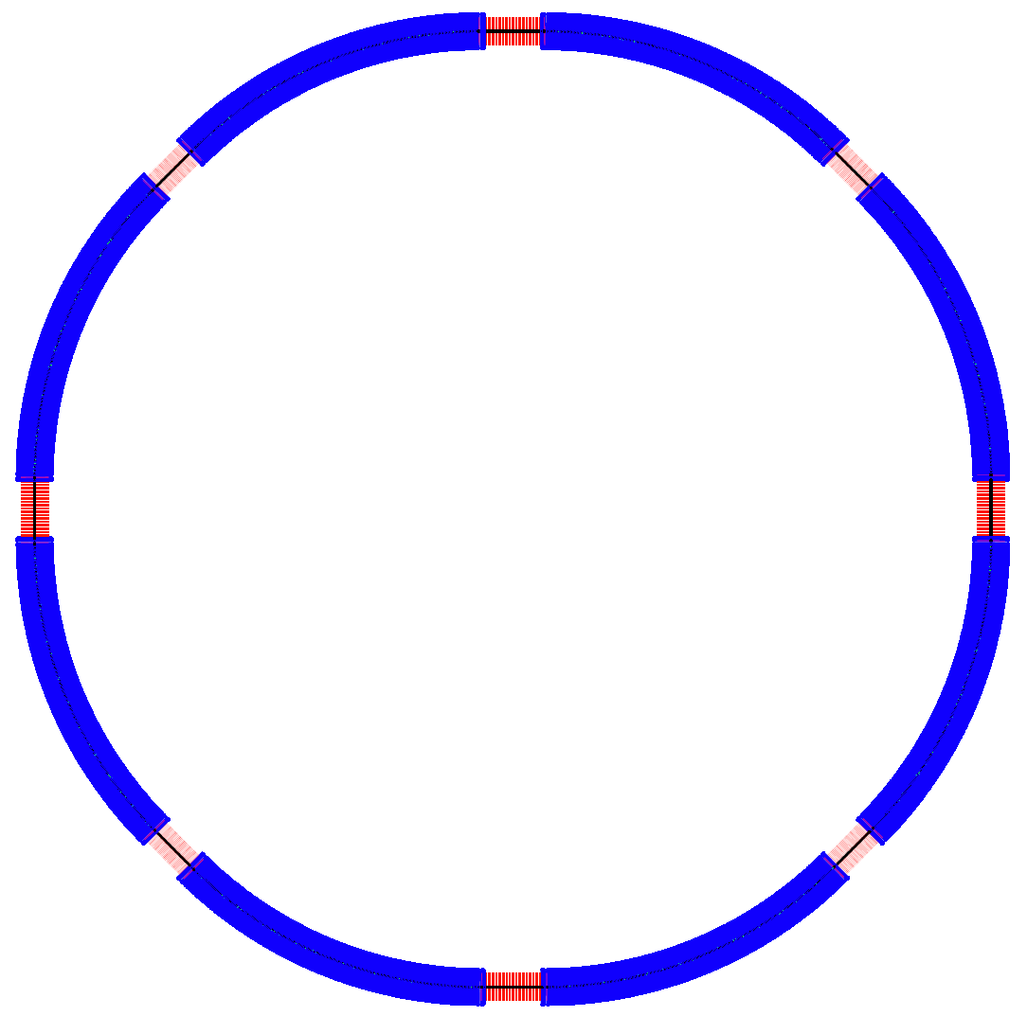
SPPC Layout
（Su Feng Jan. 10, 2016）
ARC81
ARC12
LSS1_coll
P.S.
arccell1
arccell2
P.S.
LSS8_extr
LSS2_inj
ARC78
ARC23
arccell2
arccell1
LSS7_pp
LSS3_pp
C = 59381 km
arccell1
arccell2
ARC67
ARC34
LSS1/5_coll ：3.2Km
LSS2/4/6/8：788.31m
LSS3/7_pp: 973.83m
ARC: 5963.2m
LSS6_RF
LSS4_RF
P.S.
arccell2
arccell1
P.S.
LSS5_coll
ARC56
ARC45
Notes:
8段弧区，90度相移4个FODO Cell可消色散，若每个Cell 8块Dipole，则nB需是256的倍数。
This is the layout of SPPC, we rename the straight section as Long Straight Section 1 /2 and … . Configuration maybe change in the future.

Slide 7
New ARC
WANG Yiwei

Slide 8
Thank You !

