Slide 1

CEPC partial double ring FFS design
Dou Wang, Jie Gao, Feng Su, Yuan Zhang, Yiwei Wang, Bai Sha, Huiping Geng, Tianjian Bian, Na Wang, Xiaohao Cui
CEPC AP meeting, 2016.05.20

Slide 2
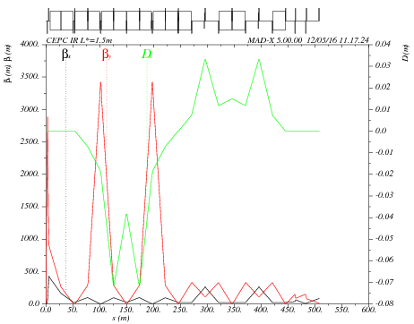
Main sextupole scan-1
ANGLE:=0.55*0.11E-2
Critical energy= 104kev
VARIABLE "TAR" SET TO 1.03759159e-21
k2hs = 12.0390943 ;
k2vs = 61.05953775 ;
sdqx = 0.0003550753638 ;
sdqy = 0.001262171022 ;
wwx = 31.40871865 ;
wwy = 25.84760159 ;
dqx0 = 4.722257884e-12 ;
dqy0 = -3.186364495e-11 ;

Slide 3

Main sextupole scan-2
ANGLE:=0.11E-2
Critical energy= 190kev
VARIABLE "TAR" SET TO 5.96771436e-21
k2hs = 6.582430847 ;
k2vs = 33.55590912 ;
sdqx = 0.0003778515548 ;
sdqy = 0.001134476048 ;
wwx = 33.39201438 ;
wwy = 21.79579772 ;
dqx0 = -7.523853893e-11 ;
dqy0 = 1.751789441e-11 ;

Slide 4

Main sextupole scan-3
ANGLE:=1.5*0.11E-2
Critical energy= 285kev
VARIABLE "TAR" SET TO 1.99795144e-21
k2hs = 4.864862799 ;
k2vs = 22.3536694 ;
sdqx = 0.0002047489039 ;
sdqy = 0.002049013286 ;
wwx = 21.33725775 ;
wwy = 24.68472653 ;
dqx0 = 2.6563816e-11 ;
dqy0 = 3.594878472e-11 ;

Slide 5
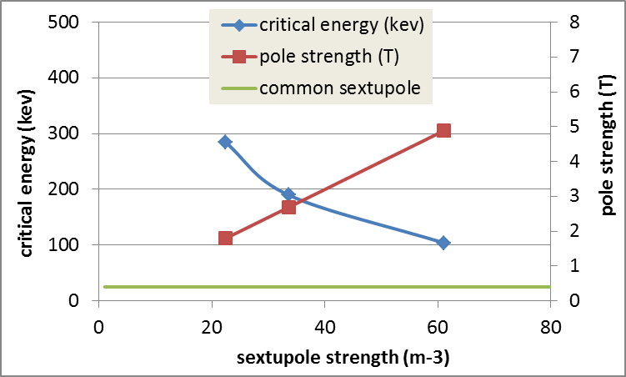
K2 vs. critical energy
* Assume the inner iris of sextupole is 2cm.

Slide 6
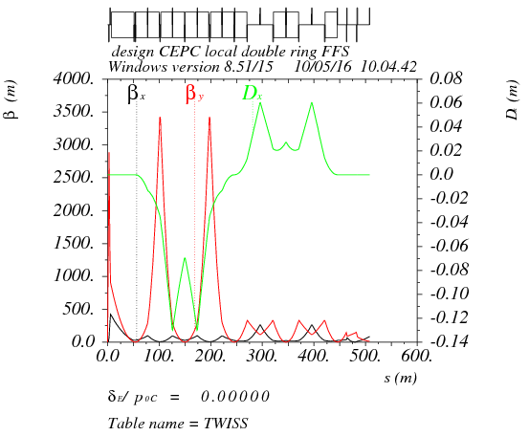
Betax*= 0.25m,Betay*=1.36mm
Crab sex
Critical energy= 190kev
K2HS := 28.25 m⁻³
K2VS := 32.18 m⁻³

Slide 7

Betax*= 0.25m,Betay*=2mm
Crab sex
Critical energy= 190kev
K2HS := 36.00 m⁻³
K2VS := 39.41 m⁻³

Slide 8
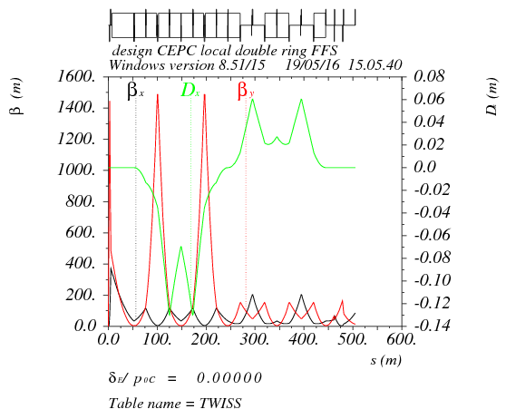
Betax*= 0.25m,Betay*=3mm
Crab sex
Critical energy= 190kev
K2HS := 36.03 m⁻³
K2VS := 43.46 m⁻³

Slide 9
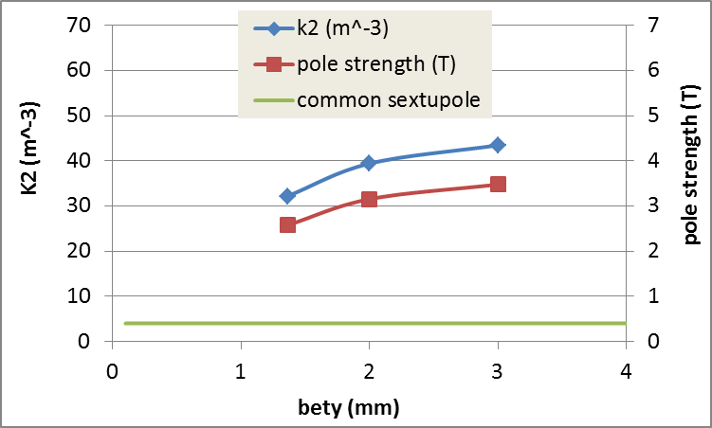
Sextupole strength vs. bety*
* Assume the inner iris of sextupole is 2cm.

Slide 10
Thanks！

