Slide 1
ARC lattice design for CEPC PDR
Yiwei Wang, Feng Su, Jie Gao
20th May 2016, CEPC AP meeting

Slide 2
CEPC primary parameter （wangdou20160325）
 | Pre-CDR | H-high lumi. | H-low power | W | Z
Number of IPs | 2 | 2 | 2 | 2 | 2
Energy (GeV) | 120 | 120 | 120 | 80 | 45.5
Circumference (km) | 54 | 54 | 54 | 54 | 54
SR loss/turn (GeV) | 3.1 | 2.96 | 2.96 | 0.59 | 0.062
Half crossing angle (mrad) | 0 | 15 | 15 | 15 | 15
Piwinski angle | 0 | 2.5 | 2.6 | 5 | 7.6
N_{e}/bunch (10¹¹) | 3.79 | 2.85 | 2.67 | 0.74 | 0.46
Bunch number | 50 | 67 | 44 | 400 | 1100
Beam current (mA) | 16.6 | 16.9 | 10.5 | 26.2 | 45.4
SR power /beam (MW) | 51.7 | 50 | 31.2 | 15.6 | 2.8
Bending radius (km) | 6.1 | 6.2 | 6.2 | 6.1 | 6.1
Momentum compaction (10⁻⁵) | 3.4 | 2.5 | 2.2 | 2.4 | 3.5
β_{IP} x/y (m) | 0.8/0.0012 | 0.25/0.00136 | 0.268 /0.00124 | 0.1/0.001 | 0.1/0.001
Emittance x/y (nm) | 6.12/0.018 | 2.45/0.0074 | 2.06 /0.0062 | 1.02/0.003 | 0.62/0.0028
Transverse σ_{IP} (um) | 69.97/0.15 | 24.8/0.1 | 23.5/0.088 | 10.1/0.056 | 7.9/0.053
ξ_{x}/IP | 0.118 | 0.03 | 0.032 | 0.008 | 0.006
ξ_{y}/IP | 0.083 | 0.11 | 0.11 | 0.074 | 0.073
V_{RF} (GV) | 6.87 | 3.62 | 3.53 | 0.81 | 0.12
f _{RF} (MHz) | 650 | 650 | 650 | 650 | 650
Nature σ_{z} (mm) | 2.14 | 3.1 | 3.0 | 3.25 | 3.9
Total σ_{z} (mm) | 2.65 | 4.1 | 4.0 | 3.35 | 4.0
HOM power/cavity (kw) | 3.6 | 2.2 | 1.3 | 0.99 | 0.99
Energy spread (%) | 0.13 | 0.13 | 0.13 | 0.09 | 0.05
Energy acceptance (%) | 2 | 2 | 2
Energy acceptance by RF (%) | 6 | 2.2 | 2.1 | 1.7 | 1.1
n_{γ} | 0.23 | 0.47 | 0.47 | 0.3 | 0.24
Life time due to beamstrahlung_cal (minute) | 47 | 36 | 32
F (hour glass) | 0.68 | 0.82 | 0.81 | 0.92 | 0.95
L_{max}/IP (10³⁴cm⁻²s⁻¹) | 2.04 | 2.96 | 2.01 | 3.09 | 3.09

Slide 3
Considerations on ARC lattice design
FODO cell, 90 ° /90 °
non-interleaved sextupole scheme
n=5
All 3rd and 4th RDT due to sextupoles cancelled
Amplitude-dependent tune shift is very small
Ncell= 120
LB= 19.96
Lcell= 47.92
theta= .0032188449319567555
Lring= 54820.479999999996
Nstr1= 18
Nstr2= 20
Vrfc= 220625000
frf= 6.5e+08

Slide 4
this lattice
H-low power wangdou20160325
NIP=2
Eng=120
Lring=54820.48
U0=2.933
thetaC=-
thetaP=-
Ne=2.67
Nb=44
Ib=.0105
Pbeam=30.800
rhoB=6200
alfap=1.668E-5
bxstar=-
bystar=-
ex=2.094e-09
ey=0
sigxIP=-
sigyIP=-
ksix=-
ksiy=-
Vrf=3.53e+09
frf=6.5e+08
sigmaz=.00264
sigmazt=-
Phom=-
sigmae=.00130
eapt=-
eaptrf=-
ngamma=-
tbs=-
Fhg=-
Lmax=-
NIP=2 ! Number of IPs [1]
Eng=120 ! Energy [GeV]
Lring=54*1E3 ! Circumference [m]
U0=2.96 ! SR loss/turn [GeV]
thetaC=15 ! Half crossing angle [mrad] thetaP=2.6 ! Piwinski angle [1]
Ne=2.67 ! Ne/bunch [10^11] Nb=44 ! bunch number [1]
Ib=10.5*1e-3 ! Beam current[A]
Pbeam=31.2 ! SR power/beam [MW] rhoB=6.2*1e3 ! Bending radius [m]
alfap=2.2e-5 ! Momentum compaction [1] bxstar=0.268 ! beta x at IP [m]
bystar=0.00124 ! beta y at IP [m]
ex=2.06*1e-9 ! emittance x [m*rad]
ey=0.0062*1e-9 ! emittance y [m*rad]
sigxIP=23.5*1e-6 ! beam size x at IP [m]
sigyIP=0.088*1e-6 ! beam size y at IP [m] ksix=0.032 ! ksix/IP [1]
ksiy=0.11 ! ksiy/IP [1]
Vrf=3.53*1e9 ! Vrf [V]
frf=650*1e6 ! frf [Hz]
sigmaz=3.0 ! Nature sigmaz [mm]
sigmazt=4.0 ! Total sigmaz [mm]
Phom=1.3 ! HOM power/cavity [kw] sigmae=0.13/100 ! Energy spread [1] eapt=2/100 ! energy acceptance [1] eaptrf=2.1/100 ! energy acceptance by RF [1] ngamma=0.47 ! number of gamma
tbs=32 ! life time due to beamstrahlung [min] Fhg=0.81 ! Factor of hour glass
Lmax=2.01 ! Lmax/IP [10^34/cm^2/s]
Damping time 15ms, i.e. 82 turns; filling factor 72.2%

Slide 5
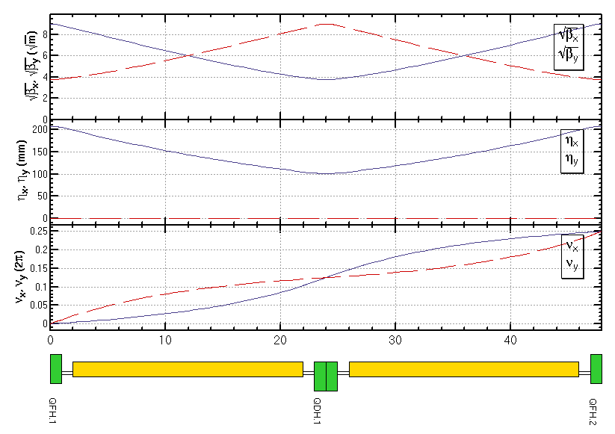
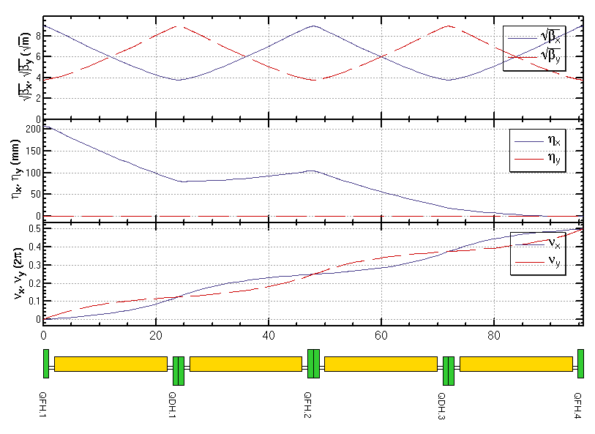
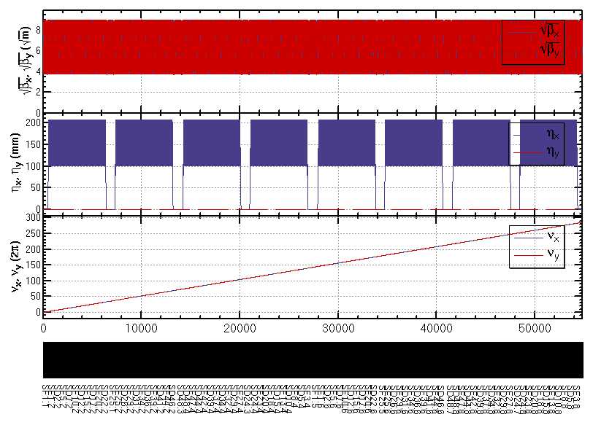
ARC lattice
FODO cell
Dispersion Suppressor
Whole ARC (w/o FFS,PDR)

Slide 6
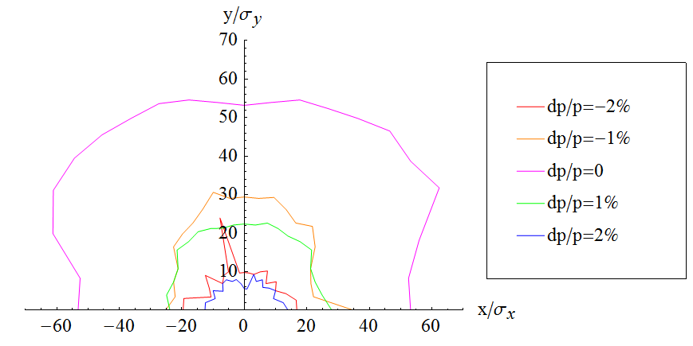
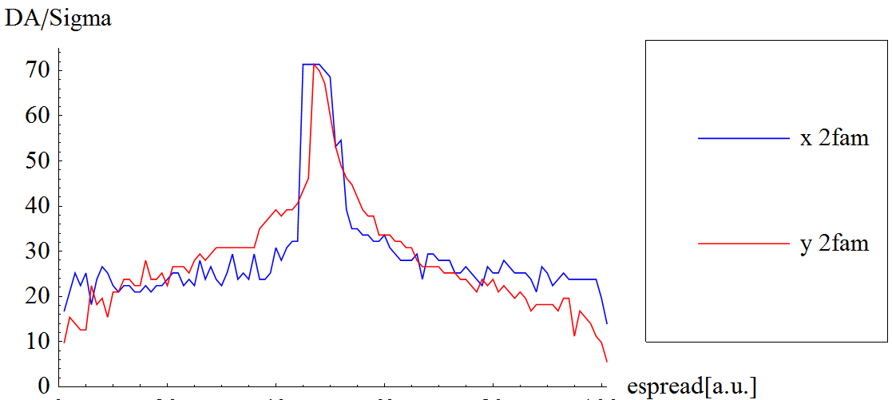
2 families of sextupoles
SF1 =(L =.39999999999999997 K2 =.9680546863280827 )
SD1 =(L =.39999999999999997 K2 =-1.8843252788821787 )
No strong resonance line in dp/p=2%

Slide 7
Optimization of DA with non-interleaved sextupoles
Optimize bandwidth of Q vs. dp/p and constraint the break down of –I
In SAD, Q(dp/p) is calculated w/o synchrotron motion. However, the results will be very different between w/ and w/o synchrotron motion.
Optimize the DA vs. dp/p directly
Four cases should be optimized together: (0,0),(0,Pi/2), (Pi/2, 0), (Pi/2,Pi/2)
w/o damping

Slide 8
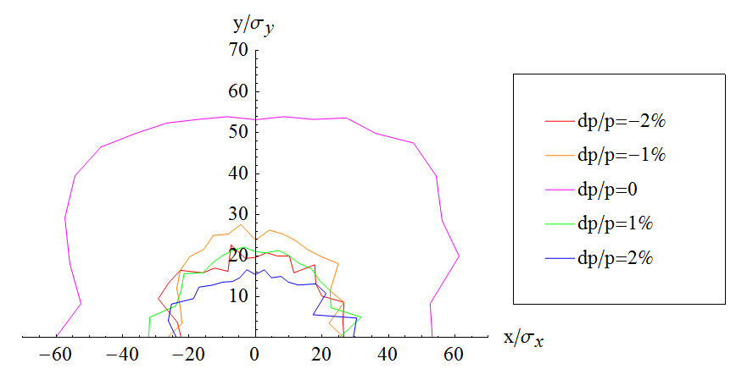
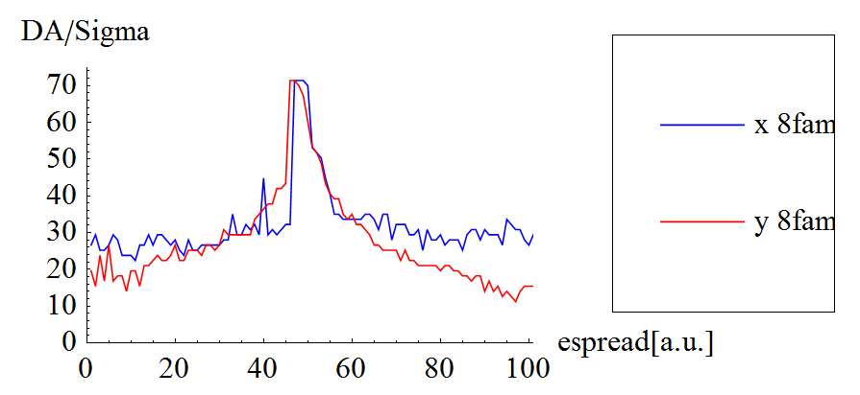
8 families of sextupoles
SF1 =(L =.39999999999999997 K2 =1.0049552085951383 )
SD1 =(L =.39999999999999997 K2 =-1.8774102185487131 )
SF13 =(L =.39999999999999997 K2 =.9570321356746315 )
SD13 =(L =.39999999999999997 K2 =-1.8569945561714651 )
SF25 =(L =.39999999999999997 K2 =.9829370588944072 )
SD25 =(L =.39999999999999997 K2 =-1.848948069693812 )
SF37 =(L =.39999999999999997 K2 =1.012913577646016 )
SD37 =(L =.39999999999999997 K2 =-1.8893114648552132 )

Slide 9
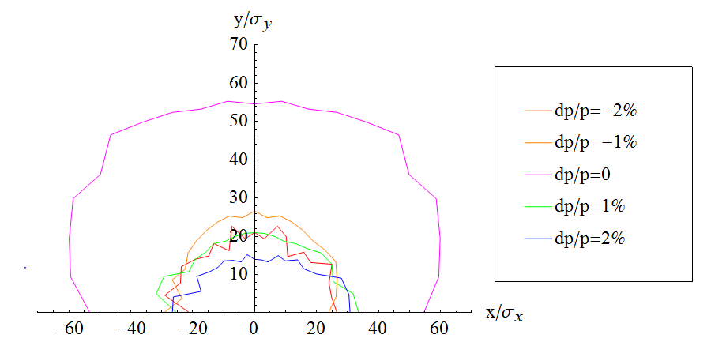
32 families of sextupoles
Priliminary result for 32 families
Further optimization is possible: initial setting, different configuration of families

Slide 10
DA vs. Circumfence
If fix emittance, L↑ ⇒ Dx ↑ ξ↓ ⇒ K2↓ ⇒ DA ↑
(FODO cell, 90 ° /90 °)

Slide 11
Summary
An ARC lattice designed for the CEPC PDR
FODO cell, 90 ° /90 °, non-interleaved sextupole scheme
Most of the lattice parameters are consistent with the design goal
The dynamic aperture is optimized directly.
2 families: (55×55) for dp/p=0, (15 ×10) for dp/p=2%
8 families: (55×55) for dp/p=0, (27×18) for dp/p=2%
Further optimization is possible: initial setting, more families
A larger ring has a bigger DA.

