Slide 1
Update on pretzel scheme design
Huiping Geng
CEPC Accelerator Group Meeting
2016.05.20

Slide 2
Contents
DA optimization on main ring (change the dispersion suppressor type).

Slide 3
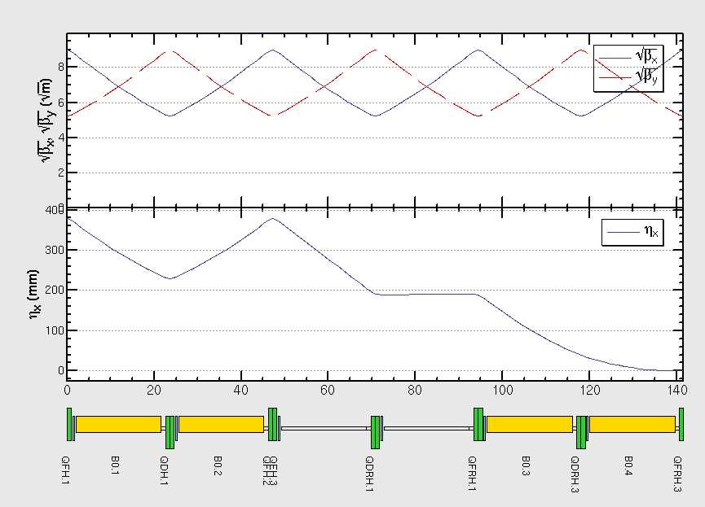
Present dispersion suppressor

Slide 4
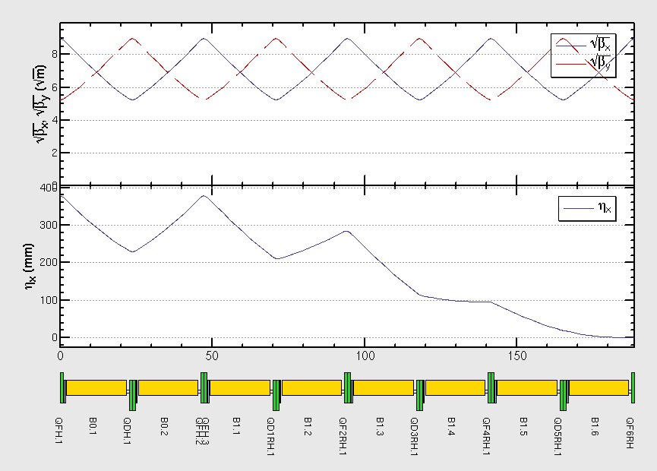
New dispersion suppressor

Slide 5
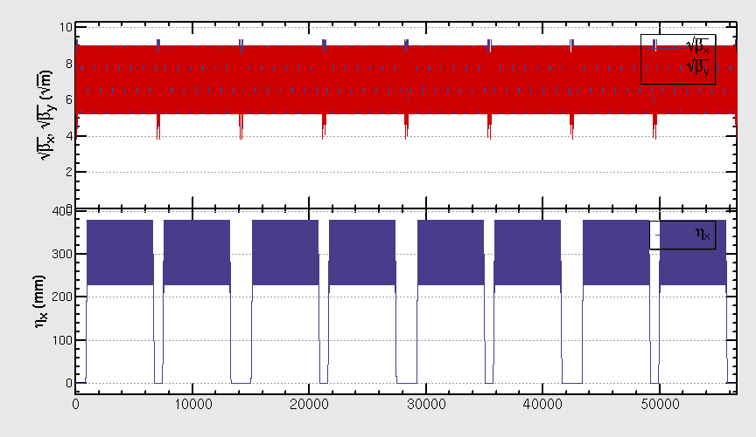
New matched ring
DISP +1FODO, ARC -1FOODO, STRLR: -1FODO, STRSR: 0FODO

Slide 6
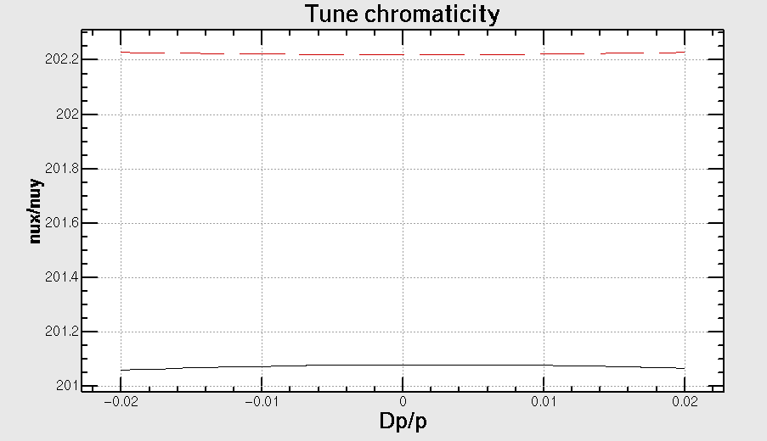
Chromaticity correction

Slide 7
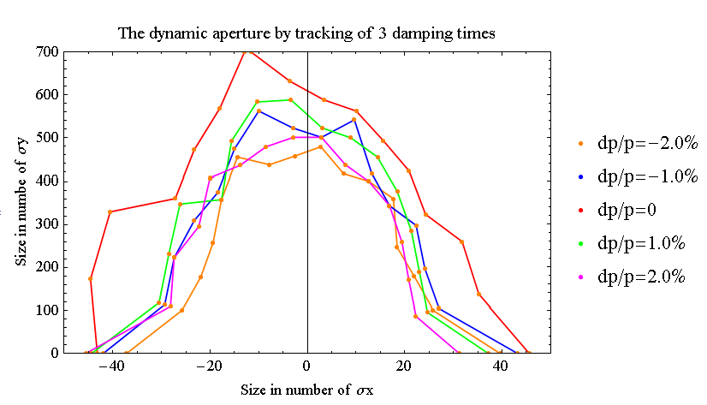
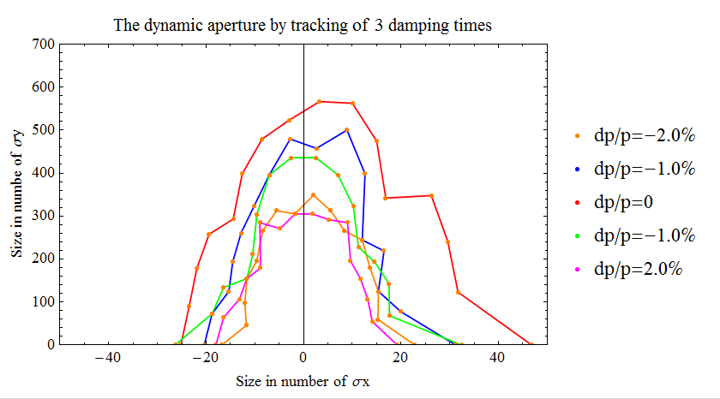
DA optimization
Strength of bends are the same. Change the scheme of dispersion suppressor.
18+34
Circumference and working point remains the same.

Slide 8
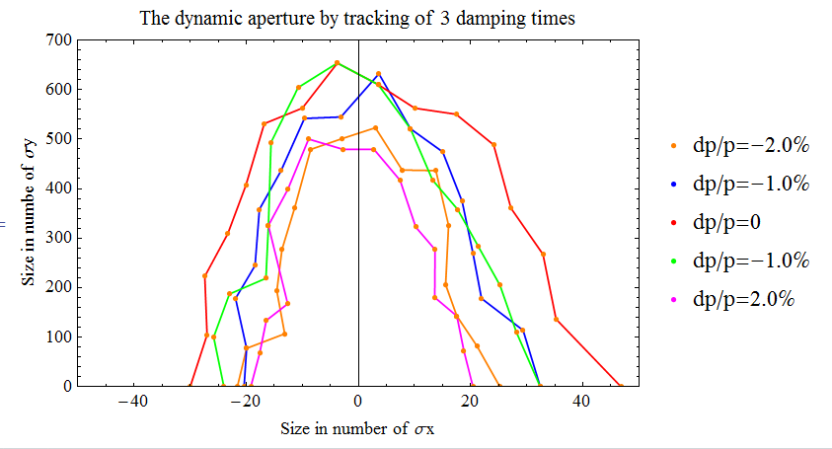
DA optimization-2
Keep standard cells in ARC has number 120, change the strength of bends.
Circumference and working point remains the same.

Slide 9
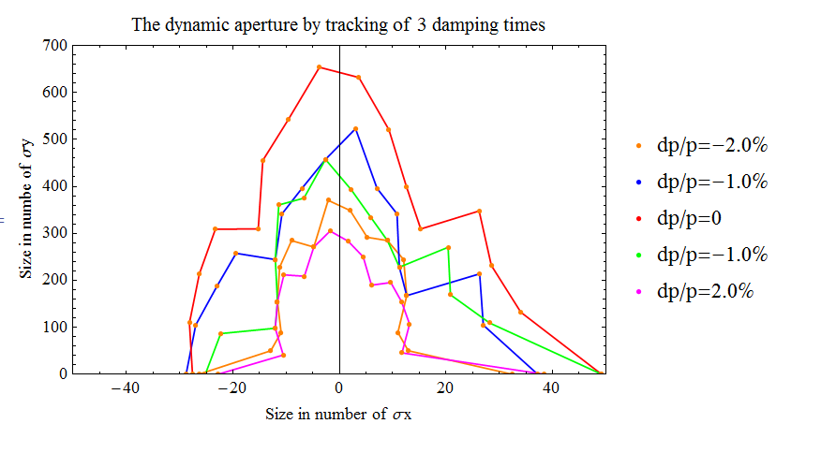
DA optimization-3
Keep standard cells in ARC has number 120, change the strength of bends; and keep the phase advance difference between arc and straight sections the same(make straight section longer, the working point changes.)
Circumference changes

Slide 10
Summary
Dispersion suppressor with missing bends scheme seems better.

