Slide 1
Application of Differential Evolution Algorithm in Future Circular Colliders
Yuan Zhang(zhangy@ihep.ac.cn), IHEP, Beijing
Demin Zhou, KEK, Ibaraki, Japan
Presented at IPAC’16, May 8-13, 2016, BEXCO, Busan Korea

Slide 2
Outline
Introduction
Differential Evolution Algorithm
Application in CEPC & SuperKEKB
Summary

Slide 3
Multi-objective genetic algorithm (MOGA)
Application in storage ring based light source is very popular and successful
  APS/DLS, ELEGANT, M. Borland, in 48th ICFA Beam Dynamics Workshop on Future Light Sources
  NSLSII，L. Yang, Y. Li, W. Guo and S. Krinsky, PRST-AB, 14, 054001 （2011）
  SLS, BMAD, M. Ehrlichman , arXiv: 1603.02459
  HEPS, Accelerator Toolbox, Y. Jiao and G. Xu, in this proceeding
  …

Slide 4
Different Algorithm
Particle Swarm, SPEAR3, X. Huang, J. Safranek, Nucl. Instr. Meth. In Phys. Research A. 757, 48, 2014
Differential Evolution, J. Qiang et al., IPAC’13
Downhill Simplex, SuperKEKB, FCC, K. Oide et al.
…….

Slide 5
Excitation
K. Oide, “A design of beam optics for FCC-ee”, Sep. 2015 @IHEP
255 sextupole pairs per half ring.
Resulting dynamic aperture alomost satisfies the requirements

Slide 6
Why we did the job?
We need to optimize the DA of CEPC
We want to try the direct DA optimization in collider, just as the community has done in light source
Different optimization algorithm is worth to be used
SAD(http://acc-physics.kek.jp/sad/) is used for the DA determination. It is a parallel code, but the scalability is not very good. A MPI-based parallel code to call SAD will be much more efficient.

Slide 7
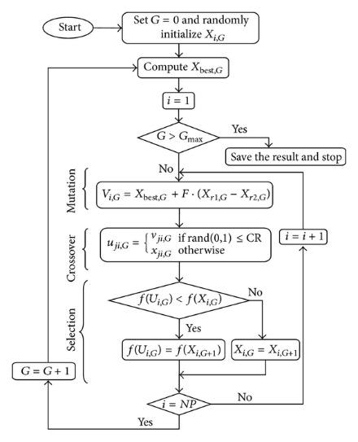
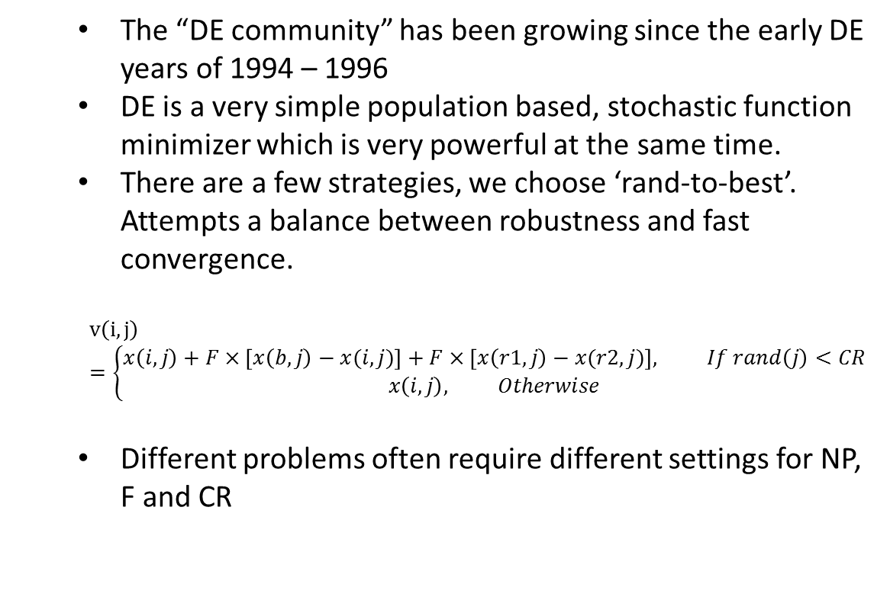
Differential Evolution Algorithm (single objective)
The “DE community” has been growing since the early DE years of 1994 – 1996
DE is a very simple population based, stochastic function minimizer which is very powerful at the same time.
There are a few strategies, we choose ‘rand-to-best’. Attempts a balance between robustness and fast convergence.
$$v\left(i,j\right)=\left\{\begin{matrix}x\left(i,j\right)+F×\left[x\left(b,j\right)−x(i,j)\right]+F×\left[x\left(r1,j\right)−x(r2,j)\right], If rand\left(j\right)<CR \\ x\left(i,j\right), Otherwise\end{matrix}\right.$$
Different problems often require different settings for NP, F and CR
http://www.hindawi.com/journals/ijap/2013/713680.fig.003.jpg

Slide 8
Parallel Computation
Yongjun Li, “Multi-objective Dynamic Aperture Optimization for NSLS-II Ring”, IAS program on HEP Conference 2016, Hong Kong

Slide 9
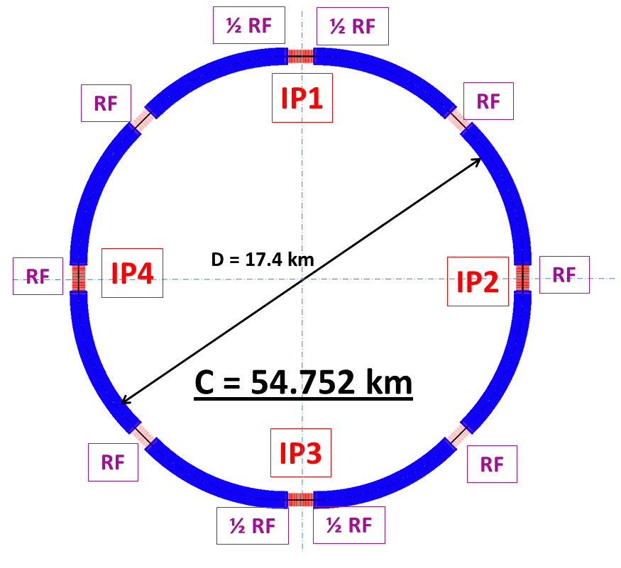

CEPC (PreCDR)
Beam energy: 120GeV
Circumference: 54 km
SR power: 51.7 MW/beam
8*arcs, 2*Ips
Luminosity: 2e34/IP
Emittance X/Y: 6.12/0.018 nmrad
$β_{x}^{∗}/β_{y}^{∗}$=0.8m/1.2mm
FODO cell: 47.2m, 60/60 degrees
Damping time: 78/78/39 turns
Dynamic Aperture: 20$σ_{x}×$40$σ_{y}×$0.02

Slide 10

Case of CEPC
Before optimization:
One SF/SD family in arc
Initial IR optimization
(by Y. Wang, Mar 2015)
$β_{x}^{∗}/β_{y}^{∗}$=0.8m/3mm
Without pretzel scheme
No solenoid and compensation

Slide 11
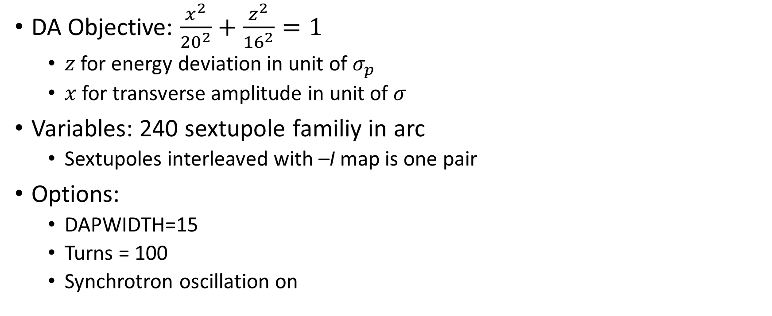
CEPC:
Dynamic Aperture Optimization
DA Objective: $\frac{x^{2}}{{20}^{2}}+\frac{z^{2}}{{16}^{2}}=1$
  $z$ for energy deviation in unit of $σ_{p}$
  $x$ for transverse amplitude in unit of $σ$
Variables: 240 sextupole familiy in arc
  Sextupoles interleaved with –I map is one pair
Options:
  DAPWIDTH=15
  Turns = 100
  Synchrotron oscillation on
DA almost satisfies the requirements

Slide 12
CEPC: Dynamic Aperture Optimization (2)
SF
SD
Tune cross integer resonance!

Slide 13
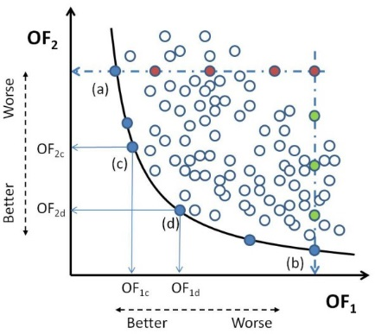
Multi-objective Optimization
Most problems in nature have several (possibly conflicting) objectives to be satisfied.
Many of these problems are frequently treated as single-objective optimization problems by transforming all but one objective into constraints.
The term optimize means finding such a solution which would give the values of all the objective functions acceptable to the decision maker.
Kung et al., J. ACM 22, 4 (Oct. 1975), 469-476
Giuseppe Narzisi, “Multi-Objective Optimization”, 2008

Slide 14
MODE:
Multi-Objective optimization by Differential Evolution
The parallel algorithm is referencing to J. Qiang(IPAC’13)
Initialize the population of parameter vectors
Generate the offspring population using the above differential evolution algorithm
Find the non-dominated population, which are treated as the best solutions in DE to generate offspring
Sorting all the population, select the best NP solution as the parents
Return to step 2, if stopping condition not met

Slide 15

Multi-Objective Optimization of CEPC
Objectives:
  $ν_{x}∈\left(0.05,0.31\right), ν_{y}∈\left(0.10,0.31\right), \text{for} δ_{p}∈(−0.02,0.02)$, with $ν_{x0}=0.08, ν_{y0}=0.12$
  $\frac{x^{2}}{{20}^{2}}+\frac{z^{2}}{{16}^{2}}=1$, for z=Range[-15,15,1]
  Options: DAPWIDTH=30, turns=200

Slide 16
Multi-Objective Optimization of CEPC
The dynamic aperture required in X-Y space not satisfying

Slide 17
Dynamic Aperture with Damping
Synchrotron oscillation
Radiation damping
Synchrotron oscillation

Slide 18
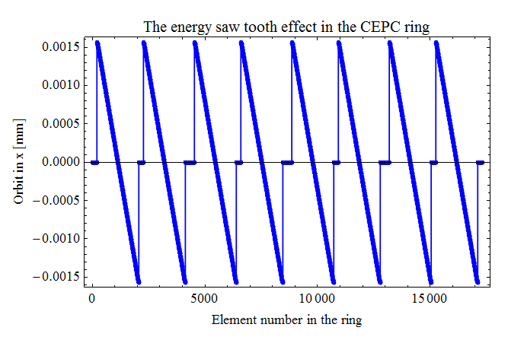
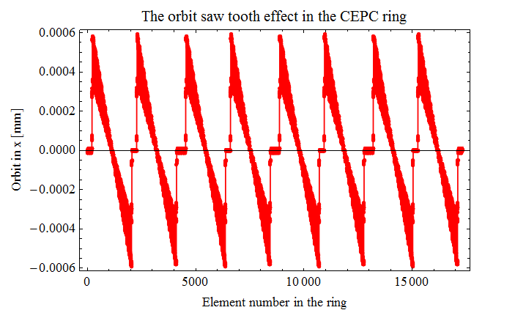
Sawtooth effect without FFS
Energy sawtooth amplitude 0.15%
Orbit sawtooth amplitude 0.6mm
Courtesy of Huiping Geng@IHEP

Slide 19
Dynamic Aperture with Damping & Fluctuation
Synchrotron oscillation
Radiation damping
Synchrotron oscillation
Synchrotron Radiation (Fluctuation)

Slide 20
SuperKEKB: dynamic aperture is a serious issue
Y. Ohnishi, “Optics Issues”, 18th KEKB Review, March 3-5, 2014

Slide 21

DA Optimization of LER
Momentum aperture is increased.
Objectives:
  $ν_{x}∈\left(0.53,0.66\right), ν_{y}∈\left(0.55,0.66\right),$
  for $δ_{p}∈\left(−0.019,0.019\right)$
  $\frac{x^{2}}{{50}^{2}}+\frac{z^{2}}{{26}^{2}}=1$, for z=Range[-24,24,3],
  $ε_{x,0}=1.89$nmrad, $δ_{p,0}$=7.7e-4
Variables: 68
  2 Octupoles
  54 sextupole pairs
  12 skew sextupole pairs

Slide 22
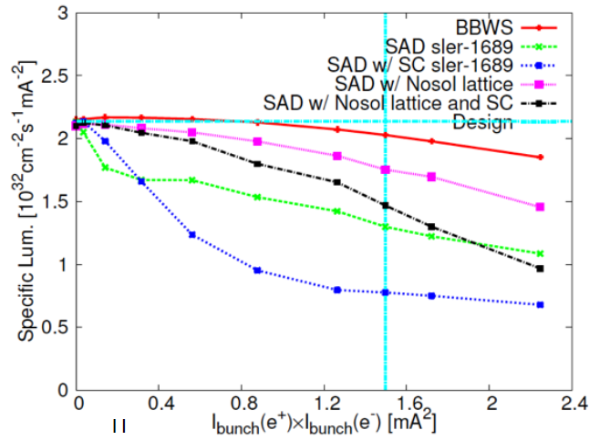
LER: beam-beam and lattice nonlinearity
Skew-sext resonance reduce the beam-beam performance
D. Zhou, “Beam Dynamics Issuses in SuperKEKB”, The 20th KEKB Accelerator Review Committee, Feb, 2015.
D. Zhou and et al, “Interplay of Beam-Beam Lattice Nonlinearity and Space Charge Effects in the SuperKEKB Collider”, IPAC’15

Slide 23
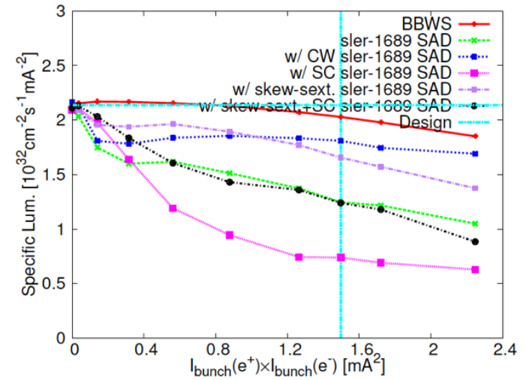
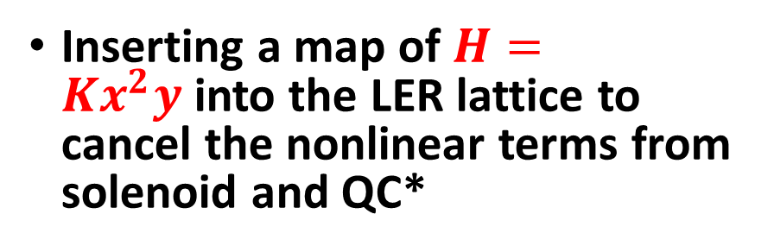
LER: beam-beam and lattice nonlinearity
Skew-sext resonance reduce the beam-beam performance
Inserting a map of $H=Kx^{2}y$into the LER lattice to cancel the nonlinear terms from solenoid and QC*
D. Zhou, “Beam Dynamics Issuses in SuperKEKB”, The 20th KEKB Accelerator Review Committee, Feb, 2015.
D. Zhou and et al, “Interplay of Beam-Beam Lattice Nonlinearity and Space Charge Effects in the SuperKEKB Collider”, IPAC’15

Slide 24
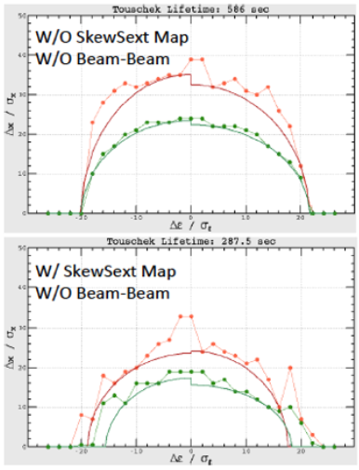
LER: beam-beam and lattice nonlinearity
Skew-sext resonance reduce the beam-beam performance
Inserting a map of $H=Kx^{2}y$into the LER lattice to cancel the nonlinear terms from solenoid and QC*
Skew-sext map cause loss in DA and lifetime
D. Zhou, “Beam Dynamics Issuses in SuperKEKB”, The 20th KEKB Accelerator Review Committee, Feb, 2015.
D. Zhou and et al, “Interplay of Beam-Beam Lattice Nonlinearity and Space Charge Effects in the SuperKEKB Collider”, IPAC’15

Slide 25
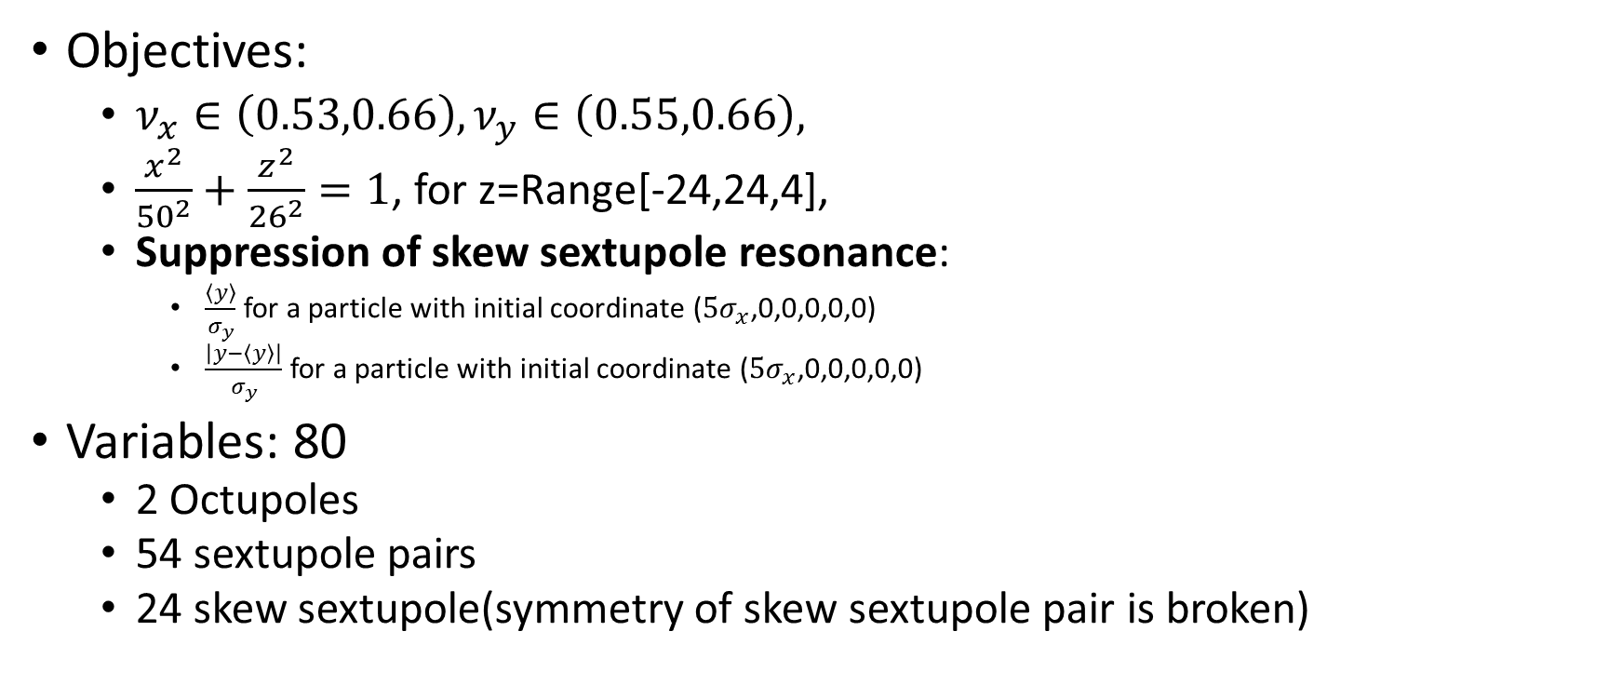
Optimization of LER
Objectives:
  $ν_{x}∈\left(0.53,0.66\right), ν_{y}∈\left(0.55,0.66\right),$
  $\frac{x^{2}}{{50}^{2}}+\frac{z^{2}}{{26}^{2}}=1$, for z=Range[-24,24,4],
  Suppression of skew sextupole resonance:
    $\frac{\left\langle y\right\rangle }{σ_{y}}$ for a particle with initial coordinate ($5σ_{x}$,0,0,0,0,0)
    $\frac{\left|y−\left\langle y\right\rangle \right|}{σ_{y}}$ for a particle with initial coordinate ($5σ_{x}$,0,0,0,0,0)
Variables: 80
  2 Octupoles
  54 sextupole pairs
  24 skew sextupole(symmetry of skew sextupole pair is broken)

Slide 26
Optimization of LER (2)
Difference resonance

Slide 27
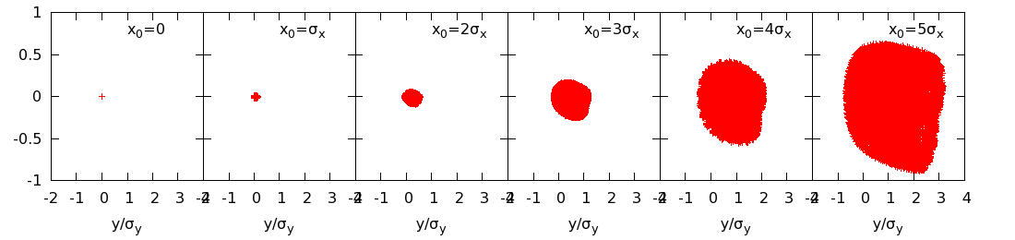
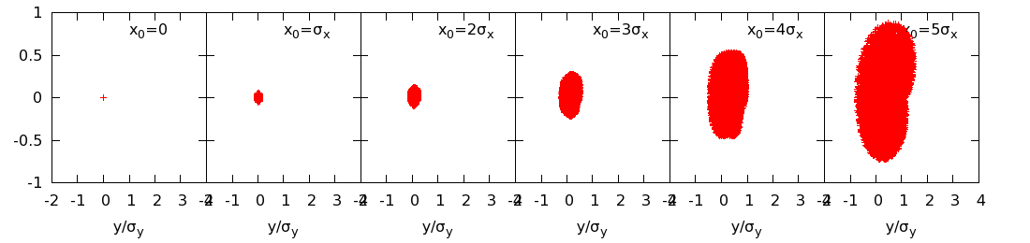
Optimization of LER (3)
Suppression of skew sextupole resonance

Slide 28
Speed-up Method
Brute-force dynamic aperture tracking is very time consuming
The objective is first eased, for example only track 100 turns instead of 1000 turns.
Some constraints must be satisfied and may be much faster. Referencing to Ehrilichman’s work[arXiv: 1603.02459], the multi-objectives are classified into two kinds. The time consuming cost function be calculated only when the necessary constraints (or objective) be satisfied.

Slide 29
Summary
The multi-objective optimization has been used in light source machine (not only storage ring based) for a few years.
We did a few multi-objective optimization for future colliders. It shows it could help us.
The MODE is just a tool, no physics. Physics exist in the definition of objective function. We should continue to find smart objective functions to save time.

Slide 30
Backup- 2016-05-19, update of CEPC

Slide 33
-15
-12
-9
-6
-3
0
3
6
9

Slide 34
12
15

