Slide 1
CEPC Booster 研究进展
魏源源 张闯 崔小昊 边天剑
2016年5月20日

Slide 2
Noninterleaved Sextupoles
To keep the π phase advance between sextupoles, use a (60,60) FODO cell.
70.8米
π

Slide 3
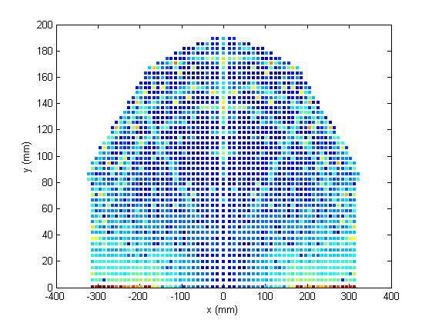
Comparison with Xiaohao’s results
Elegant from Xiaohao
AT from Xiaohao
AT from Weiyy

Slide 4
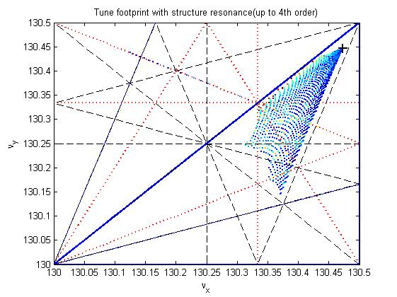
Comparison with Xiaohao’s results
AT from Xiaohao
AT from Weiyy

Slide 5
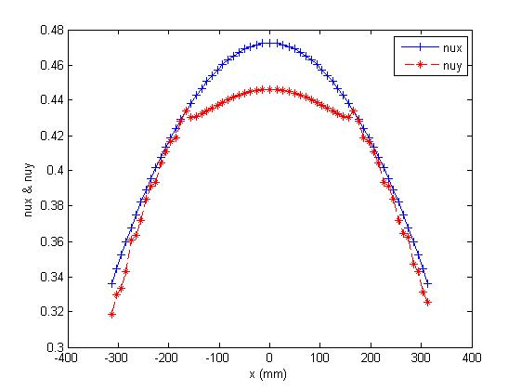
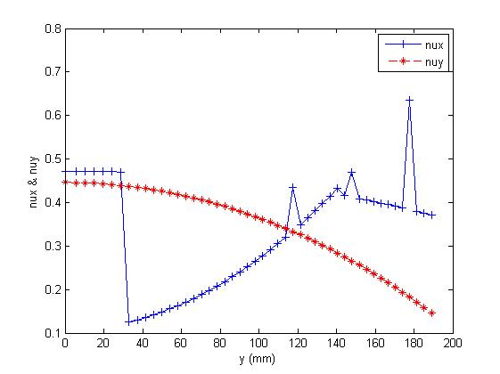

Slide 6
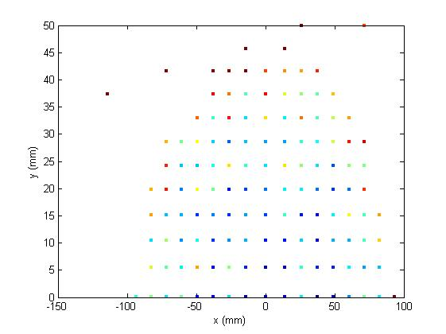
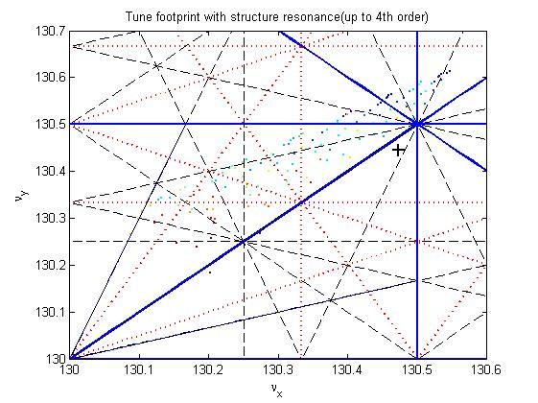
DA off-momentum
Δp/p=0.02
Δp/p=0.02

Slide 7
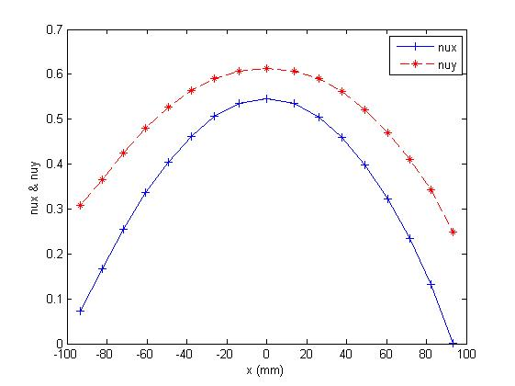
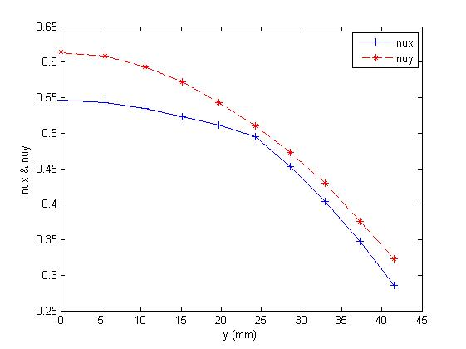
DA off-momentum
Δp/p=0.02
Δp/p=0.02

Slide 8
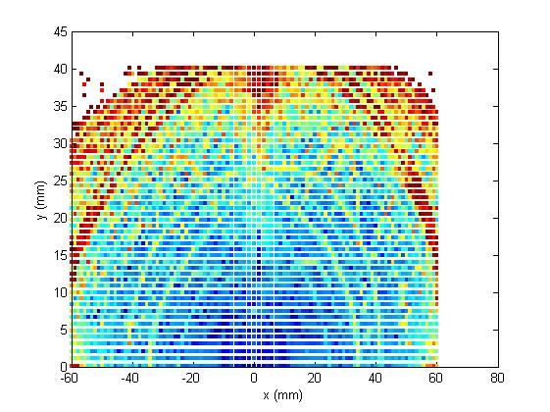
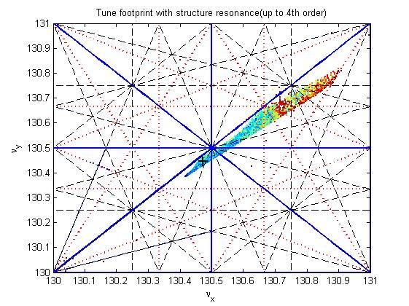
DA off-momentum
Δp/p=-0.02
Δp/p=-0.02

Slide 9
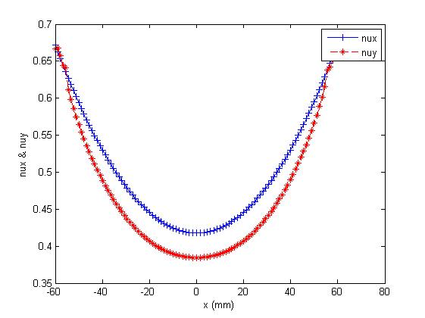
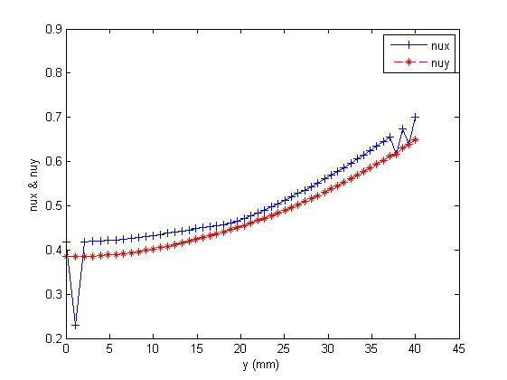
DA off-momentum
Δp/p=-0.02
Δp/p=-0.02

Slide 10
Booster Magnet Field errors
Dipole magnets 〈ΔB/B〉 < 2×10⁻³ Quadrupole magnets 〈ΔK/K〉 < 5×10⁻⁴
Alignment parameters
Component | 〈y〉 (mm) | 〈x〉 (mm) | 〈tilt〉 (mrad)
Dipole | ±0.2 | ±0.3 | ±0.1
Quadrupole | ±0.1 | ±0.1 | ±0.1

Slide 11
Tolerances on the systematic field components in lattice elements（r.m.s. values)
Field Dipole magnets Quadrupole Sextupole Component |ΔB/B|_{59mm} |ΔG/G|_{59mm} |ΔK’/K|_{59mm} Quadrupole 3×10⁻⁴ Sextupole 2×10⁻⁴ 6×10⁻⁴ Octupole 7×10⁻⁵ 5×10⁻⁴ 1.7×10⁻³ Decapole 1.3×10⁻⁴ 6.9×10⁻⁴ 3.4×10⁻³ Dodecapole 1.4×10⁻⁴ 1.0×10⁻³ 6.5×10⁻³ 18-pole 1.6×10⁻²
Tolerances on the random field components in lattice elements（r.m.s. values)
Field Dipole magnets Quadrupole Sextupole Component |ΔB/B|_{59mm} |ΔG/G|_{59mm} |ΔK’/K|_{59mm} Quadrupole 2×10⁻⁴ Sextupole 2.9×10⁻⁴ 1.2×10⁻³ Multipole 2×10⁻⁴ 10⁻³ 2×10⁻²

Slide 12
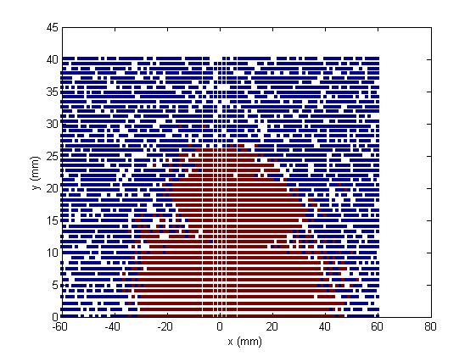
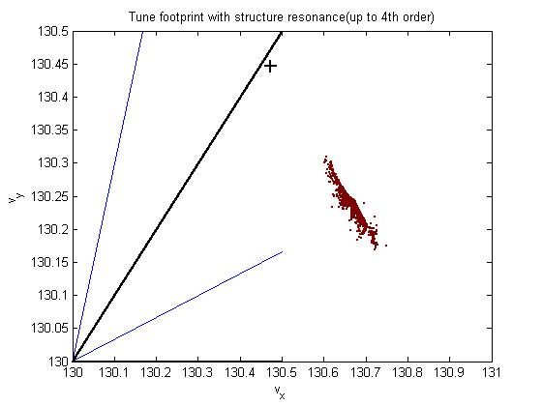
DA with errors

Slide 13
To do list
Optimize the off-momentum DA
DA with errors

