Slide 1
Calorimeter Optimization
Calibration constant adjustment
Liu Bing & LI Haoqing

Slide 2
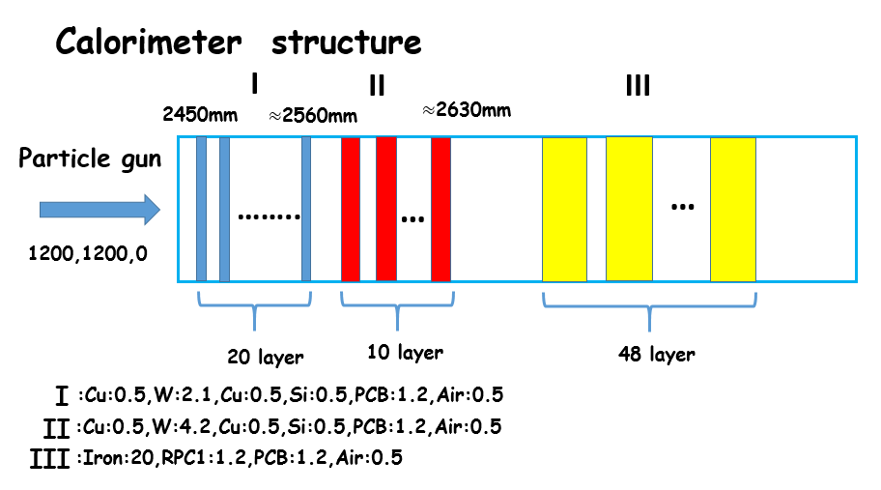
New calorimeter structure needs new calibration method
Calibration equation: $E=k1∗\sum_{i}{{EI}_{i}+k2∗\sum_{i}{{EII}_{i}}+NIII∗0.1}$
The proportion of the weight of the two ECAL parts(k1:k2) should be 1:2, while k should be adjusted to ensure best energy linearity
At now, k1=46

Slide 3
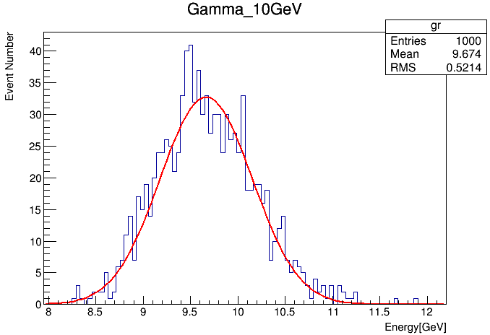
Adjustment reference: Gamma_10GeV
Can only go through the first two layers
The reconstructed energy should be the same as beam energy
As shown in the picture, k1 and k2 should be multiplied by: 10/9.674=1.0337

Slide 4
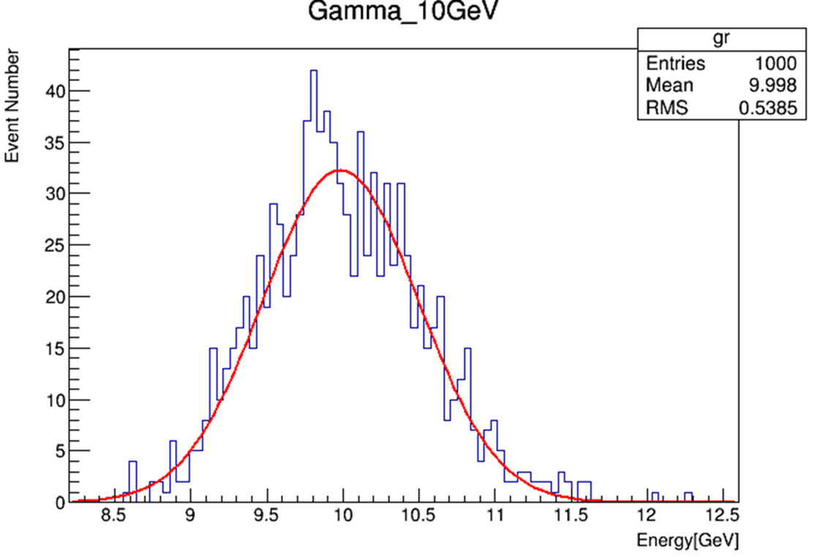
After we apply the adjustment, the fit mean value of Gamma_10GeV goes closer to 10GeV

Slide 5
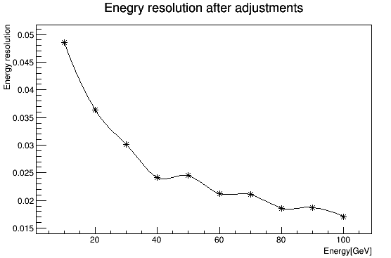
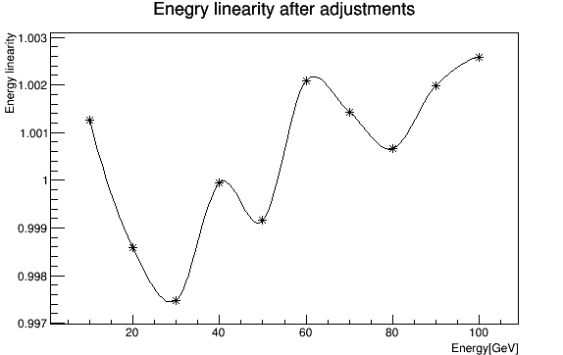
Energy Resolution and Linearity of Electrons

Slide 6
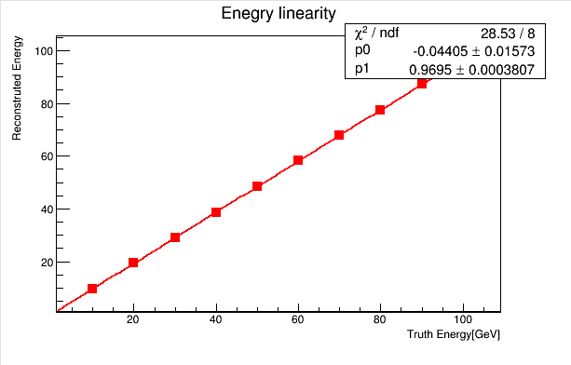
Energy Resolution and Linearity of Electrons

Slide 7
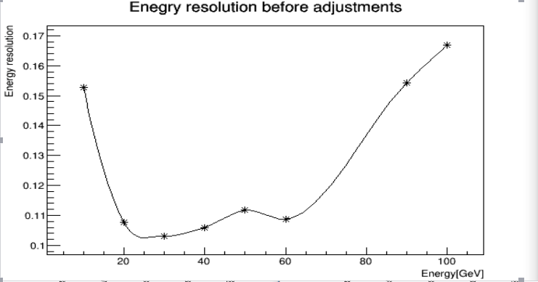
HCAL Adjustment
ECAL: k1~47.55
k2~95.1
HCAL: 0.1
pi+ 10GeV-100GeV

Slide 8
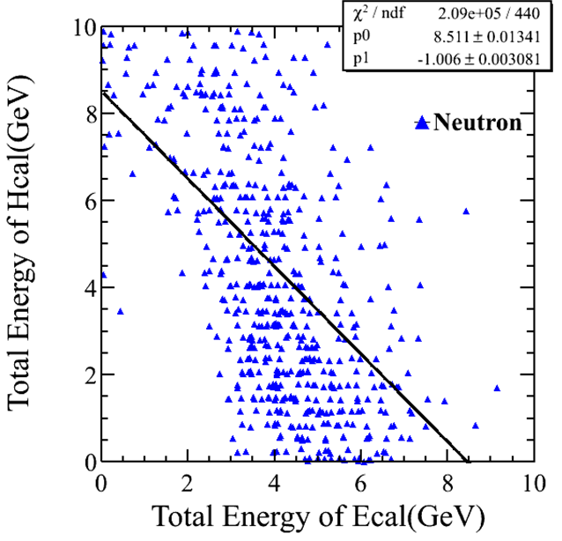
HCAL Adjustment
ECAL: k1~47.55
k2~95.1
HCAL: 0.29
Neutron 5GeV

