Slide 1
On Friedrichs model and “XYZ” states
In collaboration with Zhiguang Xiao
Based on
Zhiguang Xiao, ZYZ,arXiv:1608.00468, Phys. Rev. D 94, 076006
Zhiguang Xiao, ZYZ arXiv:1608.06833
Zhiguang Xiao, ZYZ arXiv:1610.07460
Zhi-Yong Zhou
Southeast University
周智勇
东南大学
2016.11. Guangxi

Slide 2
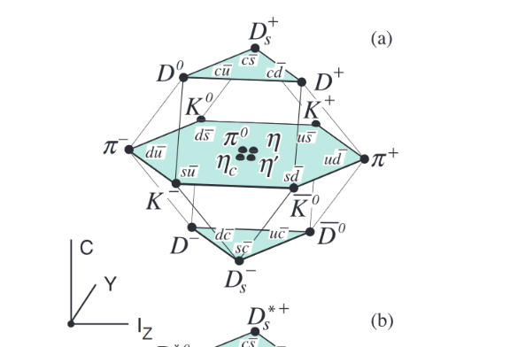
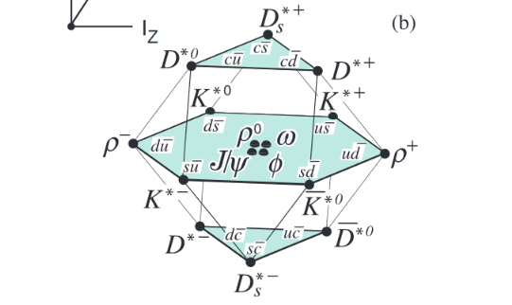
Motivation
How to understand the hadron world?
Quark model seems to work well somewhere.

Slide 3
Motivation
How to understand the hadron world?
Quark model seems to work well.
Godfrey and Isgur, Phys.Rev. D32 (1985) 189-231
-
CC states

Slide 4
Motivation
Godfrey and Isgur, Phys.Rev. D32 (1985) 189-231
Nonrelativistic => “relativized”
The GI model gives a successful prediction to the mass spectroscopy, but more and more discrepancies between the predicted values and the measured ones appear for those states above the open-flavor thresholds.

Slide 5
Motivation
“Exotic” D₀*(2318)
Mass
Width
D₀*(2318)

Slide 6
Motivation
“Exotic” X(3872)
X(3872)
6

Slide 7
Motivation
Coupling to the open-flavor thresholds will cause the mass shifts, and it will also cause the decay widths at the same time.
Based on Cutkosky rule, the imaginary part of the self-energy function could be represented pictorially as

Slide 8
Motivation
Origin of light 0⁺ resonances, ZYZ and Z.Xiao, Phys.Rev.D83,014010,2011
Most of scalar states below 2GeV could be produced by the same “bare” state
interacting with the coupled channels.
“Conventional” “Unconventional”
Nc traj move to real axis move to complex plane
Nature qqbar-dominant tetroquark or molecule-dominant
States be 2GeV f₀(1370) , f₀(1500 ), f₀(2020) f₀(500), f₀(980)
a₀(1450), a₀(2020) a₀(980)
K₀*(1430), K₀*(1950) K₀*(800)

Slide 9
Motivation
Origin of light 0⁺ resonances, ZYZ and Z.Xiao, Phys.Rev.D83,014010,2011
I=0
f₀(500) and f₀(1370) are caused by the same bare coupled to or channels.
K₀*(800) and K₀*(1430) are also such kind of accompany pair.
a₀(980) and a₀(1450) are also such kind of accompany pair.
I=1/2
I=1

Slide 10
Motivation
Charmed meson spectrum
Without free parameters(the parameters are all from the GI’s papers), the pole parameters of the generated poles give good descriptions to the masses and widths of the most observed states at the same time.
ZYZ and Z.Xiao, Phys.Rev.D84,034023,2011

Slide 11
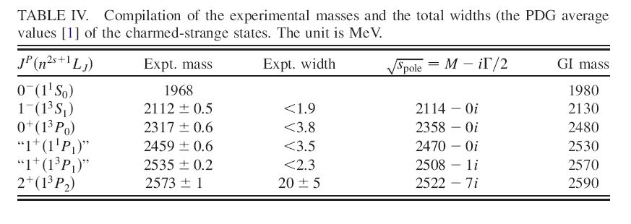
Motivation
Charmed-strange meson spectrum
ZYZ and Z.Xiao, Phys.Rev.D84,034023,2011

Slide 12
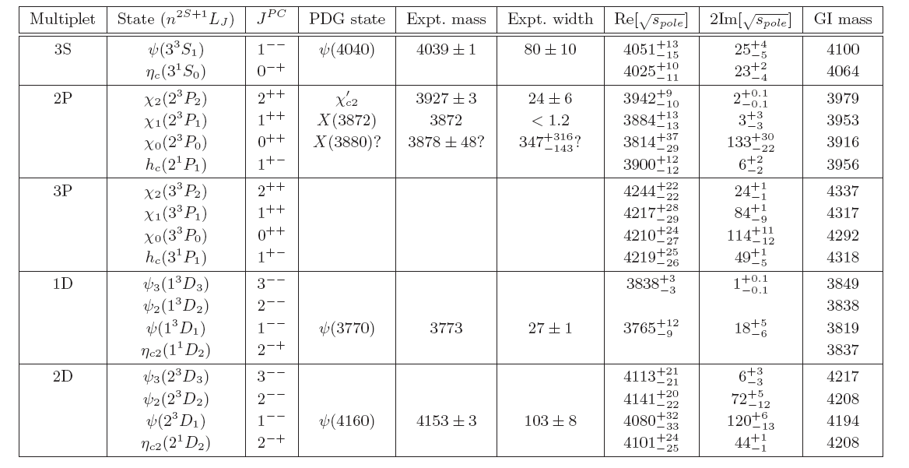
Motivation
Charmonium-like states
ZYZ , Zhiguang Xiao, Eur. Phys. J. A (2014) 50: 165
ZYZ , Zhiguang Xiao, Hai-Qing Zhou, Phys.Rev.Lett. 115 (2015) no.2, 022001

Slide 13
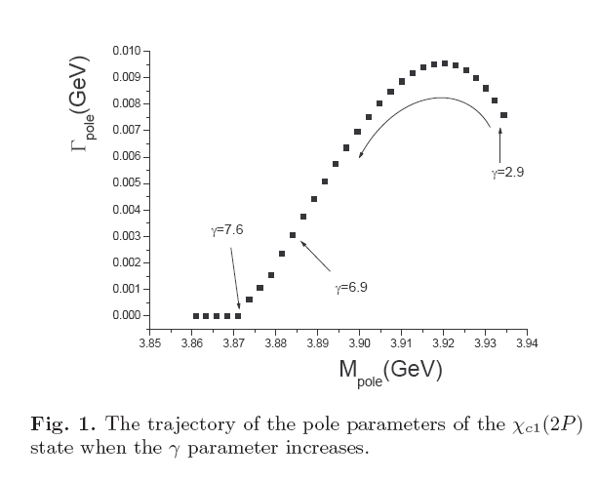
Motivation
X(3872) and χ_{c1}(2P)
ZYZ , Zhiguang Xiao, Eur. Phys. J. A (2014) 50: 165

Slide 14
Gamow state
Energy eigenfunction with a complex eigenvalue, proposed by G.Gamow to understand alpha decay
G.Gamow , Z.Phys. 51 (1928) 204-212
However, in Hilbert space, a self-adjoint operator can only admit real eigenvalues. A rigorous treatment to Gamow state require an extension of Hilbert space to Rigged Hilbert space(RHS).
A.Bohm, M.Gadella, Dirac kts, Gamow vectors, and Gelfund Triplets,
Springer Lectures Notes in Physics Vol.348, Springer, Berlin
Plane wave is also not in Hilbert space but in RHS.

Slide 15
Rigged hilbert space
I.M. Gel’fand, N.Ya. Vilenkin, Generalized Functions, Vol. IV, Academic Press, New York, 1964
Gel’fand triplet space
the space of the anti-linear continuous functionals on the nuclear space
Nuclear space , dense in H
Hilbert space of normalizable state
The space of Gamow states
More mathematical background :
A. Bohm, J. D. Dollard, and M. Gadella, Dirac Kets,
Gamow Vectors and Gel’fand Triplets, Lecture Notes in Physics, Vol. 348
O. Civitaresea, M. Gadella ,Physics Reports 396 (2004) 41–113

Slide 16
Friedrichs model
A solvable model to demonstrate the properties of Gamow state.
K. O. Friedrichs,
Communications on Pure and Applied Mathematics 1, 361 (1948).
Several variants:
Lee model
Fano model
Anderson model
T. D. Lee, Phys. Rev. 95, 1329 (1954), [,11(1954)].
U. Fano, Phys. Rev. 124, 1866 (1961).
P. W. Anderson, Phys. Rev. 124, 41 (1961).

Slide 17
Simplest Friedrichs model
Free Hamiltonian with a simple continuous spectrum , and a discrete eigenstate with the eigenvalue .
Then the free Hamiltonian is
Normalization :

Slide 18
Simplest Friedrichs model
Suppose there is an interaction between the continuous and discrete parts
where represent the interaction strength.
We can solve the eigenstate of the full Hamiltonian with eigenvalue .
Since the and form a complete set, could be
expressed as

Slide 19
Simplest Friedrichs model
Solution:
where
The reduced resolvent

Slide 20
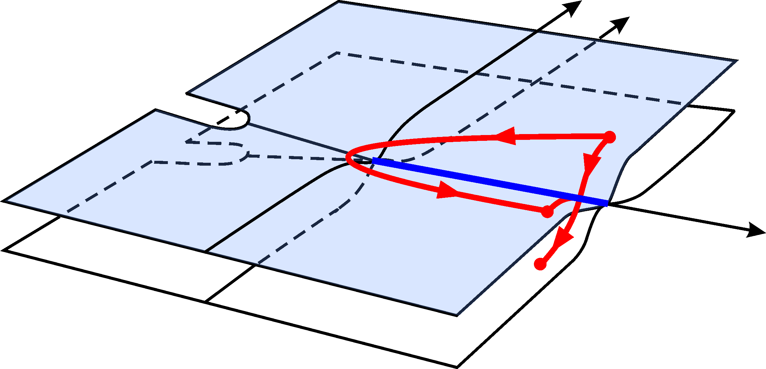
properties of function
A complex analytic function with no singularities on the complex plane other than a branch cut coinciding with the positive semi-axis R+ provided that . It admits analytic continuations through the cut , from above to below from below to above. The continuation has a zero at z₀ with Im[z₀]<0, which is an analytic function. Analogously, has a zero at z∗₀, which is also an analytic function.

Slide 21
Gamow vector in Friedrichs model
decaying state
growing state
omit the normalizations
Special properties

Slide 22
Norms of gamow states
Some people think is not well-defined.
unable to be normalized as usual
T. Petrosky, I. Prigogine, and S. Tasaki, Physica A173, 175 (1991).
but is well-defined.

Slide 23
main results by extending Friedrichs model(see Zhiguang xiao’s talk)
(1)Mostly generalized completeness relation with higher-order
virtual poles, bound-states, and resonances.
Different origins of virtual states.
Zhiguang Xiao, ZYZ,arXiv:1608.00468, Phys. Rev. D 94, 076006
(2) Find the solutions in multichannel case. The wave functions of Gamow states in different Riemann sheets.
The compositeness relations of multi-channel case.
Zhiguang Xiao, ZYZ , arXiv:1608.06833
(3) Partial wave decomposition for non-relativistic and relativistic theory in extended Friedrichs model.
Probability explanations for bound states.
But for resonance the “compositeness” and “elementariness” are complex. Probability explanation?
Zhiguang Xiao, ZYZ , arXiv:1610.07460

Slide 24
two-channel case
Free Hamiltonian with two simple continuous spectrum , ,whose threshold from and , respectivly, and a discrete eigenstate with the eigenvalue .
Then the free Hamiltonian is
Interaction part :

Slide 25
two-channel case solutions
Case A:
Case B:
Case C:

Slide 26
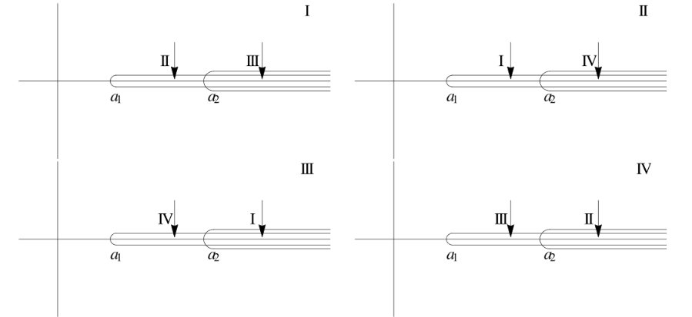
on different Riemann sheets

Slide 27
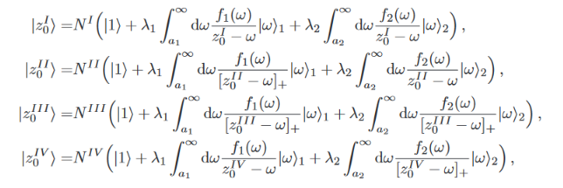
wave functions on different sheets
Generalized representations

Slide 28
integration contours for poles on different riemann sheets

Slide 29
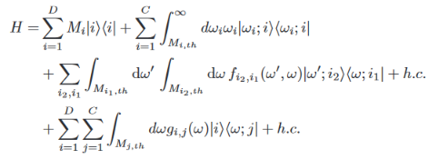
partial wave decompostion in non-relativistic and relativistic theories with self-interactions
We can label the continuum states with diﬀerent λ using sequential integers 1, 2, ... as ,j = 1,··· ,C and using |i⟩ to denote diﬀerent discrete states, i = 1,2···D, for a totally C continuum states and D discrete states in one partial-wave channel.
It is solvable in some case.
See Zhiguang Xiao, ZYZ , arXiv:1610.07460

Slide 30
Summary
Extend the Friedrichs model to general cases.
General properties of Gamow states in Friedrichs-like model are obtained.
It could help us to understand the wave functions of unstable states.
Applications of the Friedrichs-like model in hadron physics.

Slide 31
Thanks for your patience!

