Slide 1
Dibaryon search based on
NN interaction
Fan Wang
Dept. of Physics, Nanjing university
fgwang@chenwang.nju.edu.cn

Slide 2
Outline
Introduction, similarity of nuclear and molecular force
II. Meson exchange or quark delocalization
III. Conclusion

Slide 3
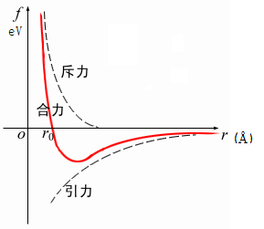
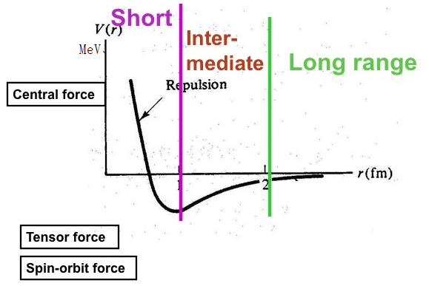
I. Introduction
Similarity of nuclear force and molecular frce
Similarity
electron percolation quark delocalization

Slide 4
Statement of US CPEP
(contemporary physics education project)
Critiscism from P.W. Anderson:
Meson exchange model ignores nucleon internal structure, nuclear force can not be solely due to meson exchange.
Phys. Today, 53（2），11（2000）14，http://dx.doi.org/10.1063/1.882955
CPEP statement(2003):
The binding force to bind the nucleon into nucleus is a residual interaction, which is due to the color interaction between the color quark within the colorless nucleon. This is similar to the molecular bond, the interaction between the chargeless atom is due to the electric interaction between the electron within the chargeless atom. When two electric neutral atom close together, the electron cloud distorted due to delocalization of electron from one atom to neighbouring atom, this induces the residual interaction to bound the atom into molecular. Nucleus is a residual strong interaction bound molecule.

Slide 5
II. Meson exchange and quark delocalization
The orthodox model or theory of nuclear force is the meson exchange, from Yukawa meson exchange model through one boson exchange model to QCD based chiral perturbation. Both the one boson exchange and the chiral perturbation describe the vast NN scattering data and the deuteron bound state properties very well with about 30 parameters. However non of these model or theory explain the similarity of nuclear and molecular force.
Since the end of 1970’s the QCD based quark model has gone up on the stage, through worldwide over 30 years efforts quark model is now good enough to describe the vast NN scattering data and deuteron bound state properties as well as the meson exchange approach.
Quark model gives rise a non-local effective NN interaction potential due to quark exchange and so it is not as convenient as the meson exchange NN interaction potential to be used for nuclear structure and neutron star study.

Slide 6
Two kinds of quark model
There are two kinds of quark model which describes the NN interaction as well as the meson exchange approach.
The chiral quark model includes both meson exchange and gluon exchange.
R. Machleidt criticism: Chiral quark model is mainly a duplicate of Bonn one
boson exchange model.
My own view: Taking into account the nucleon internal structure with much less parameters (7 in comparison of 30 in meson exchange) explaining the repulsive core of NN interaction physically and vast NN scattering data as well as meson exchange approach, but leave the similarity between nuclear and molecular force unexplained.

Slide 7
Hamiltonian of chiral quark model

Slide 8
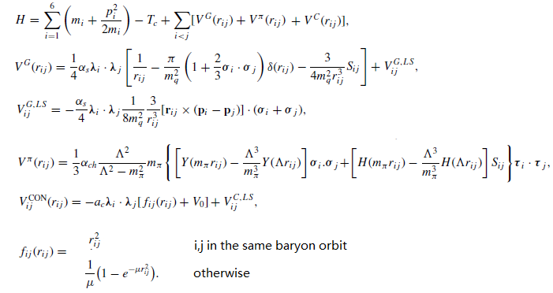
QDCSM(Quark delocalization, color screening model)
color screening: intra-inter confinement different

Slide 9
Quark delocalization:
the parameter ε is determined by system dynamics。
The main advantage of QDCSM :
the delocalization parameter is determined through its own dynamics, so multiquark system choose its most favorable configuration by variation.

Slide 11
RGM+GCM
RGM wavefunction

Slide 12
QDCSM vs ChQM
PRC 76(2007) 014001

Slide 13
deuteron

Slide 14
NN phase shifts

Slide 15
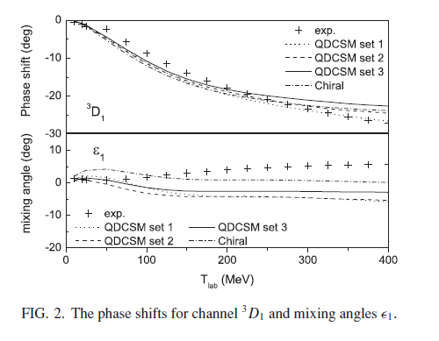

Slide 17
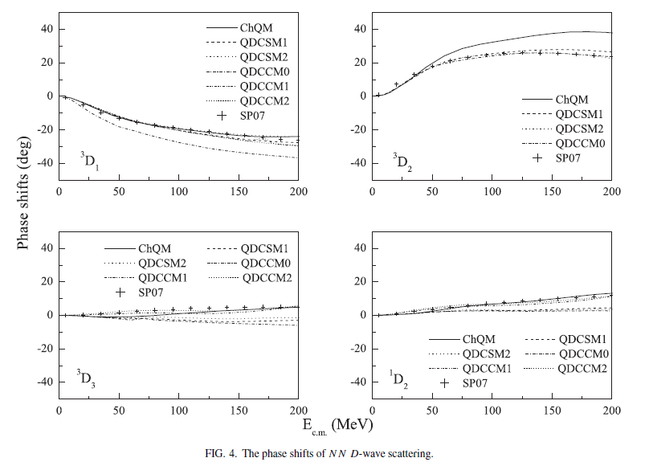

Slide 21
Color screening is an effective description of hidden color channel coupling
In PRC84(2011)064001 we studied hidden color channel coupling effect and showed that we can reproduce the NN scattering phase shifts and deuteron properties as well as chiral quark model and QDCSM through the adjusting of hidden color channel coupling constants.
This in turn shows that the color screening confinement introduced in QDCSM is an effective description of the more complicated hidden color channel coupling.
The comparative study of chiral quark model and QDCSM in PRC76(2007)014001 shows that the σ meson introduced in chiral quark model is an effective description of the quark delocalization and color screening.
Combining these together the σ meson exchange can be replaced by the quark delocalization and hidden color channel coupling.

Slide 22
Prediction of dibaryon
Nanjing-UCLA-LANL collaboration
In 1989, “Inevitable nonstrange dibaryon”
T.Goldman, K. Maltman, and F. Wang et al., PRC 39(1989) 1889
If the physical contents of quark model is correct
the existence of IJ^{P}=03⁺ dibaryon is inevitable
IJ^{P}=03⁺ dibaryon: a spin excitation of d, named d*

Slide 23
Why d* is “inevitable”
T. Goldman, K. Maltman, F. Wang et al.,
in Brookhaven 1988:Glueballs, hybrids and exotic hadrons, p. 413;
PRC39 (1989)1889.
1. Kinetic energies: quark delocalization reduces the quark kinetic energy of dibaryon systems.
2. Color-Magnetic Interaction gives rise effective attraction between flavor decuplet baryons.
the existence of IJ^{P}=03⁺ dibaryon is inevitable
IJ^{P}=03⁺ dibaryon: a spin excitation of d, named d*

Slide 24
Comprehensive studies of d*
Quark delocalization color screening model:
PRL69(1992)2901;
PRC51 (1995) 3411;
Relativistic QM: Ping, Mod. Phys. Lett., A13 (1998) 59;
QDCSM d* decay: NPA688 (2001) 871;
Extended QDCSM d* decay: PRC65 (2002) 044003;
d* production and decay: PRC57 (1998) 1962;
three-body decay of d*: PRC58 (1998) 2414;
d* decay: PRC70 (2004) 035201;
Feshbach resonance d*: ΔΔ bound state coupling to NN scattering
QDCSM and ChQM: PRC 79 (2009) 024001;
90(2014)064003.

Slide 25
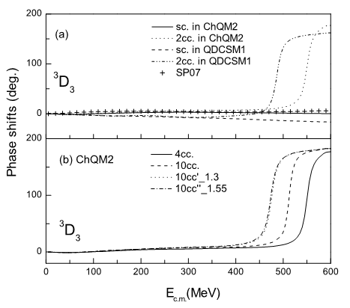
Fashbach resonance

Slide 26
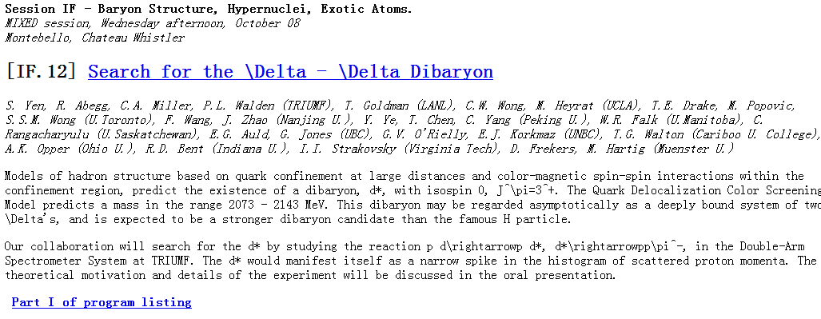
Proposals for d* searching
In 1990, LAMPF: four proposed experiments in 1990-2000
A better dibaryon than H particle
In 1997, TRIUMF: Search for the \Delta - \Delta Dibaryon
S. Yen, … (TRIUMF), T. Goldman (LANL), C.W. Wong, … (UCLA),
T.E. Drake, … (U.Toronto), F. Wang, … (Nanjing U.),
Y. Ye, … (Peking U.),
W.R. Falk (U.Manitoba), C. Rangacharyulu (U.Saskatchewan),
E.G. Auld, … (UBC), G.V. O'Rielly, … (UNBC),
T.G. Walton (Cariboo U. College), A.K. Opper (Ohio U.),
R.D. Bent (Indiana U.), I.I. Strakovsky (Virginia Tech),
D. Frekers, M. Hartig (Muenster U.)

Slide 27
Other dibaryons in QDCSM
D₁₂ (IJ^{P}=12⁺): M=2168 MeV, Γ=121 MeV
Experimental signal: M=2148 MeV, Γ=118 MeV
NΩ(IJ^{P}=1/2 2⁺): M=2549--2566 MeV, Γ< 1 MeV
ΩΩ(IJ^{P}=00⁺): M ~ 3300 MeV

Slide 28
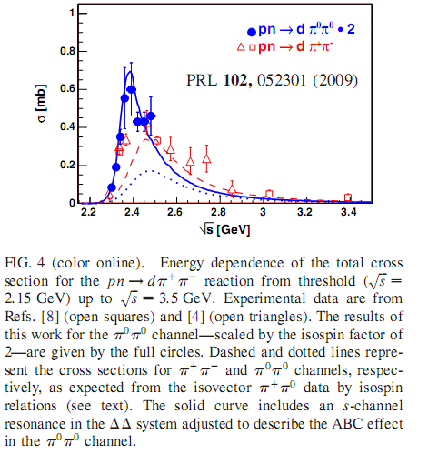
Discover of d*: WASA-at-COSY measurements

Slide 29
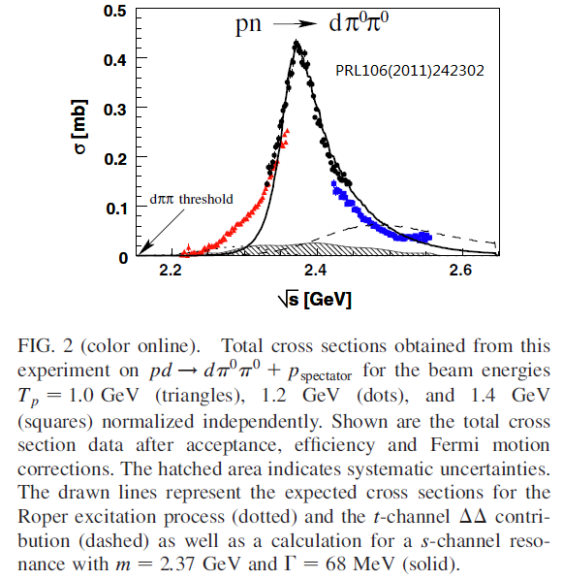

Slide 30
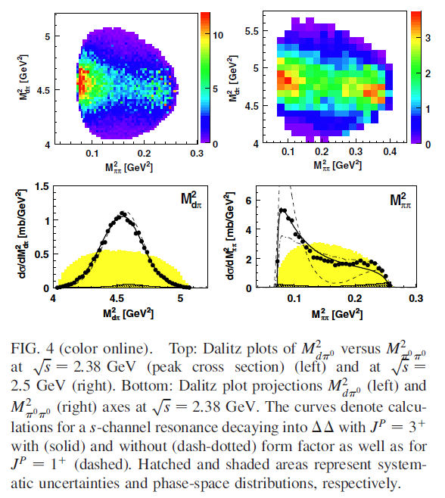

Slide 31
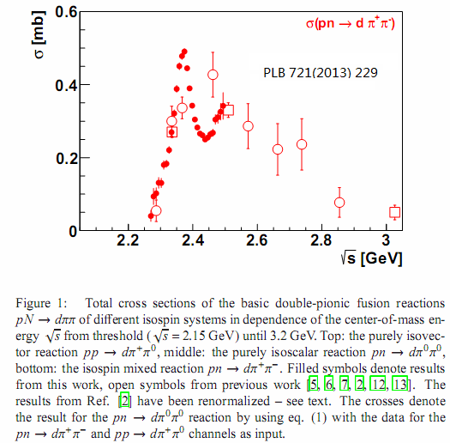

Slide 32
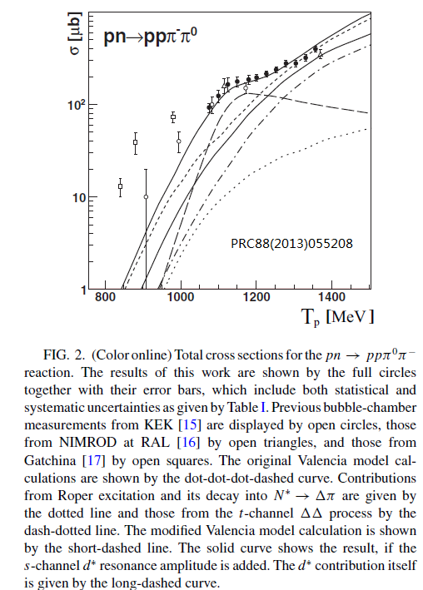

Slide 33
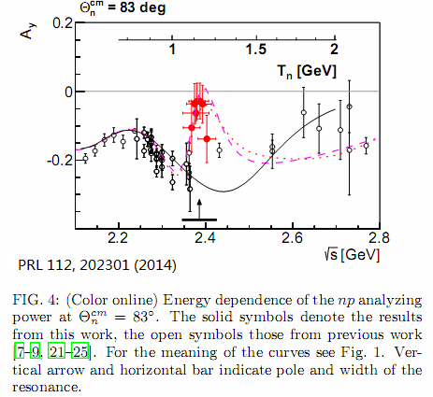

Slide 34
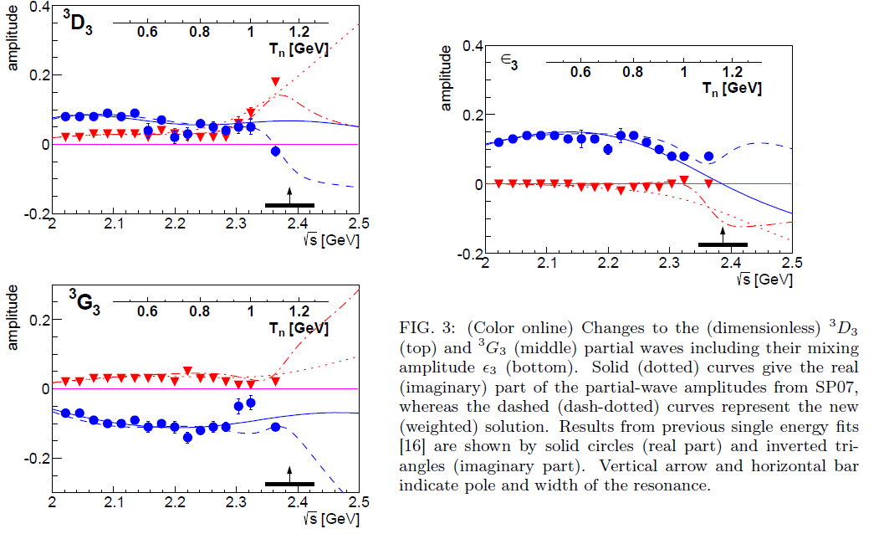

Slide 36
III. Conclusion
NN interaction can not be solely due to meson exchange, nucleon structure must play role.
Chiral perturbation hides the nucleon structure in the phenomenological contact terms.
Chiral perturbation and chiral quark model both describe the NN interaction well but have not explained the characteristic property of NN interaction-similar to the molecular force.
Quark delocalization and hidden color channel coupling model not only describes the NN scattering phase shifts and deuteron properties as well as meson exchange approaches but also explains the similarity of nuclear and molecular force, moreover it predicts that the IJP=03+ d* dibaryon is inevitable. This prediction has been confirmed by comprehensive WASA-at-COSY collaboration measurements, especially the polarized np scattering.

