Slide 1
Seismic images in Guangdong and approaches to retrieve density information
Liang ZHAO
State Key Laboratory of Lithospheric Evolution
IGG,CAS
May 23, 2016

Slide 2
Outlines
Seismic arrays in South China and the seismic images in Guangdong
Methods of retrieving density models

Slide 3
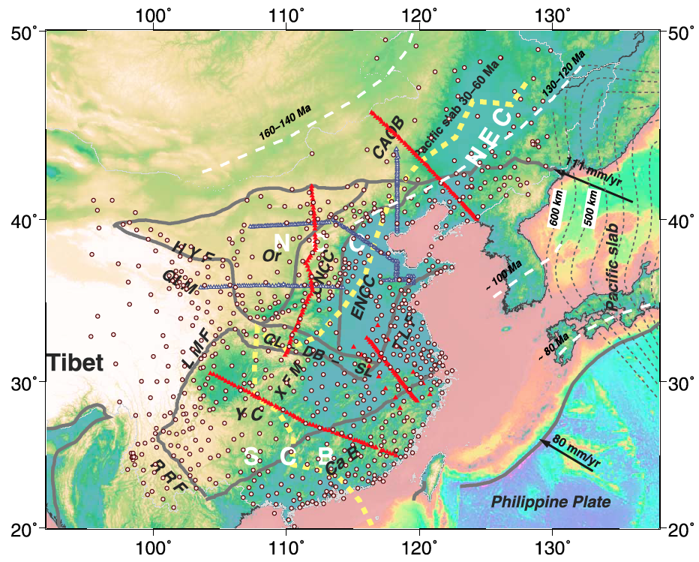
1. Seismic arrays in eastern China
~1300 stations

Slide 4
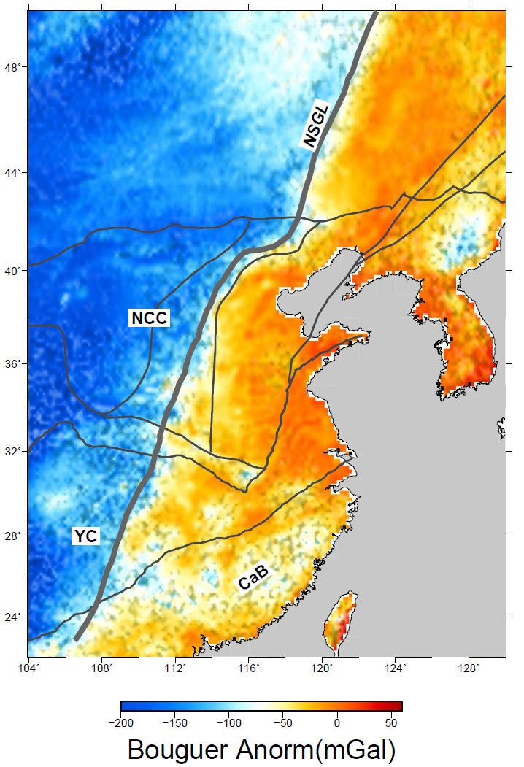
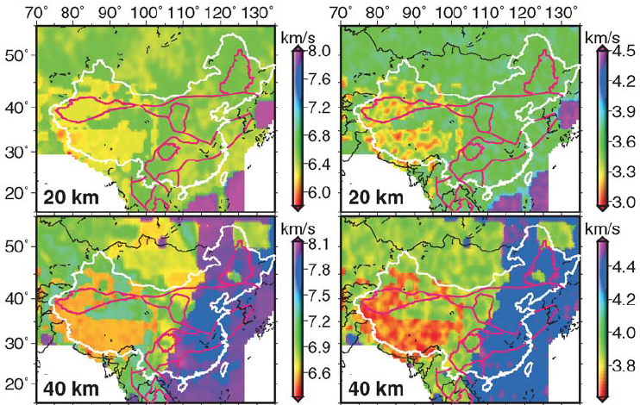
Bouguer anomaly
Sun et al., BSSA, 2008

Slide 5
Vp and Vs models
Sun et al., BSSA, 2008

Slide 6
Sun et al., BSSA, 2008

Slide 7
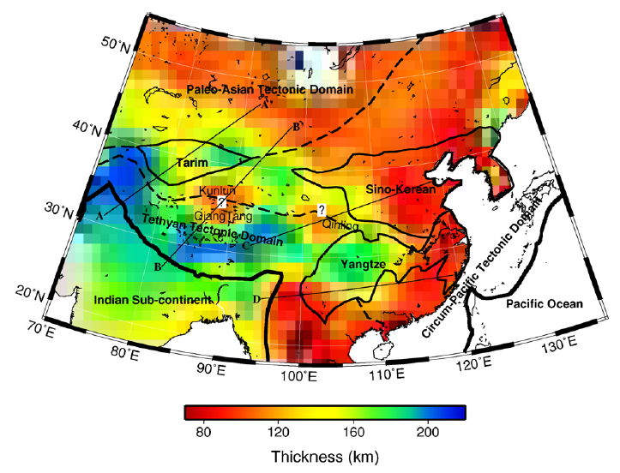
Lithosphere-asthenosphere boundary
An and Shi. PEPI, 2006

Slide 8
Upper mantle
Zhao et al., GGG, 2012

Slide 9
Chen et al., JGR, 2015

Slide 10
Shear wave model: average of 120-300 km

Slide 11
Except permanent stations, we did not have specified arrays in Guangdong yet,
So,
We do not have good enough images

Slide 12
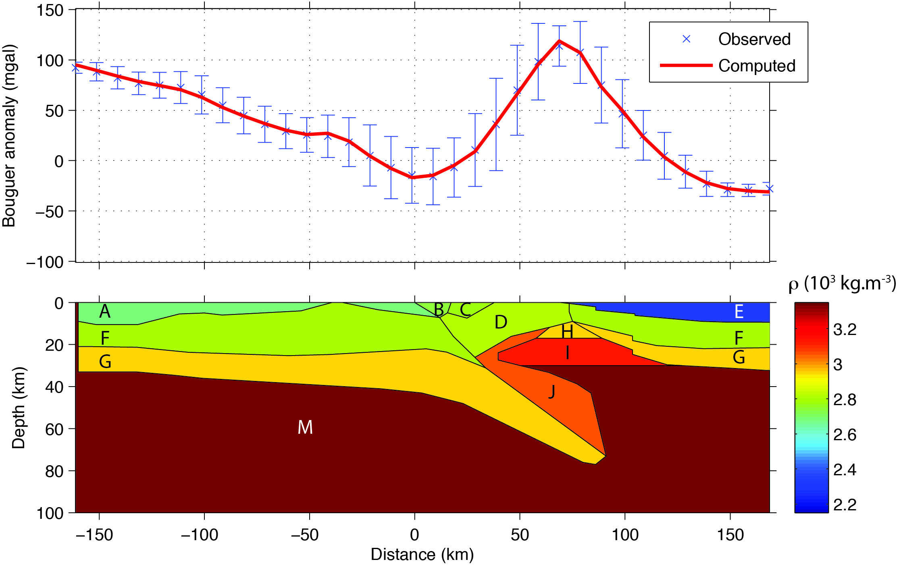
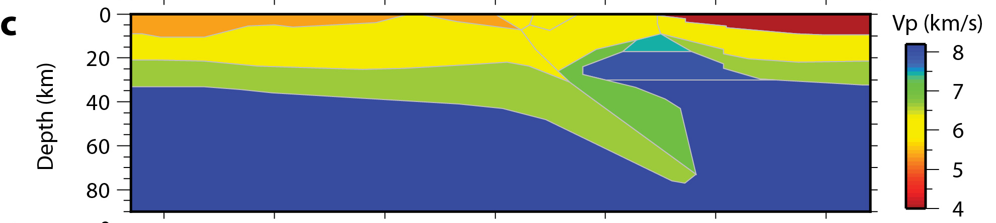
2. Methods of retrieving density model
Empirical linear relationship
Sediment layers (Vp = 3.85ρ - 4.81 with Vp in km∙s⁻¹ and ρ in 10³ kg∙m³; Perrier and Ruegg, 1973)
Upper and lower crust (Nafe and Drake, 1957; Ludwig, 1970),
Subduction zones for the Ivrea body and mantle layer (Christensen, 2004 ; Reynard, 2013)
Zhao et al., Geology, 2015

Slide 13
Perple_x

Slide 14
Perple_x

Slide 15
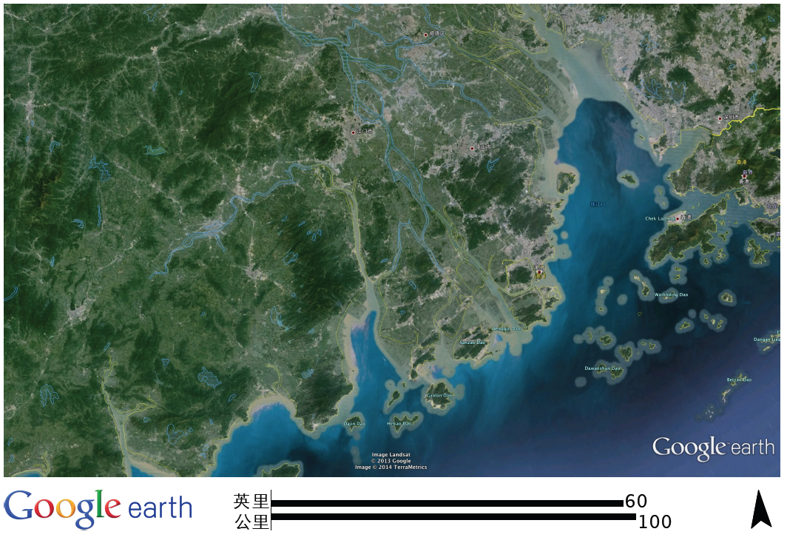
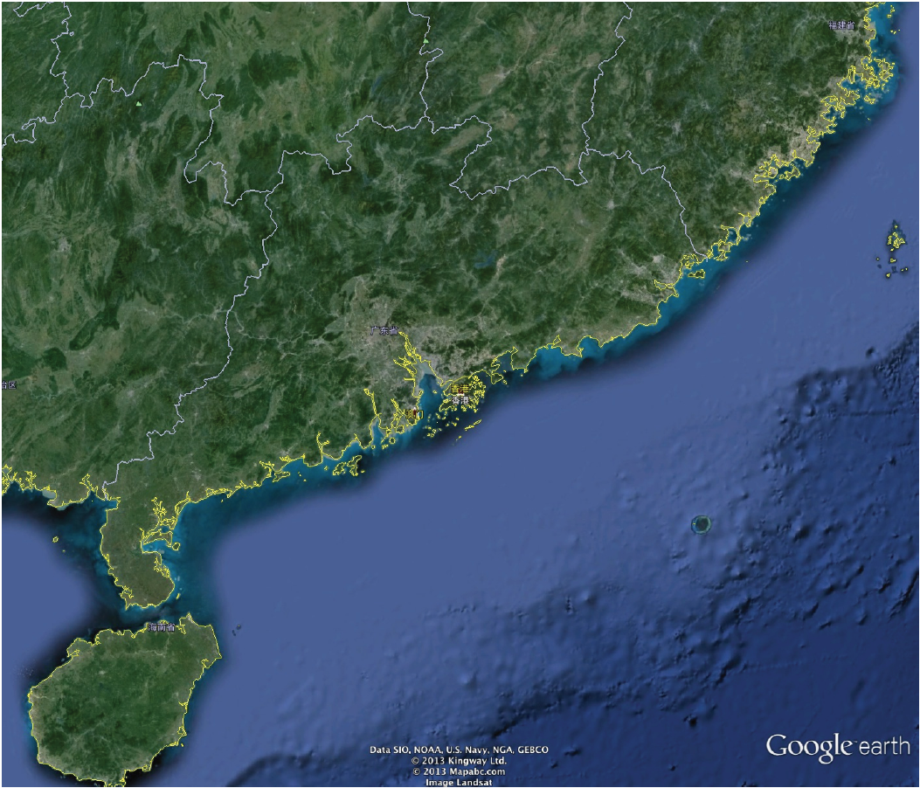
Increasing the density of seismic array
+ Using adopted network
+ OBS in the sea
Explosive method is impossible here!

Slide 16
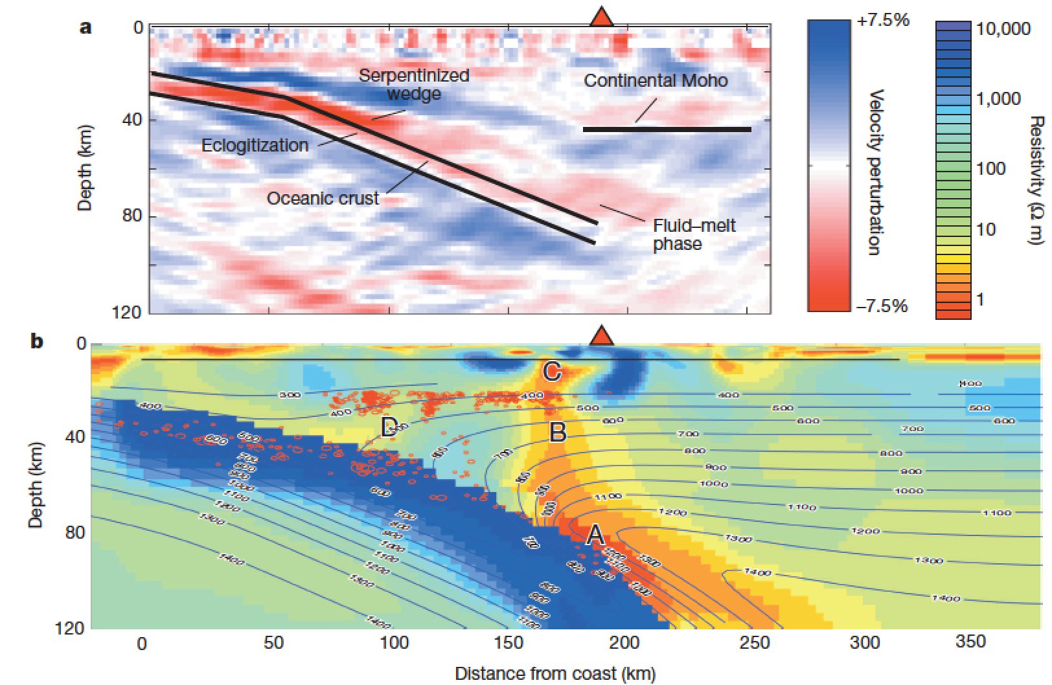
MT-image
[McGary et al., 2014]

Slide 17
Thank you for your attention

