Slide 1
Temperature in the Crust
Lijuan He
Institute of Geology and Geophysics,
Chinese Academy of Sciences

Slide 2
Determining crustal temperature:
What needs to be done?
a. Equation
b. Heat flow
c. Radiogenic heat production
d. Thermal conductivities of rocks

Slide 3
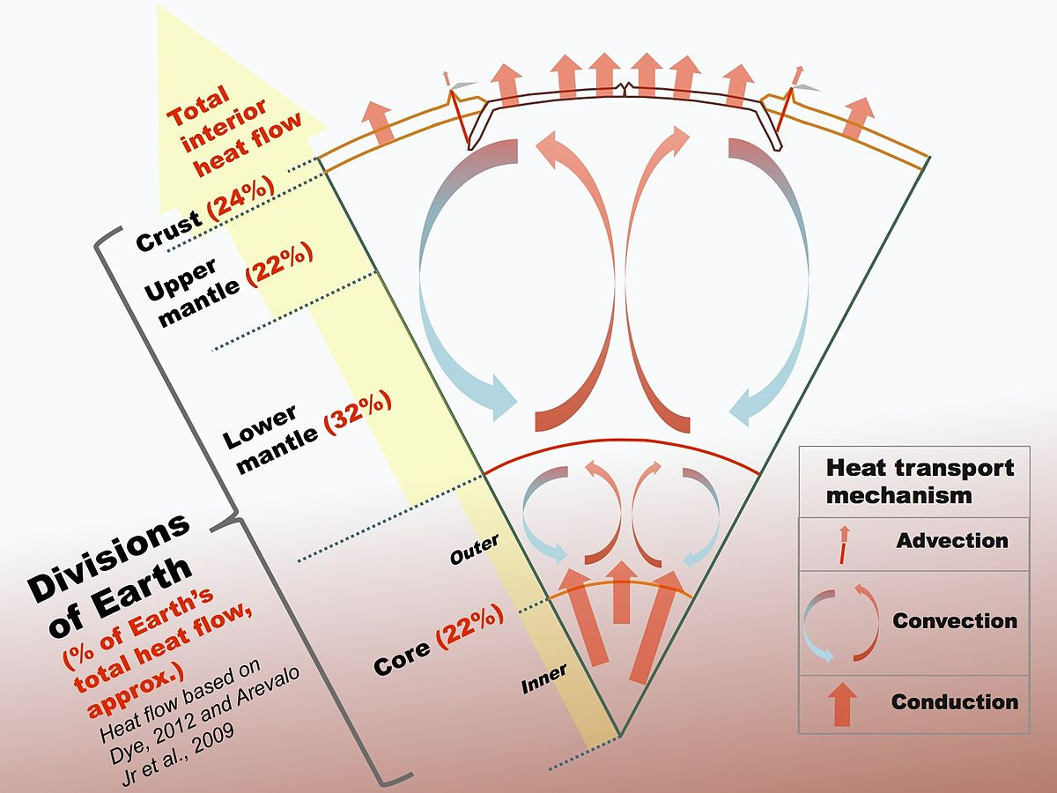
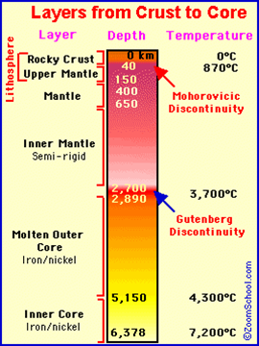
Temperature field of Earth and transient heat transfer equation

Slide 4
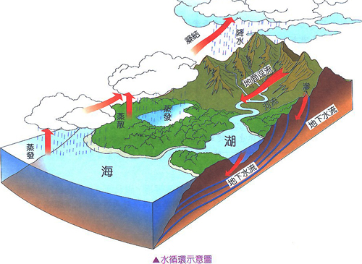
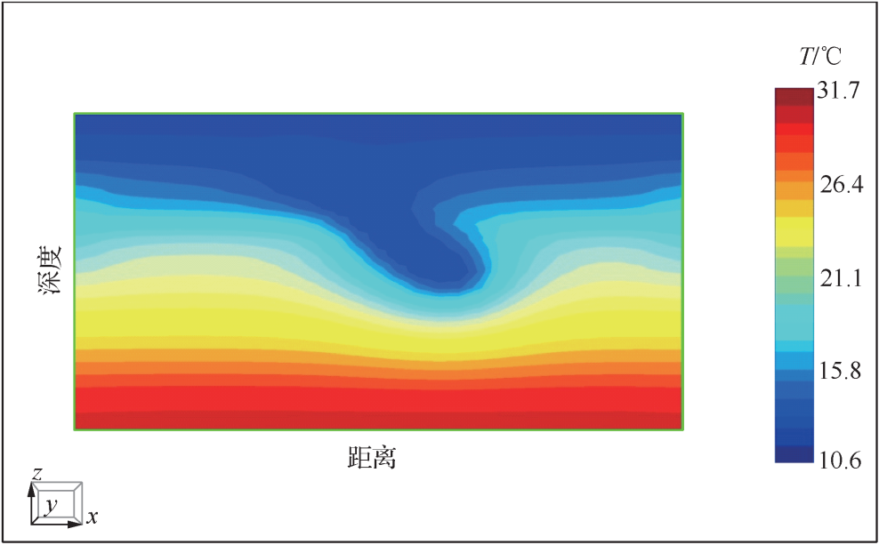
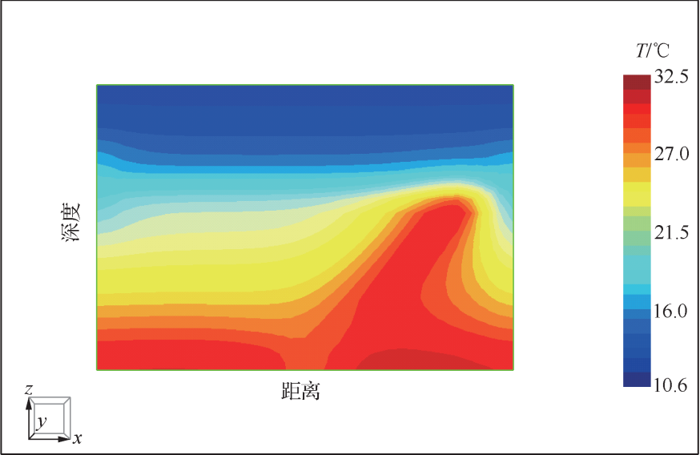
Effects of water circulation on temperature field
Low-Medium temperature geothermal resources are widespread in the Southeast China
Faults, detailed crustal structure

Slide 5
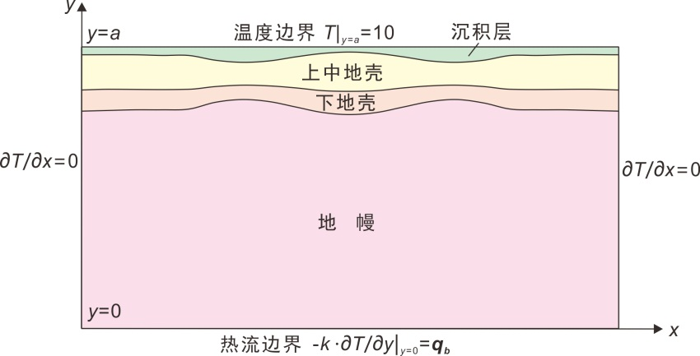
From transient to steady
Boundary conditions

Slide 6
Determining crustal temperature:
What needs to be done?
a. Equation
b. Heat flow
c. Radiogenic heat production
d. Thermal conductivities of rocks

Slide 8
(921)

Slide 10
Determining crustal temperature:
What needs to be done?
a. Equation
b. Heat flow
c. Radiogenic heat production
d. Thermal conductivities of rocks

Slide 11
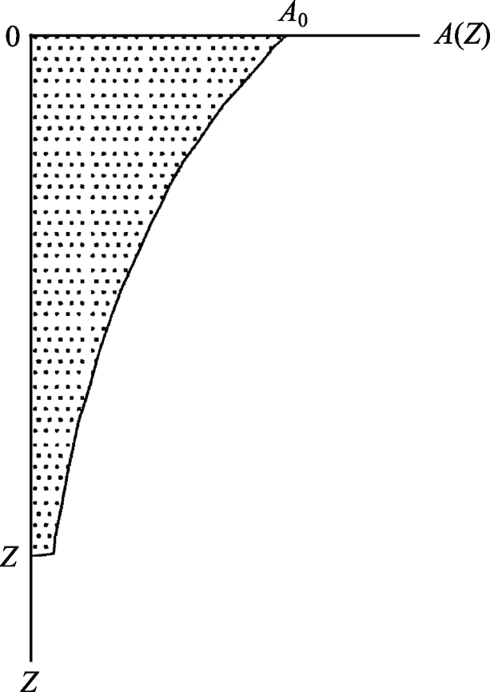
Vertical distribution of A in the crust
the downward-decreasing exponential model
The exponential distribution model for radiogenic heat production has seen widespread use and acceptance since it was first proposed by Lachenbruch (1968).

Slide 12
Continental Scientific Drilling Project
Implement of the continental scientific drilling made it possible to observe directly the detailed distribution of the heat production in the upper part of the crust, and to verify the heat production model of crust.
There are more than 20 continental scientific drillings in the worldwide up to now, none of them has observed the downward-decreasing exponential distribution.

Slide 13
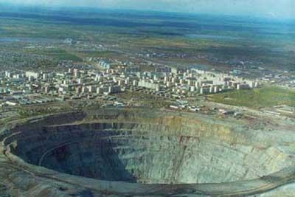
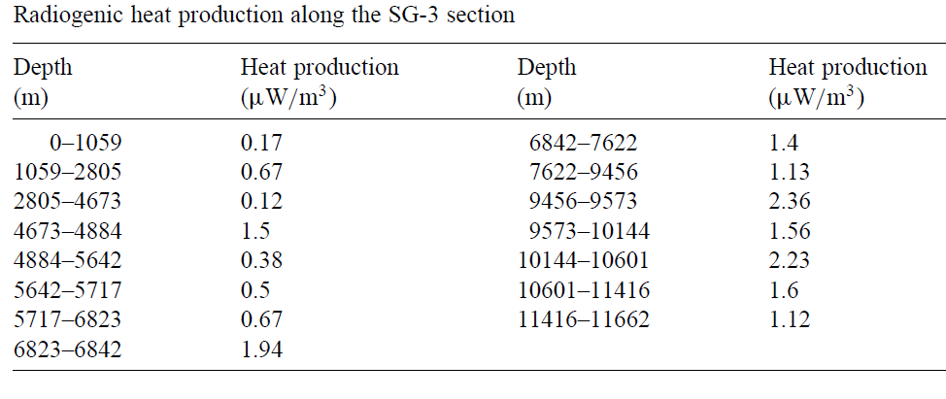
the Kola superdeep well SG-3
(Popov et al., 1999)

Slide 14
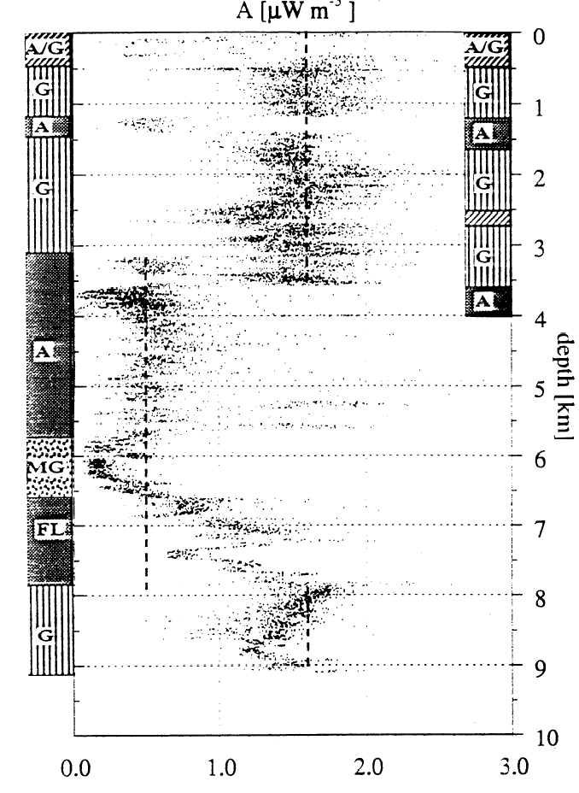
Continental Scientific Drilling Project
KTB
CCSD
(Pribnow and Winter, 1997)
(He et al., 2009)

Slide 15
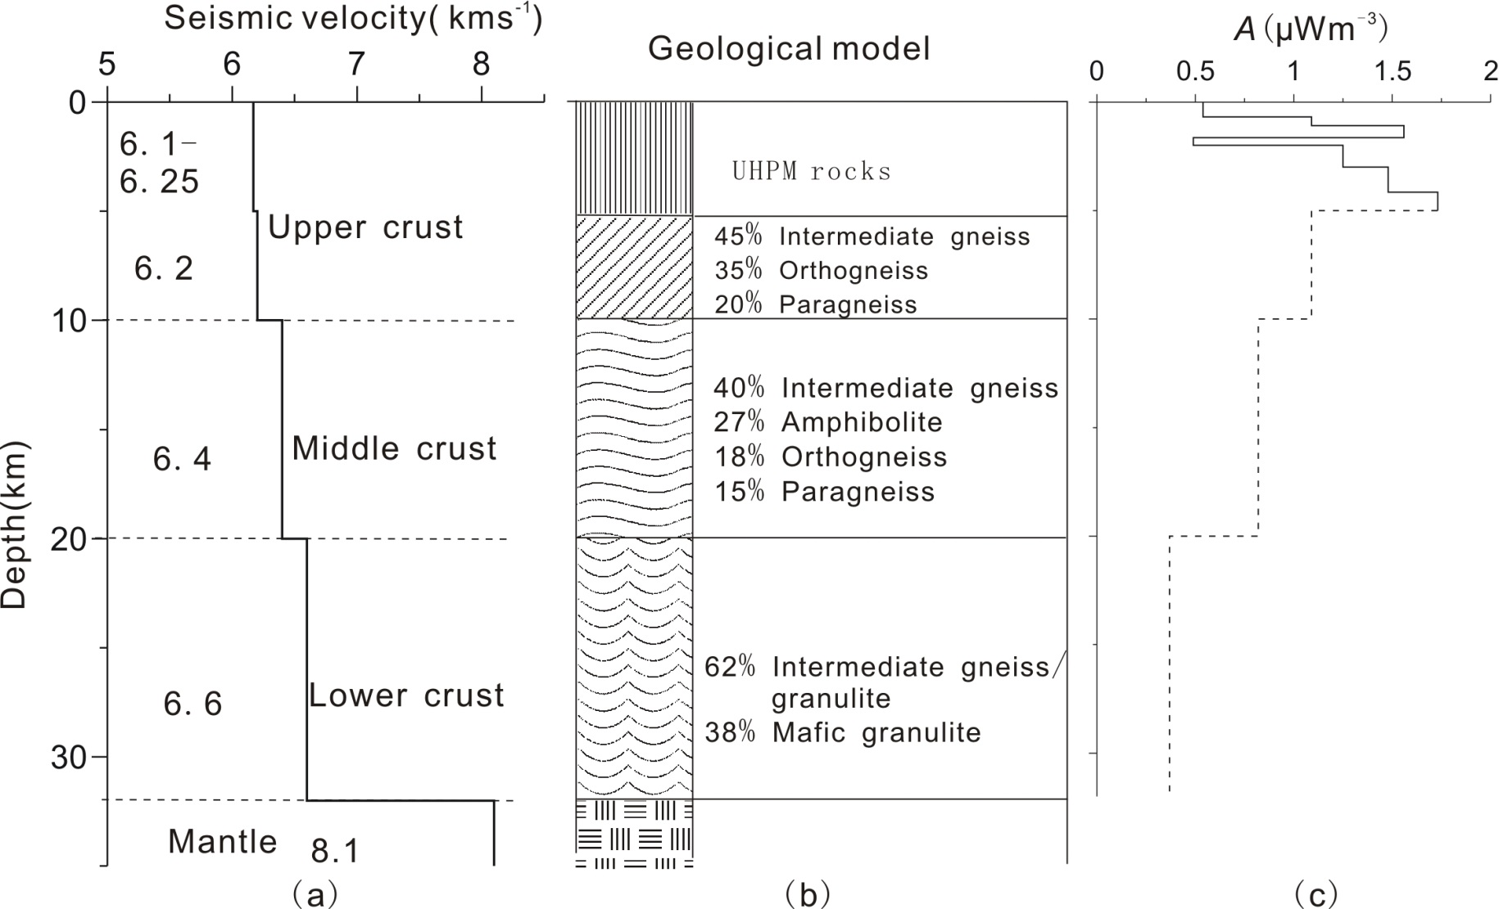
Multi-layer model

Slide 16
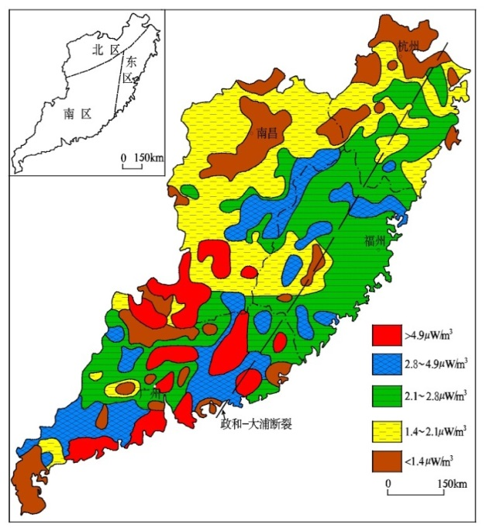
Radiogenic heat production in the Southeast China (Zhao et al., 1995)
Meso-Cenozoic volcanic rocks
granite
Such large high-A area is rare in the global continents

Slide 17
Determining crustal temperature:
What needs to be done?
a. Equation
b. Heat flow
c. Radiogenic heat production
d. Thermal conductivities of rocks

Slide 18
2D/3D numerical modeling of temperature field based on software
Detailed simulation of crustal temperature acquires deep understanding about heat flow, the crustal structure and the thermo-physical properties of rocks.

Slide 19
Uncertainty analysis of thermal modeling
Parameters | Values | Error ( %) | Thermal thickness of L( %) | T of Moho (%) | Mantle Q(%)
Heat flow | 62 mW·m⁻² | +10 | -18 | +14 | +19
Thickness
sediments | 2.5 km | +10 | -0.1 | +0.2 | +0.02
Upper-Mid crust | 22 km | +10 | +5 | +2 | -7
Lower crust | 14 km | +10 | +0.4 | +3 | -1
A
sediments | 1.08 μW·m⁻³ | +10 | +1 | +0.6 | -1
Upper-Mid crust | 1.1 μW·m⁻³ | +10 | +7 | -3 | -7
Lower crust | 0.3μW·m⁻³ | +10 | +1 | -0.2 | -1
Upper mantle | 0 μW·m⁻³ | 0.03 μW·m⁻³ | +2 | +0.01 | 0
K
sediments | 2.2 W·m⁻¹K⁻¹ | +10 | +1 | +1 | 0
Upper-Mid crust | 2.56 W·m⁻¹K⁻¹ | +10 | +3 | +5 | 0
Lower crust | 2.6 W·m⁻¹K⁻¹ | +10 | +2 | +3 | 0
Upper mantle | 3.2 W·m⁻¹K⁻¹ | +10 | +6 | 0.01 | 0

Slide 20
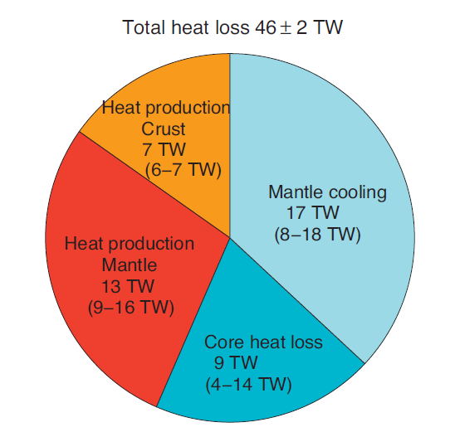
Concluding remarks
1. Importance of crustal thermal structure for Geo-neutrinos
2. Significance of Geo-neutrinos for secular cooling and thermal structure of earth: Provided that the crustal contribution to the geoneutrino flux can be very precisely calculated, it will be possible to put robust constraints on mantel radioactivity and its contribution to the Earth’s energy budget (Mareschal et al., 2012).
15%
37%
28%
20%
(Mareschal et al., 2012)

Slide 21
Thank you !

