Slide 1
Lattice design for CEPC PDR
Yiwei Wang, Feng Su, Jie Gao
27th May 2016, CEPC AP meeting

Slide 2
CEPC primary parameter （wangdou20160325）
 | Pre-CDR | H-high lumi. | H-low power | W | Z
Number of IPs | 2 | 2 | 2 | 2 | 2
Energy (GeV) | 120 | 120 | 120 | 80 | 45.5
Circumference (km) | 54 | 54 | 54 | 54 | 54
SR loss/turn (GeV) | 3.1 | 2.96 | 2.96 | 0.59 | 0.062
Half crossing angle (mrad) | 0 | 15 | 15 | 15 | 15
Piwinski angle | 0 | 2.5 | 2.6 | 5 | 7.6
N_{e}/bunch (10¹¹) | 3.79 | 2.85 | 2.67 | 0.74 | 0.46
Bunch number | 50 | 67 | 44 | 400 | 1100
Beam current (mA) | 16.6 | 16.9 | 10.5 | 26.2 | 45.4
SR power /beam (MW) | 51.7 | 50 | 31.2 | 15.6 | 2.8
Bending radius (km) | 6.1 | 6.2 | 6.2 | 6.1 | 6.1
Momentum compaction (10⁻⁵) | 3.4 | 2.5 | 2.2 | 2.4 | 3.5
β_{IP} x/y (m) | 0.8/0.0012 | 0.25/0.00136 | 0.268 /0.00124 | 0.1/0.001 | 0.1/0.001
Emittance x/y (nm) | 6.12/0.018 | 2.45/0.0074 | 2.06 /0.0062 | 1.02/0.003 | 0.62/0.0028
Transverse σ_{IP} (um) | 69.97/0.15 | 24.8/0.1 | 23.5/0.088 | 10.1/0.056 | 7.9/0.053
ξ_{x}/IP | 0.118 | 0.03 | 0.032 | 0.008 | 0.006
ξ_{y}/IP | 0.083 | 0.11 | 0.11 | 0.074 | 0.073
V_{RF} (GV) | 6.87 | 3.62 | 3.53 | 0.81 | 0.12
f _{RF} (MHz) | 650 | 650 | 650 | 650 | 650
Nature σ_{z} (mm) | 2.14 | 3.1 | 3.0 | 3.25 | 3.9
Total σ_{z} (mm) | 2.65 | 4.1 | 4.0 | 3.35 | 4.0
HOM power/cavity (kw) | 3.6 | 2.2 | 1.3 | 0.99 | 0.99
Energy spread (%) | 0.13 | 0.13 | 0.13 | 0.09 | 0.05
Energy acceptance (%) | 2 | 2 | 2
Energy acceptance by RF (%) | 6 | 2.2 | 2.1 | 1.7 | 1.1
n_{γ} | 0.23 | 0.47 | 0.47 | 0.3 | 0.24
Life time due to beamstrahlung_cal (minute) | 47 | 36 | 32
F (hour glass) | 0.68 | 0.82 | 0.81 | 0.92 | 0.95
L_{max}/IP (10³⁴cm⁻²s⁻¹) | 2.04 | 2.96 | 2.01 | 3.09 | 3.09

Slide 3
Considerations on ARC lattice design
FODO cell, 90 ° /90 °
non-interleaved sextupole scheme
n=5
All 3rd and 4th RDT due to sextupoles cancelled
Amplitude-dependent tune shift is very small
Ncell= 120
LB= 19.96
Lcell= 47.92
theta= .0032188449319567555
Lring= 54820.479999999996
Nstr1= 18
Nstr2= 20
Vrfc= 220625000
frf= 6.5e+08

Slide 4
this lattice
H-low power wangdou20160325
NIP=2
Eng=120
Lring=54820.48
U0=2.933
thetaC=-
thetaP=-
Ne=2.67
Nb=44
Ib=.0105
Pbeam=30.800
rhoB=6200
alfap=-
bxstar=-
bystar=-
ex=2.094e-09
ey=0
sigxIP=-
sigyIP=-
ksix=-
ksiy=-
Vrf=3.53e+09
frf=6.5e+08
sigmaz=.00264
sigmazt=-
Phom=-
sigmae=.00130
eapt=-
eaptrf=-
ngamma=-
tbs=-
Fhg=-
Lmax=-
NIP=2 ! Number of IPs [1]
Eng=120 ! Energy [GeV]
Lring=54*1E3 ! Circumference [m]
U0=2.96 ! SR loss/turn [GeV]
thetaC=15 ! Half crossing angle [mrad] thetaP=2.6 ! Piwinski angle [1]
Ne=2.67 ! Ne/bunch [10^11] Nb=44 ! bunch number [1]
Ib=10.5*1e-3 ! Beam current[A]
Pbeam=31.2 ! SR power/beam [MW] rhoB=6.2*1e3 ! Bending radius [m]
alfap=2.2e-5 ! Momentum compaction [1] bxstar=0.268 ! beta x at IP [m]
bystar=0.00124 ! beta y at IP [m]
ex=2.06*1e-9 ! emittance x [m*rad]
ey=0.0062*1e-9 ! emittance y [m*rad]
sigxIP=23.5*1e-6 ! beam size x at IP [m]
sigyIP=0.088*1e-6 ! beam size y at IP [m] ksix=0.032 ! ksix/IP [1]
ksiy=0.11 ! ksiy/IP [1]
Vrf=3.53*1e9 ! Vrf [V]
frf=650*1e6 ! frf [Hz]
sigmaz=3.0 ! Nature sigmaz [mm]
sigmazt=4.0 ! Total sigmaz [mm]
Phom=1.3 ! HOM power/cavity [kw] sigmae=0.13/100 ! Energy spread [1] eapt=2/100 ! energy acceptance [1] eaptrf=2.1/100 ! energy acceptance by RF [1] ngamma=0.47 ! number of gamma
tbs=32 ! life time due to beamstrahlung [min] Fhg=0.81 ! Factor of hour glass
Lmax=2.01 ! Lmax/IP [10^34/cm^2/s]
Damping time 15ms, i.e. 82 turns; filling factor 72.2%

Slide 5
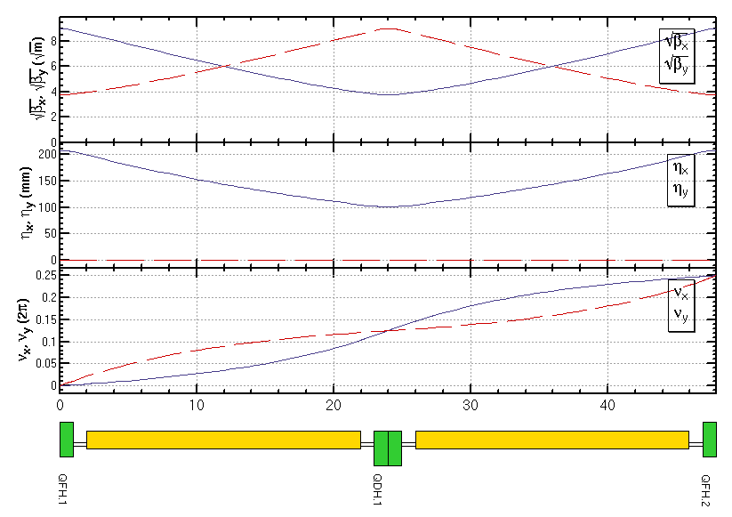
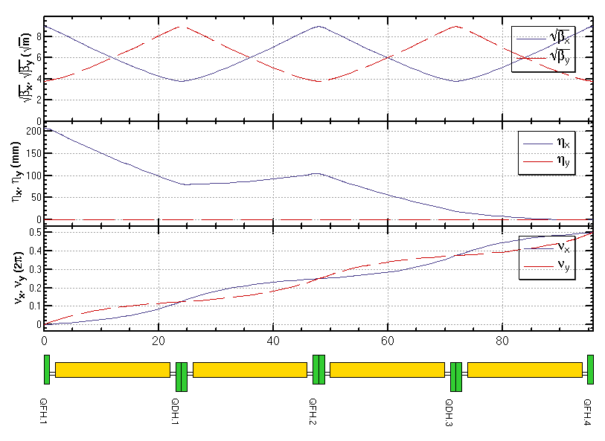
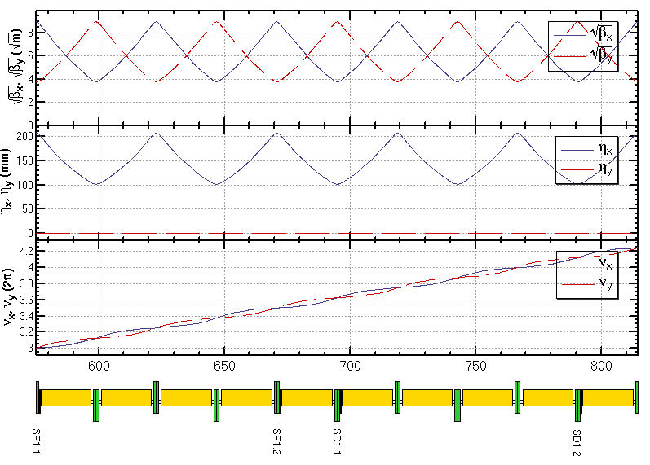
ARC lattice
FODO cell
Dispersion Suppressor
Sextupole configuration

Slide 6
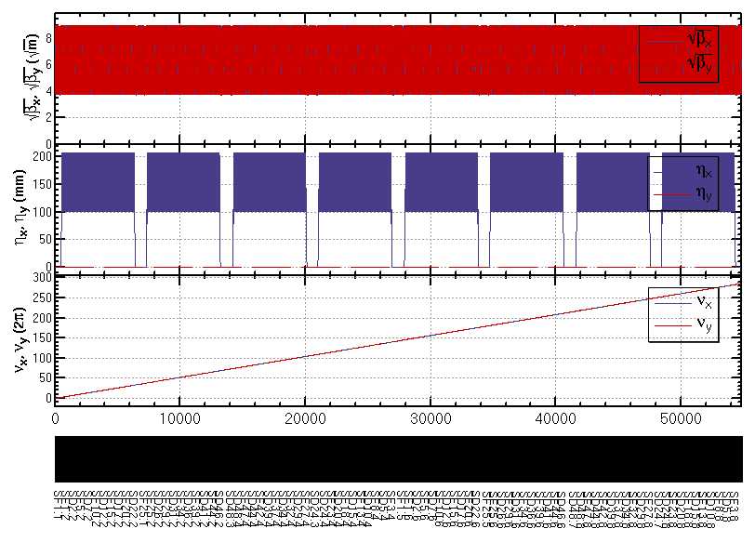
ARC lattice (cont.)
Whole ARC (w/o FFS,PDR)

Slide 7
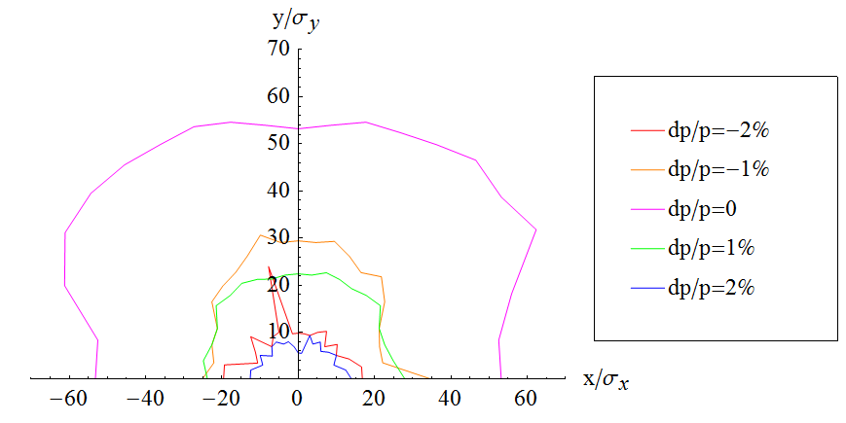
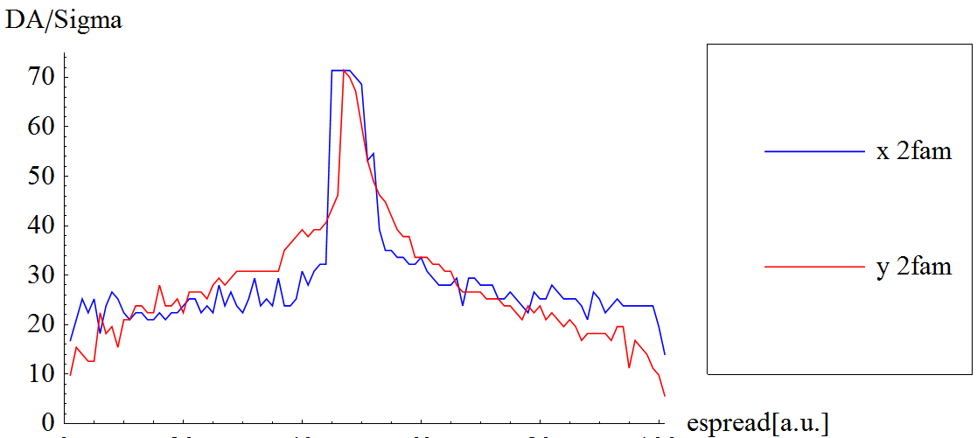
2 families of sextupoles
ARC_3
90/90 non-interleaved
SF1 =(L =.39999999999999997 K2 =.9680546863280827 )
SD1 =(L =.39999999999999997 K2 =-1.8843252788821787 )
No strong resonance line in dp/p=2%

Slide 8
Optimization of DA with non-interleaved sextupoles
Optimize bandwidth of Q vs. dp/p and constraint the break down of –I
In SAD, Q(dp/p) is calculated w/o synchrotron motion. However, the results will be very different between w/ and w/o synchrotron motion esp. dp/p is large.
Optimize the DA vs. dp/p directly
Four cases should be optimized together: (0,0),(0,Pi/2), (Pi/2, 0), (Pi/2,Pi/2)
w/ damping, w/o damping

Slide 9
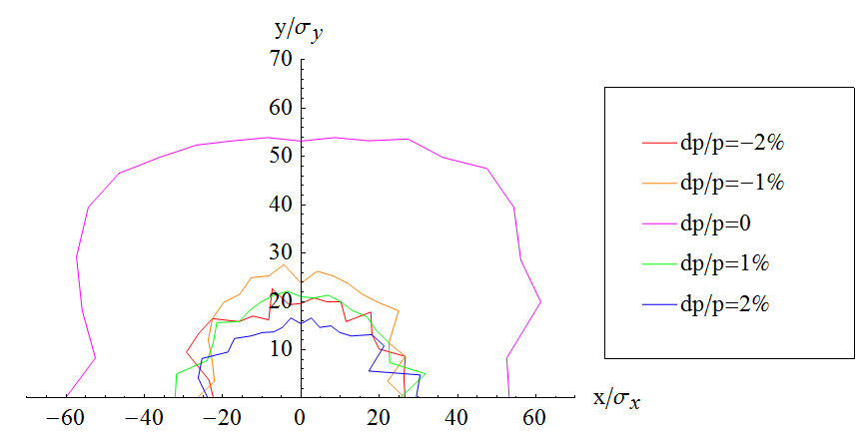
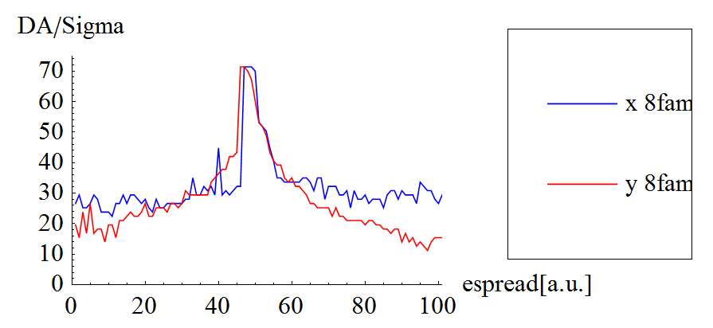
8 families of sextupoles (1)
SF1 =(L =.39999999999999997 K2 =1.0049552085951383 )
SD1 =(L =.39999999999999997 K2 =-1.8774102185487131 )
SF13 =(L =.39999999999999997 K2 =.9570321356746315 )
SD13 =(L =.39999999999999997 K2 =-1.8569945561714651 )
SF25 =(L =.39999999999999997 K2 =.9829370588944072 )
SD25 =(L =.39999999999999997 K2 =-1.848948069693812 )
SF37 =(L =.39999999999999997 K2 =1.012913577646016 )
SD37 =(L =.39999999999999997 K2 =-1.8893114648552132 )

Slide 10
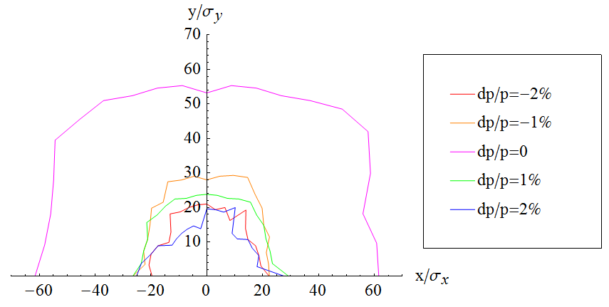
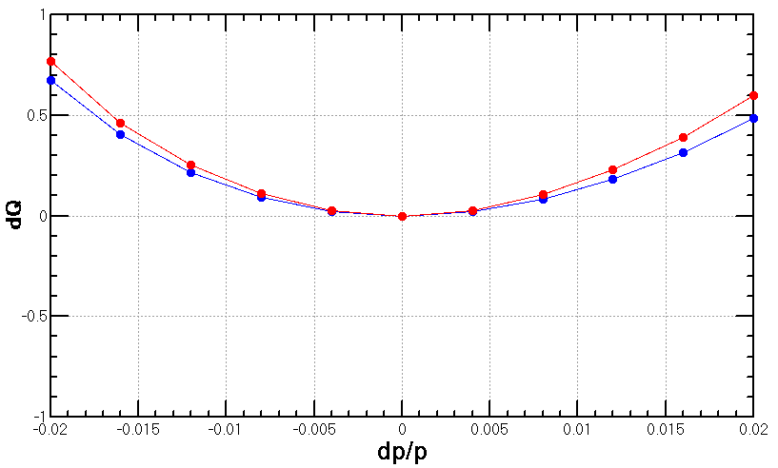
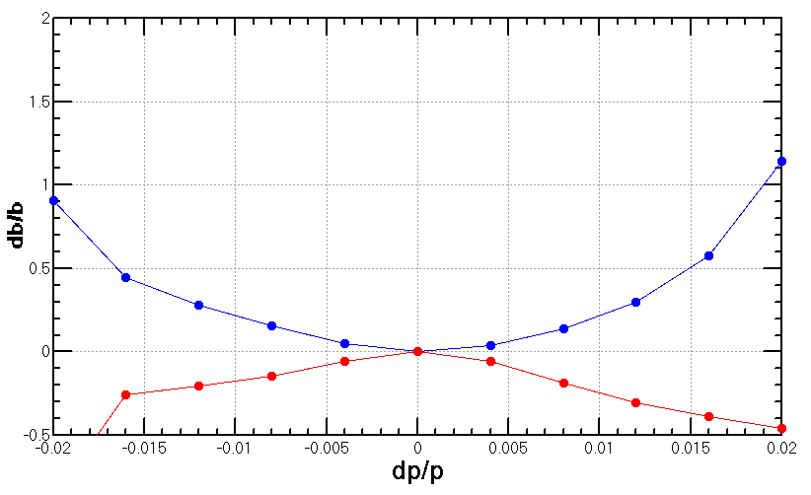
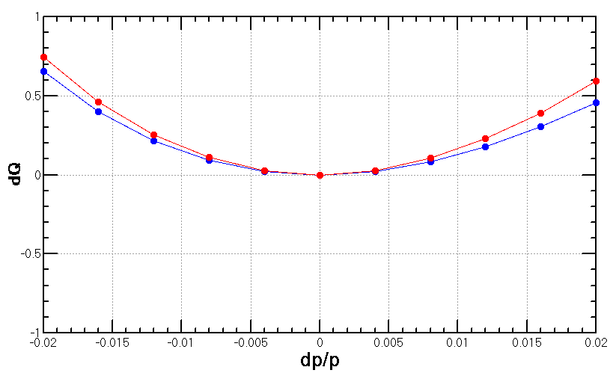
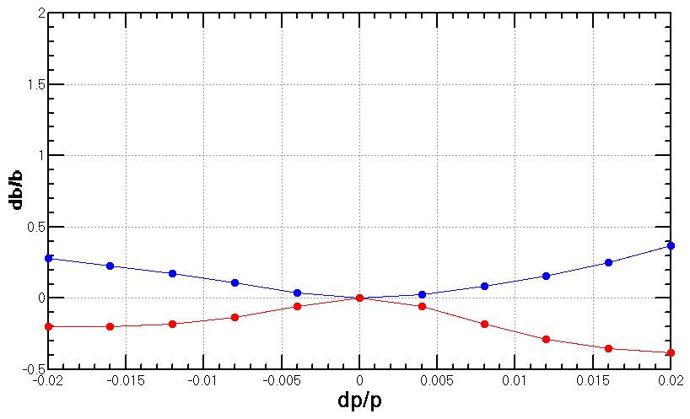
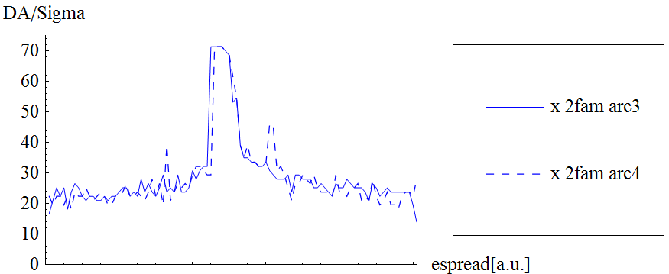
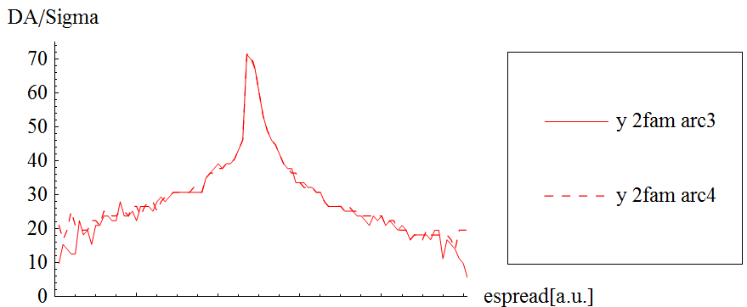
Phase advance between sections
ARC_3
ARC_4
90/90 non-interleaved
90/90 non-interleaved
SF1 =(L =.39999999999999997 K2 =.9680546863280827 )
SD1 =(L =.39999999999999997 K2 =-1.8843252788821787 )
SF1 =(L =.39999999999999997 K2 =.9680546863397813 )
SD1 =(L =.39999999999999997 K2 =-1.8843252788338383 )
w/o sync. motion
w/o sync. motion

Slide 11
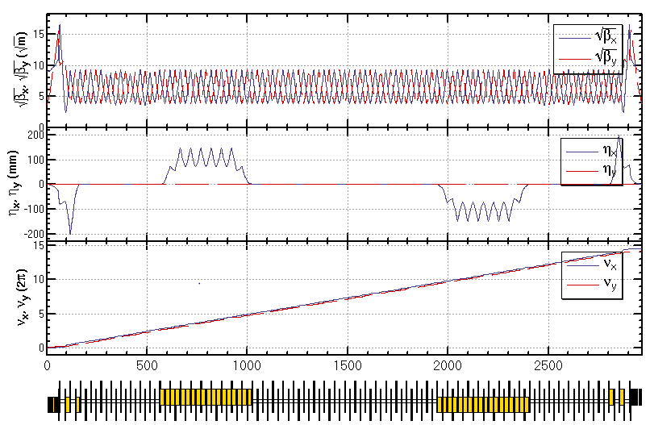
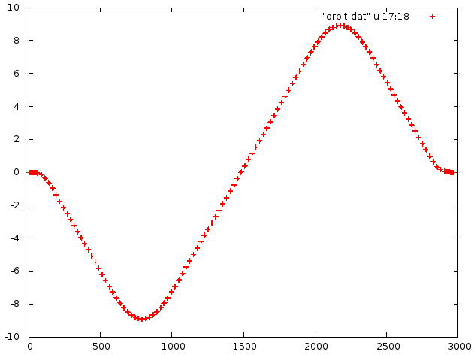
PDR
Adjust phase advance to be integer for 2*PDR
OGY [m]
OGX [m]

Slide 12
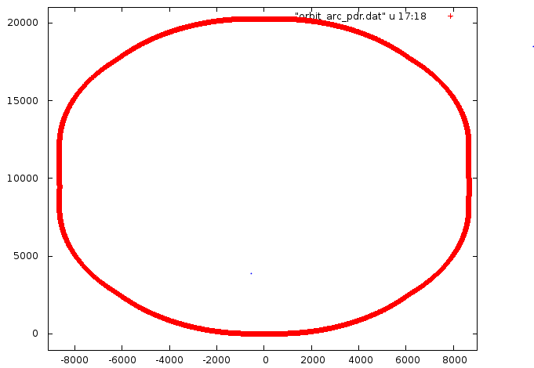
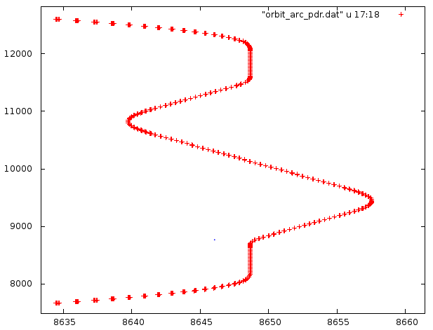
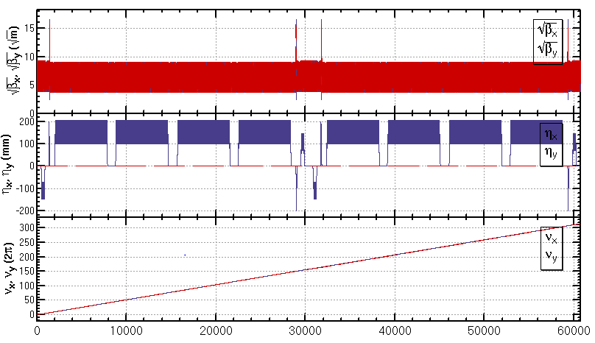
Geometry of ARC+PDR

Slide 13
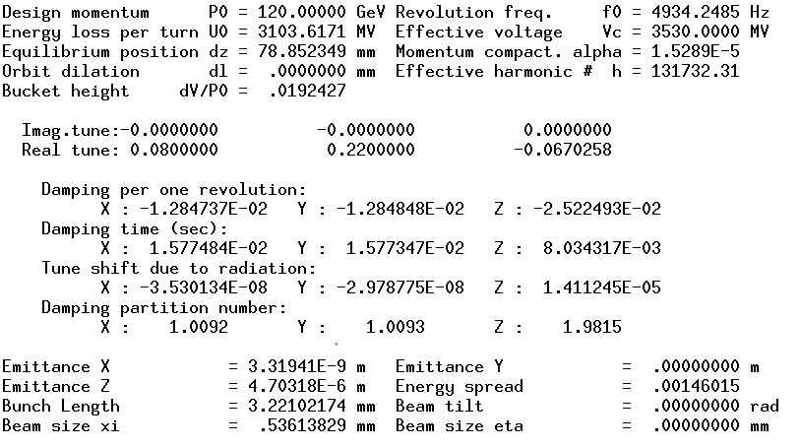
Para of ARC+PDR
Emittance growth is too much!
The bending region should be optimized.

Slide 14
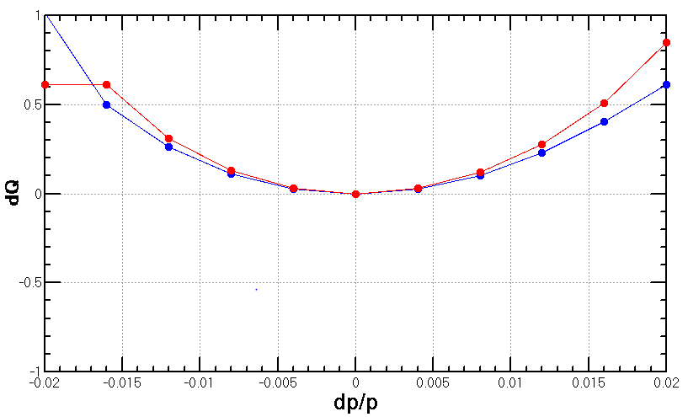
Chromaticity correction
w/o sextupoles in PDR
w/o sync. motion
w/o sync. motion

Slide 15
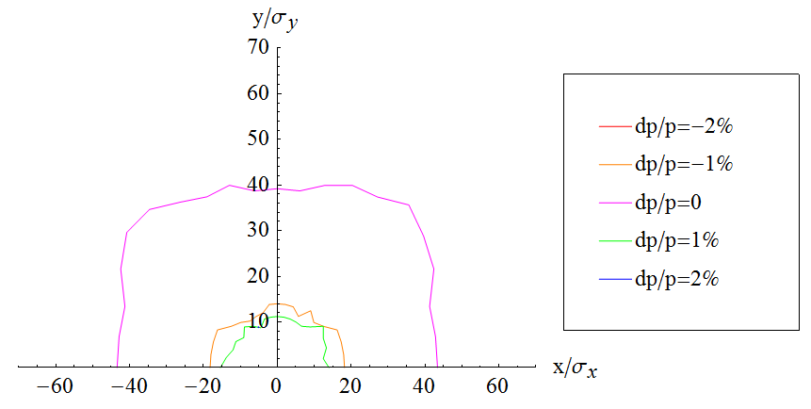
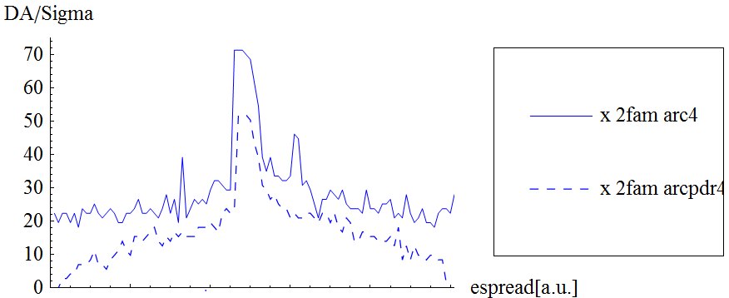
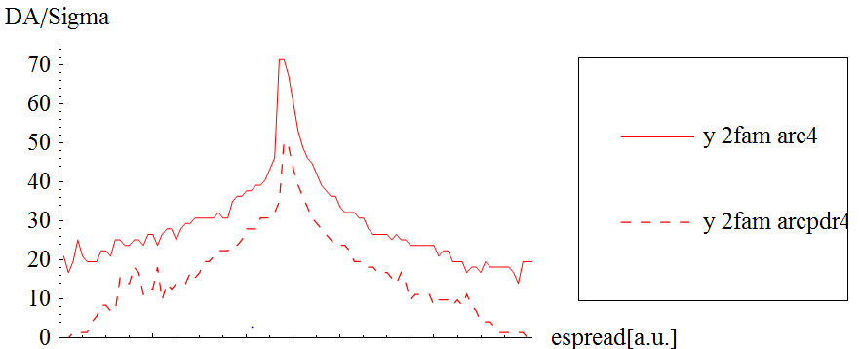
First result of DA
Sign of the sextupole in PDRL and PDRR should be oppisite.

Slide 16
Summary
An ARC lattice designed for the CEPC PDR
FODO cell, 90 ° /90 °, non-interleaved sextupole scheme
Most of the lattice parameters are consistent with the design goal
The dynamic aperture is optimized directly.
2 families: (55×55) for dp/p=0, (15 ×10) for dp/p=2%
2 families: (60×55) for dp/p=0, (20 ×20) for dp/p=2%
8 families: (55×55) for dp/p=0, (27×18) for dp/p=2%
Further optimization is possible: initial setting, more families
A larger ring has a bigger DA.

Slide 17
DA vs. Circumfence
If fix emittance, L↑ ⇒ Dx ↑ ξ↓ ⇒ K2↓ ⇒ DA ↑
(FODO cell, 90 ° /90 °)

Slide 18
Soure of the high order chromaticities
Consider only quadrupoles and sextupoles:

