Slide 1

CEPC partial double ring FFS design
Dou Wang, Jie Gao, Feng Su, Yuan Zhang, Yiwei Wang, Bai Sha, Huiping Geng, Tianjian Bian, Na Wang, Xiaohao Cui
CEPC AP meeting, 2016.05.27

Slide 2
parameter for CEPC partial double ring
（wangdou20160325）
 | Pre-CDR | H-high lumi. | H-low power | W | Z
Number of IPs | 2 | 2 | 2 | 2 | 2
Energy (GeV) | 120 | 120 | 120 | 80 | 45.5
Circumference (km) | 54 | 54 | 54 | 54 | 54
SR loss/turn (GeV) | 3.1 | 2.96 | 2.96 | 0.59 | 0.062
Half crossing angle (mrad) | 0 | 15 | 15 | 15 | 15
Piwinski angle | 0 | 2.5 | 2.6 | 5 | 7.6
N_{e}/bunch (10¹¹) | 3.79 | 2.85 | 2.67 | 0.74 | 0.46
Bunch number | 50 | 67 | 44 | 400 | 1100
Beam current (mA) | 16.6 | 16.9 | 10.5 | 26.2 | 45.4
SR power /beam (MW) | 51.7 | 50 | 31.2 | 15.6 | 2.8
Bending radius (km) | 6.1 | 6.2 | 6.2 | 6.1 | 6.1
Momentum compaction (10⁻⁵) | 3.4 | 2.5 | 2.2 | 2.4 | 3.5
β_{IP} x/y (m) | 0.8/0.0012 | 0.25/0.00136 | 0.268 /0.00124 | 0.1/0.001 | 0.1/0.001
Emittance x/y (nm) | 6.12/0.018 | 2.45/0.0074 | 2.06 /0.0062 | 1.02/0.003 | 0.62/0.0028
Transverse σ_{IP} (um) | 69.97/0.15 | 24.8/0.1 | 23.5/0.088 | 10.1/0.056 | 7.9/0.053
ξ_{x}/IP | 0.118 | 0.03 | 0.032 | 0.008 | 0.006
ξ_{y}/IP | 0.083 | 0.11 | 0.11 | 0.074 | 0.073
V_{RF} (GV) | 6.87 | 3.62 | 3.53 | 0.81 | 0.12
f _{RF} (MHz) | 650 | 650 | 650 | 650 | 650
Nature σ_{z} (mm) | 2.14 | 3.1 | 3.0 | 3.25 | 3.9
Total σ_{z} (mm) | 2.65 | 4.1 | 4.0 | 3.35 | 4.0
HOM power/cavity (kw) | 3.6 | 2.2 | 1.3 | 0.99 | 0.99
Energy spread (%) | 0.13 | 0.13 | 0.13 | 0.09 | 0.05
Energy acceptance (%) | 2 | 2 | 2
Energy acceptance by RF (%) | 6 | 2.2 | 2.1 | 1.7 | 1.1
n_{γ} | 0.23 | 0.47 | 0.47 | 0.3 | 0.24
Life time due to beamstrahlung_cal (minute) | 47 | 36 | 32
F (hour glass) | 0.68 | 0.82 | 0.81 | 0.92 | 0.95
L_{max}/IP (10³⁴cm⁻²s⁻¹) | 2.04 | 2.96 | 2.01 | 3.09 | 3.09

Slide 3
parameter for CEPC partial double ring
（wangdou20160525）
 | Pre-CDR | H-high lumi. | H-low power
Number of IPs | 2 | 2 | 2
Energy (GeV) | 120 | 120 | 120
Circumference (km) | 54 | 60 | 60
SR loss/turn (GeV) | 3.1 | 2.96 | 2.96
Half crossing angle (mrad) | 0 | 15 | 15
Piwinski angle | 0 | 4.0 | 4.0
N_{e}/bunch (10¹¹) | 3.79 | 1.56 | 1.56
Bunch number | 50 | 135 | 81
Beam current (mA) | 16.6 | 16.9 | 10.1
SR power /beam (MW) | 51.7 | 50 | 30
Bending radius (km) | 6.1 | 6.2 | 6.2
Momentum compaction (10⁻⁵) | 3.4 | 2.2 | 2.2
β_{IP} x/y (m) | 0.8/0.0012 | 0.104/0.003 | 0.104/0.003
Emittance x/y (nm) | 6.12/0.018 | 2.03/0.0061 | 2.03/0.0061
Transverse σ_{IP} (um) | 69.97/0.15 | 14.5/0.14 | 14.5/0.14
ξ_{x}/IP | 0.118 | 0.0086 | 0.0086
ξ_{y}/IP | 0.083 | 0.11 | 0.11
V_{RF} (GV) | 6.87 | 3.72 | 3.72
f _{RF} (MHz) | 650 | 650 | 650
Nature σ_{z} (mm) | 2.14 | 3.0 | 3.0
Total σ_{z} (mm) | 2.65 | 3.9 | 3.9
HOM power/cavity (kw) | 3.6 | 1.3 | 0.76
Energy spread (%) | 0.13 | 0.13 | 0.13
Energy acceptance (%) | 2 | 2 | 2
Energy acceptance by RF (%) | 6 | 2.5 | 2.5
n_{γ} | 0.23 | 0.44 | 0.44
Life time due to beamstrahlung_cal (minute) | 47 | 43 | 43
F (hour glass) | 0.68 | 0.97 | 0.97
L_{max}/IP (10³⁴cm⁻²s⁻¹) | 2.04 | 1.60 | 0.96

Slide 4
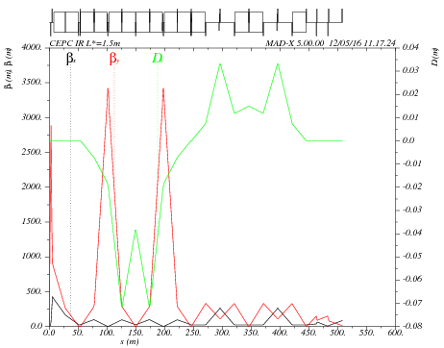
Main sextupole scan-1
ANGLE:=0.55*0.11E-2
Critical energy= 104kev
VARIABLE "TAR" SET TO 1.03759159e-21
k2hs = 12.0390943 ;
k2vs = 61.05953775 ;
sdqx = 0.0003550753638 ;
sdqy = 0.001262171022 ;
wwx = 31.40871865 ;
wwy = 25.84760159 ;
dqx0 = 4.722257884e-12 ;
dqy0 = -3.186364495e-11 ;

Slide 5

Main sextupole scan-2
ANGLE:=0.11E-2
Critical energy= 190kev
VARIABLE "TAR" SET TO 5.96771436e-21
k2hs = 6.582430847 ;
k2vs = 33.55590912 ;
sdqx = 0.0003778515548 ;
sdqy = 0.001134476048 ;
wwx = 33.39201438 ;
wwy = 21.79579772 ;
dqx0 = -7.523853893e-11 ;
dqy0 = 1.751789441e-11 ;

Slide 6

Main sextupole scan-3
ANGLE:=1.5*0.11E-2
Critical energy= 285kev
VARIABLE "TAR" SET TO 1.99795144e-21
k2hs = 4.864862799 ;
k2vs = 22.3536694 ;
sdqx = 0.0002047489039 ;
sdqy = 0.002049013286 ;
wwx = 21.33725775 ;
wwy = 24.68472653 ;
dqx0 = 2.6563816e-11 ;
dqy0 = 3.594878472e-11 ;

Slide 7
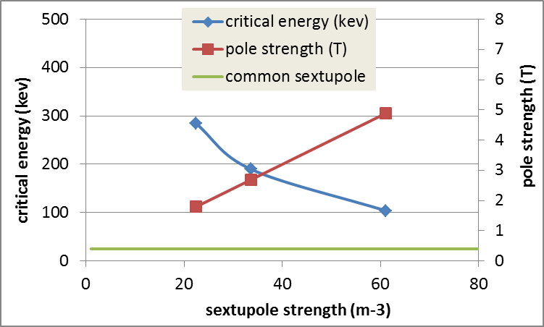
K2 vs. critical energy
* Assume the inner iris of sextupole is 2cm.

Slide 8
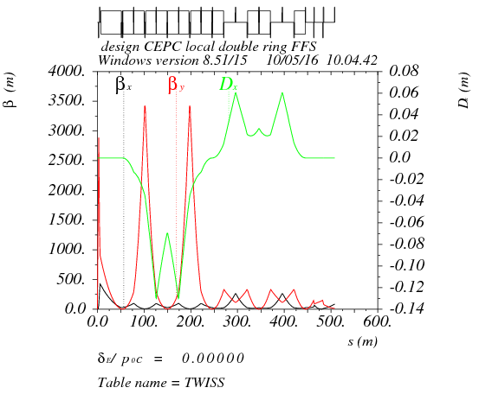
Betax*= 0.25m,Betay*=1.36mm
Crab sex
Critical energy= 190kev
K2HS := 28.25 m⁻³
K2VS := 32.18 m⁻³

Slide 9

Betax*= 0.25m,Betay*=2mm
Crab sex
Critical energy= 190kev
K2HS := 36.00 m⁻³
K2VS := 39.41 m⁻³

Slide 10
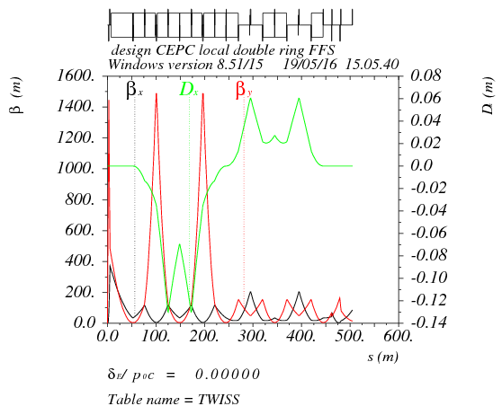
Betax*= 0.25m,Betay*=3mm
Crab sex
Critical energy= 190kev
K2HS := 36.03 m⁻³
K2VS := 43.46 m⁻³

Slide 11
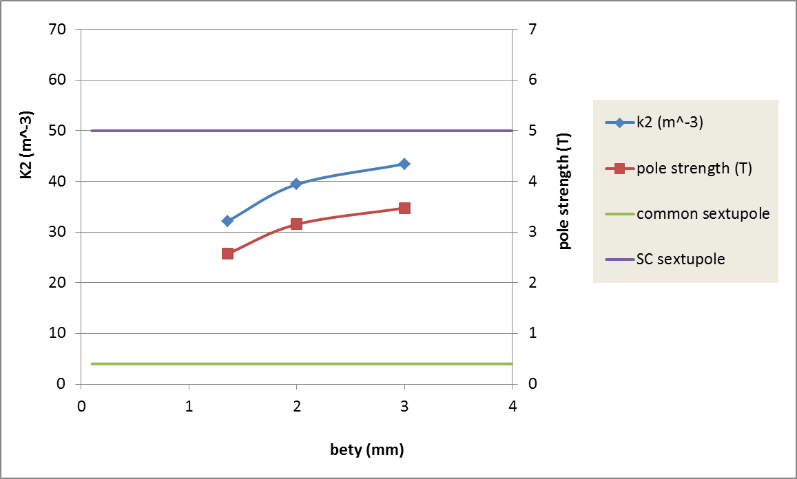
Sextupole strength vs. bety*
（190kev）
* Assume the inner iris of sextupole is 2cm.

Slide 12
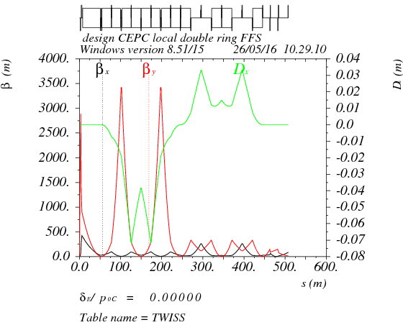
Betax*= 0.25m,Betay*=1.36mm
Crab sex
Critical energy= 104kev
K2HS := 48.8 m⁻³
K2VS := 58.7 m⁻³

Slide 13
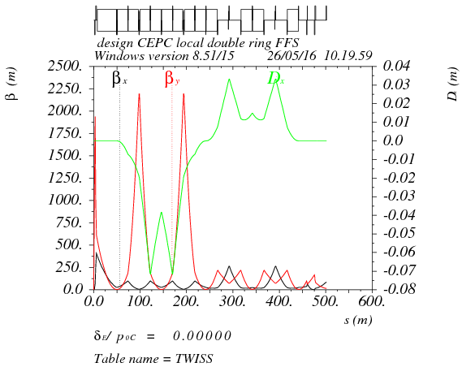
Betax*= 0.25m,Betay*=2mm
Crab sex
Critical energy= 104kev
K2HS := 65.4 m⁻³
K2VS := 71.6m⁻³

Slide 14
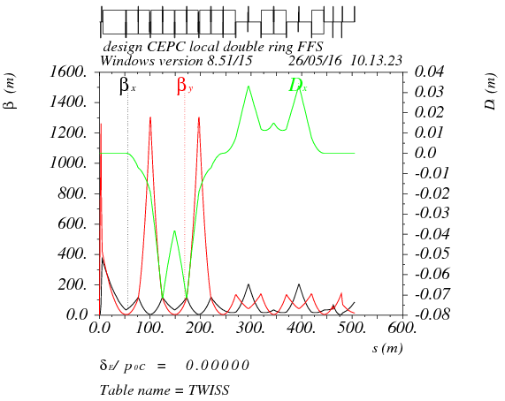
Betax*= 0.25m,Betay*=3mm
Crab sex
Critical energy= 104kev
K2HS := 65.5 m⁻³
K2VS := 79.0 m⁻³

Slide 15
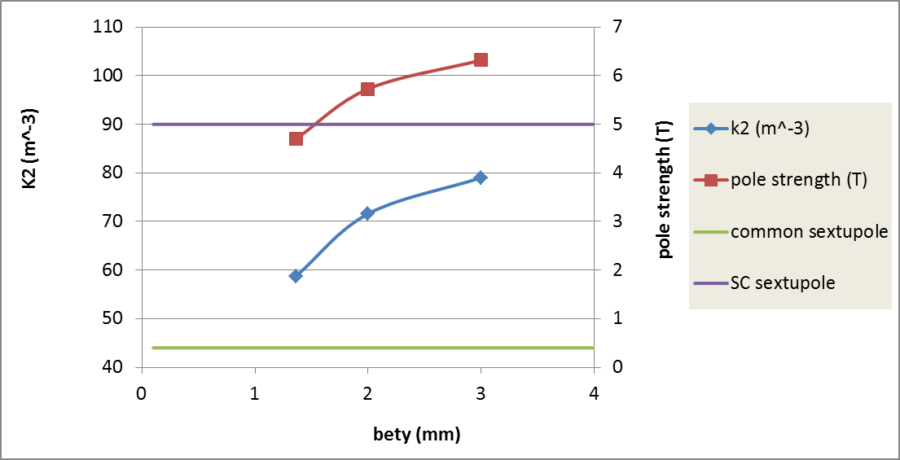
Sextupole strength vs. bety*
（104kev）
* Assume the inner iris of sextupole is 2cm.

Slide 16
Thanks！

