Slide 1
CEPC Partial Double Ring Lattice Design and DA Study
SU Feng GAO Jie WANG Dou WANG Yiwei
Li Yongjun BIAN Tianjinan BAI Sha DUAN Zhe GENG Huiping ZHANG Yuan XU Gang XIAO Ming
Key Laboratory of Particle Acceleration Physics and Technology
Institute of High Energy Physics
Chinese Academy of Sciences
2016.5.5

Slide 2
Out line
CEPC APDR (Advanced Partial Double Ring) Layout
Redesign PDR Lattice by SAD and DA study
Change Pylatt ( Li Yongjun code) more faster
Next

Slide 3
CEPC Advanced Partial Double Ring Layout Feng Su, Jie Gao 2016.5.23

Slide 4
CEPC Advanced Partial Double Ring Layout I
1/2RF
1/2RF
ARC1
IP1_ee
RF
RF
ARC2
APDR
3Km
APDR
ARC3
1/2RF
1/2RF
Bypass
about 42m
IP4_pp
IP2_pp
ARC4
1/2RF
1/2RF
IP1_ee/IP3_ee, 2.968Km
IP2_pp/IP4_pp, 1132.8m
APDR, 1052.87m
4 Short Straights, 141.6m
4 Medium Straights, 566.4m
4 Long Straights, 1132.8m
4 ARC1, 124*FODO, 5852.8m
4 ARC2, 24*FODO, 1132.8m
4 ARC3, 79*FODO, 3728.8m
2 ARC4, 24*FODO, 1132.8m
ARC3
APDR
C=62967.86m
APDR
RF
RF
ARC2
IP3_ee
ARC1
1/2RF
1/2RF
SU Feng
2016.5.23

Slide 5
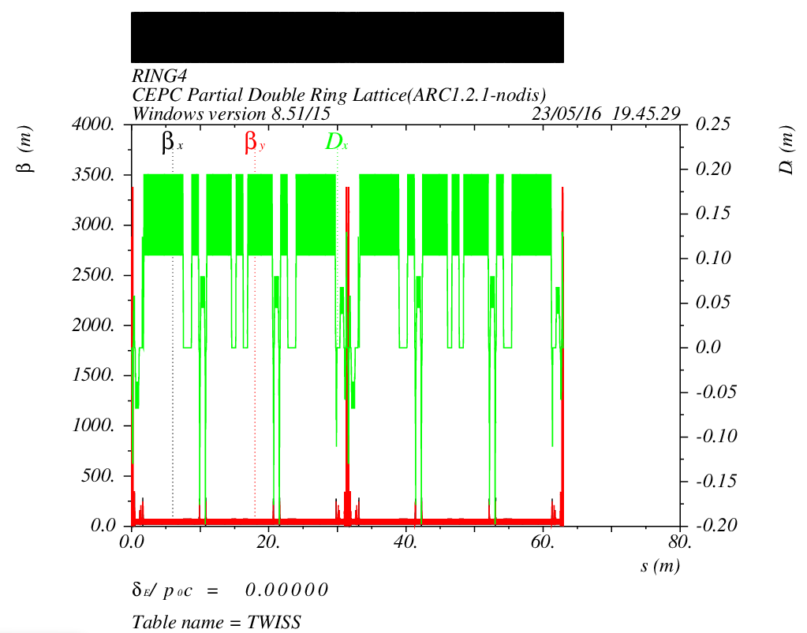
CEPC Advanced Partial Double Ring Optics
PDR1
PDR3
Bypass2
Bypass4
APDR
APDR
APDR
APDR

Slide 6
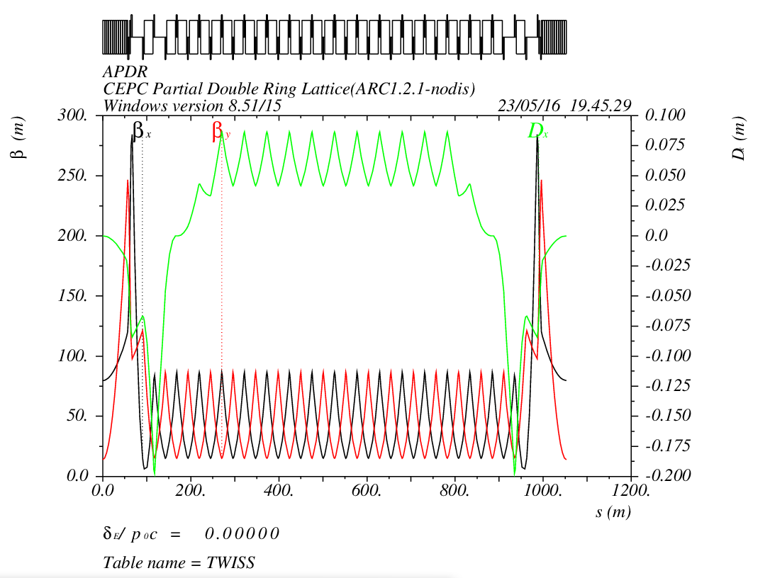
APDR Part
1052.87m

Slide 7
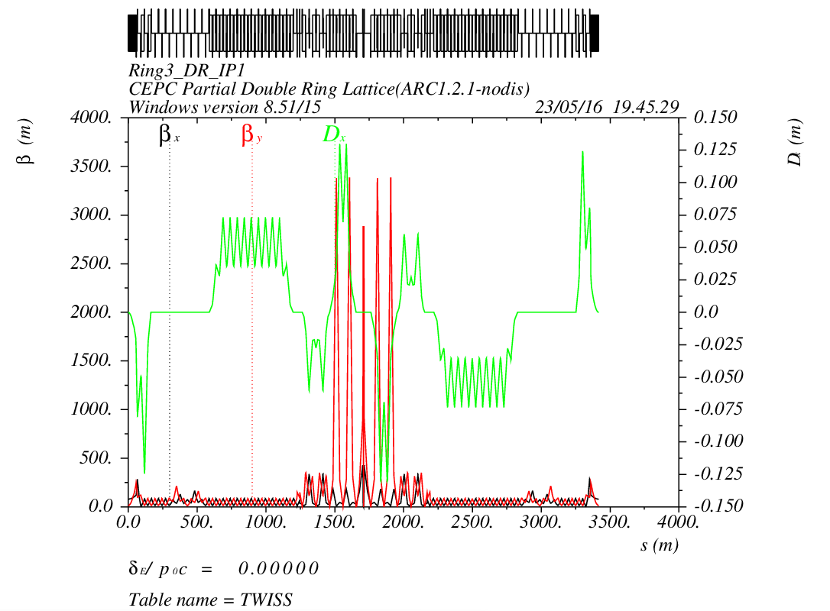
PDR Part

Slide 8
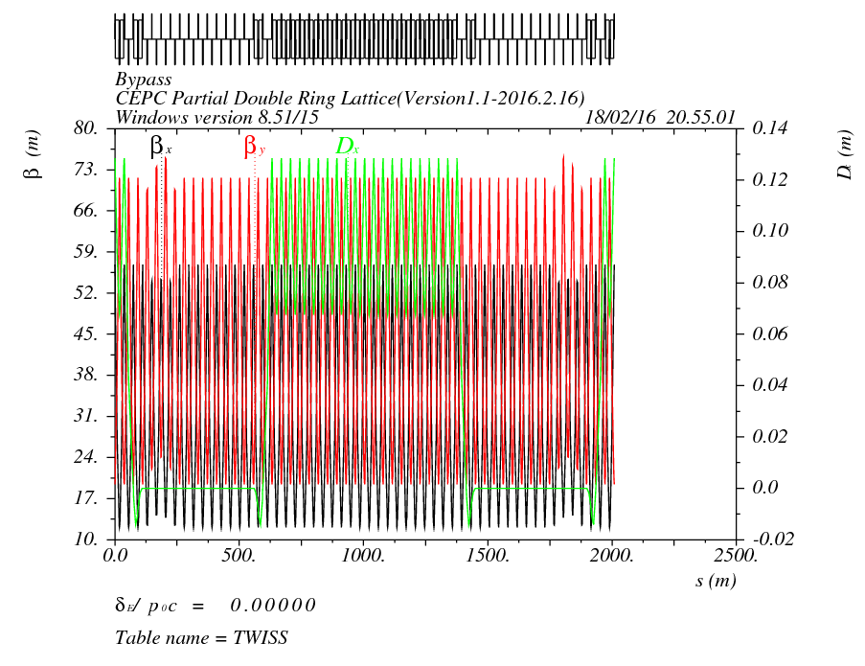
Bypass Part at IP2/4
12L_{c}
12L_{c}
566.4m
12L_{c}
12L_{c}
566.4m
L=42m
s
s
12L_{c}
24L_{c}
12L_{c}
566.4m
566.4m
Cell length=47.2m

Slide 9
CEPC Advanced Partial Double Ring Layout II
1/2RF
1/2RF
1/2RF
ARC
1/2RF
IP1_ee
1/2RF
APDR
APDR
1/2RF
3Km
1/2RF
1/2RF
APDR
APDR
1/2RF
1/2RF
C=66772.8m
1/2RF
APDR
APDR
1/2RF
IP1_ee/IP3_ee, 2.968Km
IP2_pp/IP4_pp, 1132.8m
APDR, 1052.87m
4 Short Straights, 141.6m
4 Long Straights, 566.4m
8 ARC, 124*FODO, 5852.8m
IP3_ee
1/2RF
1/2RF
1/2RF
1/2RF
SU Feng
2016.5.26

Slide 10
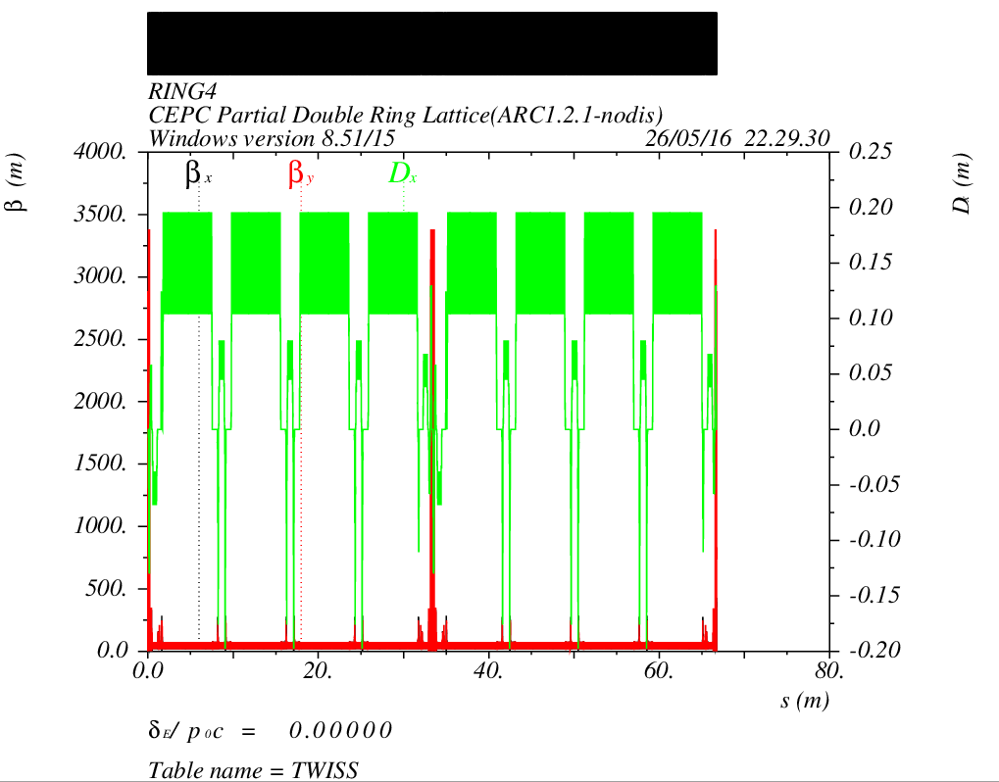
CEPC Advanced Partial Double Ring Optics
PDR1
PDR3
APDR
APDR
APDR
APDR
APDR
APDR

Slide 11
PDR Lattice
Redesign by SAD and DA study
Feng Su，Yiwei Wang
2016.5.26

Slide 12
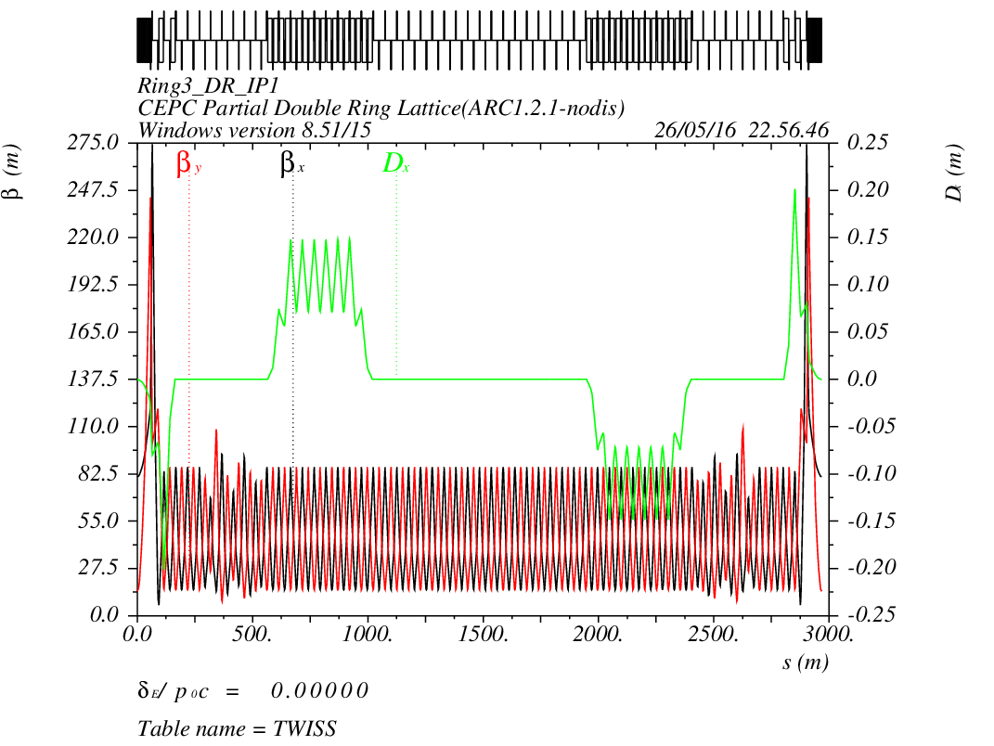
CEPC PDR1.0.2 noFFS

Slide 13
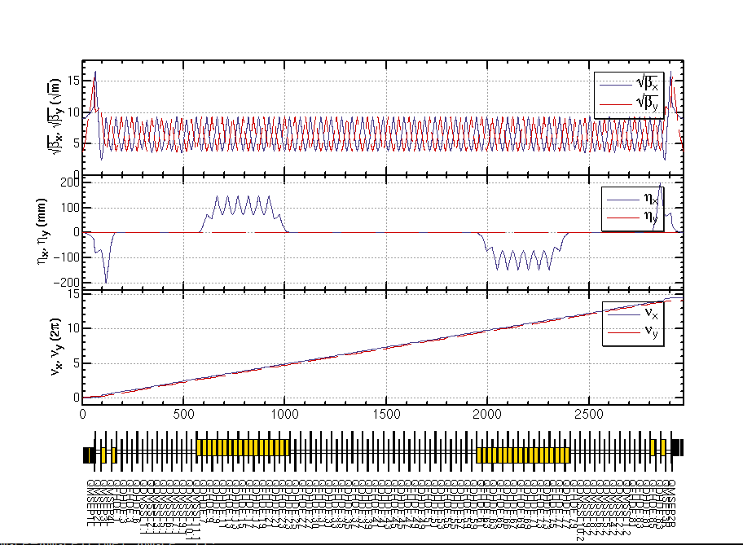
CEPC PDR1.0.2 noFFS

Slide 14
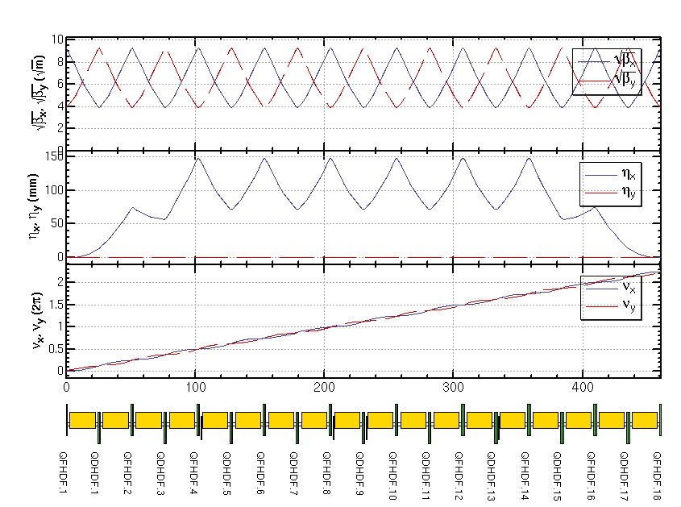
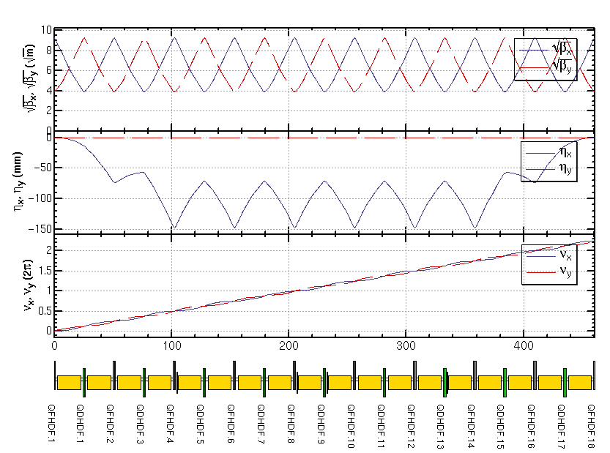
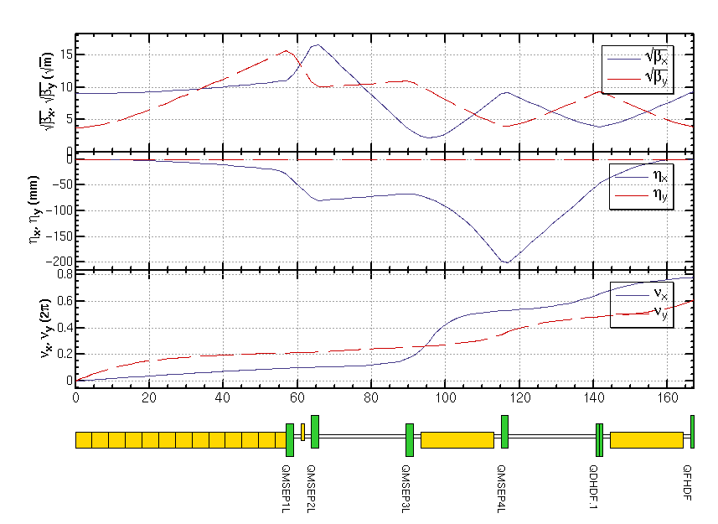
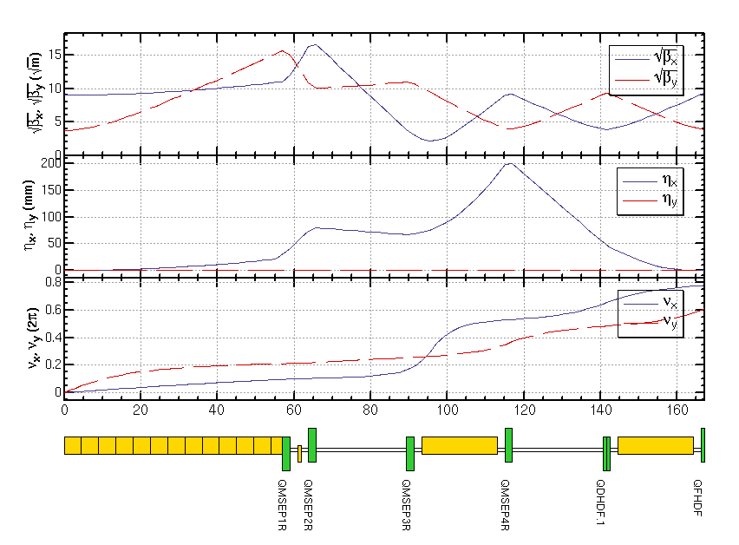
CEPC PDR1.0.2 noFFS

Slide 15
CEPC PDR1.0.2 noFFS
1. ErrorX (IP1)-> 0 automatically
2. ErrorX (IP1)=10^-13 in MAD8
ErrorX (IP1)=10^-5 in SAD ?
3.

Slide 16
Improve Pylatt ( Li Yongjun code) to calculate ndr more faster
Feng Su, Yongjun Li, Yiwei Wang
2016.5.26

Slide 17
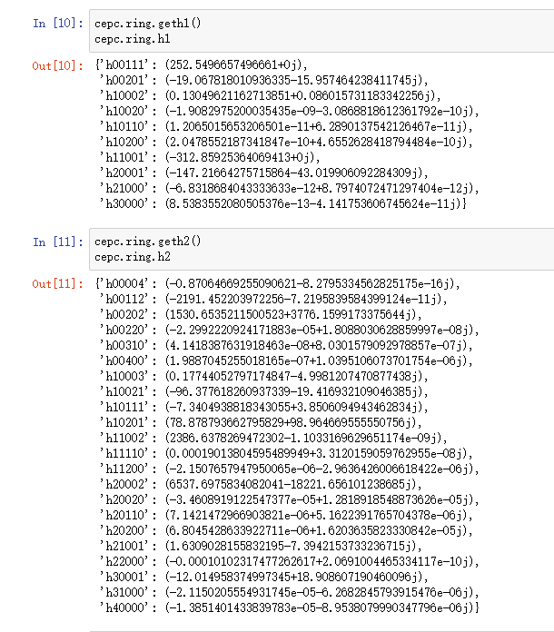
Nonlinear Driving Term
h_{abcde} , a+b+c+d+e=3 ,
1st order nonlinear driving term
a+b+c+d+e=4 ,
2nd order nonlinear driving term
1st order chromaticity: h11001, h00111
2nd order chromaticity: h11002, h00112
Tune with amplitude: h11110, h22000, h00220

Slide 19
Thank You !

