Slide 1

CEPC partial double ring FFS design
Dou Wang, Jie Gao, Feng Su, Yuan Zhang, Yiwei Wang, Bai Sha, Huiping Geng, Tianjian Bian, Na Wang, Xiaohao Cui
CEPC AP meeting, 2016.06.03

Slide 2
parameter for CEPC partial double ring
（wangdou20160325）
 | Pre-CDR | H-high lumi. | H-low power | W | Z
Number of IPs | 2 | 2 | 2 | 2 | 2
Energy (GeV) | 120 | 120 | 120 | 80 | 45.5
Circumference (km) | 54 | 54 | 54 | 54 | 54
SR loss/turn (GeV) | 3.1 | 2.96 | 2.96 | 0.59 | 0.062
Half crossing angle (mrad) | 0 | 15 | 15 | 15 | 15
Piwinski angle | 0 | 2.5 | 2.6 | 5 | 7.6
N_{e}/bunch (10¹¹) | 3.79 | 2.85 | 2.67 | 0.74 | 0.46
Bunch number | 50 | 67 | 44 | 400 | 1100
Beam current (mA) | 16.6 | 16.9 | 10.5 | 26.2 | 45.4
SR power /beam (MW) | 51.7 | 50 | 31.2 | 15.6 | 2.8
Bending radius (km) | 6.1 | 6.2 | 6.2 | 6.1 | 6.1
Momentum compaction (10⁻⁵) | 3.4 | 2.5 | 2.2 | 2.4 | 3.5
β_{IP} x/y (m) | 0.8/0.0012 | 0.25/0.00136 | 0.268 /0.00124 | 0.1/0.001 | 0.1/0.001
Emittance x/y (nm) | 6.12/0.018 | 2.45/0.0074 | 2.06 /0.0062 | 1.02/0.003 | 0.62/0.0028
Transverse σ_{IP} (um) | 69.97/0.15 | 24.8/0.1 | 23.5/0.088 | 10.1/0.056 | 7.9/0.053
ξ_{x}/IP | 0.118 | 0.03 | 0.032 | 0.008 | 0.006
ξ_{y}/IP | 0.083 | 0.11 | 0.11 | 0.074 | 0.073
V_{RF} (GV) | 6.87 | 3.62 | 3.53 | 0.81 | 0.12
f _{RF} (MHz) | 650 | 650 | 650 | 650 | 650
Nature σ_{z} (mm) | 2.14 | 3.1 | 3.0 | 3.25 | 3.9
Total σ_{z} (mm) | 2.65 | 4.1 | 4.0 | 3.35 | 4.0
HOM power/cavity (kw) | 3.6 | 2.2 | 1.3 | 0.99 | 0.99
Energy spread (%) | 0.13 | 0.13 | 0.13 | 0.09 | 0.05
Energy acceptance (%) | 2 | 2 | 2
Energy acceptance by RF (%) | 6 | 2.2 | 2.1 | 1.7 | 1.1
n_{γ} | 0.23 | 0.47 | 0.47 | 0.3 | 0.24
Life time due to beamstrahlung_cal (minute) | 47 | 36 | 32
F (hour glass) | 0.68 | 0.82 | 0.81 | 0.92 | 0.95
L_{max}/IP (10³⁴cm⁻²s⁻¹) | 2.04 | 2.96 | 2.01 | 3.09 | 3.09

Slide 3
parameter for CEPC partial double ring
（wangdou20160525）
 | Pre-CDR | H-high lumi. | H-low power
Number of IPs | 2 | 2 | 2
Energy (GeV) | 120 | 120 | 120
Circumference (km) | 54 | 60 | 60
SR loss/turn (GeV) | 3.1 | 2.96 | 2.96
Half crossing angle (mrad) | 0 | 15 | 15
Piwinski angle | 0 | 4.0 | 4.0
N_{e}/bunch (10¹¹) | 3.79 | 1.56 | 1.56
Bunch number | 50 | 135 | 81
Beam current (mA) | 16.6 | 16.9 | 10.1
SR power /beam (MW) | 51.7 | 50 | 30
Bending radius (km) | 6.1 | 6.2 | 6.2
Momentum compaction (10⁻⁵) | 3.4 | 2.2 | 2.2
β_{IP} x/y (m) | 0.8/0.0012 | 0.104/0.003 | 0.104/0.003
Emittance x/y (nm) | 6.12/0.018 | 2.03/0.0061 | 2.03/0.0061
Transverse σ_{IP} (um) | 69.97/0.15 | 14.5/0.14 | 14.5/0.14
ξ_{x}/IP | 0.118 | 0.0086 | 0.0086
ξ_{y}/IP | 0.083 | 0.11 | 0.11
V_{RF} (GV) | 6.87 | 3.72 | 3.72
f _{RF} (MHz) | 650 | 650 | 650
Nature σ_{z} (mm) | 2.14 | 3.0 | 3.0
Total σ_{z} (mm) | 2.65 | 3.9 | 3.9
HOM power/cavity (kw) | 3.6 | 1.3 | 0.76
Energy spread (%) | 0.13 | 0.13 | 0.13
Energy acceptance (%) | 2 | 2 | 2
Energy acceptance by RF (%) | 6 | 2.5 | 2.5
n_{γ} | 0.23 | 0.44 | 0.44
Life time due to beamstrahlung_cal (minute) | 47 | 43 | 43
F (hour glass) | 0.68 | 0.97 | 0.97
L_{max}/IP (10³⁴cm⁻²s⁻¹) | 2.04 | 1.60 | 0.96

Slide 4
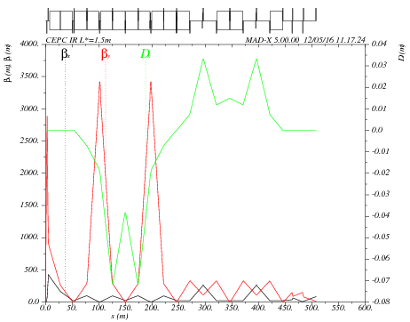
Main sextupole scan-1
ANGLE:=0.55*0.11E-2
Critical energy= 104kev
VARIABLE "TAR" SET TO 1.03759159e-21
k2hs = 12.0390943 ;
k2vs = 61.05953775 ;
sdqx = 0.0003550753638 ;
sdqy = 0.001262171022 ;
wwx = 31.40871865 ;
wwy = 25.84760159 ;
dqx0 = 4.722257884e-12 ;
dqy0 = -3.186364495e-11 ;

Slide 5

Main sextupole scan-2
ANGLE:=0.11E-2
Critical energy= 190kev
VARIABLE "TAR" SET TO 5.96771436e-21
k2hs = 6.582430847 ;
k2vs = 33.55590912 ;
sdqx = 0.0003778515548 ;
sdqy = 0.001134476048 ;
wwx = 33.39201438 ;
wwy = 21.79579772 ;
dqx0 = -7.523853893e-11 ;
dqy0 = 1.751789441e-11 ;

Slide 6

Main sextupole scan-3
ANGLE:=1.5*0.11E-2
Critical energy= 285kev
VARIABLE "TAR" SET TO 1.99795144e-21
k2hs = 4.864862799 ;
k2vs = 22.3536694 ;
sdqx = 0.0002047489039 ;
sdqy = 0.002049013286 ;
wwx = 21.33725775 ;
wwy = 24.68472653 ;
dqx0 = 2.6563816e-11 ;
dqy0 = 3.594878472e-11 ;

Slide 7
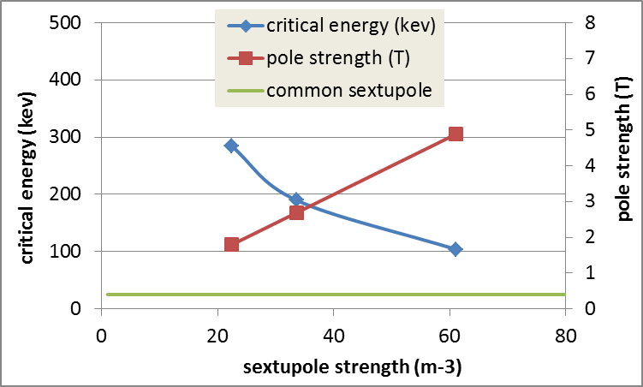
K2 vs. critical energy
* Assume the inner iris of sextupole is 2cm.

Slide 8
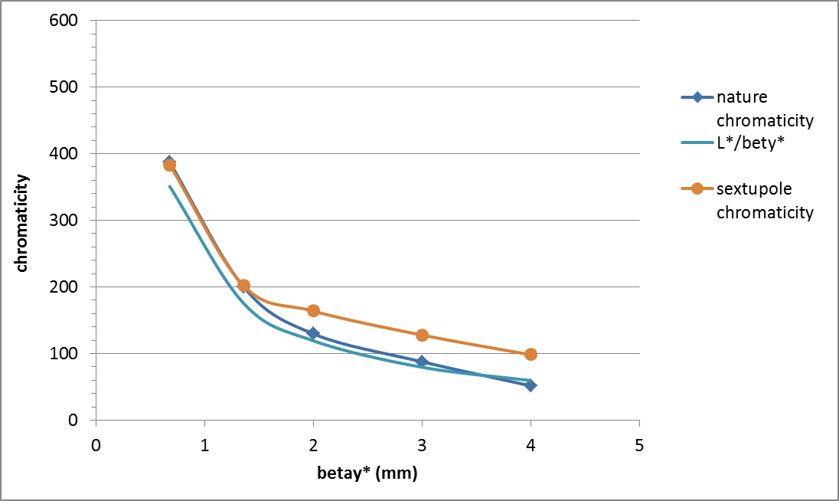
Chromaticity vs. betay*
(Ec=190keV)

Slide 9
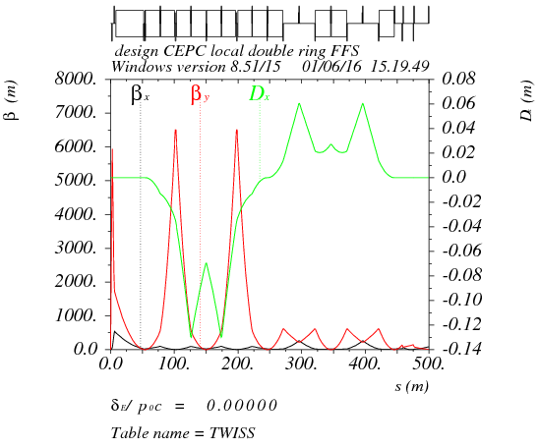
Betax*= 0.25m,Betay*=0.68mm
Crab sex
Critical energy= 190kev
dmux = -13.544027
dmuy = -387.274966
K2HS := 11.17m⁻³
K2VS := 32.49 m⁻³

Slide 10
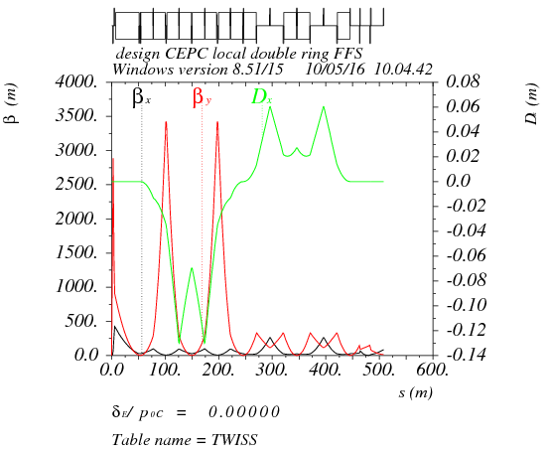
Betax*= 0.25m,Betay*=1.36mm
Crab sex
Critical energy= 190kev
dmux = -14.464497
dmuy = -200.084478
K2HS := 11.96m⁻³
K2VS := 32.74 m⁻³

Slide 11

Betax*= 0.25m,Betay*=2mm
Crab sex
Critical energy= 190kev
dmux = -14.240966
dmuy = -129.755943
K2HS := 36.00 m⁻³
K2VS := 41.06 m⁻³

Slide 12
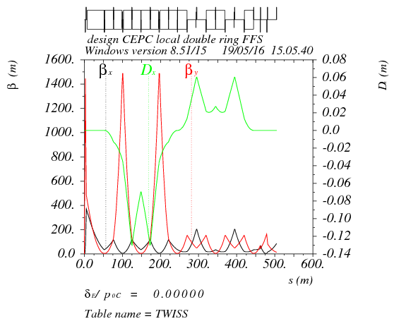
Betax*= 0.25m,Betay*=3mm
Crab sex
Critical energy= 190kev
dmux = -10.370695
dmuy = -87.841992
K2HS := 36.03 m⁻³
K2VS := 47.32 m⁻³

Slide 13
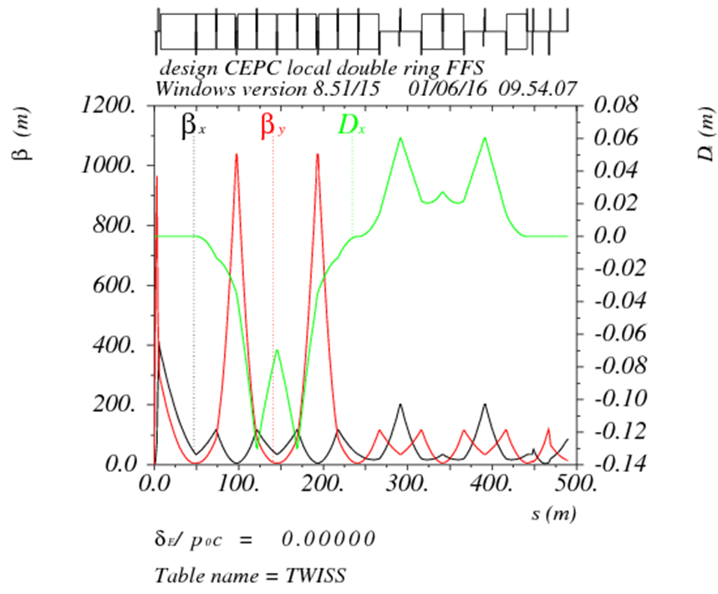
Betax*= 0.25m,Betay*=4mm
Crab sex
Critical energy= 190kev
dmux = -4.095673
dmuy = -51.751750
K2HS := 5.2 m⁻³
K2VS := 51.6 m⁻³

Slide 14
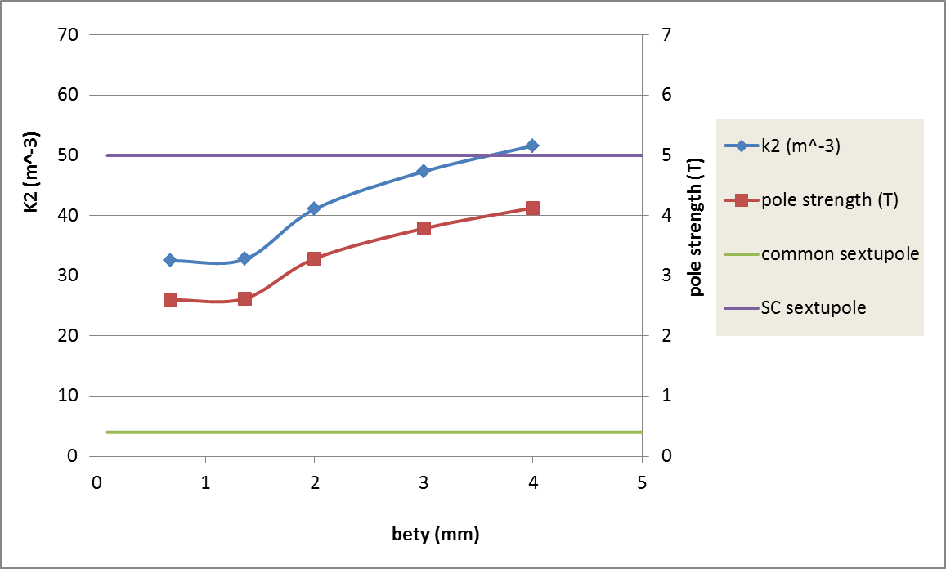
Sextupole strength vs. betay*
（190kev）
1.4
For lower betay*, the sextupole strength keep constant because the chromaticity of FD is dominant.
Enlarging betay*, we need stronger sextupoles.
There is potential to get sub-mm betay* and hence increase luminosity further.
* Assume the inner iris of sextupole is 2cm.

Slide 15
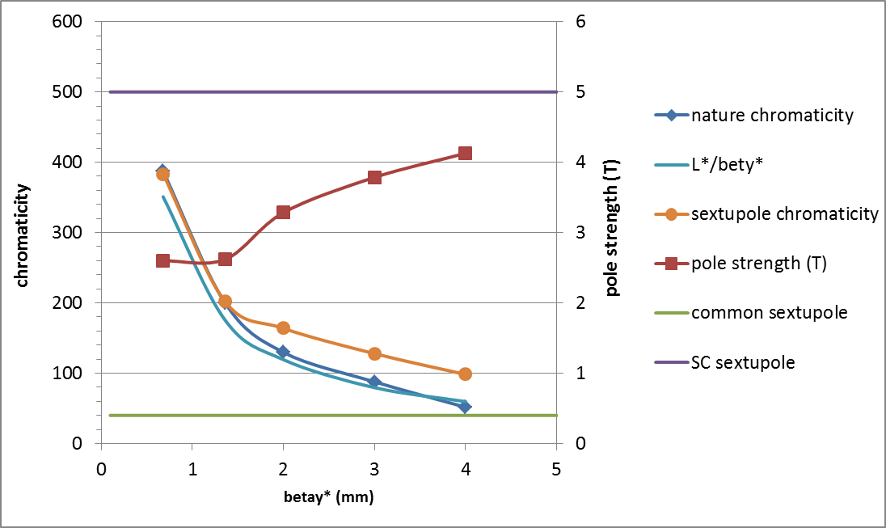

Slide 16
Thanks！

