Slide 1

CEPC Partial Double Ring
Lattice Design and DA Study
SU Feng GAO Jie WANG Dou WANG Yiwei
Li Yongjun BIAN Tianjinan BAI Sha DUAN Zhe GENG Huiping ZHANG Yuan XU Gang XIAO Ming
Key Laboratory of Particle Acceleration Physics and Technology
Institute of High Energy Physics
Chinese Academy of Sciences
2016.6.3

Slide 2
Out line
Redesign PDR Lattice by SAD and DA study
Change Pylatt ( Li Yongjun code) more faster
CEPC APDR (Advanced Partial Double Ring) Layout
Next

Slide 3
PDR Lattice
Redesign by SAD and DA study
Feng Su，Yiwei Wang
2016.5.26

Slide 4
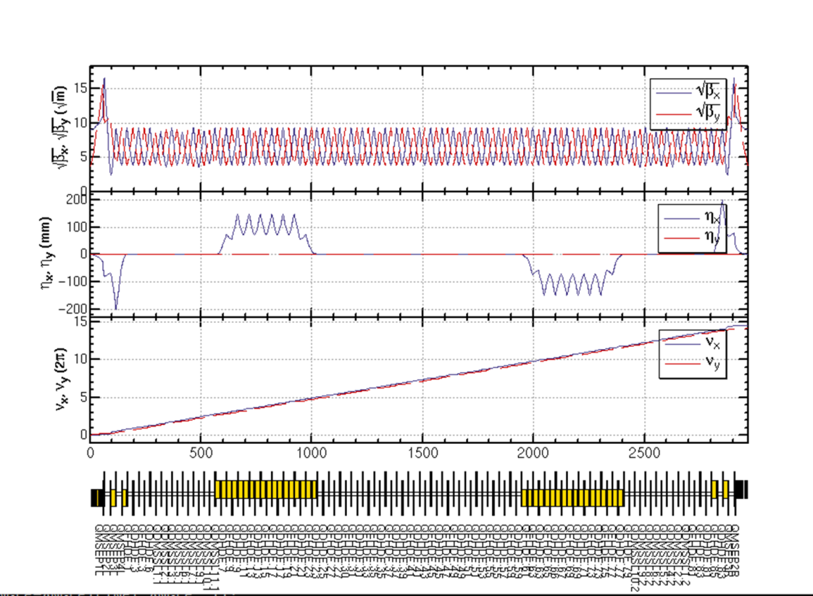
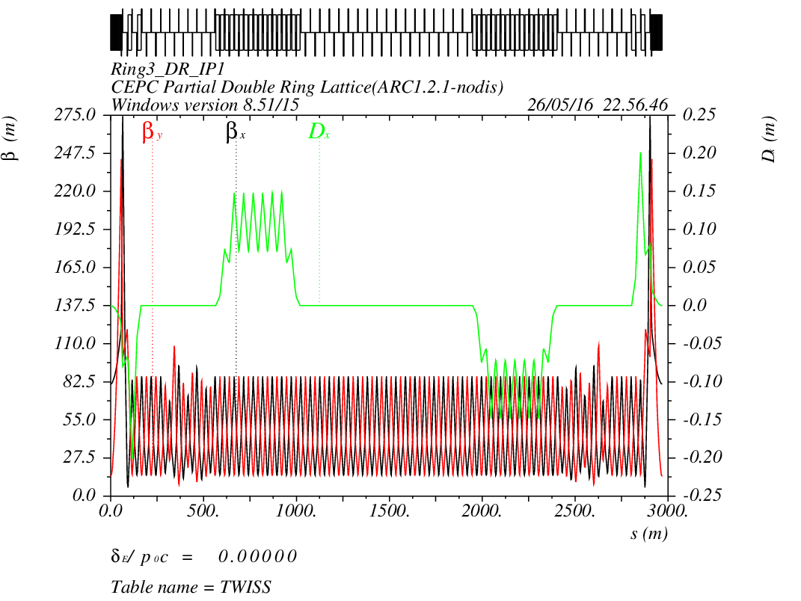
CEPC PDR1.0.2 noFFS

Slide 5
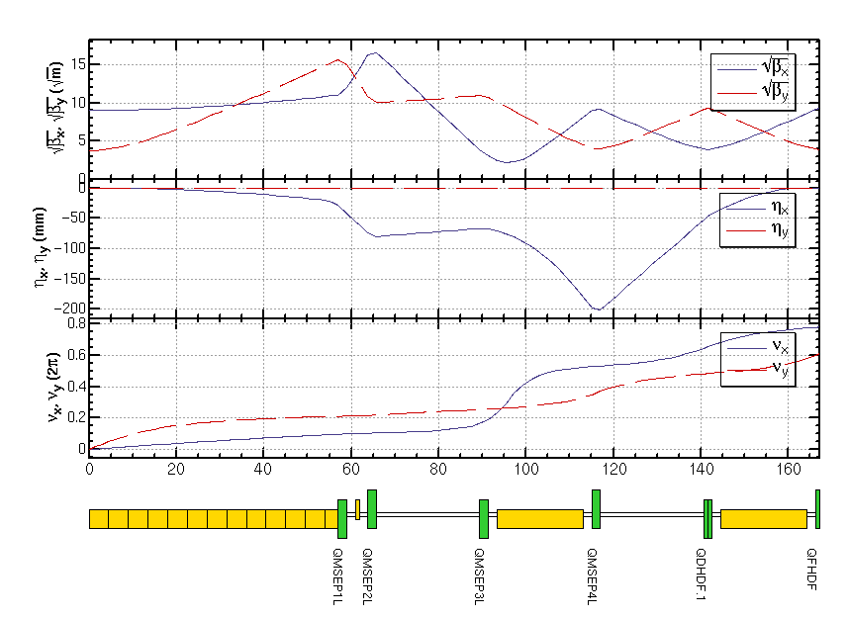
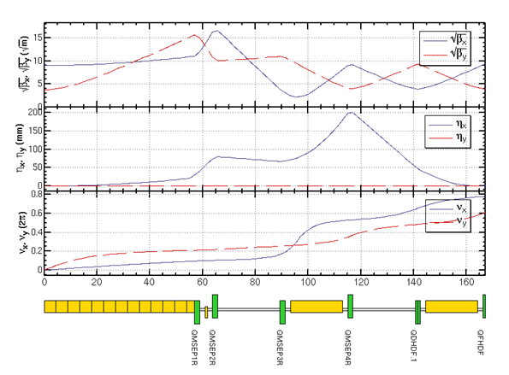
CEPC PDR1.0.2 noFFS
I5
L

Slide 6
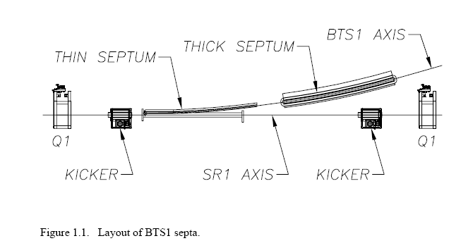
Suggestion from last meeting
(2015.10.30)
2、脉冲磁铁（Kicker），切割磁铁，静电分离器等长度、造价、性能的调研和考虑。

Slide 7
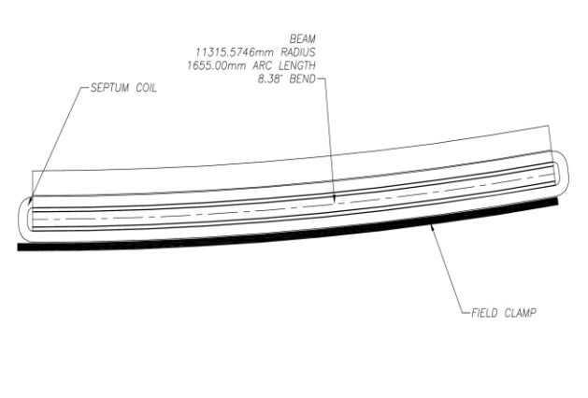
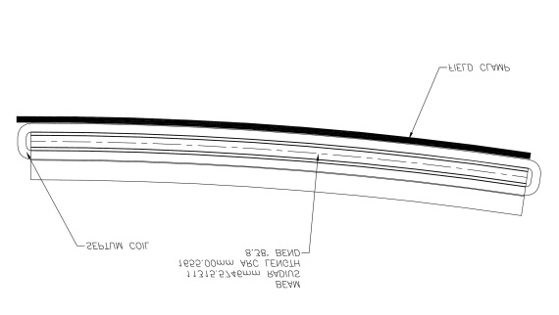
Seperator with Thin Septum Magnet
Sigmax=697.8um 20sigma=14mm
20mm
Septum Magnet：L=2m
angle=？mrad
太强吗？多少合适？需要调研。。。
（2.25mrad）thicknes=3-5mm
Separator： 62.5 urad
12 个
0.75 mrad

Slide 8
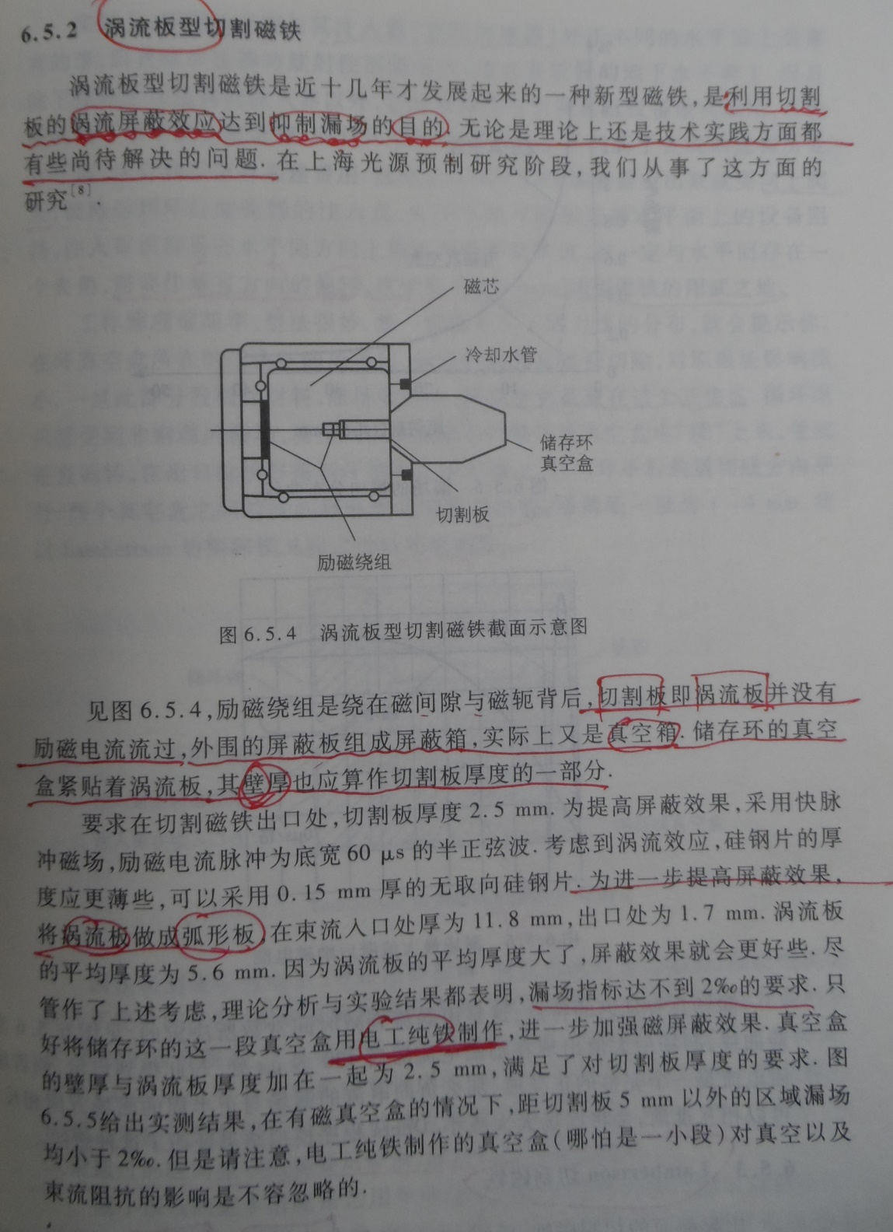
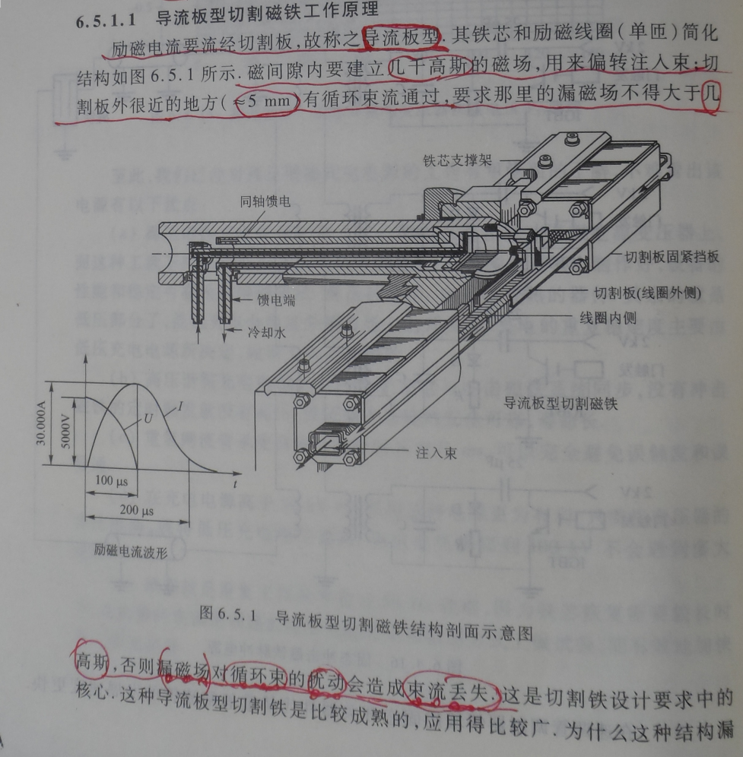
Septum Magnet
SSRF：弧形板
入口：11.8mm
出口：1.7mm
平均：5.6mm
5mm 几千高斯

Slide 9
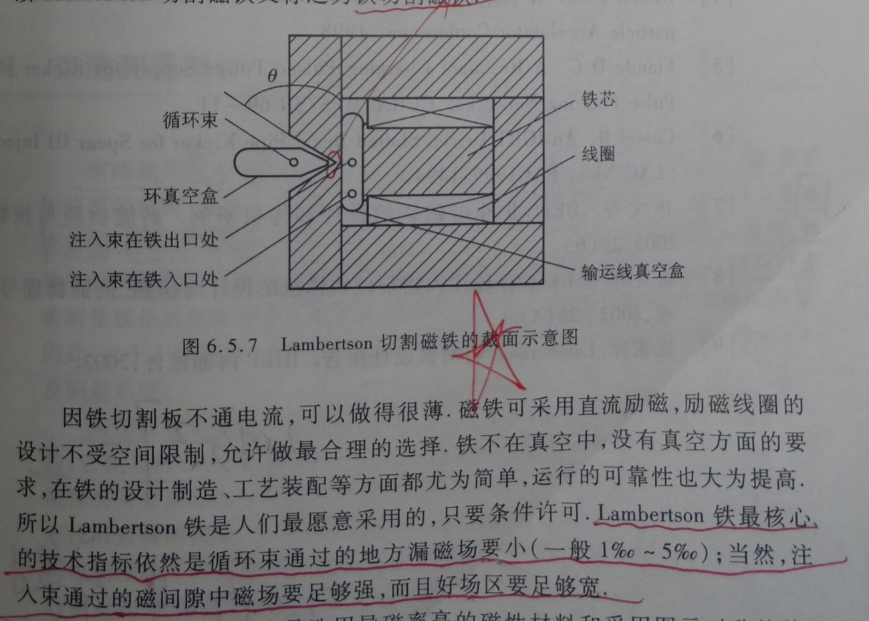
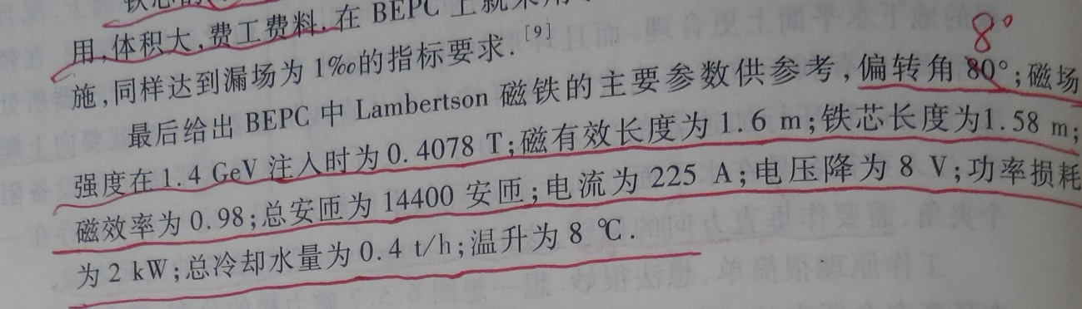
Septum Magnet
垂直偏转：
0.4078T

Slide 10

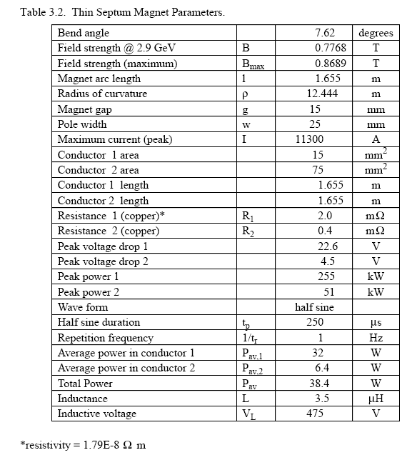
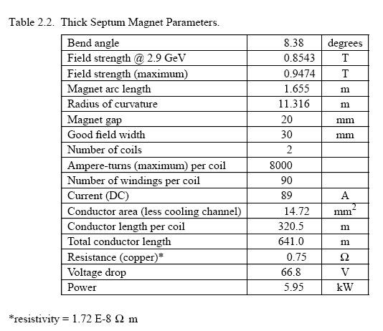
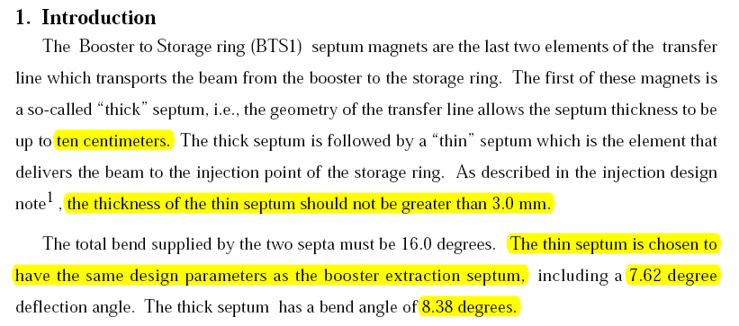
Septum Magnet

Slide 11
Separator with Thin Septum Magnet
Sigmax=697.8um 20sigma=14mm
20mm
Beam
dump
Septum Magnet：L=3m
（4.25mrad）thicknes=3-5mm
rho=705.822m B=0.56T
Separator： 62.5 urad
12 个
0.75 mrad
Notes:
Beam size is 700 micrometer。 just in case 以防万一

Slide 12
Dipole Strength Version 1.0 without FFS
 | Angle(mrad) | L(m) | Rho(m) | Brho(E0/c)(T/m) | B(T) | Ek(KeV) | KeV/m
B0 | 3.232 | 19.6 | 6064.36 | 400 | 0.06596 | 631.625 | 32.226
BSepL | -0.0625 | 4.5 | -72000 | 400 | -0.00556 | 53.2 | 11.822
BSeptumL | -4.25 | 3 | -705.822 | 400 | -0.56667 | 5426.4 | 1808.8
BMatch1L | -0.469 | 4.9 | -10447.8 | 400 | -0.03829 | 366.624 | 74.821
BMatch2L | -3.171 | 19.6 | -6181.02 | 400 | -0.06471 | 619.704 | 31.618
BMatch3L | -4.36 | 19.6 | -4495.41 | 400 | -0.08898 | 852.069 | 43.473
B2 | 2.167 | 19.6 | 9044.76 | 400 | 0.04422 | 423.494 | 21.607
B3 | 2.167 | 19.6 | 9044.76 | 400 | 0.04422 | 423.494 | 21.607
B4 | -2.167 | 19.6 | -9044.76 | 400 | -0.04422 | 423.494 | 21.607
B5 | -2.167 | 19.6 | -9044.76 | 400 | -0.04422 | 423.494 | 21.607
BMatch3R | 4.36 | 19.6 | 4495.41 | 400 | 0.08898 | 852.069 | 43.473
BMatch2R | 3.171 | 19.6 | 6181.02 | 400 | 0.06471 | 619.704 | 31.618
BMatch1R | 0.469 | 4.9 | 10447.8 | 400 | 0.03829 | 366.624 | 74.821
BSeptumR | 4.25 | 3 | 705.822 | 400 | 0.56667 | 5426.4 | 1808.8
BSepR | 0.0625 | 4.5 | 72000 | 400 | 0.00556 | 53.2 | 11.822

Slide 13
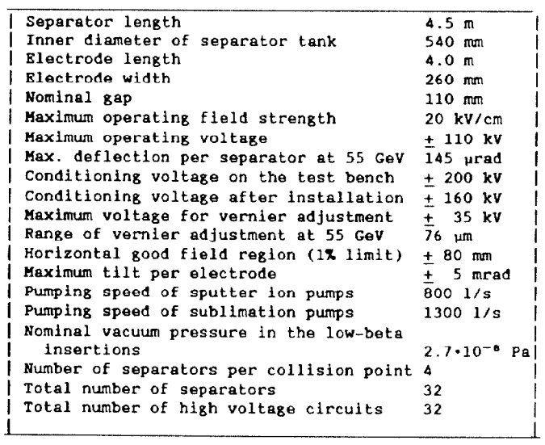
Electrostatic Separator in LEP
L=4.5m
Lelectrode=4.0m
Efield=2MV/m
E=55GeV
Angle=145urad

Slide 14
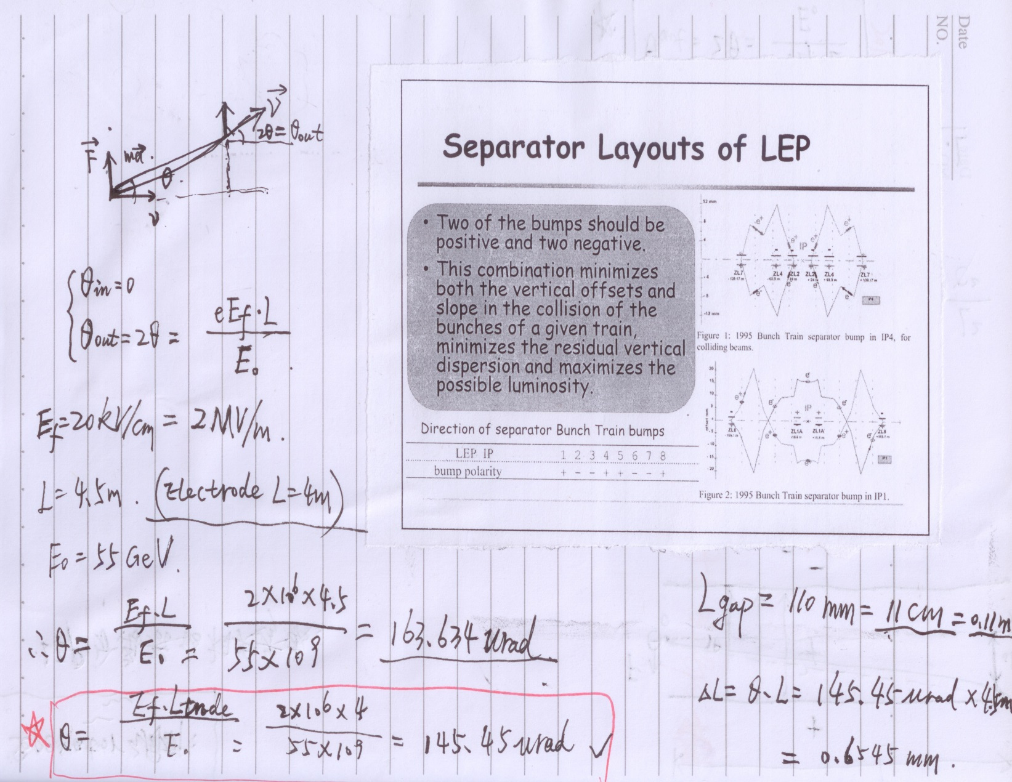
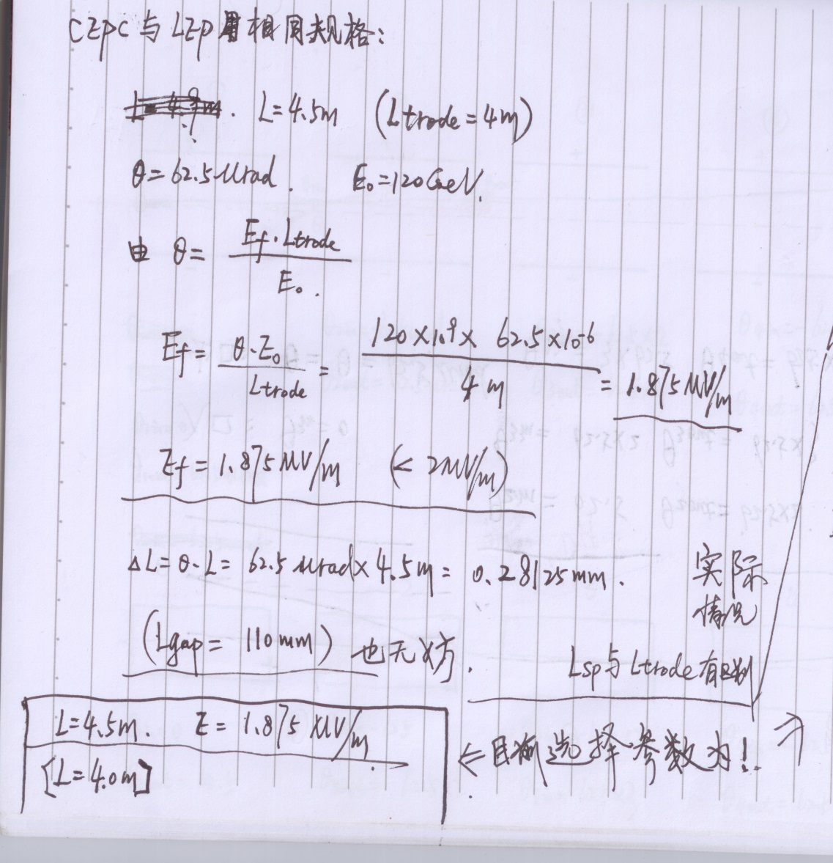
Electrostatic Separator

Slide 15
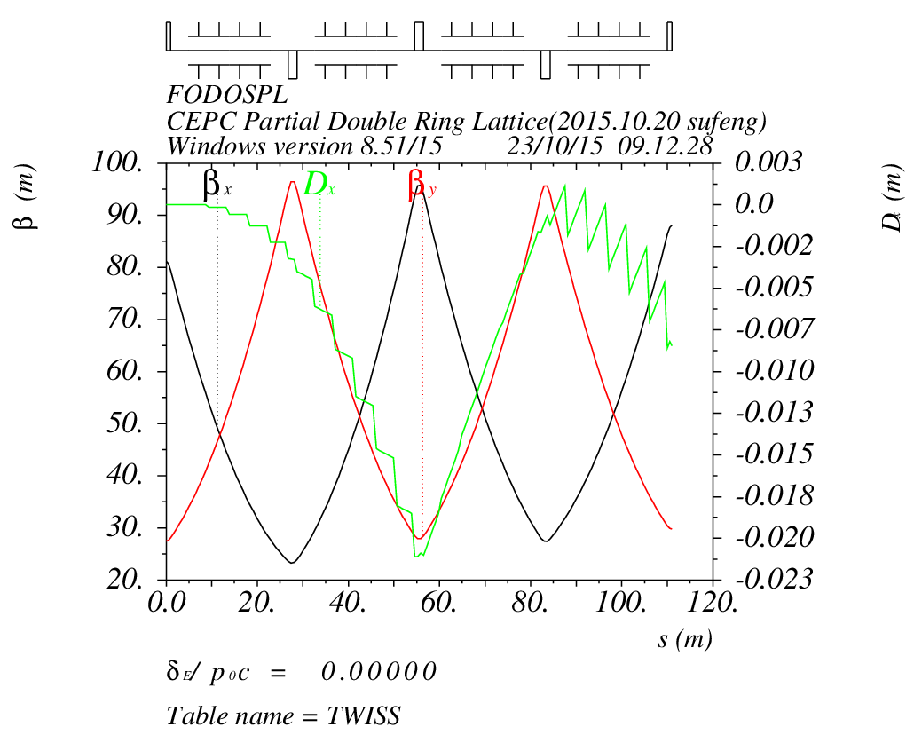
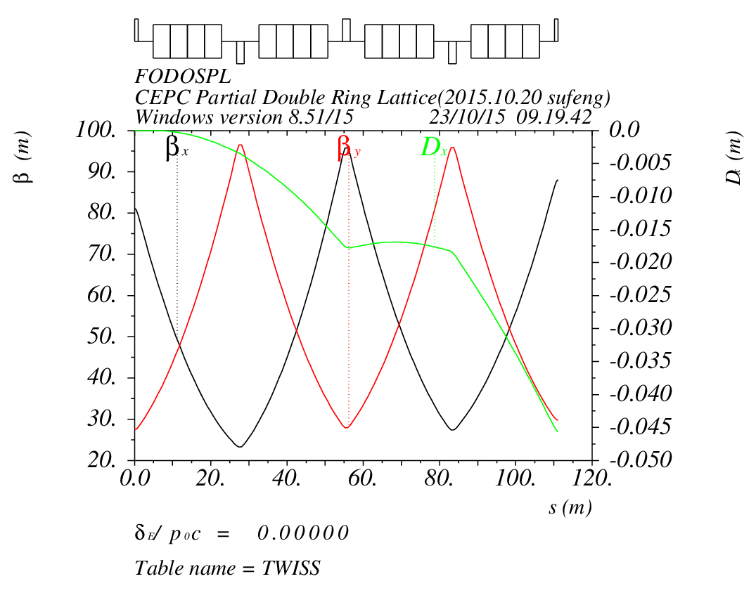
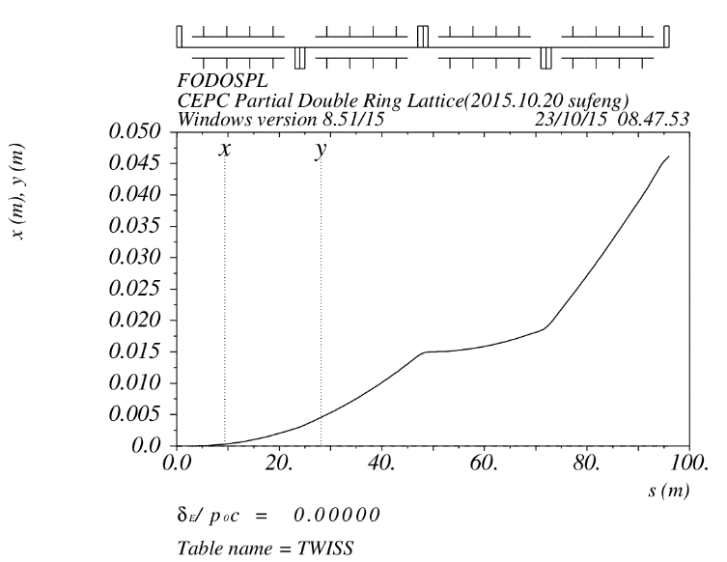
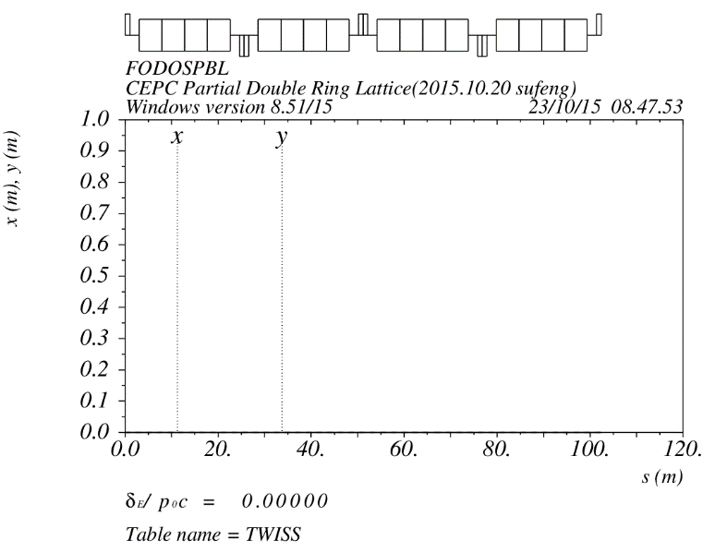
Electrostatic Separator & Dipole
Seperator :
n=16
L=4.5m
angle=62.5urad
Dipole:
n=16
L=4.5m
angle=62.5urad

Slide 16
Next

Slide 17
CEPC PDR DA Study
Feng Su, Yongjun Li, Yiwei Wang
2016.5.26

Slide 18
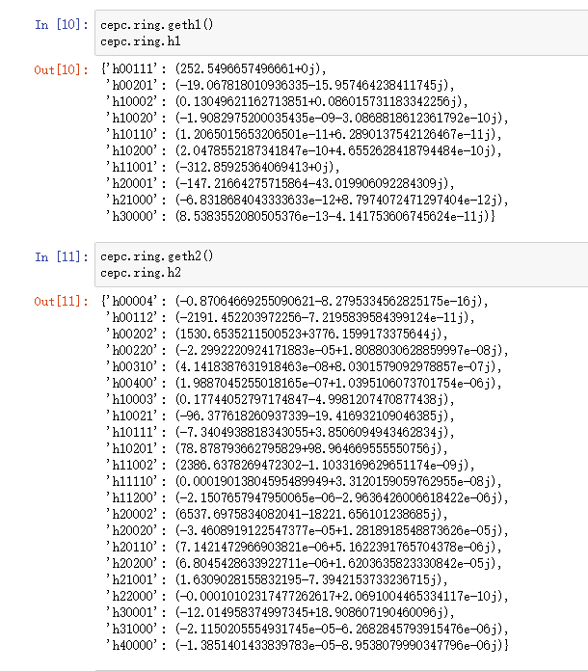
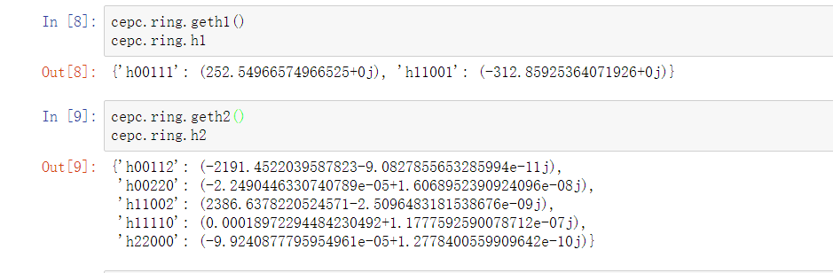
Nonlinear Driving Term
h_{abcde} , a+b+c+d+e=3 ,
1st order nonlinear driving term
a+b+c+d+e=4 ,
2nd order nonlinear driving term
1st order chromaticity: h11001, h00111
2nd order chromaticity: h11002, h00112
Tune with amplitude: h11110, h22000, h00220

Slide 19
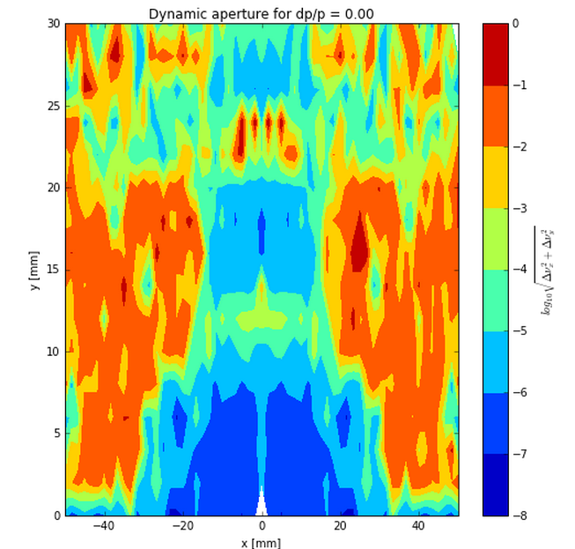
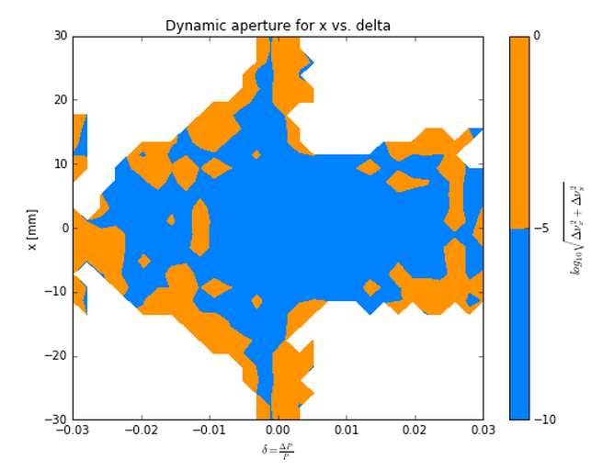
Nonlinear Driving Term
Betx：80.992367
bety：14.172123
2nm
Sizmax：402.47um
Sigmay：9.22um

Slide 20
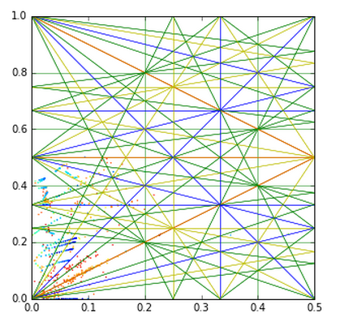
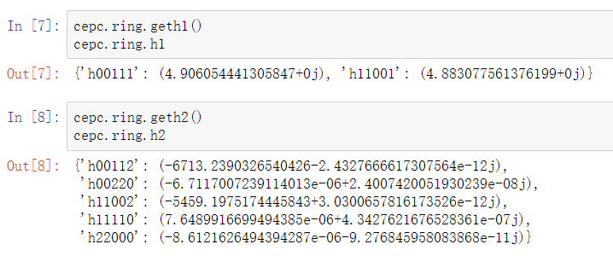

Slide 22
CEPC Advanced
Partial Double Ring Layout
Feng Su, Jie Gao
2016.5.23

Slide 23
CEPC Advanced Partial Double Ring Layout II
1/2RF
1/2RF
1/2RF
ARC
1/2RF
IP1_ee
1/2RF
APDR
APDR
1/2RF
3Km
1/2RF
1/2RF
APDR
APDR
1/2RF
1/2RF
C=65640.2m
IP1_ee/IP3_ee, 2.968Km
IP2_pp/IP4_pp, 1132.8m
APDR, 1052.87m
4 Short Straights, 94.4m
12 Long Straights, 566.4m
4 Long ARC, 124*FODO, 5852.8m
4 Medium ARC, 104*FODO, 4908.8m
4 Short ARC, 14*FODO, 660.8m
1/2RF
1/2RF
APDR
APDR
1/2RF
IP3_ee
1/2RF
1/2RF
1/2RF
SU Feng
2016.6.2

Slide 24
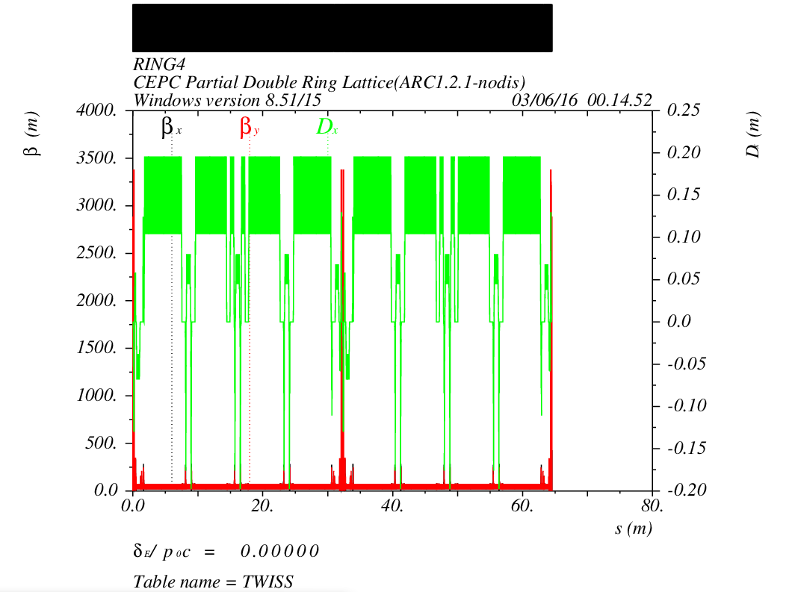
CEPC Advanced Partial Double Ring Optics
PDR1
PDR3
APDR
APDR
APDR
APDR
Bypass
APDR
Bypass
APDR

Slide 25
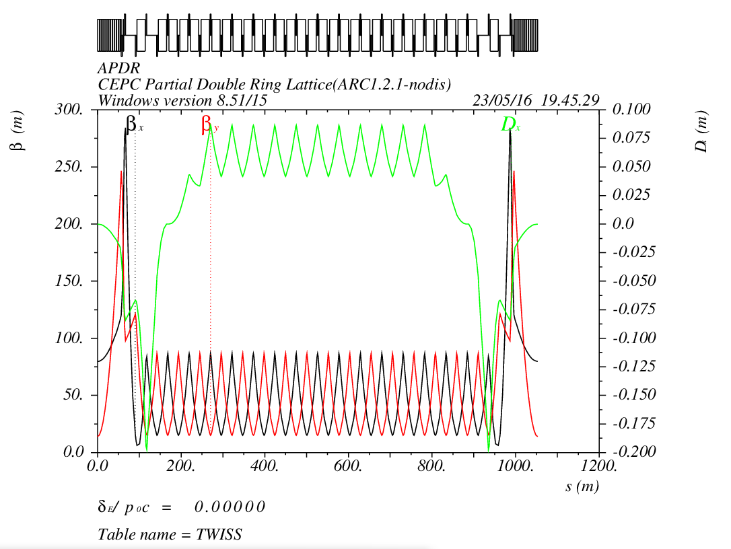
APDR Part
1052.87m

Slide 26

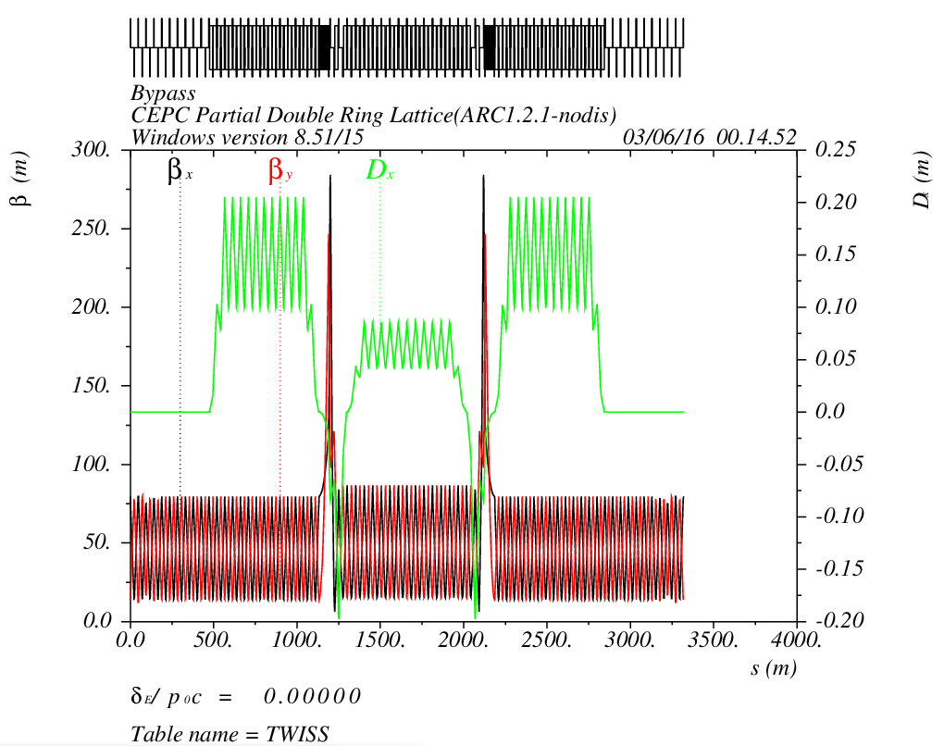
Bypass Part at IP2/4
12L_{c}
12L_{c}
566.4m
12L_{c}
12L_{c}
566.4m
L=42m
s
12L_{c}
24L_{c}
12L_{c}
566.4m
566.4m
Cell length=47.2m

Slide 27
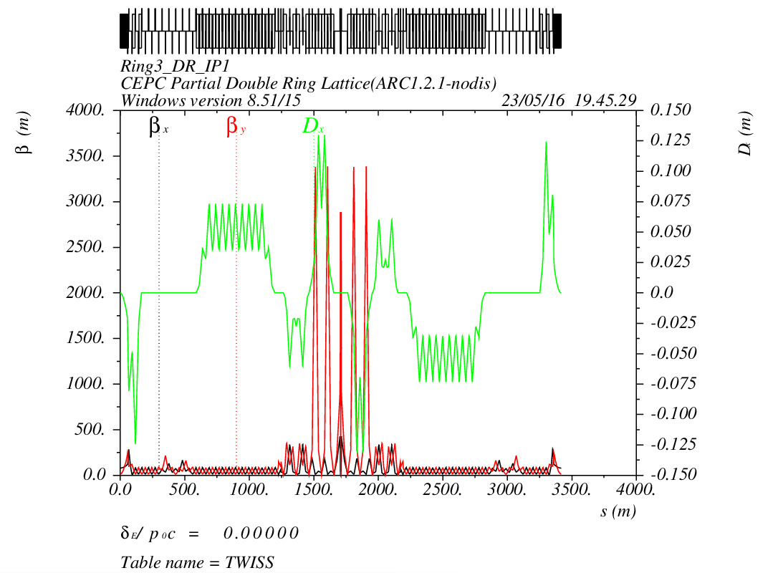
PDR Part

Slide 29
Thank You !

Slide 30
CEPC Advanced Partial Double Ring Layout I
1/2RF
1/2RF
ARC1
IP1_ee
RF
RF
ARC2
APDR
3Km
APDR
ARC3
1/2RF
1/2RF
Bypass
about 42m
IP4_pp
IP2_pp
ARC4
1/2RF
1/2RF
IP1_ee/IP3_ee, 2.968Km
IP2_pp/IP4_pp, 1132.8m
APDR, 1052.87m
4 Short Straights, 141.6m
4 Medium Straights, 566.4m
4 Long Straights, 1132.8m
4 ARC1, 124*FODO, 5852.8m
4 ARC2, 24*FODO, 1132.8m
4 ARC3, 79*FODO, 3728.8m
2 ARC4, 24*FODO, 1132.8m
ARC3
APDR
C=62967.86m
APDR
RF
RF
ARC2
IP3_ee
ARC1
1/2RF
1/2RF
SU Feng
2016.5.23

Slide 31

CEPC Advanced Partial Double Ring Optics
PDR1
PDR3
Bypass2
Bypass4
APDR
APDR
APDR
APDR

