Slide 1

Lattice design for CEPC PDR
Yiwei Wang, Feng Su, Jie Gao
3th Jun 2016, CEPC AP meeting

Slide 2
CEPC primary parameter （wangdou20160325）
 | Pre-CDR | H-high lumi. | H-low power | W | Z
Number of IPs | 2 | 2 | 2 | 2 | 2
Energy (GeV) | 120 | 120 | 120 | 80 | 45.5
Circumference (km) | 54 | 54 | 54 | 54 | 54
SR loss/turn (GeV) | 3.1 | 2.96 | 2.96 | 0.59 | 0.062
Half crossing angle (mrad) | 0 | 15 | 15 | 15 | 15
Piwinski angle | 0 | 2.5 | 2.6 | 5 | 7.6
N_{e}/bunch (10¹¹) | 3.79 | 2.85 | 2.67 | 0.74 | 0.46
Bunch number | 50 | 67 | 44 | 400 | 1100
Beam current (mA) | 16.6 | 16.9 | 10.5 | 26.2 | 45.4
SR power /beam (MW) | 51.7 | 50 | 31.2 | 15.6 | 2.8
Bending radius (km) | 6.1 | 6.2 | 6.2 | 6.1 | 6.1
Momentum compaction (10⁻⁵) | 3.4 | 2.5 | 2.2 | 2.4 | 3.5
β_{IP} x/y (m) | 0.8/0.0012 | 0.25/0.00136 | 0.268 /0.00124 | 0.1/0.001 | 0.1/0.001
Emittance x/y (nm) | 6.12/0.018 | 2.45/0.0074 | 2.06 /0.0062 | 1.02/0.003 | 0.62/0.0028
Transverse σ_{IP} (um) | 69.97/0.15 | 24.8/0.1 | 23.5/0.088 | 10.1/0.056 | 7.9/0.053
ξ_{x}/IP | 0.118 | 0.03 | 0.032 | 0.008 | 0.006
ξ_{y}/IP | 0.083 | 0.11 | 0.11 | 0.074 | 0.073
V_{RF} (GV) | 6.87 | 3.62 | 3.53 | 0.81 | 0.12
f _{RF} (MHz) | 650 | 650 | 650 | 650 | 650
Nature σ_{z} (mm) | 2.14 | 3.1 | 3.0 | 3.25 | 3.9
Total σ_{z} (mm) | 2.65 | 4.1 | 4.0 | 3.35 | 4.0
HOM power/cavity (kw) | 3.6 | 2.2 | 1.3 | 0.99 | 0.99
Energy spread (%) | 0.13 | 0.13 | 0.13 | 0.09 | 0.05
Energy acceptance (%) | 2 | 2 | 2
Energy acceptance by RF (%) | 6 | 2.2 | 2.1 | 1.7 | 1.1
n_{γ} | 0.23 | 0.47 | 0.47 | 0.3 | 0.24
Life time due to beamstrahlung_cal (minute) | 47 | 36 | 32
F (hour glass) | 0.68 | 0.82 | 0.81 | 0.92 | 0.95
L_{max}/IP (10³⁴cm⁻²s⁻¹) | 2.04 | 2.96 | 2.01 | 3.09 | 3.09

Slide 3
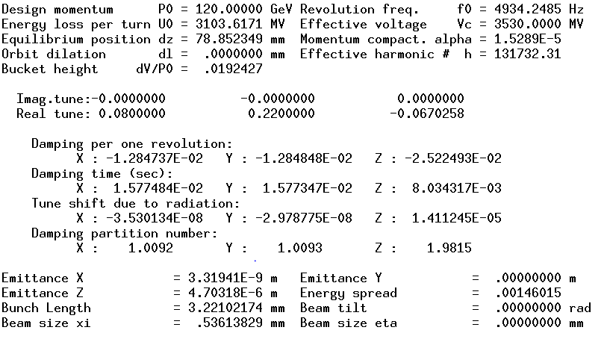
Para of ARC+PDR
Emittance growth is too much!
The bending region should be optimized.

Slide 4
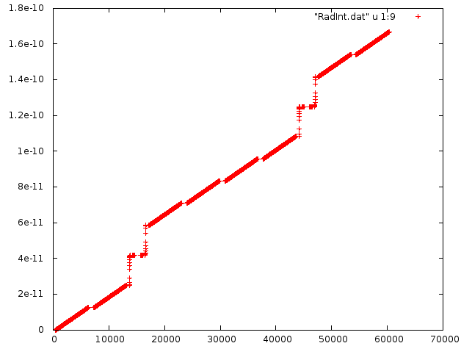






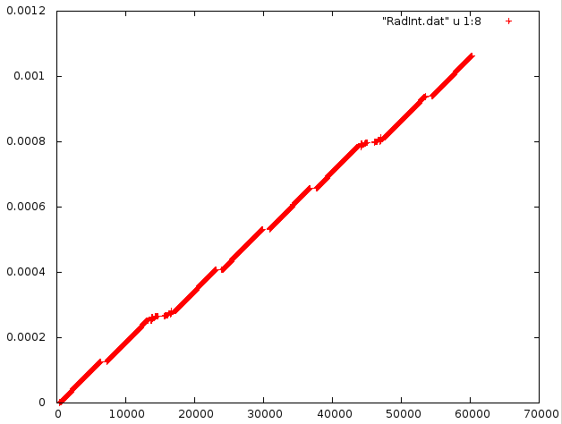
Emittance growth source
I5x
S
Cq*(120/0.511E-3)^2/1*I5x[[-1]]/I2[[-1]]
Out[15]:= 3.3103495751811973e-09
I2
S

Slide 5
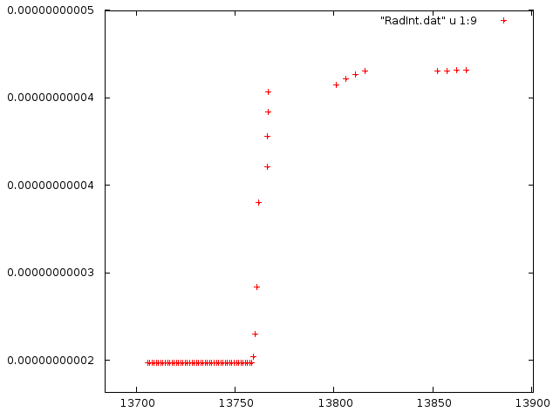
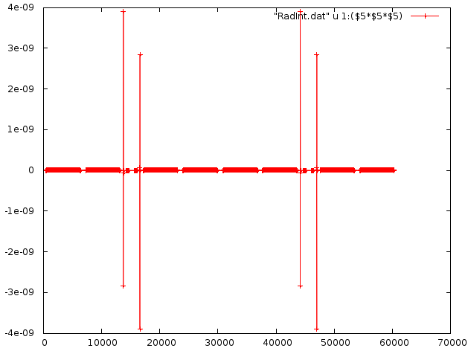
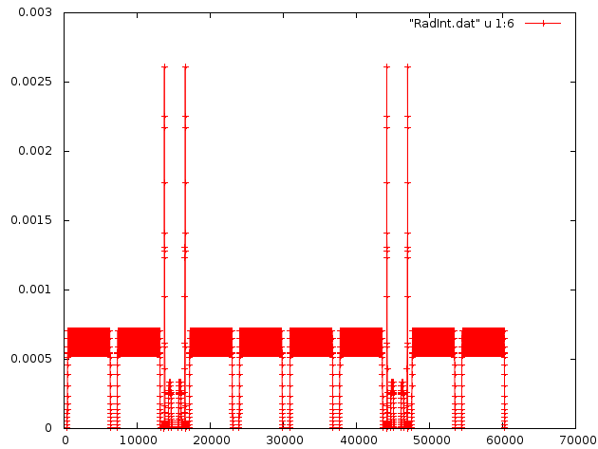
Emittance growth source(cont.)
I5x
I5x
BSEP1L
SEPTUML
S
S
1/ρ^3
BSEP1L
Hx
SEPTUML
S
S
# 1 ss, 2 name, 3 type, 4 ll, 5 k0, 6 hx, 7 hy, 8 I2, 9 I5x
13759.495 SEPTUML.1 BEND .75 -.001416667 1.62647044E-4 0 2.52753398E-4 2.5221389E-11
13760.245 SEPTUML.1 BEND .75 -.001416667 5.86817293E-4 0 2.54258606E-4 2.6472706E-11
13760.995 SEPTUML.1 BEND .75 -.001416667 .001280679 0 2.55763814E-4 2.9203599E-11
13761.745 SEPTUML.1 BEND .75 -.001416667 .002247713 0 2.57269023E-4 3.3996574E-11
13766.2220833 BSEP1L.1 BEND .204166667 .001574185 .002604845 0 2.5777496E-4 3.6071173E-11
13766.42625 BSEP1L.1 BEND .204166667 .001574185 .00217032 0 2.58280897E-4 3.7799699E-11
13766.6304166 BSEP1L.1 BEND .204166667 .001574185 .001770866 0 2.58786834E-4 3.9210085E-11
13766.8345833 BSEP1L.1 BEND .204166667 .001574185 .001408064 0 2.59292771E-4 4.0331521E-11

