Slide 1
Pretzel scheme of CEPC
J. Wu, H. Geng, G. Xu, Y. Zhang, Q. Qin, J. Gao, W. Chou, Y. Guo, N. Wang, Y. Peng, X. Cui, T. Yue, Z. Duan, Y. Wang, D. Wang, S. Bai, F. Su

Slide 2
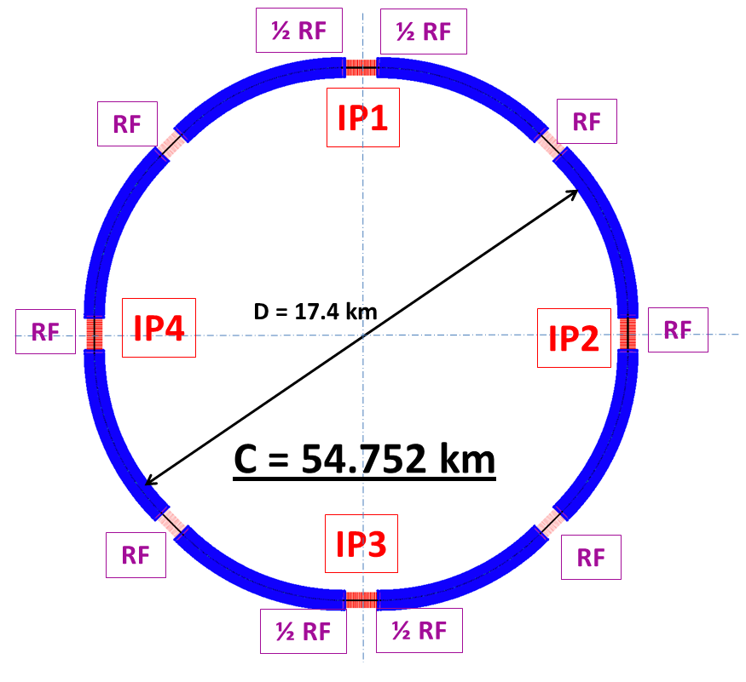
Introduction
CEPC is a Circular Electron Positron Collider to study the Higgs boson
Critical parameters:
Beam energy: 120GeV
Circumference: 54 km
SR power: 51.7 MW/beam
8*arcs
2*IPs
8 RF cavity sections (distributed)
Filling factor of the ring: ~70%
Length of the straight sections are compatible with SppC requirement

Slide 3
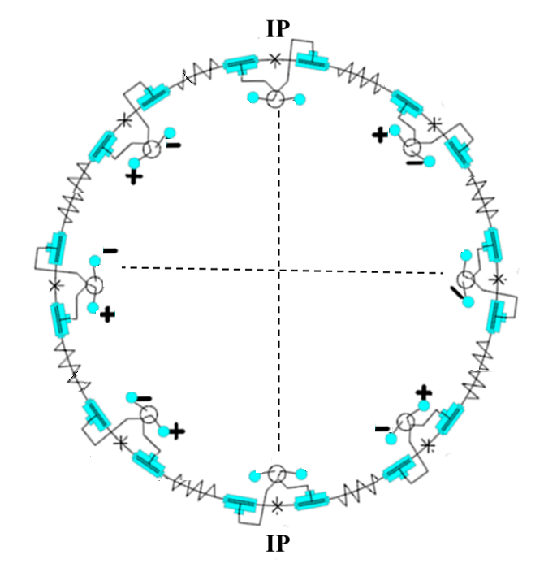
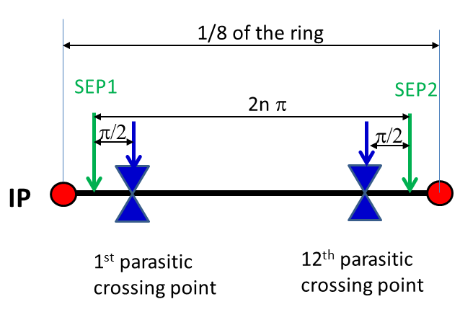
Pretzel scheme
Horizontal separation is adopted to avoid big coupling
No orbit in RF section to avoid beam instability and HOM in the cavity
One pair of electrostatic separators for each arc

Slide 4
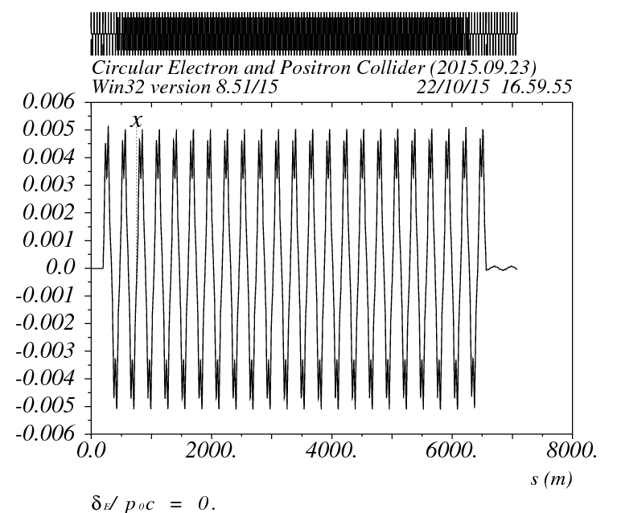
Principles of pretzel scheme
For our lattice, it is comprised of 60/60 degree FODO cells, every 6 cells have a phase advance of 2Pi, so the relationship can be written as:
For 50 bunches, there are 100 collision points in total, thus the ring circumference must be
For a ring with circumference of ~50km, N=2, which means there is one collision point every 4Pi phase advance. The exact length of the ring is 56640m.

Slide 5
twiss etc

Slide 6
chromaticity

Slide 7
add pretzel correction(matching)
fix AXI 0 AYI 0 !BYI 27.44 BXI 81.17
fix EXI 0 EPXI 0
fit QFH1C.2 QFH1C.4 nx 2 11
fit QFH1C.2 QFH1C.4 ny 2 11
fit QFH1C.4 QFH1C.6 nx 2 11
fit QFH1C.4 QFH1C.6 ny 2 11
fit QFH1C.1 QFH1C.3 nx 2 11
fit QFH1C.1 QFH1C.3 ny 2 11
fit QFH1C.7 QFH1C.9 nx 2 11
fit QFH1C.7 QFH1C.9 ny 2 11
fit BSP1H.1 BSP2H.1 nx 22.5 11
fit AX 0 11
fit AY 0 11
fit dx 0 11
fit dpx 0 11
fit ex 0 11
fit epx 0 11
FitFunction:=Twiss["BX","BSP1H.1"]-Twiss["BX","BSP2H.1"]
FitFunction:=Mod[(Twiss["NX","BSP2H.1"]-Twiss["NX","BSP1H.1"])/2/Pi,1]-0.5
FitFunction:=Twiss["BX","$$$"]-Twiss["BX","^^^"]
FitFunction:=Twiss["BY","$$$"]-Twiss["BY","^^^"]
free q*H*C
free Q*RH
!fit nx 25.176588 11
fit ny 25.31335 11
free Q*M*H
free S*

Slide 8
arc(1/8 ring)

Slide 10
the whole ring

Slide 12
dynamic aperture
240 turns is tracked for dynamic aperture

