Slide 1
Status of DA Optimization
ZHANG, Yuan
zhangy@ihep.ac.cn
2016-06-03

Slide 2
LER DA
IPAC’16
Now

Slide 3
To do next
Further optimization of DA
Variable range constraint
Nonlinear + Linear optics optimization (need more knowledge of SuperKEKB Design)

Slide 4
Development of MODE
Motivation:
SAD could not output resoance driving terms directly
Different code has different functionality
Different objective may be calculated by different code
Achievement:
Combination of SAD & MADX now
It is easily to call different codes to calculate objection function

Slide 5
Test at BEPCII
Main Objectives:
Try to increase the detuning term which help to suppress the instability by Landau damping (calc with madx)
Try to enlarge the dynamic aperture (track with sad)

Slide 6
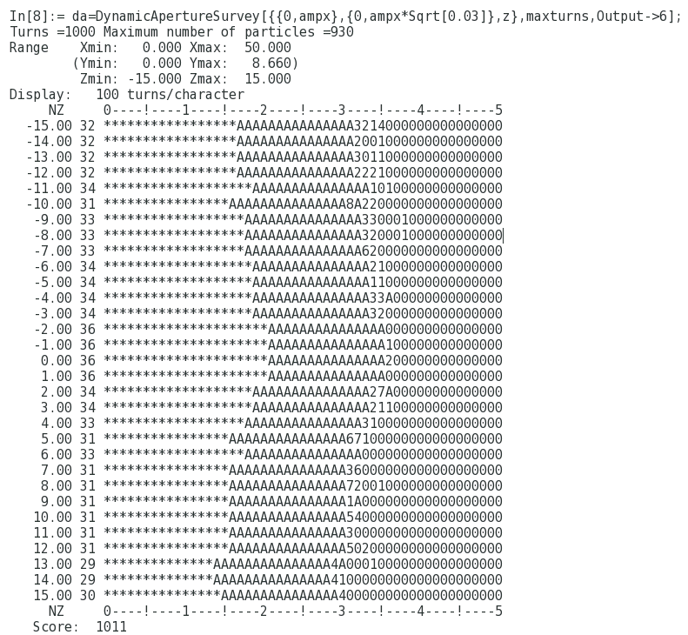
Detuning
DA

