Slide 1
Summary on SPPC Accelerators
Tang Jingyu for SPPC group
September 2-3, 2016,
CEPC-SPPC Symposium, Beihang

Slide 2
Talks on SPPC Accelerators
12 talks, 19 attendees in the parallel sessions
  IHEP, USTC, PKU, THU, SINAP
Young generation (students/postdocs) is playing a very important role (7/12 talks), especially in accelerator physics studies.
  Prof. Xiangqi Wang (>70) also gave a talk
We reported the design work on the accelerator physics for both the collider and injector accelerators, and also technical issues
Good discussions about the key accelerator physics problems and key technical issues

Slide 3
General Progress
Tang Jingyu
More young people (especially students) joined the study team
Maintaining regular monthly meetings
Accelerator Physics studies
  Good progress on the major problems in the collider: lattice, collimation, beam-beam effects, instabilities, injection and extraction, luminosity leveling etc.
  Schematic design on the injector accelerators: main parameters, stage schemes, lattice and layout, etc
Key technology studies
  Design and R&D on high-field superconducting magnets
  Study on beam screen and cryogenic vacuum
  Identifying other key technical challenges: beam dump, collimators etc.
A paper on general SPPC design submitted to PRAB is under revision

Slide 4
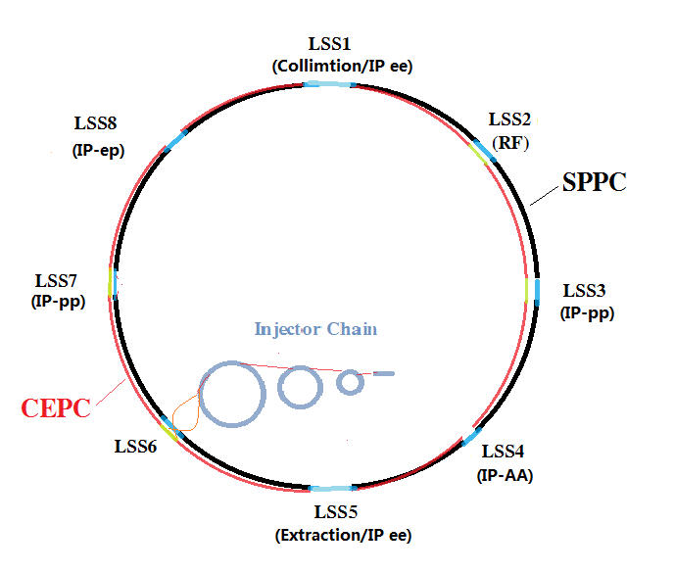
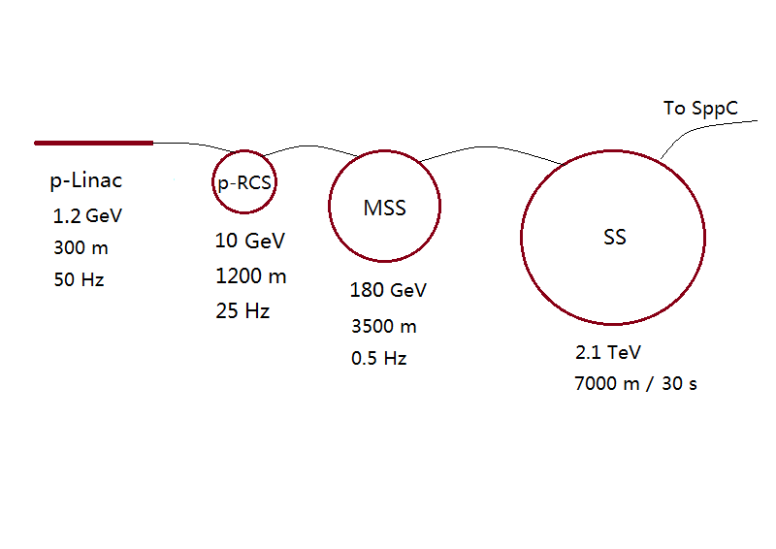
Parameter | Value | Unit
Circumference | 54.3 | km
Beam energy | 35.3 | TeV
Dipole field | 20 | T
Injection energy | 2.1 | TeV
Number of IPs | 2
Peak lumi./IP | 1.2E+35 | cm⁻²s⁻¹
Beta* | 0.75 | m
Circu. current | 1.0 | A
Bunch separation | 25 | ns
Bunch population | 2.0E+11
Arc SR heat load | 56.7 | W/m
Notes:
Left: Whole accelerator complex; Right: injector chain of 4 acceleration stages

Slide 5
Key technological issues
High-field superconducting magnets
  Continuous efforts by Xu Qingjin and his group
  International collaborations (recent visit of Tiina Salmi, Finland)
  Domestic collaboration: Workshop on High-Temperature and High-Field Superconducting Materials and Application Technology was held on April 28-29, 2016 in Shanghai
Beam screen and vacuum
  Zhu Kun and Gan Pingping continue to study new schemes; recent discussion about strip-like structure looks interesting
  Wang Yong (and students) studying SEY for different materials
RF systems
  Dai Jianping is focusing on the high-Q ferrite-loaded RF systems for the injector accelerators
Other technical issues
  Needing motivation and funds

Slide 6
R&D efforts and preparation
We need long-term R&D efforts to meet the requirements for building SPPC; some of key technologies are extremely challenging.
Both funds and manpower are needed
The CEPC project obtained the first R&D fund from MoST, while SPPC should try more efforts from NSFC (Tang Jingyu in 2015 and Xu Qingjin in 2016).
Paper work on key issues should be pursued, to learn the technical progress and tendency around the world; to provide evidence support for the future R&D applications

Slide 7
About team and collaboration
There are a few new students and also international experts joined the study
Collaboration on beam collimation with LAL (France) and LHC established; on High-Field Magnets with US labs and others; will seek further collaboration partners
CEPC-SPPC is discussing to form an international collaboration structure. We will fit us within the frame

Slide 8
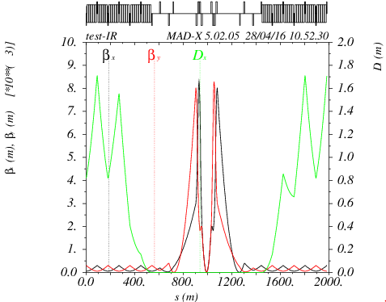
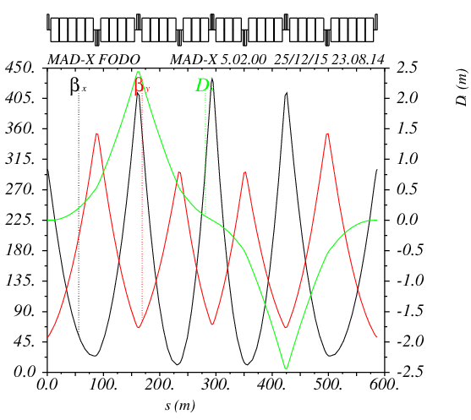
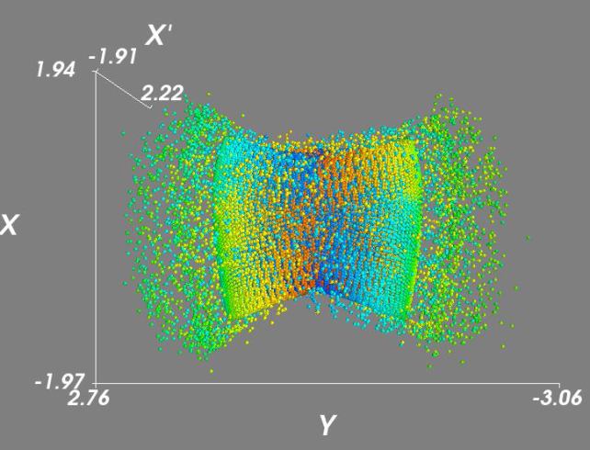
Collider Lattice Design
Su Feng, Chen Yukai, Zhang Linhao
Design work in parallel
  Useful lattice versions have been obtained, also used for other studies
  Two lattice designs for 70 TeV and one for 100 TeV
  Compatible with CEPC partial double ring (3.5 km LSS)
  Dynamic aperture calculations (Sixtrack) show reasonable designs

Slide 9
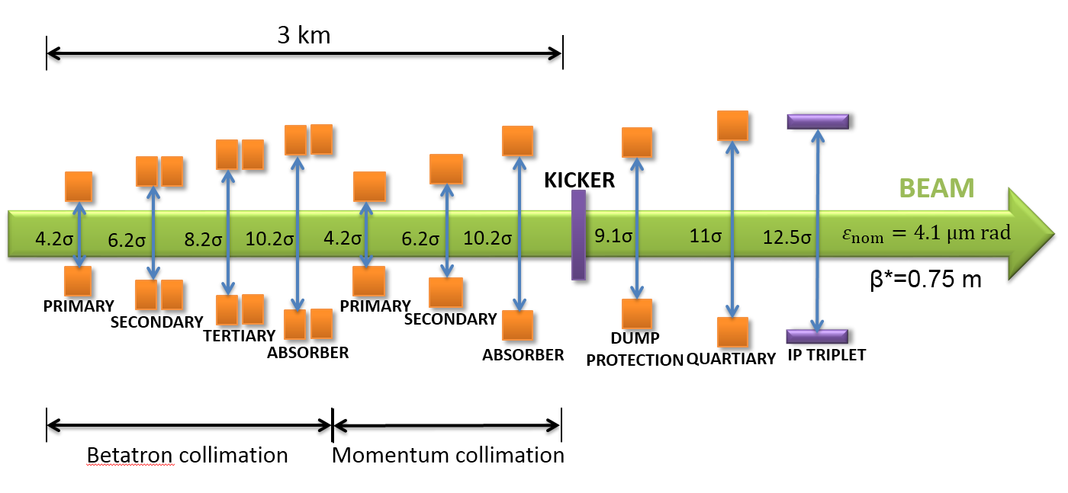
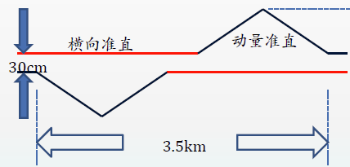
Beam Collimation
Zou Ye, Yang Jianquan
Beam collimation is extremely important and difficult for SPPC (Stored energy: 6.3 GJ)
  Heavy beam losses: beam-beam interactions, transverse and longitudinal diffusion, residual gas scattering, instabilities and so on (peak loss: MW level)
  Quench protection of SC magnets
  Machine protection
  Hands-on maintenance
  Cleaning of physics debris
  Reducing experiment background
Key issues: lattice, methods, materials
New idea: Transverse and longitudinal collimation in the same LSS almost proved by simulations (FCC is also studying the scheme)

Slide 10
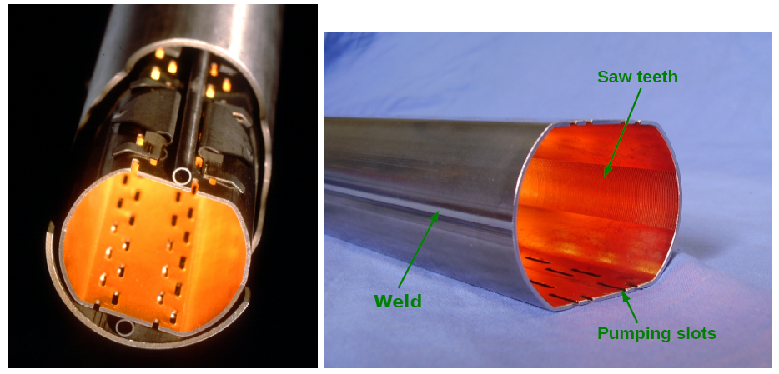
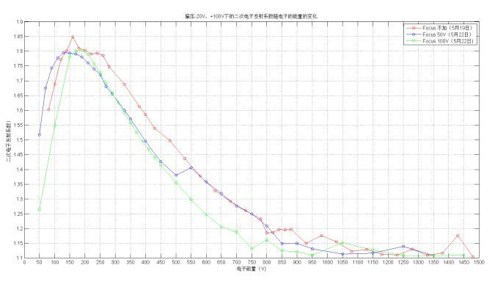
Impedance and Instabilities
Liu Yudong
Analysis on key impedance contributions: beam screens and collimators
Study on wall impedance for multilayer chamber: analytical and simulations
  Beam screen: stainless steel (0.6mm) with coating copper (50um), now also HTS
  Injection protection collimator: hBN (hexagonal boron nitride, 六方氮化硼) coating with Ti（5um）
  Others
Electron cloud study in different sections;
characteristics measurements (with a NSFC fund)

Slide 11
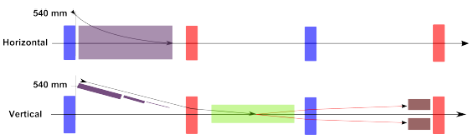
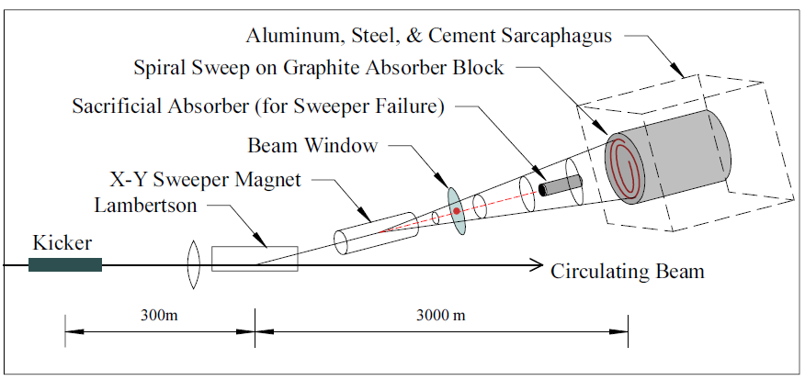
Injection/extraction
Li Guangrui
Injection is important for SPPC turnaround time
Extraction is key for machine protection
The talk: reviewed the challenges of the injection (e.g. power limit - 5 MJ for each injection) and the injection schemes at FCC-hh; dumping system (extraction) challenges and design concept at SPPC and FCC-hh; lattice considerations

Slide 12
Injector Chain General and p-RCS
Tang Jingyu
Injector chain by itself is a very complicated and powerful accelerator system, large enough by a single stage
Rich physics programs for each stage
No close reference accelerators (scaled up by large factors)
  Totally new, different from LHC or Tevatron (building-up by steps)
Design work on each accelerator started: scheme, lattice and even more details (not only feeding the collider but also independent physics program)
Key technical challenges should be identified, so needed R&D program can be pursued.
Some more details about p-RCS and i-RCS
p-linac: 1.63 MW
p-RCS: 3.4 MW
MSS: 3.7 MW
SS: 90 MJ

Slide 13
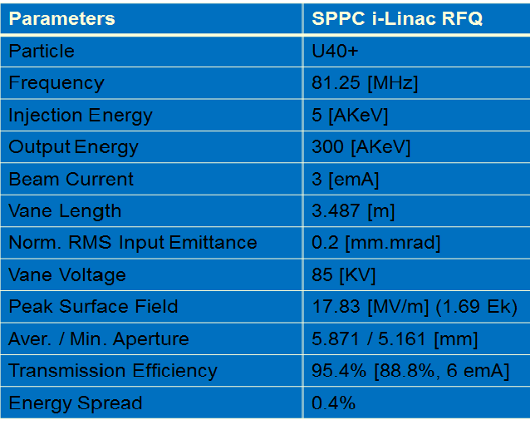
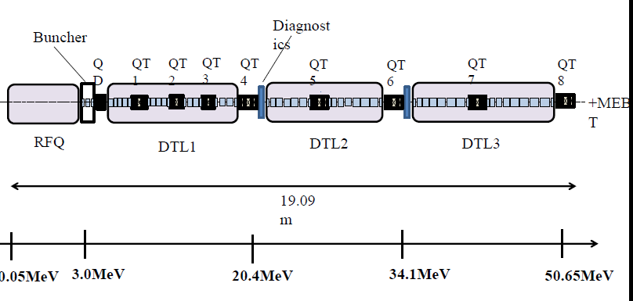
p-linac and i-linac
Lu Yuanrong
Different proton and ion reference linacs around the world are reviewed
First design for the low-energy parts of proton (RFQ, CH-DTL) and ion linacs (RFQ, IH-DTL), simulation results

Slide 14
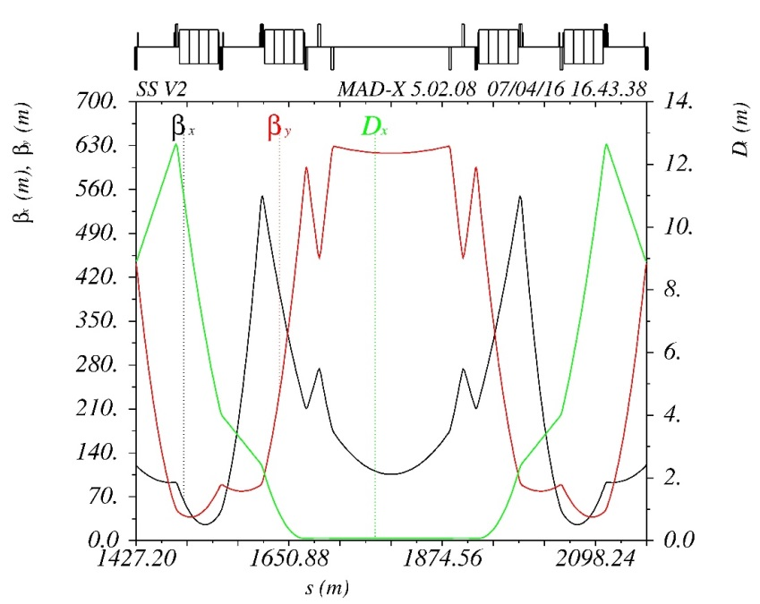
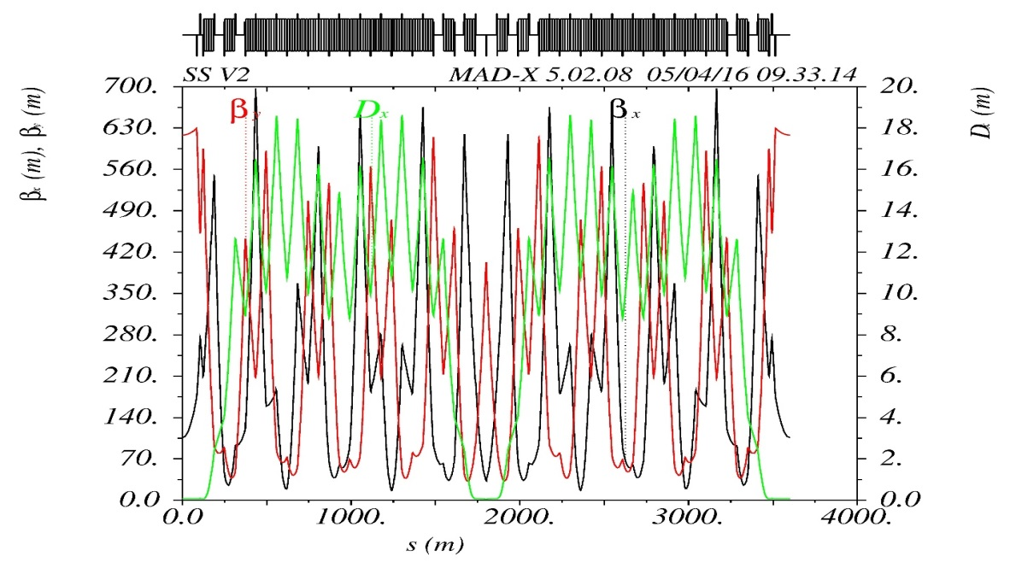
SS – Super Synchrotron
Wang Xiangqi
Layout and preliminary lattice design
Dynamic aperture calculations
Injection and extraction considerations
Fast ramping issue: 30 cycle, 8-10 ramping time, 8-9 T SC magnet, very challenging

Slide 15
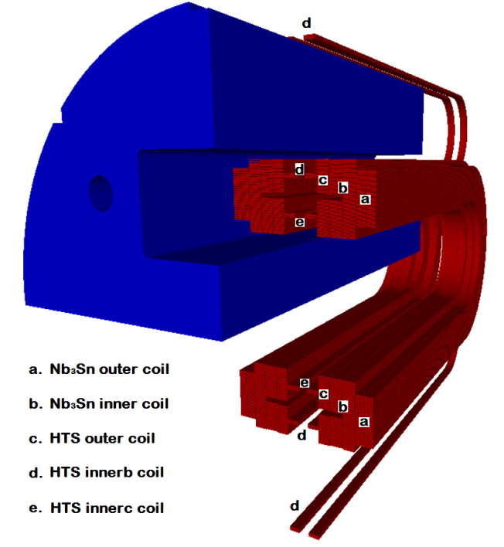
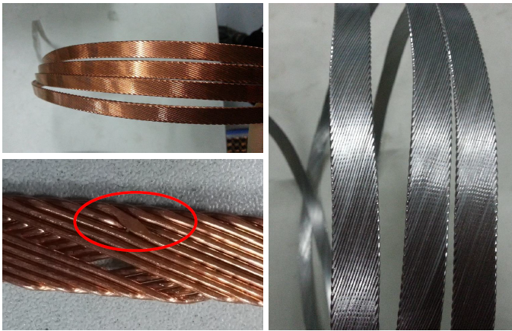
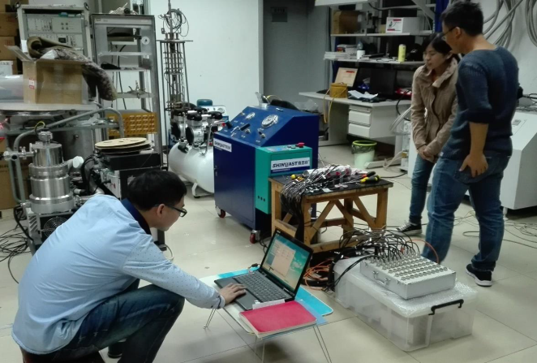
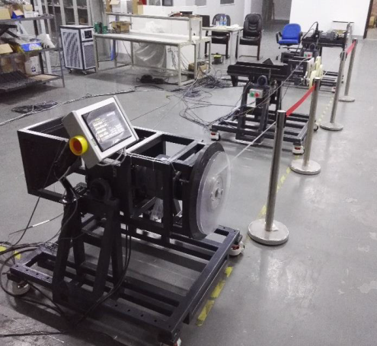
High-field Superconducting Magnets
Xu Qingjin
High-field superconducting magnets are the most challenging and costly part of the SPPC
Work is focused on:
  Design Study of the SPPC Dipole Magnet
  R&D Steps for the SPPC Dipole Magnet
  Development of Nb3Sn Rutherford Cable
  R&D of High Field ReBCO Tape by SSTC
  R&D of Bi-2212 Superconductor by NIN
  Preparation for the Model Magnet R&D
Very slow building-up of infrastructure
Domestic and international collaborations

Slide 16
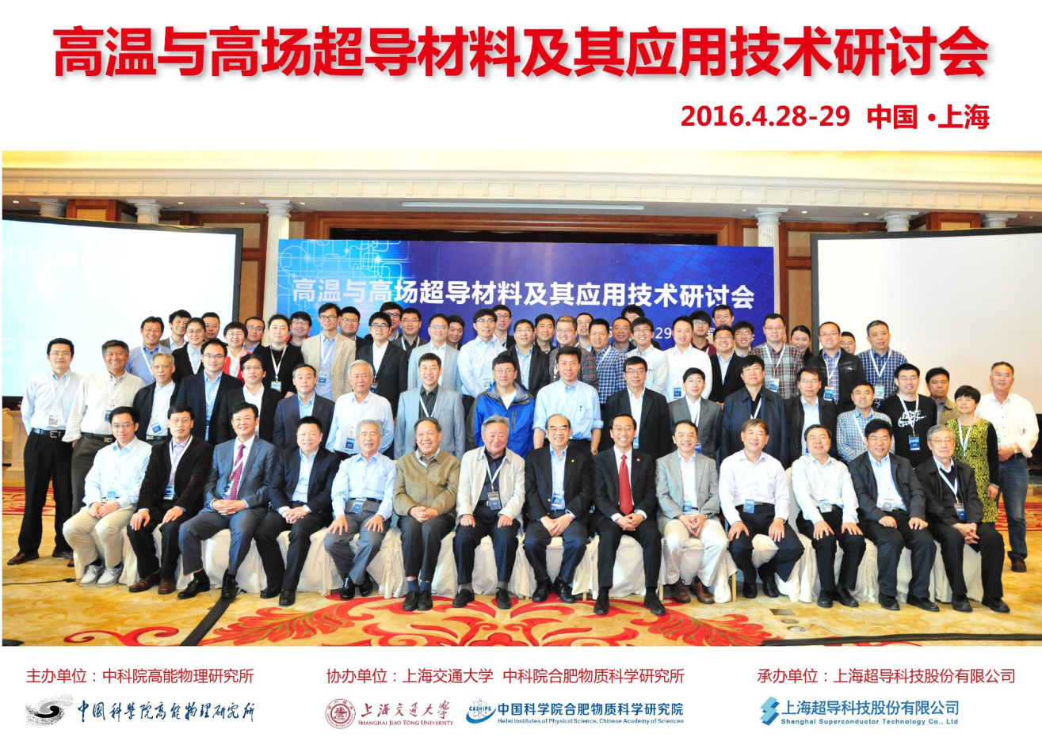
Workshop on HTS Materials and Applications on April 28-29
  Almost key figures in the field attended
  Try to find our own way to develop HFM for SPPC, and also boost technology development and applications in China

Slide 17
Discussions
On key problems (accelerator physics, techniques)
On work organization
On future collaboration

Slide 18
Thanks to all the speakers and contributors for the nice work and presentations!

