Slide 1
Progress of CEPC Detector Magnet
Feipeng Ning
Zian Zhu/ Ling Zhao/Meifen Wang/Zhilong Hou/Wei Zhao/Guoqing Zhang
Institute of High Energy Physics
2016.9.2

Slide 2
Outline
General requirements
Progress of field design
Progress of Rutherford cable
Progress of cooling system
Research on iron yokes
Summary

Slide 3
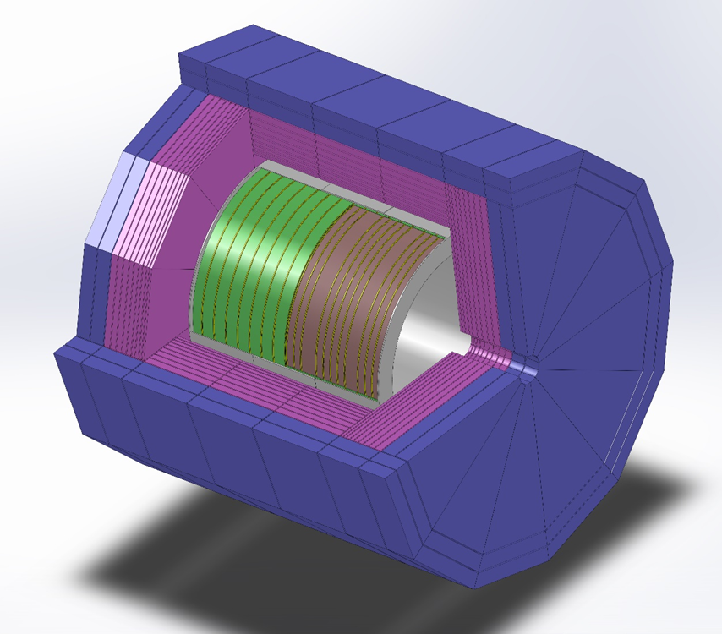
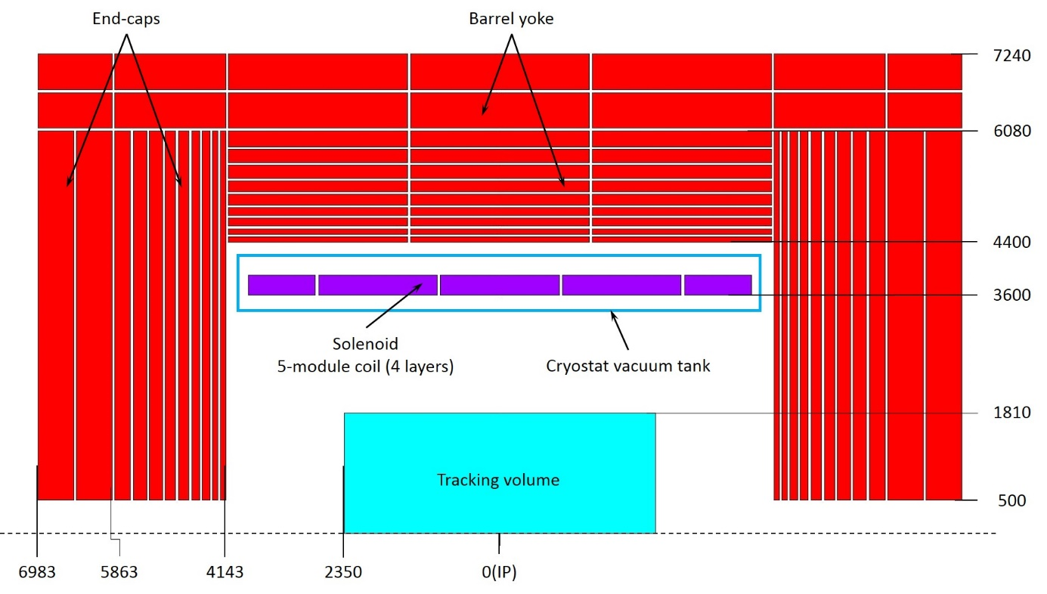
General requirements
Requirements：
Provide an axial magnetic field to deflect the charged particles.
Carrying all sub-detectors.
Absorber of Muon.
Magnetic field shielding .
General Design
Inner diameter:6.8m
Length:8.05m
Tracking volume (TV): diameter 3.62m,length 4.7m，
Central field:3.5Tesla
By reference to the design of ILC-ILD &LHC-CMS magnet
2D layout of CEPC magnet(mm)

Slide 4
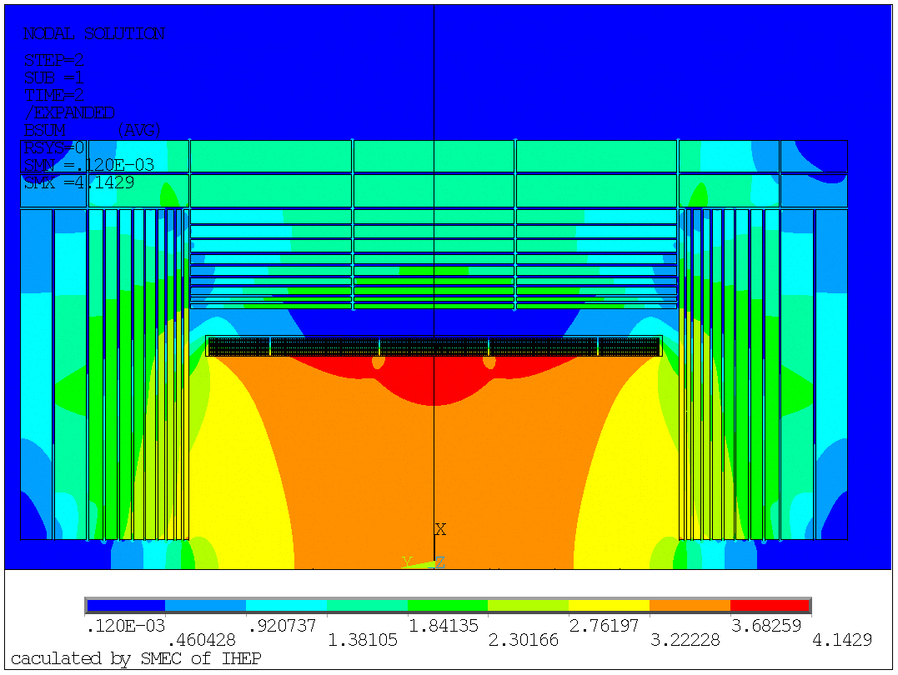
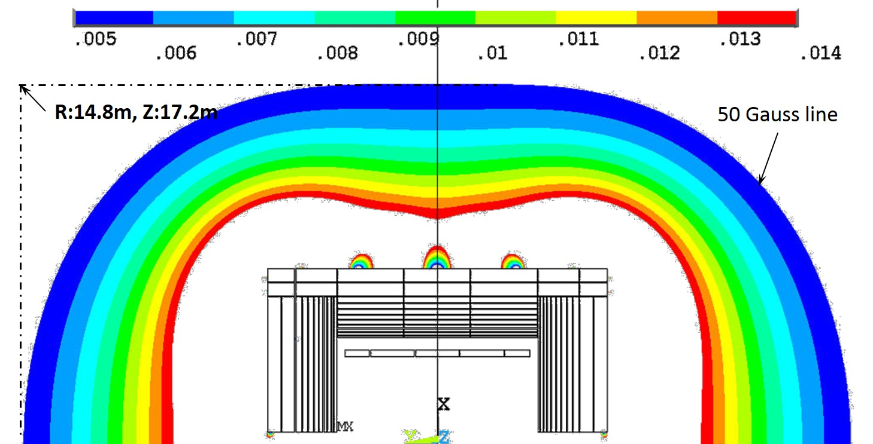
Progress of field design
Feipeng Ning
Magnetic field distribution：central field 3.5T，the Peak-peak field percent deviation of TV is 10.1%
  The 50 G line is at 14.8 m radial distance and 17.2 m axial distance with a total thickness of iron of 2.44 m both in the barrel and the two end-caps with the 3.5 T central field.
Stray field distribution outside the magnet
(the field is given in T)
Magnetic field distribution(unit：T)

Slide 5
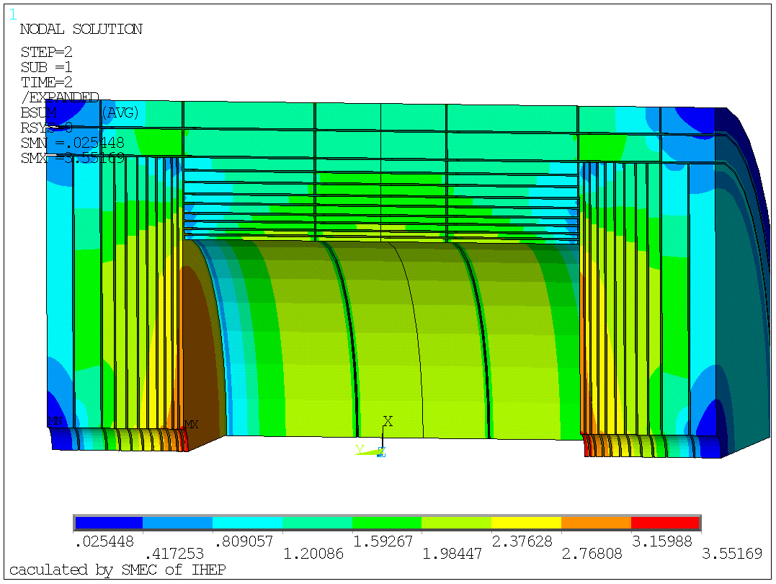
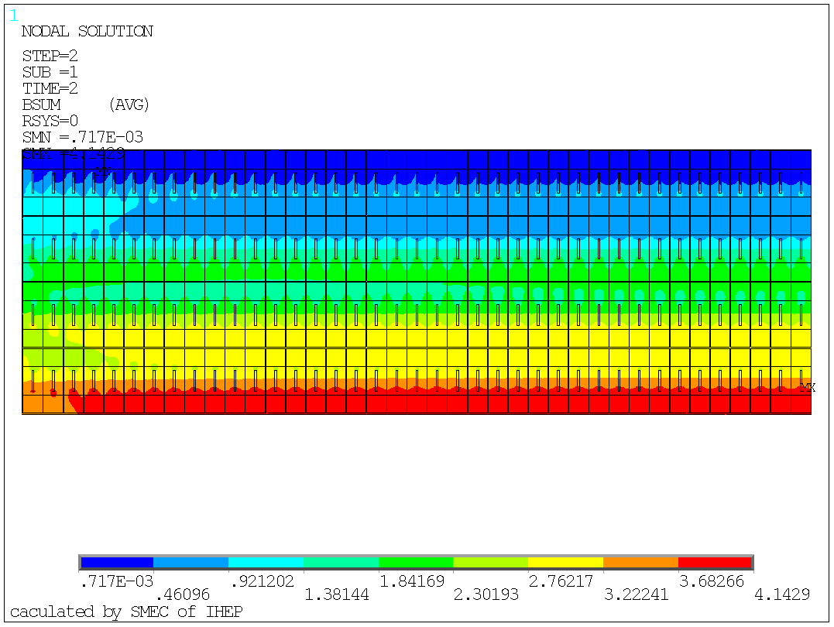
Progress of field design
Feipeng Ning
Magnetic field distribution of the iron, Maximum field is 3.55T.
Magnetic field distribution of the conductor，Maximum field is on the pure Aluminum stabilizer, it is 4.14 T，maximum field on NbTi cable is 4 T.

Slide 6
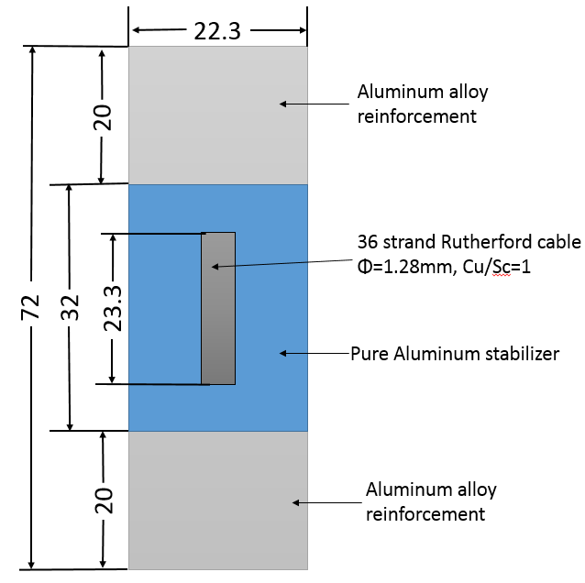
Stress analysis of SC coil
Feipeng Ning
  thermal mechanical force caused by inconsistent of the material expansion coefficient；
  The magnetic force
Material properties：
Material | Temperature(K) | Young’s Modulus(Gpa) | Poisson’s ratio
Al | 4.2 | 0.8 | 0.49
Al-Alloy | 4.2 | 77.7 | 0.327
Sc strand | 4.2 | 130 | 0.3
Fibre glass epoxy | 4.2 | 12.5 | 0.21
Material | Mean integral thermal expansion coefficient 293K—4.2K K⁻¹
Aluminium | 14.23e-6
Al-alloy | 14.16e-6
Sc strand | 8.79e-6
Fibre glass epoxy | 25.5e-6

Slide 7
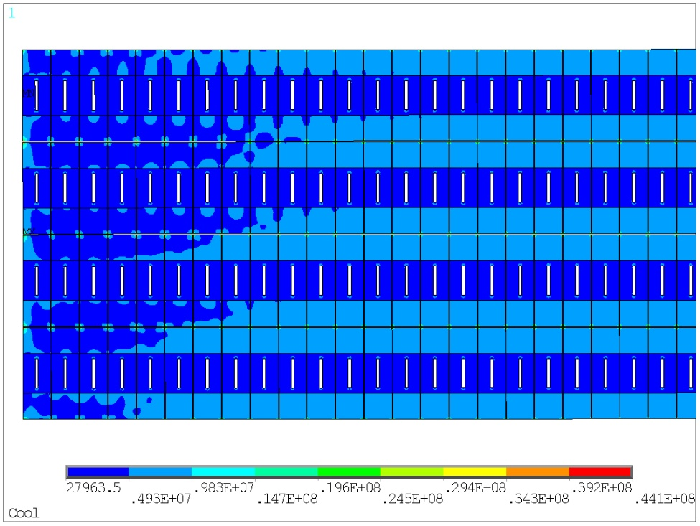
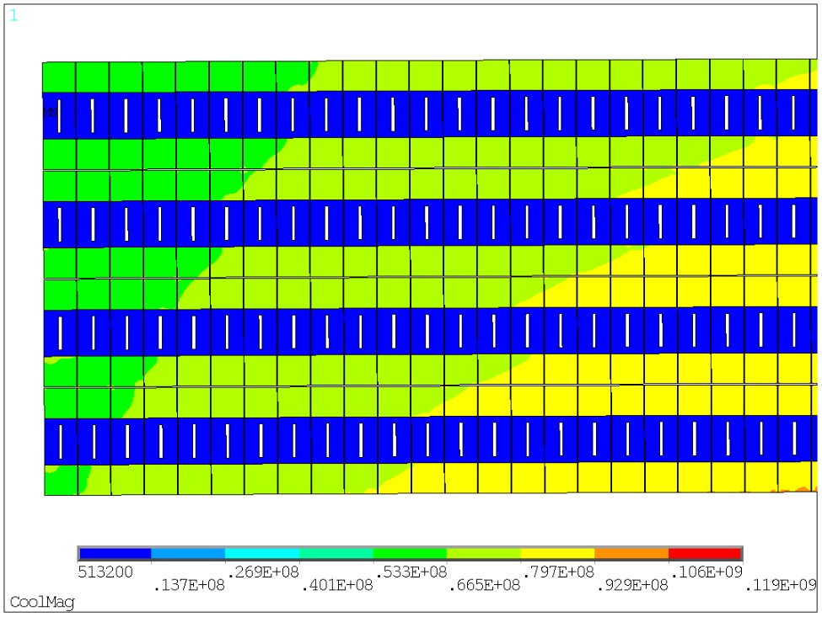
Stress analysis of SC coil
Feipeng Ning
Stress analysis is divided into two conditions:
  coil at 4.2 K
  Coil at 4.2 K, energized
Maximum Von Mise of conductors.
Coil at 4.2 K, Von Mise distribution of the end coil pure Aluminum and Aluminum alloy：
Material | Von Mises stress, MPa End coil | Von Mises stress, MPa Middle coil | Von Mises stress, MPa End coil
Coil at 4.2 K
Pure Aluminum | 0-7 | 0-7 | 0-7
SC cable | 189—205 | 189-200 | 190—201
Al alloy | 2—44 | 5-43 | 5—39
Coil at 4.2 K, energized
Pure Aluminum | 0—10 | 0—10 | 0—9
SC cable | 46—121 | 20—78 | 14—69
Al alloy | 54—119 | 88-132 | 100—134
Coil at 4.2 K, energized, Von Mise distribution of the end coil pure Aluminum and Aluminum alloy：

Slide 8
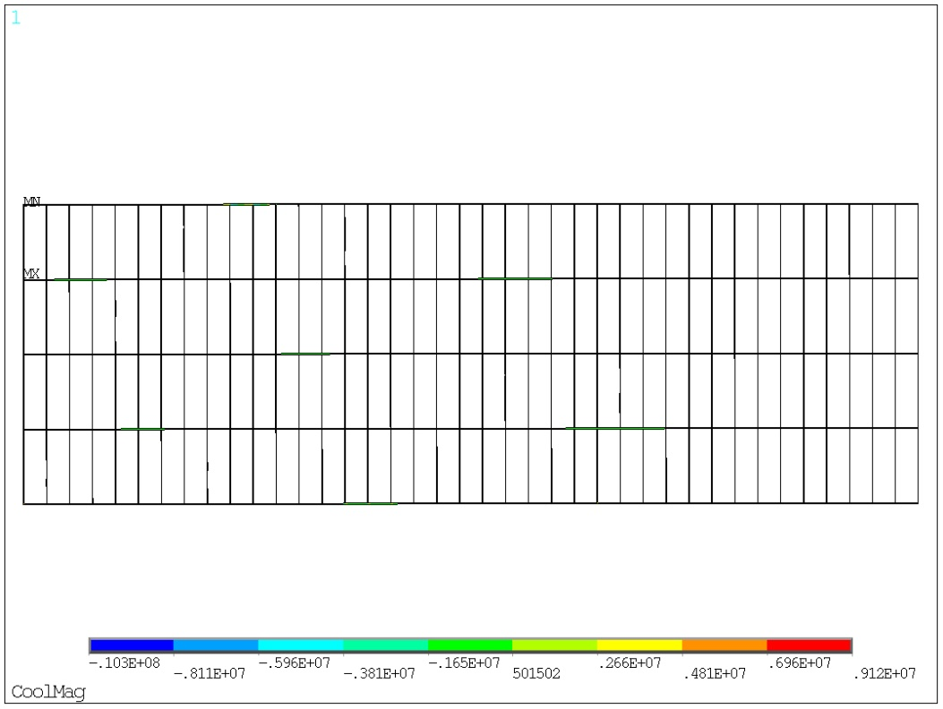
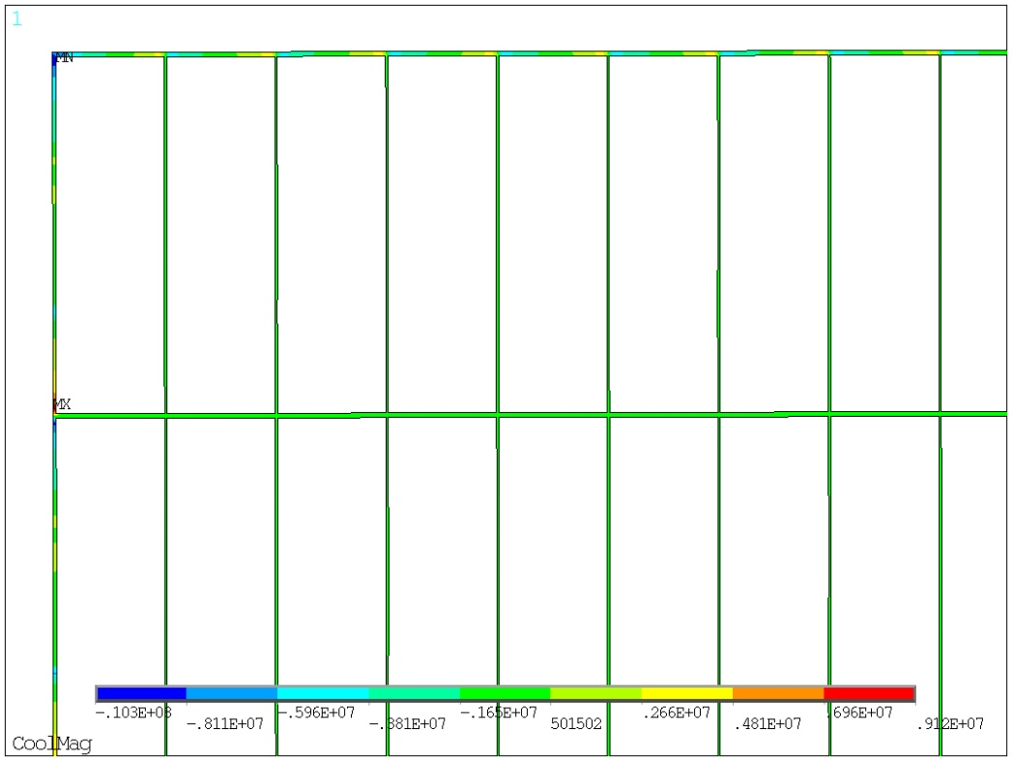
Stress analysis of SC coil
Feipeng Ning
Shear stress of the insulation：
  Maximum shear stress
Coil at 4.2K | Shear Stress MPa
Central coil | 10
Middle coil | 13
End coil | 12
Shear stress distribution of the central coil insulation：
Coil at 4.2K, energized | Shear Stress MPa
Central coil | 10
Middle coil | 13
End coil | 13

Slide 9
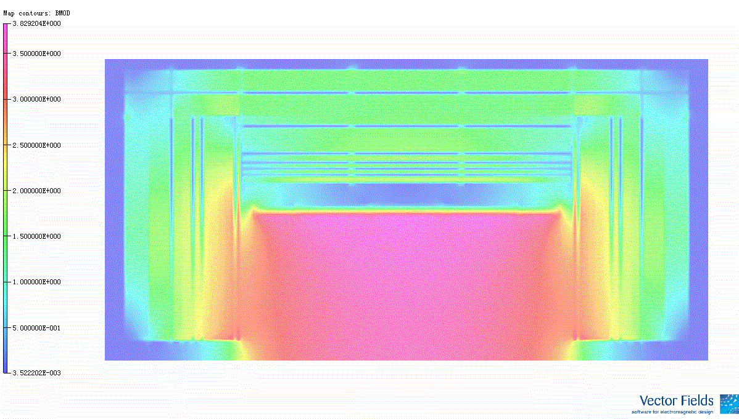
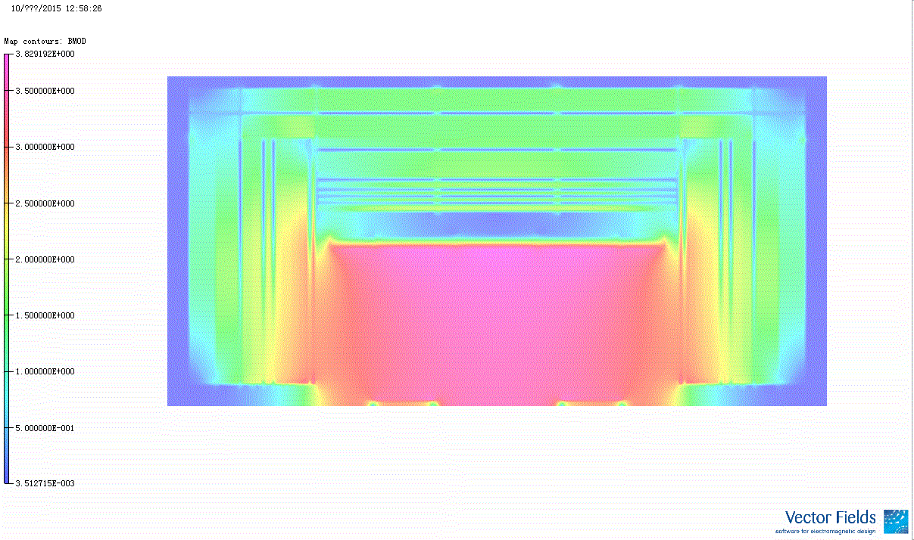
Influence of the Anti-Solenoid at interaction region
Magnetic field distribution on Axis direction
Magnetic field distribution on Axis direction
without Anti-Solenoid
with Anti-Solenoid

Slide 10
New design without iron yoke
Wei Zhao
Principle：
The inner coil is the main coil, and the outer coil is the shielding coil, which generates a reverse field.
Inner coil contributes the central field 5.5T
Outer coil contributes the central field -2T
Central field is 3.5T
1.2 T
2.3 T
3.5 T
5.5 T
2 T
3.5 T

Slide 11
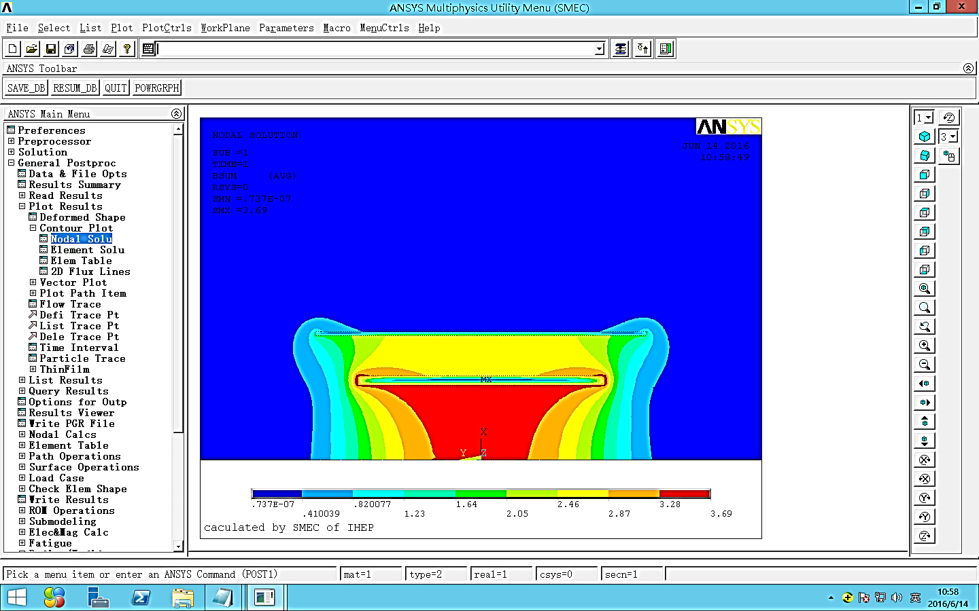
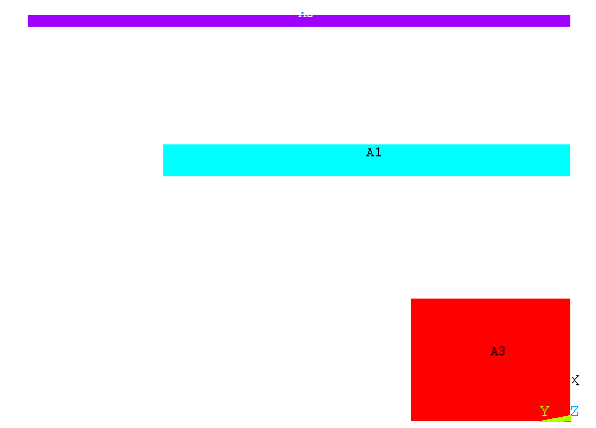
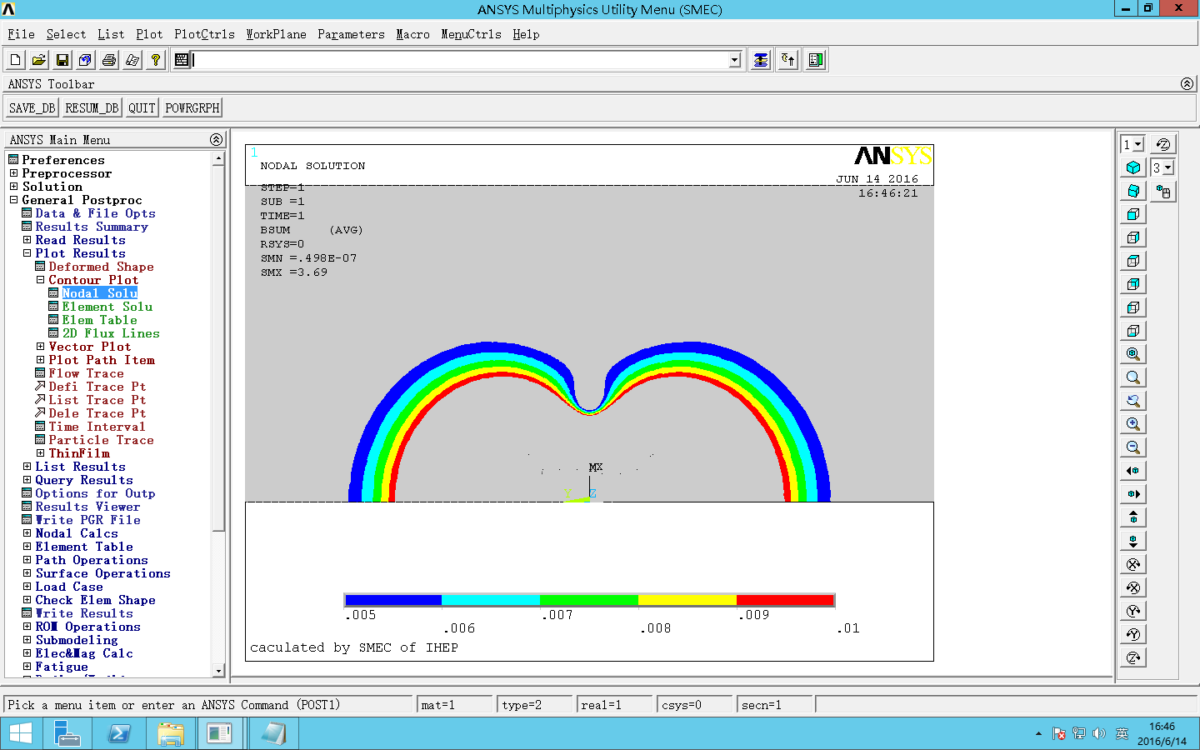
Preliminary result
Wei Zhao
simulation model
Shielding coil
Inner coil: length 12m, inner radius 3.6m,
Outer coil: length 16m，inner radius 5.8m，
Central field is 3.5T.
the Peak-peak field percent deviation of TV is 7.9%.
Max field is 3.69T on the inner coil。
8m
6m
Main coil
5.8m
3.6m
Magnetic field distribution
Stray field distribution
50Gauss line: R 19m，Z 28m

Slide 12
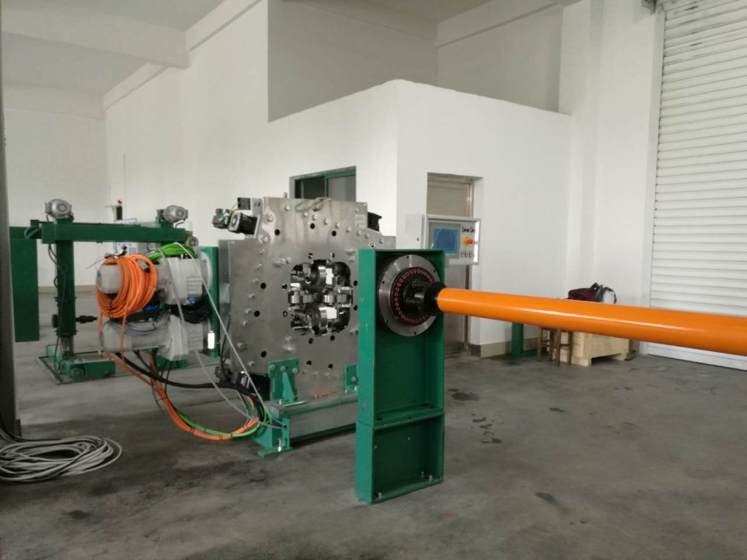
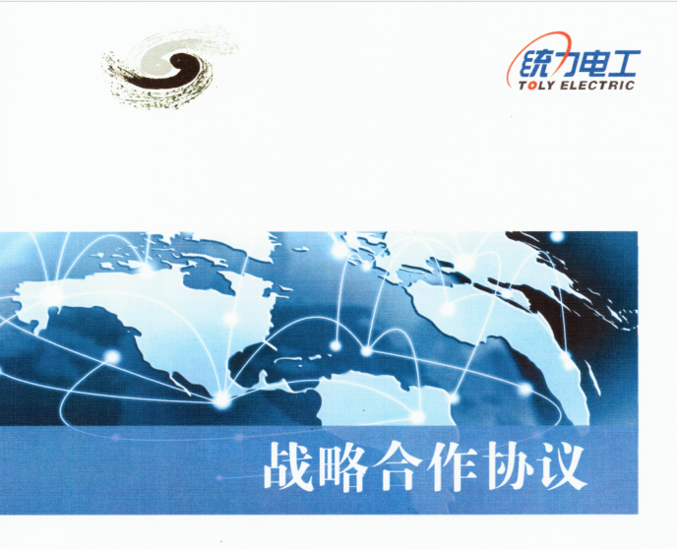
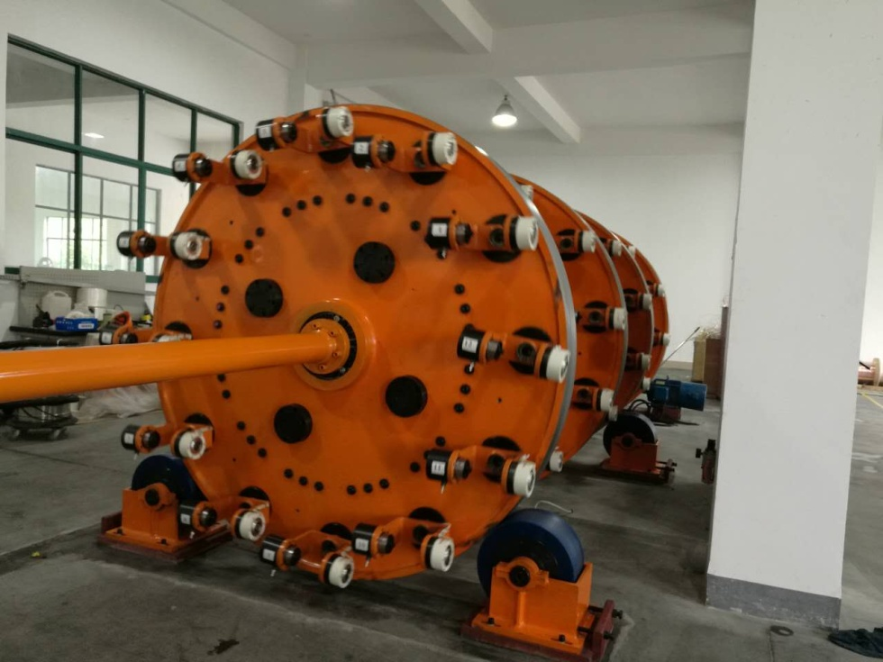
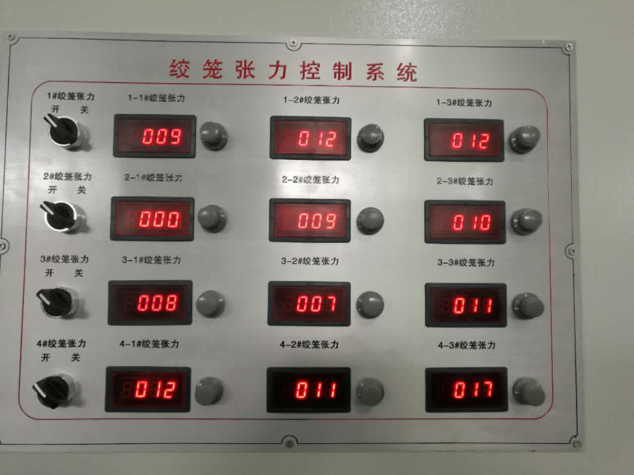
Progress of the Rutherford cable
Ling Zhao
2015.6，Cooperation agreement with Toly Electric and began the development of Rutherford cable.
New cabling machine and tension control system of strands were put into use this year.

Slide 13
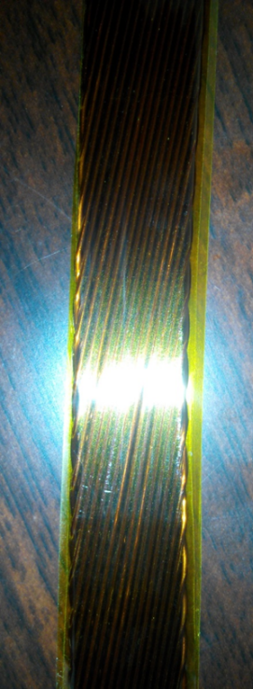
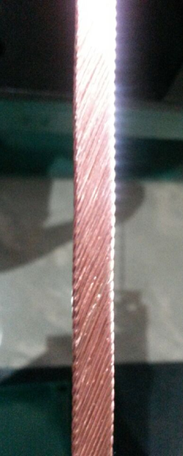
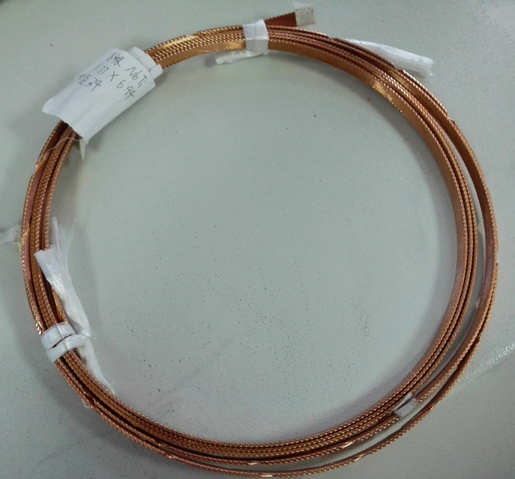
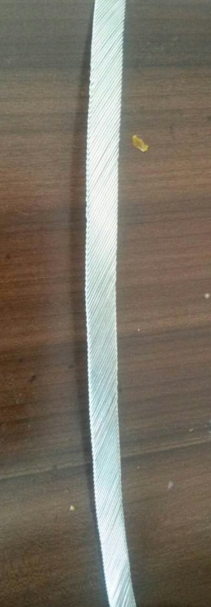
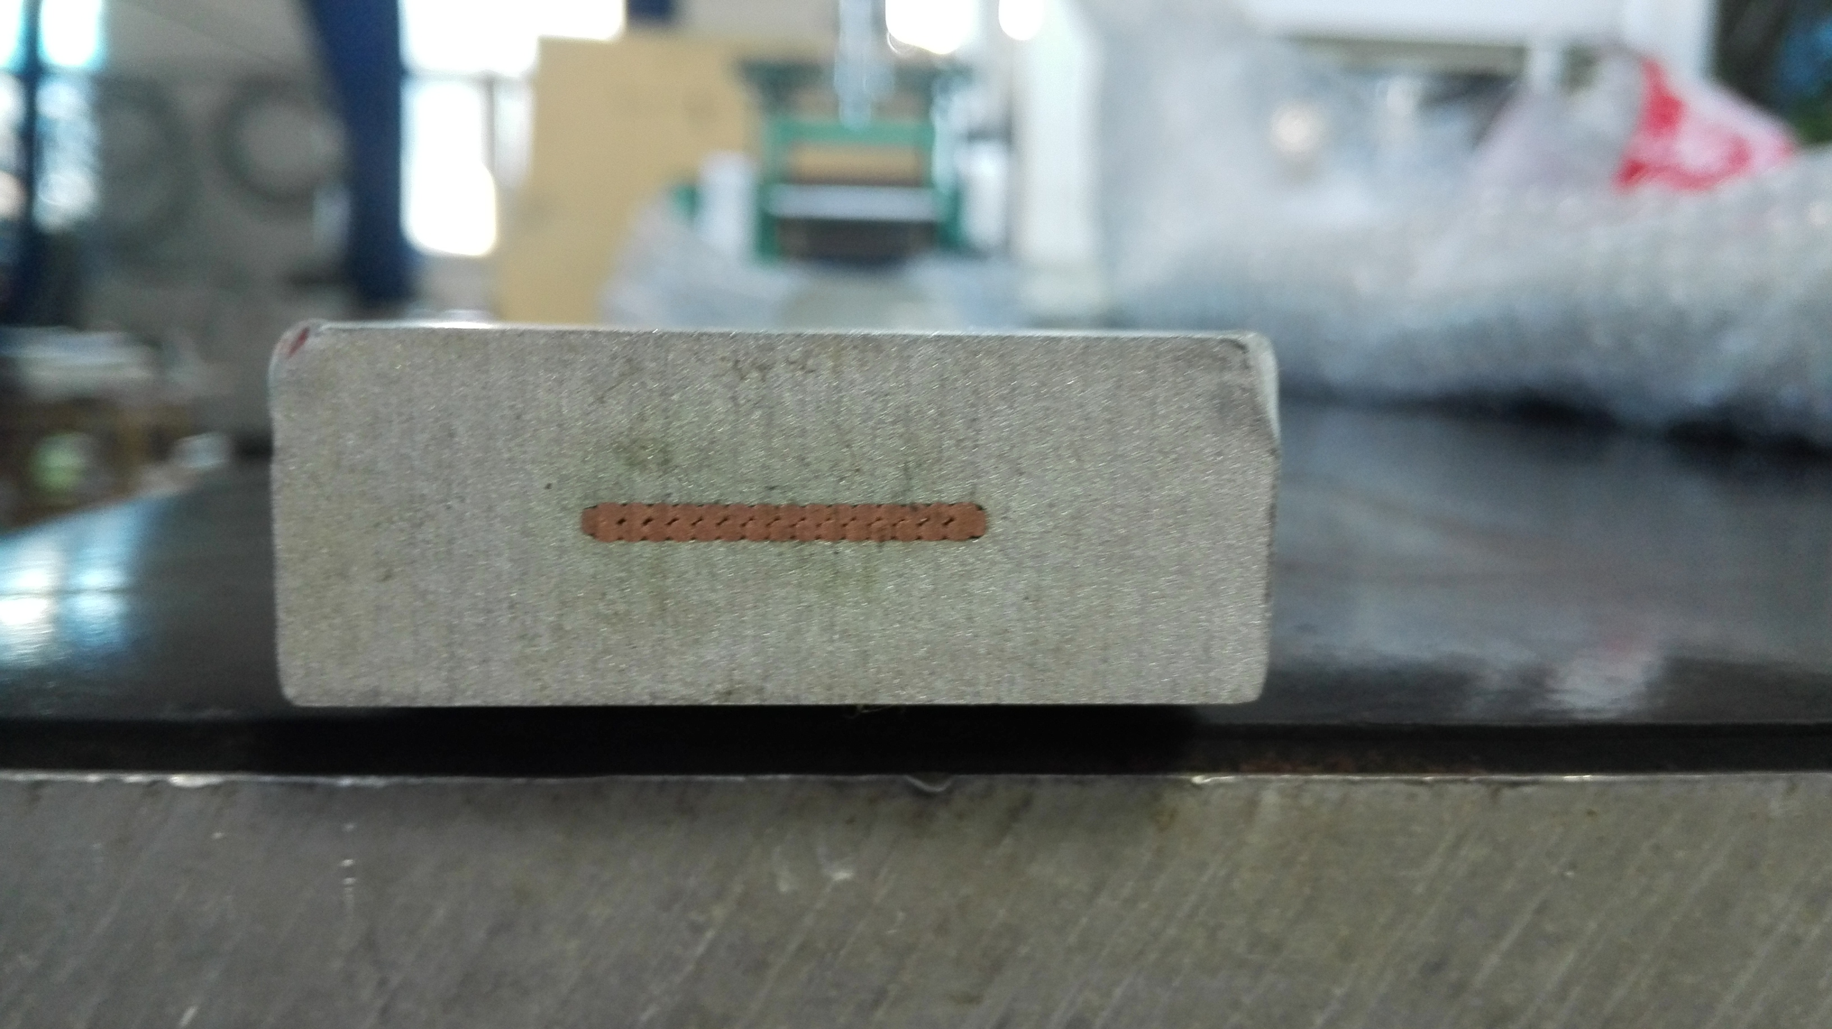
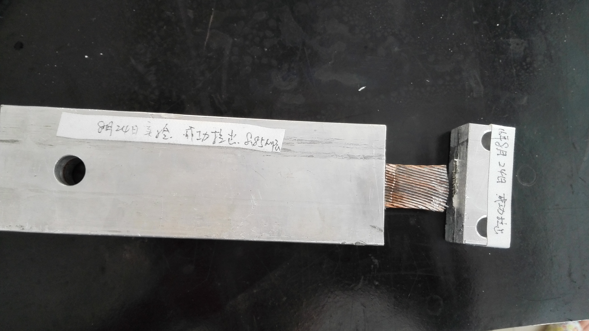
Progress of the Rutherford cable
Ling Zhao
Number of strands：20
Strand diameter：1.0mm
Materiel: Copper
Complete time:2015.5
Number of strands ：17
Strand diameter ：0.727mm
Materiel :Nb/Ti
Complete time:2015.7
Number of strands ：24
Strand diameter ：0.727mm
Materiel :Nb/Ti
Complete time:2015.8
Number of strands ：18
Strand diameter ：1.2mm
Materiel :Nb/Ti
Complete time:2016.2
Number of strands ：32
Strand diameter ：1.2mm
Materiel :Nb/Ti
Tangle：17.32
Length：》100m
RRR： 》100
Complete time:2016.5
Number of strands ：32
Strand diameter ：1.2mm
Materiel :COPPER+Al
Length：1m
Complete time:2016.8
Shear strength（copper &Al）：8.85MPa
Cable research has made great progress!

Slide 14
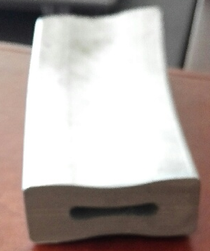
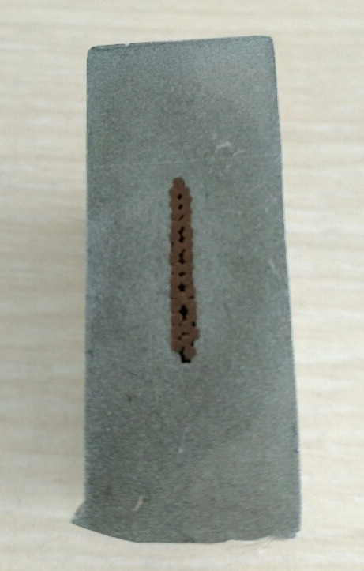
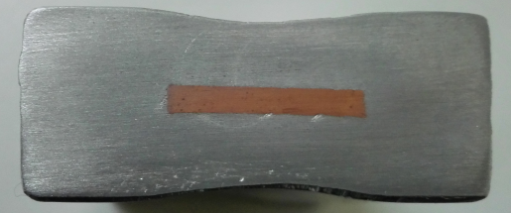
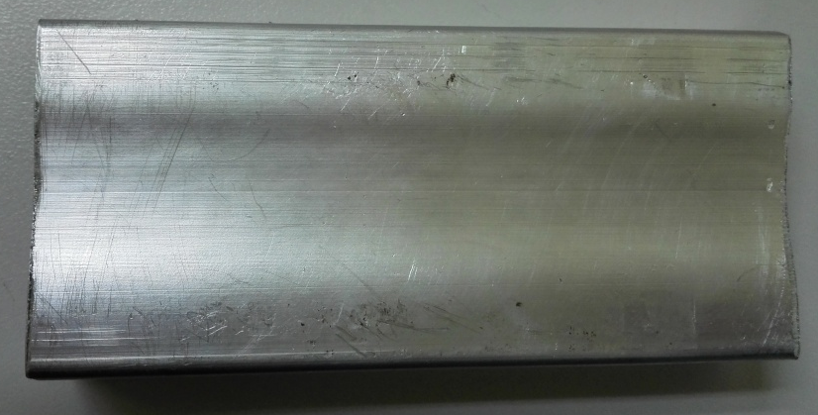
Insert progress
Ling Zhao
Completed two rounds of insert process:
Hollow aluminum alloy, Aluminum alloy + copper cable
Result: Depression in the middle and the tooling needs to be improved.(2016.4)
The strands of the cable are separate after the tooling improvement.
There is a great improvement from the result of last month.
2016.1
Hollow aluminum alloy
2016.5~6：
Aluminum alloy + copper cable
2016.2
Aluminum alloy + copper cable
2016.8：
Aluminum alloy + copper cable

Slide 15
Cable test results
Ling Zhao
Test by WTS
1. RRR value declined by about 1/3 after the stranding process
2.Less affected by larger twist pitch of strands.
The decrease of the critical current is less than 7% after the stranding process.

Slide 16
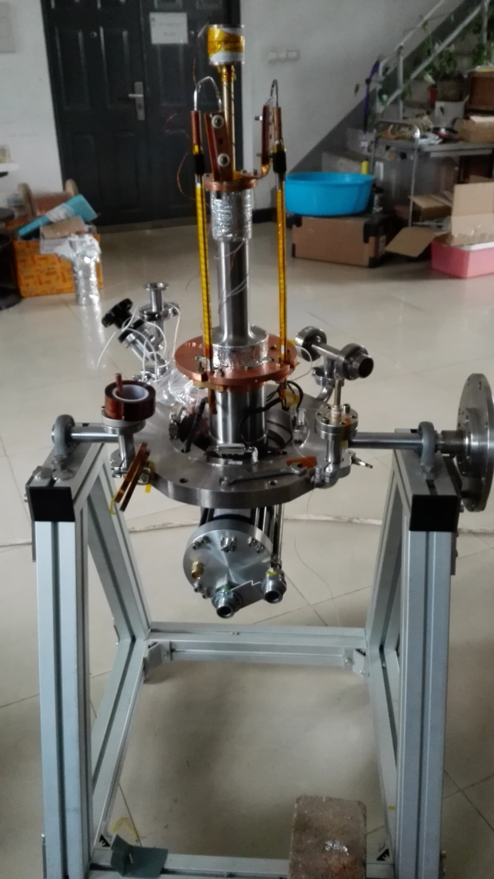
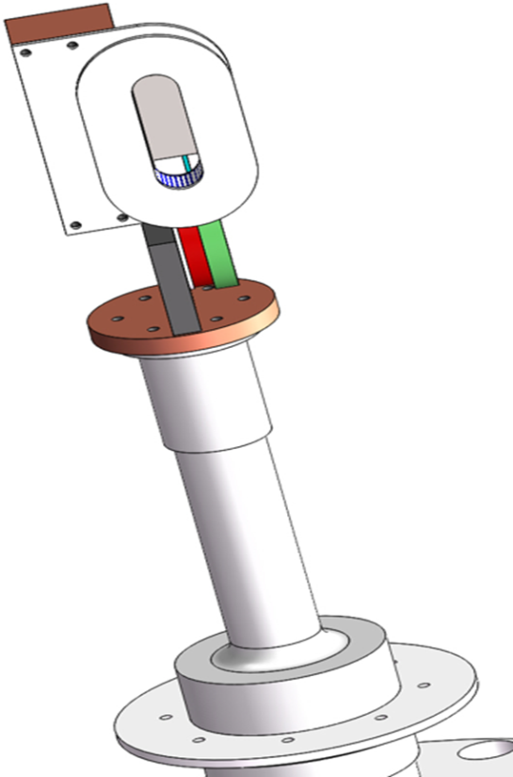
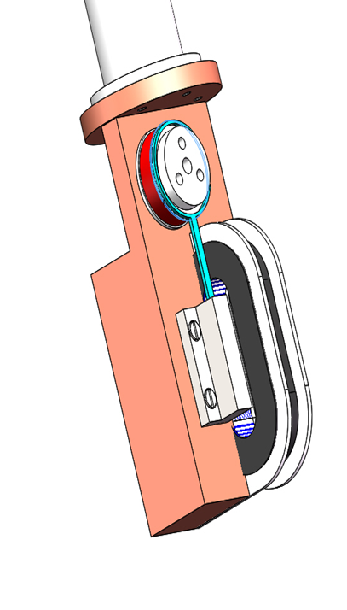
Development of testing device
Ling Zhao
RRR value test
Ic test by induction method
Testing device based on small refrigerator for Ic and RRR value have put into use.
Testing device is based on a small refrigerator.

Slide 17
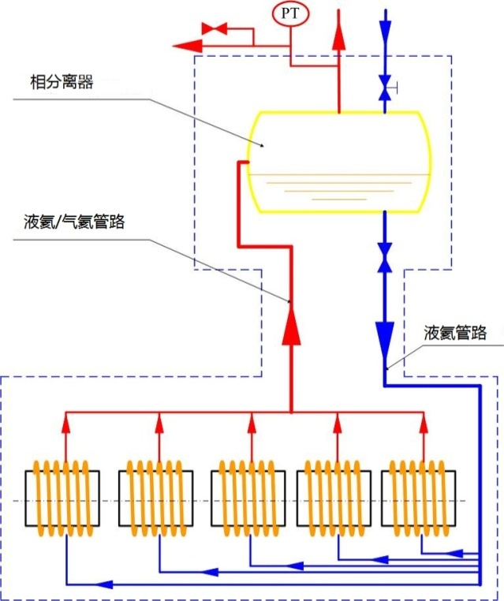
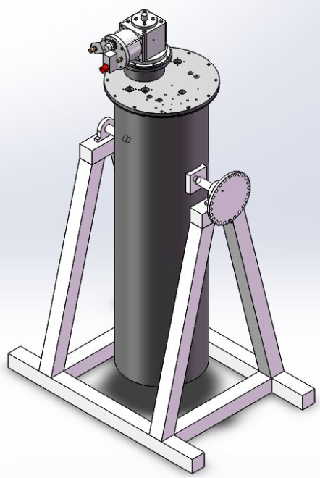
Progress of cooling system
Meifen Wang
phase separator
The coils are cooled by conductive method.
A thermal siphon principle experiment platform was built based on liquid nitrogen. The next plan will be based on liquid helium.
Liquid/Gas helium line
Liquid helium line

Slide 18
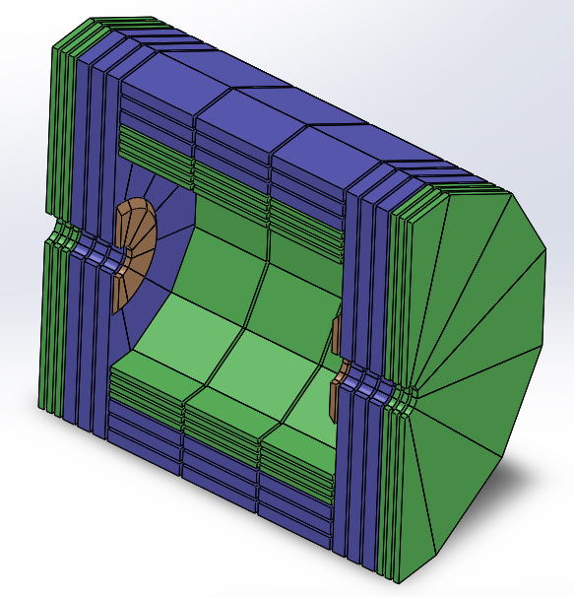
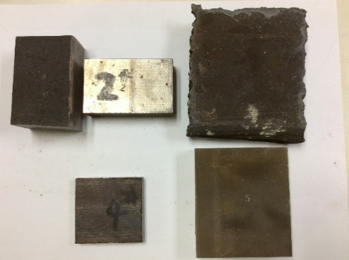
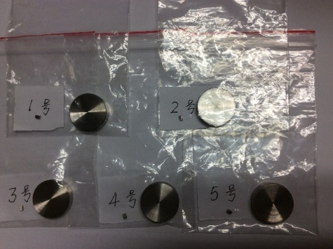
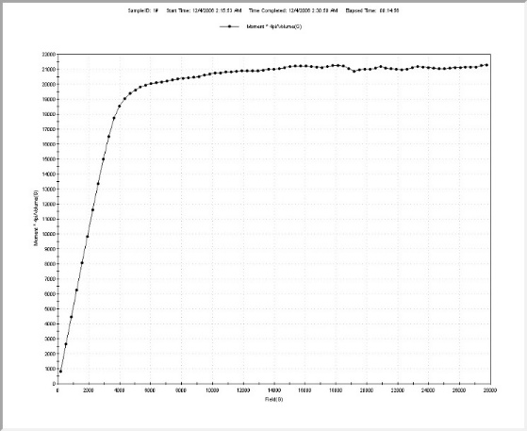
Research on iron yoke
Zhilong Hou
The magnetization curves of different materials were measured.
Cooperation is on discussion in the research of large, thick plate with high magnetic conductivity with Anshan Steel co.
Raw material for magnetization curves measurement from Anshan Steel Co.
Samples
Measured result
The multilayer structure of the yoke

Slide 19
Summary
Several designs have completed on the requirements of different central field and different thickness of yokes, compared the key parameters such as homogeneity /stray field /cost etc.
Stress analysis on the different position of superconducting cables offers reference for designs.
Significant progress in the development of cables: RRR value and Ic meet the requirements. Began the insert process from this year.
Cooperation is on discussion about the yokes with Anshan Steel Co.
Thanks

