Slide 1
CEPC Waveguide HOM 5-cell and 2-cell Cavity Study and EP Facility
S. Jin, J. Gao, Z.C. Liu,
H.J. Zhen, J. Y. Zhai, T. X. Zhao
CEPC-SppC Study Group Meeting, Beijing, Sept. 2-3 , 2016

Slide 2
Outline
Introduction
Waveguide HOM SRF Cavities
EP Facility
Summary

Slide 3
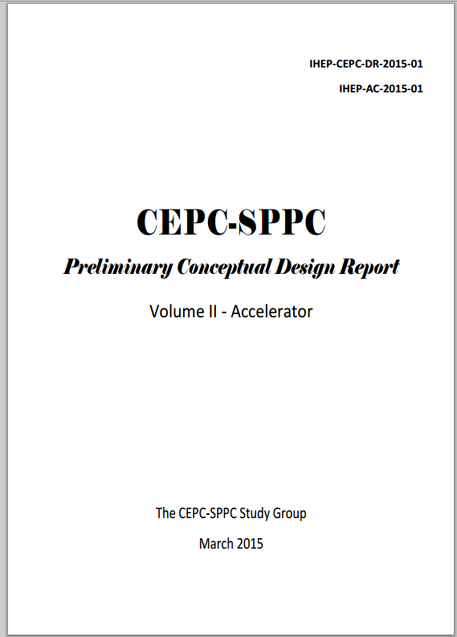
Introduction
CEPC Pre-CDR was published in Mar. 2015
On this background, a project called Study on SRF Accelerator for Large Colliders (ILC and CEPC) was applied by Prof. Jie GAO and his group in August, 2015 to Beijing Municipal Science & Technology Commission.
Then the project was approved and the funding was available in May, this year of 2016.
The project mainly includes 650MHz Cavity, EP facility, T-Mapping and Cavity Repair setups.
In this presentation, we will report the progress of the studies of SRF cavities and EP facility.

Slide 4
CEPC Waveguide HOM 5-Cell and 2-Cell Cavities

Slide 5
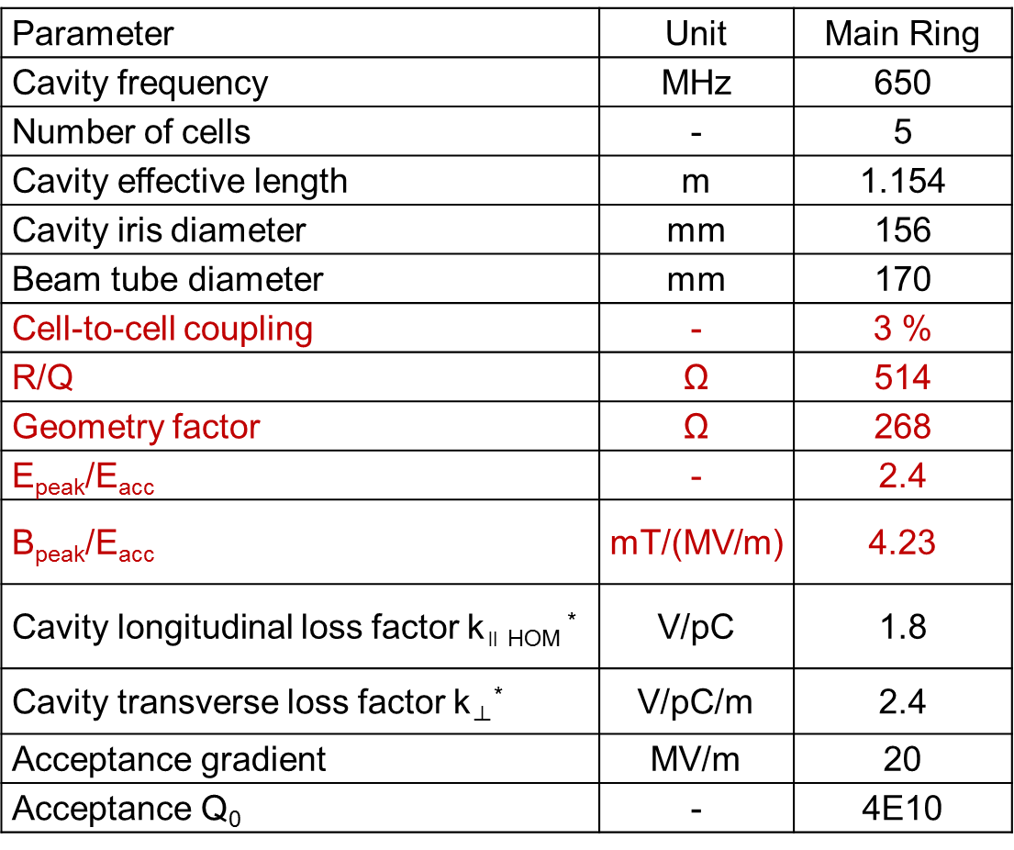
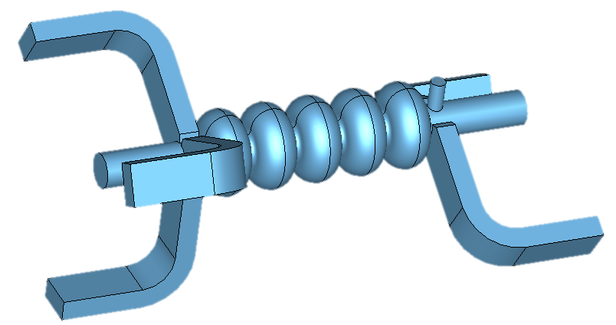
History
In Pre-CDR, due to a high HOM power of 3.6 kW per cavity, a 5-cell SRF cavity with waveguide HOM coupler was designed for main ring of CEPC*.
5 cell cavity with waveguide HOM coupler can meet the damping requirements.
There is no trap mode until 2GHz.
*Hongjuan Zhen,et. al., CEPC Main Ring Cavity Design with HOM couplers. CEPC-SPPC Study Group Meeting, Sept. 11-12, 2015.

Slide 6
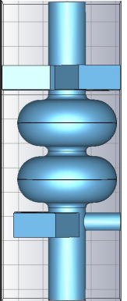
In the other hand, with the progress of cavity optimization and proposal of Partial Double Ring (RDR), a 2-cell SRF cavity was designed. *
Parameters** | H (Pre-CDR) | H (Low P)
650 MHz cavity (bulk Nb) | 5-cell | 2-cell
Cavity number | 384 | 384
V_{RF} (GeV) | 7 | 3.56
E_{acc} (MV/m) | 15.9 | 20.1
Q₀ @ 2 K | 4E10 | 2E10
Cryomodule number | 96 | 64
Peak power / cav. (MW) | 0.28 | 1.4
Average power / cav.* (kW) | 276 | 587
HOM power / cav. (kW) | 3.6 | 0.5
Total RF power * (MW) | 106 | 225
Total cav. wall loss@4.5K eq. (kW) | 22.2 | 28.5
*Hongjuan Zhen,et. al., SRF Cavity Design for CEPC PDR Scheme, CEPC-SPPC Symposium, April 8-9, 2016. IHEP, Beijing.
**J. Gao, CEPC Accelerator Status After Pre-CDR, For the CEPC Accelerator Group, CEPC-SppC Symposium, April 8-9, 2016, IHEP

Slide 7
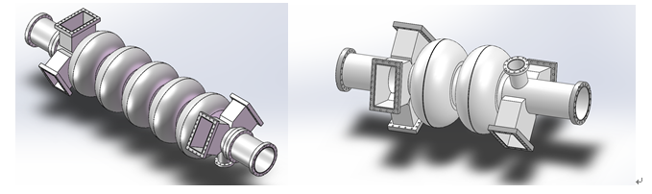
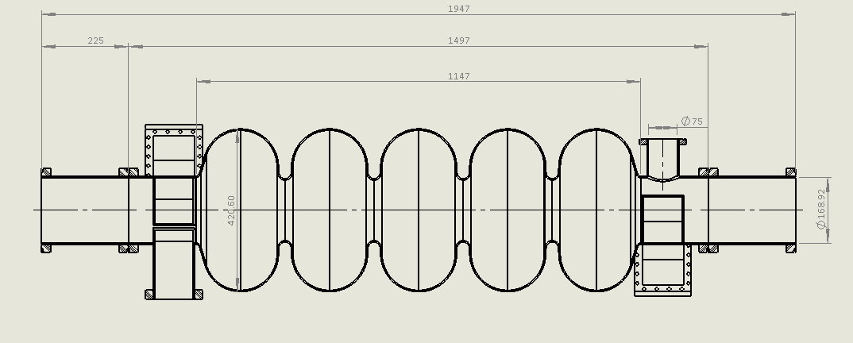
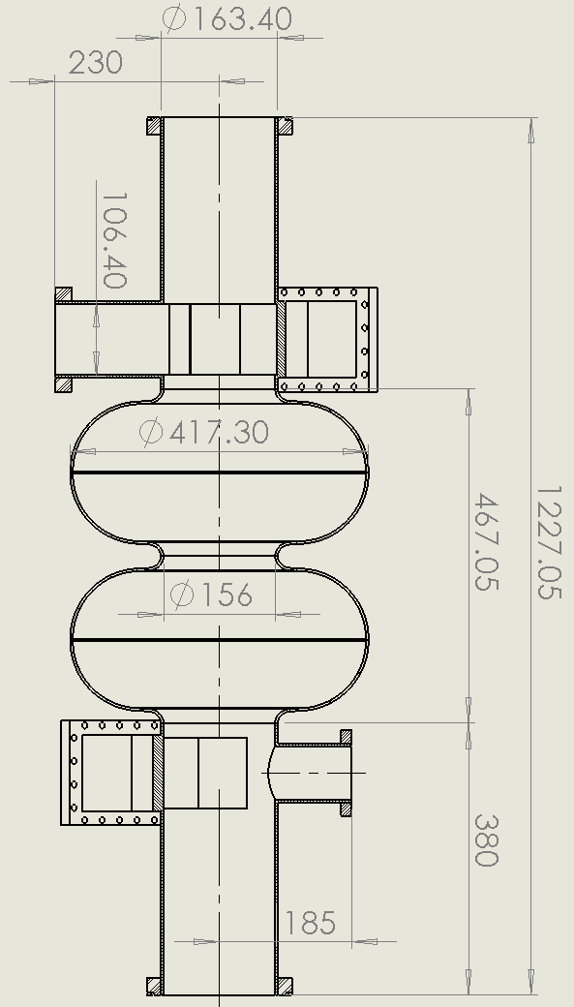
Mechanical Structure of Cavities
3D model of 5-cell and 2-cell SRF cavities
Key dimensions of 5-cell and 2-cell SRF cavities

Slide 8
Characteristics
Characteristics:
Big aperture for HOM waveguide and beam tubes.
Large dimension and weight , especially for 5-cell cavity, which will be more than 120 kg , and near 2 m long.
Risks:
Need long waveguide and beam tube to avoid field leaking, which can lower the Qo of the cavity.
Large dimension may bring difficulties for later fabrication such as annealing, HPR et. al.
For example:
After simulation*, if we would like Qext high than 1E11, each of the 5 waveguides will be near 1m.
For the beam tube, the length of each one should be 400mm, related to which Qext will be 4.2E11 and 3.8E11 for each side.
* The simulation was done by Hongjuan ZHEN.

Slide 9
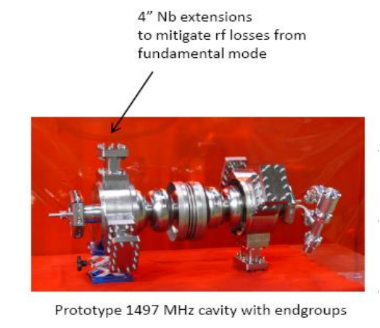
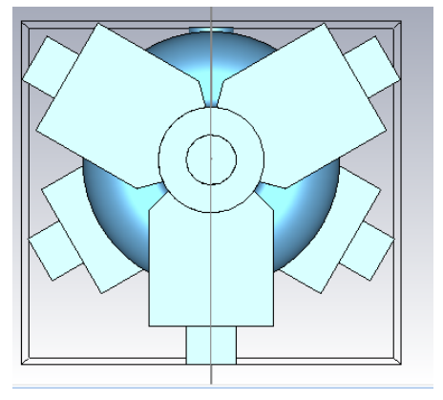
Solutions
The way to resolve the problem in other Labs.
However, for our cases, if we also add a extensions of 60mm to waveguide, the Qext only 3E8. Paying attention, we also need consider it cannot be too large to vertical test. So, this way cannot work well.
At last, we would like to use niobium or Ti55Nb flange put on the waveguide.
But for beam tube, we will use a same size extensions to avoid the 5-cell cavity is to long.

Slide 10
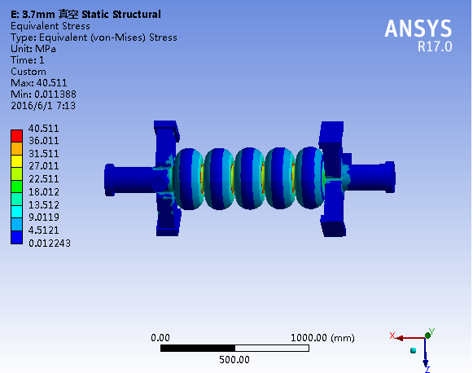
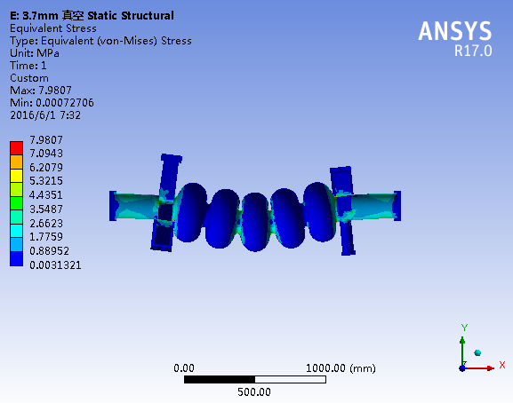
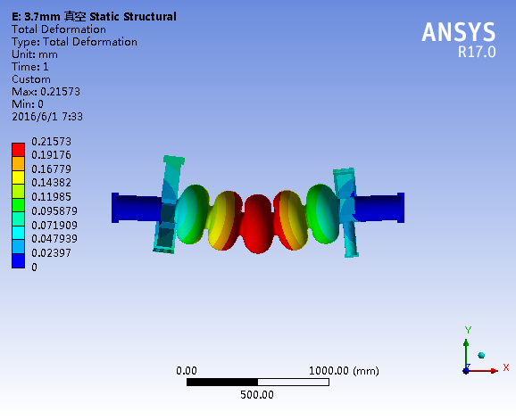
Mechanical Performance
For such a heavy cavity, mechanical performance is another risk.
v. M. stress at vacuum
v. M. stress at gradient
Displacement at gravity

Slide 11
Other risks
Fields leaking at interface between beam tube and extensions (indium).
Stiffener:
We need consider the df/dp, Lorenz detuning to check whether a stiffener structure is needed.
Flanges: sealing and material
Sealing: rectangle is much harder for sealing than round one, especially at cool status. The location of screw hole will pay a importance effect. The flange design need experiments for test.
The material for the flanges. Niobium or Ti55Nb.
HPR.
It is important since there is very little experience. As we know for ILC 1.3GHz, the nozzle are carefully designed including water pressure, nozzle holes and so on.
Multipacting.

Slide 12
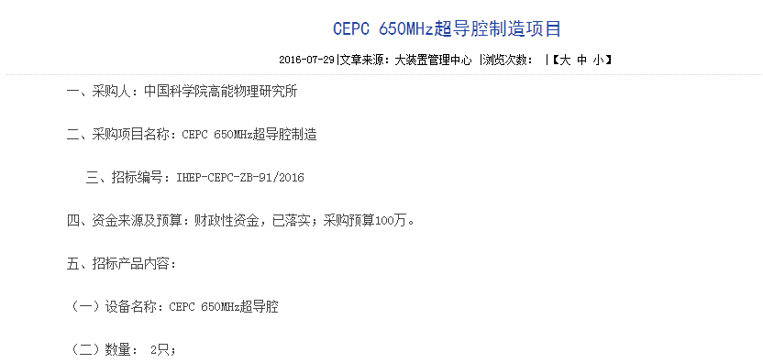
Status and schedule
Now we have finished the administrative procedure of calling for bids.
Besides studies shows in previous page, we need to mainly focus on the condition and technology preparing for fabrication and treatment.
Schedule

Slide 13
Electropolishing Facility

Slide 14
Introduction
In PreCDR of CEPC-SppC, a Qo of 4E10 for main ring SRF cavities is required.
To achieve this goal, a new technique called nitrogen-doping, as one of most important candidate technologies for SRF cavities, will be developed.
However, for the best of our knowledge, only after nitrogen-doping, SRF cavities cannot obtain a high quality factor unless another technology, electropolishing, is used following it.
At present, systematically studies on electropolishing for SRF cavities are nearly blank in China. So, firstly we need to build a electropolishing facility.
This facility will also benefit the studies on high accelerating gradient SRF cavities, such as ILC cavities.

Slide 15
Main EP facilities in the world
We would like to choose horizontal EP technology.

Slide 16
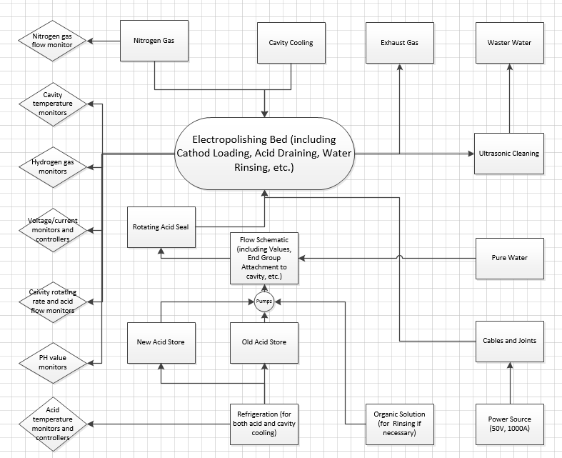
Critical Units for EP facility

Slide 17
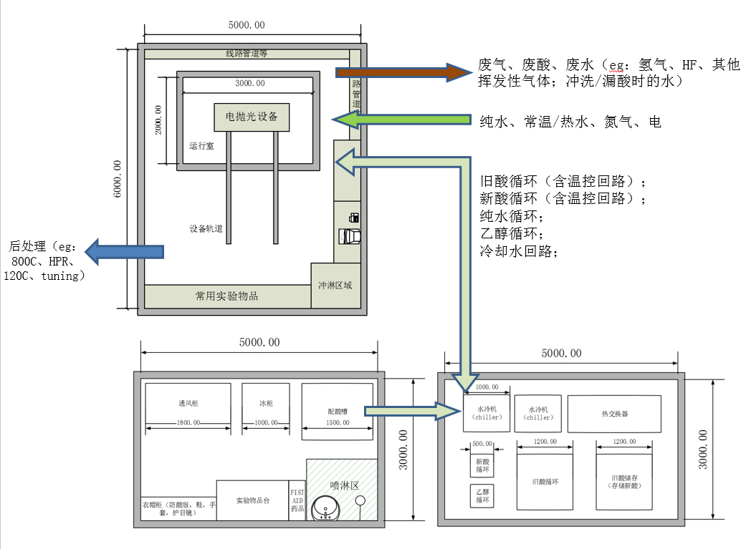
Layout Design for EP Facility

Slide 18
Schedule
Key Time Points:
Oct. 2016: Finish the Conceptual Design
Dec. 2016: Finish Review and Administrative process for choosing company
Feb. 2017: Finish Engineering Design and Review
Oct. 2017: Finish Critical Units fabrication or Purchase
Dec. 2017: Finish Assembly
Apr. 2018: Finish Commissioning and Acceptance

Slide 19
Thanks!

