Slide 1
SS Conceptual design
USTC Group: Xiangqi WANG, Yang HONG, Ershuai KONG, Linbo LIANG, Jiawen LI, Zhiliang REN, Bin SUN, Kai XIE, Hongliang XU, Jiayang YAN, Penghui YANG, Yuangji PEI
IHEP Group: Feng SU, Jiangping DAI, Jingyu TANG, Qingjin XU , Linhao ZHANG
CEPC-SPPC Beihang Symposium
Sep. 02-03, 2016, IHEP, Beijing

Slide 2
Content
Introduction
Consideration of injection and extraction
Preliminary lattice design result
Conclusion

Slide 3
Introduction

Slide 4
SS is the last booster in the injection chain

Slide 5
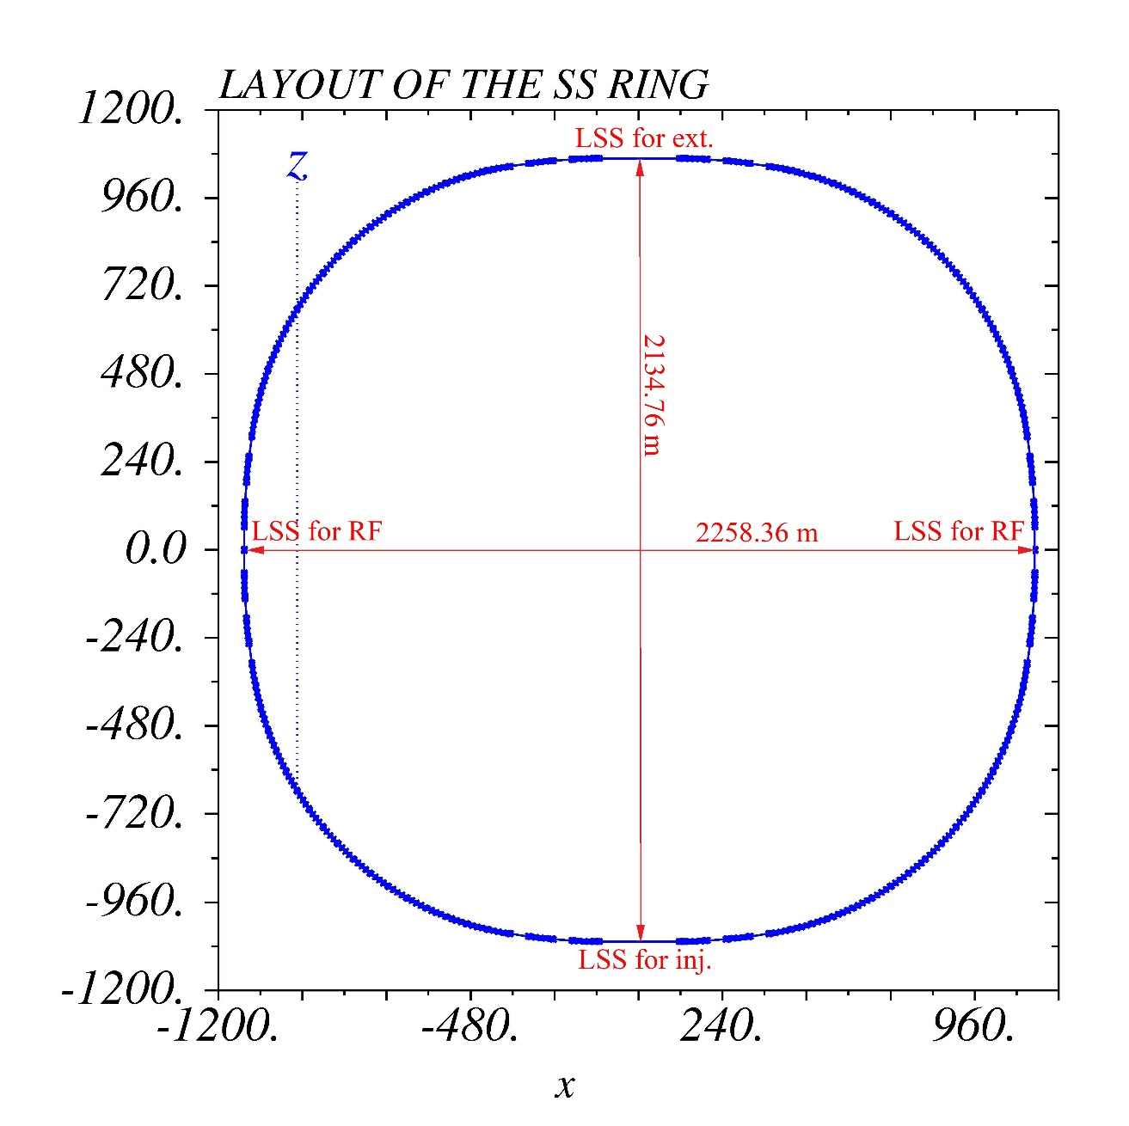
SS Layout
Total length is 7200 m.
Two super period structure
Four long straight sections:
2 for injection or extraction;
2 for RF cavities and other
equipments

Slide 6
New parameters for SPPC by late 2015
Collision energy is 35.3 TeV and injection energy is 2.1 TeV.
Circumference of each ring is 57.36 km for the SPPC.
Beam current is 1 A.
A peak luminosity is 1.2×10³⁵ cm⁻²·s⁻¹.
Momentum rigidity is 7008.0 T·m.
Maximum strength of dipole magnetic field is 20T.
RF frequency is about 200.02817 MHz used for injection.
Notes:
质子静止能量：938.2720813（58）MeV。299792428.1.
5.22650677 kHz，38272 Bunch。

Slide 7
Beam parameters of SS
The injection energy of SPPC is 2100 GeV and the extraction energy
of MSS is 180 GeV.
Harmonic number of SS is chosen to be 4804, and the circumference
is 7200 m. The cyclotron frequency is from 41.6373 to 41.6378 kHz.
So the RF frequency is from 200.0255 to 200.0282 MHz. The adjust-
ment amount can be calculated as 2.7 kHz.
Beam current is 1 A, which is a challenge for SS design.
The proton number per bunch (3828* bunches) is 3.9159×10¹⁰, and
the total number of proton is 1.4928×10¹⁴ .
* Assuming the injection filling factor from MSS to SS is 80%

Slide 8
Considerations of
injection and extraction

Slide 9
Requirement of SS extraction
To obtain a continuous bunch string in SPPC, the bump orbit injection scheme to SPPC is needed.
If the repetition period of the injection process to SPPC is about 30 s, then multi partial injection by bunch to bunch to the two rings of SPPC would take 8-10 min.
Fast extraction scheme is taken according to SS lattice.
The proton cyclotron time is 24.0166 micro seconds in SS ring, and 1/8 of which in SPPC is 23.9165 micro seconds. If the length of a filled bunch string in SS is less than 21 micro seconds (or 21.5 micro seconds), according to the leading edge of kicker field waveform, the limit of bunch string length is 22 micro seconds in SS. This partially filled long bunch string pattern assures the safe process of rapid extraction.
Notes:
4804/2=2402, 注入质子速度299788427.2，200.02550 MHz，根据1月25日下午视频会议讨论调整为５ps。
C/299788427.2=T=f⁻¹，

Slide 10
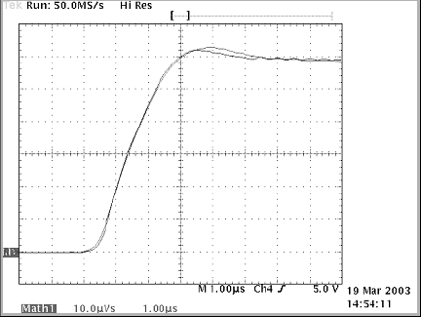
Kicker magnetic field wave form of LHC
The leading edge (from 10% to 90%) of kicker magnetic field
wave is about 2-2.5 micro seconds.

Slide 11
Requirement for injection
Bump orbit injection scheme is considered for SS injection operation.
For a 180 GeV beam, proton cyclotron time in SS is 24.0169 micro
seconds while in MSS it is11.6749 micro seconds.
Twice injection from MSS to SS is needed to fill the whole SS ring.
the length for each beam bunch string in MSS is at least 11 micro
seconds.
In order to reduce the difficulty of kicker design, large beam
envelop in the injection as well as extraction long straight section is
required.

Slide 12
Operation process of SS
To set the working parameters of the injected magnetic field, about 3 s
Two partial injection, bunch to bunch from the MSS, time piece is about 2 s
Ramping Up, about 8 s up to 2.1 TeV.
Extraction from the SS ring into the SPPC, about 50 micro seconds
Ramping Down, about 8 s
Once again to set working parameters of the injected magnetic field, and so on.
Repetition period of operation process of SS is 30 s!
Notes:
Tc,ss=24.01662 micro second, and 23.91655 micro second. Tc,sppc=191.33238409 micro second.
引出不需要长时间，微秒级；引出时间必须长于23.917 micro second。
注入磁铁不需要长时间，1微秒左右；注入时间必须长于0.5倍的23.917 micro second，等于11.9959 micro second。
SS周期的主要时间是RampingUp时间，其次是RampingDown时间，再其次是注入。

Slide 13
Preliminary
lattice design result

Slide 14
Dipole magnet
Maximum magnetic field strength is 9.0319 T
Minimum magnetic field strength is 0.7778 T
Effective curvature radius of arc is 775.9122 m
Number of dipole magnets is 352
Effective length of dipole magnets is 13.85 m
Magnet gap is 50 mm

Slide 15
Quadrupole and sextupole magnet
Effective length is 4.0 m.
Effective aperture is 50 mm.
Maximum magnetic field 10 T, so maximum gradient magnetic field is 400 T·m⁻¹.
Maximum focus intensity is equal to 0.0057 m⁻² (the gradient magnetic field is less than 400 T·m⁻¹).
The integration of other high order fields is less than 10⁻⁴ times of quadrupole field.
The parameters of sextupole magnet is under research.

Slide 16
Structure of the bare lattice
The length of a single super periodic structure is 3600.0 meters
Structure of a superperiod:
half of LSS1 + DSPL + ARC + DSPR + LSS2+DSPL + ARC + DSPR + half of LSS1
LSS1: long straight section for injection or extraction
DSPL: dispersion suppressor at the upstream of arc
DSPR: dispersion suppressor at the downstream of arc
LSS2: long straight section for RF cavities and other equipment
ARC: consisting of 9 ARC FODOs

Slide 17
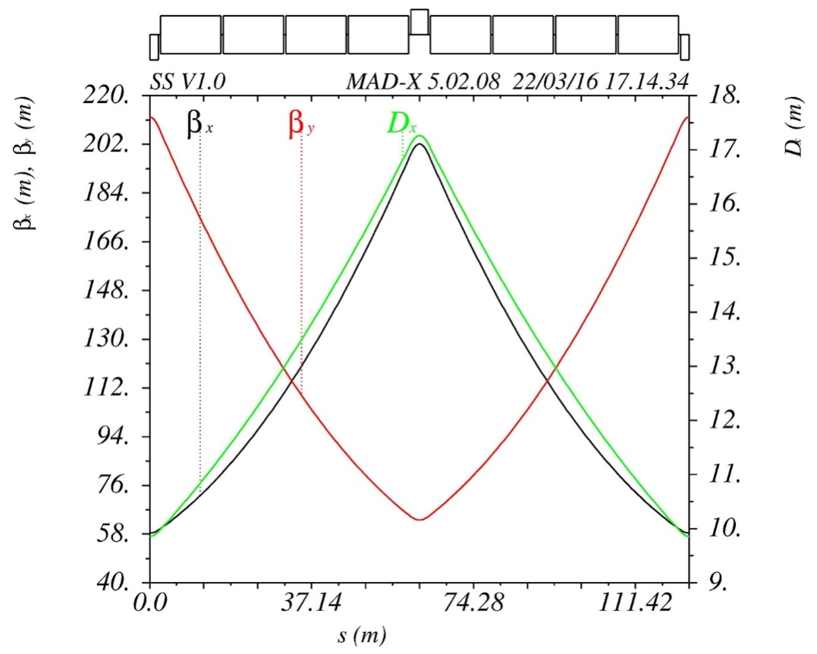
ARC FODO
Parameters of quadrupole magnets
 | Length [m] | Focusing strength [m⁻²]
QF | 4 | 0.00463
QD | 4 | -0.00435
ARC FODO structure：
½ QF + 4*DM + QD + 4*DM + ½ QF
The length of drifts between magnets is
0.5 m
There are nine ARC FODOs in the ARC
section of half of a superperiod
L=123.8 m

Slide 18
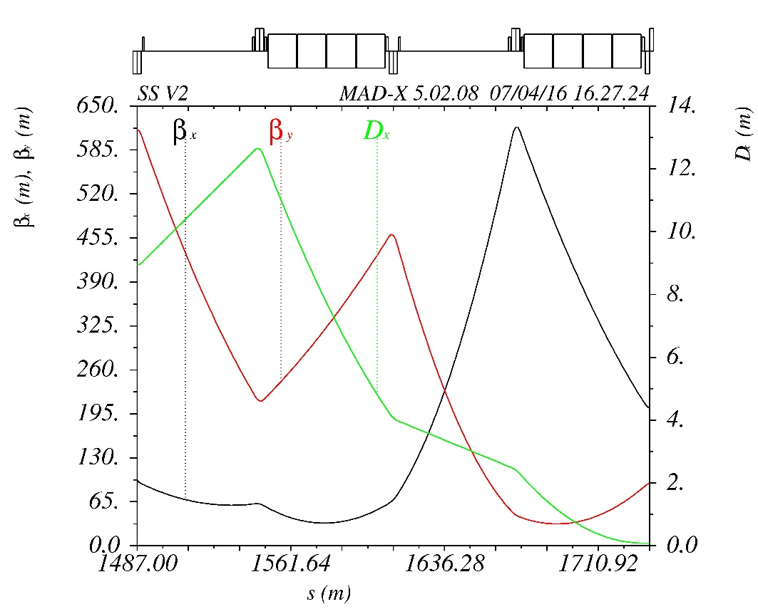
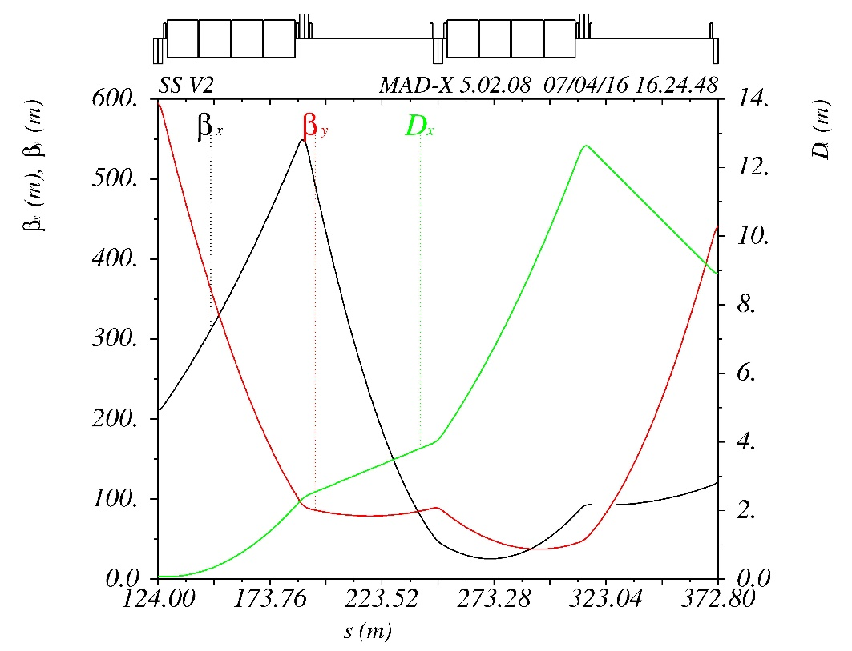
Dispersion suppressor
DSPL
DSPR
Length of DSPL or DSPR is 244.8 m
DSPL and DSPR use the same dipole magnets with the ARC
Nearly the same focusing strength of quadrupole magnets with the ARC
Sextupole magnets for chromaticity correction are installed by the side of
quadrupole magnets

Slide 19
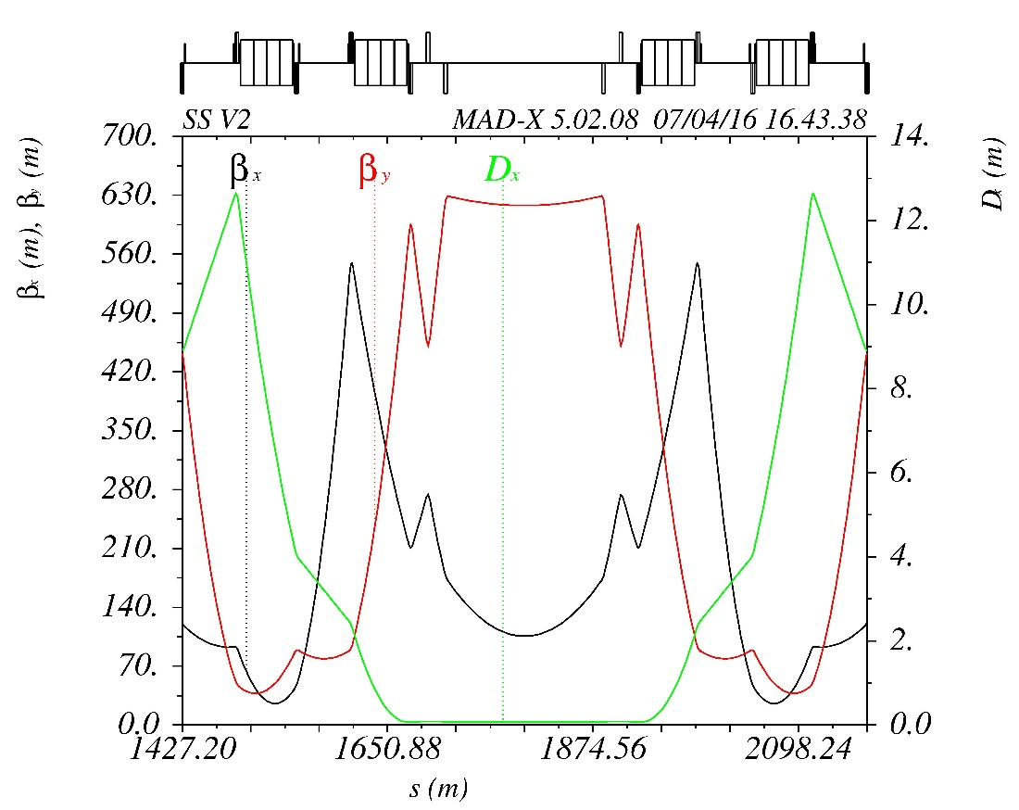
LSS1 for injection or extraction
The length of LSS1 for injection
is 248 m. The length of short drift
in LSS1 is 15 m, and the length of
longer drift is 84 m..
The triplet structure of quadrupole
magnets is installed at the end of
both sides of LSS1 to get large
envelop
The two short drift in LSS1 is used
for installing kicker magnets and
the long drift in the center is used
for installing spetrum magnets.

Slide 20
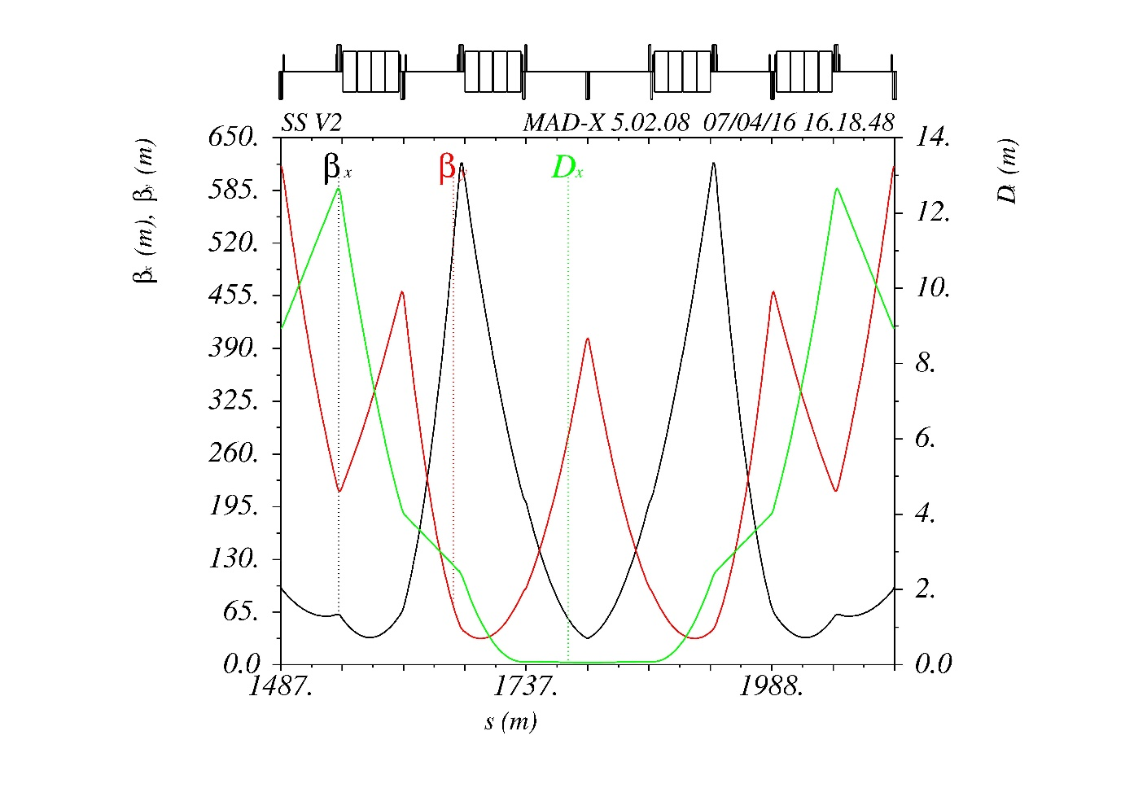
LSS2 for RF cavity
The total length of a LSS2 for RF
cavity is 128.4 m, and the length
of a long drift without magnets
in LSS2 is 60.2 m.
As the research for RF cavity is
not finished yet, the length and
structure of LSS2 are not determined.

Slide 21
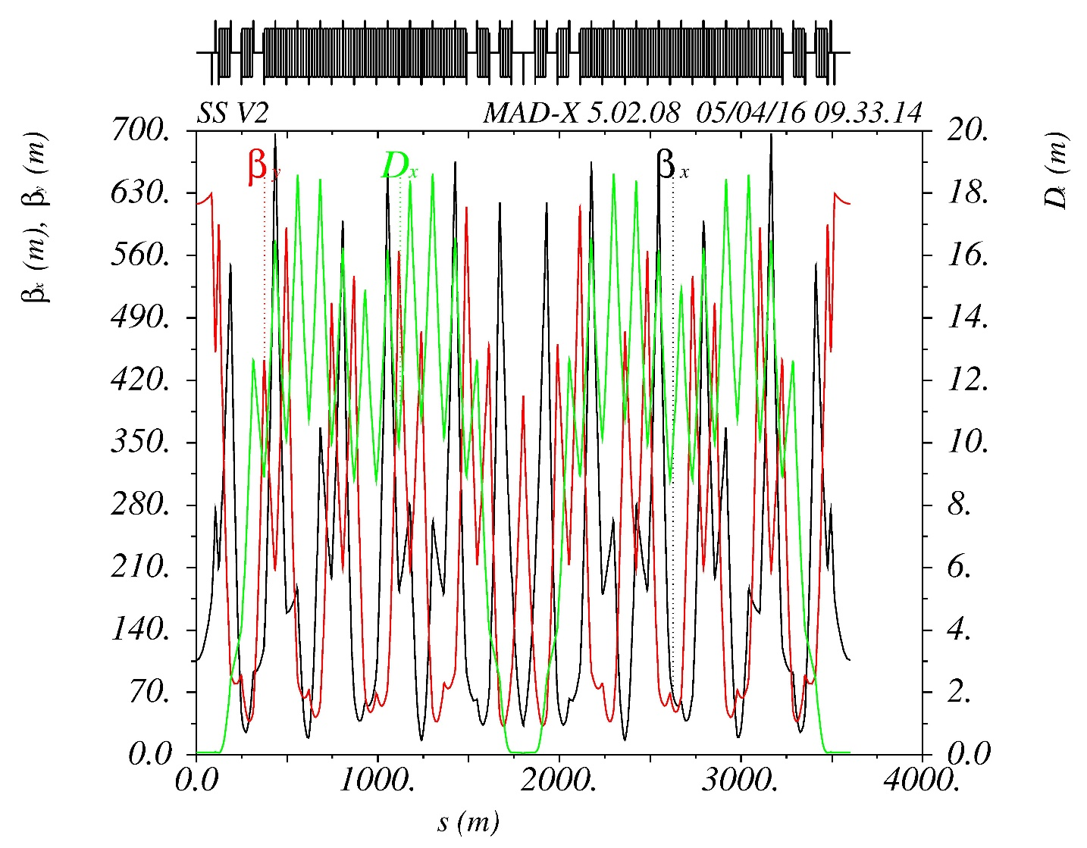
Full superperiod
Momentum compaction
factor is 0.0100422
The horizontal tune for a
superperiod is 5.58744
The vertical tune for a
superperiod is 4.83483
The maximum horizontal
beta function is 685.345 m
The maximum vertical
beta function is 629.219 m
The maximum absolute
horizontal dispersion is
18.465 m
Is it appropriate?
* This version of lattice is named SS V1.1

Slide 22
Closed orbit deviation
The maximum momentum deviation of SS V1.1 lattice is
The maximum absolute horizontal closed orbit deviation is 0.3246 mm.
The r.m.s horizontal closed orbit deviation is 0.2020 mm
It is acceptable in this preliminary analysis!
* The closed orbit deviation is calculated by the MAD-X V5.02.08

Slide 23
First calculation of
dynamic aperture of SS ring
*

Slide 24
X: 1.612913 mm
Y: 5.058169 mm
*

Slide 25
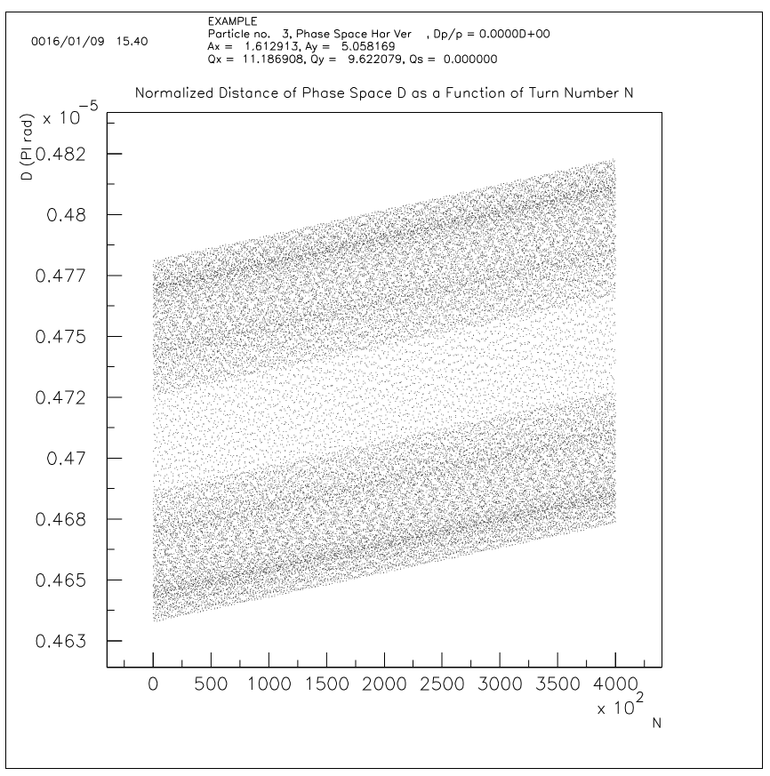
Preliminary calculation of dynamic aperture
* The closed orbit deviation is calculated by the MAD-X V5.02.08

Slide 26
Preliminary calculation of dynamic aperture
*

Slide 27
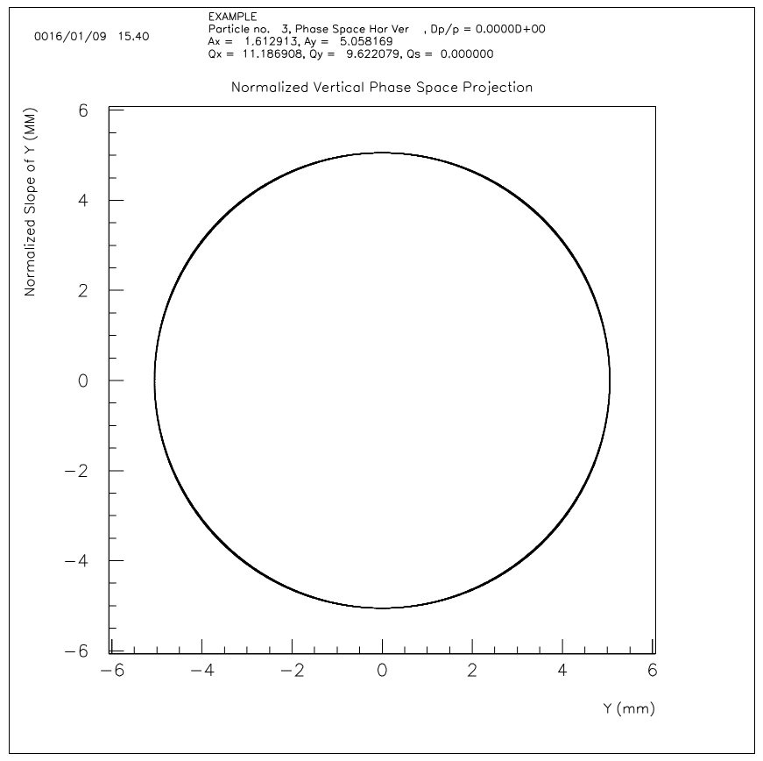
Preliminary calculation of dynamic aperture
*

Slide 28
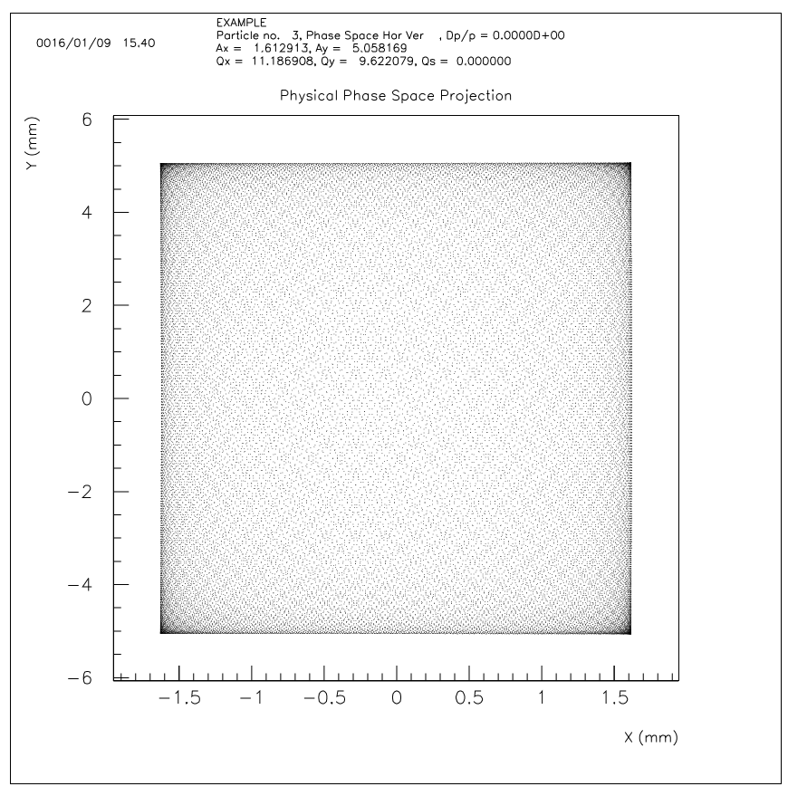
Preliminary calculation of dynamic aperture
It is
*

Slide 29
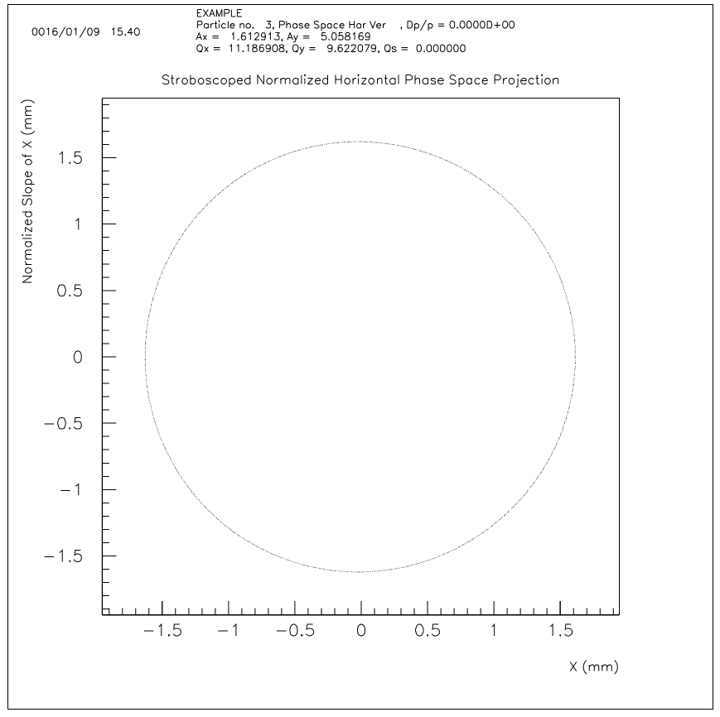
Preliminary calculation of dynamic aperture
*

Slide 30
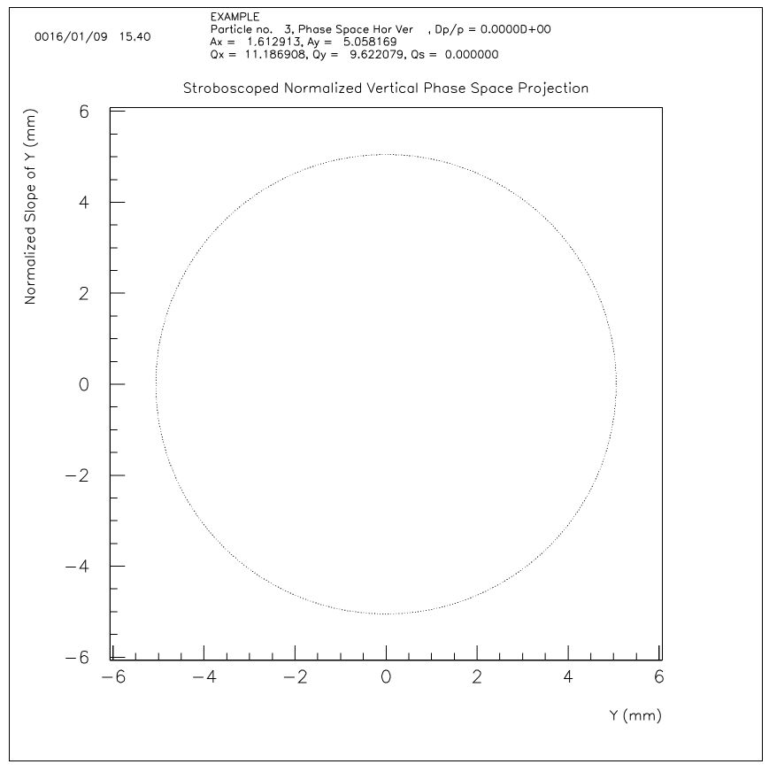
Preliminary calculation of dynamic aperture
*

Slide 31
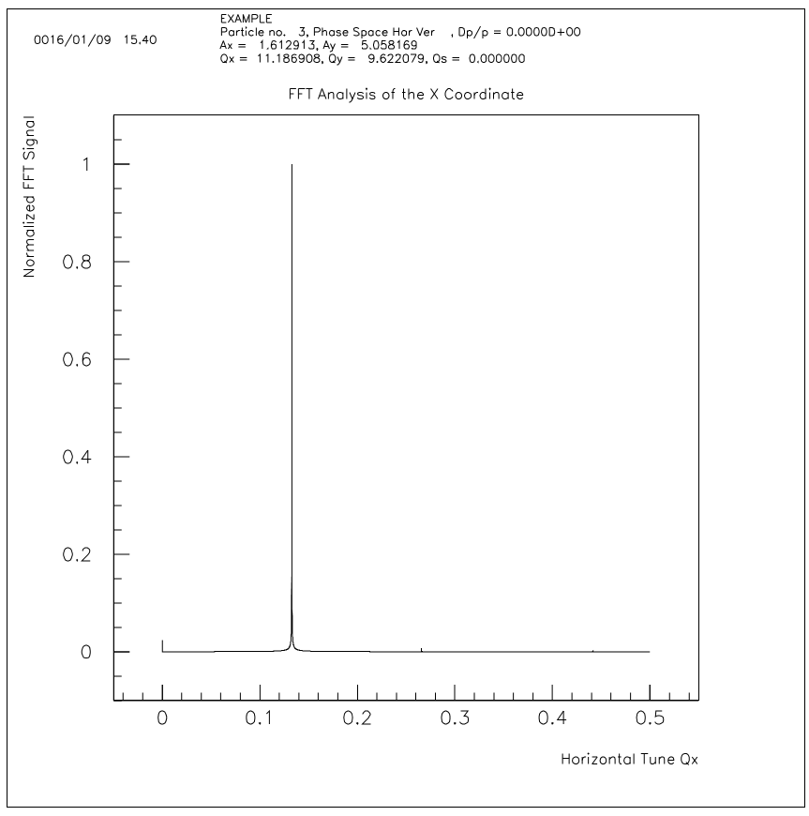
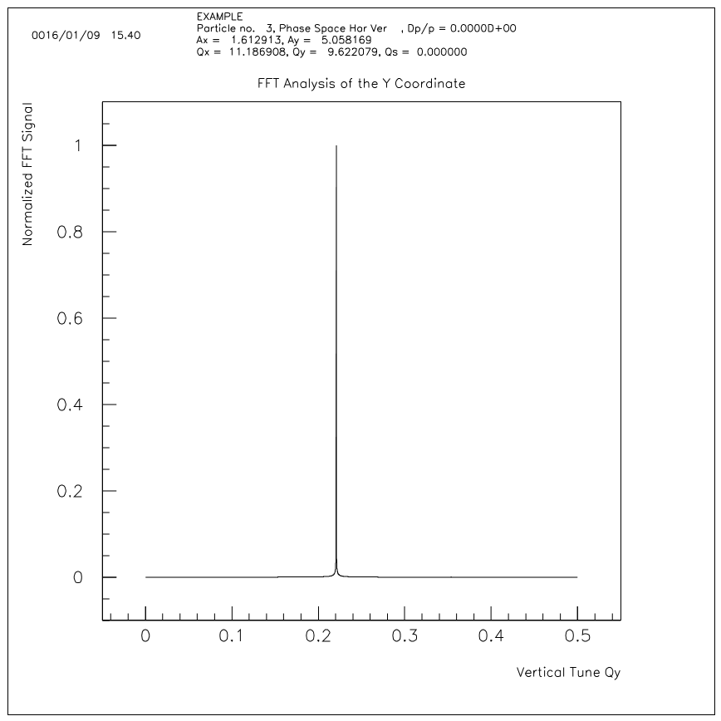
Preliminary calculation of dynamic aperture
*

Slide 32
X: 14.516136 mm
Y: 45.523273 mm
*

Slide 33
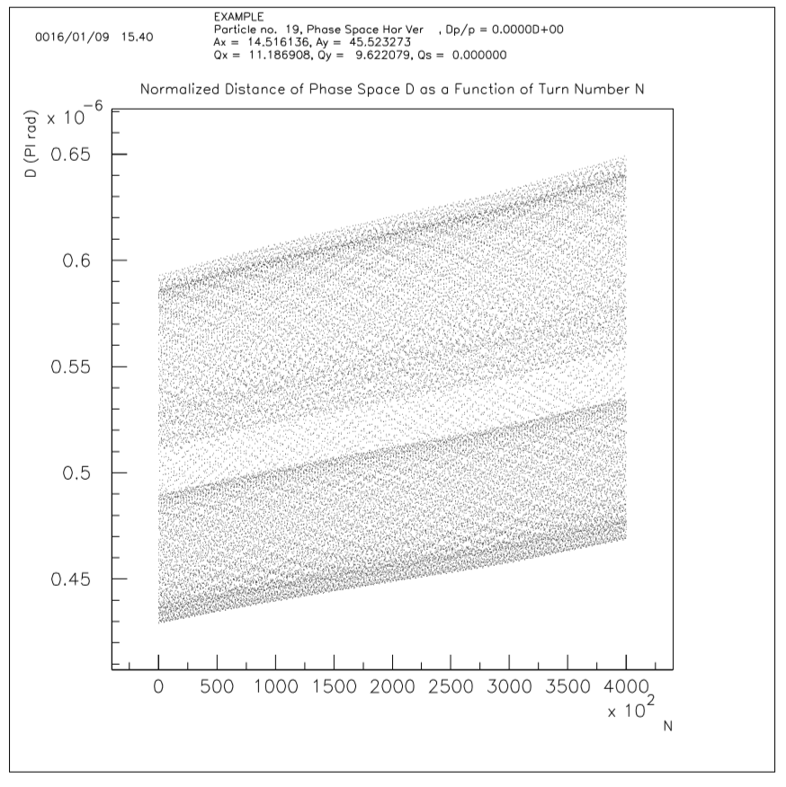
Preliminary calculation of dynamic aperture
*

Slide 34
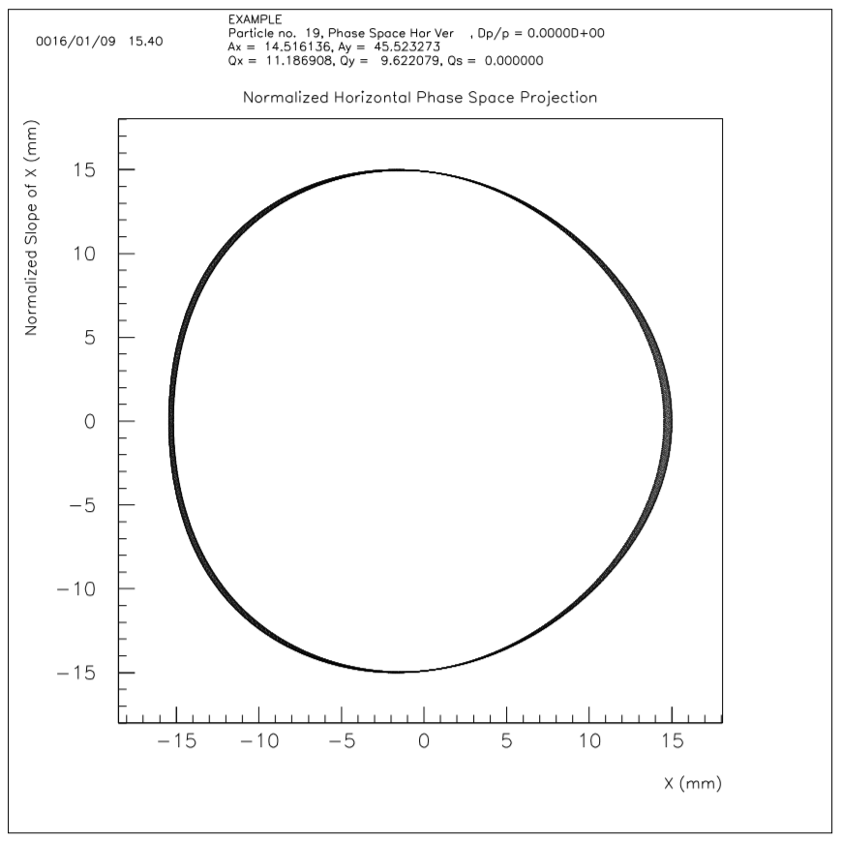
Preliminary calculation of dynamic aperture
*

Slide 35
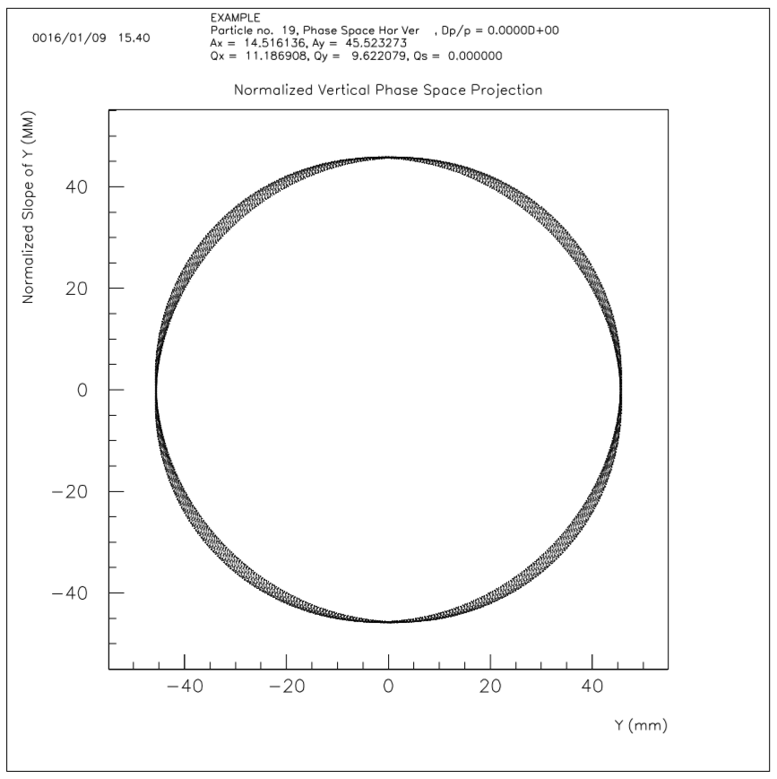
Preliminary calculation of dynamic aperture
*

Slide 36
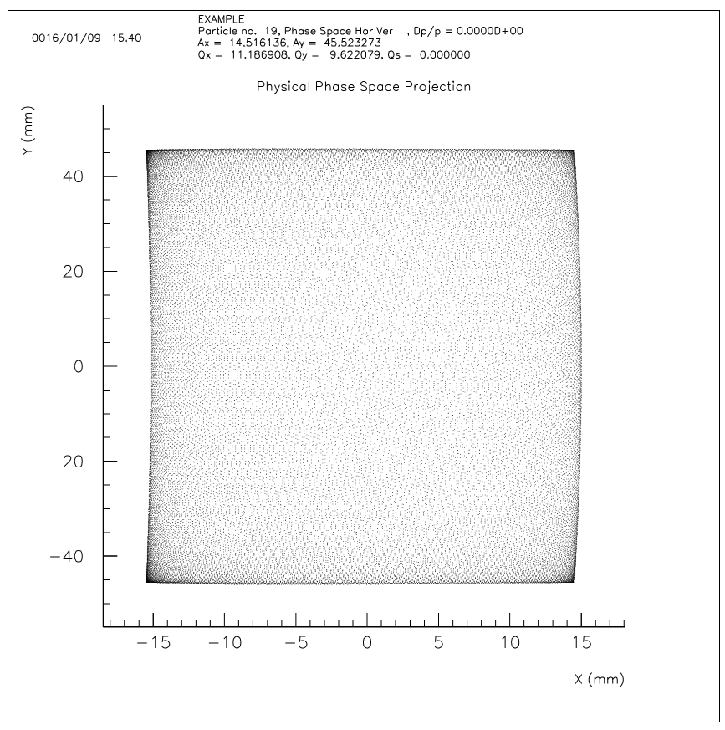
Preliminary calculation of dynamic aperture
*

Slide 37
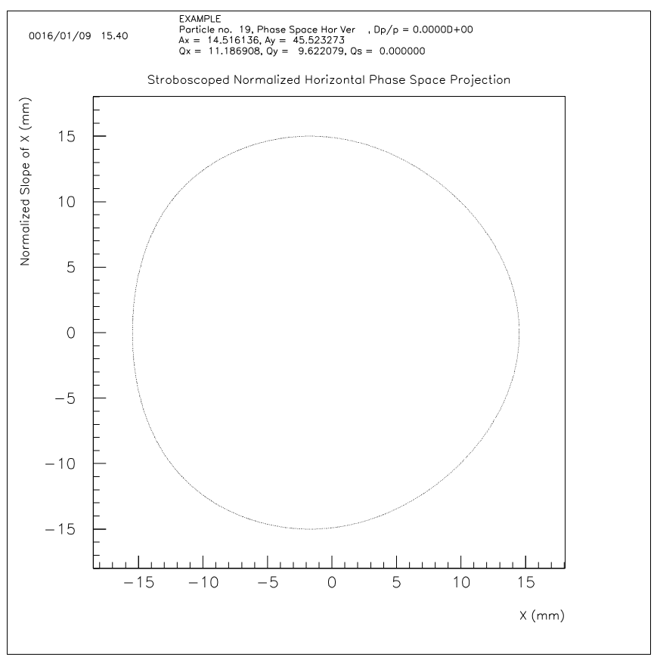
Preliminary calculation of dynamic aperture
*

Slide 38
Preliminary calculation of dynamic aperture
*

Slide 39
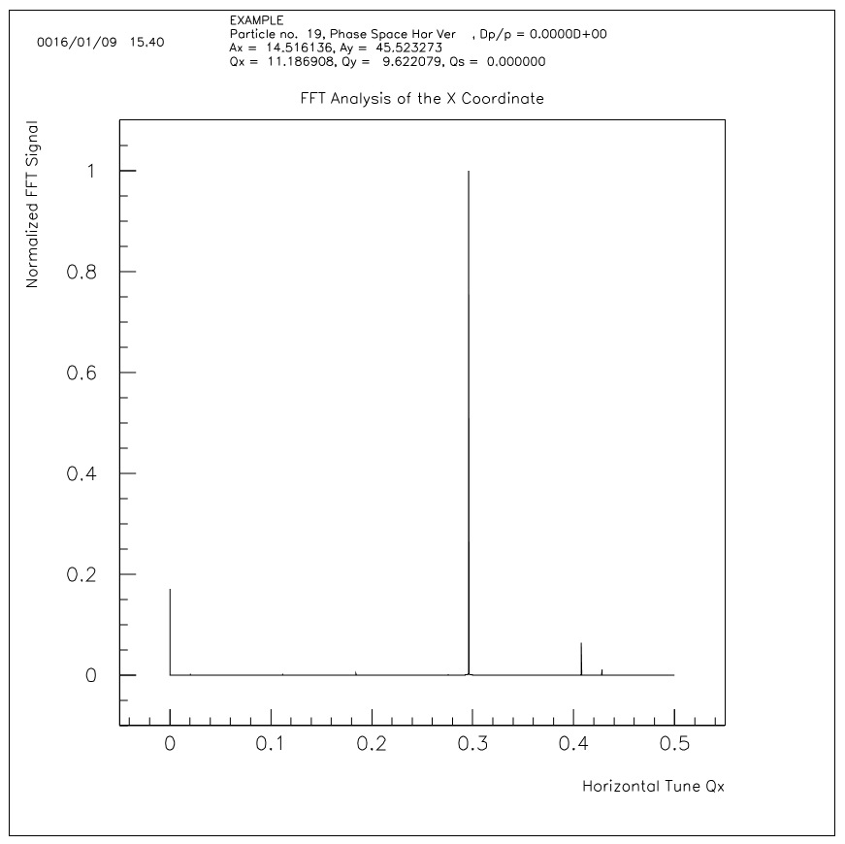
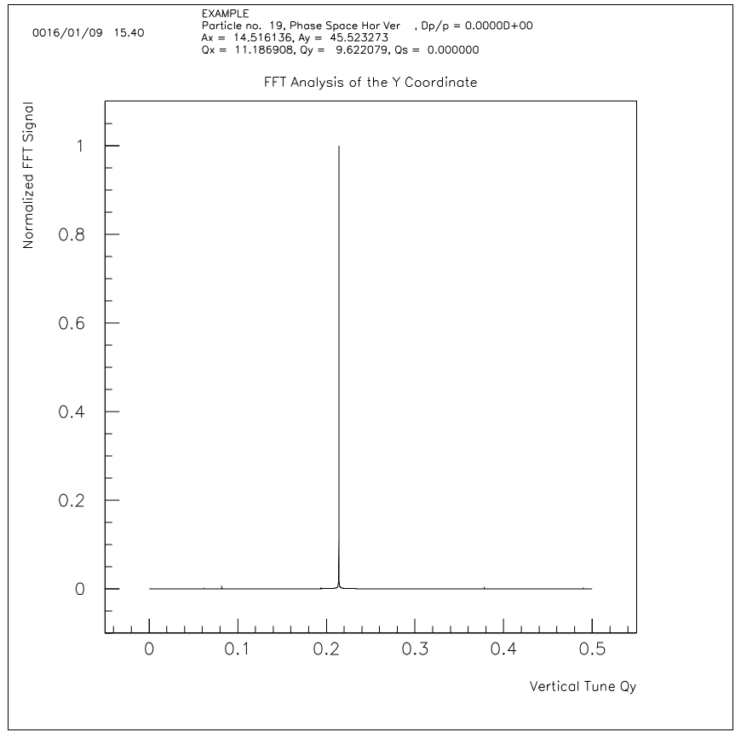
Preliminary calculation of dynamic aperture
*

Slide 40
X: 29.032262 mm
Y: 91.046514 mm
*

Slide 41
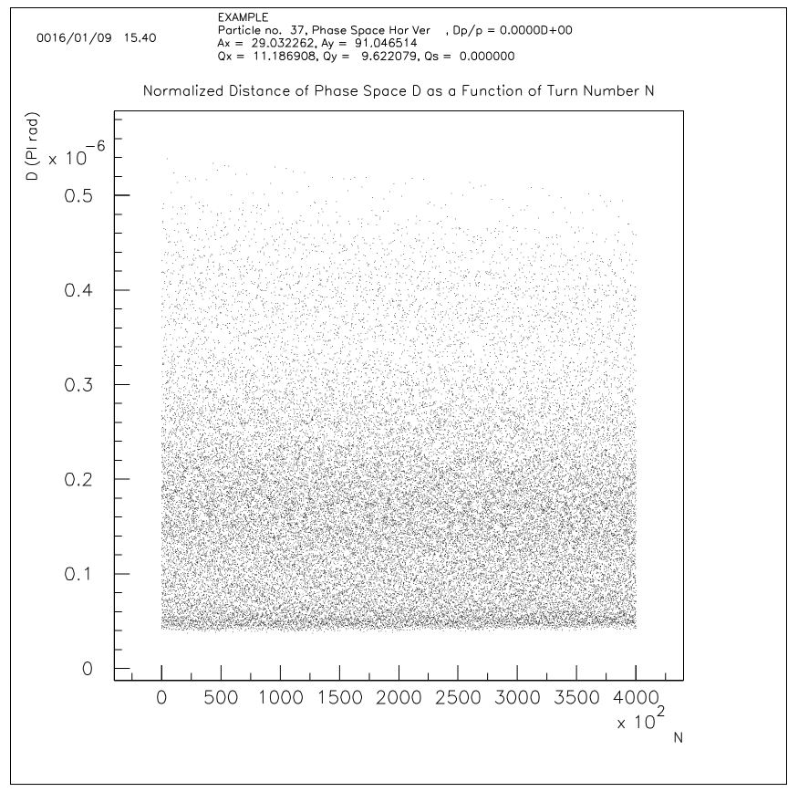
Preliminary calculation of dynamic aperture
*

Slide 42
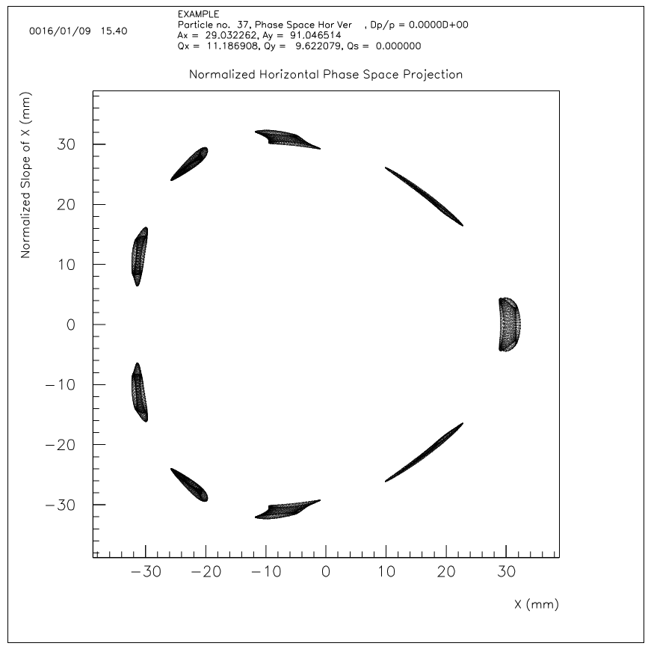
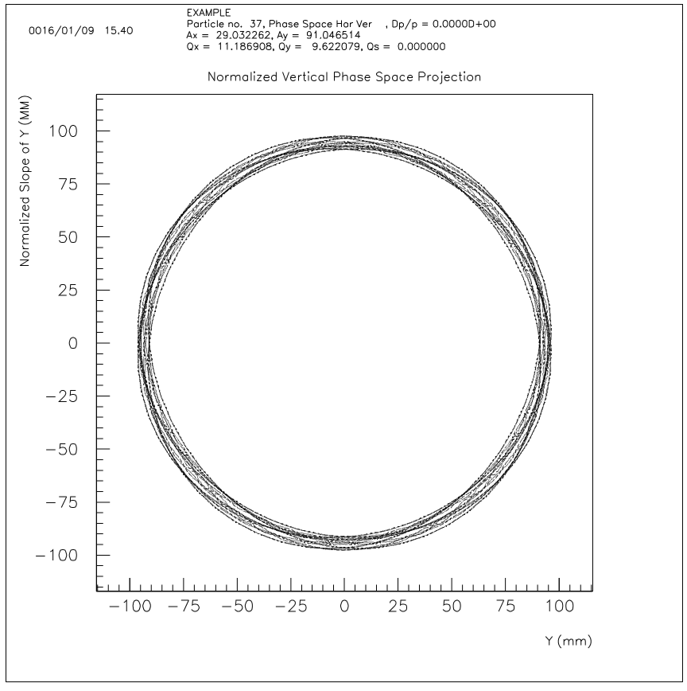
Preliminary calculation of dynamic aperture
*

Slide 43
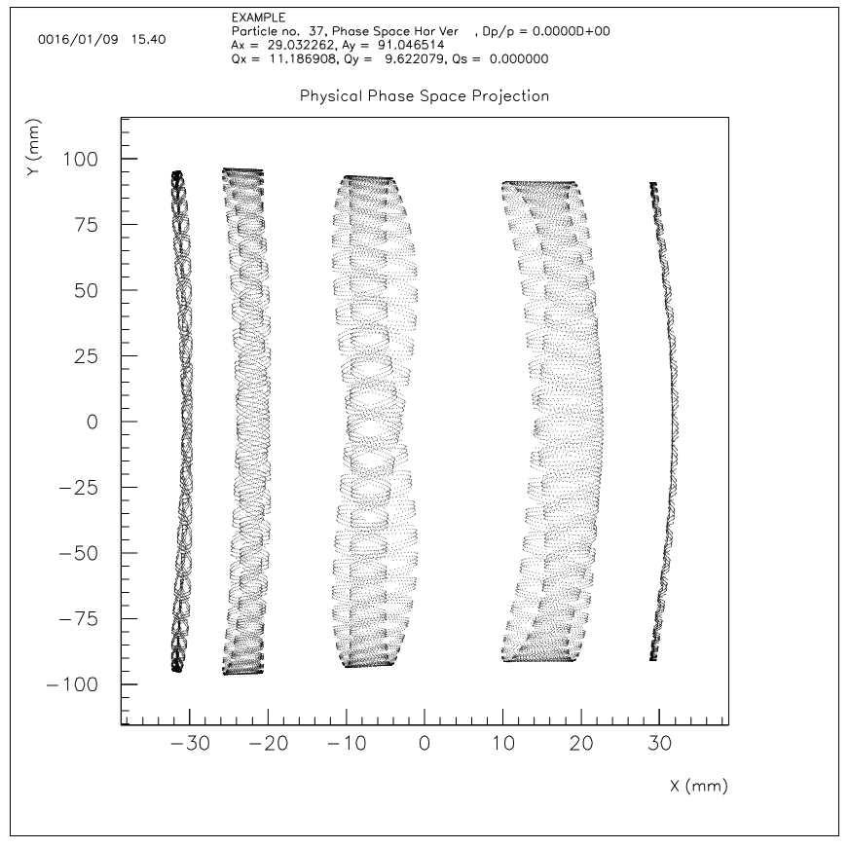
Preliminary calculation of dynamic aperture
*

Slide 44
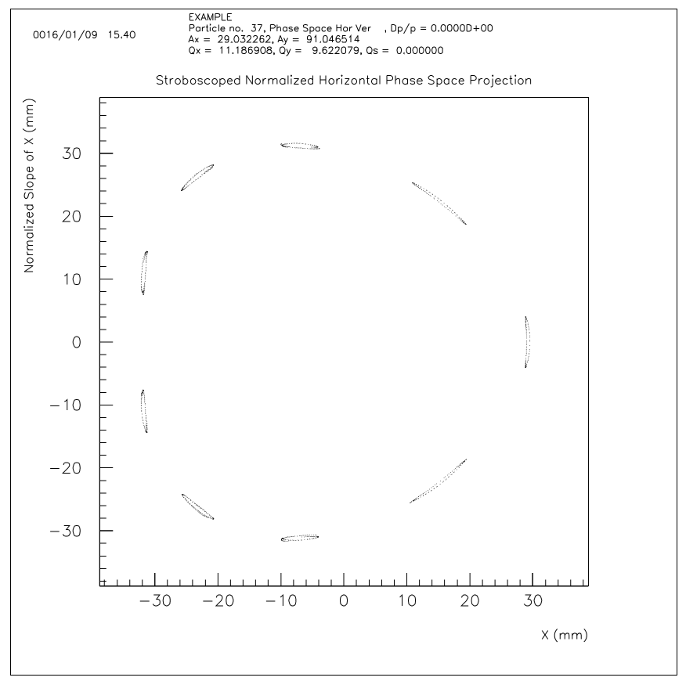
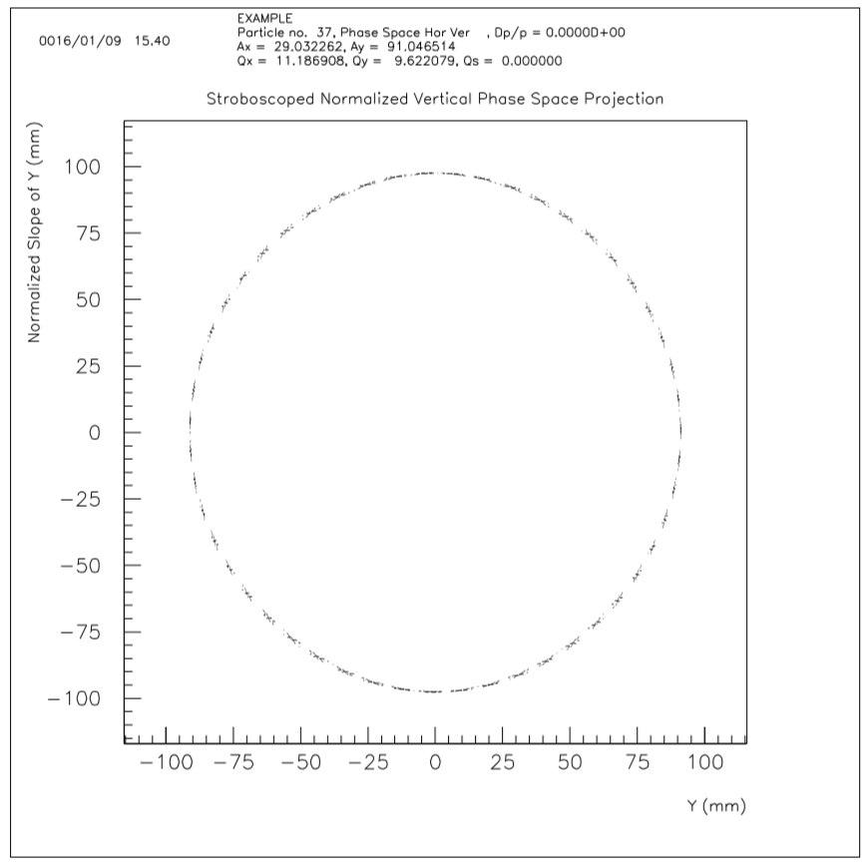
Preliminary calculation of dynamic aperture
*

Slide 45
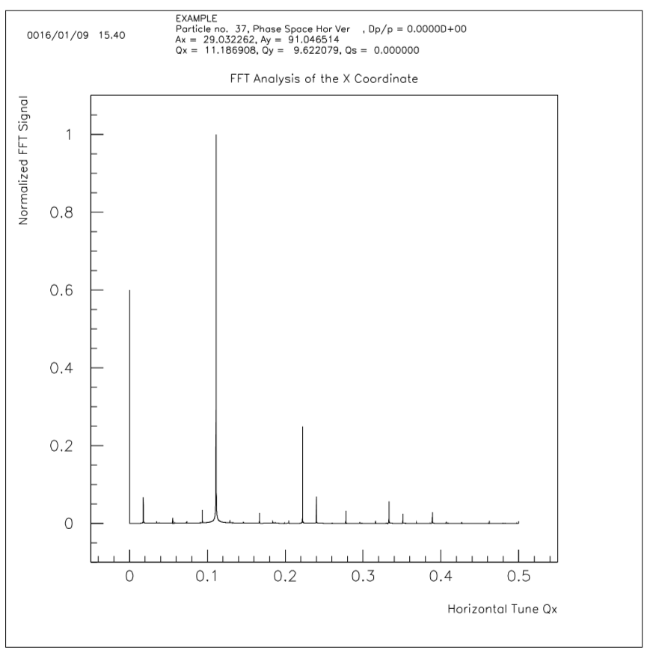
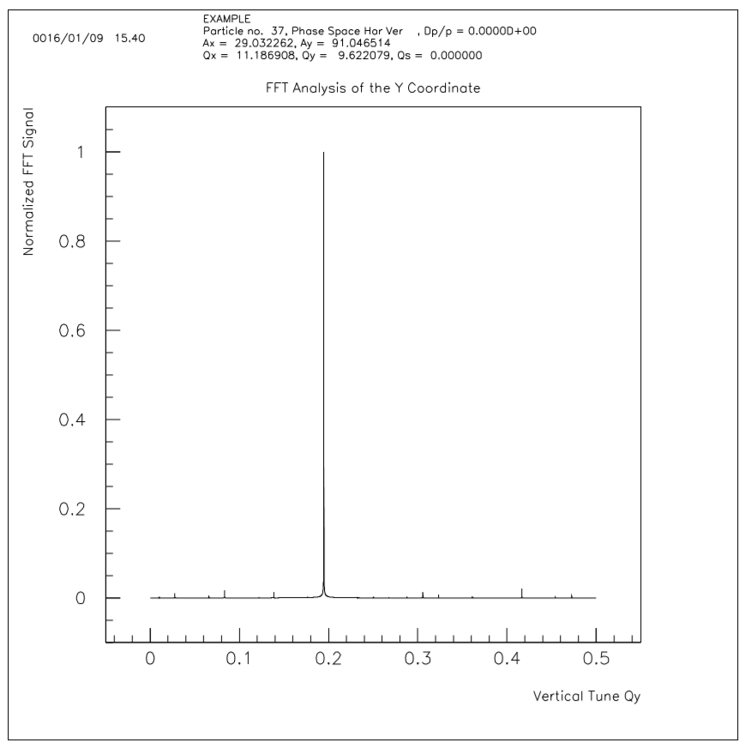
Preliminary calculation of dynamic aperture
*

Slide 46
Base data of first calculation of dynamic aperture
Lattice version: V1.0.0, June 5, 2016
Energy of 2100 MeV
Ring circumference of 7200 m
Cycle frequancy of 41.63(8) kHz
Tracking numbers of 400,000: about 10 second
Dynamic aperture: 29 mm$×$ 91 mm
Suitable for injection or extraction, in the vertical direction
The lattice of cell’s period is not optimized
The tracking has not been done: injection and Ramping Up processes
*

Slide 47
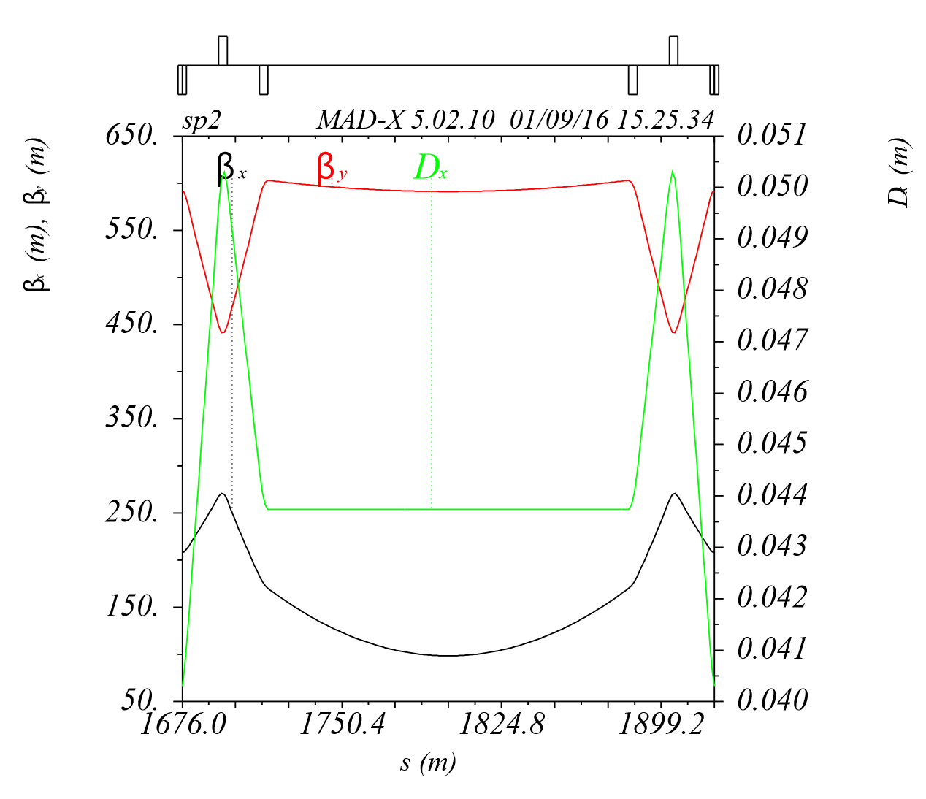
Check calculation of Lattice
Twiss function is
used to injection
and extraction
* The closed orbit deviation is calculated by the MAD-X V5.02.08

Slide 48
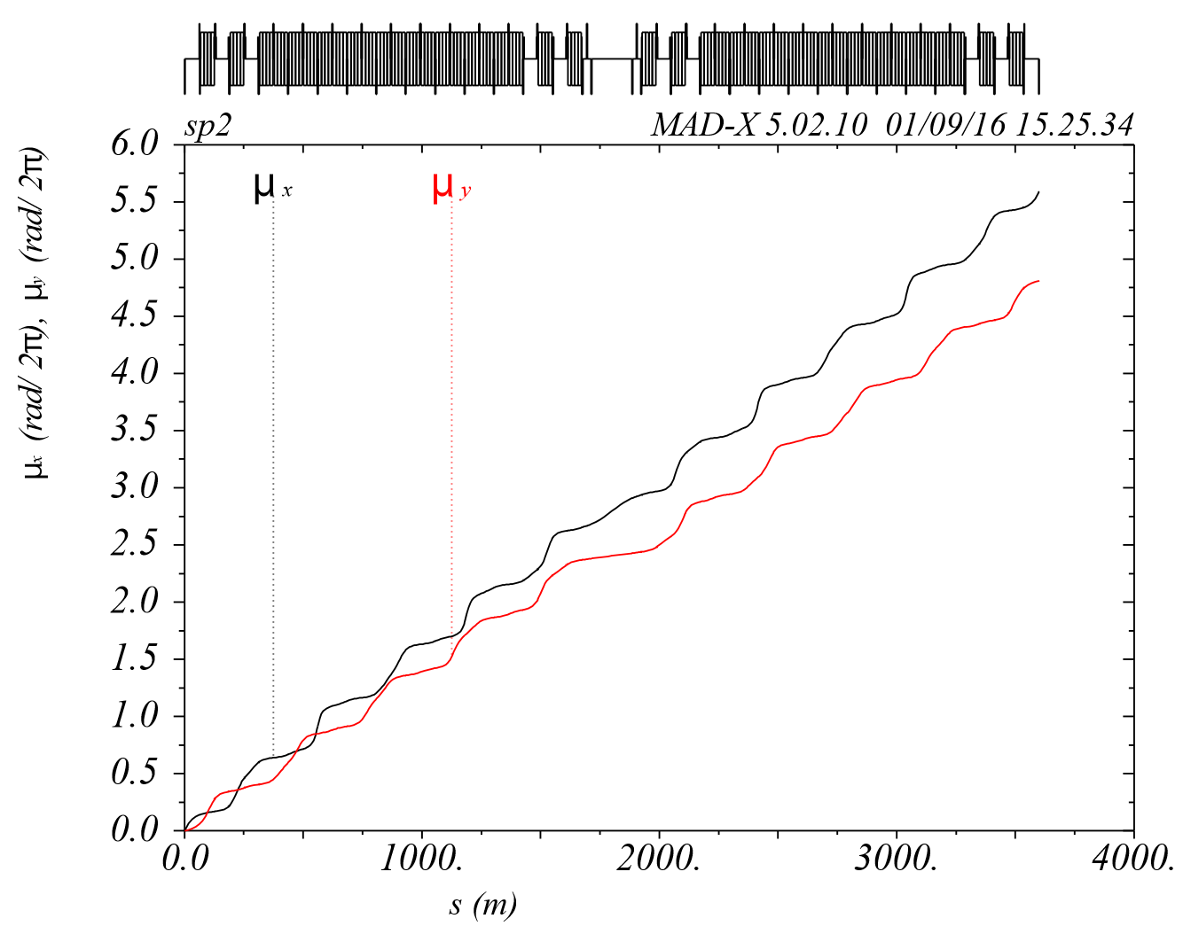
Check calculation of Lattice
It is acceptable in this preliminary analysis
* The closed orbit deviation is calculated by the MAD-X V5.02.08
The phase advance of A super period

Slide 49
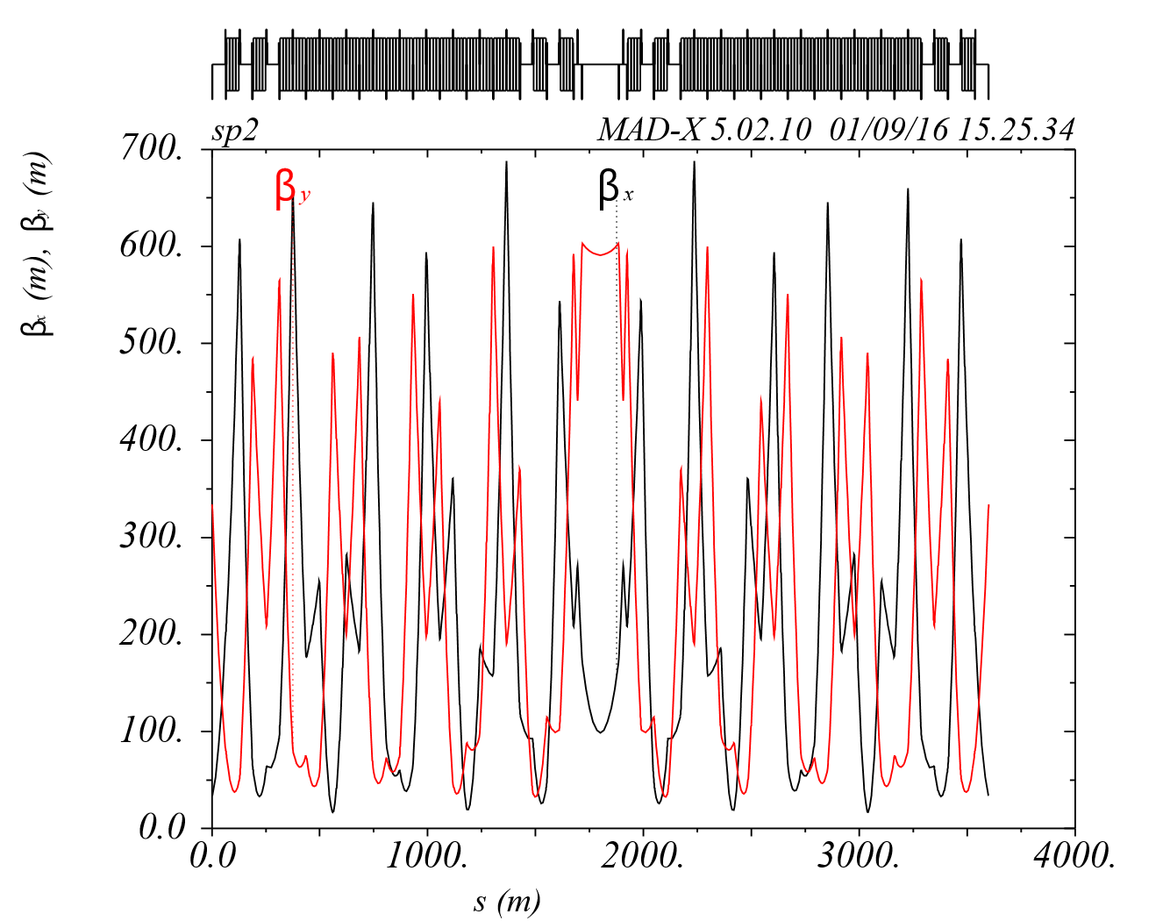
Check calculation of Lattice
Twiss function of
A super period of
SS ring
* The closed orbit deviation is calculated by the MAD-X V5.02.08

Slide 50
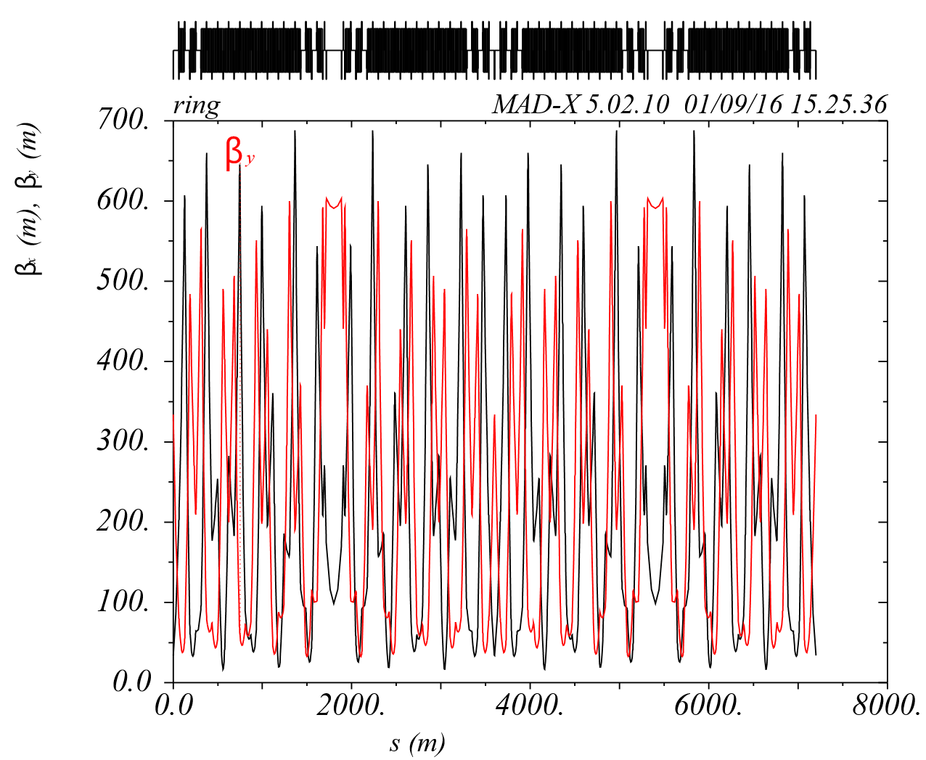
Check calculation of Lattice
Twiss function
of SS ring
* The closed orbit deviation is calculated by the MAD-X V5.02.08

Slide 51
Conclusion

Slide 52
The high intensity proton beam of 1 A gives challenge to injection
and extraction system. SS should adopt fast extraction scheme and
bump orbit injection scheme. It is proved that the machine operates
safely particularly during the injection (180 GeV, 11 microseconds)
and extraction (2.1 TeV, 22 microseconds) process.
A lattice with large envelop in the LSS for injection and extraction is
proposed which is named SS V1.1. This lattice also reduces the
difficulties of kicker magnets design.
The closed orbit deviation is less than 0.3246 mm, corresponding to
the maximum momentum deviation of . It comes to a
preliminary conclusion that the beam can operate stably with this
lattice scheme.
The r.m.s horizontal closed orbit deviation is 0.2020 mm .

Slide 53
To optimize the layout of the Lattice calculation,
for all the cell’s periods
The dynamic aperture tracking,
with the high frequency system
The dynamic aperture tracking,
under injected energy
The dynamic aperture tracking,
in the process of ramping up
The large beta function and dispersion function,
in arc section still need
To be optimize to a reasonable value,
in the future work.

Slide 54
Thanks for your attention !
Thanks to the help of the collaborator !

