Slide 1
Discussions on CEPC international collaboration
03 September, 2016

Slide 2
Acknowledgements
Shan Jin, Jie Gao, Xiaoyan Shen, Jingyu Tang

Slide 3


International collaboration is very very important in the CEPC-SPPC project!

Slide 4
Some examples
Atlas @ LHC

Slide 5
BES III @ BEPCII
Spokesperson
Institutional Board (IB)
Executive Board (EB)
Nominating
committee
Membership
committee
Run coordinator
Technical Board
committee
Software coordinator
Publication
committee
Computing coordinator
Physics coordinators
Speakers
bureau
Convener-1
Convener-2
………
Shift
committee

Slide 6
Cooperation of ILC host- and hub-laboratories
ILC Host-Lab
Technical Coordination
for Lab-Consortium
Regional Hub-Lab:
A
Regional Hub-Lab:
E, & …
World-wide
Industry responsible to
‘Build-to-Print’ manufacturing
Regional Hub-Lab:
B
Regional Hub-Lab:
D
Regional Hub-Lab:
C: responsible to
Hosting System Test and Gradient Performance
Regional hub-laboratories responsible to regional procurements to be open for any world-wide industry participation
: Technical
coordination link
: Procurement link
6

Slide 7
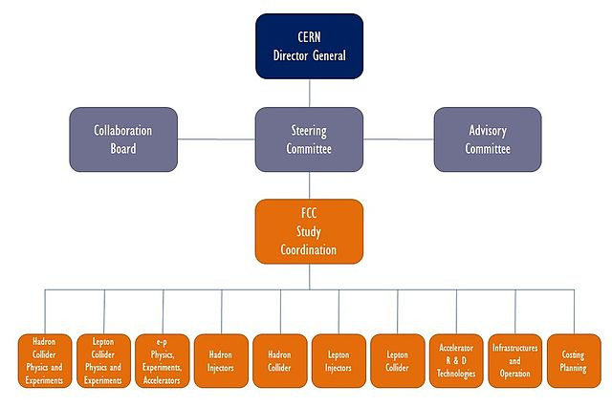
FCC organization

Slide 8
LBNF
Resource Review Board
FERMI
Experiment1
Experiment2
Experiment3
International Joint oversight Group
Exp-Facility Interface Group
Fermi Physics Advisory Commi.

Slide 9
CEPC
Institutional Board
Steering Committee
Project Directors
IAC
Theory
Accelerator
Detector

Slide 10
Next IAC meeting
November 8-9, Beijing
Charge
  Review the progress of CEPC project, theory, detector and accelerator
  Discussion on international collaboration

