Slide 1


TPCs for neutron
Yulan Li
Tsinghua University
TPC tracker detector technology mini-workshop
2016-9-1
IHEP, Beijing, China

Slide 2
Outline
nTPC: TPC as a fast neutron spectrometer
  Working principle
  Performance simulation
  System design
  Neutron beam test results
nimTPC: TPC as a fast neutron imaging detector
  Working principle
  Simulation

Slide 3
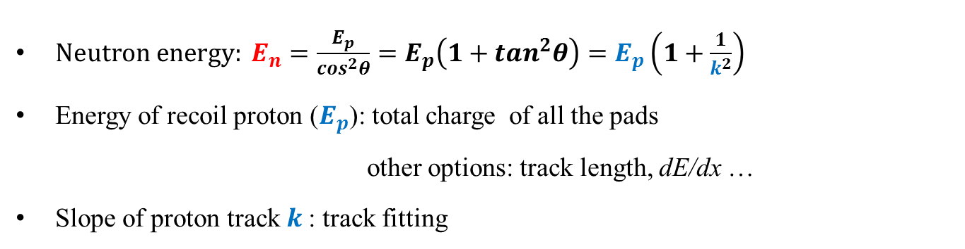
nTPC Working Principle: Elastic Scattering with H
  $Neutron energy: E_{n}=\frac{E_{p}}{\cos^{2}θ}=E_{p}\left(1+\tan^{2}θ\right)=E_{p}\left(1+\frac{1}{k^{2}}\right)$
  Energy of recoil proton ($E_{p}$): total charge of all the pads
  other options: track length, dE/dx …
  Slope of proton track $k$: track fitting

Slide 4
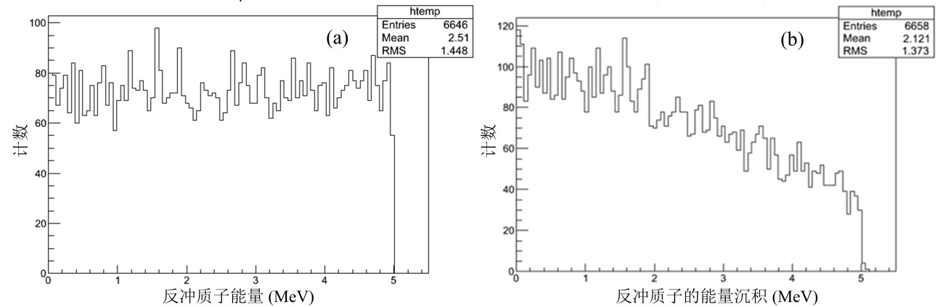
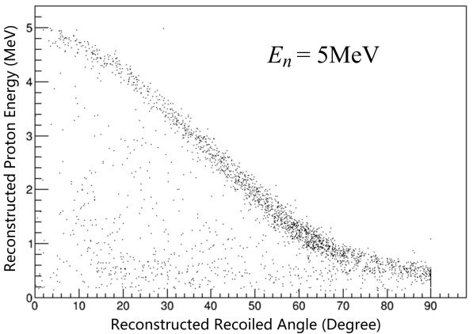
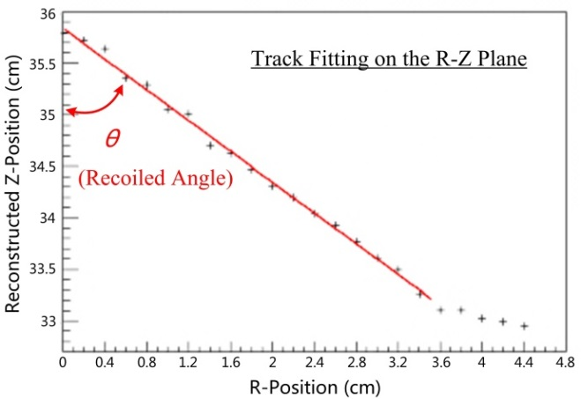
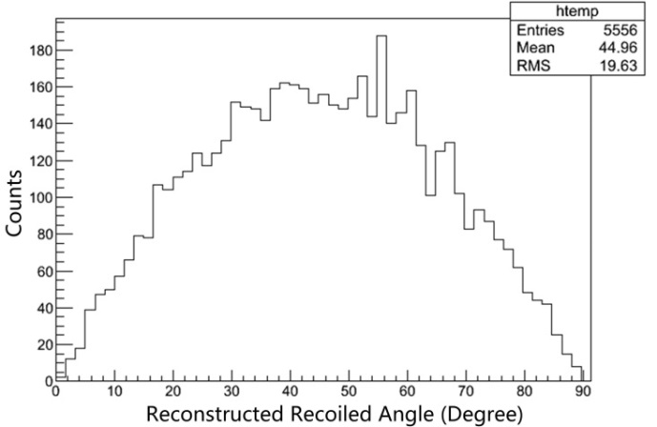
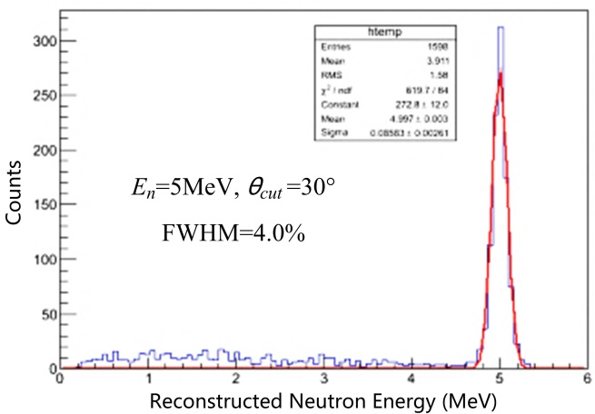


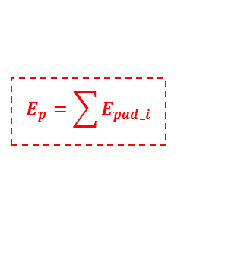




Performance Simulation (1)
Initial energy of proton $E_{p0}$
Energy deposited in TPC $E_{p}$
$E_{p}$ vs. $θ$
$E_{n}$=5MeV
Ar-C₂H₆(50-50)
$$E_{p}=\sum{E_{pad_i}}$$
Proton’s recoil angle $θ$
Neutron’s energy spectrum
fitting
distribution
$$f\left(θ\right)=sin2θ$$

Slide 5
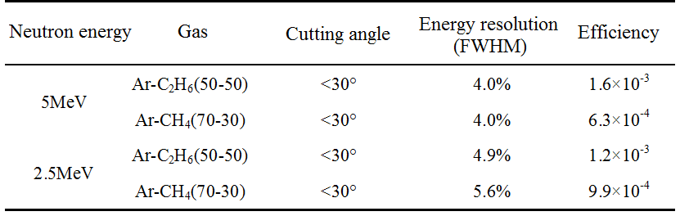
Performance Simulation (2)
Simulation result of energy resolution and efficiency
Huang Meng, Li Yulan, Deng Zhi, et al. A fast neutron spectrometer based on GEM-TPC. 2012 IEEE NSS-MIC Conference Records, 146-148.
Huang Meng, Li Yulan, Deng Zhi, et al. The characteristics of signals from nTPC and its application in background suppression. 2013 IEEE NSS-MIC Conference Records, 1-3.
Niu Libo, Li Yulan, Huang Meng, et al. Track reconstruction based on Hough-transform for nTPC. Chinese Physics C, 2014, 38 (12): 126201.
Niu Libo, Li Yulan, Huang Meng, et al. Adaptive multitrack reconstruction for particle trajectories based on fuzzy c-regression models. Chinese Physics C, 2015, 39 (3): 38-44.

Slide 6
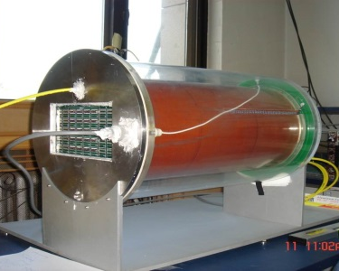
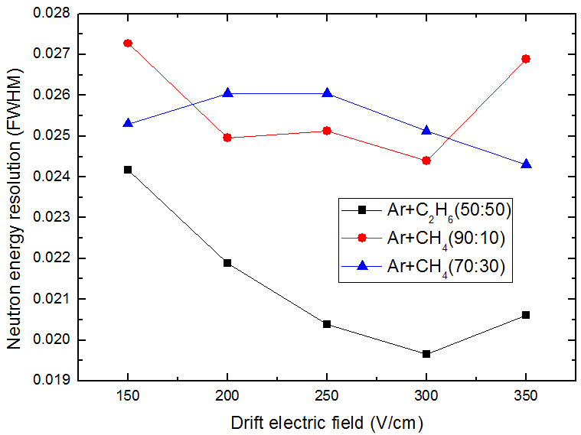
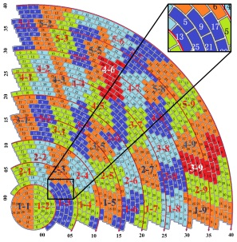
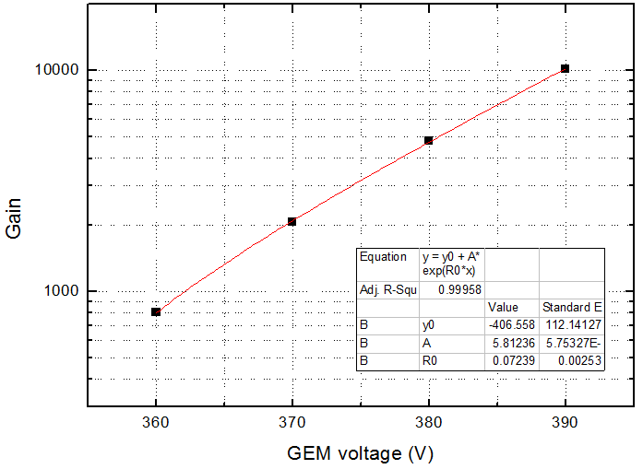
System Design
nTPC design parameters
Based on: TU-TPC
Detector | Size | Φ30cm×50cm (TU-TPC)
 | Gas | Ar-CH₄(70-30) or Ar-C₂H₆(50-50)
 | Drift field | ~200V/cm
 | Readout detector | 3GEM
 | pad | ring, 5mm×2mm
ASIC | Shaping time | 80ns
 | Gain | 2mV/fC
DAQ | Sampling parameters | 12bit，25MHz
 | Triggering Mode | Single trigger
Data processing | Platform | Labview
 | Mode | Online
TU-TPC
Gas and drift field optimizing
Pad
Gain of 3GEM(P30)
Huang Meng, Li Yulan, Niu Libo, et al. Design of a neutron-TPC prototype and its performance evaluation based on an alpha-particle test. Chinese Physics C, 2015, 39 (8): 086003.

Slide 7
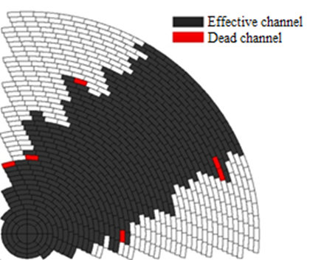
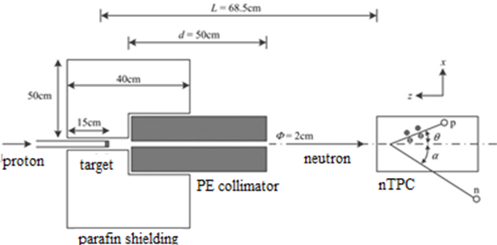
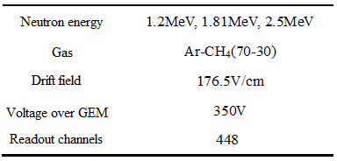
Neutron Beam Test - Setup
@ Key Laboratory of Nuclear Data Measurement and Evaluation Technology, China Institute of Atomic Energy

Slide 8
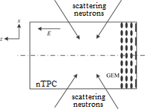
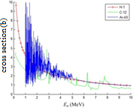
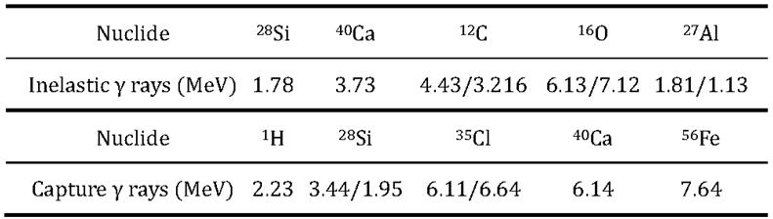
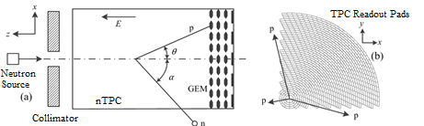
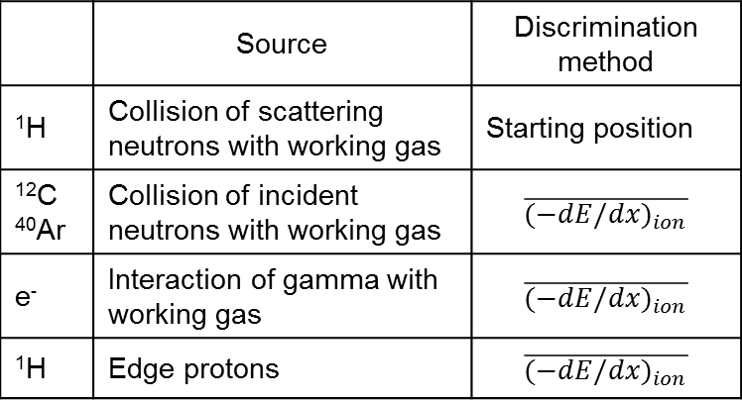
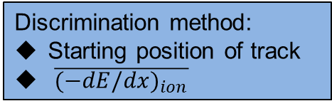
Discrimination of Background Events (1)
Associated γ：
Protons produced by the scattered neutrons
Discrimination method:
Starting position of track
$\overline{{(−dE/dx)}_{ion}}$
¹²C and ⁴⁰Ar
 | Source | Discrimination method
¹H | Collision of scattering neutrons with working gas | Starting position
¹²C ⁴⁰Ar | Collision of incident neutrons with working gas | $$\overline{{(−dE/dx)}_{ion}}$$
e⁻ | Interaction of gamma with working gas | $$\overline{{(−dE/dx)}_{ion}}$$
¹H | Edge protons | $$\overline{{(−dE/dx)}_{ion}}$$
edge protons:
only part energy deposition collected

Slide 9
Discrimination of Background Events (2)
Track length(mm) vs. deposited energy(pC)
Deposited energy(pC) vs. recoil angle(Degree)

Slide 10
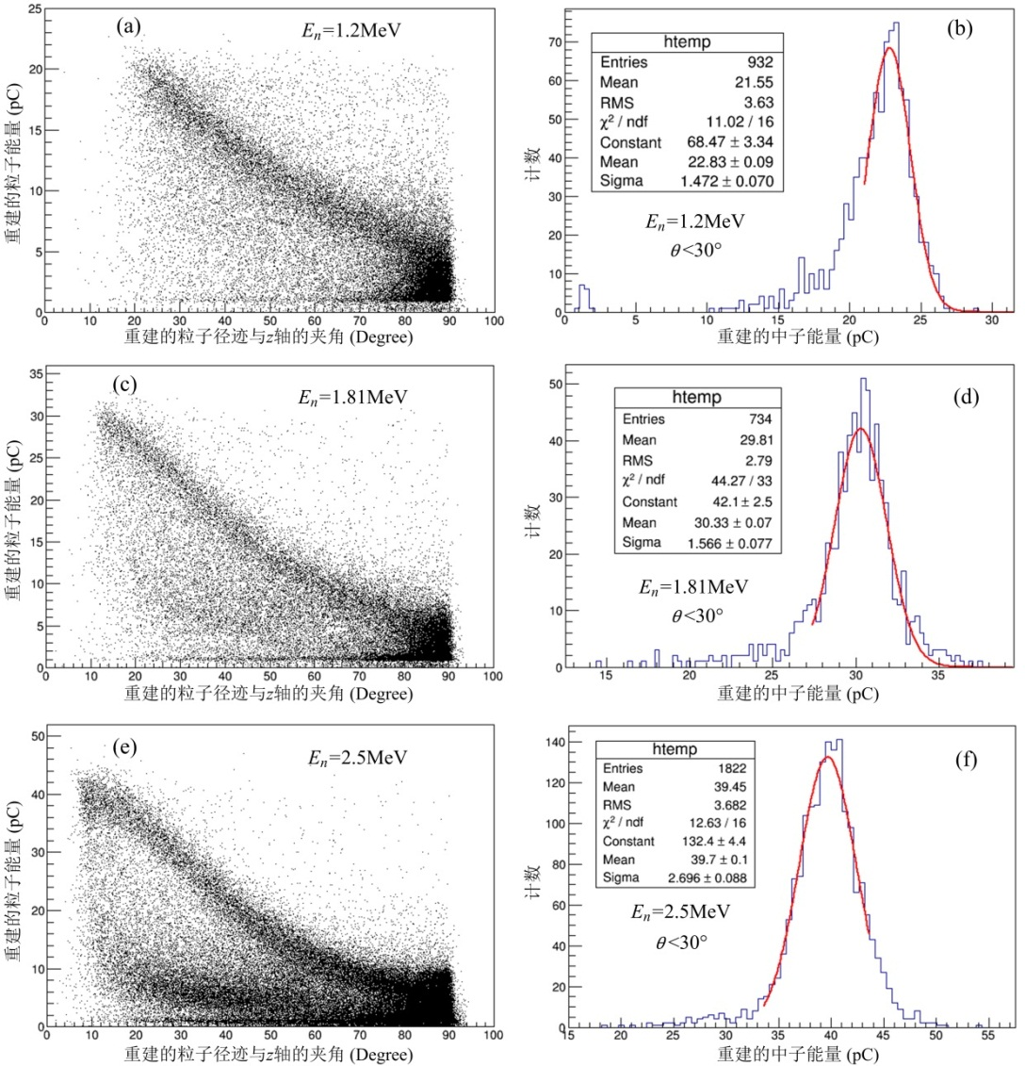

Reconstruction of Neutron Spectrum
Deposited energy vs.
recoil angle θ
Reconstructed
neutron spectrum
1.2MeV
Peak=22.8pC
Charge response vs. neutron energy
1.81MeV
Peak=30.3pC
2.5MeV
Peak=39.7pC
$$Cut：\text{dep}\text{>1}\text{pC} \text{(\sim 60}\text{keV}\text{)}\text{, }\text{θ} \text{<}\text{30}\text{°}$$

Slide 11
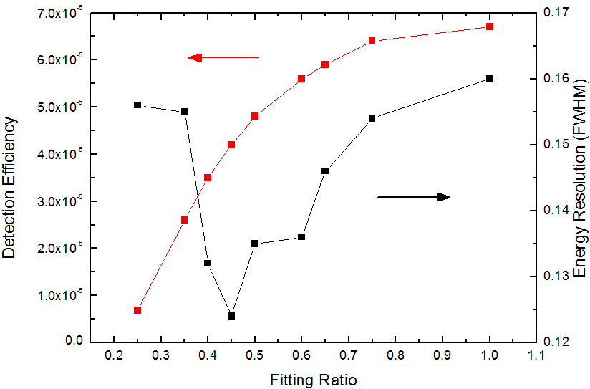
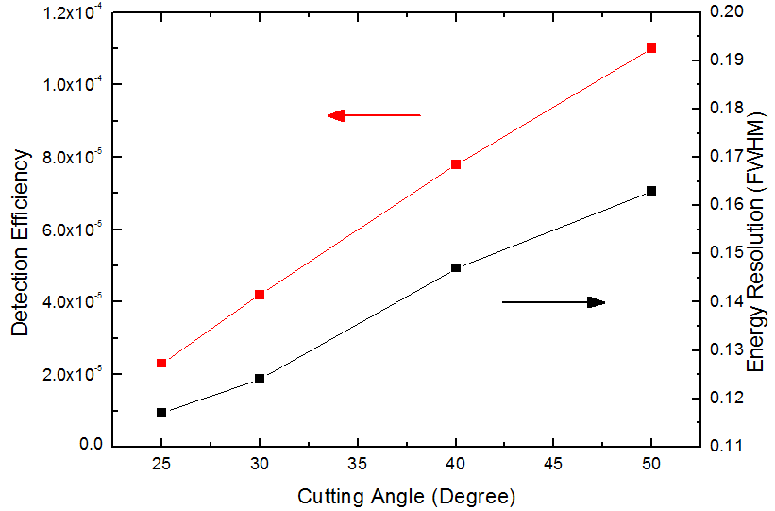
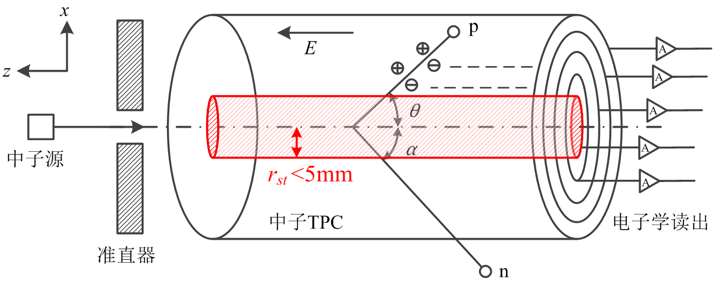
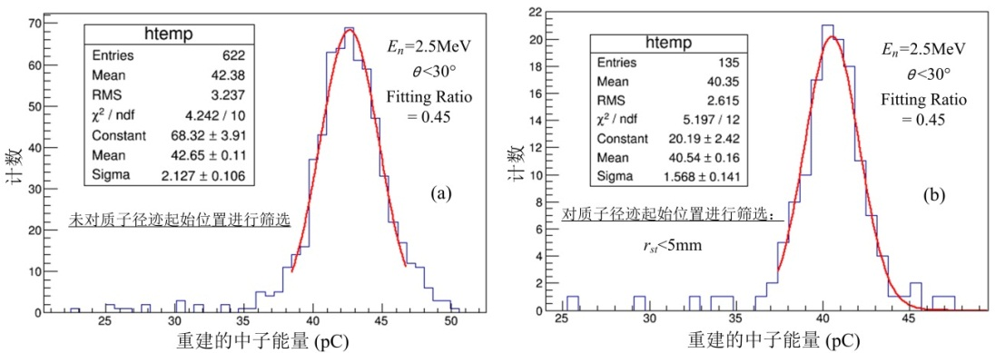
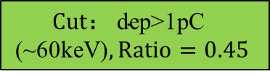

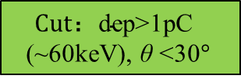

Energy Resolution vs Detection Efficiency (1)
$E_{n}$=2.5MeV
$E_{n}$=2.5MeV
$$Cut：\text{dep}\text{>1}\text{pC} \text{(\sim 60}\text{keV}\text{),} \text{θ} \text{<30}\text{°}$$
$$Cut： \text{dep}\text{>1}\text{pC} \text{(\sim 60}\text{keV}\text{)}, Ratio=0.45$$
Track fitting length (relative）
Cutting angle
Starting position
Cutting in starting position:
Energy resolution from 11.7% to 9.1% (FWHM)
Huang Meng, Li Yulan, Niu Libo, et al. Analysis and optimization of energy resolution of neutron-TPC. NUCLEAR SCIENCE AND TECHNIQUES, 2015, 26 (040602).

Slide 12
Energy Resolution vs Detection Efficiency
Optimized results of the neutron energy resolution
Neutron energy | recoil angle cutting | Track fitting part (ratio) | Starting position | Energy resolution(FWHM) |  | Detection efficiency
 |  |  |  | Simulation | Experiment
1.2 MeV | 30° | 0-1 | r_{st}<10mm | 15.7% | 14.6% | 3.6×10⁻⁴
1.81 MeV | 30° | 0.1-0.6 | r_{st}<5mm | 10.3% | 8.3% | 6.4×10⁻⁴
2.5 MeV | 25° | 0.1-0.4 | r_{st}<5mm | 7.0% | 6.3% | 1.4×10⁻⁵
Due to that the effective readout pads only covers about 45°angle range, the detection efficiency of the neutron-TPC could be improved further by add more channel.

Slide 13
Outline
nTPC: TPC as a fast neutron spectrometer
  Working principle
  Simulation
  System design
  Neutron beam experiment results
nimTPC: TPC as a fast neutron imaging detector
  Working principle
  Simulation

Slide 14
TPC for Fast Neutron Imaging: Working Principle
n₀
n₀
Event reconstruction:
Time windows:
p⊥n
p: direction of track
n: vector between positions of 2 events
p
p
α
n
α
n
n’
n’
p'
p'
Outer-ring neutron convertors
Outer-ring neutron convertors
GEM
GEM
①line-line mode
②line-point mode
Energy, direction of both p and p’ measured:
Both energy and direction of n₀ can be determined.
Energy, direction of p,
and start position of p’ measured:
Direction of n₀ limited to <90°in a plane.

Slide 15
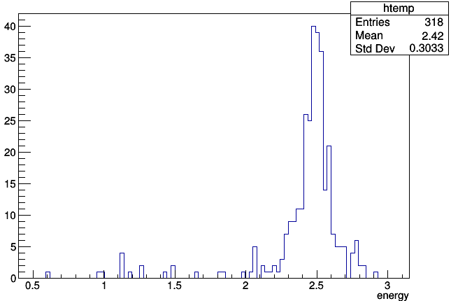
TPC for Fast Neutron Imaging: Simulation
Φ30cm×50cm TPC filled with Ar-C₂H₆(50-50), no outer-ring neutron converters.
2MeV neutrons incidented from the axial direction.
①line-line
FWHM~8.0%
@2.5MeV
①line-line
FWHM~4.8°
@2.5MeV
②line-point
FWHM~8.9°@2.5MeV
Efficiency: 1.38×10⁻⁵
Efficiency: 3.31×10⁻⁶

Slide 16
Conclusion
nTPC is developed as a fast neutron spectrometer;
High energy resolution with relatively high efficiency;
Energy resolution reach 7.0%(FWHM) @ 2.5 MeV;
Detection efficiency > 10⁻⁵ @2.5MeV;
nimTPC for fast neutron imaging is under developed;
Angle resolution ~4.8°(FWHM) @2.5MeV in simulation;
Total detection efficiency~1.7×10⁻⁵@2.5MeV in simulation.

Slide 17
Thanks a Lot!!

