Slide 1
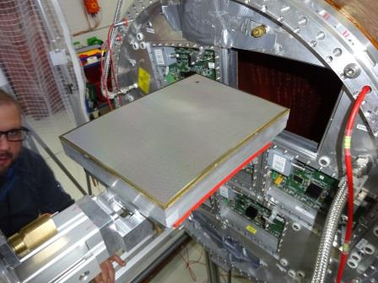
Micromegas module for ILC-TPC
TPC Tracker Detector Technology Mini Workshop, Beijing, September 1, 2016
A decade of R&D
Paul COLAS, CEA Saclay
Early tests
Magnetic field
charge spreading
Ion Back Flow
Single-module tests
Micromegas development
Seven-module test
Integration issues : electronics, cooling

Slide 2
Introduction
TPCs have good records in e+e- physics (ALEPH and DELPHI at LEP), and showed adaptability to dense high-rate environment (STAR, ALICE)
MPGDs yield a promise for improvement : smaller structures lead to smaller ExB effects, ion feedback can be naturally suppressed, light construction of large area is possible.

Slide 3
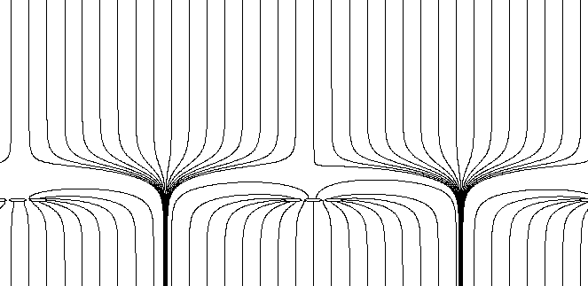
Micromegas
Charged tracks cross a medium with a low (drift) field : 200 V/cm.
Ionization electrons drift to a mesh maintained ~100 µ above sensitive pads : the very high field (O(60kV/cm)) multiplies the electrons.
Very small gap : very fast detector
Funnel effect: avalanche spread by diffusion of electrons, ions follow back field lines, most of them closing on the mesh.
S1
S2
S2/S1 = E_{drift}/E_{amplif} ~ 200/60000= 1/300

Slide 4
Charge spreading
Continuous RC network spreading evenly the charge over several pads
mesh
~100μm Amplification gap:
E
B
resistive foil: ~75μm
insulator: ~100μm
pads

Slide 5
Early tests
2001-2002 : Check that Micromegas works in a magnetic field. Requires non-magnetic mesh.
Study the ion back flow natural suppression
Select gas candidates
2000-2005 : development of the charge-spreading method (M. Dixit et al.). Tested in a 5T field: 30 µm resolution with 2mm pads

Slide 6
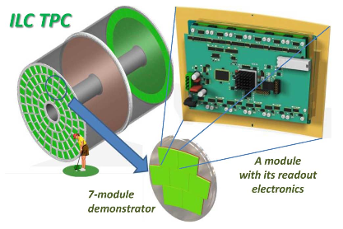

Slide 7

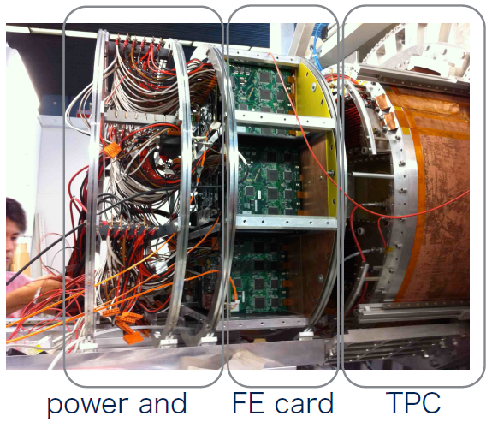
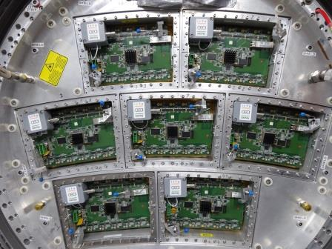
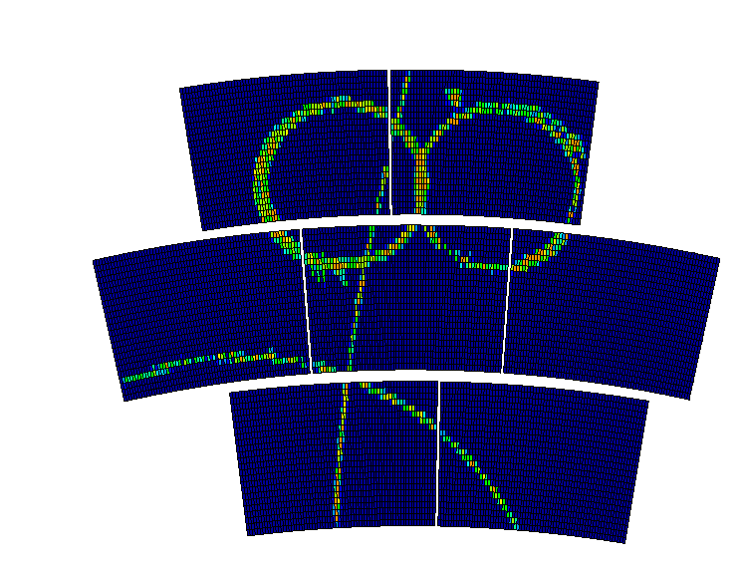
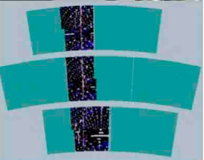
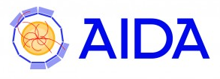
EUDET/AIDA Test facility at DESY
GEMs
Micromegas
March 2015

Slide 8
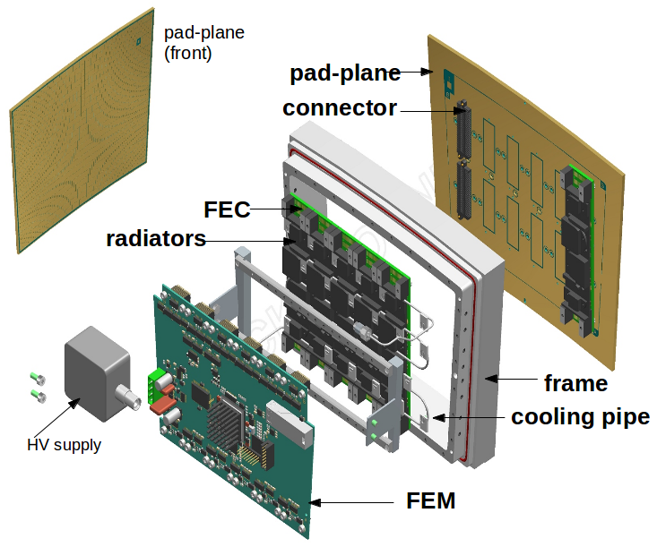
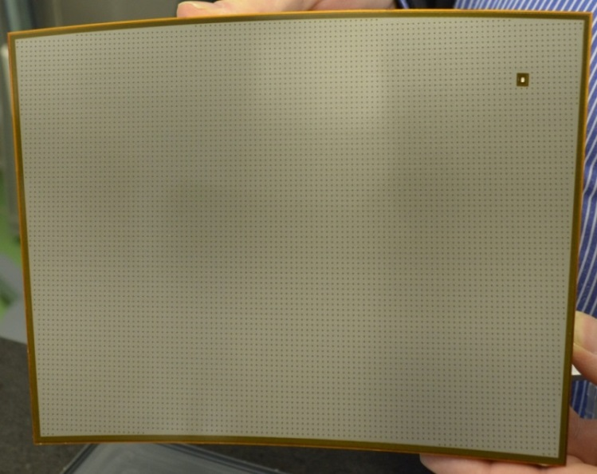
Bulk process for MM manufacture
Carbon-loaded kapton or Diamond-like carbon as resistive coating
Micromegas module
Module size: 22 cm × 17 cm
Readout: 1726 Pads
24 rows
Pad size: ~ 3 mm × 7 mm
Chips on board (wire bonding) – The resistive foil suffices to protect against sparks – 0.25 X° thick

Slide 9
Gating
Necessary to fully suppress the space charge produced by ion back flow from the amplification gap
Practical solutions under study, e.g. gating GEM (see Akira Sugiyama’s talk)
Not possible at CEPC (see Huirong’s talk)

Slide 10
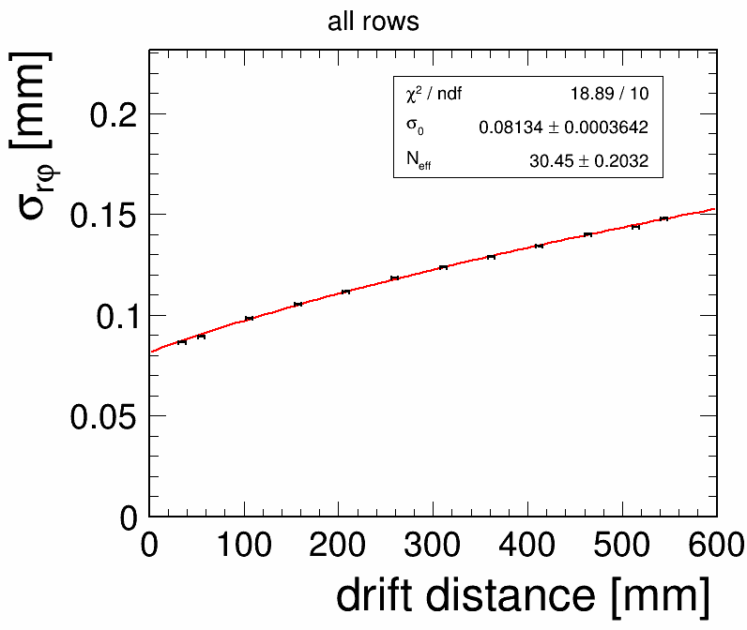
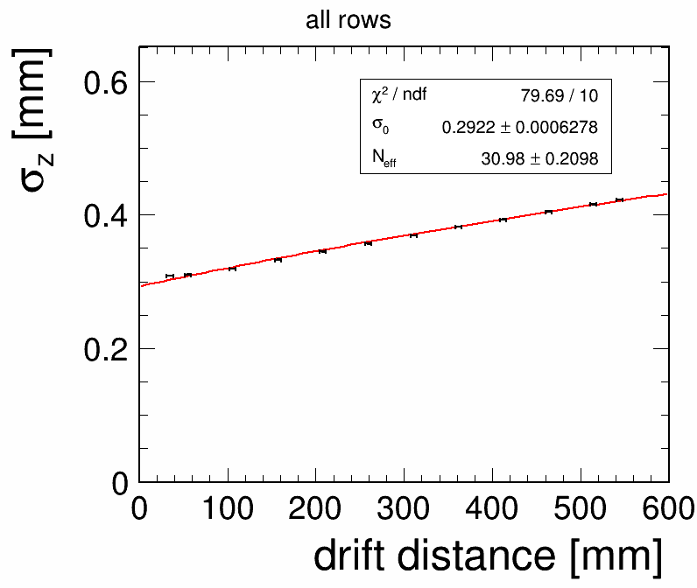
Perfomance : resolution
Resolution 70 µm in rφ and 200 µm in z at zero drift distance for 3mm-wide pads
Drift dependence follows expectation from diffusion

Slide 11
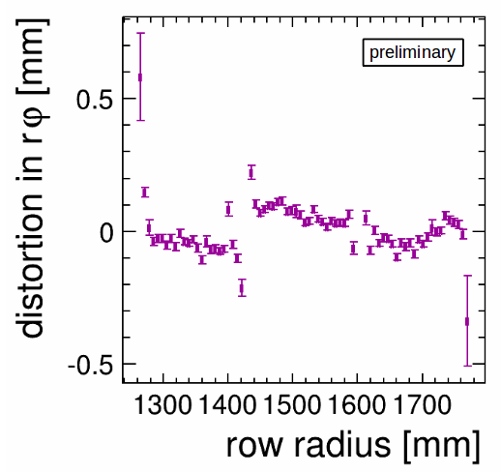
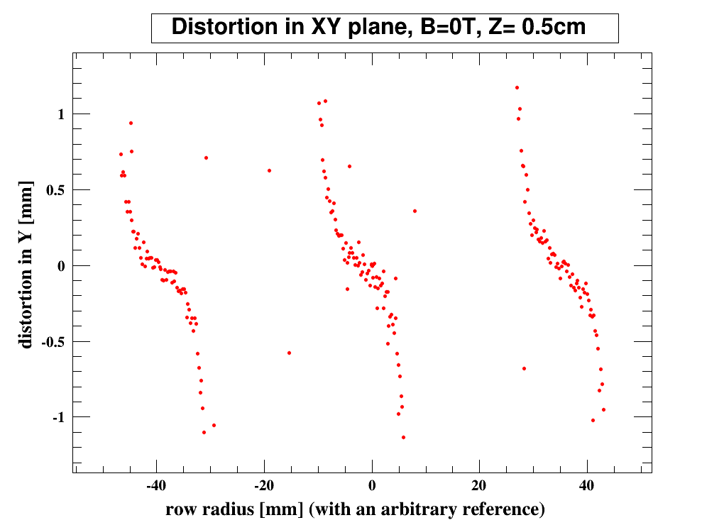
Comparison of distortion between experiment and simulation
For the Micromegas modules on the LPTPC endplate.
For the simulated Micromegas modules
B=0T
B=0T
Distribution of the residuals as obtained
in Experiment after alignment correction.
Distribution of the residuals as
obtained in Simulation

Slide 12
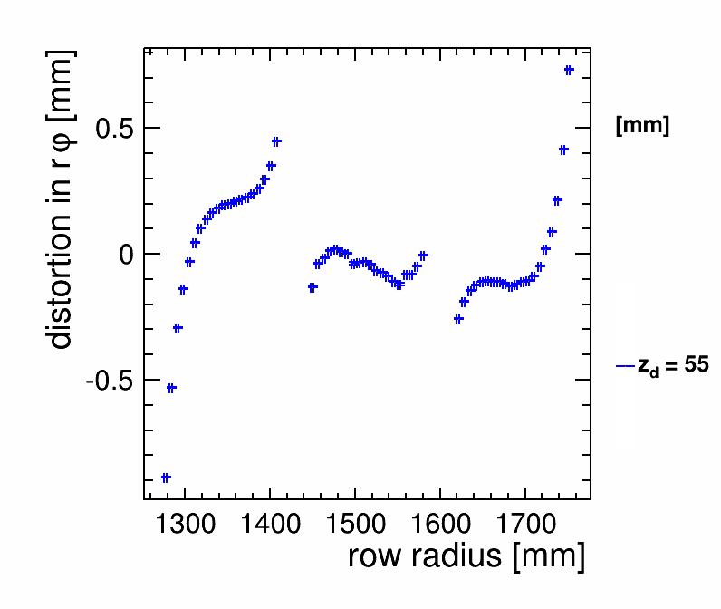
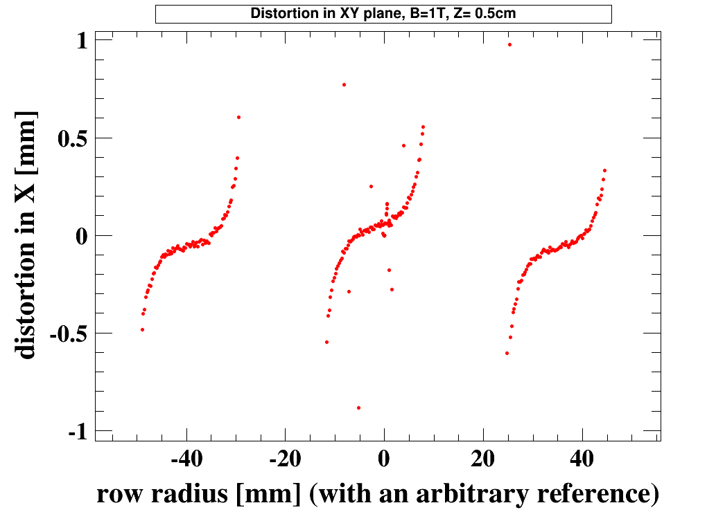
Comparison of distortion between experiment and simulation
For the Micromegas modules on the LPTPC endplate.
For the simulated Micromegas modules
B=1T
B=1T
Distribution of the residuals as obtained
in Experiment without alignment correction.
Distribution of the residuals as
obtained in Simulation

Slide 13
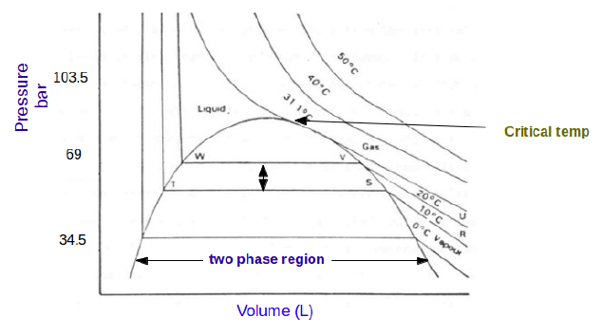
2-phase CO2 cooling
Can operate at room temperature (requires high pressure, no problem in O(1mm) pipes. Allows more uniform gas temperature and no worry with dripping condensed water.
No consequence of leaks : CO2 vaporizes
Excellent heat removal (high heat capacity and high latent heat)
Very little matter budget

Slide 14
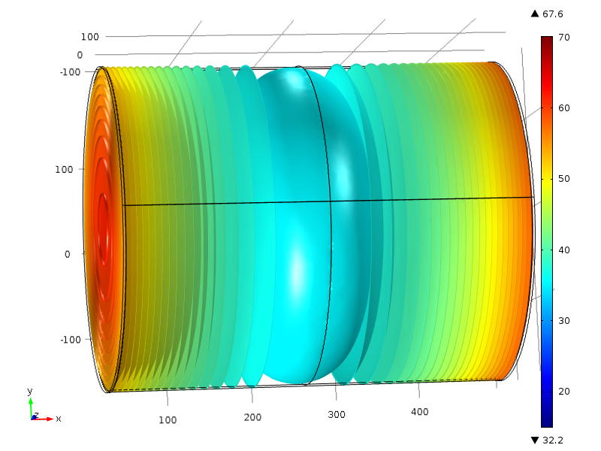
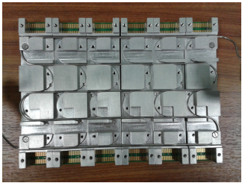
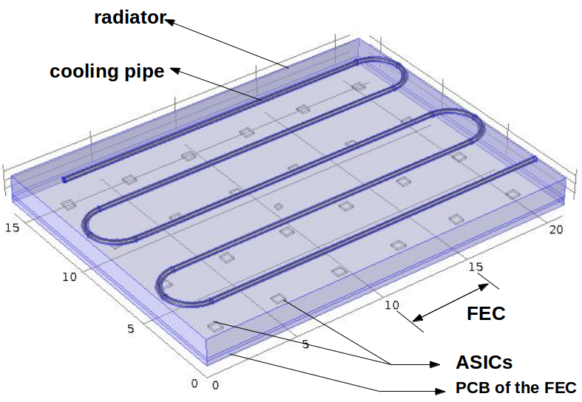
Thermal simulation of the gas volume and of the endplate modules
Thermal inhomogeneities cause changes in drift properties in the gas, hence distortions. Needs simulations.
D.S. Bhattacharya

Slide 15
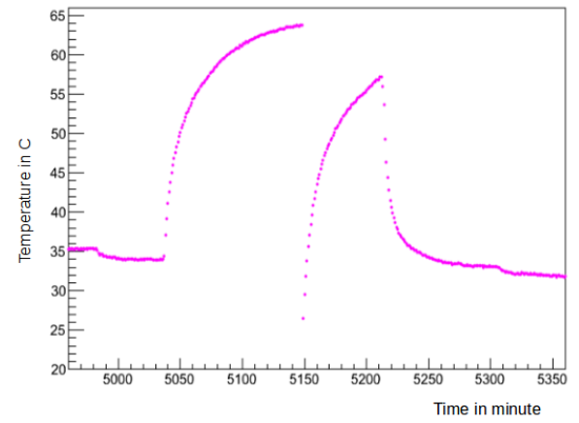
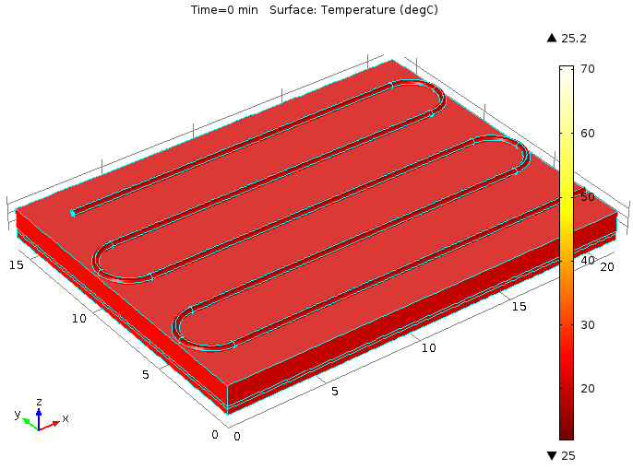
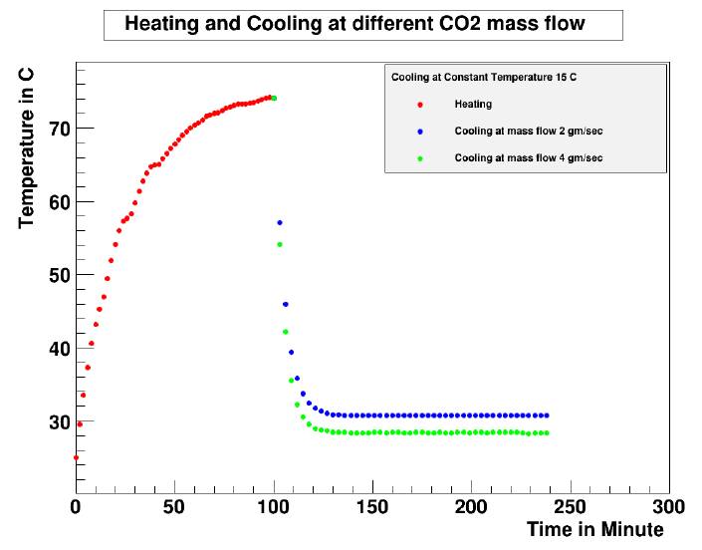
Warming up and cooling down of a module. Good agreement with data

Slide 16
Summary
Basic demonstration that a TPC can operate at ILC with required performance is made
More work needed to demonstrate that it can work at a CC (time structure, ion back flow)
A lot of progress was made in a decade towards an engineered detector

