Slide 1
Cepc simulation with Silicon-tracker
Chengdong Fu
20160630

Slide 2
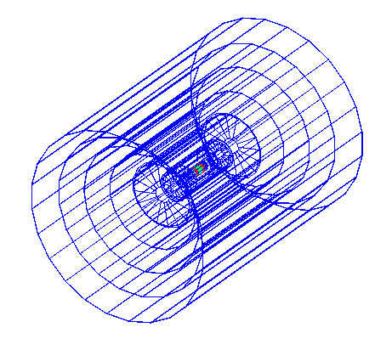
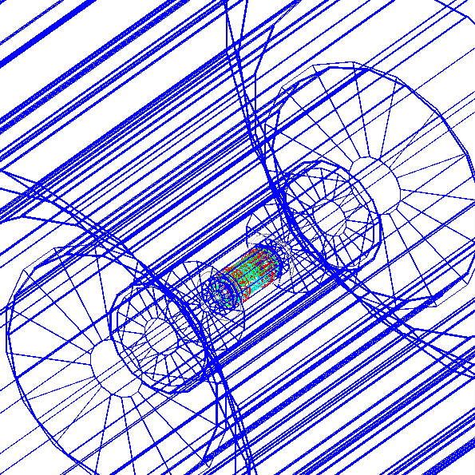
Vxd04 + SiTracker01
Mokka + Marlin
Runable NOW
Crash reason--in cepc_v1: SIT id 0-; FTD layer/module id 0-, sensor id 1-
Some hits still out of boundaries, and the local positions of hits are not at center

Slide 3
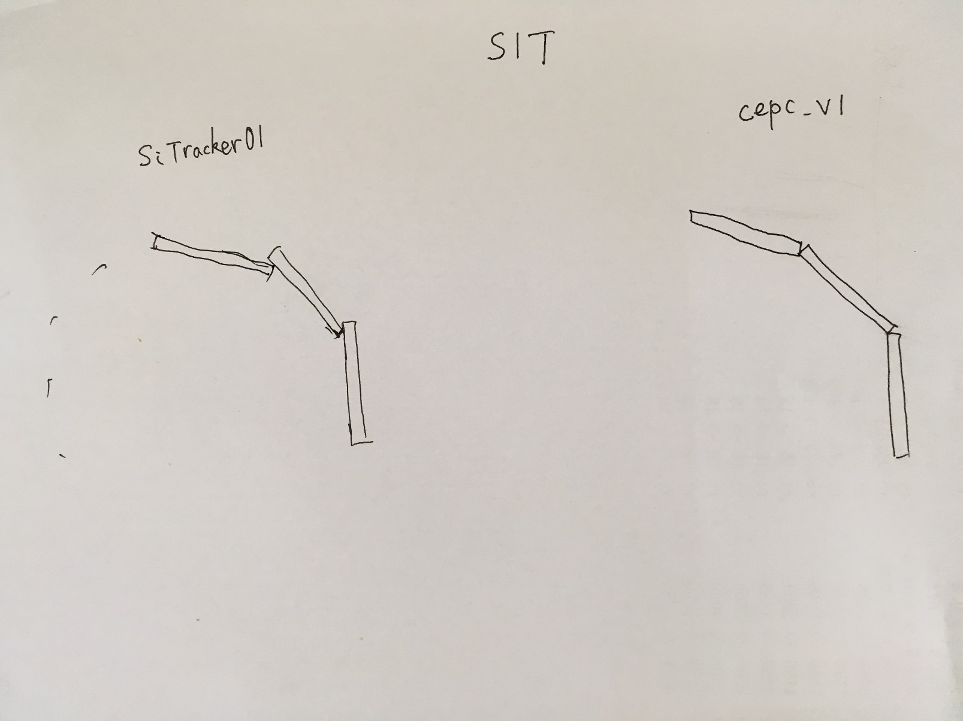
Difference for SIT
Out of boundary by Gear process
Because the thickness is small, the ratio is small too.

Slide 4
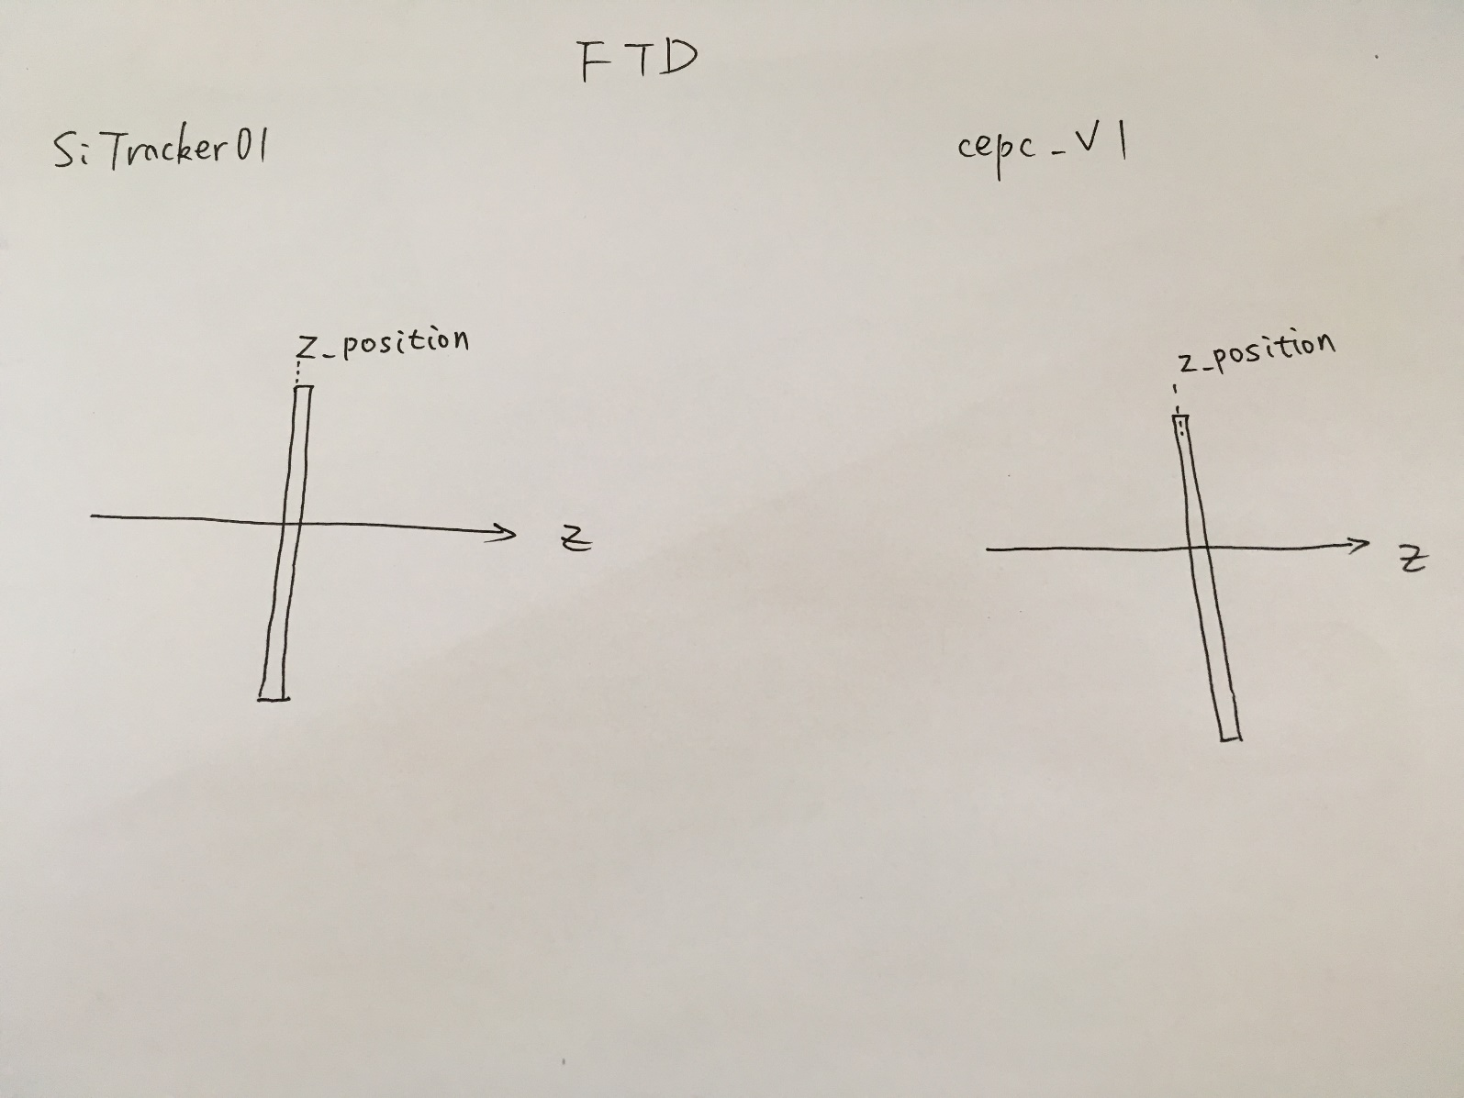
Difference for FTD
The local position of hits will be not at center.

Slide 5
How to develop
SIT
Overlap in r-phi or not
FTD(> 7 layers)
Modify Gear kernel
New reconstruction without Gear

