Slide 1
A SOI pixel sensor for vertex detector with highly compact digital pixel
Yang ZHOU, Yunpeng LU, Jing DONG, Ouyang QUN /SOI mini Workshop /2016.7.14/ BeiJing
Outline:
Vertex detector specifications
SOI/CMOS technology
*CPV1 design & preliminary test results
CPV2 design & simulation results
Conclusion and outlooks
*CPV: Compact Pixel for Vertex

Slide 2
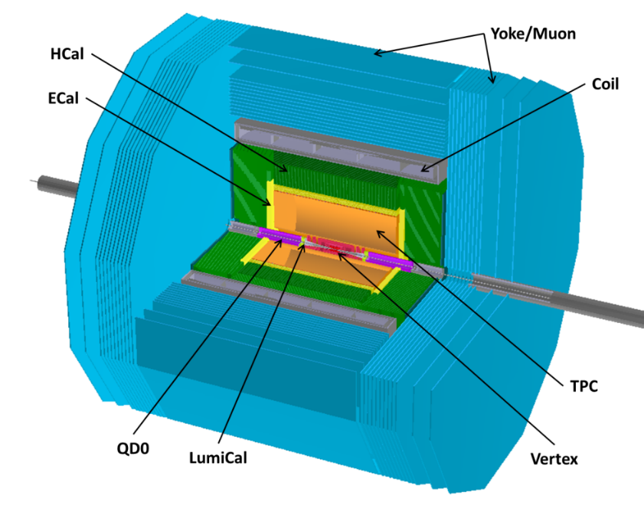
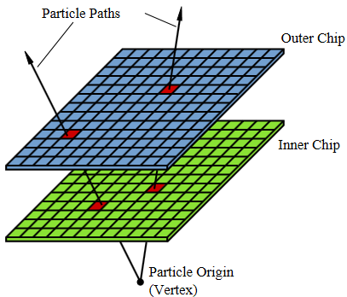
Vertex detector specifications
Vertex detector:
Inner most detector:
- high flux density;
Reconstruct the charm & bottom particle decay vertex:
- Precise spatial & time resolution; - Thin (minimize scattering effect);
- Low power consumption (simplify cooling system).

Slide 3
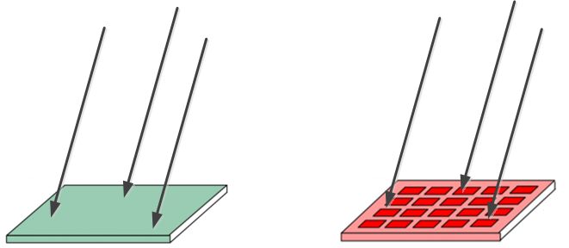
Vertex detector specifications
General requirements of vertex detector：
High granularity, fast readout, thin pixel sensors with low power consumption
Promising technologies: CMOS Pixel Sensor / SOI pixel sensor
- 100% fill-factor
- Miniaturized: sensor and signal processing integrated in the same silicon wafer
- Low cost: standard commercial technology
- Low power dissipation: monolithic sensor
- Almost dead time free: very short reset time
- Sensitive: signal collected by the sensing diode as low as 200 $e^{−}$
- High granularity: pixel pitch on the scale of several tens of μm
High granularity is beneficial for both high flux and precise special resolution

Slide 4
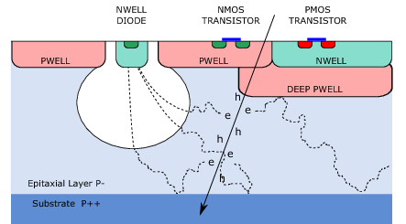
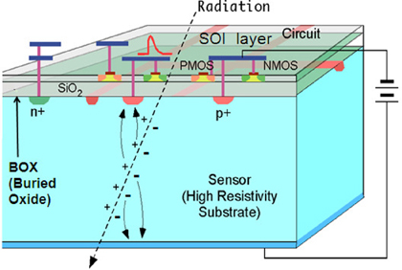
SOI/CMOS technology: concerning granularity
Sensitive layer: hundreds μm, could be back thinned to 50 μm
Sensitive layer: 10-20 μm thick
CMOS
SOI
SOI pixel technology potential advantages:
Thicker sensitive layer: simplify the electronic design
- 2-3 times signal charges for Minimum Ionizing Particles (MIP) even after the sensor back thinning down to ≈ 50μm
More compact layout: shrink the pixel size
- PMOS & NMOS transistor could be closer (no NWELL PWELL used for transistors in SOI)
Potentially high granularity
zhouyang@ihep.ac.cn

Slide 5
SOI/CMOS technology: *CPV prototype target
CPV compare with cutting edge sensors for Vertex detector: all with in-pixel discrimination process
 | ASTRAL | ALPIDE | CPV*
Process technology | 0.18 μm CMOS |  | 0.2 μm SOI
Readout strategy | Rolling shutter | asynchronous | Rolling shutter
Readout time | 20 μs | <2 μs
Power | 85 mW/cm² | 39 mW/cm²
Pixel size | 22 $×$ 33 μm² | 28 $×$ 28 μm² | 16 $×$ 16 μm²
Spacial resolution | ≈ 5μm |  | < 3μm
Total signal for MIP | ≈1600 e⁻ (≈20μm epi-layer) |  | ≈4000 e⁻ (back thinning to 50μm, fully depleted)
28
16
>65%
Pixel size
Goal: take advantages of higher signal compared to CMOS technology, design a simple digital pixel structure to shrink the pixel size.
*Compact Pixel for Vertex

Slide 6
CPV1:design & preliminary test results
CPV1 chip Layout
CPV1: 1st SOI prototype
- Designed in line with the technology roadmap
- 16*16 μm² with in-pixel-discrimination
- Based on the measurement of full depletion*
- Pixel array: 64*32 (digital) + 64*32 (analog)
- Submitted June, 2015
* Y. LIU, Y. LU, X. JU, Q. OUYANG, Chinese Physics C, Vol.40, No. 1 (2016)
Analog
Digital
CPV1 digital pixel layout
64row*32col. digital pixel
64row*32col. analog pixel
16μm
16μm

Slide 7
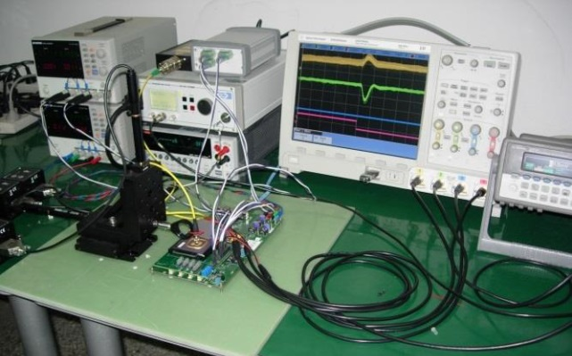
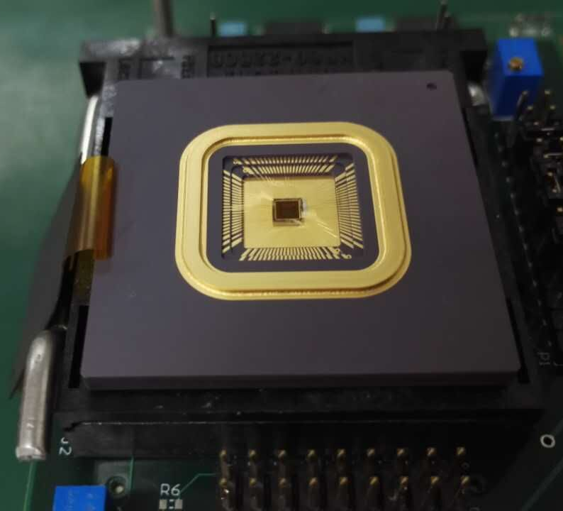
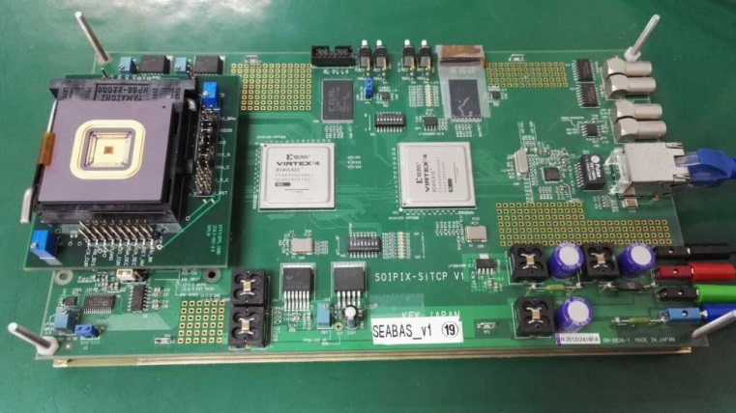
CPV1:design & preliminary test results
Test set up:
Chip delivered in Feb. 2016
Mounted in a Pin Grid Array package (176 pins)
Sub-board PCB prepared
Fit in the SEABAS DAQ system
FPGA firmware and PC software partly ready, modified from the existing system for other chips
Bare chip
Chip & Package
FPGA
Ethernet
Sub-board

Slide 8
CPV1:design & preliminary test results
Very preliminary results obtained by far:
Gain of amplifier measured on analog pixels
- Measured 10.2 agrees with the design value 10
Transfer curve measured on digital pixels
- Transition region ~5mV, equivalent to 120e⁻ , temporal noise ~ 17e⁻ (Fix Pattern Noise not included yet)
Analog output (V)
Digital output
(a.u.)
5mV
preliminary
Test input (V)
Test input (V)

Slide 9
CPV1:design & preliminary test results
Pixel amounts
Pixel analogue output (ADC unit)
Very preliminary results with ⁵⁵Fe: mostly 5.9 keV x-ray
The sensor is working
Statistical results is still in progress
One frame result without hits
Pixel amounts
Pixel analogue output (ADC unit)
One frame result with 1 hit in the matrix

Slide 10
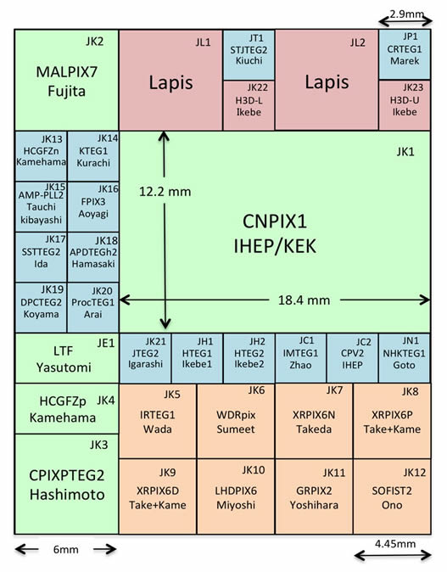
CPV2:design
10
CPV2*: 3 $×$ 3 mm²
CPV2: 2nd SOI prototype:
Constrains same with CPV1
Several optimization on pixels offset, timing;
- Submitted June, 2016

Slide 11
CPV2:design
CPV2 pixel schematic
Inpixel_CDS
Protection diode
Sensing node
INV
Pre_amp
In-pixel CDS stage: one capacitor + one switch with a clamping voltage
Pre_amp offsets are stored on the capacitor, and cancelled with appropriate operation timing
Clamping voltage is used to provide an appropriate DC voltage for INV and also used for threshold adjustment;

Slide 12
CPV2: simulation results
CS amplifier
INV
DC response
A small input variation leads to a large output variation
operation point various from pixel to pixel due to channel charge injection effect of RST transistor
Gain
DC operation point (511 mV) with RST
Ideal value for V_clamp = 865 mV, 35 mV input increasment (110 e- on the sensing node) could make the inverter overturn completely. Threshold could be set by adjusting V_clamp
Sensing diode | Sensing_node | CS_out | Gain_before_inv
4 fF + parasitic | 35 μV/e⁻ | 357 μV/e⁻ | 300 μV /e⁻
Simulation results, real results will be slightly less, due to layout generated parasitic capacitances

Slide 13
CPV2: simulation results
CPV2 Pixel timing
Readout
Row select switch_on
RST 20 ns is enough
Sensor read out speed depends on this duration, it require at least around 50 ns
At least 100 ns in this design
Clamp
CS power_on (Low active)
Row select switch_on
50 ns to read one row: frame time depends on matrix size
100 ns to reset: the larger matrix size, the smaller dead time proportion

Slide 14
CPV2: simulation results
Example of 1 hit operation
Pixel_out
INV_out
INV_in
CS_out
1 hit during last frame: 500 e-
Long recover time
timing
Signal | Sensing_node | CS_out | Inv_in | Inv overturn required
500 e- | ≈17.5 mV | 178.7 mV | 149.9 mV | 35 mV

Slide 15
CPV2: simulation results
An example: 4 hits in 8 frames, output low means pixel fired
Signal_in: 500 e-
Pixel out

Slide 16
CPV2: design
CPV2 Pixel schematic
Pixel Layout: 16 $×$ 16 μm²
Conclusion:
- Single pixel discriminate a hit require ≈110 e⁻, while a MIP generates ≈4000 e⁻ in a SOI prototype thinned to 50 μm
- The Inverter only sense the signal absolute value with the help of Offset cancellation stage;
RST noise of Clamp transistor could not be cancelled, a larger value coupling capacitance could help to reduce it;
The coupling capacitance value was chosen as 37.5 fF due to the layout limitation;
It takes 50 ns to read one row in CPV2;
CPV2 dead time proportion = 100 ns/frame time.

Slide 17
Conclusion and outlooks
- R&D of the SOI pixel sensor used for future high energy particle Colliders is in progress in IHEP;
- Two prototypes CPV1/CPV2 has been design and submitted in 0.2 μm SOI technology;
Exciting preliminary test results have been obtained from CPV1;
More test will be done to validate the concept of highly compact digital pixel with SOI technology used for vertex detector.

Slide 18
Thanks for your attention!

