Slide 1


SOI Mini-Workshop
in IHEP, on July 14th, 2016
X-ray pixel detectors for a new KEK Light Source
Shunji Kishimoto
Photon Factory, IMSS, KEK

Slide 2
Outline
KEK-LS Project and Photon Science
2. Development of Pixel Array Detectors for
Synchrotron Radiation experiments
3. Fast detector system using Si-APD pixel array
for time-resolved experiments
4. Summary

Slide 3
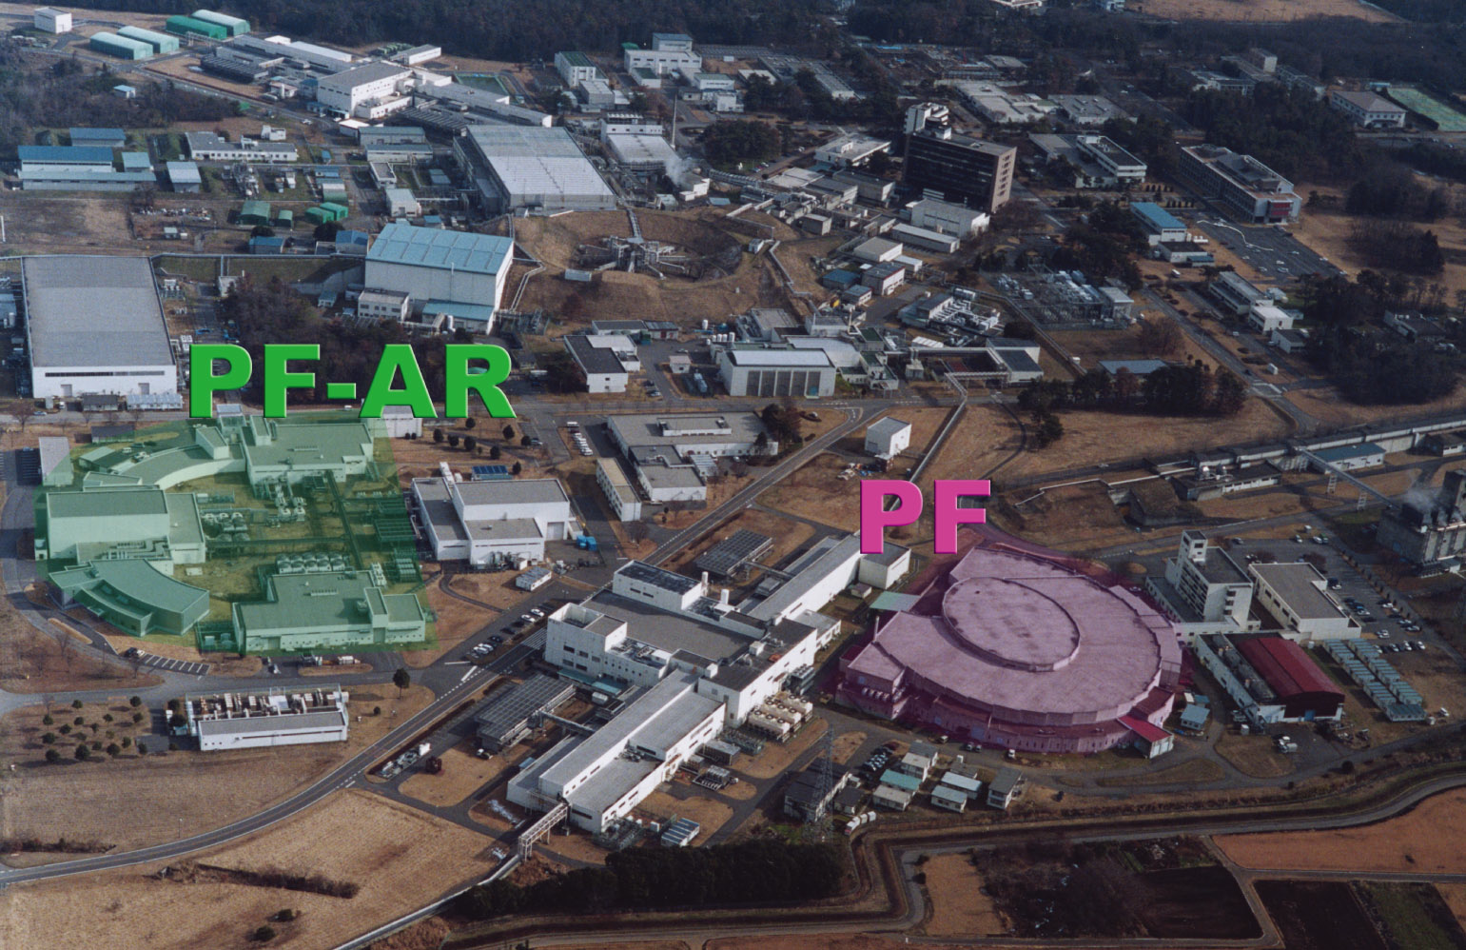
Introduction to Photon Factory (PF)
Inter-University Research Institute
running since 1983
For Synchrotron Radiation Research
(3,000 users/year, 650 papers/year)
Tsukuba Campus
PF-AR (6.5 GeV, 60mA, SB, 8 stations, 377m)
PF (2.5 GeV, 450 mA, MB, 39 stations, 187m)
・Operation start in 1987
・Operate always in single-bunch
mode to produce pulsed hard x-ray
・Operation start in 1982
・Twice large upgrades in 1996 and 2005
Emittance was reduced from 130 to 36 nmrad.
5

Slide 4
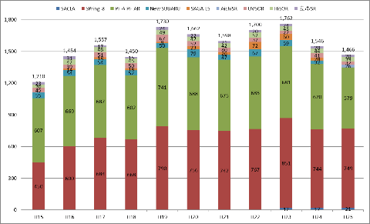
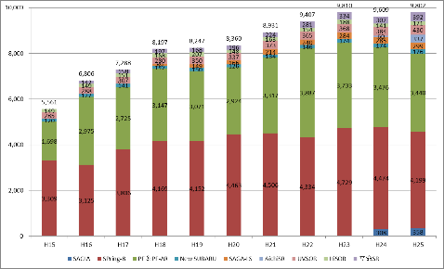
Role of Photon Factory in Japan
Number of Users
Number of Papers
Photon Factory
Photon Factory
SPring-8
SPring-8
2003~2013
Photon Factory and SPring-8 are two main Synchrotron Facilities in Japan.
9
Synchrotron Facilities in Japan : 8 places

Slide 5
New Light Source Project in Photon Factory:
“KEK Light Source” （KEK-LS)
３GeV storage ring type, with Multi-Bend Achromat
Emittance of electron beam：
nm

Slide 6
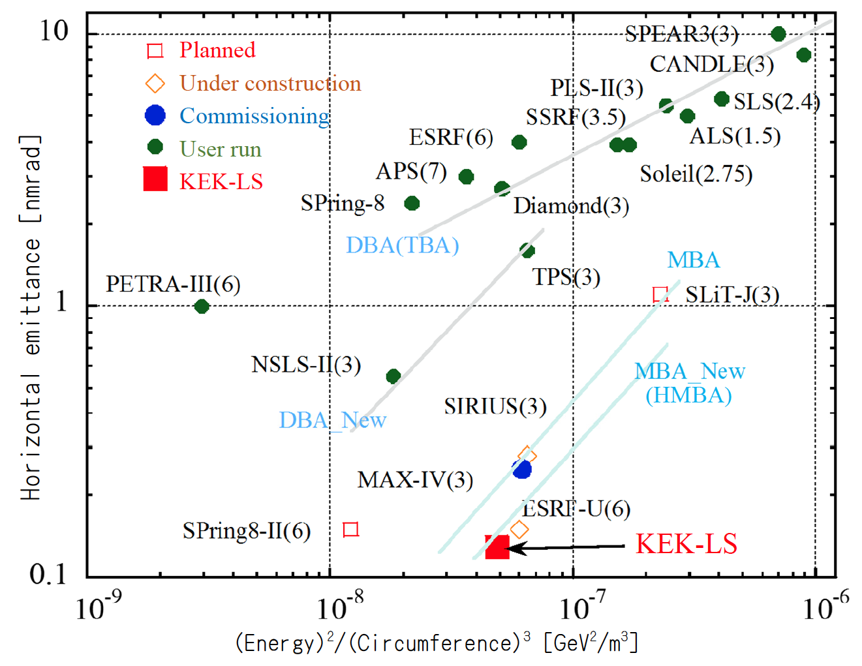
World’s most advanced synchrotron facility
Operation
Starts from 2022 ?

Slide 7
Expected Brightness of KEK-LS

Slide 9
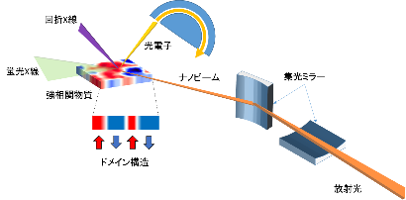
Solution: How to solve it with KEK-LS
Resonant X-ray Scattering
Photoelectron Spectroscopy
Mirrors
Nano Beam
FL-X-ray Spectroscopy
High-brightness beam：
～10²²
Spatially-resolved Spectroscopy (10 meV+10 nm)
22

Slide 10
Outline
KEK-LS Project and Photon Science
Development of Pixel Array Detectors for Synchrotron Radiation experiments
3. Fast detector system using Si-APD pixel array
for time-resolved experiments
4. Summary

Slide 11
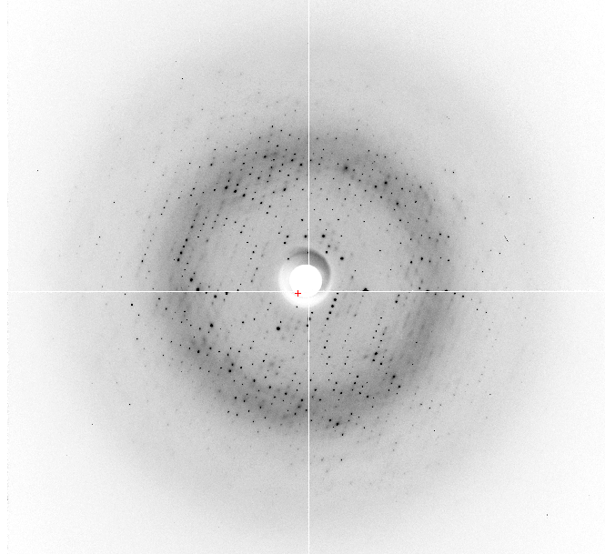
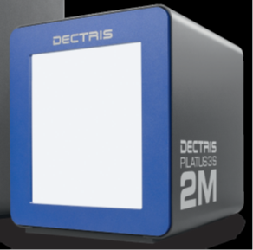
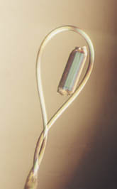
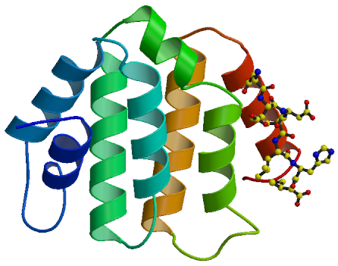
sample
X-ray beam
Pixel Array X-ray Detector
Dynamic range： 6 order
Frame rate：＜10ms/frame
Key to success!
Resolves a structure of biomolecule,
Correctly and rapidly.

Slide 12
SR： Spreads of Hybrid PAD （Ex. PILATUS）,
Development of X-ray imaging detectors for XFEL
10⁸
Response & Intelligence
New
Area
Detector
10⁶
Energy,
Timing
Hybrid
PAD
New
Area
Detector
10⁴
CCD
Photon num. Dynamic range
10²
Processing of information
Hybrid PAD
1
0.01
CCD
1
10
100
1000
Pixel size (μm)
Memory
Pixel size： < 50 μm
Dynamic range ： >10⁶
0.01
0.1
1
10
100
1000
Readout time per frame （ms,１M pix)

Slide 13
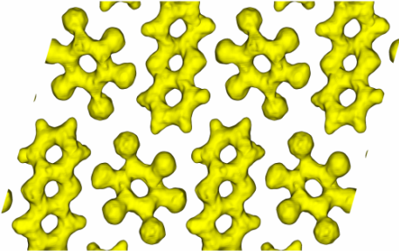

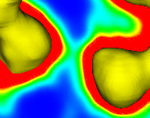
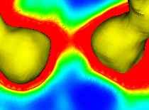
Electronic Ferroelectricity in a Molecular Crystal with Large Polarization
by complementary use of hard and soft X-rays
Hard X-ray
DH^{0…}A⁰
D^{-…}HA⁺
E
O
SOI
pixel area detector
N
H
X rays
Crystal, thin film
d_{NO} = 2.75Å
d_{NO} = 2.68Å
O
O
N
N
Precise structure analysis
Electron density distribution
Response with Ext. Field
counter:
>14 bit (16k)
30-μm□ pixel
>1 k frame/s

Slide 14
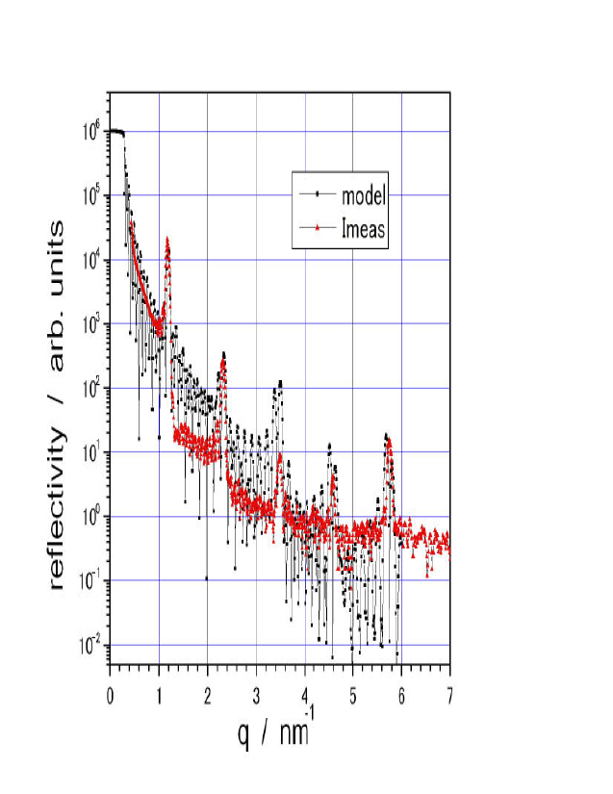
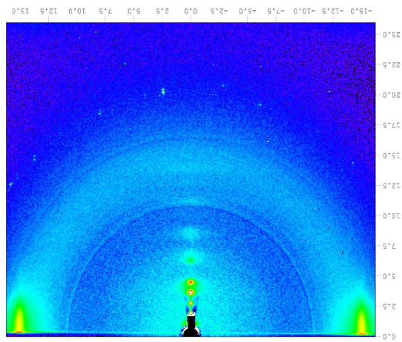
Resonant contrast method using sulfur and phosphor absorption-edges
(2.1, 2.5 keV) in the small-angle X-ray scattering
New area detector for soft X-rays ｗith high sensitivity.
The detector should has a compact size and vacuum compatibility
Signal charge is small.
2 keV: ～550 e⁻
Depth structure
Vacuum chamber
SOI Pixel Area Detector
Sample
Reflectivity
Time-resolved surface structure analysis
Reflected X-rays（~10°）
Soft X-rays
GI-diffracted X-rays
Scattering image
Goniometer

Slide 15
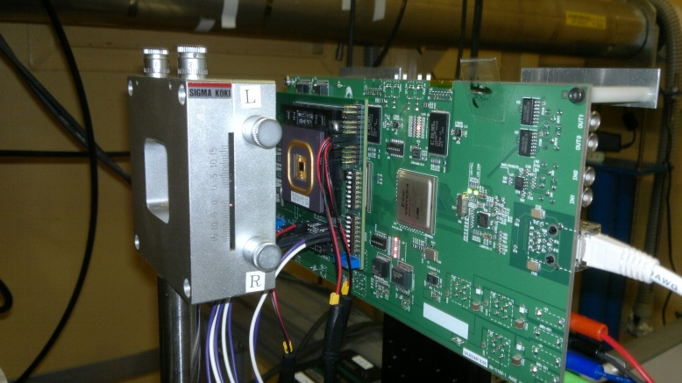
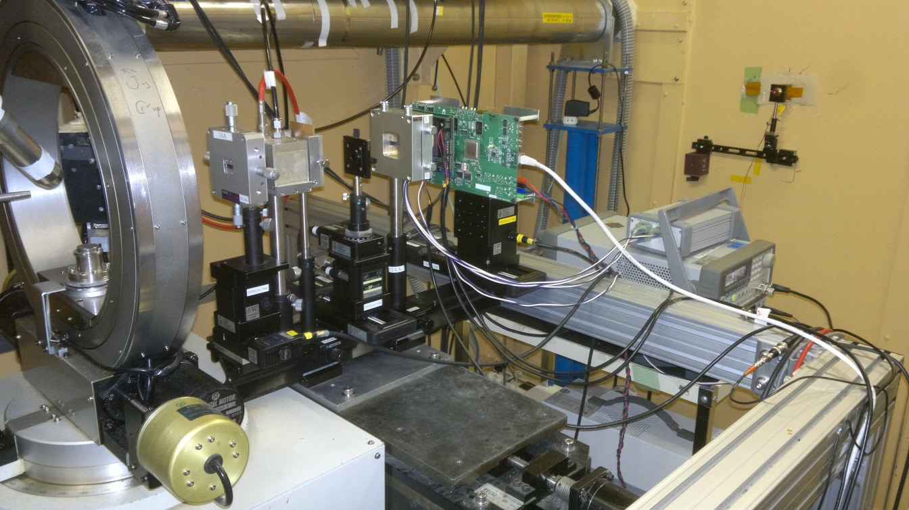
Development of counting-type SOI detector
CPIXTEG3b, designed by Y. Lu et al. (IHEP)
Beam Test at BL-14A
0.8-mm X-ray beam
5 um pinhole,
Removable
10-um X-ray beam
SEABAS Board,
Mounted on a motorized stage, 10-um step scanning
CPIXTEG3b

Slide 16
Developed by RIKEN
~50 mm
~65 mm
T. Hatsui, The 9th AOSFRR Nov. 25th, 2015

Slide 17
Outline
KEK-LS Project and Photon Science
Development of Pixel Array Detectors for Synchrotron Radiation experiments
3. Fast detector system using Si-APD pixel array
for time-resolved experiments
4. Summary

Slide 18
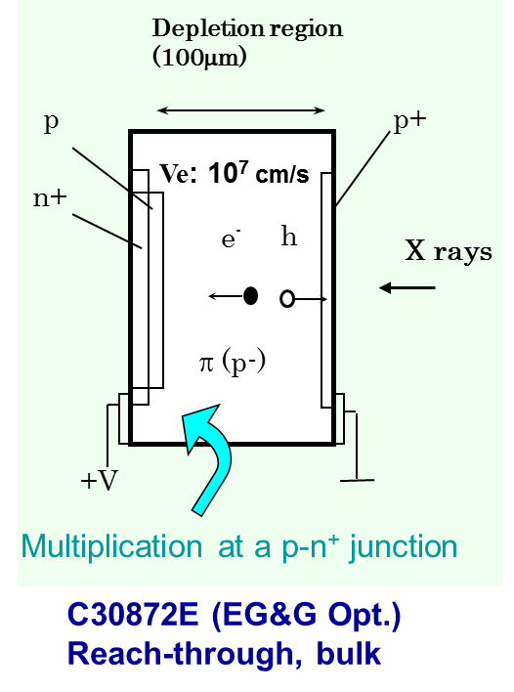
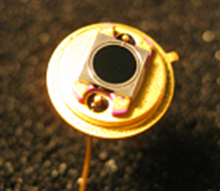
If we have a silicon avalanche photodiode (Si-APD) pixel array detector which operates in proportional mode,
Si-APD （Hamamatsu S5344）
3 mm dia.

Slide 19
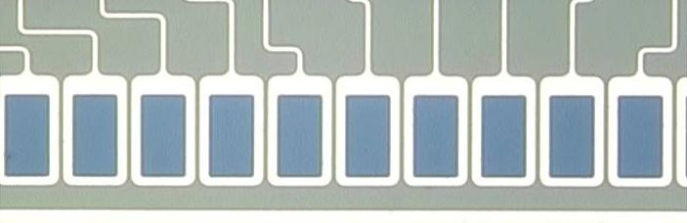
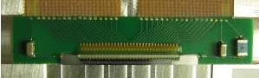
Si-APD linear array
Hamamatsu S5343-9158 Pixel size: ^{H}100 μm ×^{V}200 μm
64 pixels, 9.6 mm long with a 0.15-mm pitch
Thickness of the depletion layer:
10 μm → Time resolution (FWHM): 100 ps
200 μm
150 μm
100 μm
9.6 mm

Slide 20
MultiChannel Scaler (MCS) with 0.5 ns dwell time
Digital
SiTCP
WS
GbE
500MHz
FPGA
(XC7K355T-3FFG901C)
DAC
control
START
+12 V
（FL）
MCS
+3 V
PECL
DAC
APD FE-ASIC
Vth
Analog
+5 V
64 ch
+HV
（+160V）
Si-APD array
S. Kishimoto, et al., Rev. Sci. Instrum. 85 (2014) 113102.
S. Kishimoto, et al., Nucl. Instr. and Meth. A731 (2013) 53.

Slide 21
Trigger signal
time
ΔT: 0.5 ns
Counting input pulses
1
2
3
4
2048
1
2
3
4
2048
1024 ns
1024 ns
Counting successively in 2048 bins with ΔT
→1024 ns (ΔT=0.5 ns)
Number of time bins : 2048 (count density: 36 bits per channel)
Dwell time (ΔT): 0.5 ns to 16.7 ms.
Measuring time : 2 μs to 4295 s

Slide 22
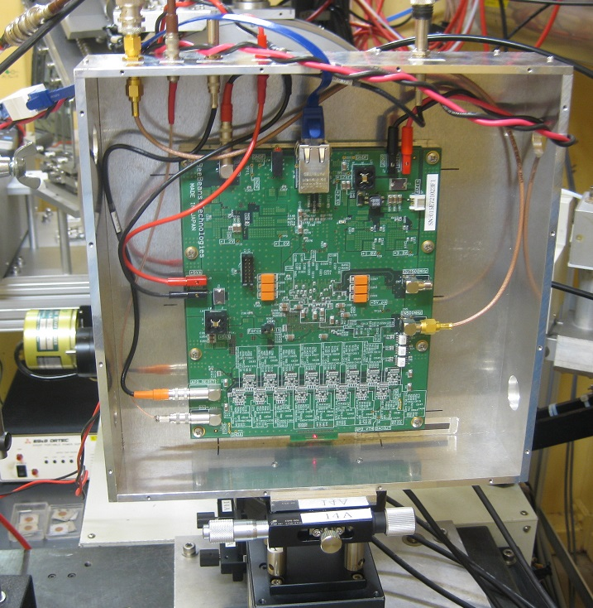
500MHz RF signal
260 mm
SiTCP
(a network processor)
for 1Gbps Ethernet
FPGA
(XC7K355T-3FFG901C)
260 mm
16 ASD-ASICs
(4ch/pixel)
250MHz/ch
170 mm
60 mm
140 mm
64ch Si-APD
Linear-array
producted by BeeBeans Technologies Co.,Ltd.

Slide 23
48 ns
108 ns
Time structure of X-ray
peaks in multibunch
mode operation of
the PF ring
Time resolution (FWHM)
of 0.5 ns was obtained:
＊Inputting PECL outputs to FPGA
from FE-ASIC without a level
converter
＊Precise timing by the 500MHz
signals from the accelerator

Slide 24
Measurements of
Nuclear Forward Scattering on Fe-57
SPring-8 BL09XU
α-Fe foil
（Fe-57 90% enriched）
Thickness： 4μm
Si(111)
14.4keV
HRM
Si(111)
SR
H
Si(111)
Si-APD
Linear-array
detector
Si(111)
ΔE: 2.5 meV
Using the pulse X-ray in the several-bunch mode:
~400 ns interval, for nuclear excitation

Slide 25
Sample: α-Fe foil
Fe-57 90%-enriched
thickness： 4 μm
Nuclear
Forward scattering
Without Ext. mag. field
With Ext. Mag. field

Slide 26
Summary
Development of new detectors for synchrotron radiation science in KEK-LS
◎ Pixel Array Detectors for investigating “Origin of
Function”:
Recording X-ray images by using
* New SOI pixel array detectors
with High-Δx, -throughput, -sensitivity,
Wide dynamic range
* Fast detector system of Si-APD pixel array
with High-ΔT, Wide count-rate

