Slide 1
Status of High Speed DAQ System for SOI Pixel Detector For X-ray Imaging e.g. 3D CT Application
IHEP Mini Workshop @ Beijing
2016/07/14-15
SOKENDAI (総合研究大学院大学)
Ryutaro NISHIMURA (西村 龍太郎)
Yasuo ARAI (KEK IPNS) , Toshinobu MIYOSHI (KEK IPNS) ,
Keiichi HIRANO (KEK IMSS) ,Shunji KISHIMOTO (KEK IMSS) ,
Ryo HASHIMOTO (KEK IMSS)
Notes:
Today I talk about Status of High Speed DAQ System for SOI Pixel Detector.
Especially for X-ray Imaging application such as 3D CT.

Slide 2
Outline
3D CT(Computed Tomography)
The Merit of Using SOI for X-Ray Imaging
Our DAQ system
Requirements to DAQ system
High-speed
Automation & Laborsaving
Multiple unit control
Test : X-ray CT Reconstruct with Small Dried Sardine
Summary & Future plan
Notes:
Today’s outline is shown here.

Slide 3
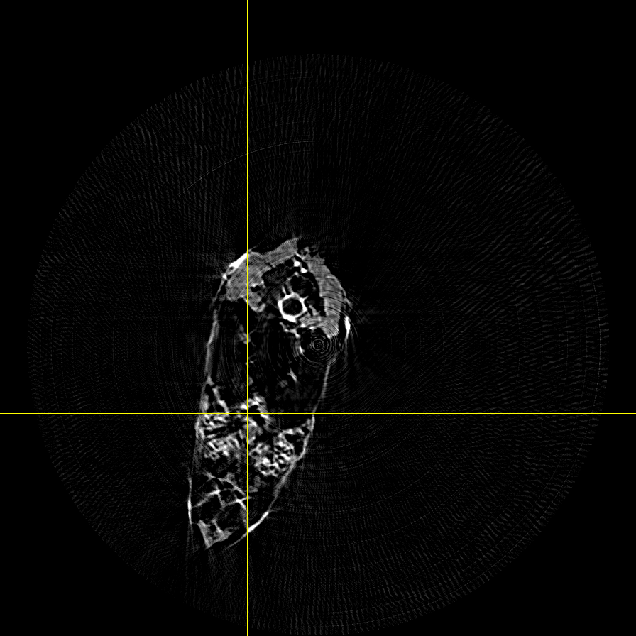
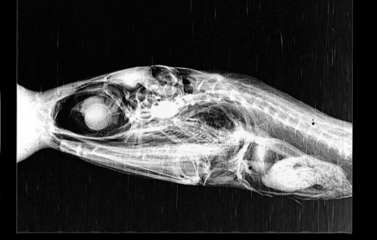
3D CT(Computed Tomography)
Projection
Back-Projection
5mm
Sample
Reconstructed Slice
Take 1line from every image and do back projection with adjust filter
Projection Image
Take sample’s projection images (0-180degree).
These images show the Radon transform of sample's X-ray absorption distribution.
=> We can reconstruct the original distribution (∝Sample’s structure) based on Projection-slice theorem.
Make 2D slices by back-projection with adjust filter. (Overlap on slice image)
Make 3D data by stacking all slices.
Notes:
First, I introduce to you about 3D CT, Computed Tomography.
To put it simply, CT is the way to estimate the structure of object from projection images of it.
So, we have to take projection images first.
In our setup, we take images from 0 to 180 degree every 1 degree step.
These data shows the Radon transform of sample's X-ray absorption distribution. So we can reconstruct object’s original distribution from these images, based on Projection-slice theorem.
In real case, we use “filtered back projection” method to make 2-dimentions slice image.
This just do back-projection with adjust filter.
After this, make 3 dimensions data to stack these slices along to pixel’s pitch.

Slide 4
The Merit of Using SOI for X-Ray Imaging (e.g. 3D CT)
Direct Conversion
Convert photons to e-h pairs directly.
Small Pixel
No mechanical bonding.
No p-well/n-well.
=>Thus can reduce circuit size more than Bulk CMOS.
=>Can make small pixel !
Can make Direct Conversion & Small pixel sensor.
Notes:
Next, I’ll talk about why we use the SOI detector for X-ray imaging like 3D CT.
In 3D CT, the quality of final data depends on the quality of projection image.
So less blur and high spatial resolution is required to detector.
The SOI can convert X-ray photons to e-h pairs directly, so no blur generated by light scattering.
Furthermore, this detector has no mechanical bonding, and no p-well/n-well.
These characteristics are good to make the detector which has small pixel and high spatial resolution.

Slide 5
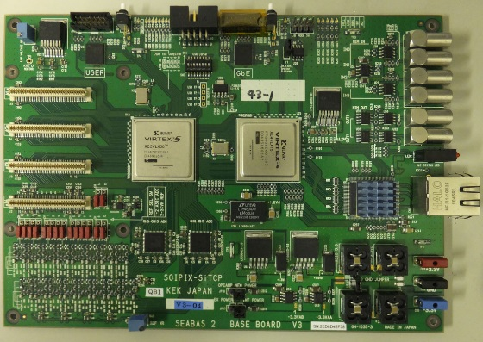
Our DAQ system
Overview
This DAQ system is consist of :
*Firmware works on Multi-purpose DAQ board, named SEABAS.
*Software works on DAQ PC (Standard PC/AT).
SEABAS(Soi EvAluation BoArd with Sitcp)
SEABAS2
Data
FADC
Data
SOI
Sensor
SiTCP
DAQ
Software
Firmware
(User FPGA)
TCP/UDP
on Ethernet
Command
Command
DAQ Software – SEABAS : Connected by Gigabit Ethernet with TCP/UDP
→Can be work on standard PC(Linux Windows Mac ・・・)
Data is saved as TIFF / Binary / ROOT(CERN) Tree etc…
Notes:
Usually we use this SEABAS DAQ to readout SOI detector.
This system is consist of multi-purpose DAQ board, named SEABAS, and PC which can drive DAQ software.
The firmware works on SEBAS FPGA can be customized for every SOI sensors.
DAQ PC and SEABAS is connected by Gigabit-Ethernet, and the software uses TCP/UDP protocol.
So most of standard PC can be used for DAQ PC.

Slide 6
Requirements to DAQ system (High-speed, Automation & Laborsaving, Multiple unit control)
High-speed Readout & Store
High-speed readout. (without dead-time)
Take large quantity data continuously.
Control peripheral equipment in same time.
Control multiple sensors.
Implement to other DAQ system.
Automation & Laborsaving
Multiple unit control
Notes:
If we use this DAQ for rich experiment, there are some requirements we should implement.
Such as,
・High-speed readout, this mean readout without dead-time.
・Take large quantity data continuously.
・Control peripheral equipment in same time.
・Control multiple sensors.
・Implement to other DAQ system.
To solve these requirements, we implemented 3 functions, High-speed processing, Automation & Laborsaving, Multiple unit control.
I introduce the detail in next slide.

Slide 7
For High-speed readout : Multi-thread processing
Single-Thread
Multi-thread
Readout from Sensor/SEABAS
Store to Storage
Viewer
(Preview)
Readout from Sensor/SEABAS
In Sequential
Viewer
(Preview)
FIFO
(std::list)
Store to Storage
Work in Parallel
(POSIX PThread(Linux)・Win32API Thread(Windows))
Readout speed
41Mbps
(6Hz in INTPIX4※)
Increase to ~613 Mbps (90Hz) in maximum.
※INTPIX4：Integrate Type sensor which has 832×512 pixels.
Notes:
This slide shows how to reduce the dead-time.
In previous system, readout and storing is process in sequential.
This makes large dead-time because readout have to wait later processes and these processes needs large time.
So we refine the structure of software.
Implement First In First Out buffer and change structure to multi-thread processing.
So all processes can work in parallel.
After this refine, readout speed is increase to about 600 Mbps from 40Mbps.

Slide 8
For Automation & Laborsaving : Batch process & Peripheral Equipment Control
External Software
DAQ PC
Control by Shell command
Peripheral Equipment
DAQ Software
(Telnet &Serial connection can be used.)
Peripheral Equipment Controller
SOI Sensor
DAQ Software
Ionization Chamber
Scaler
SEABAS
Stage Controller
Hub
For Automation & Laborsaving :
Implement Batch process function to Sensor’s DAQ software. (Can take data repeatedly)
Implement Peripheral Equipment Control module.
Implement External Software controller to Sensor’s DAQ software for Pre/Post processing.
※These functions are using Qt5 library.
Notes:
Next this slide shows about Automation & Laborsaving.
We implement these 3 functions, “Batch process function”, “Peripheral Equipment Control”, “External Software control”.
In this setup, Sensor DAQ Software works as the master of DAQ, so other modules work in accordance with master’s command.

Slide 9
For Multiple unit control : Command receiver & multiple-unit controller
Example of multiple-unit control
DAQ PC 1
If this DAQ integrated to other system, command translator will be implemented to this.
SEABAS
SOI Sensor
DAQ Software
DAQ
Control PC
SEABAS
SOI Sensor
DAQ Software
SOI DAQ
multiple-unit controller
Hub
DAQ PC 2
SEABAS
SOI Sensor
DAQ Software
Ionization Chamber
Scaler
Peripheral Equipment Controller
Command receiver is implemented to each DAQ software.
Stage Controller
※These functions are using Qt5 library.
Notes:
Next this slide shows about Multiple-unit control.
In this setup, Command receiver is implemented to Sensor DAQ Software and Peripheral Equipment Controller.
So these software modules can be controlled from outside.
And commands are issued by Multiple-unit controller.
This slide shows the example of setup when use Multiple-unit control function only.
If this DAQ integrated to other system, command translator will be implemented to Multiple-unit controller.
Now this function is under development.
So we can use basic control such as CONFIGURE, RUN, STOP and so on.

Slide 10
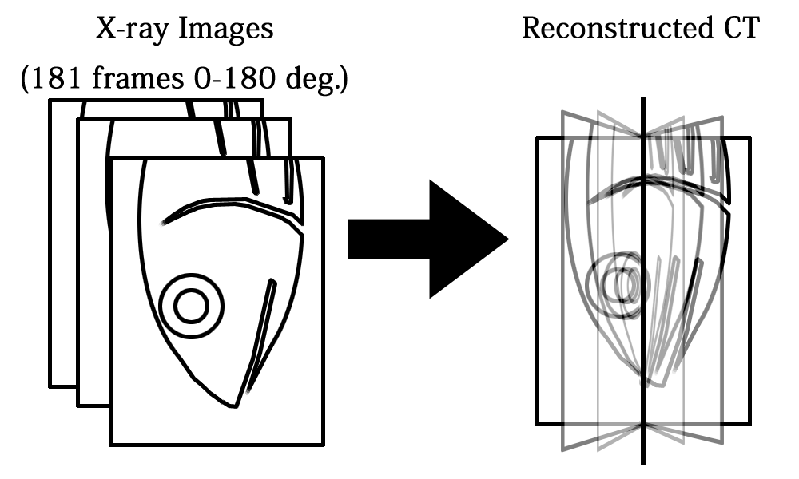
Test : X-ray CT Reconstruction with Small Dried Sardine @ KEK PF BL-14B Overview
INTPIX4
17um pixel 832x512
(13Parallel out)
10.2mm
15.4mm
INTPIX5
12um pixel 1408x896
(11Parallel out)
12.2mm
Sensor : INTPIX4 , INTPIX5
Take 181 projection images and X-Ray beam profile.
Make 3D CT data from these images.
18.4mm
In this talk, INTPIX5’s data will be shown.
Notes:
I’ll show the 3D CT data taken by our new DAQ.
This slide shows the overview of this test.
We used small dried sardine as the sample.
And detector is INTPIX4 and 5, the integration type SOI detector.
In this talk, I show INTPIX5’s data.

Slide 11
Test : X-ray CT Reconstruction with Small Dried Sardine @ KEK PF BL-14B Setup
Collimator
Mirror
37mm
Sample
Sensor
X-Ray
Rotation Stage
Sensor HV：200V , Exposure Time : 4ms×500frame (INTPIX5) , ScanTime：320ns/pix
X-Ray Energy : 9.5keV Monochrome (2016/02/23-24 : Storage Mode)
Notes:
This is the setup of test at Photon Factory BL-14B.
X-ray beam is 9.5keV monochrome.

Slide 12
Test : X-ray CT Reconstruction with Small Dried Sardine @ KEK PF BL-14B Result
5mm
Total Data set : 181set (0-180°) 2sec (4ms×500 frame)/set
Time of Peripheral Equipment Control : 22 min 37 sec (7.49sec/set)
※This data has some artifacts because of bad pixels and stability of X-ray beam intensity.
Notes:
This is the 3D CT Reconstructed data.
In this test, total time of peripheral equipment control is 22 min 37 sec.
Take data is total 181 sets, so convert to per set, 7.49sec in average.
This data has some artifacts because of bad pixels and stability of X-ray beam intensity.

Slide 13
Summary & Future plan
Summary
SOI Detector is suit for X-ray imaging application.
To solve requirements, we implemented
Speed-up by modification of data processing.
Automation & Laborsaving for X-ray Imaging.
Multiple unit control.
Future plan
Take 3D CT with practical sample & setup※.
Apply these improvement to other SOI sensors. (ex. Counting Type Sensors)
(Upgrade SEABAS.)
Extended functions are available.
※Phase-Contrast X-ray Imaging of Ti hydrogenation deposition in Titanium metal.
preliminary
Notes:
In summary, the main points of my presentation were these.
*We think SOI Detector is suit for X-ray imaging application.
*To solve requirements, we implemented
-Speed-up by modification of data processing.
-Automation & Laborsaving for X-ray Imaging.
-Multiple unit control.
And if user need extended functions, we can implement it by these framework.
Now I’m planning
*Take 3D CT with practical sample & setup.
Shown figure is Phase-Contrast X-ray Imaging of Titanium hydrogenation deposition in *Titanium metal. We’ll take 3D CT of this sample.
*Apply these improvement to other SOI sensors. Now already use these for Counting Type Sensor TEG.
*And this is just in my imagen, exist SEABAS hardware seems hit the limit of specification. So we need to upgrade SEABAS.

Slide 14
Thank You for Listening !
謝謝你的聆聽 !
Notes:
Thank You for Listening!

