Slide 1

CEPC advanced partial double ring scheme
Dou Wang, Jie Gao, Feng Su, Yuan Zhang, Yiwei Wang, Bai Sha, Huiping Geng, Tianjian Bian, Na Wang, Xiaohao Cui
CEPC AP meeting, 2016.07.01

Slide 2
parameter for CEPC partial double ring
（wangdou20160325）
 | Pre-CDR | H-high lumi. | H-low power | W | Z
Number of IPs | 2 | 2 | 2 | 2 | 2
Energy (GeV) | 120 | 120 | 120 | 80 | 45.5
Circumference (km) | 54 | 54 | 54 | 54 | 54
SR loss/turn (GeV) | 3.1 | 2.96 | 2.96 | 0.59 | 0.062
Half crossing angle (mrad) | 0 | 15 | 15 | 15 | 15
Piwinski angle | 0 | 2.5 | 2.6 | 5 | 7.6
N_{e}/bunch (10¹¹) | 3.79 | 2.85 | 2.67 | 0.74 | 0.46
Bunch number | 50 | 67 | 44 | 400 | 1100
Beam current (mA) | 16.6 | 16.9 | 10.5 | 26.2 | 45.4
SR power /beam (MW) | 51.7 | 50 | 31.2 | 15.6 | 2.8
Bending radius (km) | 6.1 | 6.2 | 6.2 | 6.1 | 6.1
Momentum compaction (10⁻⁵) | 3.4 | 2.5 | 2.2 | 2.4 | 3.5
β_{IP} x/y (m) | 0.8/0.0012 | 0.25/0.00136 | 0.268 /0.00124 | 0.1/0.001 | 0.1/0.001
Emittance x/y (nm) | 6.12/0.018 | 2.45/0.0074 | 2.06 /0.0062 | 1.02/0.003 | 0.62/0.0028
Transverse σ_{IP} (um) | 69.97/0.15 | 24.8/0.1 | 23.5/0.088 | 10.1/0.056 | 7.9/0.053
ξ_{x}/IP | 0.118 | 0.03 | 0.032 | 0.008 | 0.006
ξ_{y}/IP | 0.083 | 0.11 | 0.11 | 0.074 | 0.073
V_{RF} (GV) | 6.87 | 3.62 | 3.53 | 0.81 | 0.12
f _{RF} (MHz) | 650 | 650 | 650 | 650 | 650
Nature σ_{z} (mm) | 2.14 | 3.1 | 3.0 | 3.25 | 3.9
Total σ_{z} (mm) | 2.65 | 4.1 | 4.0 | 3.35 | 4.0
HOM power/cavity (kw) | 3.6 | 2.2 | 1.3 | 0.99 | 0.99
Energy spread (%) | 0.13 | 0.13 | 0.13 | 0.09 | 0.05
Energy acceptance (%) | 2 | 2 | 2
Energy acceptance by RF (%) | 6 | 2.2 | 2.1 | 1.7 | 1.1
n_{γ} | 0.23 | 0.47 | 0.47 | 0.3 | 0.24
Life time due to beamstrahlung_cal (minute) | 47 | 36 | 32
F (hour glass) | 0.68 | 0.82 | 0.81 | 0.92 | 0.95
L_{max}/IP (10³⁴cm⁻²s⁻¹) | 2.04 | 2.96 | 2.01 | 3.09 | 3.09

Slide 3
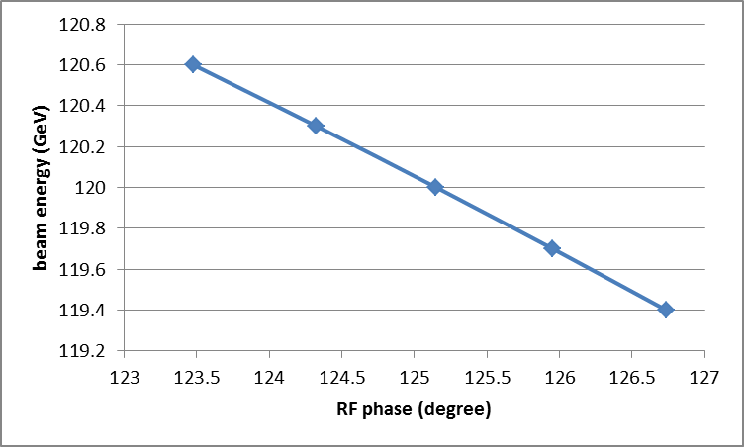
Effects of RF phase adjustment
Energy error ~ 0.4%

Slide 4
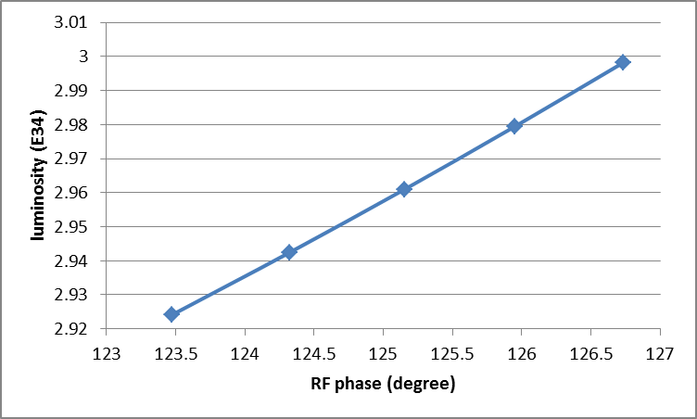
Effects of RF phase adjustment
Luminosity error ~ 1%

Slide 5
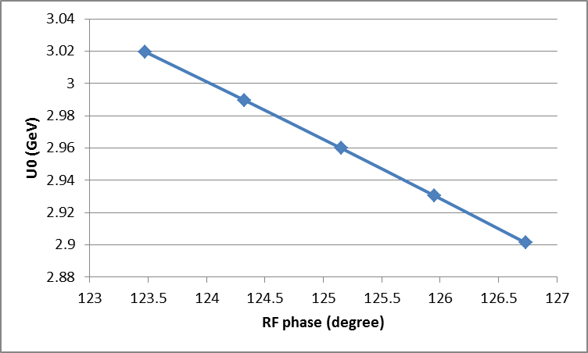
Effects of RF phase adjustment
U0 error ~ 2%

Slide 6
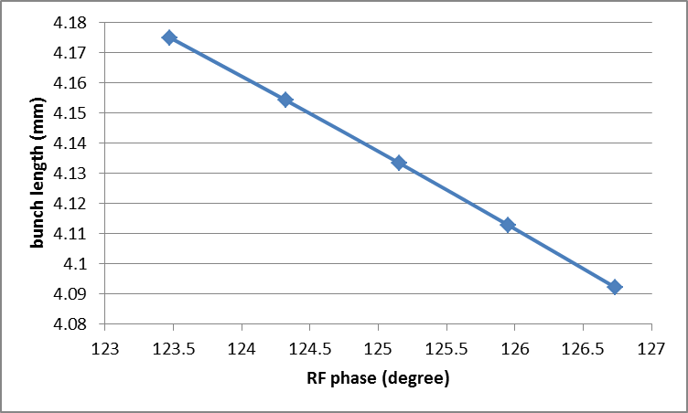
Effects of RF phase adjustment
Bunch length error ~ 1%

Slide 7
Booster emittance requirement
Acceptance ellipse > 5σ_{c}+10 σ _{i} +S
Bump height > 10 σ _{i} +S
Assume the size of beam pipe at QF1 is 20σx,
septum thickness is 2mm ,
βx at injection point is 100m.
Booster emittance εi<2.2nm, bump height > 6.7mm

Slide 8
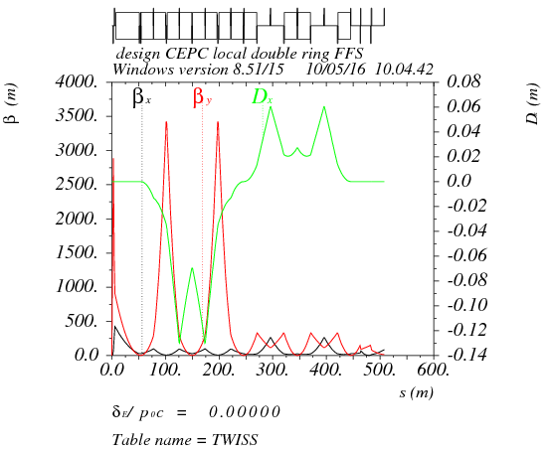
Betax*= 0.25m,Betay*=1.36mm
Crab sex
Critical energy= 190kev
dmux = -14.464497
dmuy = -200.084478
K2HS := 11.96m⁻³
K2VS := 32.74 m⁻³

Slide 9
DA of the whole ring
(arc+PDR+bypass+FFS)
Arc sextupole: 2 groups
Crab sextupoles - off
DA (on-momentum): 27σ_{x} × 57σ_{y}
DA (±0.5%): 2σ_{x} × 2σ_{y}

Slide 10
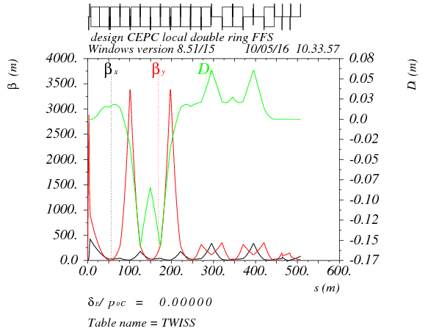
Off-momentum DA optimization

Slide 11
Thanks！

