Slide 1
CEPC Partial Double Ring Lattice Design and DA Study
SU Feng GAO Jie WANG Dou WANG Yiwei
Li Yongjun BIAN Tianjinan BAI Sha DUAN Zhe GENG Huiping ZHANG Yuan XU Gang XIAO Ming
Key Laboratory of Particle Acceleration Physics and Technology
Institute of High Energy Physics
Chinese Academy of Sciences
2016.7.1

Slide 2
Out line
CEPC PDR Lattice Redesign and Consideration
CEPC PDR DA Study

Slide 3
CEPC PDR Lattice Redesign and Consideration
Feng Su, Yiwei Wang, Jie Gao
2016.7.1

Slide 4
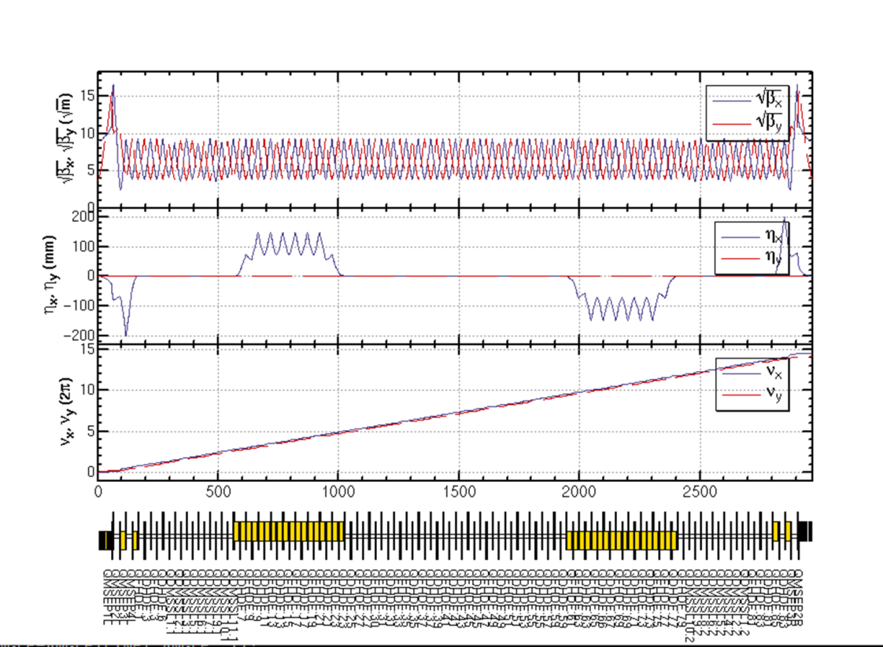
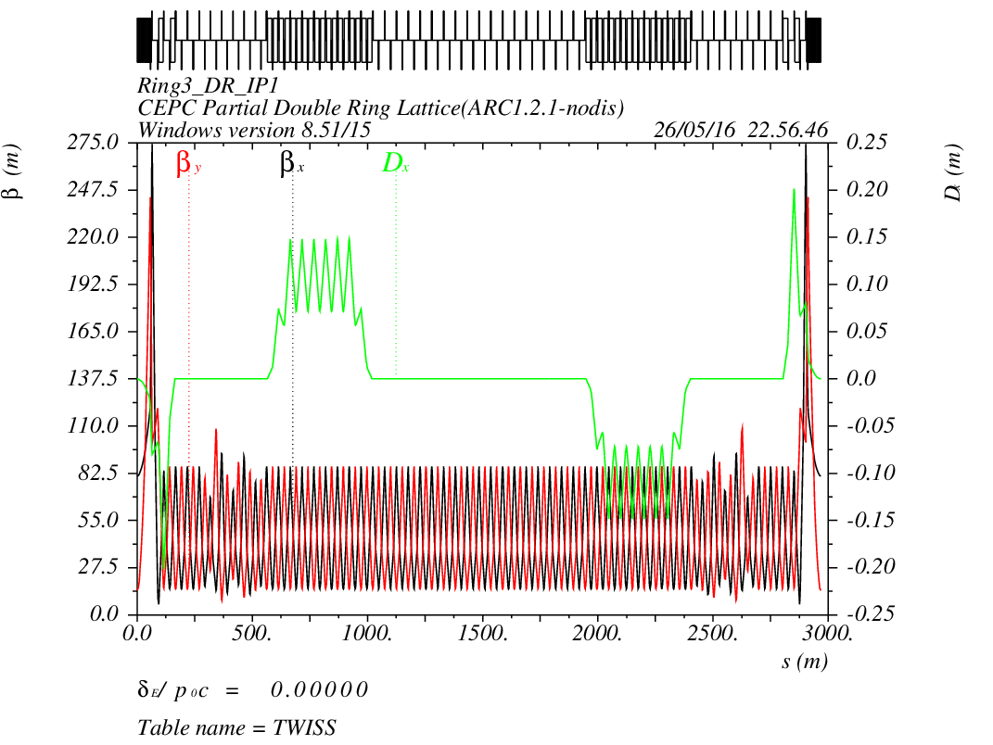
CEPC PDR1.0.2 noFFS

Slide 5
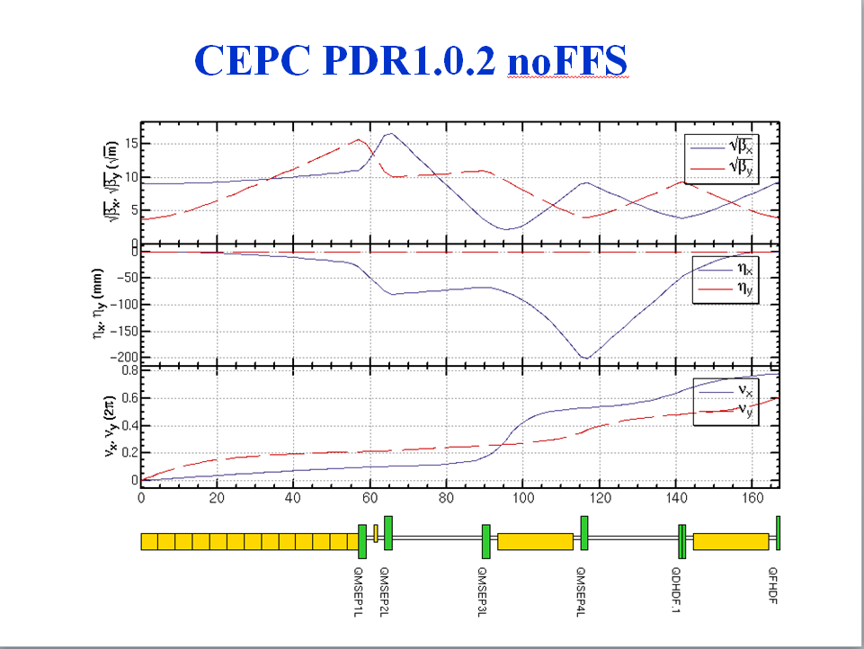
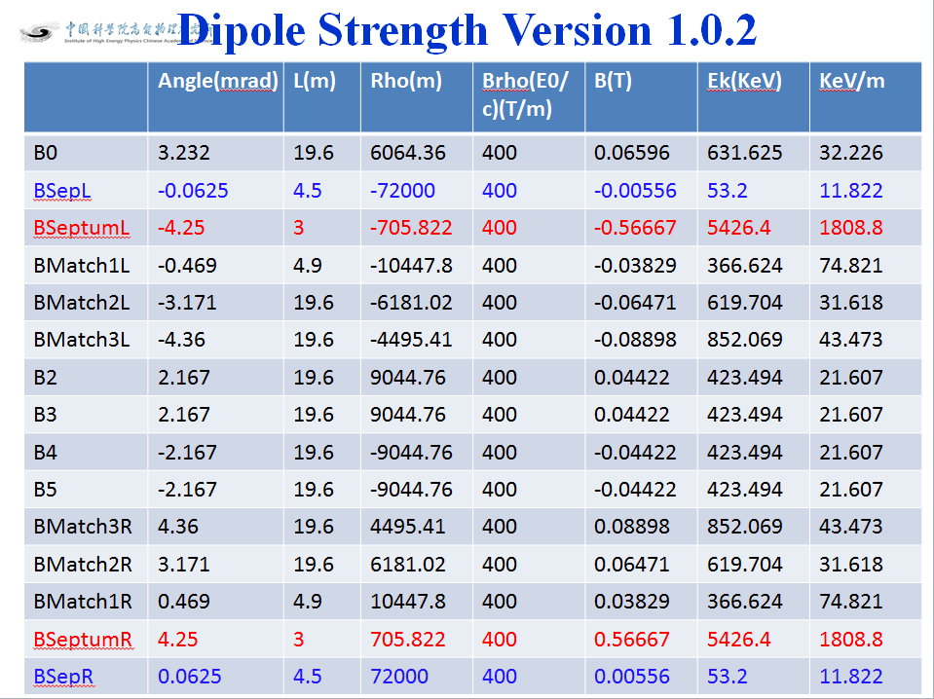
CEPC PDR1.0.2 noFFS

Slide 6
Upload Methods
Week Septum：can we make the septem much weaker and longer
No Septum: Straight section to acquire a big distance. Need dual-aperture quadrupole.
Use defocusing quadrupole.

Slide 7
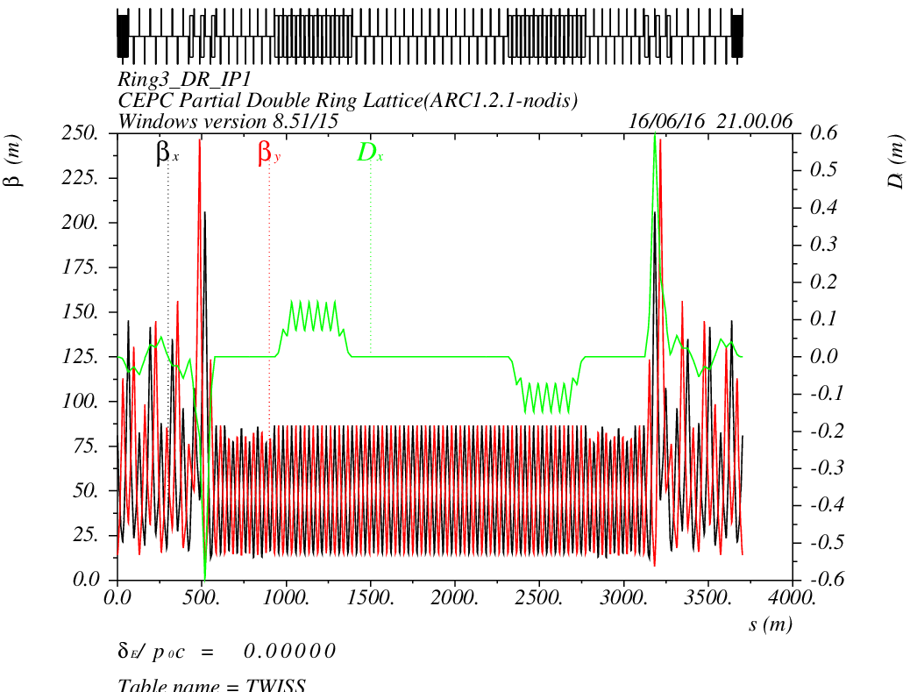
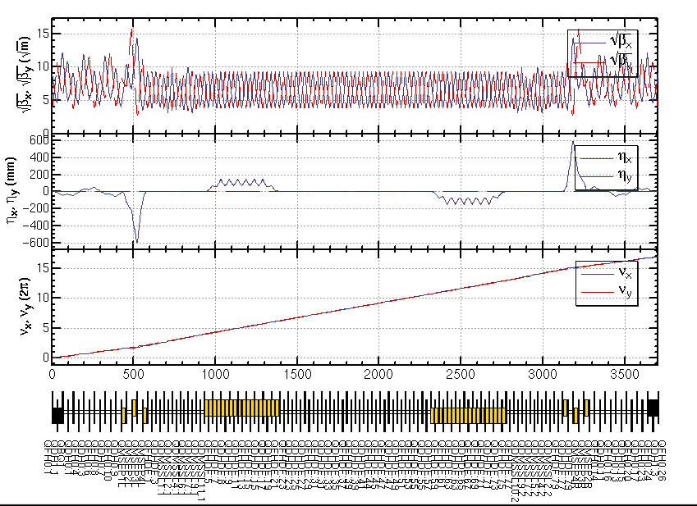
CEPC PDR1.0.3 noFFS

Slide 8
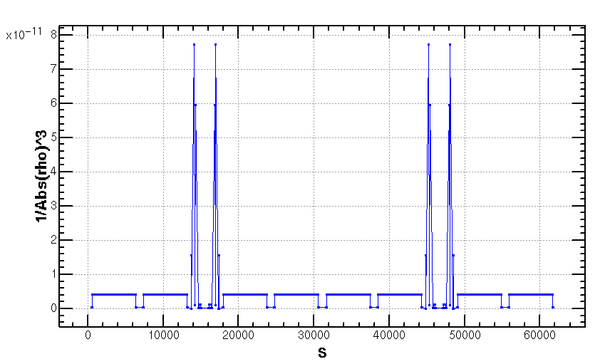
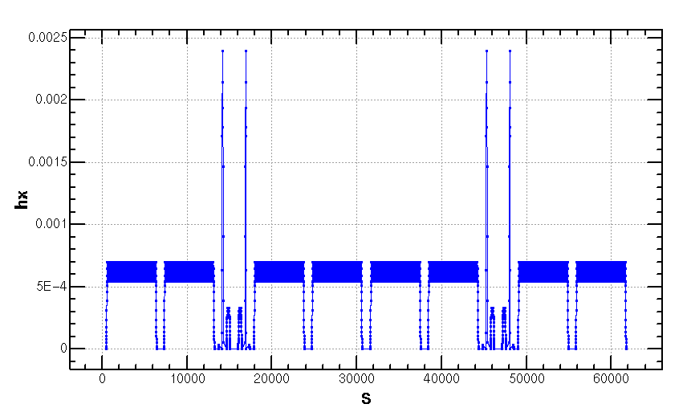
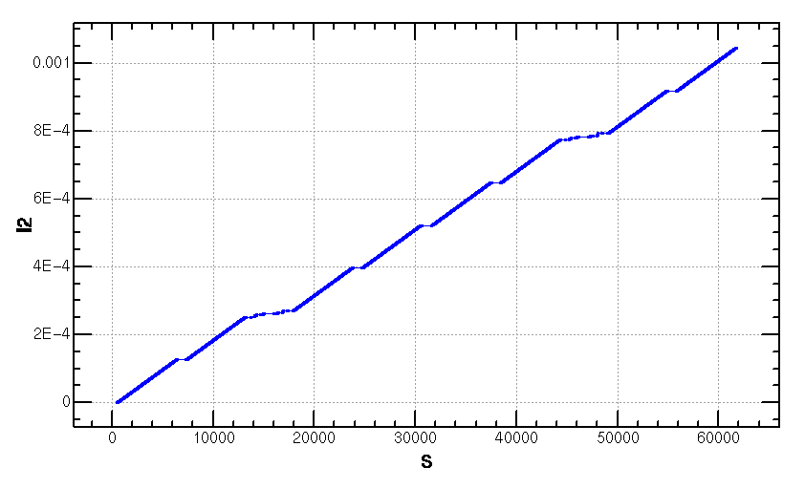
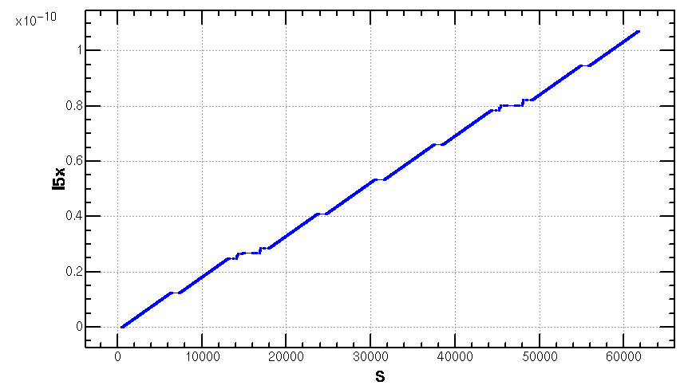
Emittance Increase (2.06nm->2.1668nm)

Slide 10
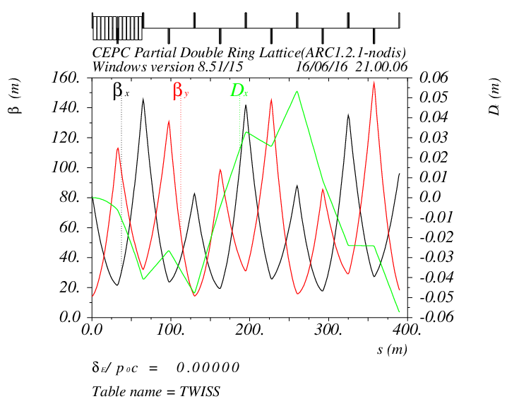
Separator + Straight Section (now)

Slide 11
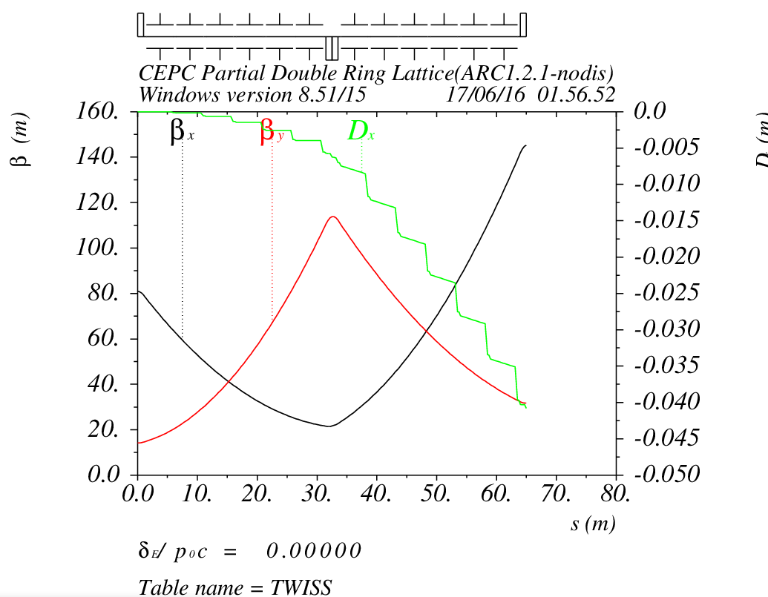
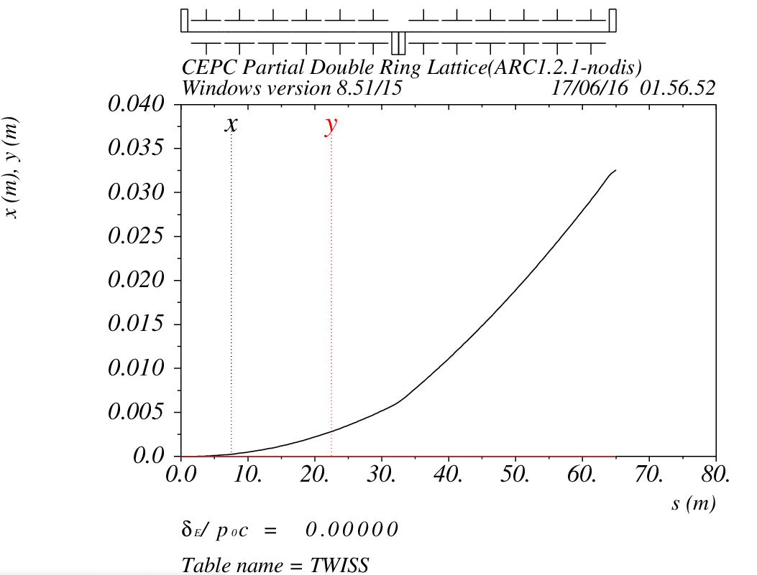
Separator + Doublet (next)
……

Slide 12
CEPC PDR DA Study
Feng Su, Yongjun Li, Yiwei Wang, Dou Wang, Jie Gao,
Tianjian Bian, Sha Bai
2016.7.1

Slide 13
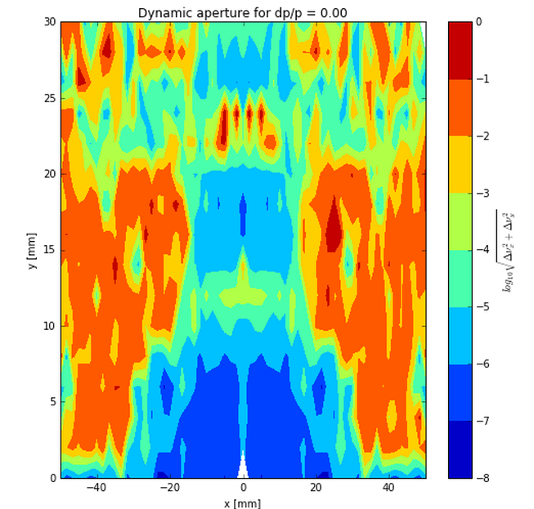
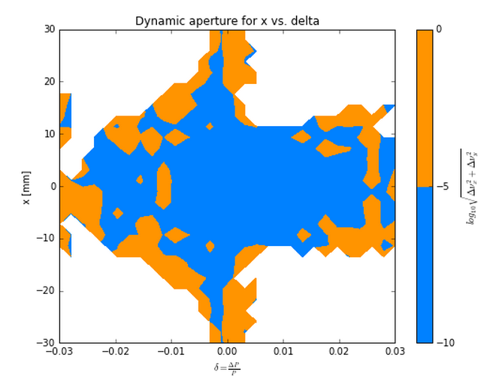
Nonlinear Driving Term (ARC)
Betx：80.992367
bety：14.172123
2nm
Sizmax：402.47um
Sigmay：9.22um
X：60 Sigma
Y：813 Sigma
2 groups

Slide 14
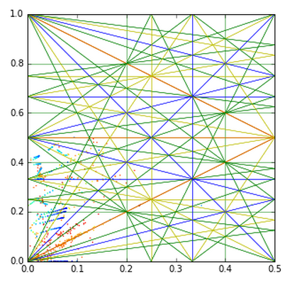
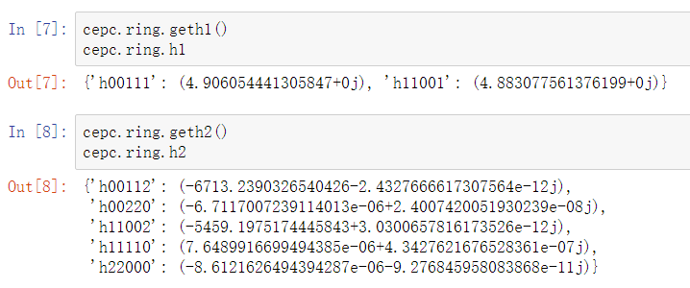

Slide 15
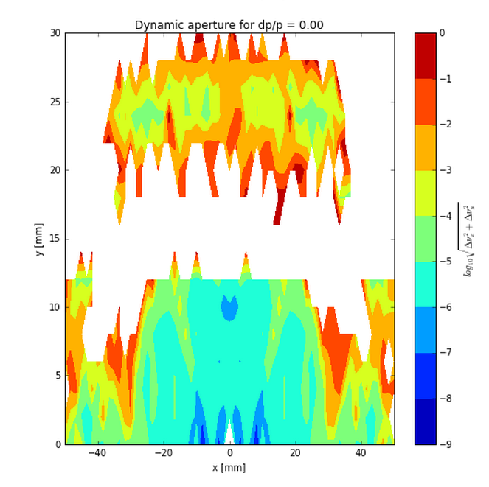
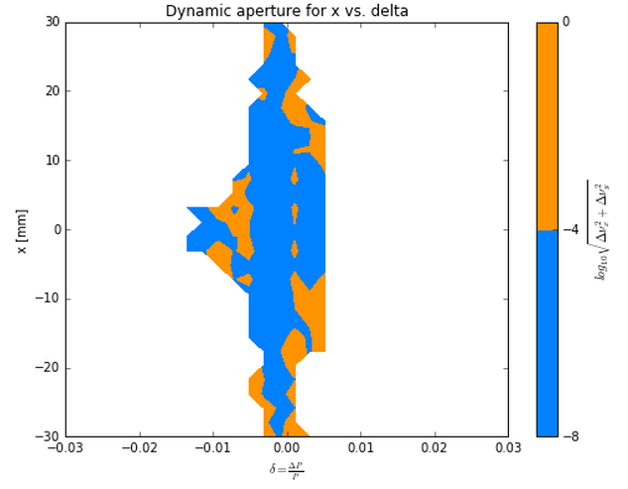
Nonlinear Driving Term (ARC-20160630)
Betx：80.992367
bety：14.172123
2nm
Sizmax：402.47um
Sigmay：9.22um
X：60 Sigma
Y：813 Sigma
96 groups

Slide 16
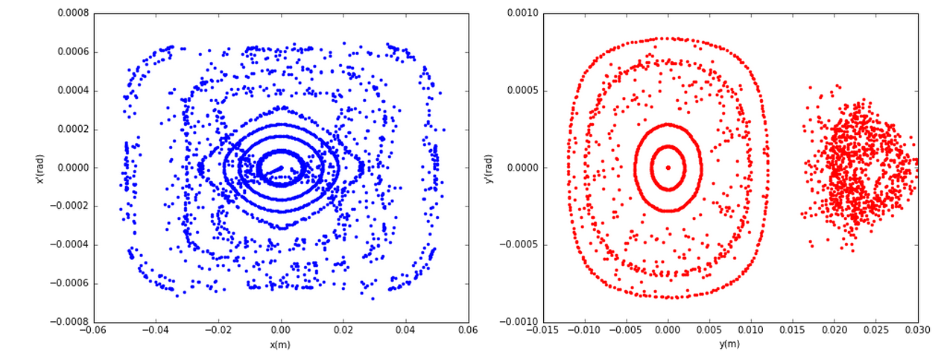
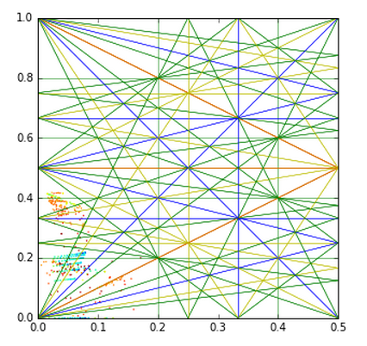
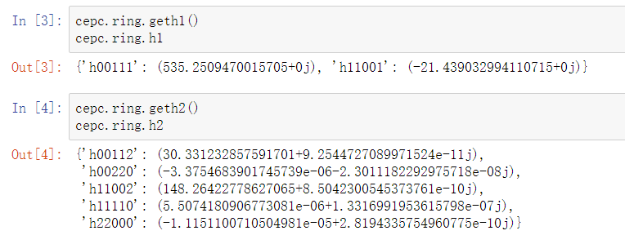

Slide 17
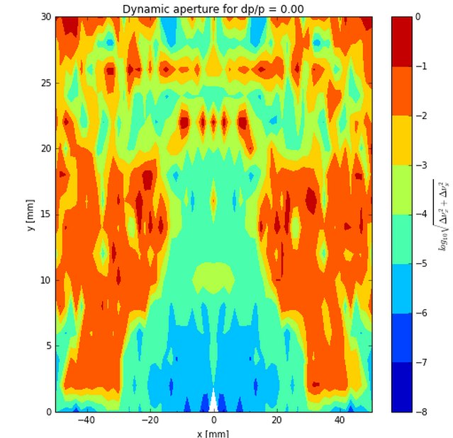
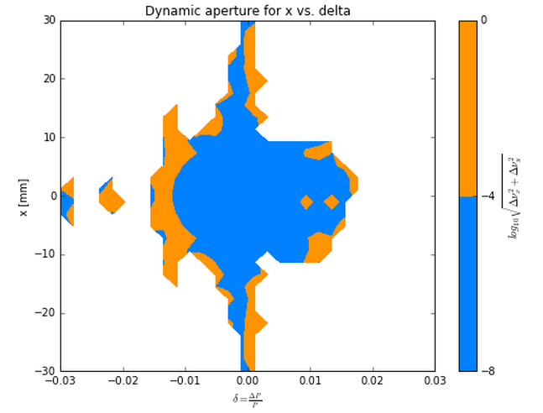
Nonlinear Driving Term (ARC_PDR_20160630)
Betx：80.992367
bety：14.172123
2nm
Sizmax：402.47um
Sigmay：9.22um
X：45 Sigma
Y：780 Sigma
2 groups

Slide 18
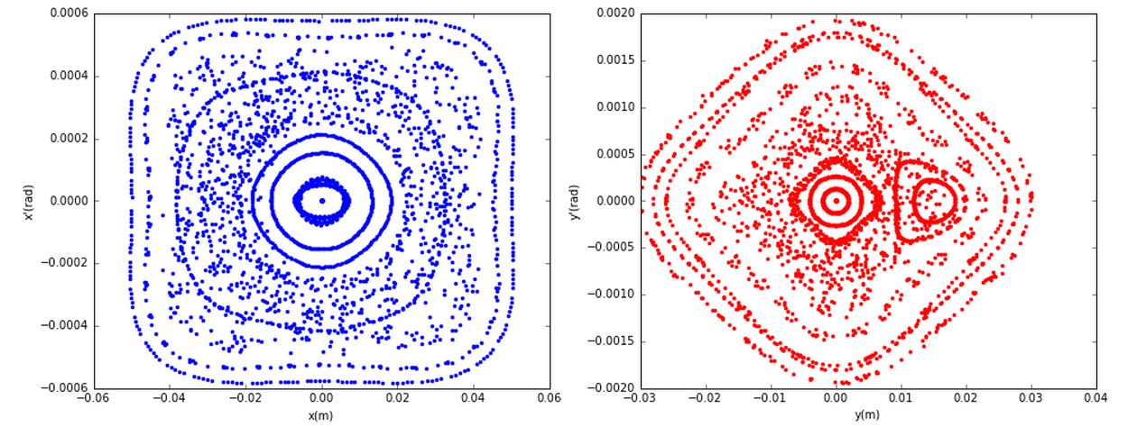
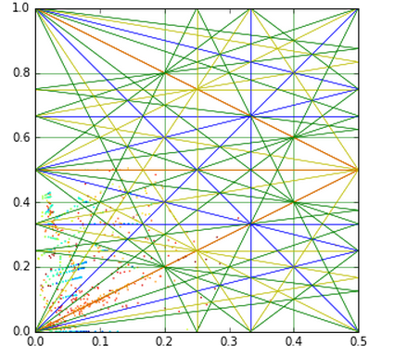
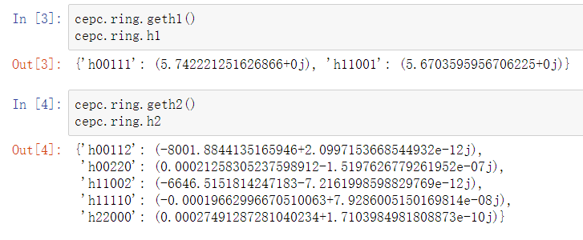

Slide 19
Nonlinear Driving Term (ARC_PDR_FFS)

Slide 20
Next

Slide 21
Thank You !

