Slide 1
Problems in Direct DA Optimization
ZHANG, Yuan
July 1st, 2016

Slide 2
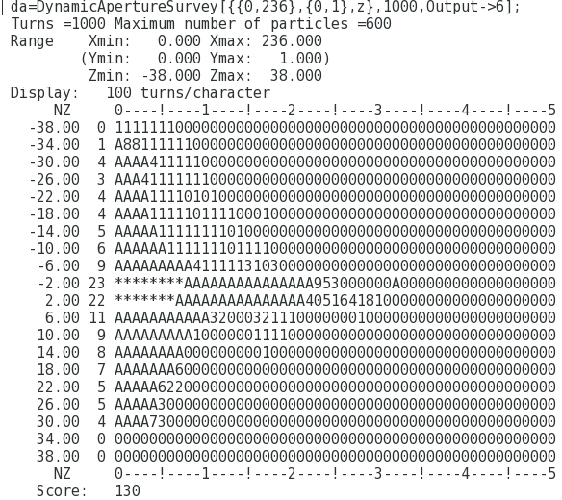
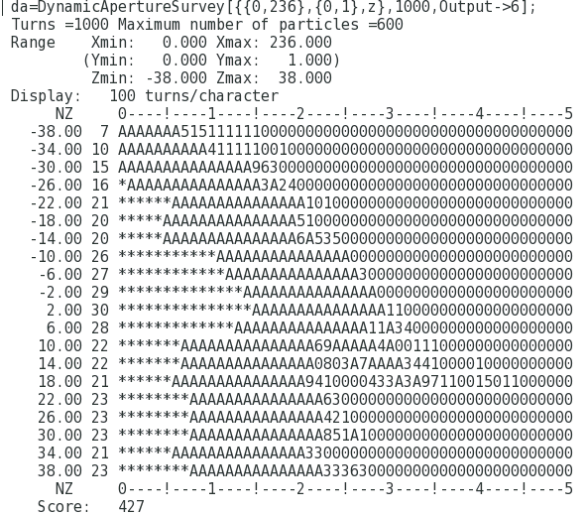

HEPS 的孔径优化（大$β$插入节）
Emit: 59.4pm, Bx=48m, By=15.3m
SigmaP: 7.97e-4, *40 = 0.032
10mm
7.5mm

Slide 3
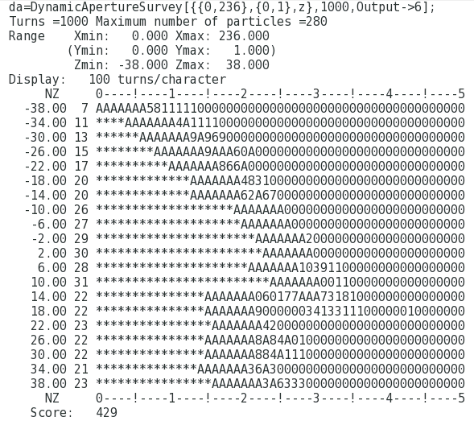
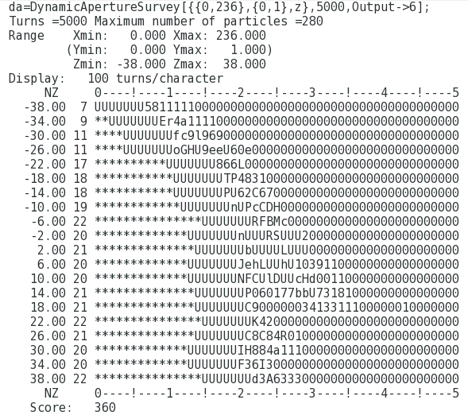
HEPS: 1000 turns vs 5000 turns
Notes:
x.22.20/0602-ini3

Slide 4
CEPC:
Dynamic Aperture with Damping & Fluctuation
Synchrotron oscillation
Radiation damping
Synchrotron oscillation
Synchrotron Radiation (Fluctuation)

Slide 5
Oide, FCC-WEEK 2016

Slide 8
MODE: Scalable Enough at 1000-nodes farm?
Yongjun Li, “Multi-objective Dynamic Aperture Optimization for NSLS-II Ring”, IAS program on HEP Conference 2016, Hong Kong

