Slide 1
CEPC PDR ARC Length Consideration
SU Feng, GAO Jie, WANG Yiwei, WANG Dou
BIAN Tianjian, Bai Sha, TANG Jingyu
2016.7.1

Slide 2
Out line
The circumference should be also considered of SPPC requirement…
Three steps：
ARC+Straight (>= 53 Km)
ARC+Straight+PDR
ARC+Straight+PDR+FFS

Slide 3
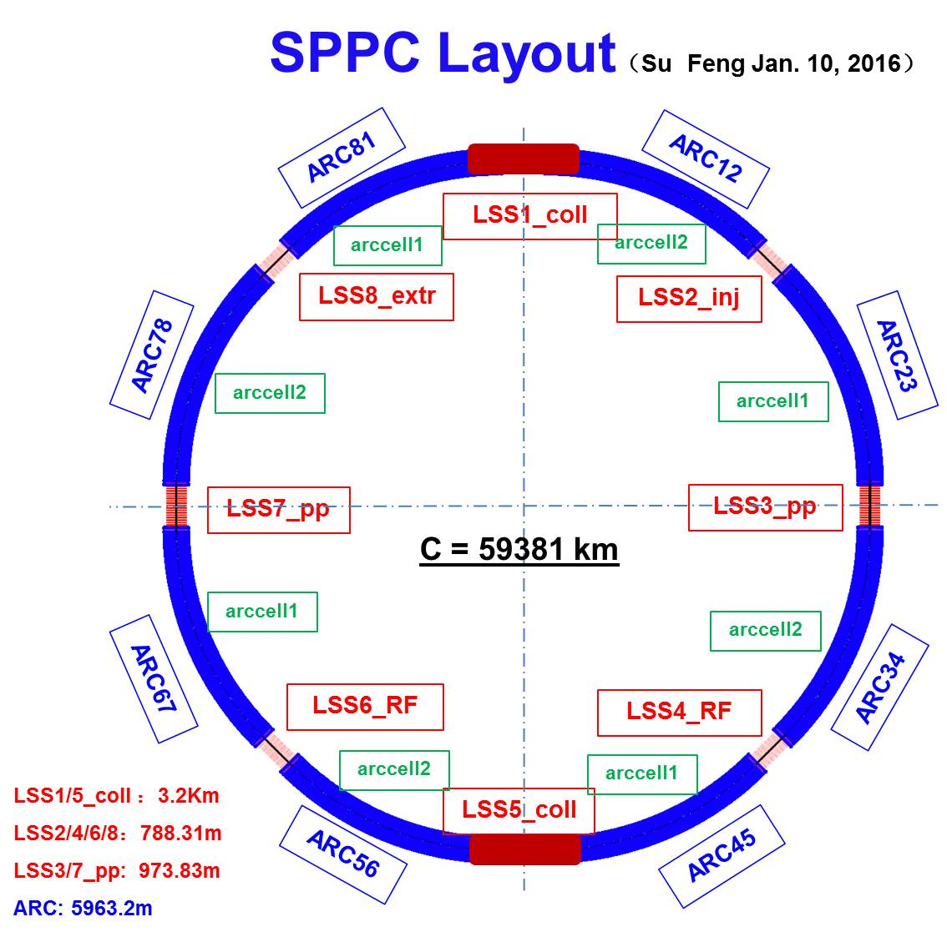
Layout of CEPC & SPPC

Slide 4
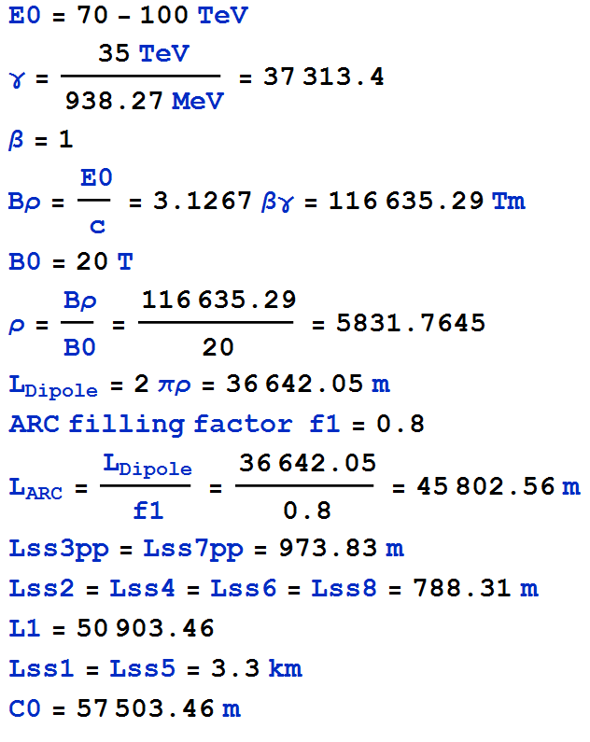
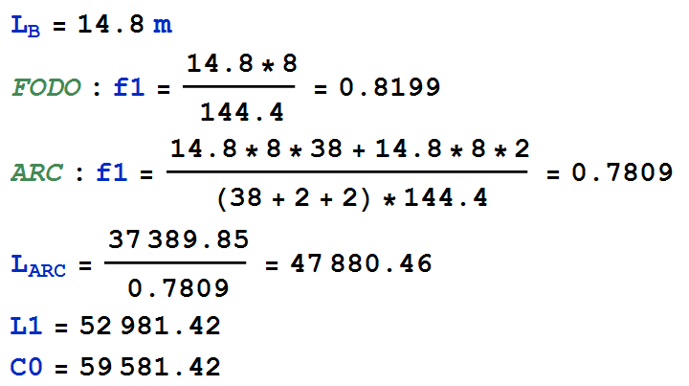
SPPC ARC Length

Slide 5
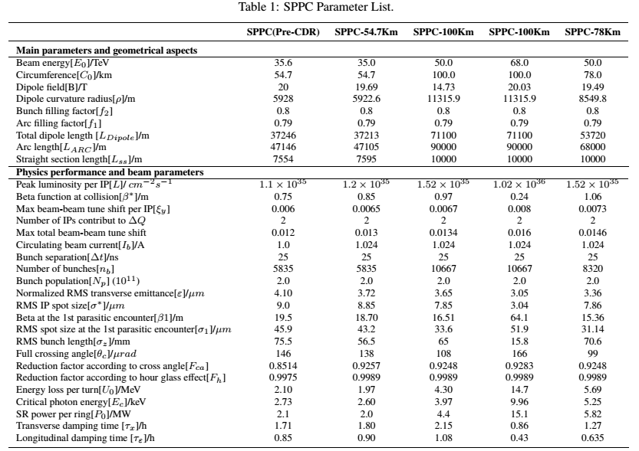
SPPC Parameter

Slide 6
Update SPPC Parameter
+4.6km

Slide 7
Thank You !

