Slide 1
Mainring prograss
6 fold emit：2.3nm
Analytical results are agree with numeric results.
8 sextupole families and two tune shift variables, and we got the result showed in the plot.
This is the best solution in that condition(8 sextupole families and two tune shift variables).
2rd chrom:270 3th chrom: 199. Pro.Cai say it is not bad, but expect more knobs to have better result.
If we want better result, more sextupole families and more tune shift variables are expected.(but he formulae are so long that Mathematica in my labtop will breakdown, maybe the code need optimization)

Slide 2
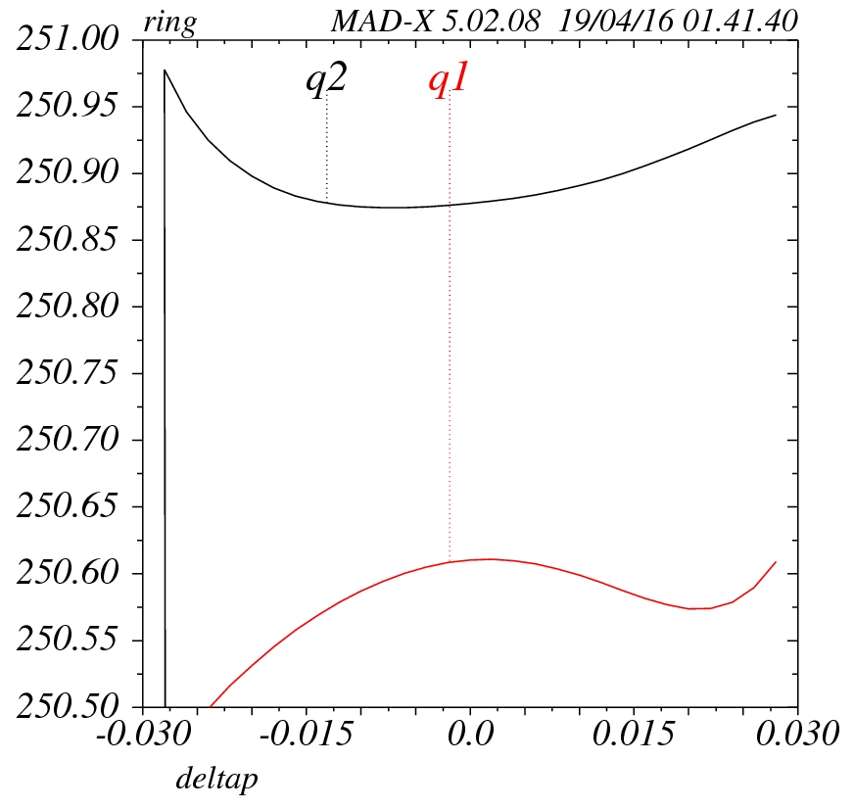
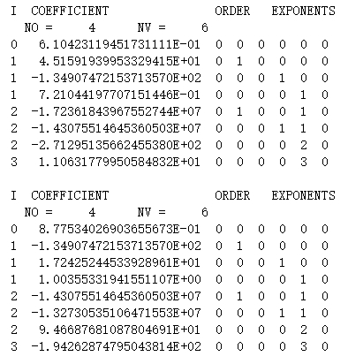

Slide 3
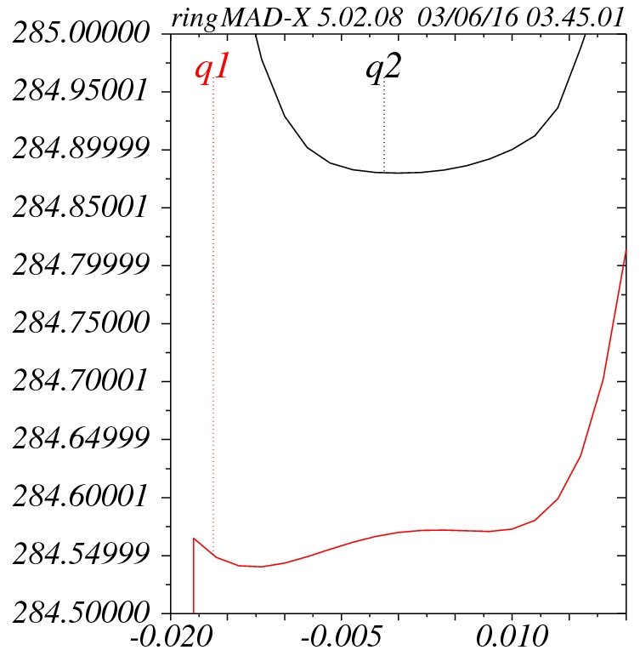

Slide 4
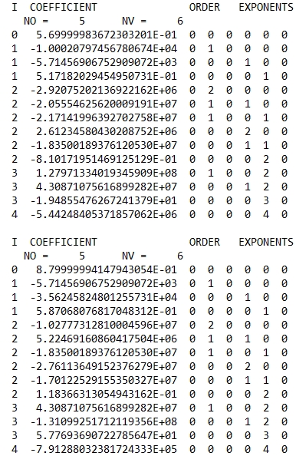
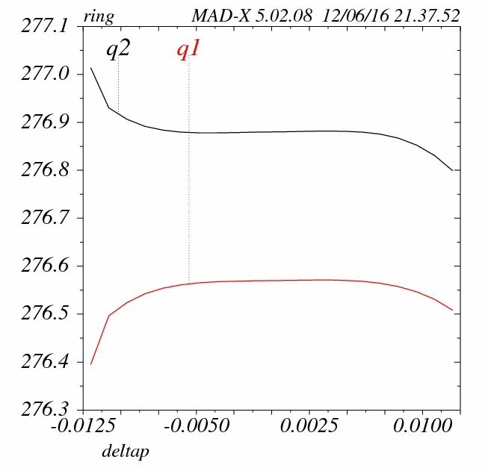

Slide 5
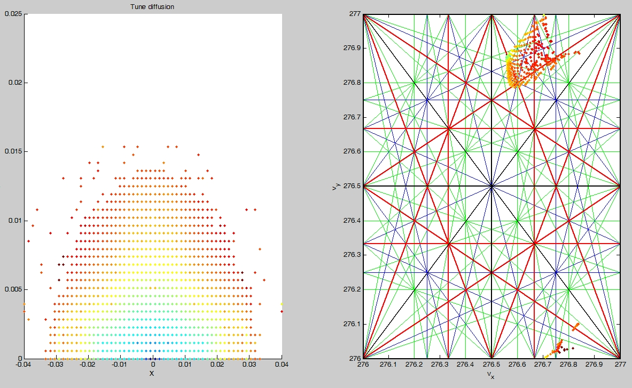
X=72.8sigma Y=1237.2sigma@0%

Slide 6
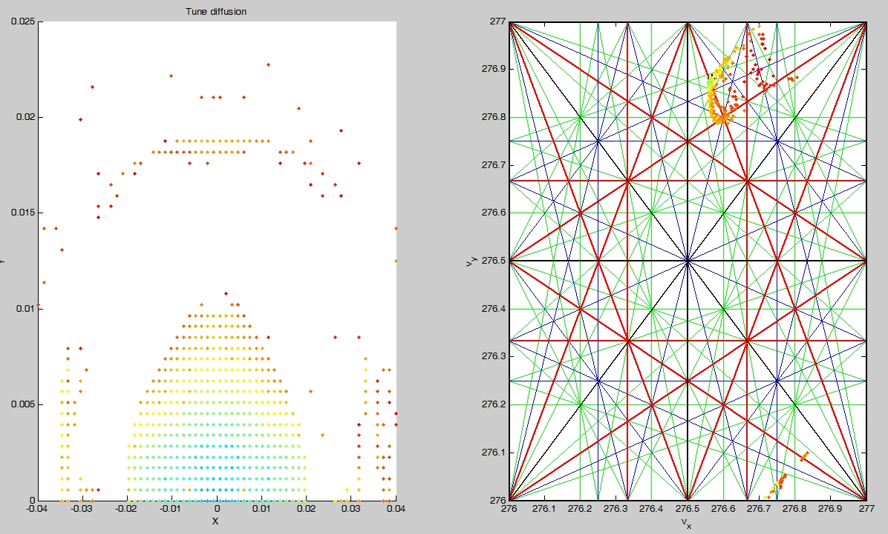
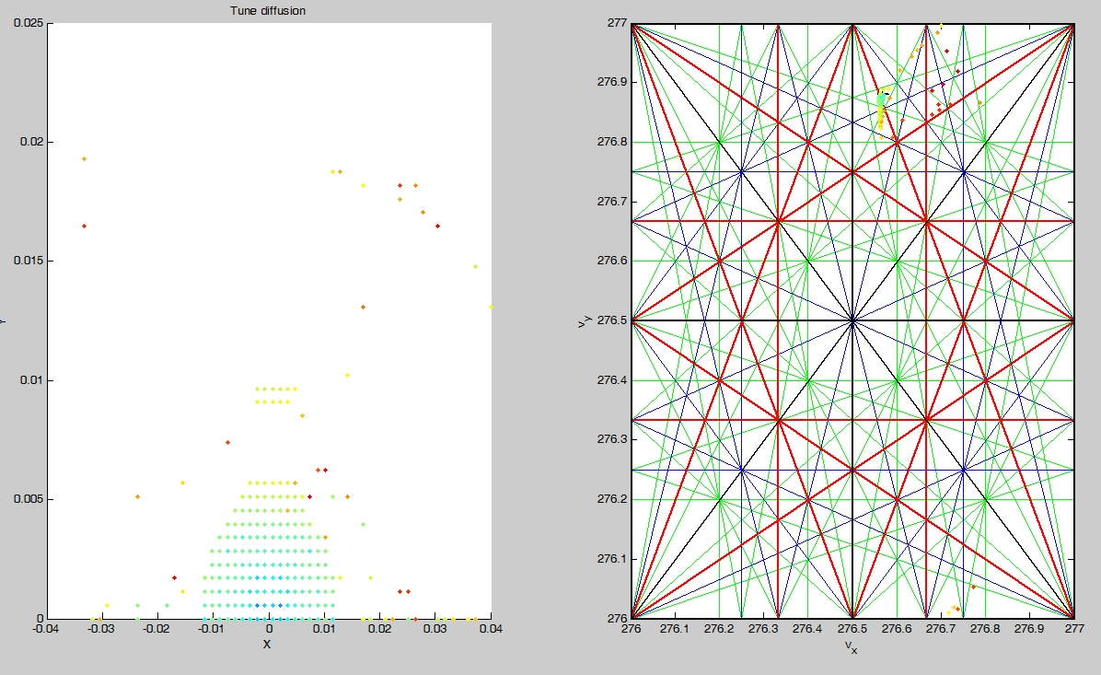
X=48.6sigma Y=824.8sigma@0.5%
X=24.3sigma Y=421.4sigma@1%

